Slide 1
FNAL BNL cold MM comparison
September 24th, 2024

Slide 2
MM taken at FNAL, BNL and CERN
Acceptance criteria calls for final Cryo-assembly MM measurements to be taken and the results to be delivered to CERN
So far only CA01 with MQXFA03 and MQXFA04 magnets MM were completed at FNAL at 1.9 K
These measurements are compared with BNL and CERN MM measurements since at CERN for CA01 full cold tests were performed

Slide 3
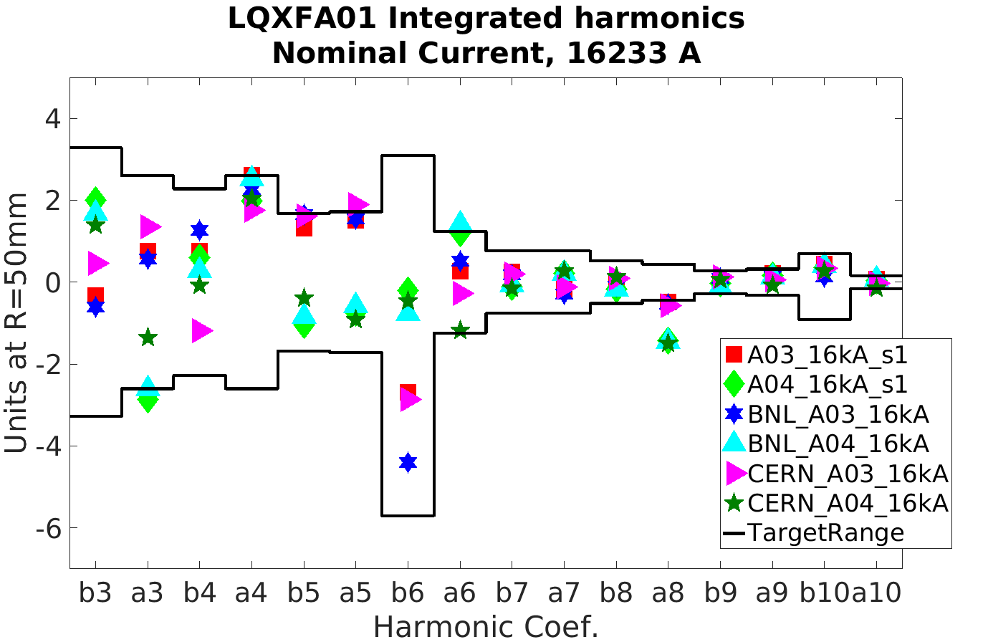
CA01 measurement at FNAL, BNL and CERN

Slide 4
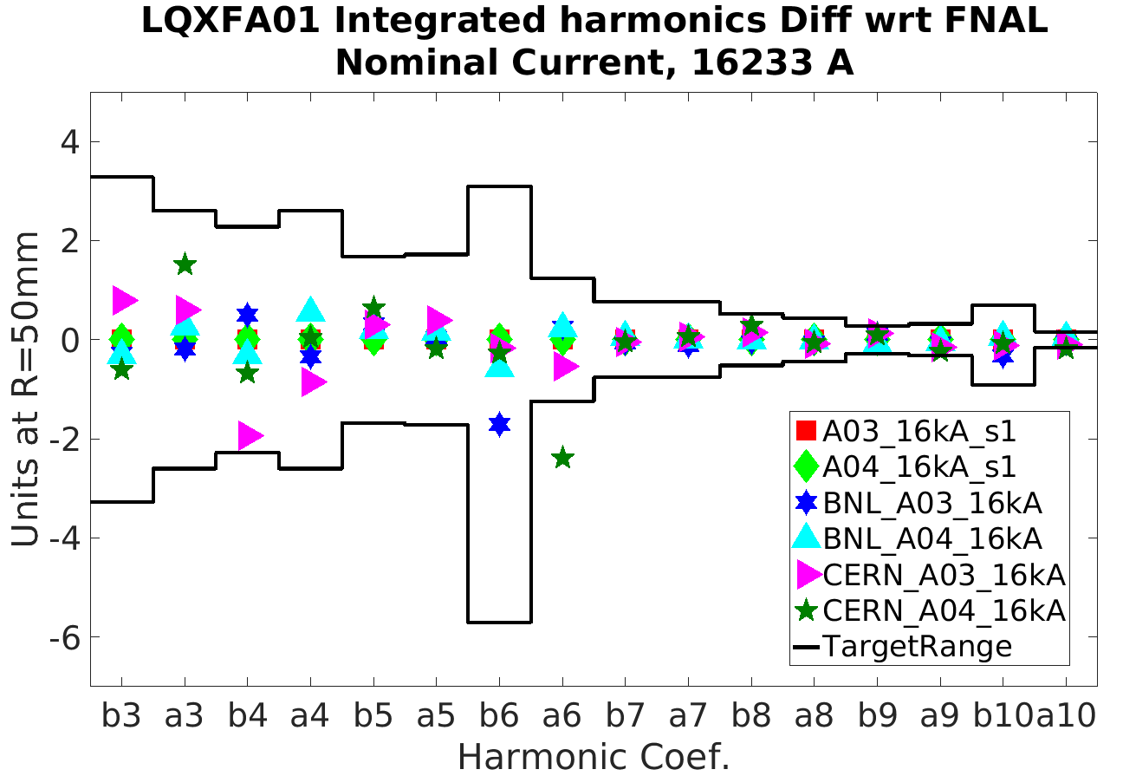
CA01 measurement at FNAL, BNL and CERN

Slide 5
FNAL provides
LQXFA01 Rotating Coil Strength Summary
Cryo-Assembly Magnet: |  | A04 | A03
Integral Gdl (T): |  | 559.95 | 559.70
Magnetic length (m): |  | 4.213 | 4.216
Body field TF (T/m/kA): |  | 8.187 | 8.178
Magnet center separation (m): |  | 4.7721

Slide 6
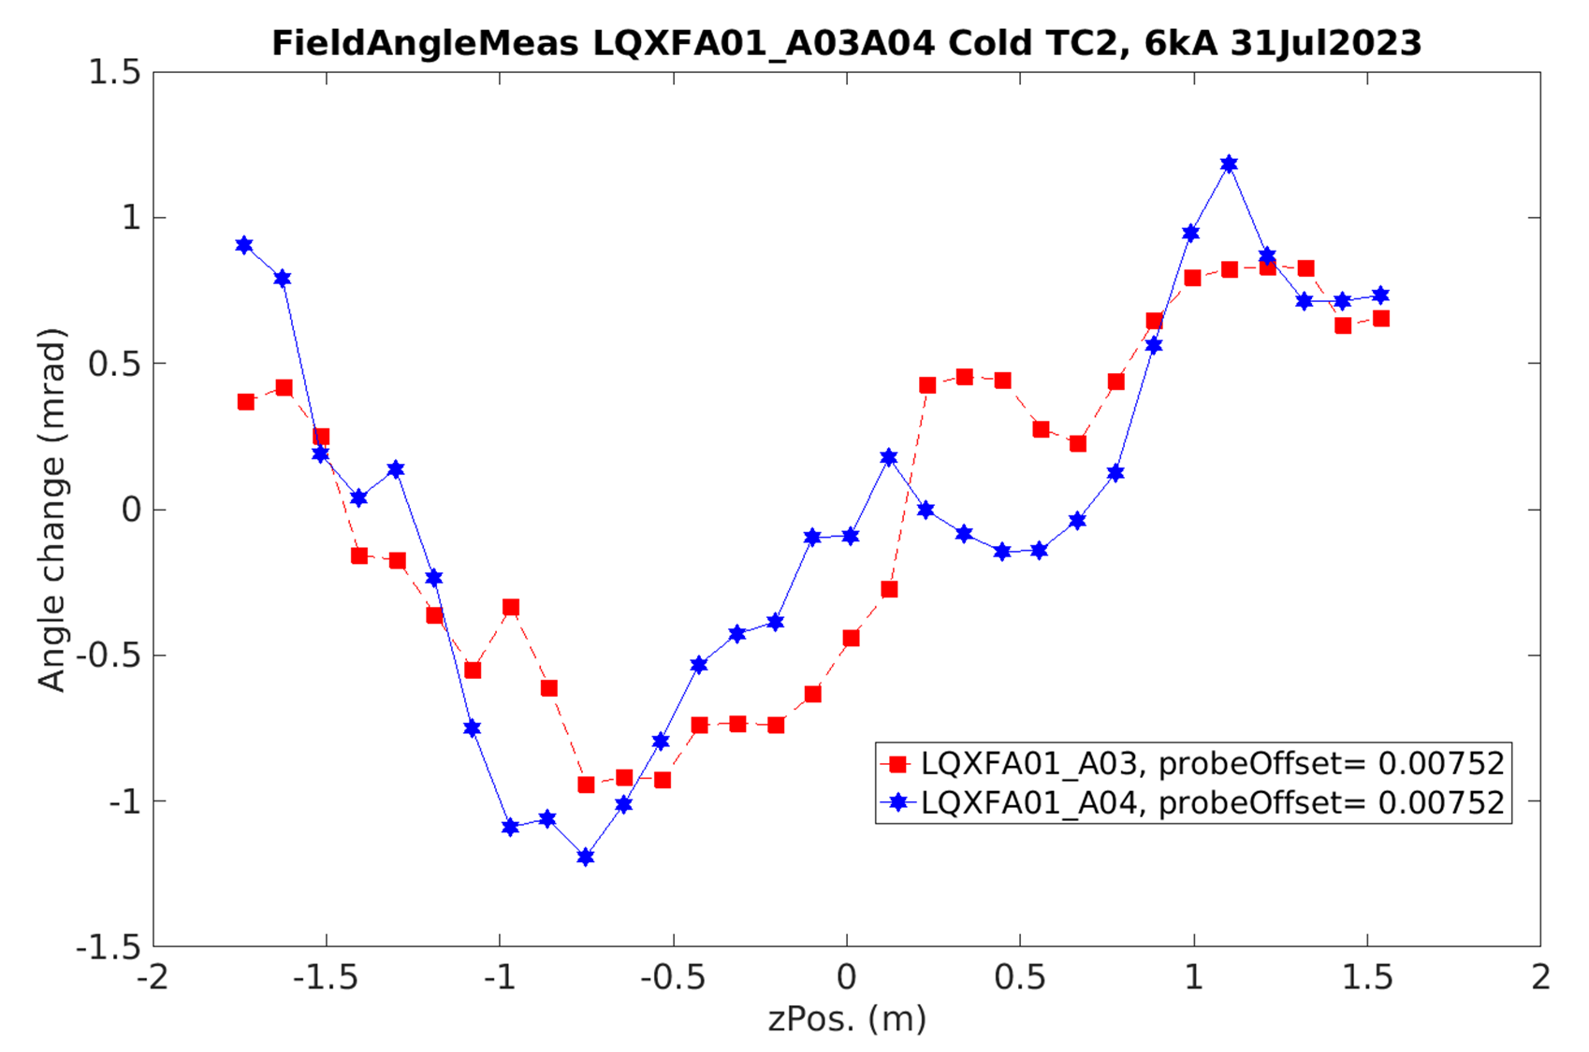
FNAL provides

Slide 7
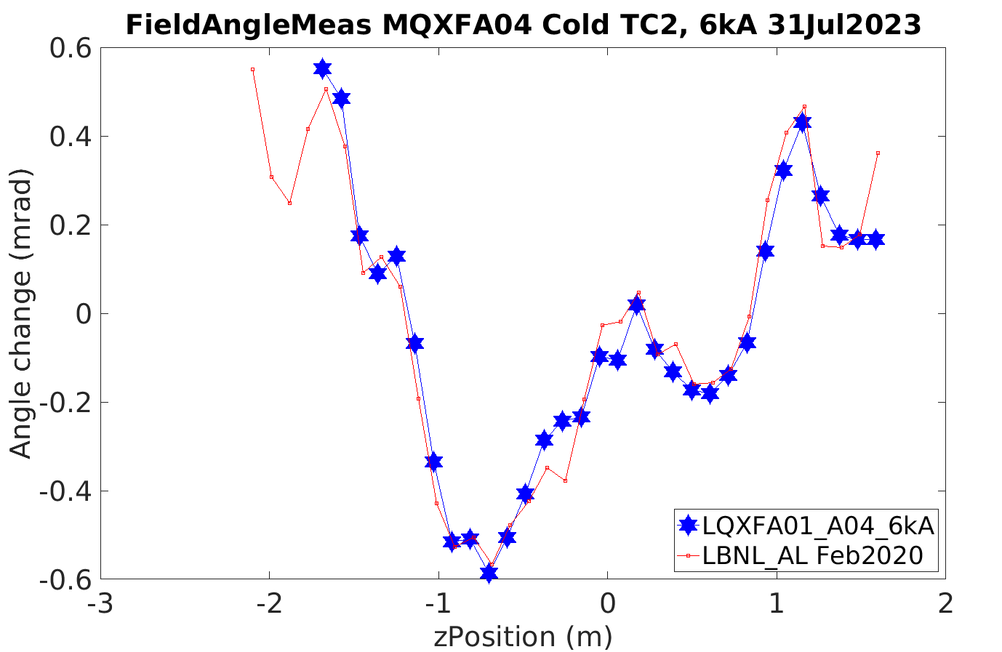
FNAL cold vs LBNL warm

Slide 8
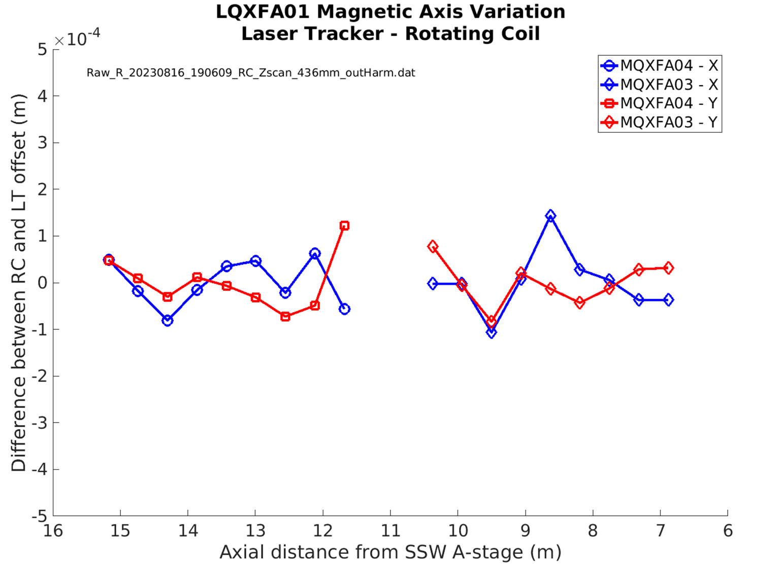
FNAL provides

Slide 9
Conclusions
BNL and FNAL measurements results show very reasonable agreement with each other
The difference except for b6 of MQXFA03 value are within one unit
CERN results a bit scatter, but those results are preliminary
Several of the FNAL MM are not done at BNL
These results show that FNAL MM results are in good agreement with BNL results, and they are sufficient to fulfill the acceptance criteria with a high confidence level, however minimum MM at BNL would help to assure that the magnets are meeting the acceptance criteria prior to installing them into the CM as shown in the previous presentation

