Slide 1
MQXFA Magnetic measurements at LBNL and BNL
GianLuca Sabbi
AUP Meeting September 25th, 2024

Slide 2
Magnetic Measurement Goals and Schedule
LBNL
Coil pack: feedback on assembly (coil size/shims) and preliminary assessment of field quality and magnetic shim options (hold point)
After pre-load: decision on magnetic shim installation (with project approval)
Completed magnet: reference data, comparison BNL warm measurements
BNL
Before cool-down: shipping QC, magnetic measurement system verification/cross-check, reference for changes before/after test
During cool-down (100 K) and at 10 kA, before training: basic field quality data in case of issues appearing during training. Verification of the saturation effect in particular because of the magnetic shims
After training: z-scans for integral gradient and harmonics at nominal and injection, transfer function and harmonics variations along the magnet length, stair-step (DC) loops for geometric, saturation and persistent current effects
During warmup (30K): z-scan for geometric harmonics at cold (no persistent currents)
After warmup: changes before/after test, shipping QC, magnetic measurement system verification/cross-check with FNAL
Color coding: higher priority, medium priority, lower priority

Slide 3
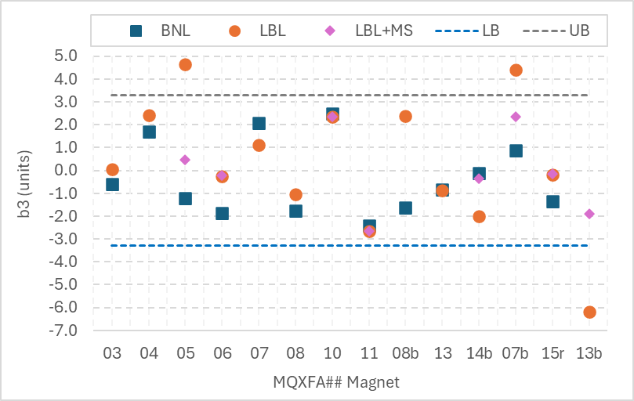
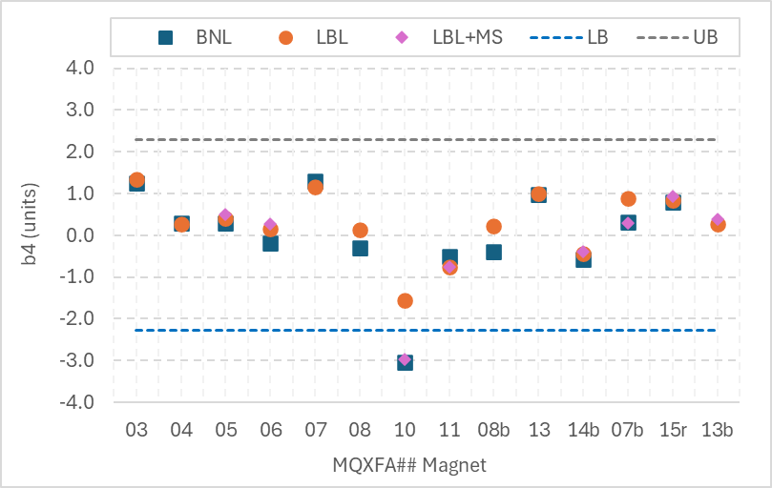
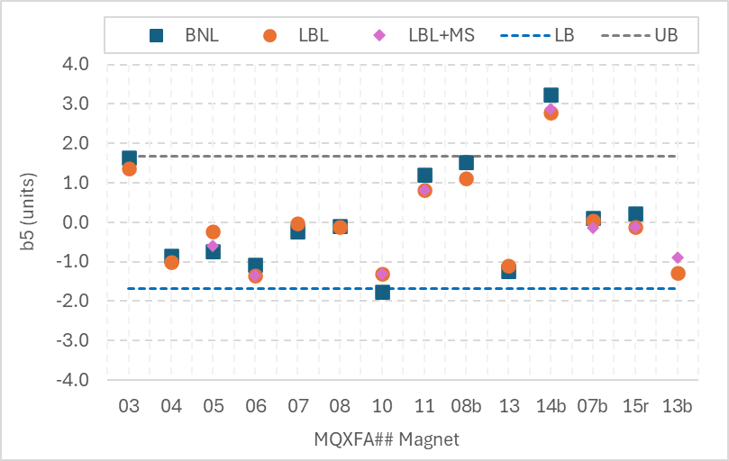
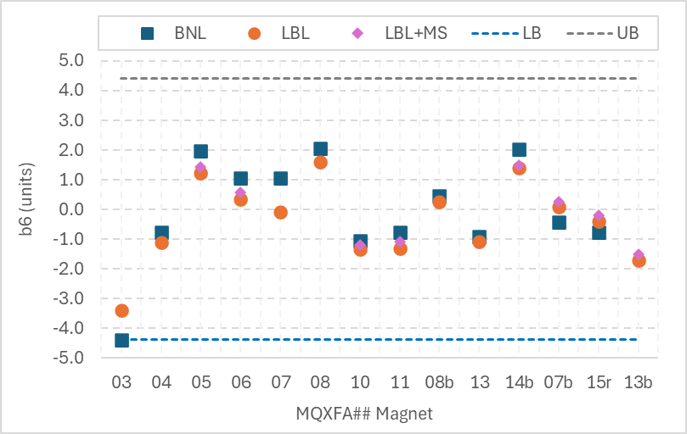
Integrated harmonics comparison (b_{n}): BNL measurements at I_{nom} vs. expected values from LBNL measurements

Slide 4
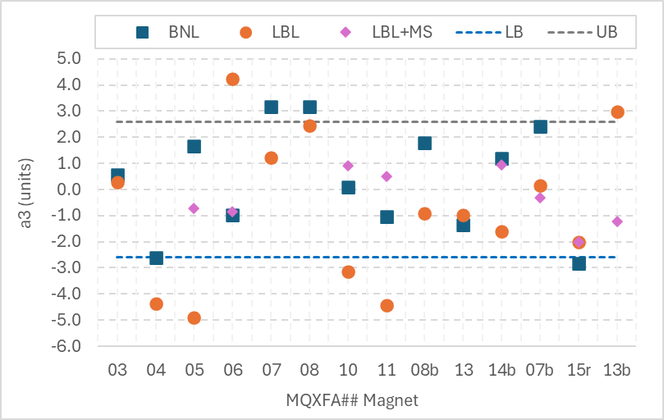
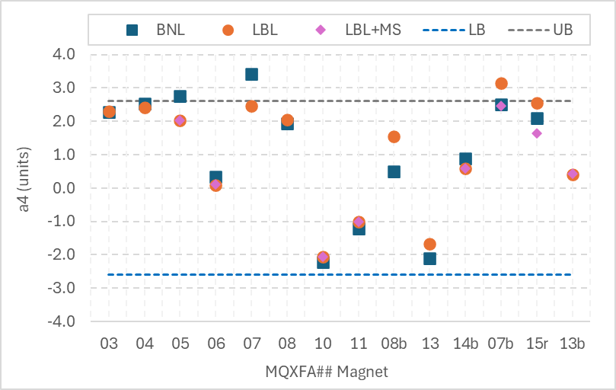
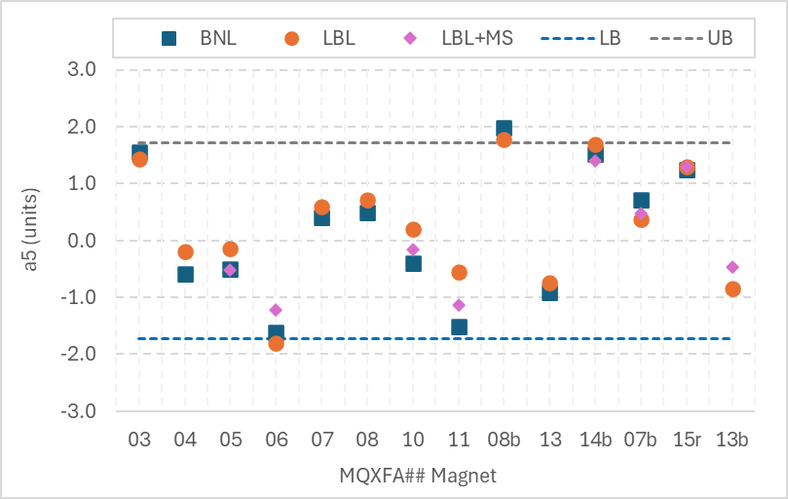
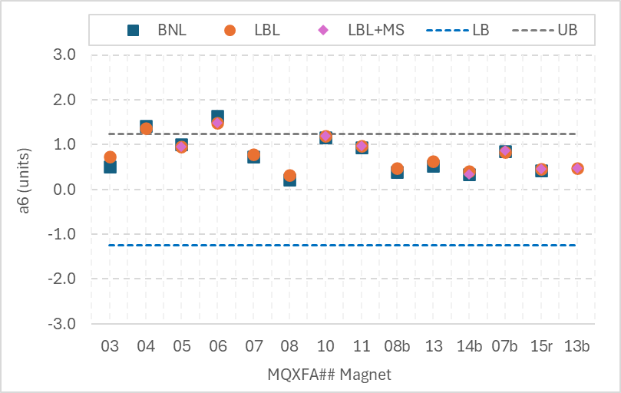
Integrated harmonics comparison (a_{n}): BNL measurements at I_{nom} vs. expected values from LBNL measurements

Slide 5
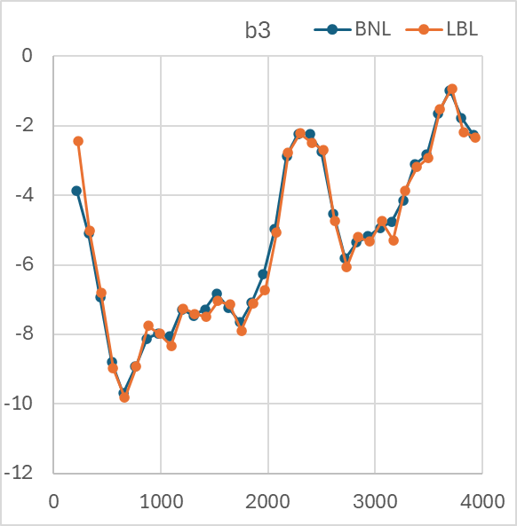
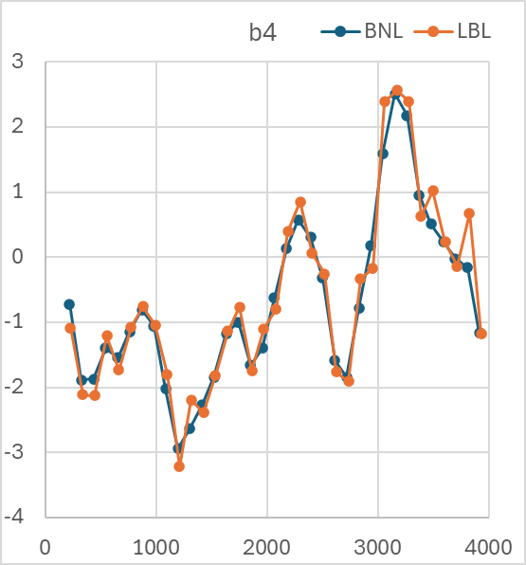
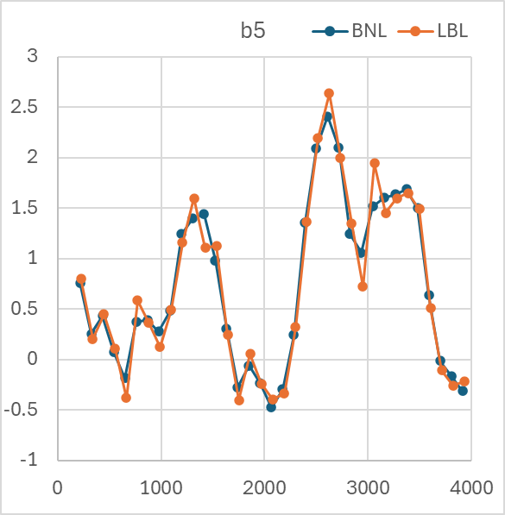
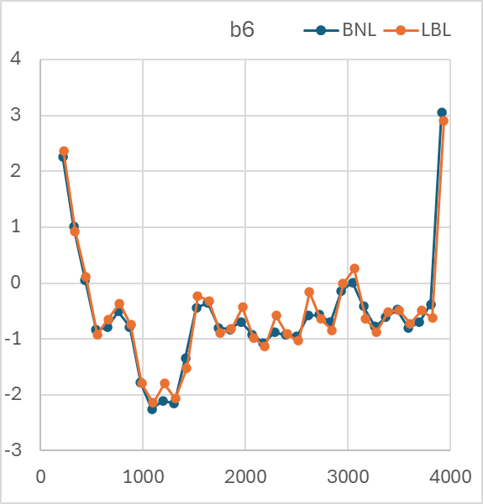
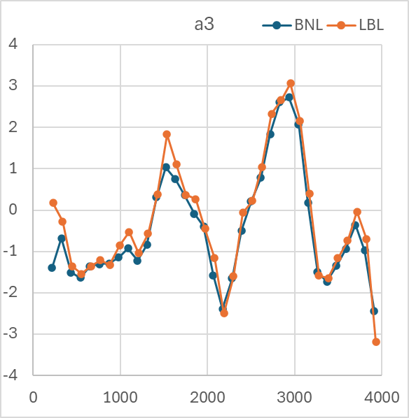
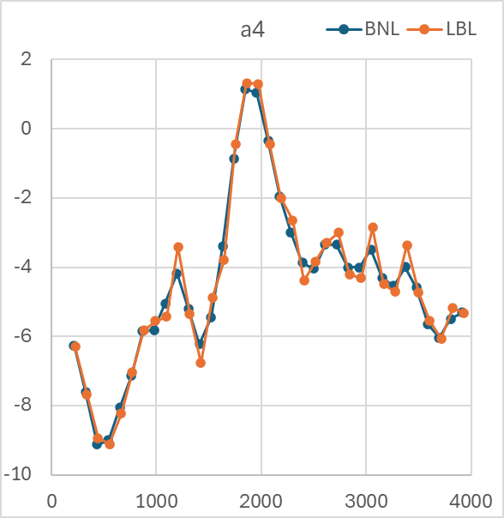
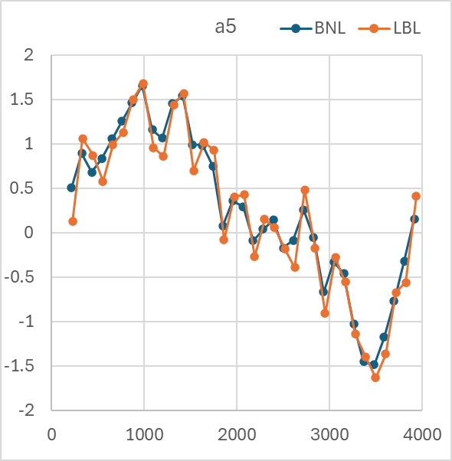
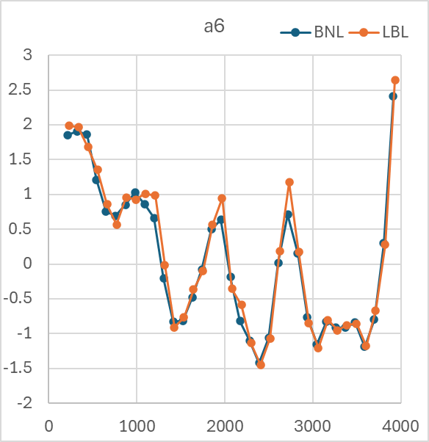
Warm Measurements
Very good consistency between LBNL before shipping and BNL (example from magnet 17)
Comparison was useful for measurement system verification/calibration in early magnet

Slide 6
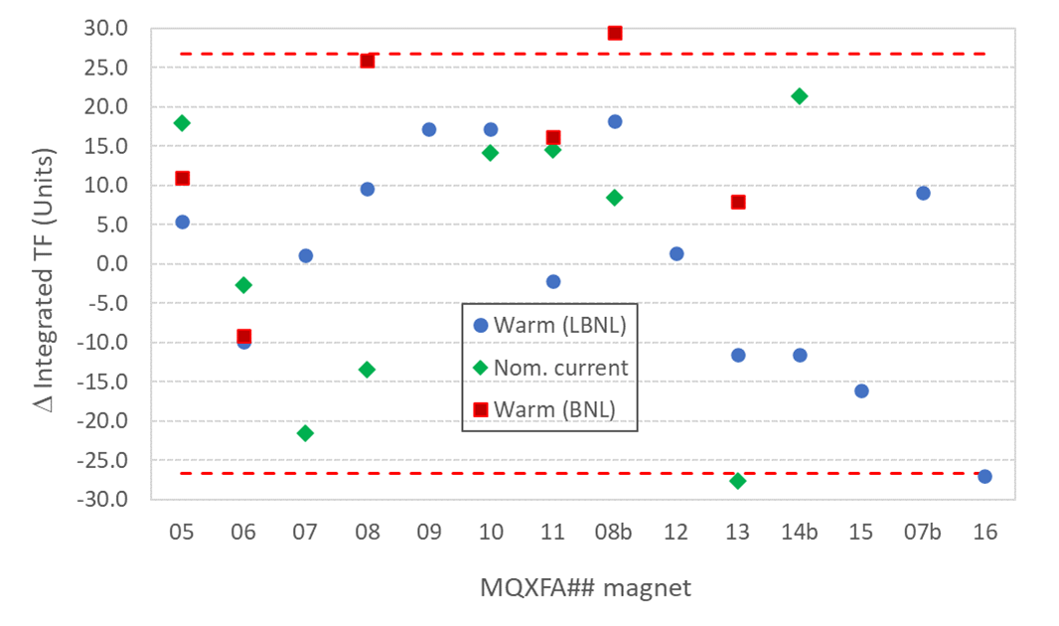
Integrated transfer function variations
Allowed integrated gradient variation of ±3T from average corresponds to ± 27 units
Using integrated TF instead than integrated gradient to include measurements taken at different current (due to change in Inom or test-related)

Slide 7
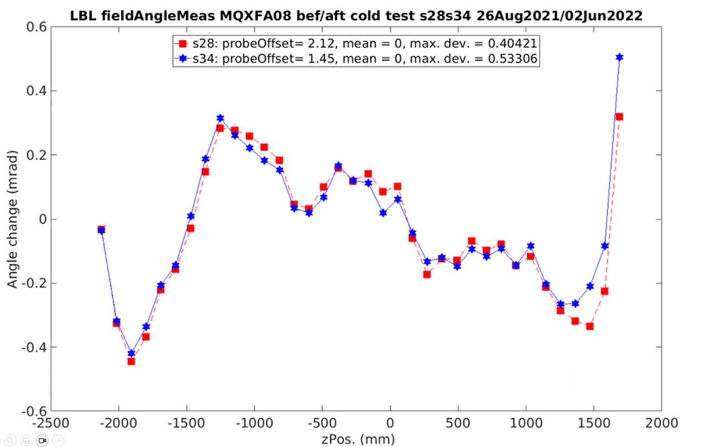
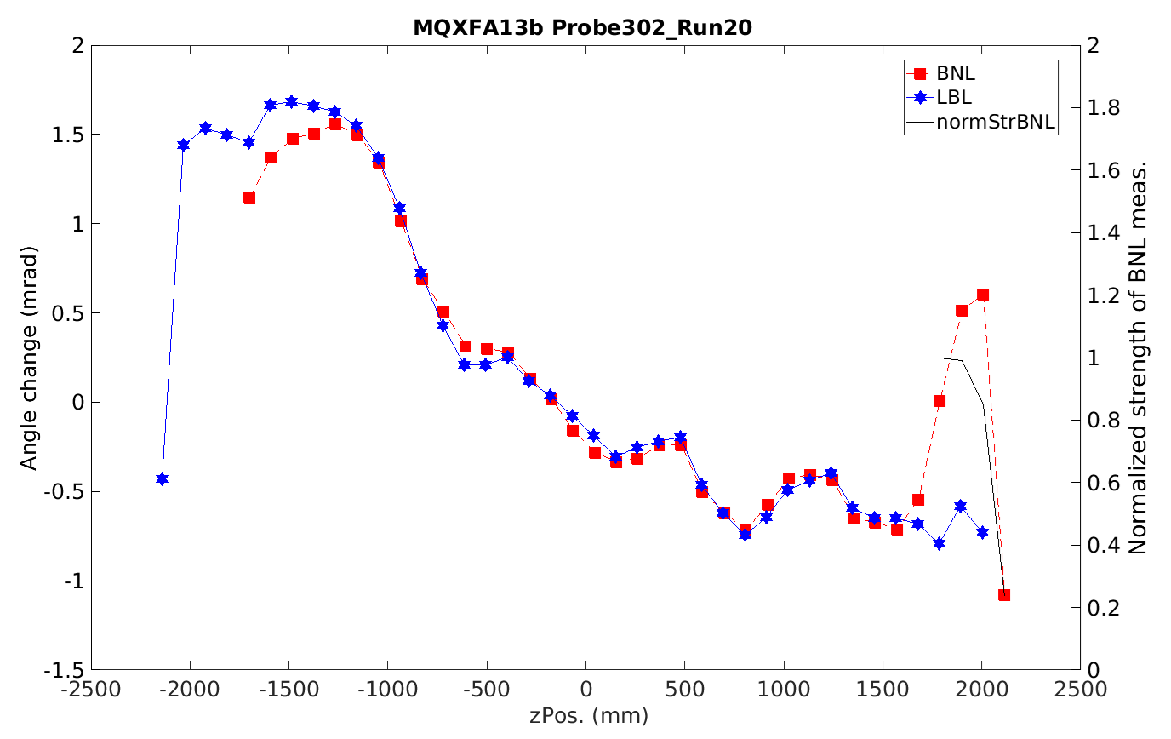
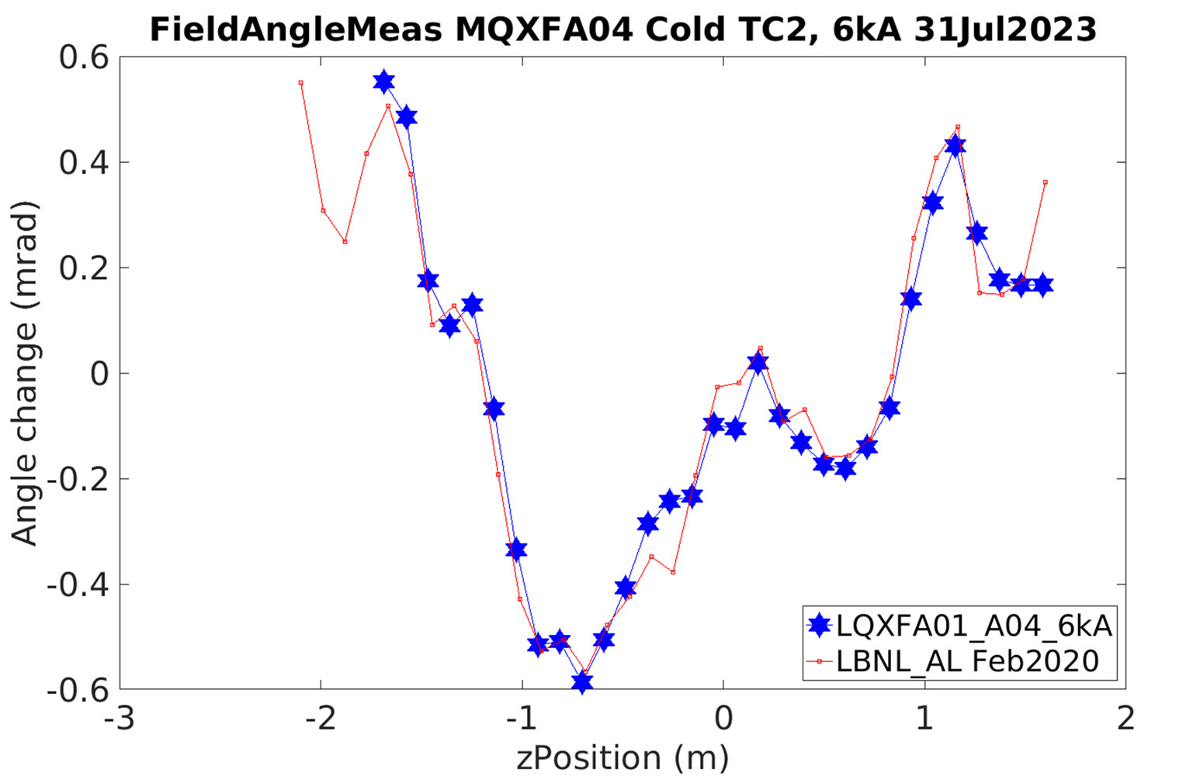
Field Angle
Limited data available: overlapping probe method is feasible but not regularly used in vertical test; and few CA measurements to date.
Straight section seems stable from fabrication to vertical test and cryo-assembly. Some changes observed in the ends would merit further study

Slide 8
Summary Points
Field harmonics:
Using the warm measurements at LBNL and the calculated magnetic shim correction after cool-down and powering, we can estimate the BNL harmonics at nominal within ~1 unit, which is generally sufficient to assess if we will be within boundaries or at risk to exceed them
Integrated gradient:
Variations from magnet to magnet are close to the acceptance limits and there is no clear correlation in the changes from warm to cold.
Field angle:
Overlapping probe measurement at BNL could be considered when LBNL measurement indicates a risk of not meeting acceptance requirements
Possible approach for future magnets
BNL:
Maintain a minimum program of measurements at nominal current, in particular the special z-scan to measure integrated gradient and harmonics (may also repeat after final warm-up)
Additional specific measurements could be included on a case-by-case basis
LBNL:
Consider possible savings from a reduced program, in connection with BNL plan

Slide 9
Acceptance Criteria for Integrated Gradient and Field Angle
Requirement MQXFA-R-O-01: The positions of the local magnetic center and magnetic field angle are measured along the magnet axis with values obtained by averaging sections ≤ 500 mm. In each section, the local magnetic center is to be within ±0.5 mm from the magnet magnetic axis both in horizontal and in vertical direction. The local magnetic field angle in each section is to be ±2 mrad from the average magnetic field angle of the whole magnet, with the exception of the first measurement in the connection side where field angle is affected by magnet leads
Verification Method: Magnetic measurements of magnetic center and magnetic field angle to external fiducials at room temperature.
Procedure summary: Analysis of magnetic measurements, using the laser tracker to measure the probe position and orientation.
Reference: Magnetic Measurements WI [SU-1010-2018], Reference system [EDMS 367802].
Requirement MQXFA-R-O-07: The difference between the integrated gradient of any pair of series magnets powered with the nominal current shall be smaller than 6 T for all magnets, and smaller than 3 T for magnets with the same cross-section. At the same reference current, the MQXFA magnetic length difference between any pair of magnets should not exceed 10 mm. The precision of the measurement of the integrated gradient shall be within ±0.02%.
Verification Method: Magnetic measurements during power test.
Procedure summary: The integrated gradient at nominal current is measured using a stretched wire.
Reference: Cryo-assembly test plan [LHC-LQXFA-ES-0002], and magnetic measurement plan [LHC-MQXFA-ES-0007], Reference system [EDMS 367802].

