Slide 1

Cost and Schedule Analysis of Testing All Remaining Magnets
Lorri Stapleton
September 25, 2024

Slide 2
Analysis Plan
A what-if scenario was created to vertically test all remaining magnets with an abbreviated test plan of 1 thermocycle and removal of magnetic measurements at BNL. This also included removing the rework of the cryo-assembly that was assumed to fail to meet specifications during horizontal testing.
  Estimates for labor and M&S resource as well as revised vertical test durations for the abbreviated tests were provided by Piyush Joshi.
  The magnet to be sent to CERN will be tested with the full 2 thermocycle test plan.
  The baseline for the what-if scenario is he July 2024 status file with August BCRs schedule and resource revisions included.

Slide 3
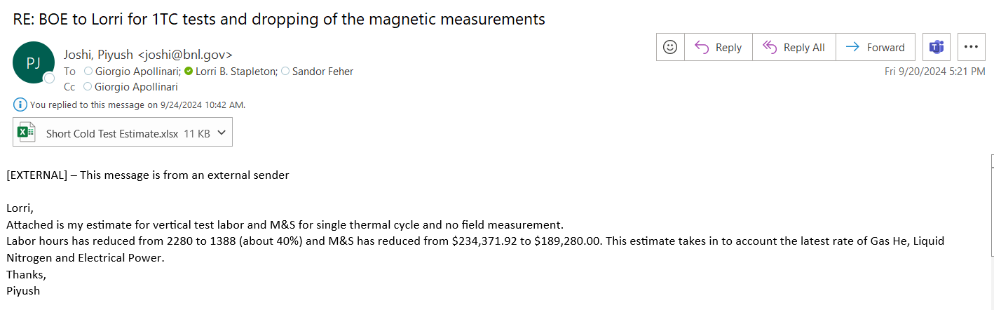
Vertical Testing Estimate Differences
Estimates for labor were reduced from 2280 to 1388 labor hours to remove all magnetic measurements as well as the 2nd thermocycle – a 39% reduction in labor hours.

Slide 4
Vertical Testing Estimate Differences
From Current BOE 302-04-01-1040
  Orange highlights are line items removed for new estimate

Slide 5
Vertical Testing Estimate Differences
Revised estimate:

Slide 6
Vertical Testing Estimate Differences
Estimates for M&S were revised from $267,001 to $189,280 - a 29% reduction in direct $.
In the current baseline the last 5 tests had a reduced helium usage/day due to cryo-facility system improvements resulting in less loss of helium. This same assumption was applied to the last 5 tests in this scenario.

Slide 7
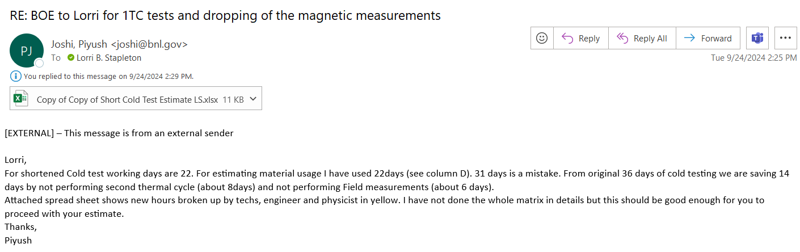
Vertical Testing Estimate Differences
Vertical test durations were shortened from 36 to 22 days.
The Vertical Test Prep and Test Breakdown activities were untouched.

Slide 8
Magnet Fabrication and Testing Sequence and CM Mapping Changes
This scenario increases the remaining number of vertical tests from 6 to 11. The current magnet vertical testing sequence is changed to match the magnet assembly order.
Magnet MQXFA-23 becomes the magnet sent to CERN. Previously the last magnet to be tested vertically, MQXFA-22 was sent to CERN, but in the revised plan the last one tested is a reworked magnet, which would not be the right magnet to send to CERN.
The mapping of magnets to cold mass was also revised based on the vertical testing sequence.

Slide 9
Cost and Schedule Impacts
Cost Impact | EU* Contingency Impact | Schedule Impact | Latest Trigger Date
-$2,624 k | -$286 k | - 6 months | immediately
Comments:
  $2.2M of the cost savings due to reductions in Level of Effort (LOE) in multiple control accounts.
  The trigger date is driven by:
    the need to know how to prepare MQXFA-16TLS, for either vertical testing or direct assembly into cold mass 07. This magnet is currently on hold awaiting this decision.
    The need to approve the test plan for MQXFA-18 which is currently on the vertical test stand at BNL.
  Cost and schedule impact are to the EAC and current working schedule T4:CD-4 milestone.
    NOTE: If this analysis results in a BCR, the actual impact to the BAC will be a smaller savings because of the current -2 month schedule variance. There is $1,144k for LOE adjustments currently in the manual EAC so the impact to the BAC in the BCR would be closer to -$1,480k.
* Estimate Uncertainty

Slide 10
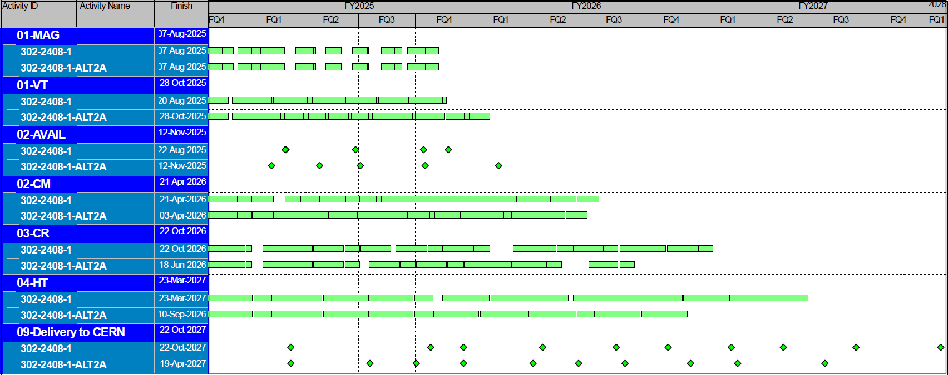
Schedule Comparison
The schedule above shows that vertical testing finishes 4 months later, cold mass finishes within the same month, cryostating finishes 4 months earlier, and horizontal testing finishes 6 months earlier.

Slide 11
Summary of Changes by Control Account
302.1 Project Management
  There was some escalation cost savings in this control account but mainly the biggest impact was the savings due to LOE
  6 months of LOE was removed from the Project Office, Magnet L2 and CA L2s due to the earlier project finish date
  2 months of LOEs were added to the BNL and LBNL management line items due to the longer testing duration
302.2.01 Magnet Integration and Coordination
  6 months of LOE was removed due to the shorter horizontal testing schedule
302.2.07 Magnet Assembly
  There is no change in cost and schedule
302.4.01 Magnet Vertical Testing
  Reduced resources and duration on 5 of the 6 existing magnet tests and added 5 abbreviated magnet tests. Kept 1 existing test the same for the magnet to send to CERN.
  Added 2 months of LOE and cryo-facility maintenance for the longer duration of testing activities

Slide 12
Summary of Changes by Control Account
302.4.02 Cold Mass Assembly
  Removed the cold mass activities associated with the reworked cryo-assembly
  Re-configured the sequence of cold mass assemblies for the 2 assembly stations
302.4.03 Cryo-Assembly Fabrication and Shipping Prep
  Removed the disassembly and cryostating activities associated with the reworked cryo-assembly
  Removed 4 months of cryostating LOE due to the shorter discrete activity schedule
302.4.04 Cryo-Assemblies Horizontal Test
  Removed the horizontal testing activities associated with the reworked cryo-assembly as well as the additional EAC for this test
  Reduced the resources and the duration for the two long tests for untrained magnets (CA07 and CA10) to match that of the standard horizontal tests with trained magnets
  Removed 6 months of horizontal testing LOE due to the shorter testing schedule
302.4.05 Cryo-Assembly Integration and Coordination
  Removed the failed cryo-assembly analysis activity
  Removed 6 months of LOE due to the shorter testing schedule

Slide 13
Impact to CERN Delivery Dates

Slide 14
Backup

Slide 15
Rec. #4
Baseline
  21 Magnets for 10 cryostat, all Horizontally tested
  5 Magnets not tested vertically (Financial/Schedule reasons)
  10 Dressed Cavities Tested
Threshold and Objectives KPPs
July 2024 IPR Management Recommendation
  Review and document the criteria by which the decision will be made to exercise scope contingency and update all project planning as needed based on this review. Complete by the end of October 2024.

Slide 16
Decision Times to Exercise Reduction of Scope
Based on the July 2024 status with August BCRs the following costs and dates were gathered.
The “Trigger Time” is 1 month prior to the scheduled start of the activity.
The costs are fully burdened for the discrete task. There are no associated LOE costs included with the activity.

Slide 17
General Criteria
Trigger a Scope Drop if:
  Contingency on Cost To Go drops below AA% ?
    Try to maintain constant (or increasing) AA from project CD2 start (~40%)
    Maybe for few (2 or 3?) sequential reporting periods
  C.L. on extant Risks drops below BB% ?
    Assume BB to be between 70% and 90%.
    Maybe for few (2 or 3?) sequential reporting periods
In any case, CERN needs to operate HL-LHC, so any scope dropped by AUP must be “pick-able” by CERN:
  CERN is good at:
    Testing AUP CryoAssemblies (already done)
    Producing AUP CryoAssemblies (never done, but it is a CERN design using CERN tooling)
  CERN is less good at:
    Producing AUP Cold Mass (never done, no tooling at CERN although it is a “simple” tooling)
    Producing an AUP MQXFA Magnet (never done, no tooling at CERN. Tooling is not “simple” )
Deferral ?

Slide 18
Example of Alternatives
Alt. #1: Test all magnets vertically
  How much does BAC increase because of Vertical scope
    How much does BAC decrease because of shorter Horizontal test
    How much does Risk decrease because of lower risk on CA test.
Alt. #2: Test all magnets vertically, but test 5 (previously) untested magnets only partially (one cool-down only with no thermal cycle because memory is well established by now)
  How much does BAC increase because of Vertical scope
    How much does BAC decrease because of shorter Horizontal test
    How much does Risk decrease because of lower risk on CA test.
Basic Question: How much do we need to “save” in Contingency
to allow scope increase mentioned above and still cover Risks at
~90-95% CL ?

Slide 19
Example of Alternatives (cont.)
Alt. #3: Test 1 (or 2, or 3) CryoAssemblies at CERN
  Magnets must be tested vertically for these CAs.
  How much does BAC decrease because of reduced scope and shorter critical path ?
  How much does Risk increase if we have to ship back a non-performing cryomodule ?
Alt. #4: Full analysis of exercise requested at IPR: avoid assembly and test of last 2 magnets, CM10, CA10 and CA10 Horizontal test dropped from Objective KPPs.
  How much does BAC decrease
  How much does Risk decrease because of lower risk on CM10/CA10.
Alt. #5: …
Same Basic Question

Slide 20
Activities Removed for Rework of Cryo-Assembly after Horizontal Testing

Slide 21
Cost Impact by Control Account
Total Change in Budget and Total Change in Contingency on WTG above includes LOE impacts from next slide

Slide 22
Cost Impact by Control Account

