Slide 1
Beam Parameters between NuMI and T2K
Katsuya Yonehara
Beam instrumentation AI meeting
10/29/2024

Slide 2
Aim of the presentation
We propose a collaborative global effort to AI-driven beam instrumentation for the neutrino program among LBNF, NuMI and T2K
It is worth to understand the beam properties for each neutrino beam line
Since LBNF and NuMI utilize the same proton beam line, I present the nominal proton beam parameter for NuMI, with the parameter for LBNF provided in parentheses

Slide 3
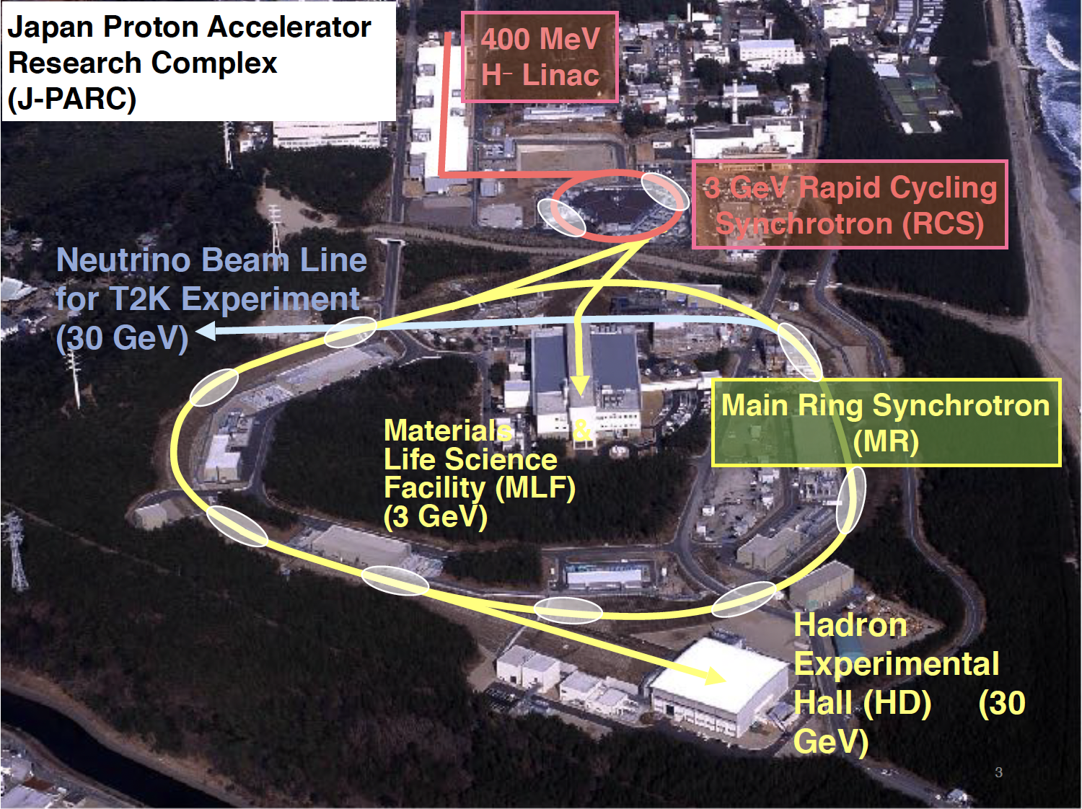
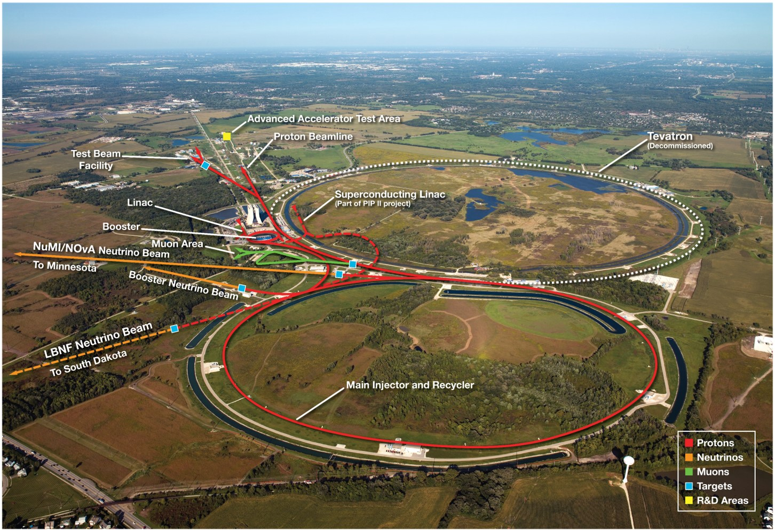
Layout
J-PARC
Fermilab
MLF facility for low energy program including muon and neutron beam facilities
MR provides beam for T2K (fast X) and Hadron experiment (slow X)
Utilize 400 MeV for radiation damage
Utilize 8 GeV for BNB and Mu2e (with RR for rebunching)
Utilize 120 GeV for NuMI (fast X) and FTBF (slow X)

Slide 4
J-PARC Accelerator Complex
It consists of three accelerator facilities, Normal conducting LINAC, Rapid Cycling Synchrotron (RCS), and Synchrotron Main Ring (MR)
LINAC = 3 MeV RFQ + 50 MeV DTL and SDTL + 400 MeV ACS (Annular Coupled Structure Linac, operate since 2014)
  400 MeV H- beam
  They planned to extend 600 MeV using SC LINAC for transmutation experiments
RCS (Rapid Cycling Synchrotron)
  3 GeV p beam
  Provide beam to MLF: MR = 9:1
MR (Main Ring, Synchrotron accelerator)
  Fast extraction for T2K
  Slow extraction (6 sec) for hadron experiments

Slide 5
Fermilab Accelerator Complex
It consists of four accelerator facilities, Normal conducting LINAC, Booster, Recycler Ring, and Main Injector
LINAC = 3 MeV RFQ + 200 MHz DTL (200 MeV) + 800 MHz Coupling RF (400 MeV)
  400 MeV H- beam
Booster (8 GeV RCS)
  8 GeV proton beam
Recycler Ring
  Permanent magnet + RF
  Slip stacking to make 12 Booster batches to 6 batches
MI (120 GeV Synchrotron)
  Fast extraction to NuMI
  Slow extraction (6 sec) to FTBF

