Slide 1
Fermilab Asian Pacific Association (FAPA)

Slide 2
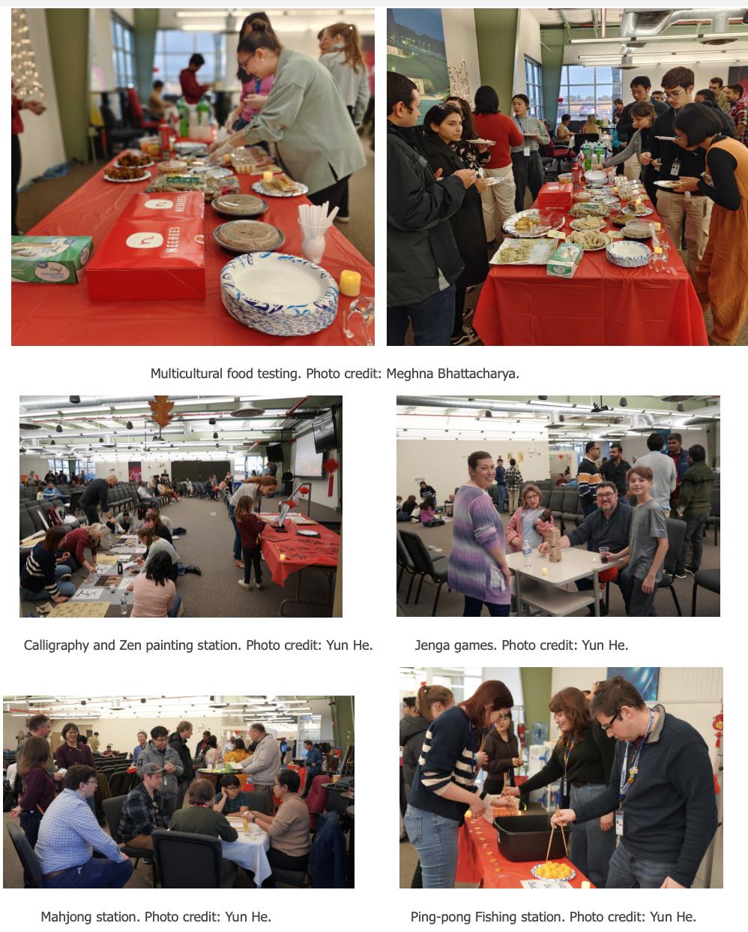
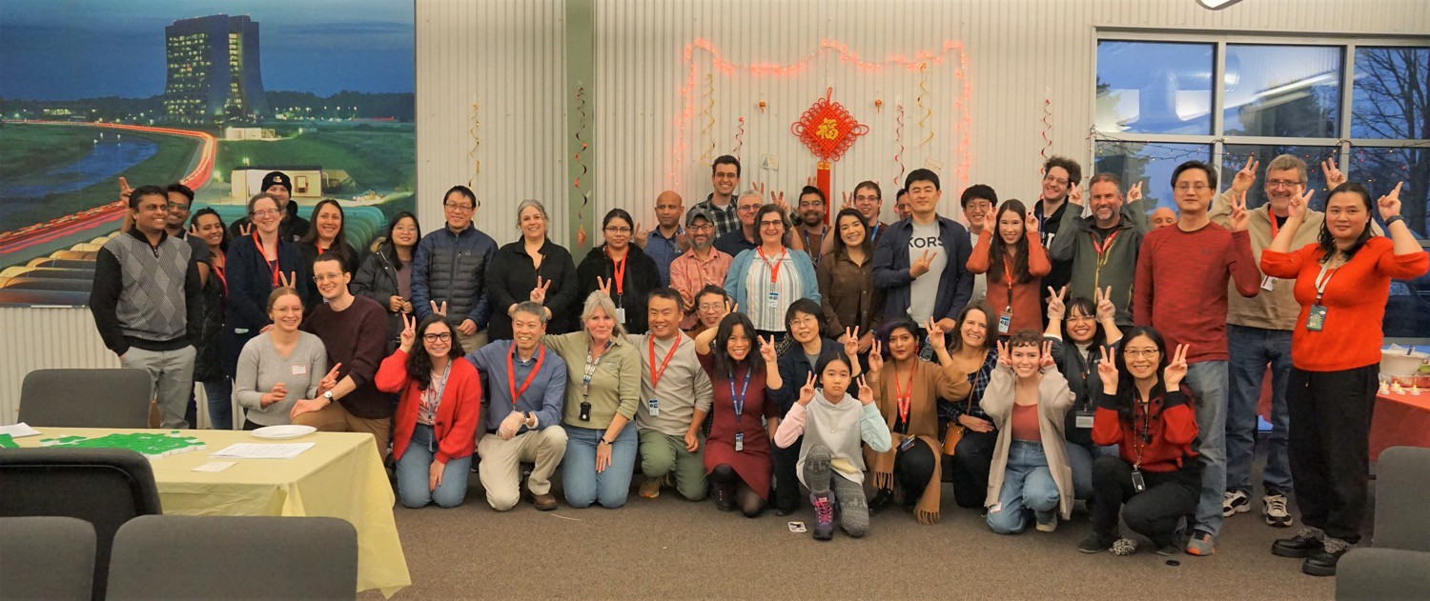
Who are we?
~ 200 members including non- AAPI allies
Fermilab Asia Pacific Association Lunar New Year 2024
Fermilab Asia Pacific Association Lunar New Year 2023
Fermilab Asia Pacific Association Diwali 2022

Slide 3
Leadership Team ​​ ​Current leade​r: ​Sudeshna Ganguly​ Current co-leader: Meghna Bhattacharya Exiting leader: Genfa Wu FAPA Officers: Officer for collaboration with other national lab LRGs - Lipika Swarup Officer for career development - Baisakhi Mitra Officer for FAPA alumni - Baisakhi Mitra Officer for new members - Amol Jaikar Officer for social events - Gaurav Arora Active Members: Vijay Chouhan, Yun He, Zunping Liu​, Genfa Wu, Yi Xie, Charles Jayakar

Slide 4
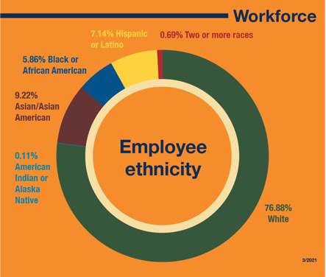
FAPA Introduction
Mission
FAPA LRG is voluntary, employee-driven, and centered on creating a positive workplace culture through a collective group of Asian-Pacifics' distinct interests, qualities, and goals
Together we hope to develop a community that will allow our members to get connected, appreciate each other's cultures, have a better sense of belonging and thrive as professionals
Mooncake Social & Stargazing 2023

Slide 5
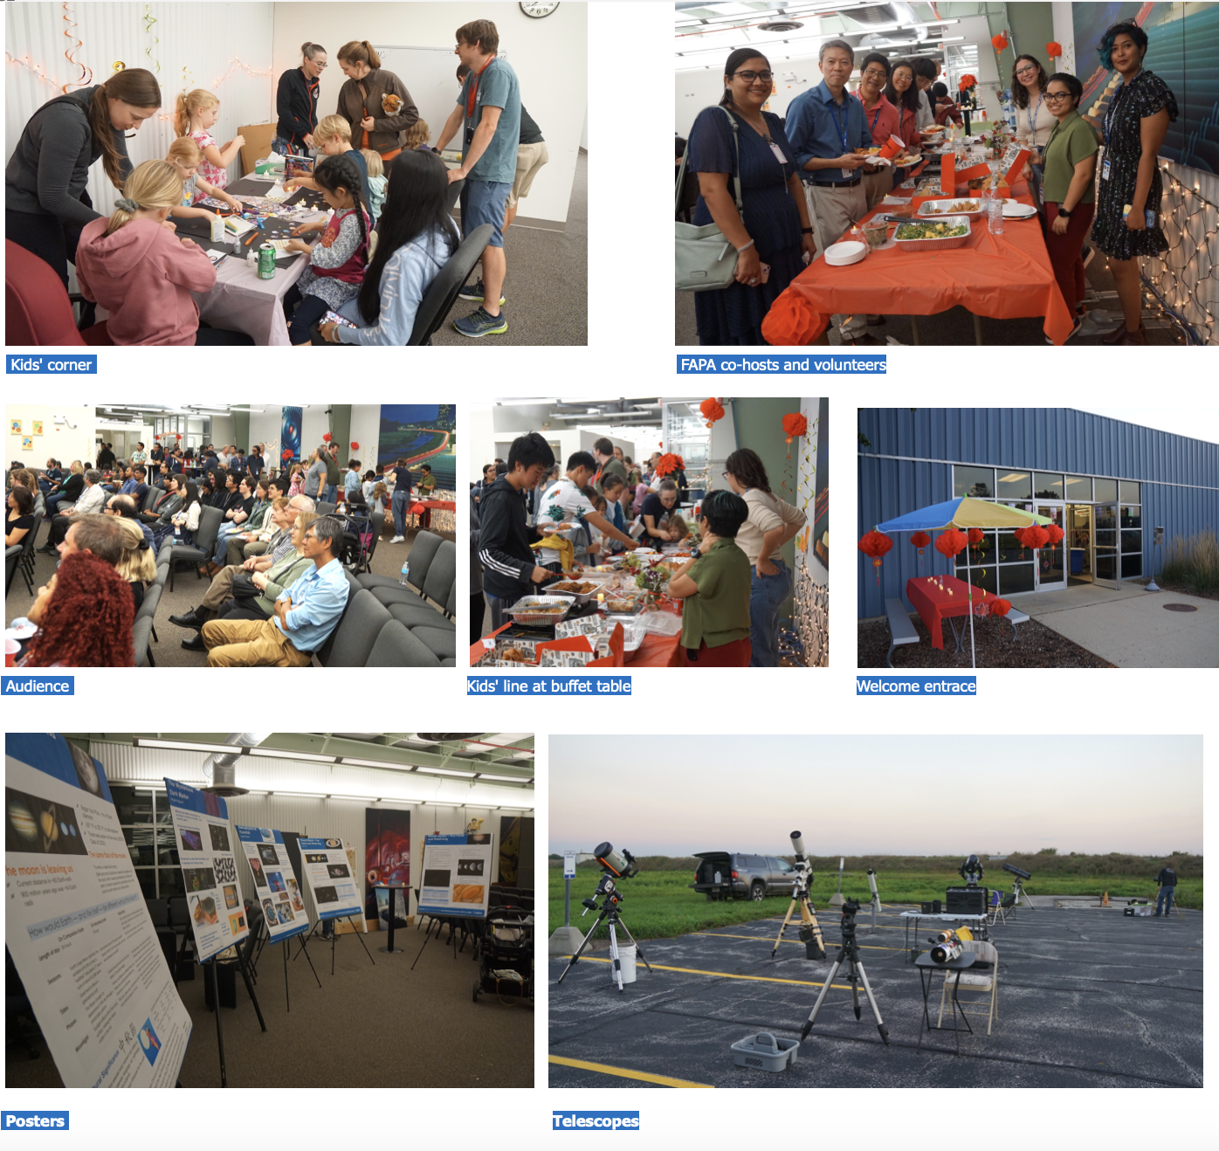
FAPA Introduction
Mission
FAPA LRG is voluntary, employee-driven, and centered on creating a positive workplace culture through a collective group of Asian-Pacifics' distinct interests, qualities, and goals
Together we hope to develop a community that will allow our members to get connected, appreciate each other's cultures, have a better sense of belonging and thrive as professionals
Mooncake Social & Stargazing 2023

Slide 6
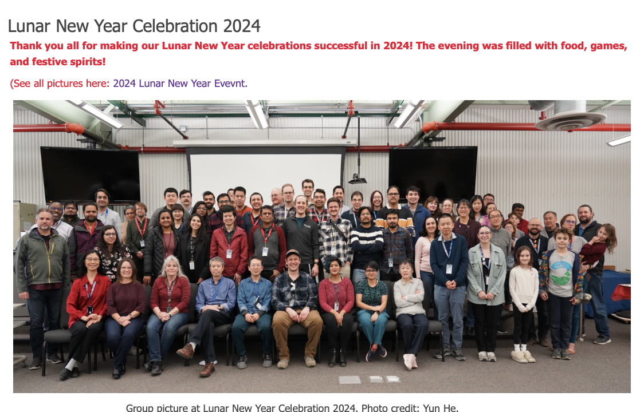
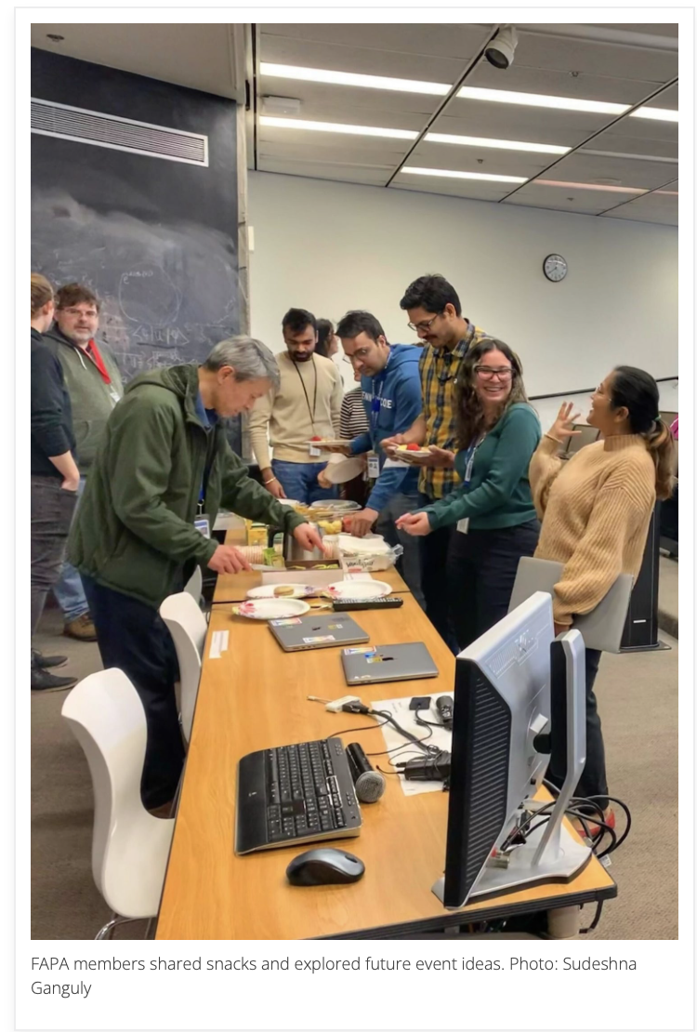
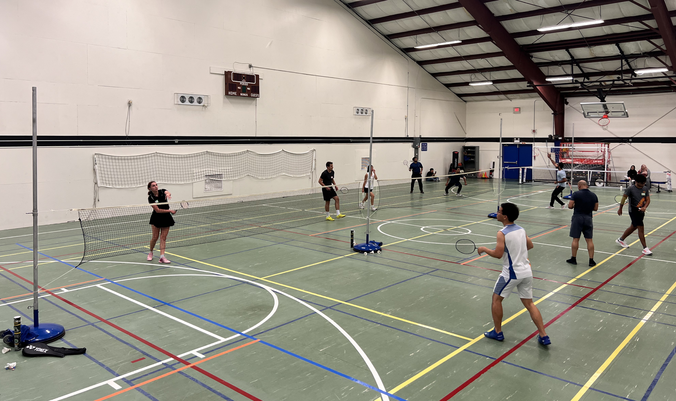
FAPA Events 2024
Lunar New Year celebration on February 9, 2024
FAPA Spring Meeting 2024
Inclusion Matters Talk on May 8, 2024
Badminton Event on July 26, 2024
FAPA has been a vibrant community!

Slide 7
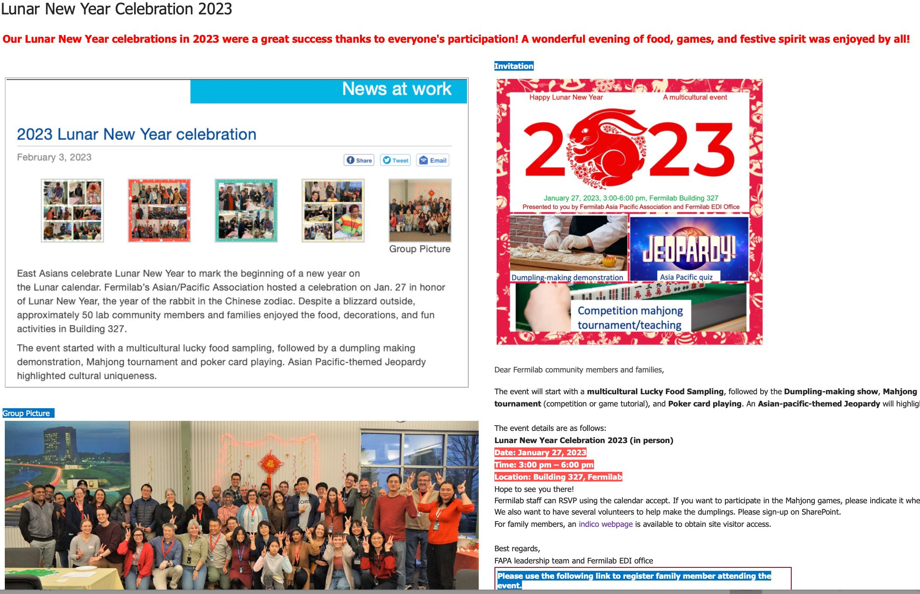
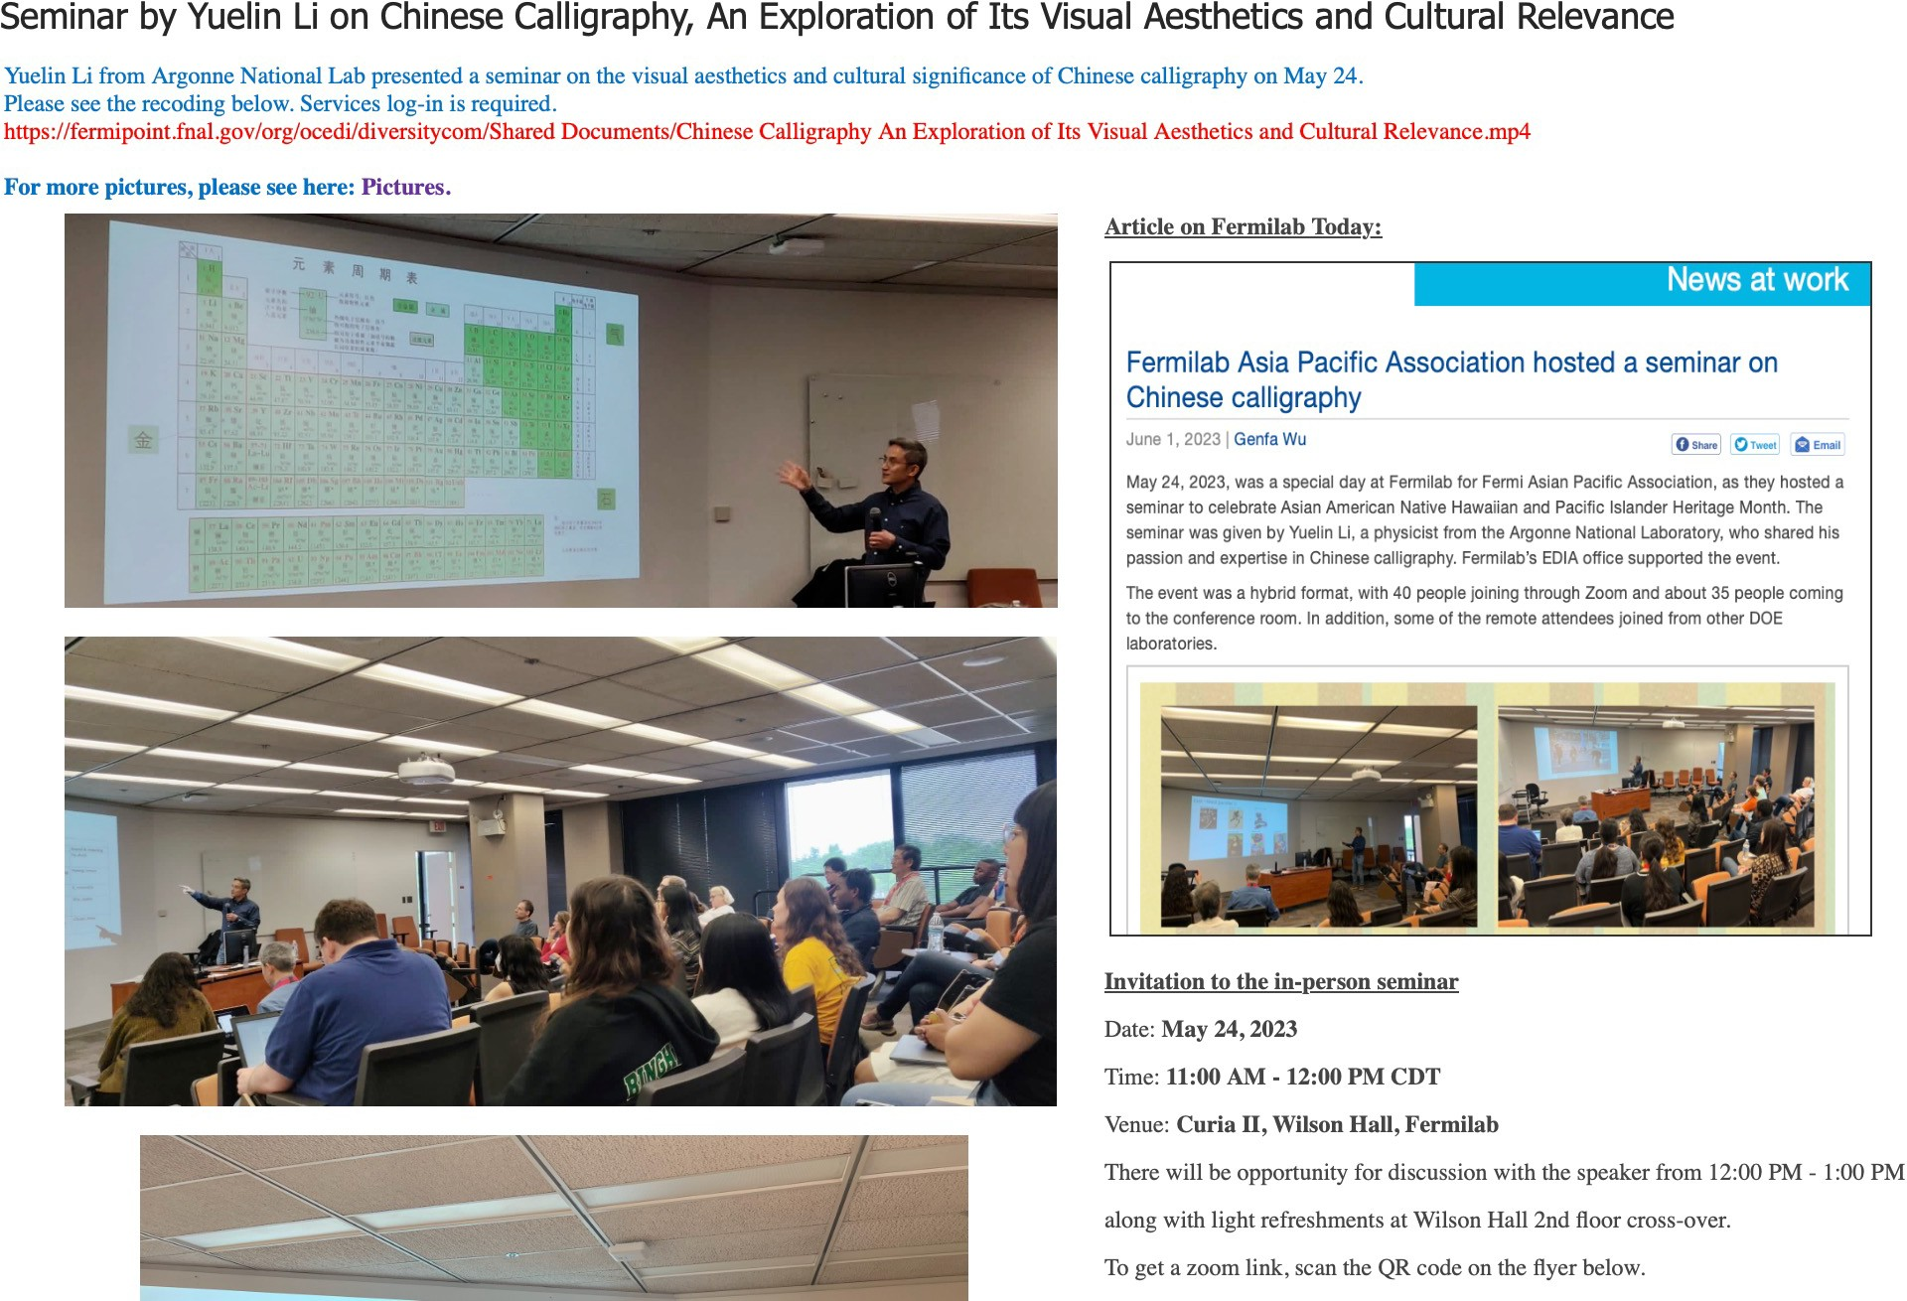
FAPA Events 2023
Lunar New Year celebration on January 27, 2023
Asian, American Native Hawaiian, and Pacific Islander Heritage Month celebration on May 24, 2023
We organize many events throughout the year!

Slide 8
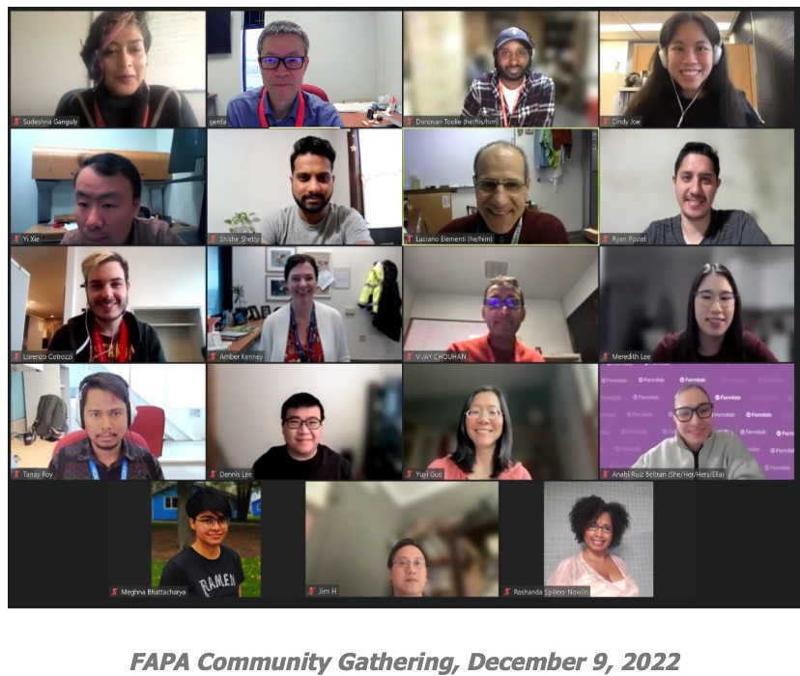
Upcoming FAPA Events in 2024
Upcoming events:
Mid-autumn Festival: Mooncake social & Star-gazing, 9/13/2024
Diwali on November 8, 2024

Slide 9
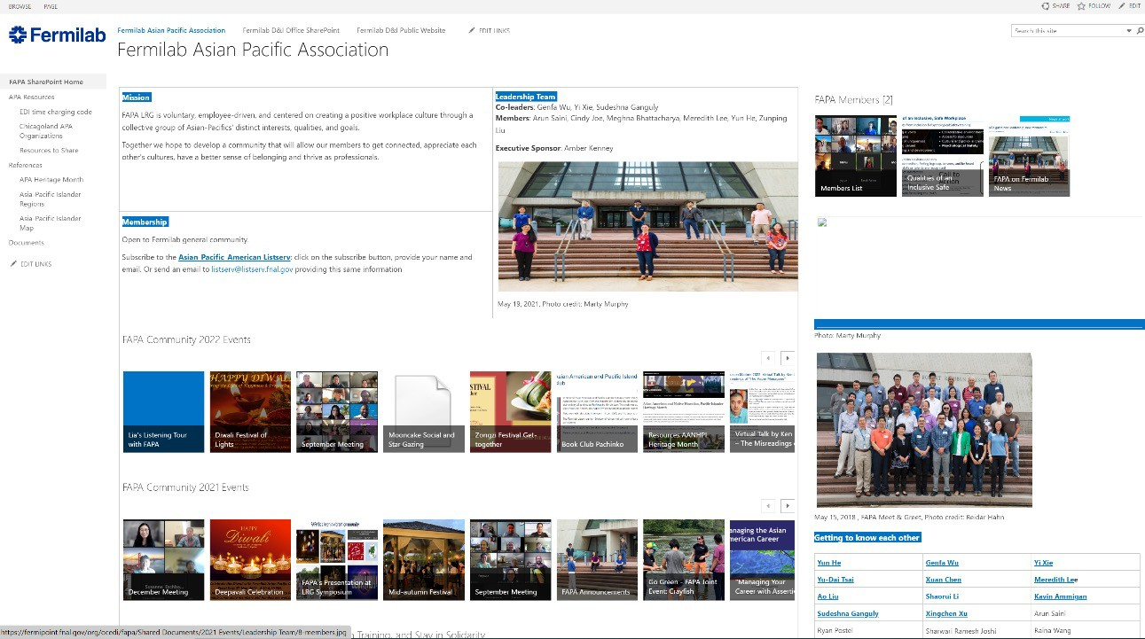
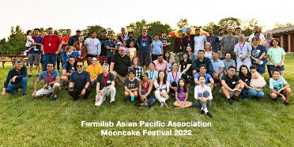
Stay Connected!
Culture events: appreciate/celebrate a diversity of culture
Monthly meetings: self-introductions, community updates, engagement
Stay in solidarity: Covid pandemic, Anti- Asian sentiment, etc.
Career advancement: workshops, discussions
FAPA SharePoint: https://fermipoint.fnal.gov/org/wdrs/eeo/fapa/SitePages/Home.aspx
Please subscribe to listserv: asian_pacific_americans@listserv.fnal.gov
6
6/17/23
AAPI ERGs Meeting

