Slide 1
NuFact 2024 Fermilab Tour Planning
Sudeshna Ganguly
Linyan Wan
Meghna Bhattacharya

Slide 2
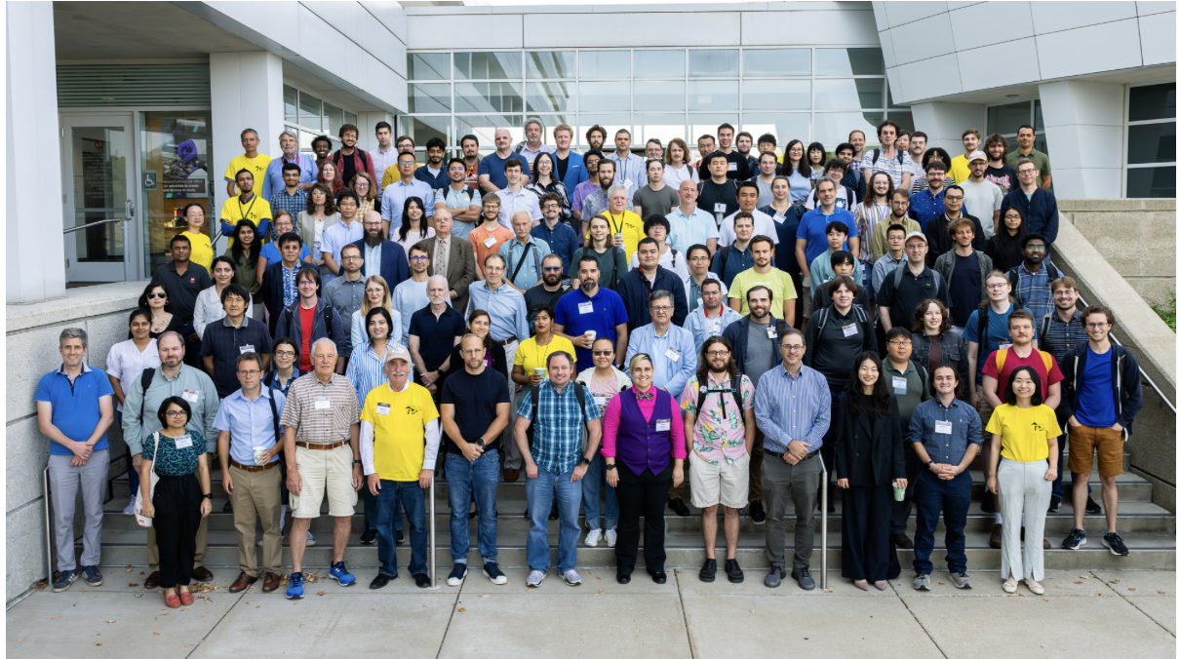
The 25th International Workshop on Neutrinos from Accelerators

Slide 3
Fermilab tour
New Muon Labs (FAST/IOTA) 2:30 - 2:45
PAB - 2:50 - 3:05
ICB - 3:10 - 3:25
WH break+walk to MCR - 3:30 -3:40
MCR - 3:40 -3:50
SBND - 4:00 drop off subgroup 1 (with Linyan)
2x2 - 4:05 drop off subgroup 2 (with Meghna or Sudeshna)
SBND - 4:20 pick up subgroup 1 (with Linyan)
2x2 - 4:25 drop off subgroup 1 (with Linyan), pick up subgroup2 (with M or S)
SBND - 4:30 drop off subgroup 2 (with M or S)
2X2 - 4:55 pick up subgroup 1 (with Linyan)
SBND - 5:00 pick up subgroup 2 (with M or S)

Slide 4
Processes We went through
Linyan filled out tour request application form, she was in charge of approving tour requests from the guests through indico
Meghna, Sudeshna took training to escort foreign nationals
Worked with Jessica Christiansen from Global Services
Special shout out to her for being extremely helpful and guiding us through the process
Jessica provided us with a detailed Fermilab map, that we used to guide our tour bus driver
Badges were also ready to be picked up on the day, visitors just had to show their REAL-ID
These experiences are all positive and we want to highlight that!

Slide 5
Difficulties
Security at the Village gate was unaware that we were coming, they were surprised to see such a large bus carrying 32 people coming to site
Our expectation was that the security would know of our arrival, bypass the long scanning QR-code process at the gate and usher us to the badging office at Aspen East
We had a printed copy of registrant list to show the security
Security looked at our various emails (between Jessica and us) and then came inside the bus and asked everyone to show their QR code – this added extra 15-20 mins to our schedule
We had to remove 2/3 tour locations and cancel on the tour guides at the last moment
Once, we were inside Aspen East, the badging process was handled very smoothly
Later, when a group of us was in 2X2 (guided by Sudeshna and Meghna) and another group was in SBND-ND (guided by Linyan), the bus was parked outside of SBND-ND, security asked Linyan to stay with the driver inside the bus at all times. Also, asked her to finish the tour and leave asap
She communicated these issues to us via phone, we went back and forth for a while trying to find a number to call to have any guidance
In the mean time, security agreed to let us finish the tour as long as Linyan stayed inside the bus

Slide 6
Difficulties
We could not find any emergency phone number to call the Global services webpage: https://get-connected.fnal.gov
Steve Hahn found some instruction from somewhere to call X2345 in case of any emergency
We called them and left a voice message, but never received a call-back
Sudeshna looked up the phone number for ASPEN EAST but no one picked up
During these chaotic “calling each other and calling different numbers”, we just decided to finish our tour as soon as group2 returned from underground. We could not take group 2 to SBND-ND. They only saw 2x2
We spoke with a security officer a week later about this experience and they told us that we made a mistake in our tour request application by not mentioning that we would be crossing the radiation gate. Though we have given the locations where we would take our guests and from the names, it should have been apparent
Overall, we were impressed by how fast badging was handled, but it seemed that there was some disconnect between badging office and security. In the least, we imagined that they would be aware of our arrival

