Slide 1
TMS Detector Steel and Detector Dimensions for the PDR
27 September 2024
T. Markiewicz/SLAC

Slide 2
Two Ways of achieving required length
Coils stick out 350mm each side
First-Last Plate must be <= 8017-700=7317mm
2x as many 80mm steel plates at rear
91 internal detector planes
80mm Less steel, 93 internal detector planes

Slide 3
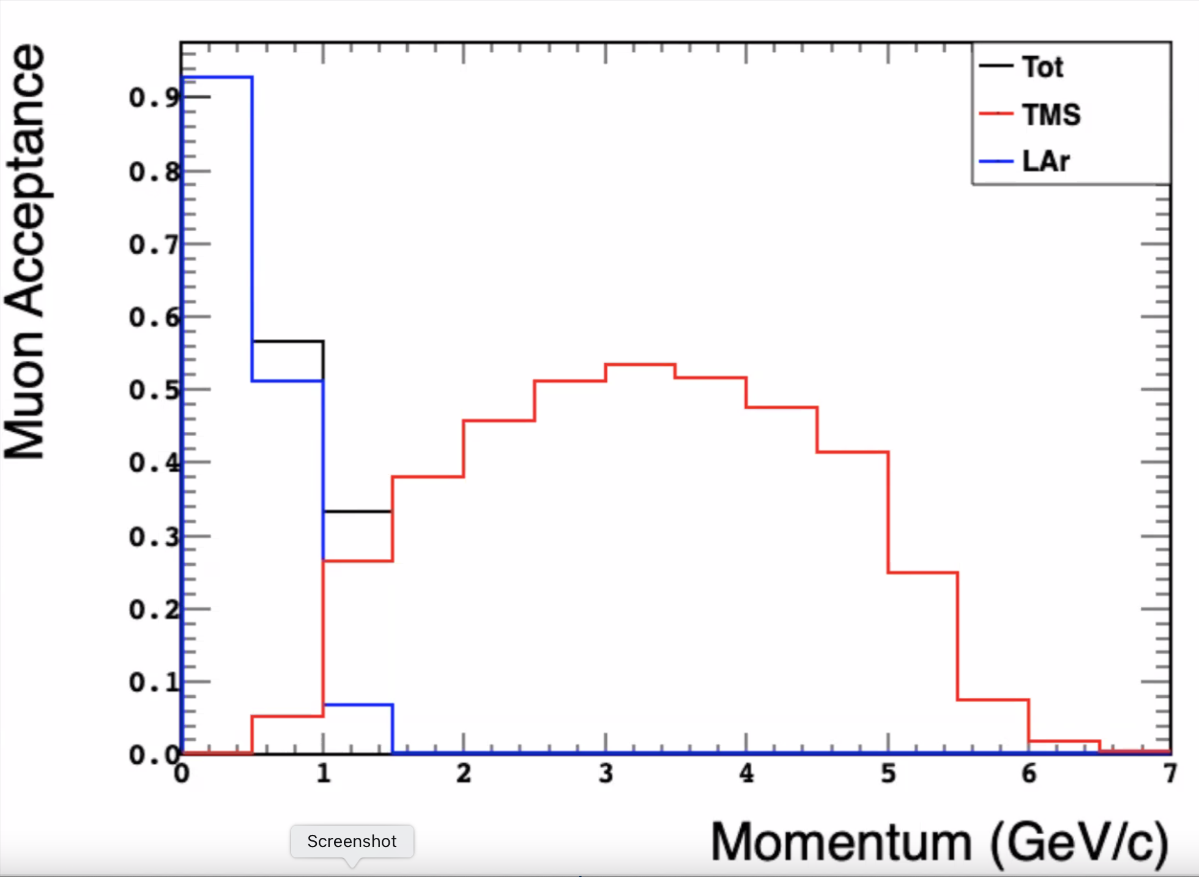
TMS and NDLAr Acceptance vs. Muon Momentum for CDR Configuration
In PDR plan we reduce steel from 3000mm to 2750mm
Expect the end point of 6 GeV/c to reduce to 5.5 GeV/c and still meet the ~5 GeV Acceptance Requirement
Scaling by 2670mm would take 6 GeV/c to 5.34 GeV/c, probably also acceptable

Slide 4
Plate Pattern: Green=50x15mm, Blue=34x40mm,Red=8x80mm, Gaps=50mm

Slide 5
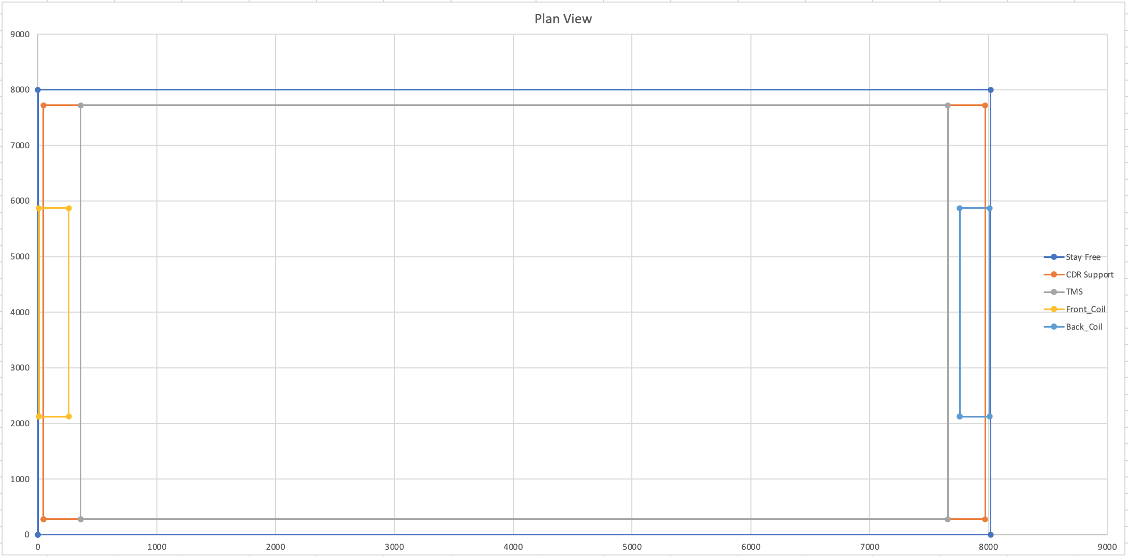
Plate Pattern: Plan View of TMS in 8017mm allotted space

Slide 6
Numbers
# Cassettes = 2 (in front) + 91 (interior) + 1 behind = 94
Channels=192 x 94 = 18048
CAEN 5202s = 18048/64 = 282
CAEN Conversions Boxes = 282/6 = 47

Slide 7
Numerical Comparison

Slide 8
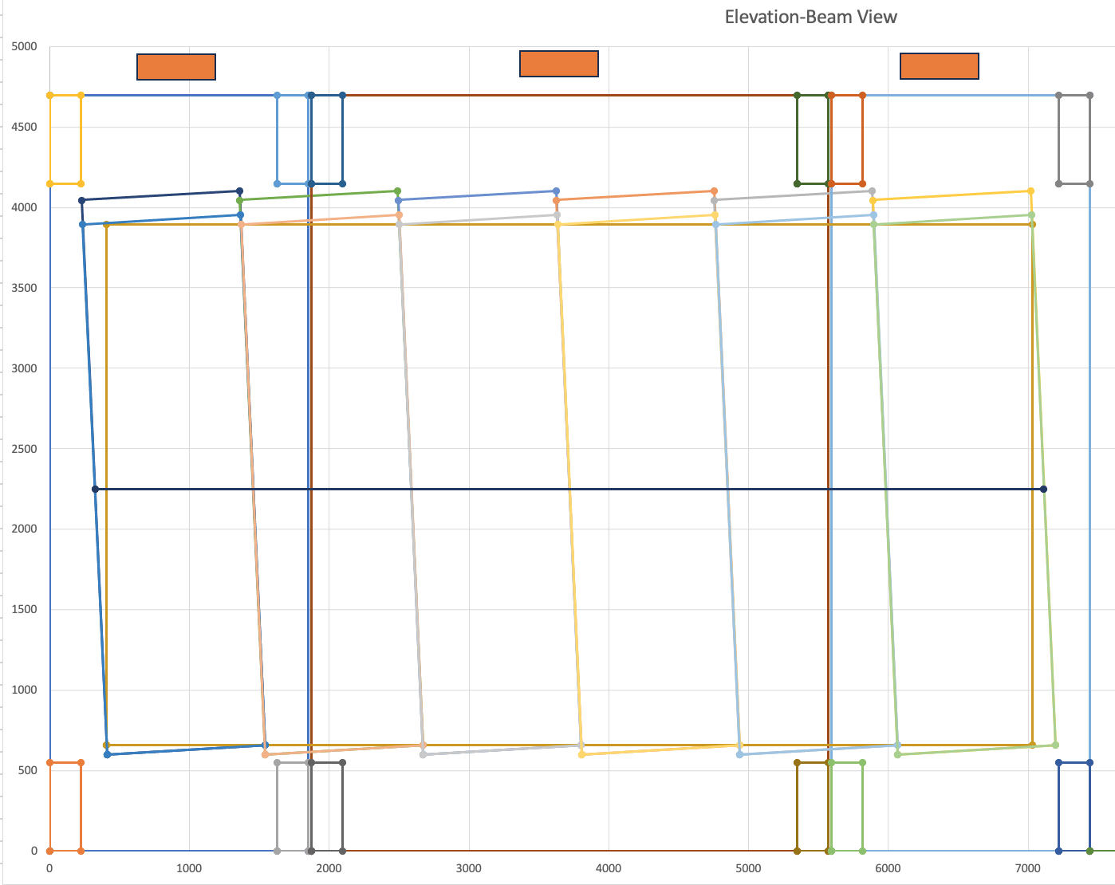
U Counter Dimensions “7m”

Slide 9
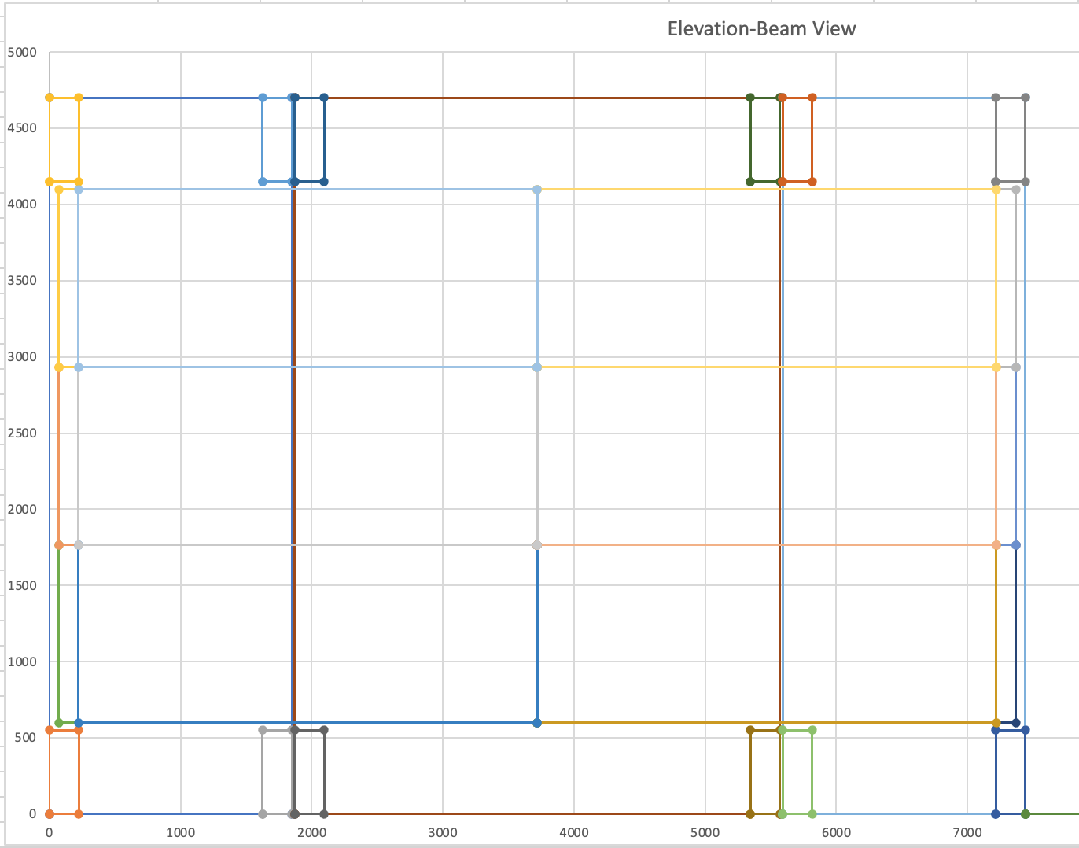
Horizontal Counter Dimensions

Slide 10
Comments
36mm bar width set by horizontal counters
  Given specified clearances “only” 50mm clearance to coil slots
Given extra long scintillator (3300, 3500) we can expand the 150mm “readout” if required. A design of this region and the cable handling is required pre-PDR.
Engineers should specify dead region required at far end
X vs. U, V and #Y counters and their locations TBD
Questions
  Is the scintillator thickness 16mm or 17mm? (I have seen both in presentations)
    At meeting thought (TBC) is 16mm is correct (with glue between Aluminum & counter needing 1mm)
  Do we agree on 1.4mm fiber? At meeting, answer is YES
    Does not affect steel but we should order a die and scintillator asap

