Slide 1
Accelerator
Summer Shutdown
Tony Busch
AD Shutdown Coordinator
Planning & Integration Department

Slide 2
Shutdown 2024 Timeline
LOMO
Milestone 1
Milestone 7
Define Shutdown Coordinators.
Milestone 3
Complete shutdown.
Milestone 8
First pass resource level Schedule.
Milestone 5
Complete
Startup.
Final resource level Schedule.
Milestone 2
ID Jobs to the 90% level.
Milestone 6
Milestone 9
Milestone 4
Return HEP
Second pass resource level Schedule.
Start Shutdown.
Dec
JAN
FEB
MAR
APR
MAY
JUN
JULY
AUG
SEP
OCT
NOV
DEC
Define Scope
Plan
Execute
Execute
HEP
Determine Jobs
Plan phase 1: Define schedule
Plan phase 2: Finalize Schedule
Crew Marching orders
Execute Shutdown
Execute Shutdown
Close out
Shutdown parameters
Original Duration: 10 weeks. LOMO period extended the timeline. We have also had some unforeseen problems come up with Kautz and Master Sub stations along with the Main Injector Heat exchangers.
Beam to BNB 11/1/24

Slide 3
Plan for restoring substation operations - overview
Phase | # Operating Transformers | Description | Impact | Timeline
1 | MSS: 2 KRS: 2 | Make repairs to Kautz Road Substation, modifications to Master Substation to restore two transformers within each station | Remove single point vulnerability, restore power service to BNB program Restore partial Main Injector operations | ETA: 30 Sep 2024
2 | MSS: 2 KRS: 3 | Make repairs to T81, relocate to Kautz Road Substation | Restore partial Main Injector operations | 6-9 months
3 | MSS: 3 KRS: 4 | Replace suspect bushings on T84 and T87 | Restore full Main Injector operations | 12-28 months
4 | MSS: 4 KRS: 4 | Replace damaged transformer | Restore resiliency within electrical distribution system | 36+ months
Plan for restoring substation operations

Slide 4
Main Injector heat exchanger inspections
While inspecting the cleaned Main Injector heat exchangers, AD engineer noticed that the interior of the heat exchanger channels are experiencing severe corrosion.
Engineers are working engineering notes to run the heat exchangers as is with precautions.

Slide 5
Shutdown Progress
100.0%
65.1%
Planned Work
Work Completed
I anticipate that we will be at ~ 80% of the work completed once
the collimator work and testing is complete.

Slide 6
Power outage schedule

Slide 7
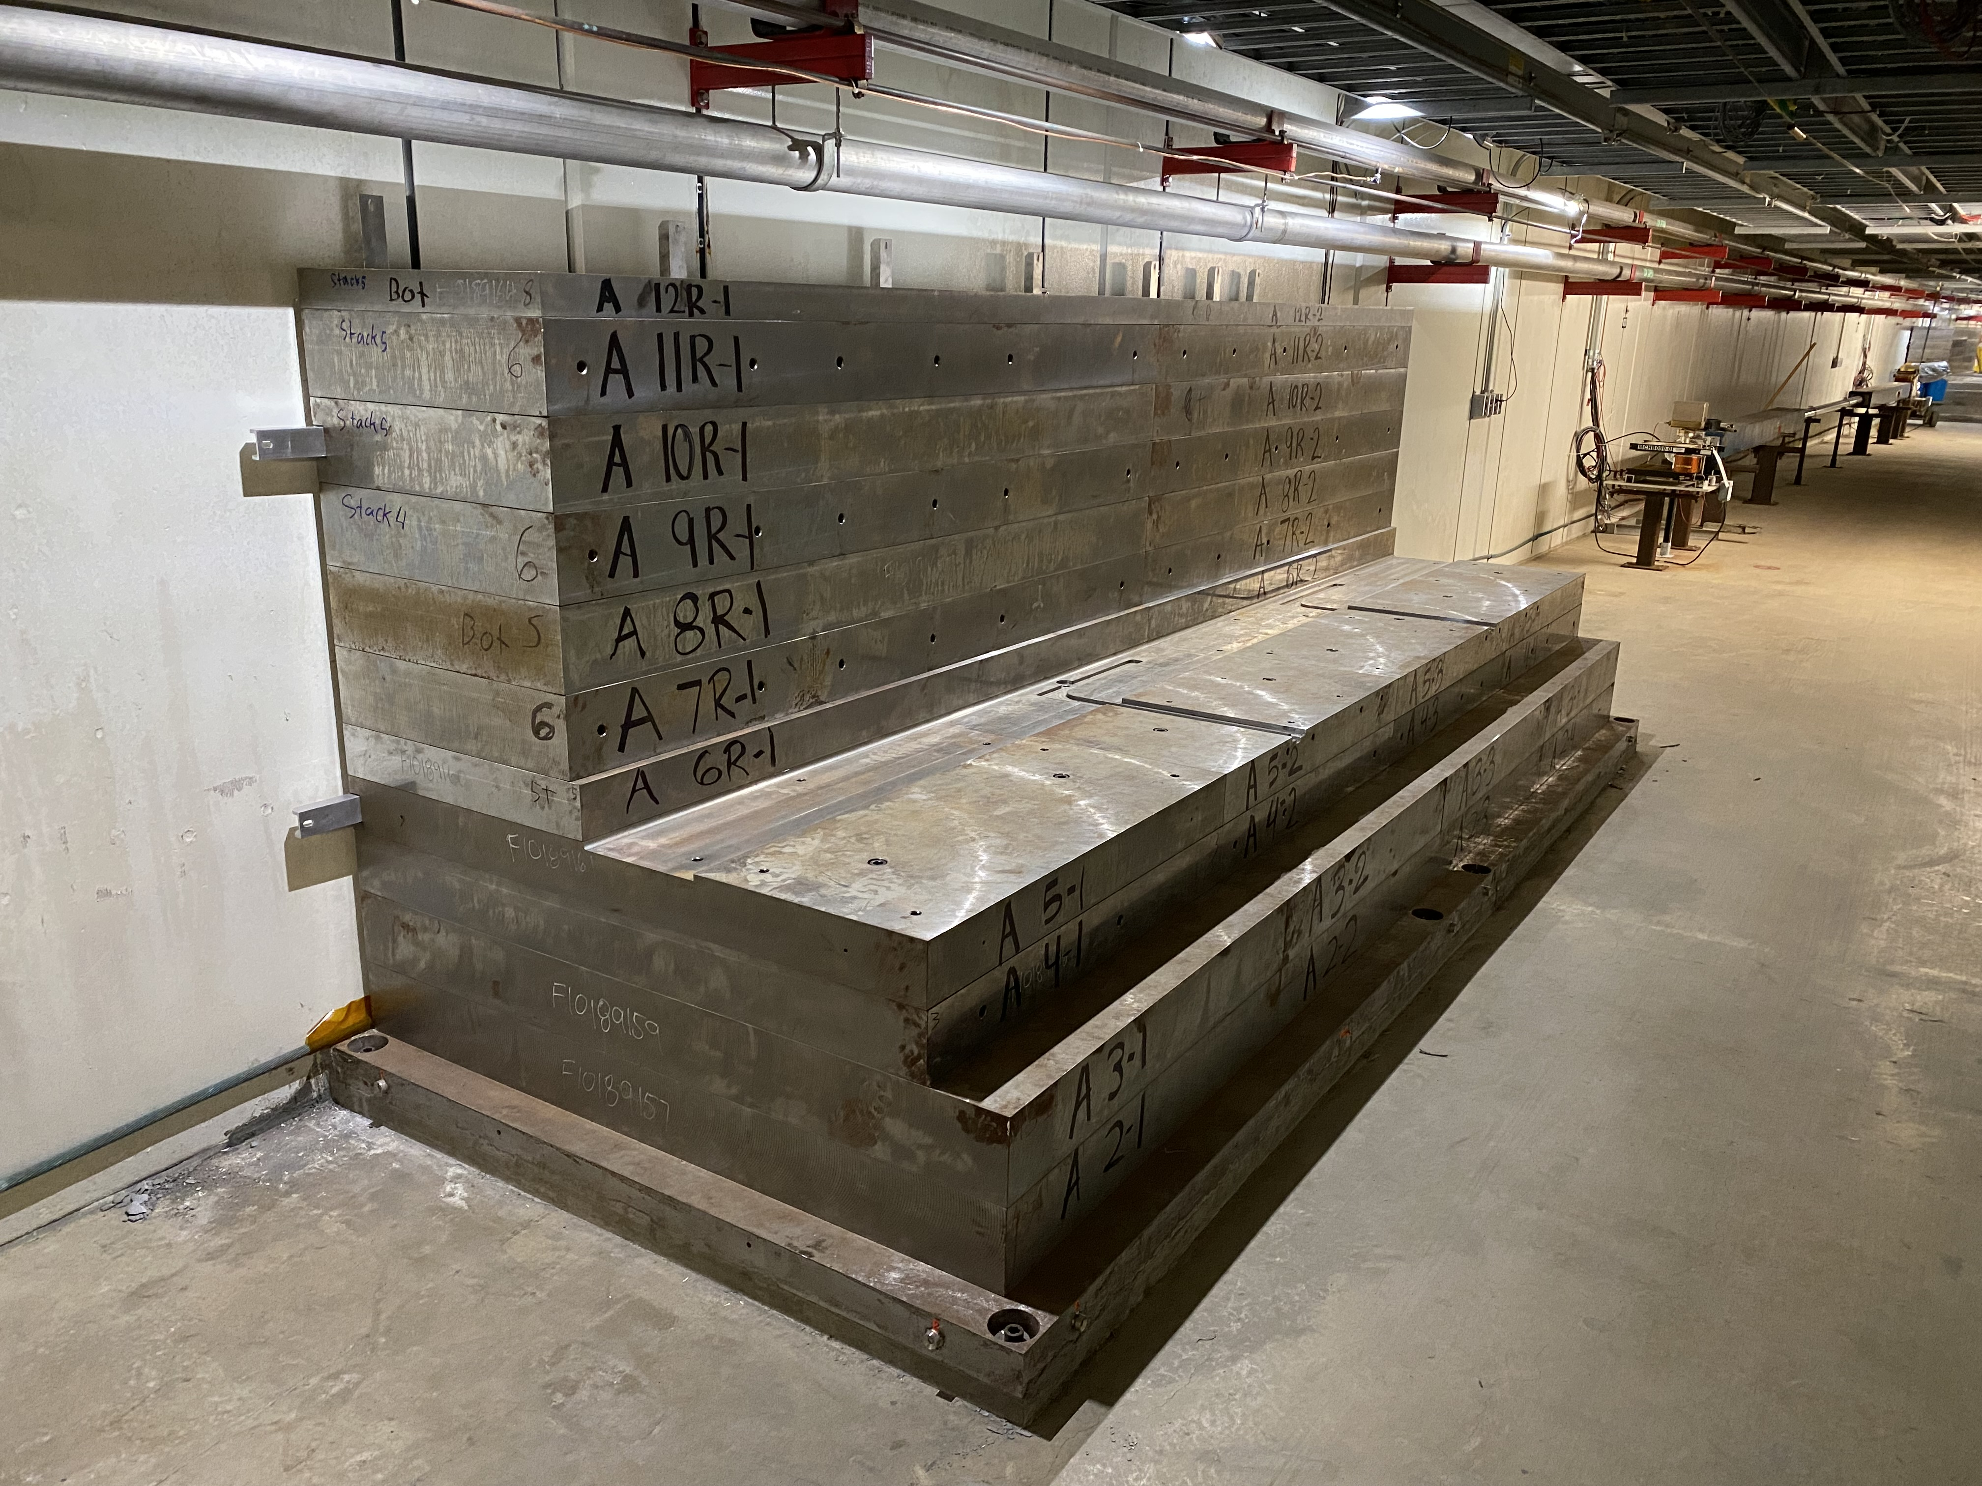
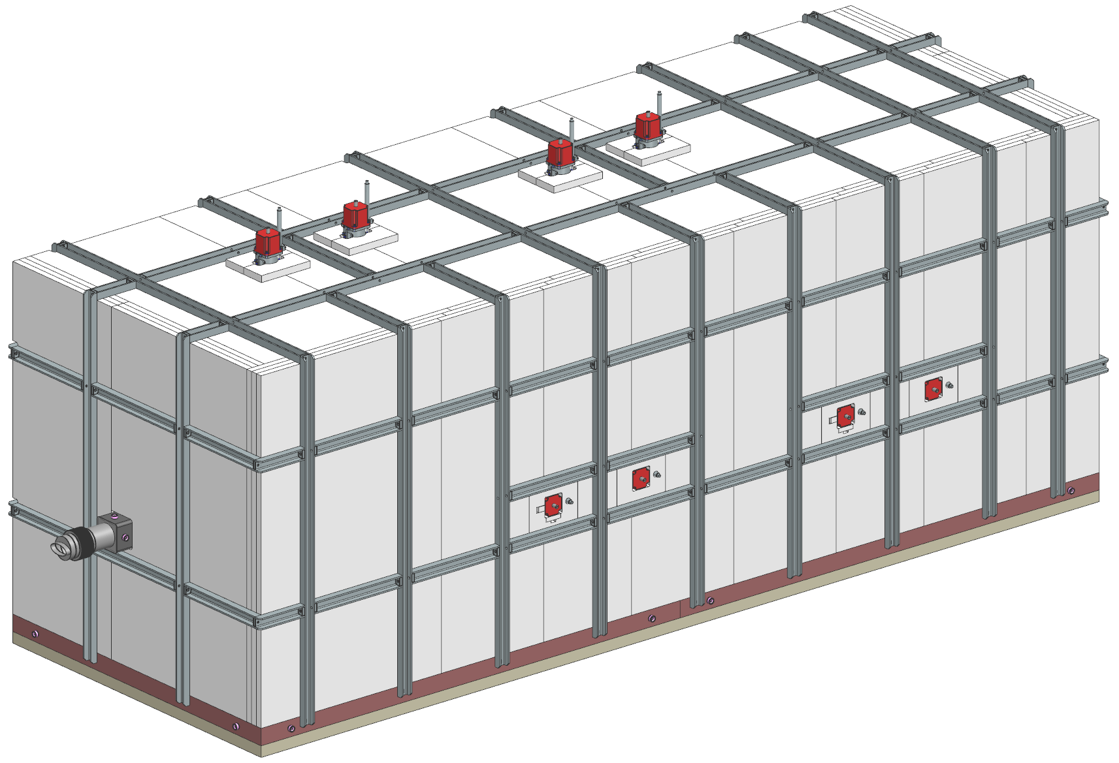
8 Gev Collimator
2 Collimators
  825-826 and 827-828
Weight per collimator station: ~175,000 lbs. (88 tons)
Vertical motion controls
Installation is 50% complete
Horizontal motion controls
Beam direction
Beamtube/ vacuum chamber

Slide 8
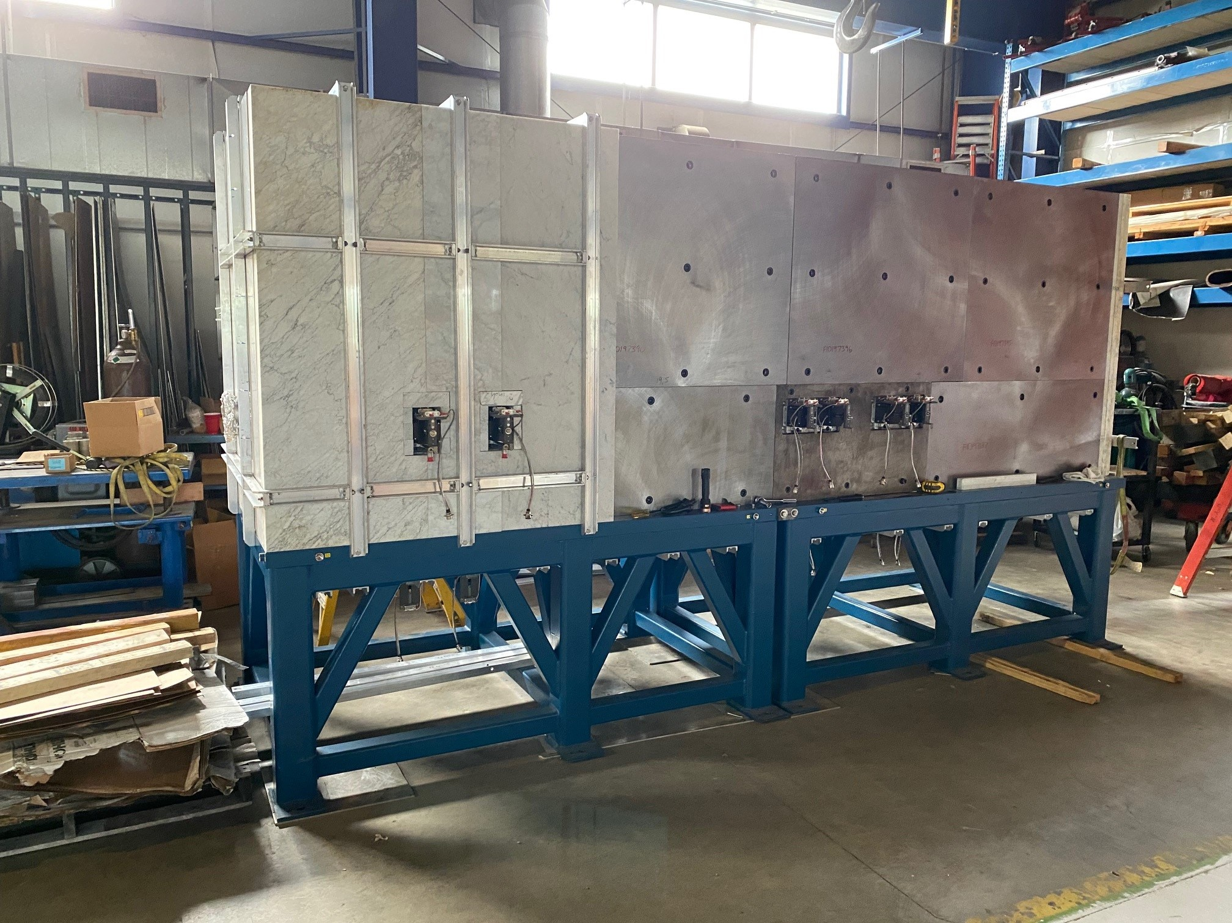
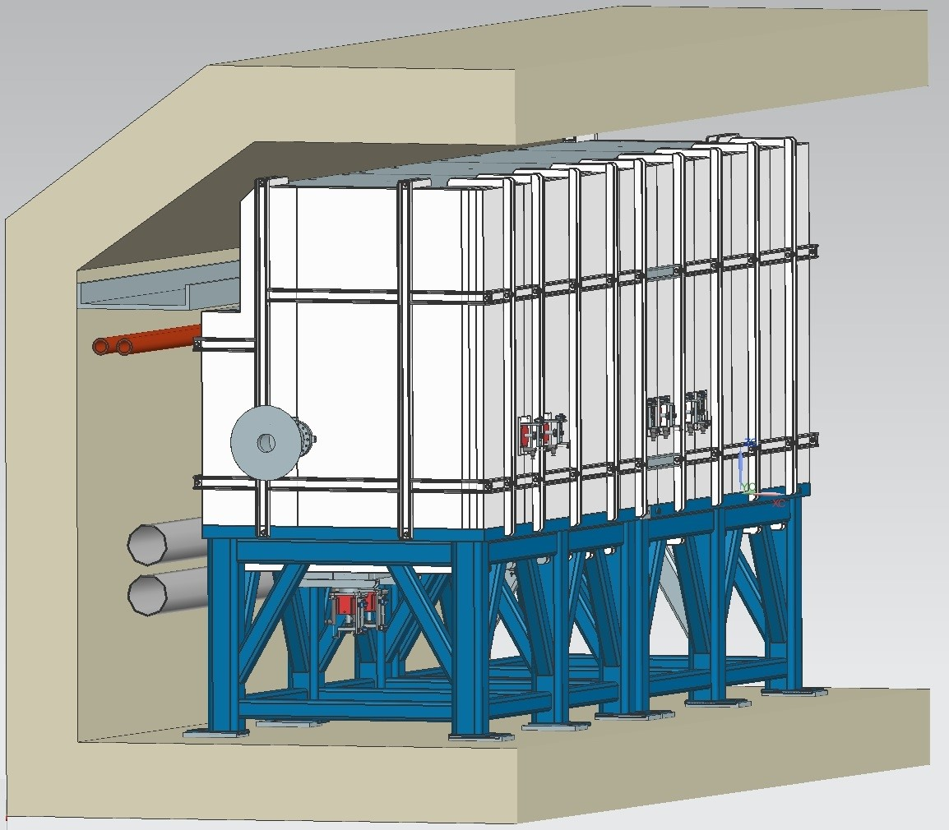
Booster Collimator
1 Collimator on 2 stands
Weight ~100,000 lbs.
Vertical motion controls
Installation complete
  Working on controls for motors.
Beam direction

Slide 9
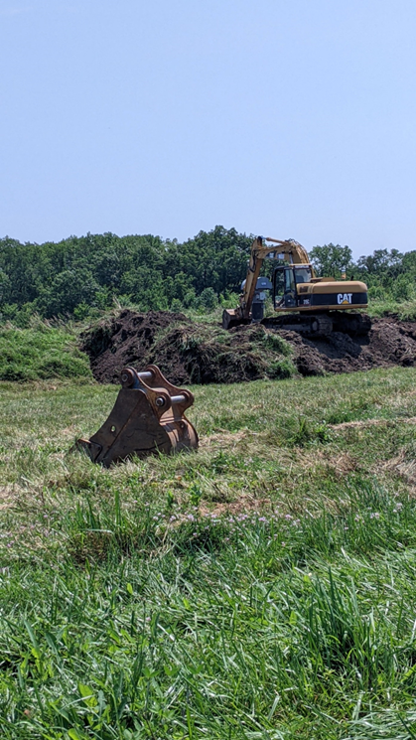
Main jobs completed
  Dual PA upgrades in Main Injector continue
  Replacement of H202-5 and SWIC in Switchyard.
  Choke repairs in Booster.
  Sump discharge repairs in Main Injector
  Cleaning of all Main Injector heat
  exchangers. Inspections continue.
  Booster collimator installed
  MI 8 collimator continues.

Slide 10
ISD Shutdown work completed
  Electrical
    Lighting repairs
      Tunnel relamping
      Service Building relamping
    Power panel inspections
      Tunnel and service buildings
    General Electrical repairs
    Upgraded the MI 40 sump controller
  Mechanical
    Sump repairs/replacement
    Generator maintenance

Slide 11
Summary
Main Injector heat exchanger inspections continue.
KRS work continues. Power outage on 10/16 to normal configuration.
Linac plans to run beam by the end of the week of 10/7.
Booster awaiting shielding assessment.
Beam to BNB 11/1.

