Slide 1



Status of US AUP Contribution
Giorgio Apollinari – FNAL
HL-LHC AUP Project Manager
14th HL-LHC Collaboration Meeting
Genova, Italy - October 2024

Slide 2
Outline
Introduction
AUP Project Overview
AUP Technical and Financial Status
Summary

Slide 3
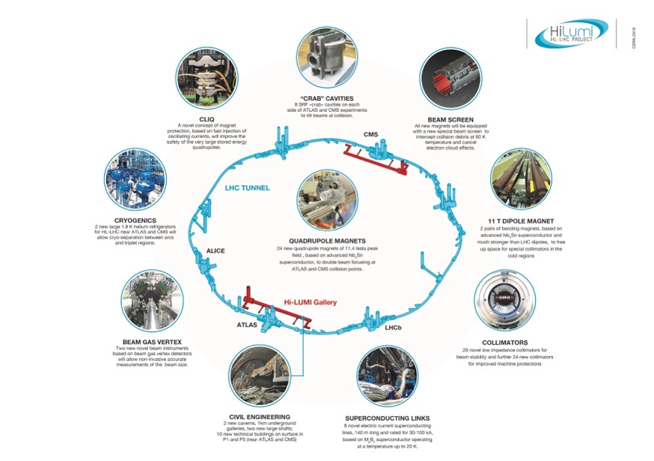

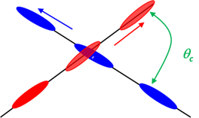
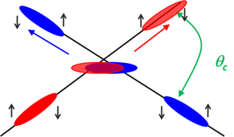
US Contribution to HL-LHC
HL-LHC AUP
Quad
Magnets
Beam size
Crab
Cavities
From HL-LHC Project Leader
O. Bruning - CERN
HL-LHC: from 300 fb⁻¹ to 3000/4000 fb⁻¹
LARP (DOE supported R&D Program) established the necessary technology for the HL-LHC Focusing Magnets and Crab Cavities
DOE baselined HL-LHC AUP Project in 2019 (FNAL, BNL, LBNL with contributions from ANL, SLAC, JLAB, ODU & FSU)
DOE re-baseline AUP in 2023 to absorb COVID impacts on Cost and Schedule
Notes:
Overall goal

Slide 4


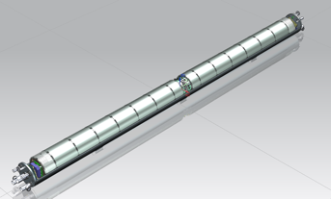
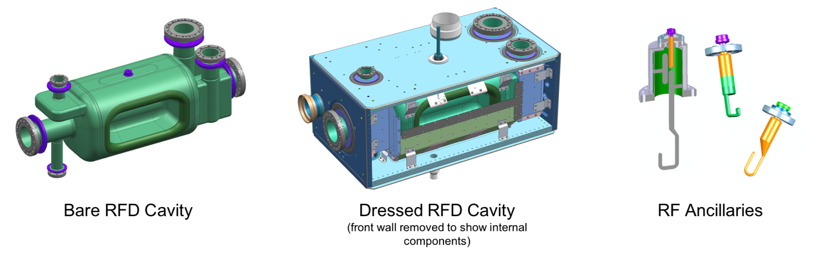
HL-LHC AUP Deliverable Scope
Technical Details
Q1/Q3 Cryoassembly
(10 CryoAssemblies with 20 Magnets)
Dressed RFD Cavity
(10 Dressed Cavities & Ancillaries)
MQXFA
Magnet
302.2
Cold Mass
Assembly
302.4
Cryo-Assembly
302.3
High Order Mode
Antennas

Slide 5
AUP Q1/Q3 and RFD Cavities KPPs
Parameters | Threshold Performance | Objective Performance
Inner Triplet Focusing Quadrupoles (Q1 and Q3) | a) 6 Q1/Q3 Cryoassemblies are accepted by CERN after testing at HL-LHC agreed upon Acceptance Criteria for the Cryoassembly. The Cryoassemblies will be assembled from Cold Masses built by HL-LHC AUP and Cryostat kits provided by CERN. b) 3 Q1/Q3 Cold Masses built with magnets tested vertically at HL-LHC agreed-upon Acceptance Criteria c) Complete coils and remaining components for 1 additional Q1/Q3 Cold Mass | 4 additional Q1/Q3 Cryoassemblies are accepted by CERN after testing at HL-LHC agreed-upon Acceptance Criteria for the Cryoassembly. The Cryoassembly will be assembled from Cold Masses built by HL-LHC AUP and Cryostat kits provided by CERN
SRF Crab Cavities | a) 8 Radio Frequency Dipoles (RFDs) Dressed cavities for the HL-LHC Crab Cavity System are accepted by CERN after being tested at HL-LHC nominal temperature, nominal frequency, and ultimate cavity voltage. Dressed cavities include HOM couplers, pick-ups, He Vessel and magnetic shields. b) Procurement of components for 2 additional RFD Dressed Cavities | 2 additional Radio Frequency Dipoles (RFDs) Dressed cavities for the HL-LHC Crab Cavity System are accepted by CERN after being tested at HL-LHC nominal temperature, nominal frequency, and ultimate cavity voltage. Dressed cavities include HOM couplers, pick-ups, He Vessel and magnetic shields.
10 Q1/Q3 Cryoassemblies
(8 Operations + 2 Hot Spares)
10 RFD Dressed Cavities
(8 Operations + 2 Hot Spares)
HL-LHC AUP Project includes Objective KPPs
Goals untouched since the Project inception

Slide 6
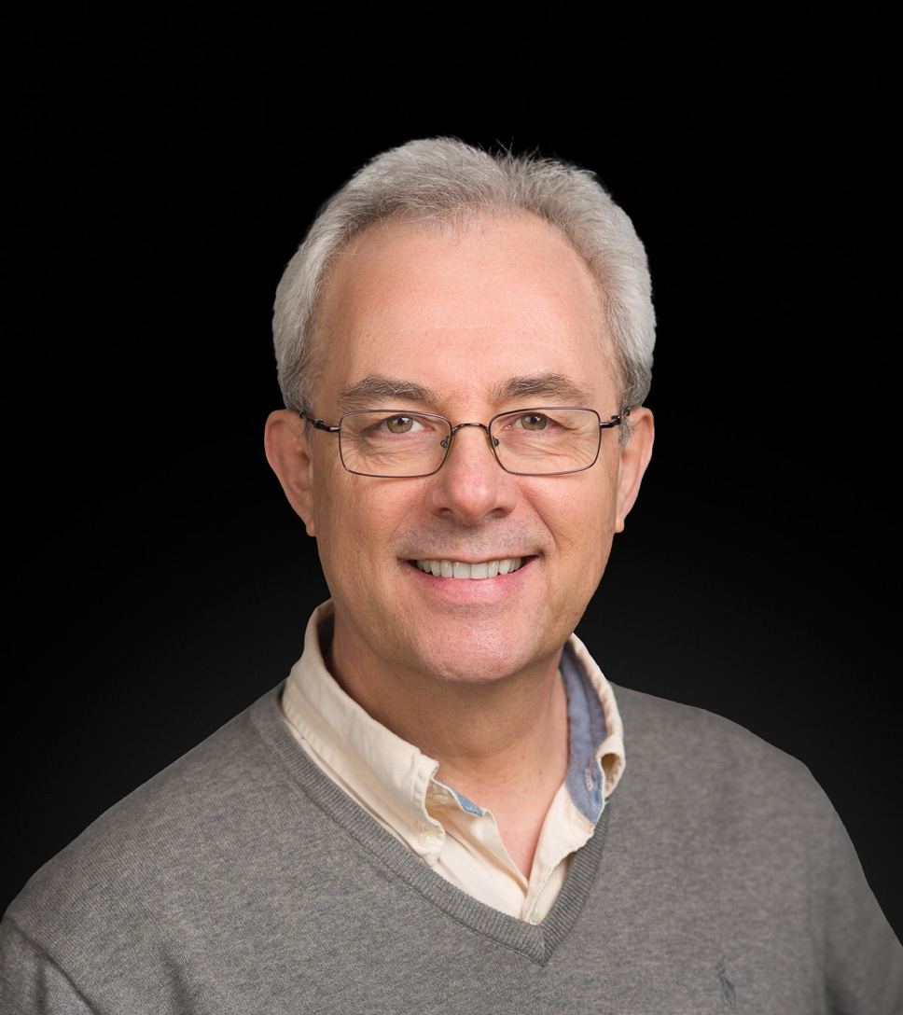
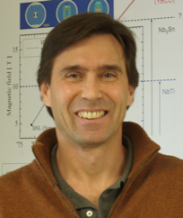
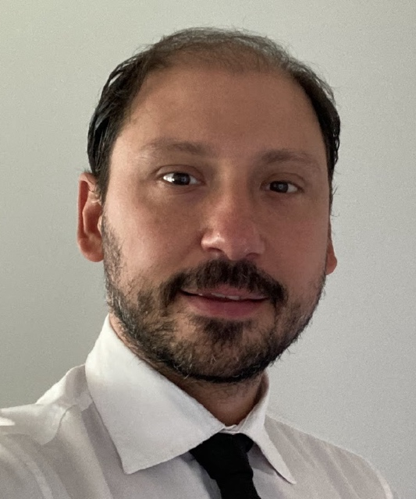

AUP Project Office Change(s)
After 26+ years at the Laboratory, Ruben Carcagno has decided to benefit from the Self-Select Voluntary Separation Program (SSVSP) initiated by Fermilab in early 2024
In name of the whole AUP and HL-LHC teams, we extended to
Ruben our most sincere thanks for everything he has done for the
HL-LHC Project, wishing him the best in this new phase of life.
Interactions with DOE
  Dr. Gianluca Sabbi (LBNL)
  Long-standing member of AUP LBNL team, previous leader in LARP.
Interactions with CERN
  Vito Lombardo (FNAL)
  Risk Manager and CAM in AUP since CD-1

Slide 7
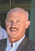
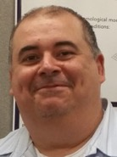
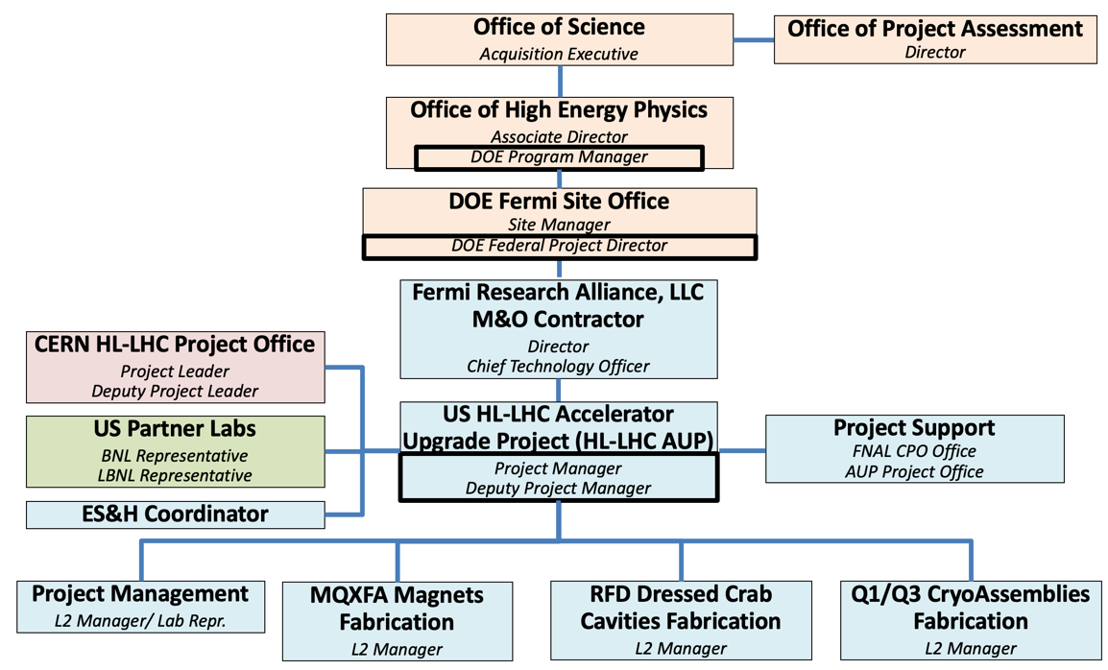


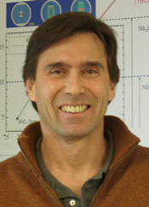
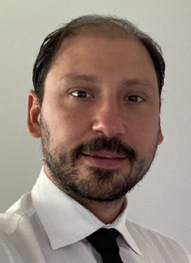

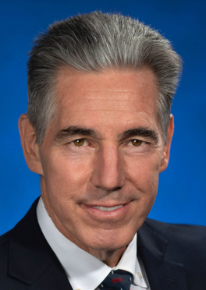
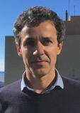
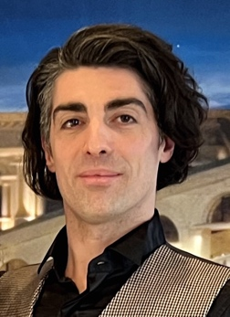

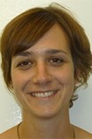

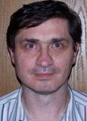
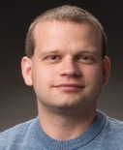
HL-LHC AUP Project Organization
K. Fisher
A. Hatzikoutelis
DOE AE: Harriet Kung
OHEP AD: Regina Rameika
DOE Program Manager: A. Hatzikoutelis
DOE FPD: Jerry Kao
FNAL Project Manager: Giorgio Apollinari
Deputy Project Manager: GianLuca Sabbi
Vito Lombardo
J. Kao
G. Apollinari
G.L. Sabbi
V. Lombardo
S. Prestemon
M. Anerella
G. Ambrosio
M. Baldini
P. Ferracin
L. Ristori
M. Narduzzi
S. Feher
T. Strauss
Notes:
Also OPSS

Slide 8
Progress since last CM on Magnets and CryoAssemblies
Ambrosio/Feher in Plenary +
6 AUP Talks in WP3
BNL Coil Factory completed Production
  FNAL Factory maintained at very low production rate for potential coil replacements
MQXFA07b and MQXFA13b re-assembled and tested
  MQXFA07 was the first magnet impacted by operations under COVID
  MQXFA13 was limited (report at last CM), coil replacement
  Successfully passed BNL Vertical Test
MQXFA14b and MQXFA15 assembled and tested
  Successfully passed BNL Vertical Test
MQXFA17 assembled and tested
  Failed to pass acceptance test at BNL, under coil replacement with TLS
MQXFA18TLS presently under test at BNL
MQXFA12bTLS has been shipped to BNL
MQXFA16TLS under final preparation at LBNL, soon to be shipped to LBNL

Slide 9
MQXFA Magnets Test History
MQXFA03 | VTS Tested OK
MQXFA04 | VTS Tested OK
MQXFA05 | VTS Tested OK
MQXFA06 | VTS Tested OK
MQXFA07 | VTS COVID Limitations, coil replaced | MQXFA07b | _{VTS Tested OK}
MQXFA08 | VTS COVID Limitations, coil replaced | MQXFA08b | VTS Tested OK
MQXFA09 | Assembly NCR (2 coils affected by folded Kapton) | Dismantled | 2 coils rejected 2 coils used in 14b and 5, structure used in 11
MQXFA10 | VTS Tested OK
MQXFA11 | VTS Tested OK
MQXFA12 | Assembly NCR (Hipot fail) coils to be replaced | MQXFA12b | TBT₄
MQXFA13 | VTS Limitations (end prestress), coil replaced | MQXFA13b | VTS Tested OK
MQXFA14 | Assembly NCR (QH hipot fail), coil replaced | MQXFA14b | VTS Tested OK
MQXFA15 | VTS Tested OK
LQXFA/B-01
LQXFA/B-02
LQXFA/B-03
LQXFA/B-04
LQXFA/B-05

Slide 10
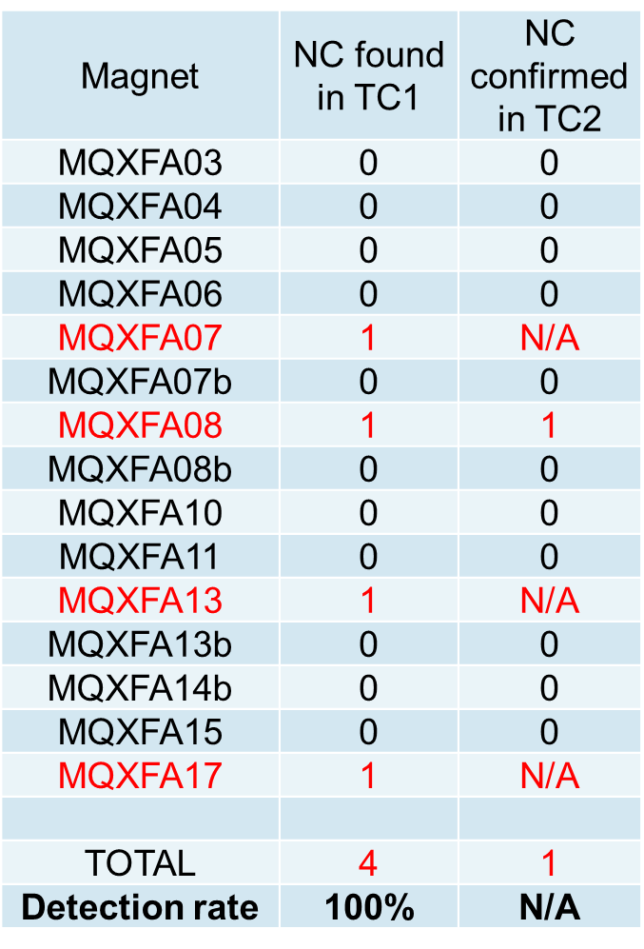
MQXFA Vertical Tests History: TC1 vs. TC2

Slide 11
Magnet Vertical Test Decision
MQXFA Magnets vertical test is a critical QC step in the execution of the AUP Project
“Demonstration of stable performance following a thermal cycle” (Memory) was a critical early demonstration at the beginning of the MQXF magnets construction
  Since the beginning of the AUP projects, all magnets have been tested vertically through 2 Thermal Cycles, and – again – horizontally in the final cryostat through 2 thermal cycle.
Early in the AUP planning - due to financial constraints - a total of ~5 MQXFA magnets were planned to be inserted in cryostats without a Vertical Test.
  Experience is indicating that the risk of not testing a magnet vertically has not decreased substantially as production progressed
  The re-assembly of an LQXFA/B Cryostat was introduced in the AUP Baseline to mitigate risks due to untested magnets

Slide 12
Magnet Vertical Test Decision (cont.)
Observation that all magnets that failed a vertical test were identified in the 1st Thermal Cycle (TC1) and the vast majority could be repaired.
Decision: Test all remaining MQXFA Magnets vertically through only TC1 and reduce number of magnetic measurements at BNL
  Pros:
    Reduce considerably risks for LQXFA/B, eliminating the necessity to carry forward a cryomodule re-assembly in the baseline schedule
    Reduces costs and anticipates schedule
    AUP critical path is stably associated with Horizontal Testing
  Cons:
    “Memory” establishment delayed from Vertical Test to LQXFA/B Horizontal Test

Slide 13
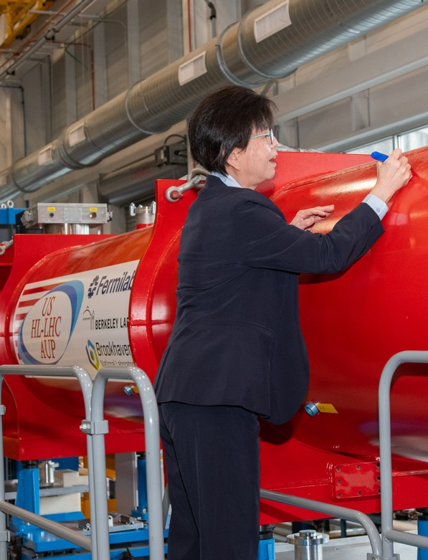
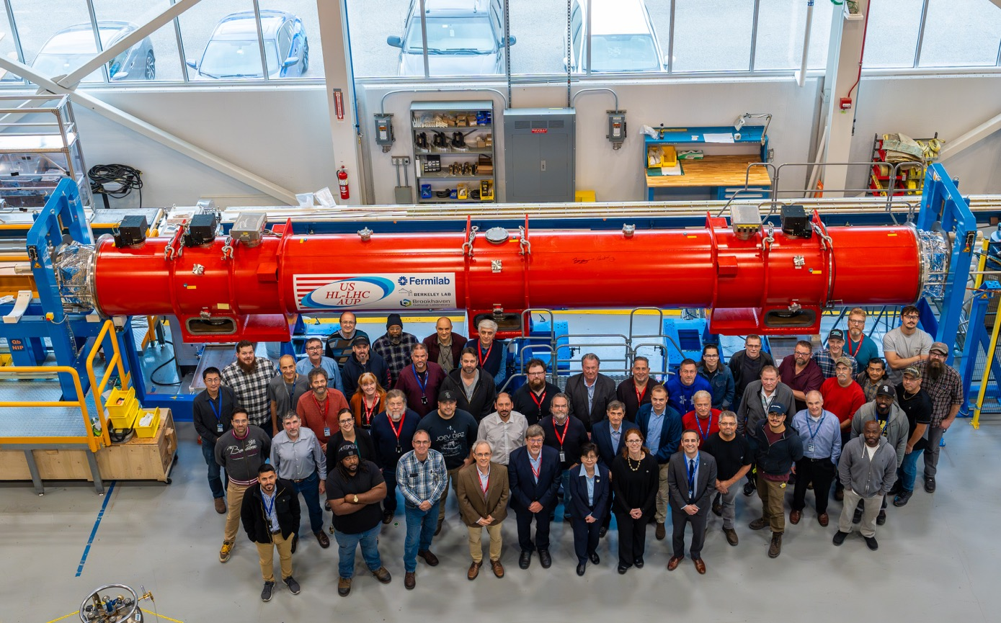
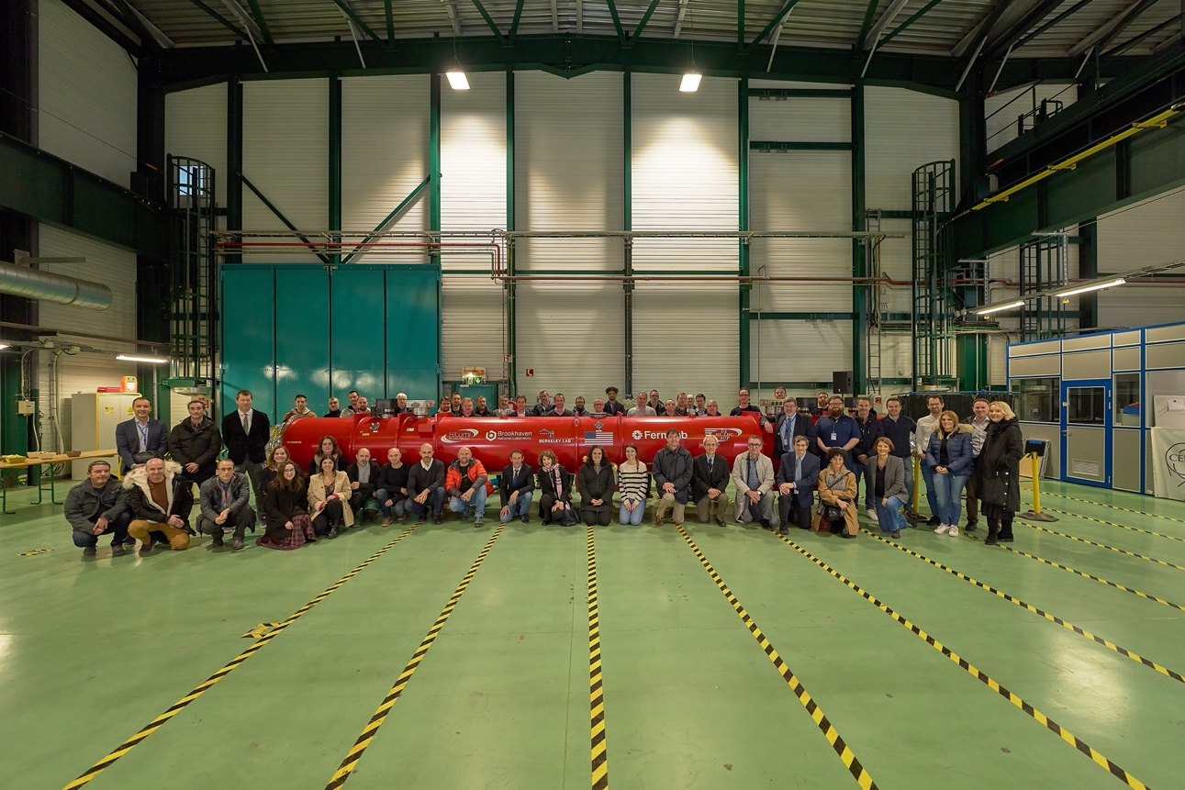
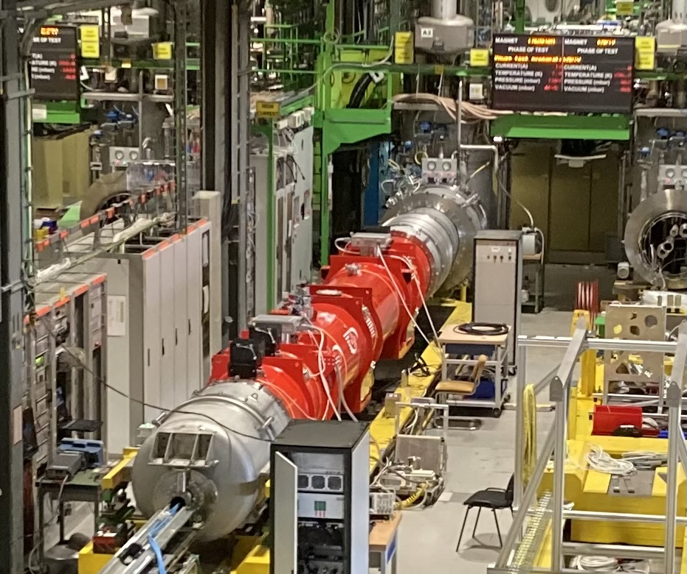
LQXFAB-01 Delivery to CERN
Dr. Harriet Kung Visit and LQXFA/B-01 in final Shipment Preparation – Oct. ‘23
CERN Arrival - Dec. ‘23
Test at CERN - Jun. ‘24
CERN Cryogenic Test of LQXFAB-01 at CERN achieved nominal Current without quenches on June 18th 2024.
Quench Heaters non-Conformities addressed by delivery of additional/spare elements to CERN (1 MQXFA Magnet, Shell, CM Tool)

Slide 14
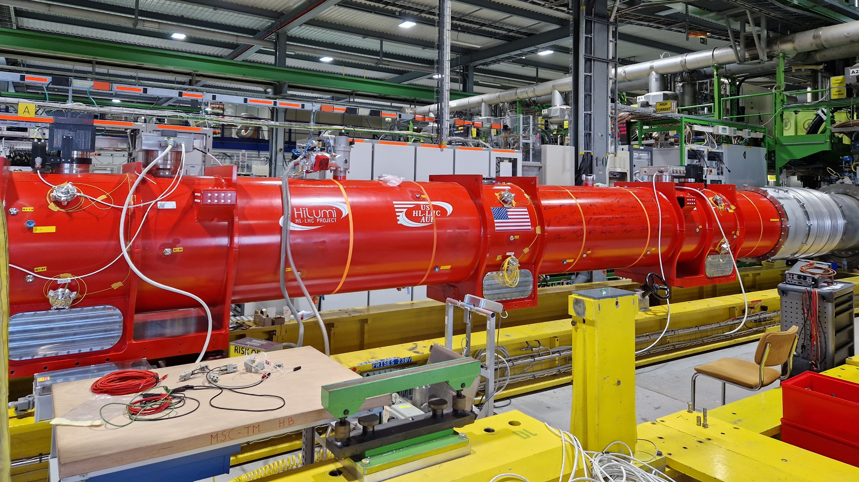
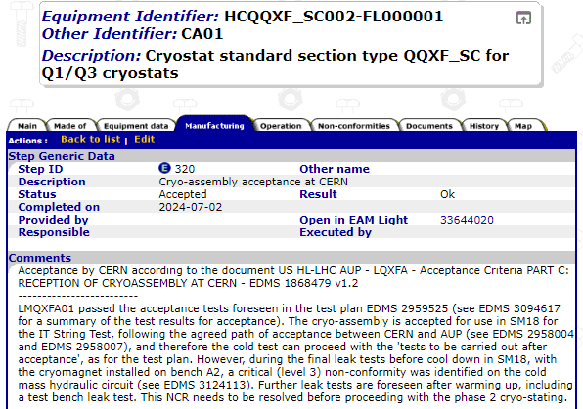
LQXFAB-01 Acceptance at CERN
LQXFAB-01 Accepted at CERN in June 2024 within the framework of AUP-CERN Acceptance Criteria agreements.
LQXFA01 is accepted after the tests carried out at CERN in the framework of the Acceptance Criteria – Part C (EDMS 1868479) with the following remarks:
The Cryo-assembly is accepted for installation in the IT String but for the installation in the LHC, the agreed path for acceptance between AUP and CERN is to be completed (See EDMS 2958004 and EDMS 2958007).
During the final leak test prior to cooldown, a leak was detected in the cold mass hydraulic circuit. This nonconformity needs to be investigated and solved prior to starting the phase 2 cryostating.

Slide 15
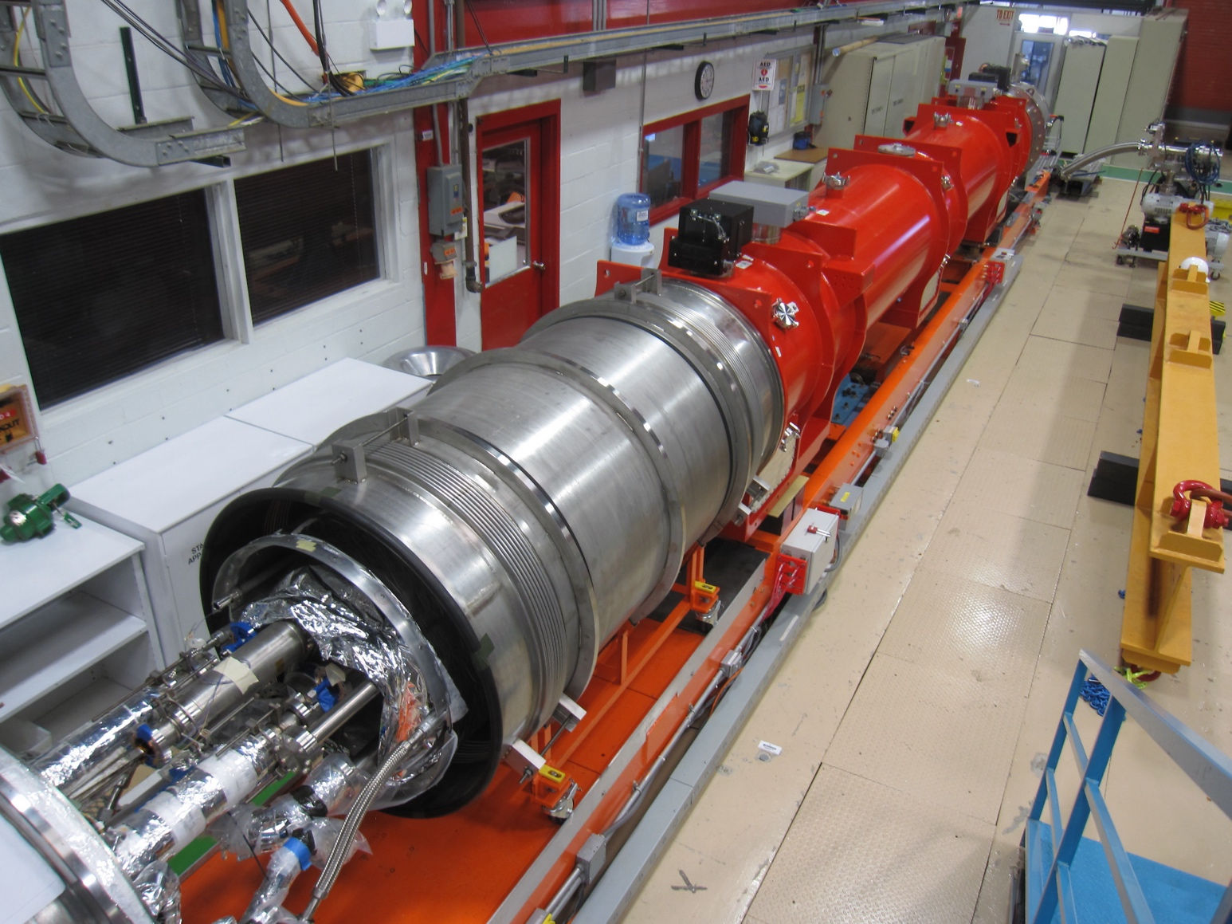
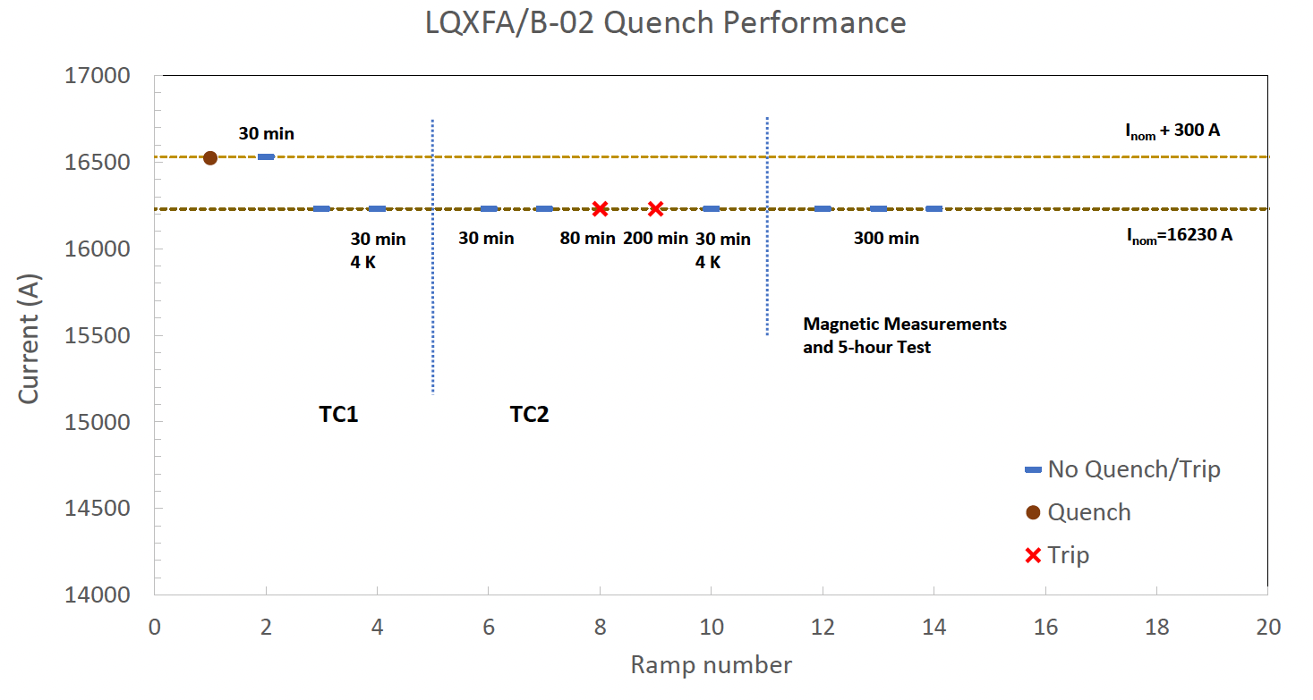
LQXFAB-02 under Test in IB1- TS4
TS4 underwent massive upgrades to expedite cold test of a cryomodule
  ~4 months for LQXFAB-01 to Acceptance
  Still ~3.5 months for LQXFAB-02 from completion of installation to Acceptance (modulo 100k HiPot)
  Planned for “Pressure & Leak Test” and shipment from FNAL to CERN by Nov. 18th (arrival at CERN by mid-December).
Trips on PS while
attempting 5h Hold Test
Installation on TS4 - Jun. ‘24

Slide 16
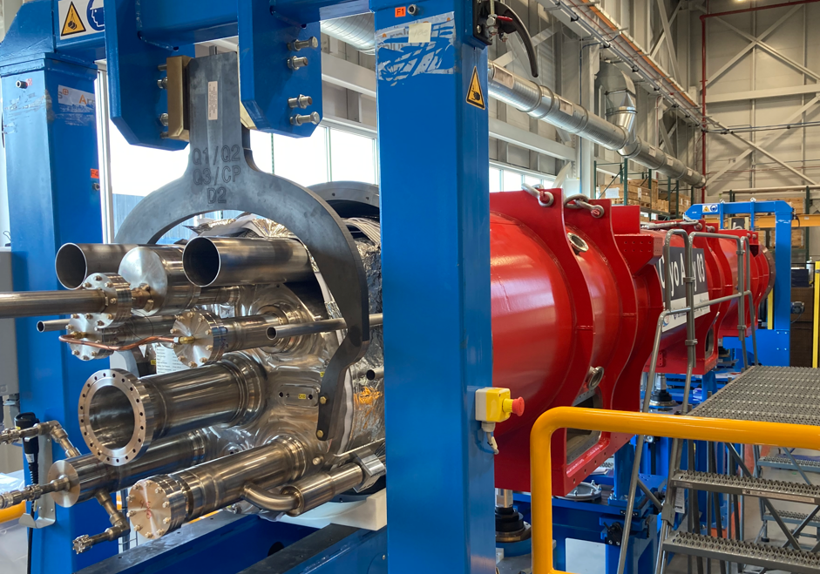
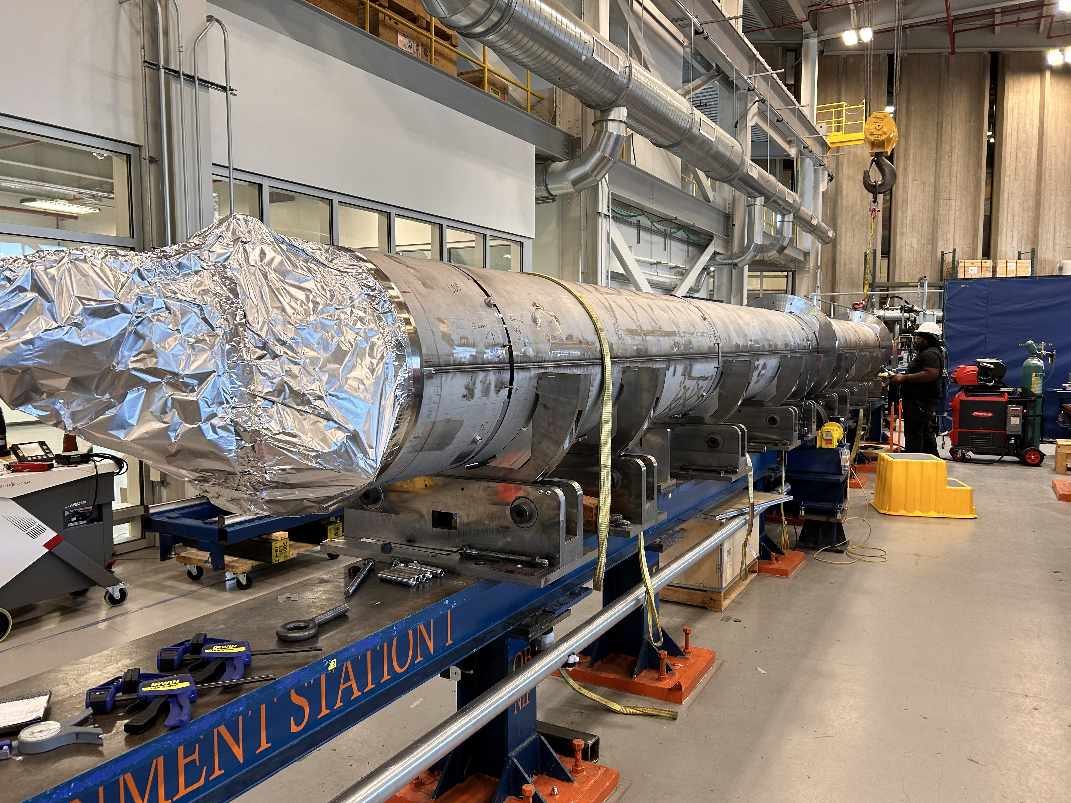
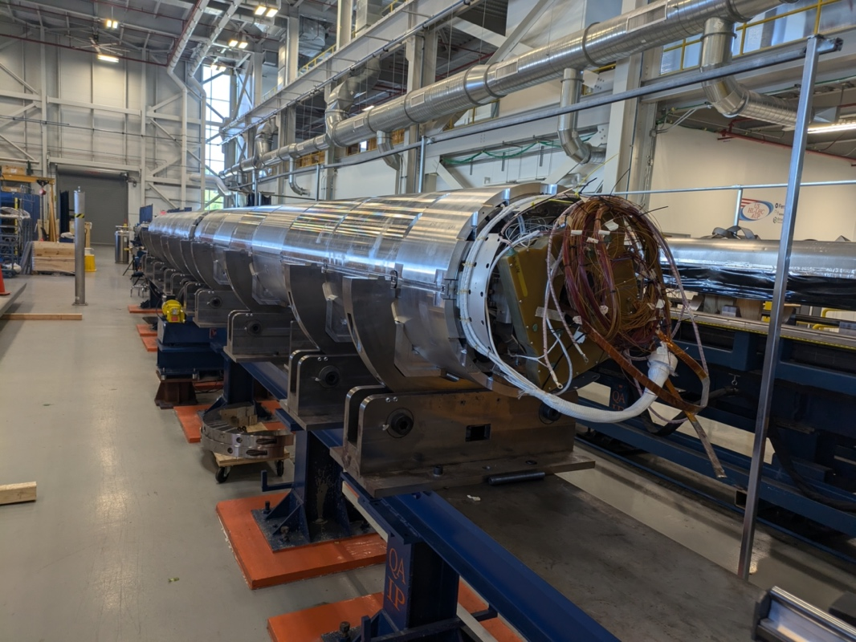
Technical Status
Cold Mass (CM) and Cryo-Assembly (CA)
CA03 (LQXFAB-03) completed
CM04 and 05 under Production
Magnets for CM06 (starting with MQXFA13b) being gathered at FNAL
LQXFA/B-03 - Completed
CM04 – Orbital Welding
CM05 – Longitudinal Welding

Slide 18
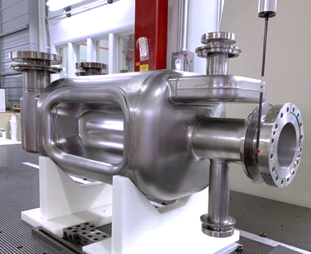
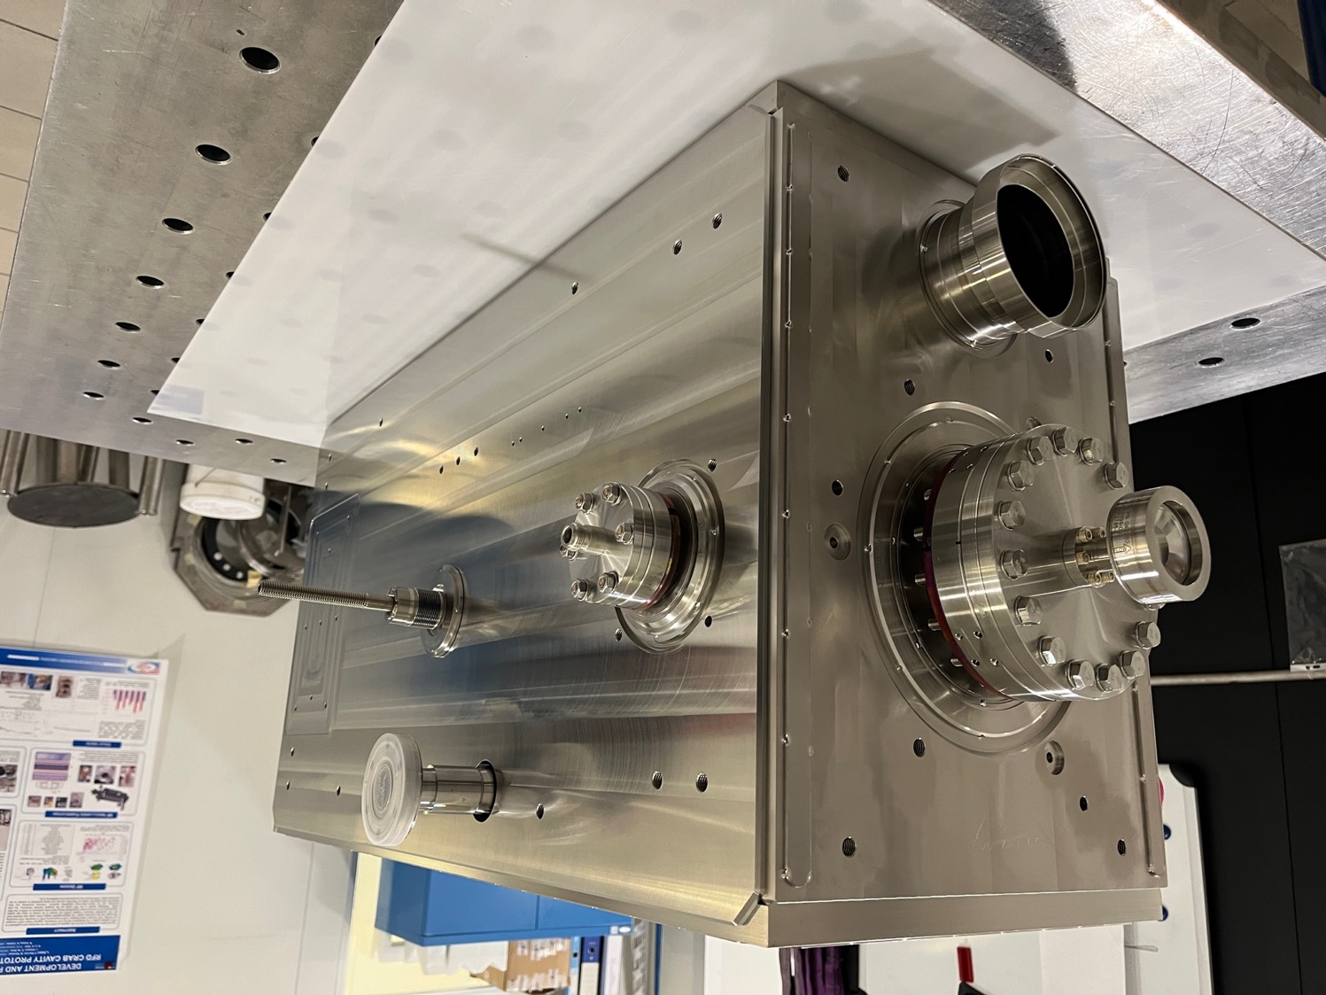
Progress since last CM on RFD Crab Cavities
L. Ristori in Plenary +
3 AUP Talks in WP4
Placed order for Production Helium Tanks.
Completed 2 Pre-series at ZANON.
  NRFD02 met requirements for Acceptance
  NRFD01 didn’t meet requirements, sent back to ZANON for reprocessing. To be tested at FNAL shortly.
Documentation under control
Prototype #2 Cavity (not a deliverable to CERN, but a “trial” delivery to TRIUMF) completed He Vessel installation, at JLAB to be tested.
  Prototype #1 at Zanon, not useable after multiple BCP cycles. Instrumental in uncovering and addressing processing issues.
JLAB successfully completed design, fabrication & test of pre-series HOMs. Concern on ceramic windows cracking addressed by HOMs production at CERN.
Completed Pre-Series
Completed Prototype Helium Tank

Slide 19
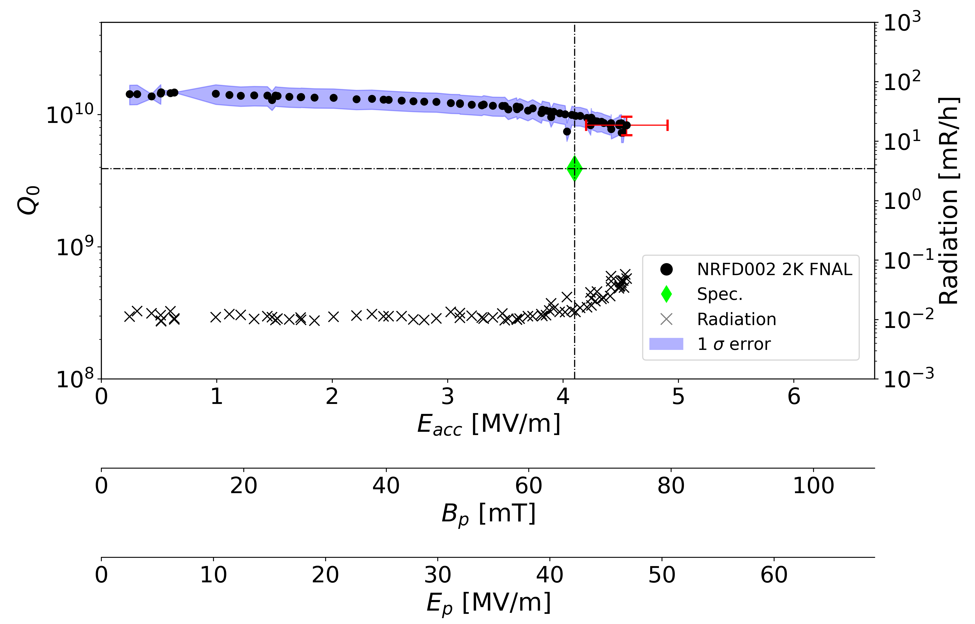
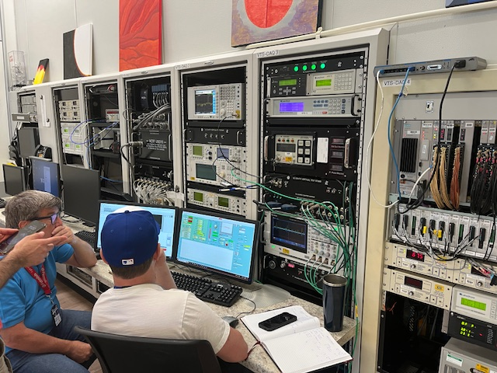

Pre-Series #2 (NRFD02) Test Results
Performed 3 tests in total, always exceeding acceptance requirements, but with radiation onset (indicative of contamination). Onset level continued to improve after successive high-pressure rinses by JLAB.
Final test shows no radiation up to acceptance level.
Low field Q₀ is high: Chemistry by Zanon is successful.
Radiation onset is at high field: HPR and clean assembly by Jlab is successful.
Plot by A. Castilla
Admin. Limit
8/26/24: FNAL VTS Control Room

Slide 20
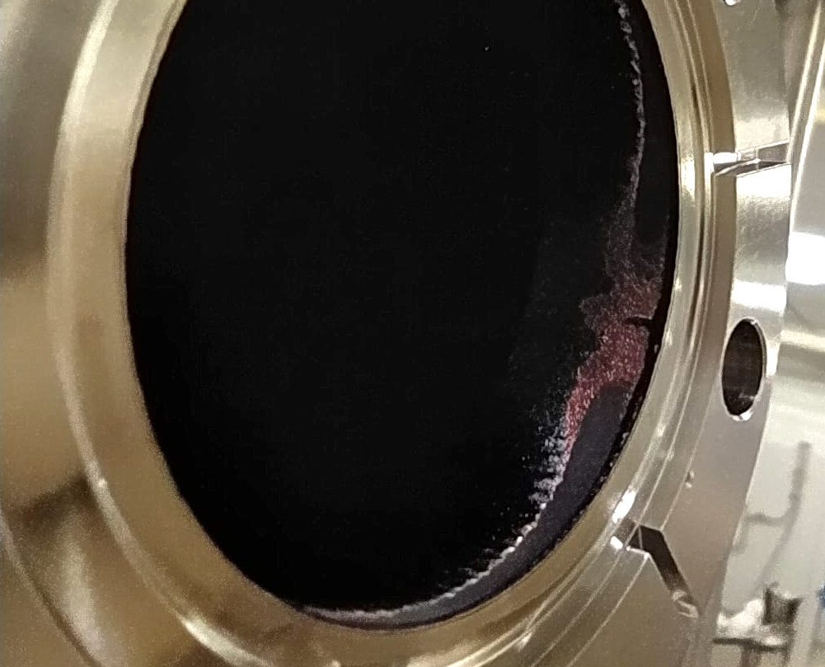
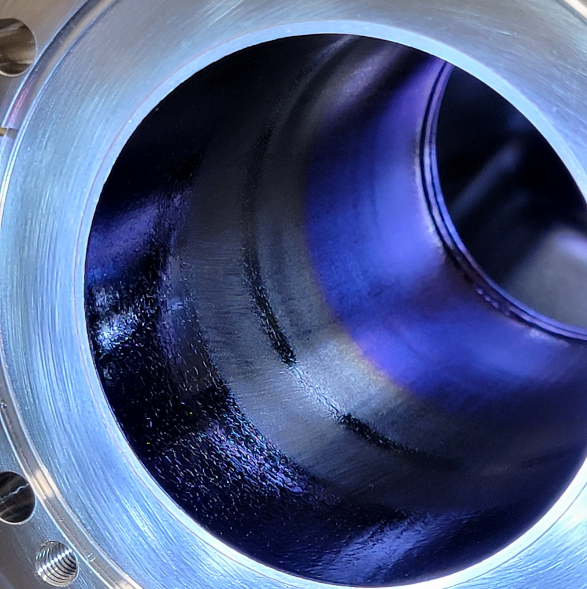
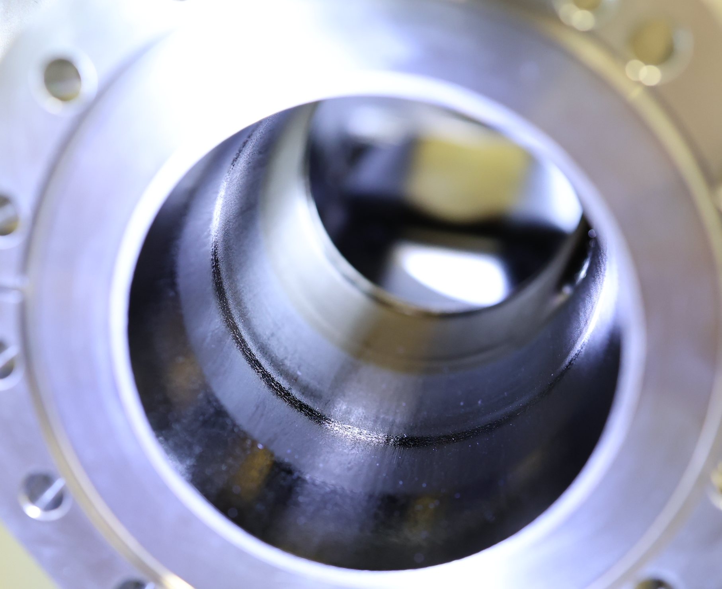
BCP & HPR Issues at Zanon
BCP: Following the investigation for the uneven removal on prototype #1, the chemistry process was improved and tested with successful results.
HPR: Both pre-series cavities are showing localized discoloration. Suspecting excessive and localized HPR pressure. JLAB performed HPR tests which resulted negative.
Meetings between JLAB and Zanon are facilitating knowledge transfer. We are also planning visits of JLAB representatives in the next months.
Prototype #1 after 3+ BCP cycles
Pre-Series #1 and #2 with internal discoloration

Slide 21
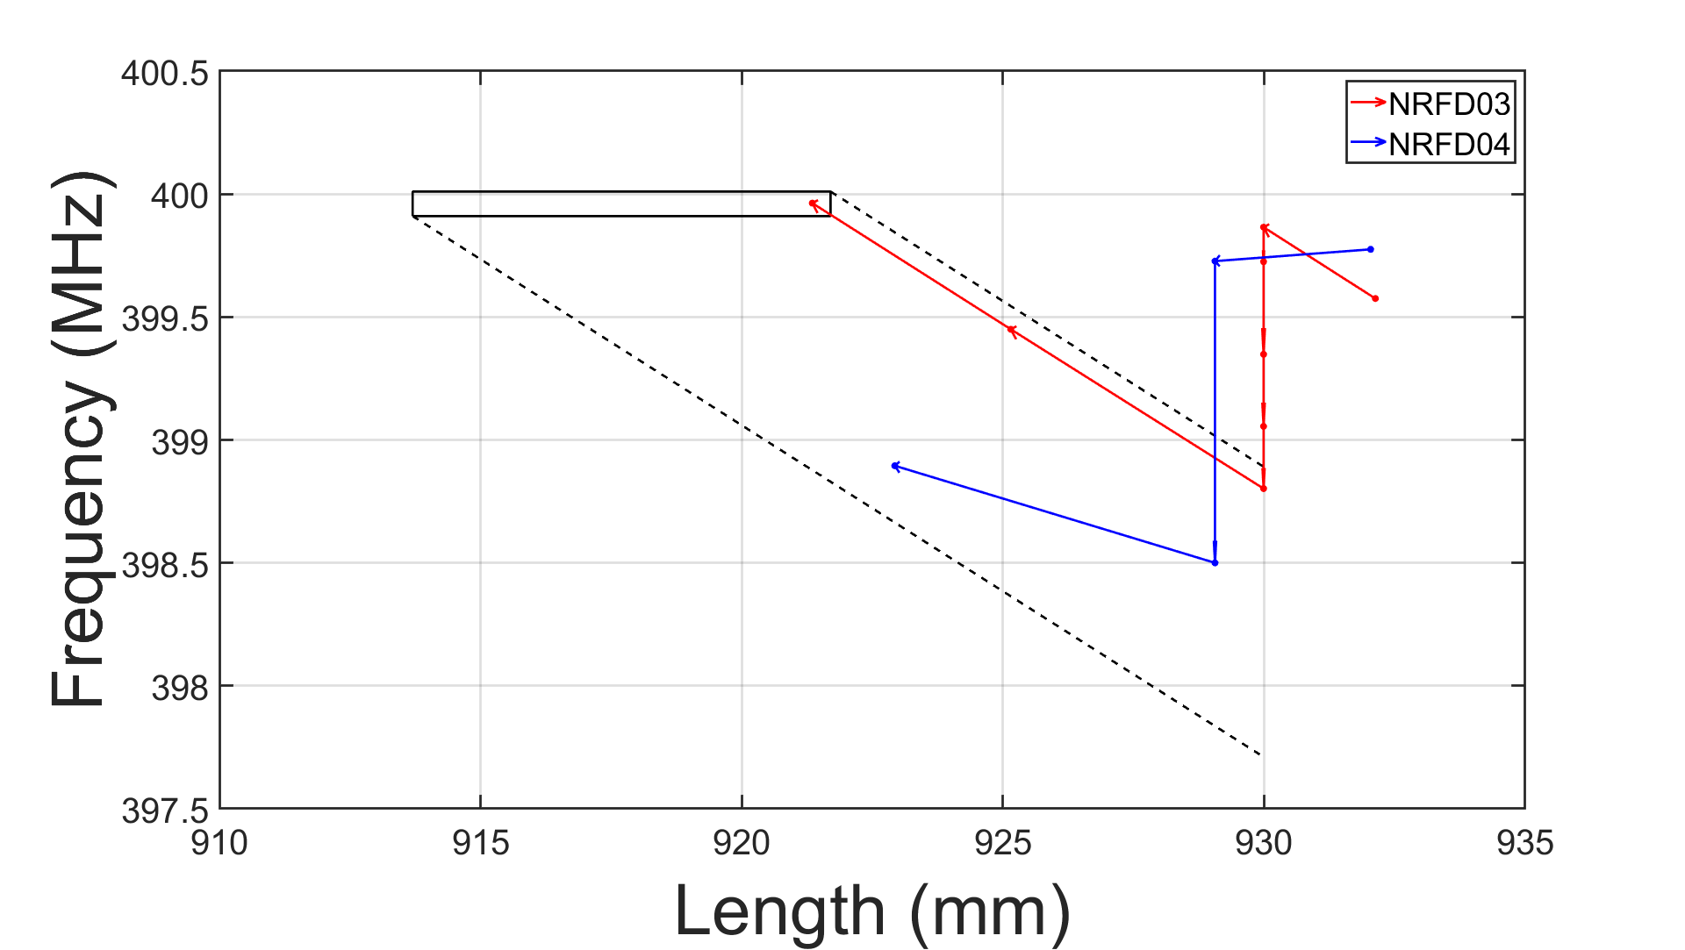
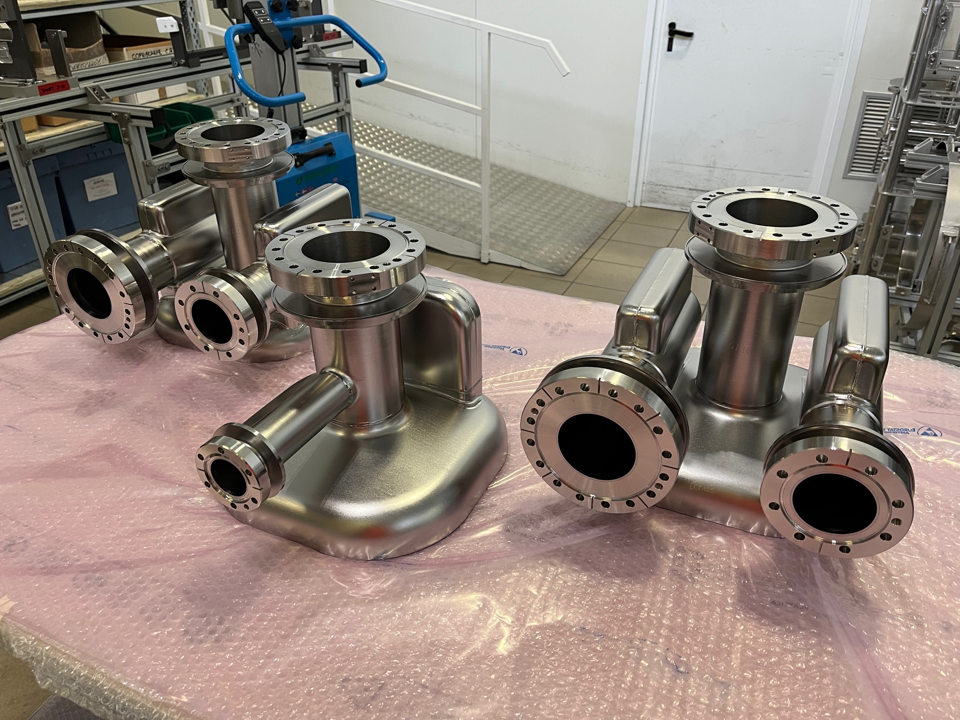
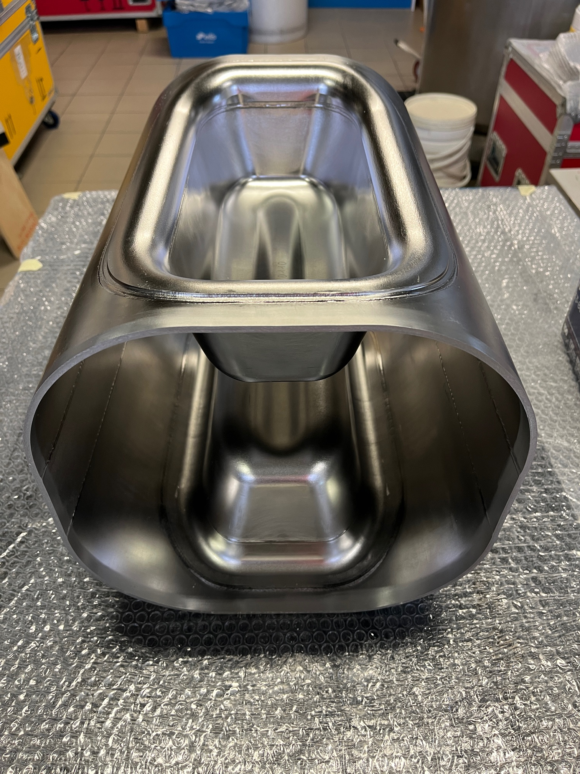
302.03 - Other Updates
First two series NRFD03 & NRFD04 are undergoing trim-tune operations (see plot and pictures).
Non-performing NRFD01 has undergone light BCP at Zanon and is in transit to FNAL for test later this month.
JLAB test facility shut-down is extended to December due to a safety stop which affected all maintenance and repair activities.
Plot by M. Narduzzi & T. Posos
Some Components of Series #3 and #4 ready for trim-tuning

Slide 22
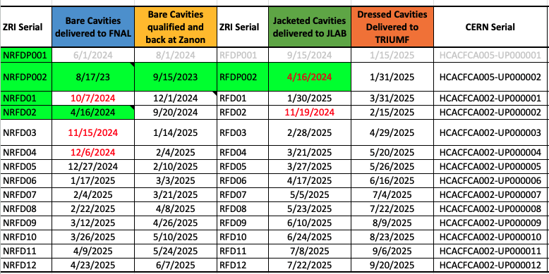
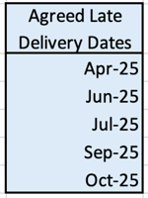
302.03 - RFD Tests and Delivery Dates
Delays since last update can be attributed to prioritizing quality and shape accuracy, managing NCRs according to QA plan, increased duration of JLAB VTA shut-down.
Dressed Prototype estimated to arrive at TRIUMF in January 2025.
Pre-Series cavities estimated to arrive at TRIUMF in Spring 2025.
Zanon BCP shut-down in October: We expect this will cause an additional delay for the 2 pre-series (still being estimated ~1-3 weeks).

Slide 23



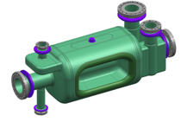
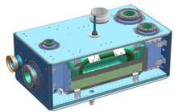
Visual Representation of KPPs Achievements
MQXFA Magnet
MQXFA16TLS
Cold Mass Assembly
MQXFA13b
MQXFA17bTSL
MQXFA18TSL
MQXFA12bTSL
Cryo-Assembly
Threshold
Objective
RFD Bare Cavity
RFD Dressed Cavity
Threshold
Objective
Completed, sitting on a shelf or delivered to CERN
Under Fabrication
Under Test

Slide 24
DOE Independent Project Review
July 2024
Standard “yearly” review run by DOE
  Thanks for help provided by HiLumi Project Office
Positive outcome
  Overall, the project is on track to complete within TPC and CD-4 date. It is fully funded and has sufficient schedule and cost contingencies. The Cost and Schedule Performance Indices (CPI/SPI) are .99 and .99, which is relatively stable. There is aligned production with CERN’s delivery/need by dates.
Few technical (Crab Cavities) and Managerial (Handling of Objective/Threshold KPPs) recommendations
  To be discussed at the CERN-AUP Steering Meeting

Slide 25
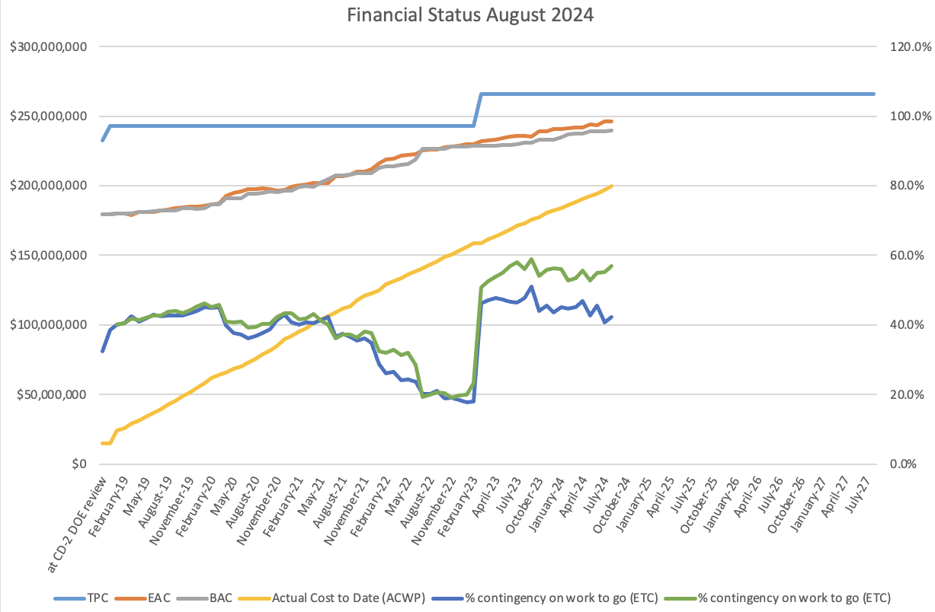
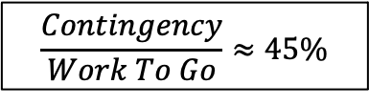
Financial Situation (Past)
DOE has disbursed $266M to the US-AUP (fully funded)
CPI_{Aug ‘24}=0.99
SPI_{Jun ’23}=0.99
Contingency
Work To Go
Estimate at Completion
Actual Cost
$$\frac{Contingency}{Work To Go}≈45\%$$
AUP is in the “last leg of the race” (~80% complete)

Slide 26
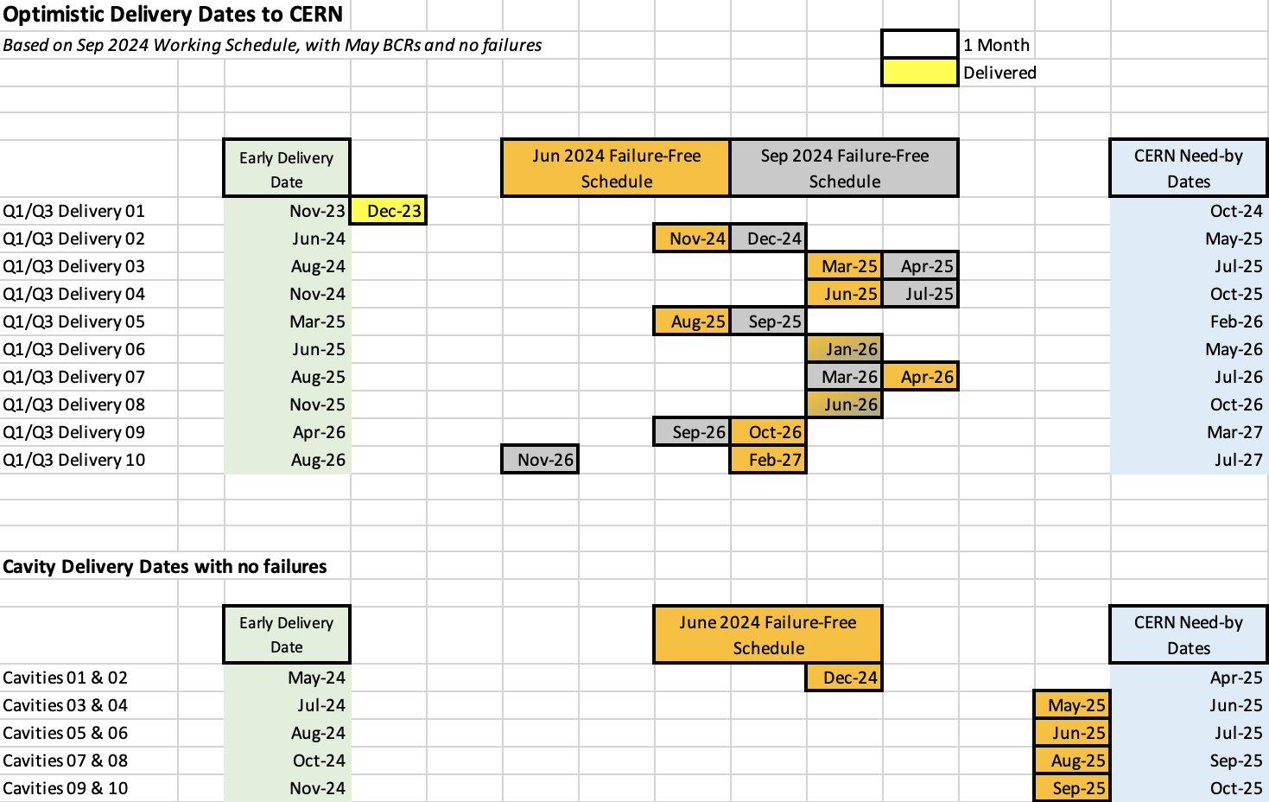
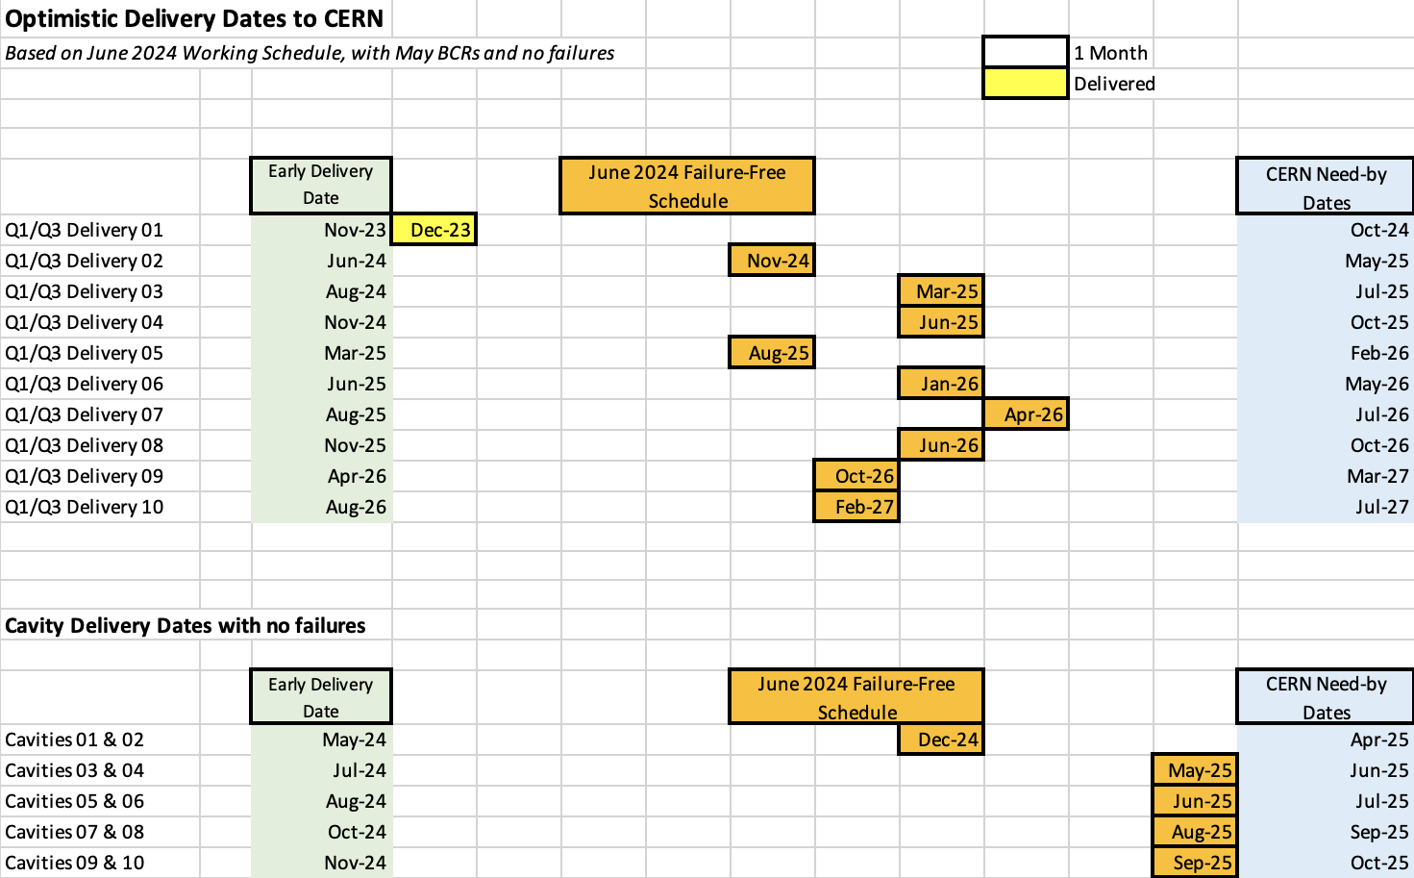
Delivery Dates to CERN (June 2024)
Extremely Preliminary “1TC”
1 cell = 1 month
Success Oriented Schedule provided to CERN WPs as input for upcoming Nov. ‘24 C&S Review

Slide 27
Conclusions
AUP is over 80% complete
Steady progress on MQXFA Construction
  11 magnets passed vertical test.
LQXFAB-01 Accepted by CERN
LQXFAB-02 under test at FNAL, planned for shipment to for String Test before end of CY.
LQXFAB-03 Close to completion, awaiting Horizontal Test
RFD Crab Cavities Series Production Order and He Vessel Production Order placed.
  Pre-series cavity accepted and moving to He Vessel Assembly.

