Slide 1



Status of MQXFA magnets
Giorgio Ambrosio - FNAL
with contributions from the whole MQXFA team

Slide 2
Acknowledgement
US HL-LHC Accelerator Upgrade Project (AUP)
  BNL: K. Amm, M. Anerella, A. Ben Yahia, M. Bornstein, H. Hocker, P. Joshi, F. Kurian, J. Muratore, J. Schmalzle, P. Wanderer
  FNAL: G. Ambrosio, G. Apollinari, M. Baldini, J. Blowers, R. Bossert, R. Carcagno, G. Chlachidze, J. DiMarco, S. Feher, S. Krave, V. Lombardo, C. Narug, A. Nobrega, V. Marinozzi, C. Orozco, T. Page, J. Seyl, S. Stoynev, T. Strauss, M. Turenne, D. Turrioni, A. Vouris, M. Yu
  LBNL: D. Cheng, J. Doyle, P. Ferracin, L. Garcia Fajardo, E. Lee, M. Marchevsky, M. Naus, I. Pong, S. Prestemon, K. Ray, G. Sabbi, G. Vallone, X. Wang
  NHMFL: L. Cooley, J. Levitan, J. Lu, R. Walsh
CERN: HL-LHC Project
  G. Arnau Izquierdo, A. Ballarino, M. Bajko, C. Barth, N. Bourcey, B. Bulat, M. Cruovizier, A. Devred, H. Felice, S. Ferradas Troitino, L. Fiscarelli, J. Fleiter, M. Guinchard, O. Housiaux, S. Izquierdo Bermudez, N. Lusa, F. Mangiarotti, A. Milanese, A. Moros, P. Moyret, C. Petrone, J.C. Perez, H. Prin, R. Principe, E. Ravaioli, T. Sahner, S. Sgobba, P. Tavares Coutinho Borges De Sousa, E. Todesco, J. Ferradas Troitino, R. Van Weelderen, G. Willering

Slide 3
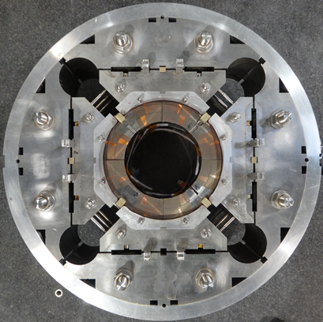
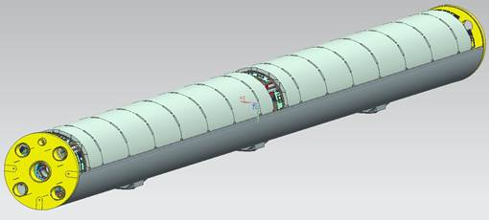
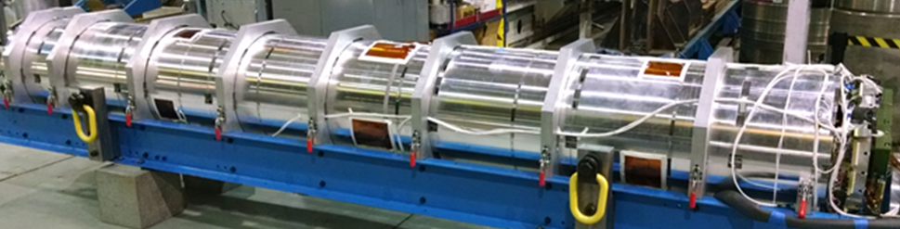

MQXFA (AUP 302.2) Deliverables
21 Magnets
  20 magnets for 10 Q1/Q3 cryo-assemblies
    2 magnets in each cryo-assembly
  1 magnet to CERN for acceptance of CA01
  Assuming 6 re-assemblies
    = post test re-work
Magnet
(MQXFA)
Cold Mass
(LMQXFA)
Cryo-assembly
(LQXFA)

Slide 4

MQXFA Status Summary
Control Account | Component status wrt Baseline* | Comments
Strand procurement & QC (FNAL, FSU) | 96% complete | Procuring spare cond.
Cable fabrication & insulation (LBNL) | 100% complete
Coil part procurement (FNAL) | ~100% complete | Completing QC
Coil fabrication (FNAL) | 98% complete | Last coil fabrication
Coil fabrication (BNL) | 100% complete
Magnet part procurement (LBNL) | 100% complete
Magnet assembly (LBNL) | 58% complete
*Will change if additional cables/coils are added to Baseline
Main task is magnet assembly.
Supported by 4 reviews / meetings per magnet
More details in “MQXFA Fabrication Status and schedule” in WP3 MQXF session Wed PM
MQXFA at BNL after shipment from LBNL

Slide 5
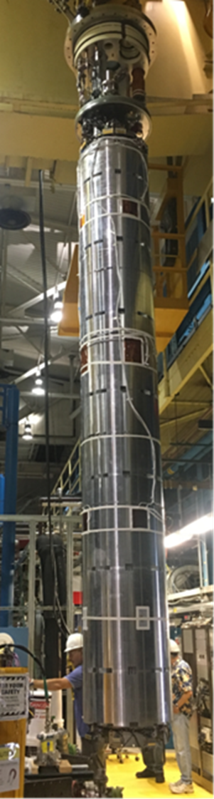
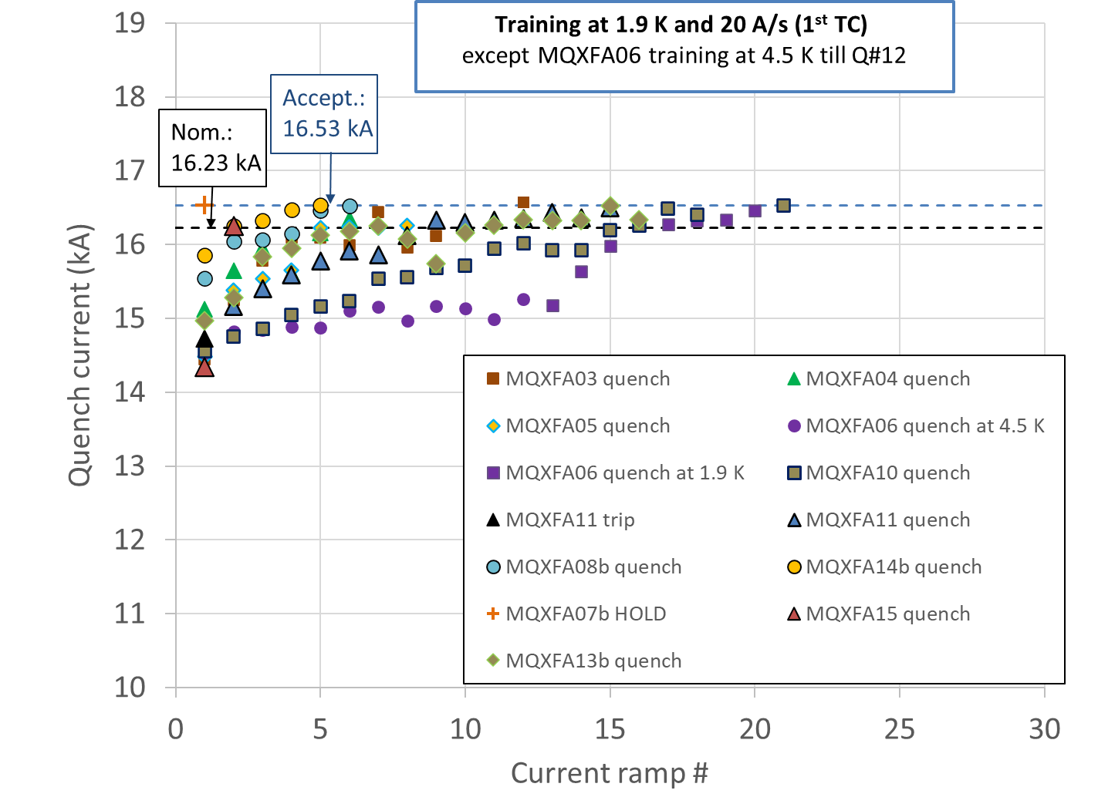
Magnet Yield
Vertical test is done at BNL by 302.4.01, post-test analysis is done by 302.2.01
11 magnets met requirements during vertical test
  3 magnets (MQXFA07/08/13) needed a coil change to meet requirements
  1 magnet (MQXFA17) is waiting for a coil change
  MQXFA05 passed an Endurance Test (7 thermal cycles, 52 quenches, …)
  MQXFA11 demonstrated resilience (after highway crash)
More details in “Production testing summary of the MQXFA magnets” in WP3 session Tue PM
MQXFA magnet being moved to vertical test station at BNL
5

Slide 6
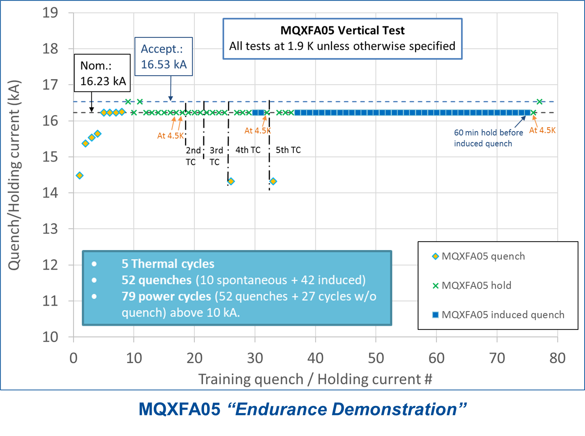
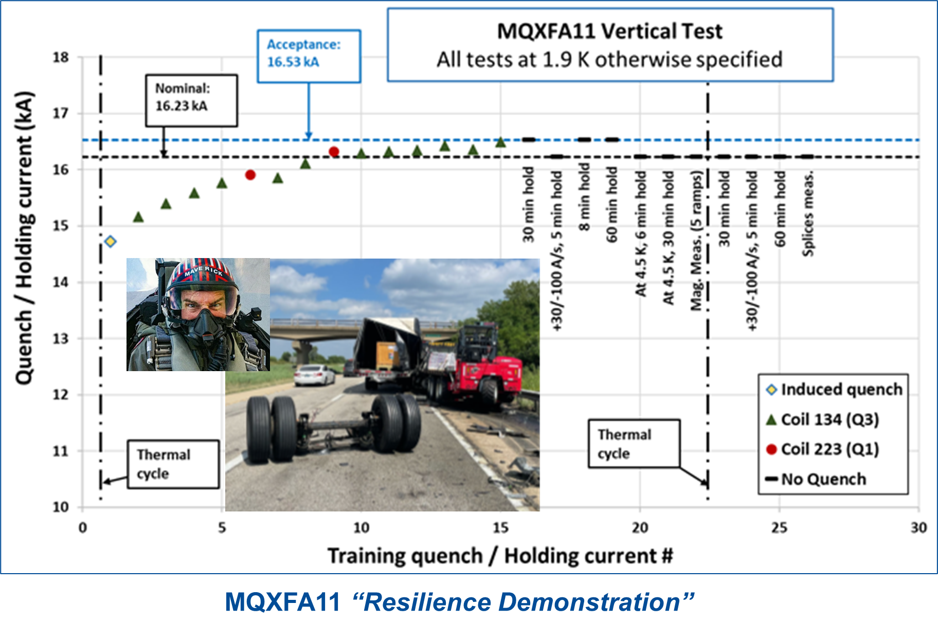
“Endurance” & “Resilience” Demonstrations
+ 2 additional thermal cycles in CA02
All magnets that met requirements demonstrated very good memory and temperature margin:
I_nom @ 4.5 K

Slide 7
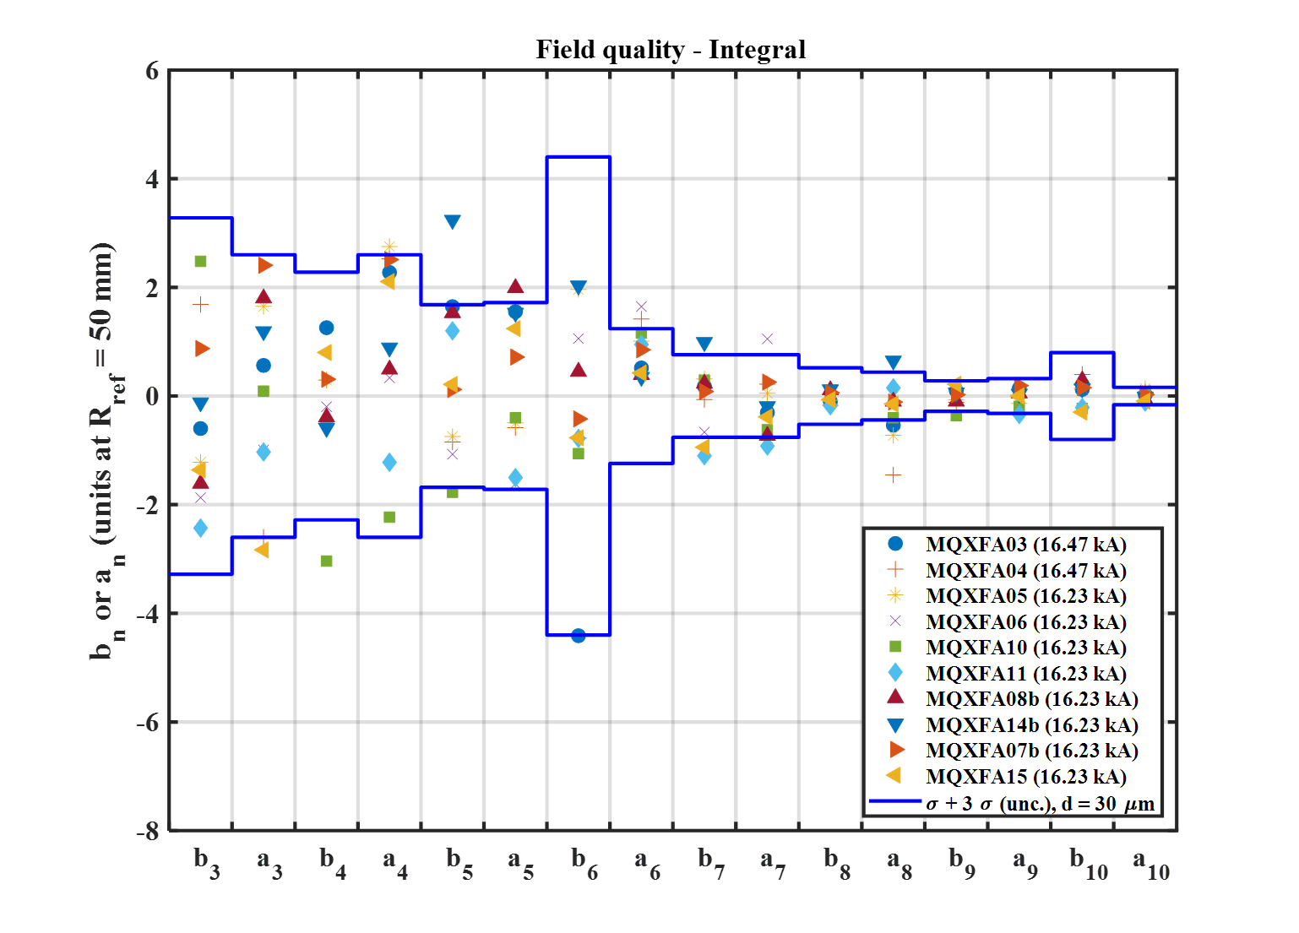
MQXFAs Integral Harmonics at Nominal Curr.
b6 correction introduced in one coil on MQXFA04 and all subsequent coils:
125 um shift toward midplane
Magnetic shims used to correct low order harmonics
Before b6 correction in cross-section
More details in “Production testing summary of the MQXFA magnets” in WP3 session Tue PM

Slide 8
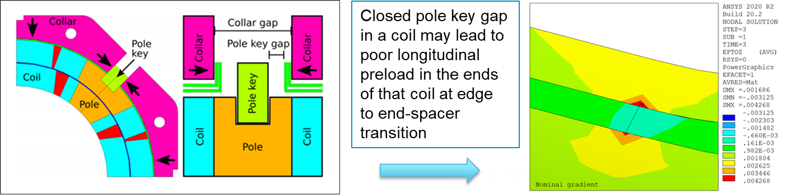
Lessons Learned from MQXFA07/08 test & analysis
  FE analysis of as-built magnets pointed to “critical area”
  Metallographic analysis by CERN team found the “Smoking gun” (broken Nb₃Sn filaments) in this area
  Excellent collaboration!
Lessons learned:
  Asymmetry during assembly may be looked-in by prestress
  2D asymmetry may cause poor preload in the ends
    Seen in MQXFA07 and MQXFA08 (presented in Vancouver)
Preventive action:
  Larger gaps and revised assembly procedure
Presented at the
13th HL-LHC Collab. Mtg.
14th HL-LHC Collaboration Meeting, Oct 7 – 10, 2024

Slide 9
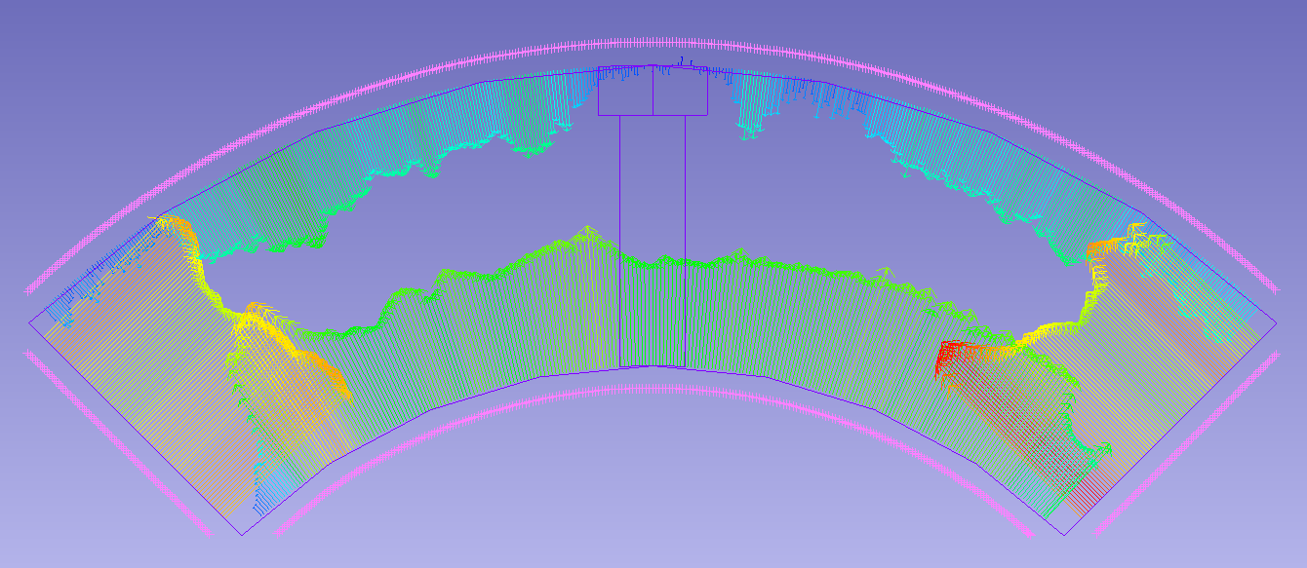
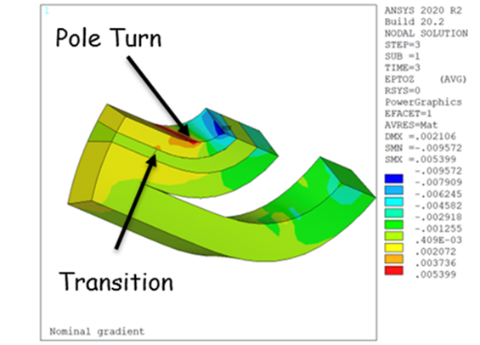
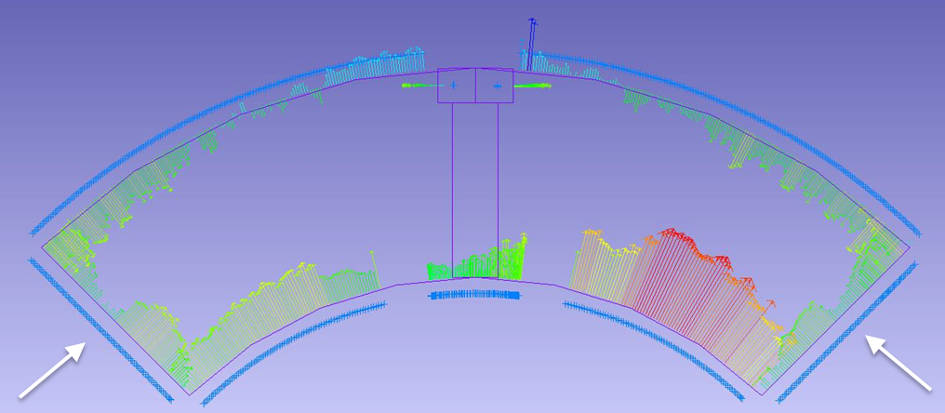
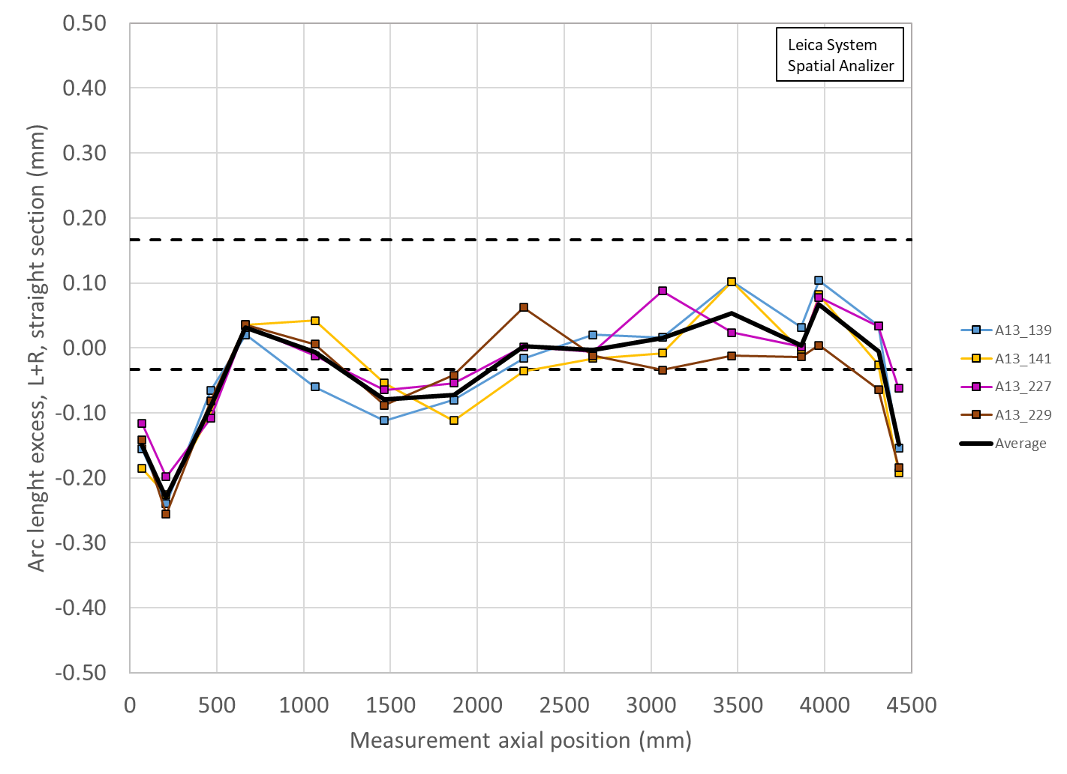
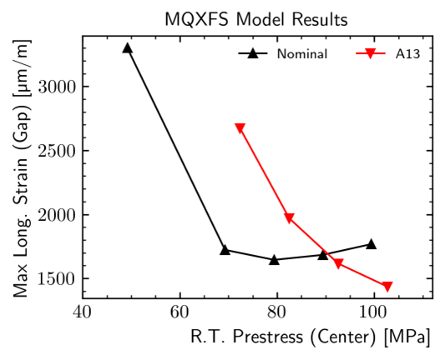
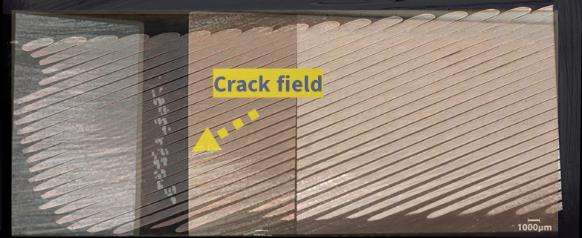
Lessons Learned from MQXFA13/17 test & analysis
If midplanes in coil ends are “too small” & there is low prestress ➔ risk of excessive strain
Coil lead end
Coil straight section
MQXFA13 coil arc-length error
Relative differences are more relevant than absolute numbers because of mesh size and de-bonding assumptions
Courtesy of A. Bartkowska

Slide 10
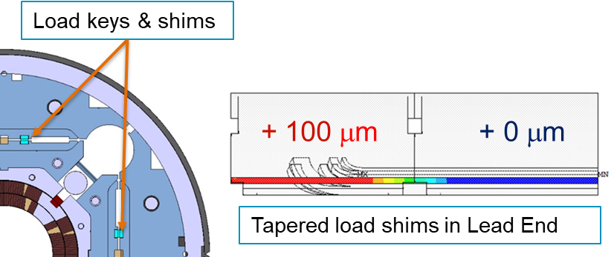
Preventive Actions
Main actions:
  Added Tapered Load Shims in magnet Lead End
    During last step of azimuthal preload
    Added coil dimension measurements in the critical area and FE analysis based on measured coil size
  Set target for minimum loading key size based on coil dimensions ➔ higher pre-stress controlled by dimensions
    Comparison with best magnets
  Increased the maximum allowable stress during preload from 110 to 135 MPa
    Based on feedback from CERN MQXFS program

Slide 11
Coil Status & Parts
After 11 magnets met requirements:
Coils available (fabricated and passed QC) | 38
Coils in production | 1
Coils to be recovered from on-hold – future issues | 1
Coils needed for 10 magnets | - 40
Expected coils balance | 0
Inventory:
  Available: strands for 1 MQXFB cable
  Incoming strands: for 3 MQXFA cables by end of October + for 2 cables by January 2026 (maybe earlier).
  Available parts: 3 full sets (poles + ends + traces)
  Incoming parts: 2 traces
Two risks for additional coils in Risk Register

Slide 12
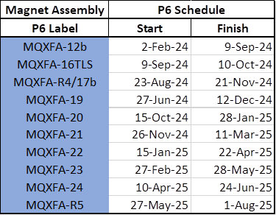
Plans and Schedule
Plans for next magnets:
  MQXFA18 (1st with TLS) is at BNL under test
  MQXFA12b retrofitted with TLS (50 um) is at BNL
  MQXFA16 retrofitted with TLS (50 um) almost complete
  Re-assembly of MQXFA17b has started
Working Schedule
  August update:
All magnets will be vertically tested at BNL
  Only one thermal cycle during vertical test

Slide 13
MQXFA Summary
11 magnets met requirements, 10 more to go
  3 magnets that did not meet requirements were repaired by changing one coil and met requirement.
  1 magnet is to be repaired
  All magnets will be vertically tested
Major procurements are complete
Last coil is in fabrication at Fermilab
Strands and parts in inventory for up ~5 coils (6 max)
Magnet assembly is at peak production rate
Lessons learned have been implemented in revised design features and assembly specs.
We plan completing the assembly of all magnets around next HL-LHC Collaboration Meeting

Slide 14
Back up Slides

Slide 15
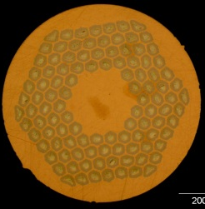
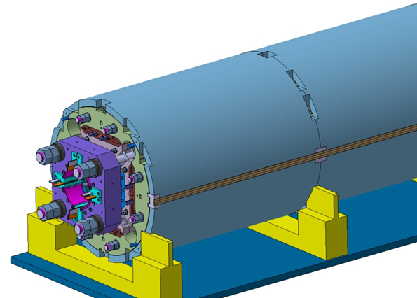
MQXFA/B Design
Parameter | Unit | MQXFA/B
Coil aperture | mm | 150
Magnetic length | m | 4.2/7.15
N. of layers |  | 2
N. of turns Inner-Outer layer |  | 22-28
Operation temperature | K | 1.9
Nominal gradient | T/m | 132.2
Nominal current | kA | 16.23
Peak field at nom. current | T | 11.3
Stored energy at nom. curr. | MJ/m | 1.15
Diff. inductance | mH/m | 8.26
Strand diameter | mm | 0.85
Strand number |  | 40
Cable width | mm | 18.15
Cable mid thickness | mm | 1.525
Keystone angle |  | 0.4
Nb₃Sn Conductor
RRP 108/127
P. Ferracin et al., “Development of MQXF, the Nb₃Sn Low-β Quadrupole for the HiLumi LHC ” IEEE Trans App. Supercond. Vol. 26, no. 4, 4000207
G. Ambrosio et al., “First Test Results of the 150 mm Aperture IR Quadrupole Models for the High Luminosity LHC” NAPAC16, FERMILAB-CONF-16-440-TD

Slide 16
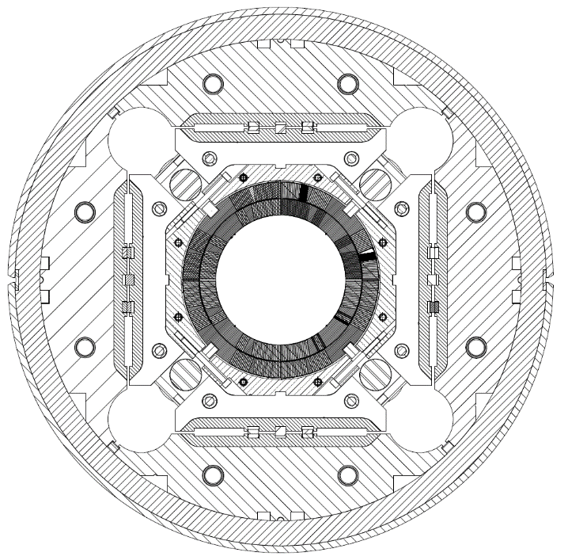
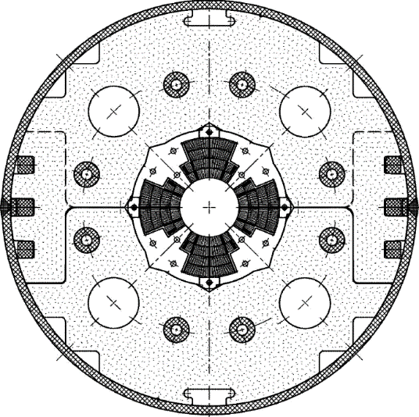
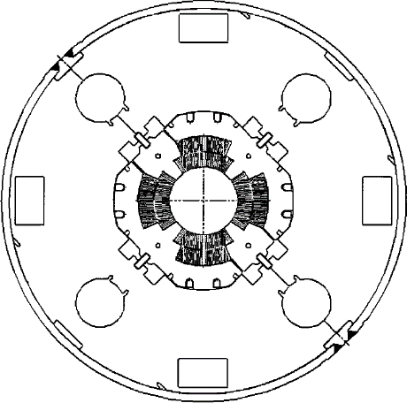
Low-β quadrupole magnets from LHC to HL-LHC
Cold mass OD from 490/420 to 630 mm
More than double the aperture: from 70 to 150 mm
~4 times the e.m. forces in straight section
~6 times the e.m. forces in the ends
State of the art quadrupoles at the time of LHC construction
MQXF
MQXA
MQXB
Same scale for all 3 plots

