Slide 1
302.4 Q1/Q3 Cryo-Assembly Fabrication Progress
Sandor Feher – HL-LHC AUP L2 manager, Fermilab
7th Steering Committee of the CERN-FNAL Collaboration for the HL-LHC Project – October 8th, 2024

Slide 2
Progress report
The update covers achievements from the Sixth meeting
Will include:
302.4.01 Magnets Vertical Test at BNL
302.4.02 Cold Mass Assembly Fabrication
302.4.03 Cryo-Assemblies Fabrication
302.4.04 Cryo-assemblies Horizontal Test

Slide 3
LQXFA/B-01 Vacuum Leak and Consequences
Anti-cryostat has heaters to prevent frosting inside the anti-cryostat bore. That is why we call this a “warm bore”
If the vacuum is not so great the heat transfer between the Beam tube and the anti-cryostat outer tube will be larger than usual (other tests where the vacuum was better are not relevant for comparison – like Q2 tests)

Slide 4
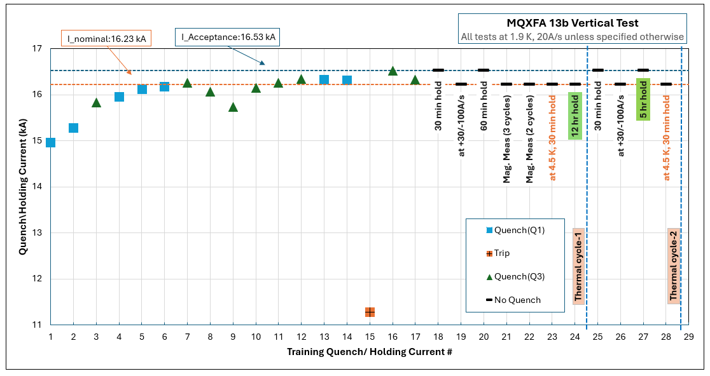
302.4.01 Magnets Vertical Test at BNL
MQXFA 7b and MQXFA15b tests were successfully completed
MQXFA7b reach acceptance current without any quenches and MQXFA15b needed only 2 quenches. Both were sent to FNAL for installation into CM05
MQXFA17 failed to reach acceptance current
Slow training and after the 10th quench the magnet de-trained. Sent back to LBNL.
MQXFA13b tests were successful
Long quench training (17 quenches) before reached acceptance current

Slide 5
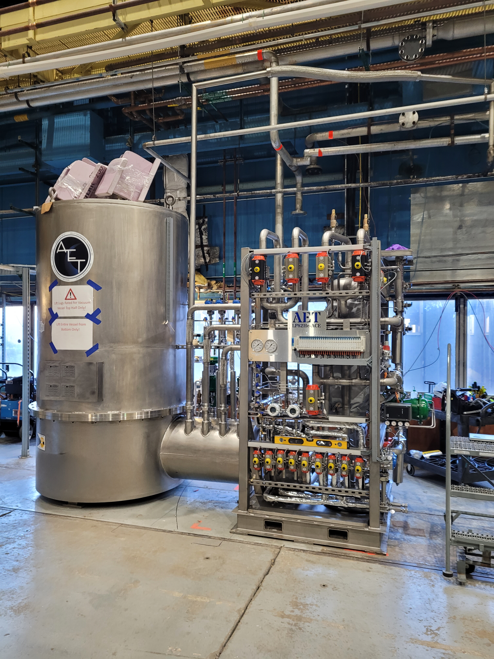
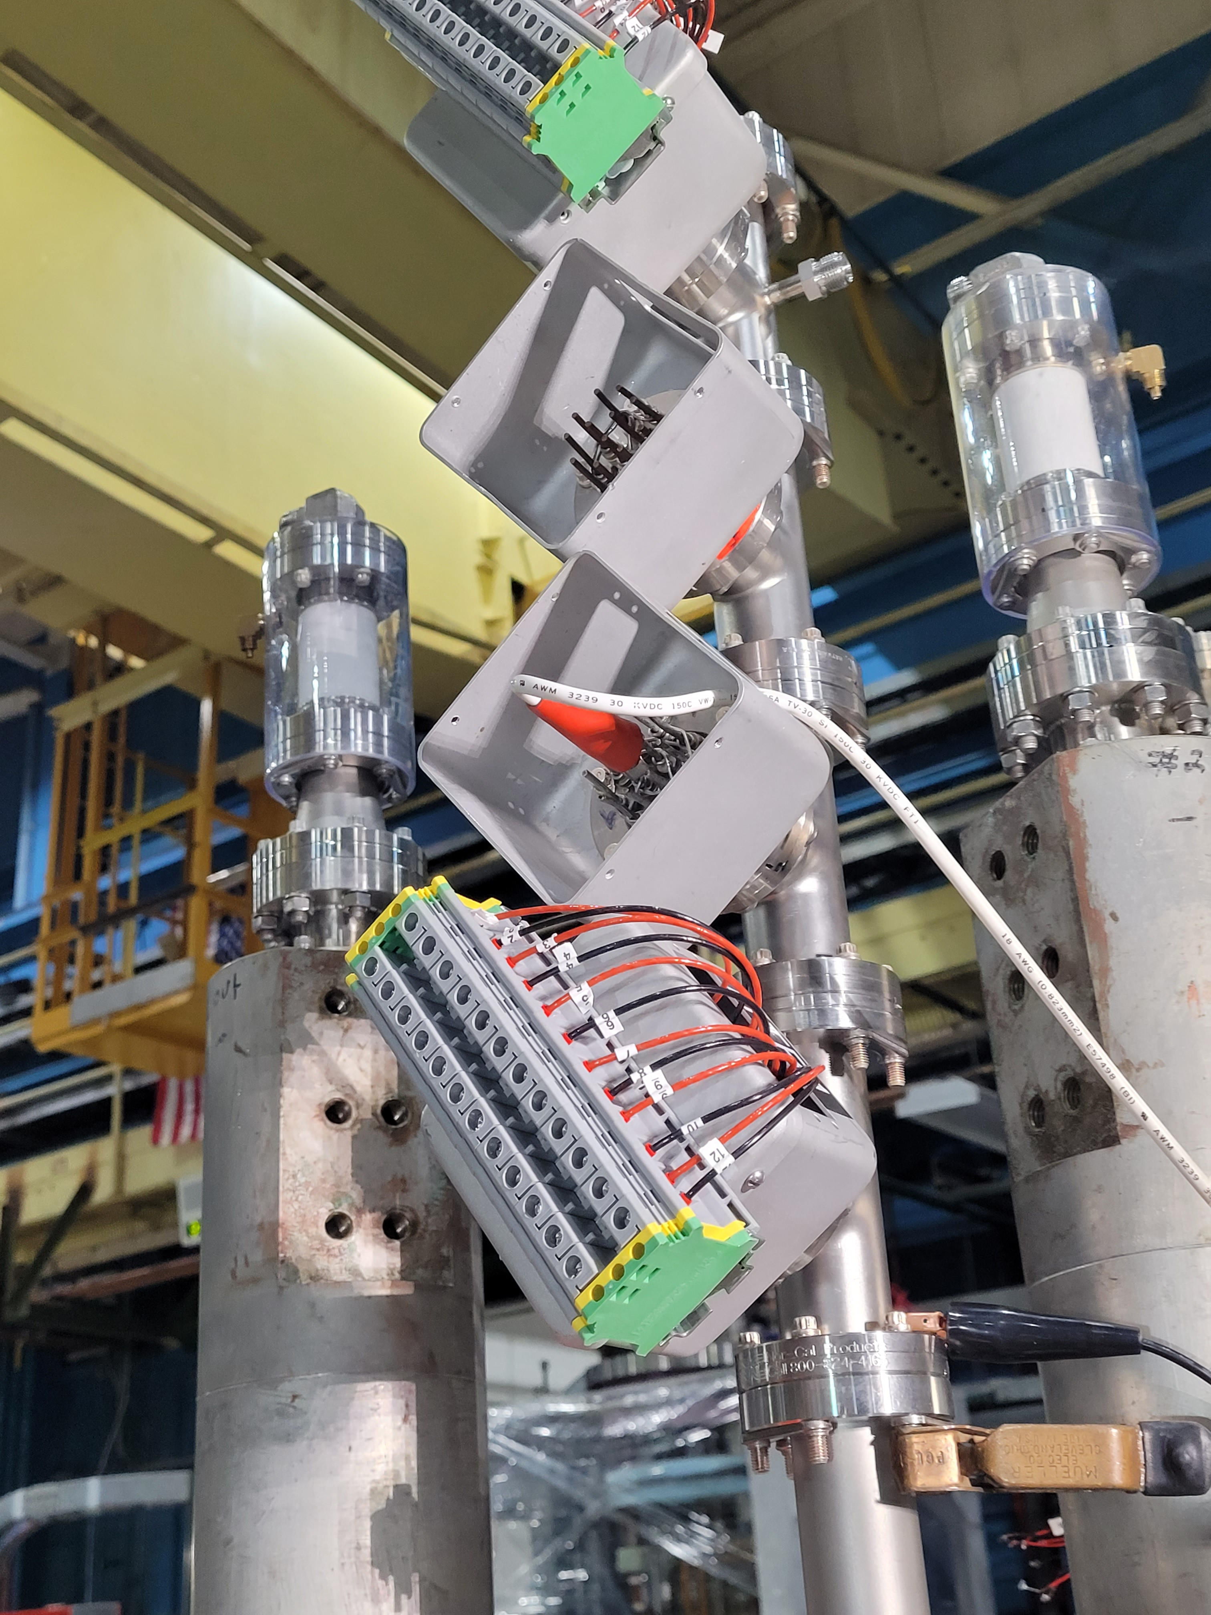
302.4.01 Magnets Vertical Test at BNL
Facility functioned very well
Went through several maintenances
New Linde 1430 liquefier installation is completed still needs final commissioning
Second Top Plate still needs to be completed

Slide 6
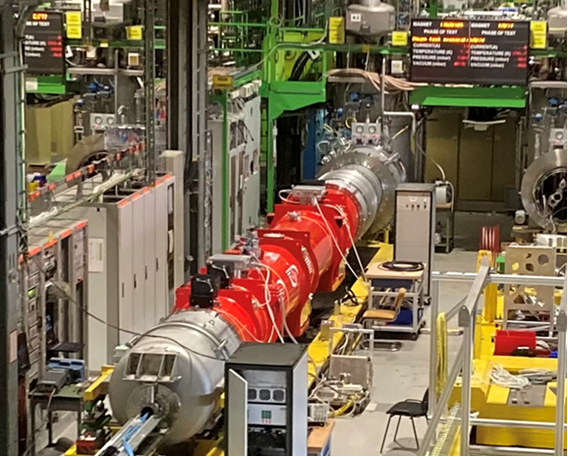
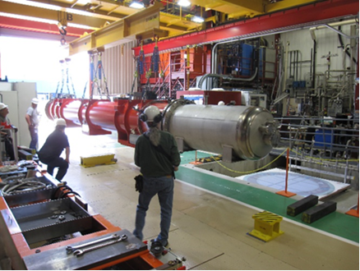
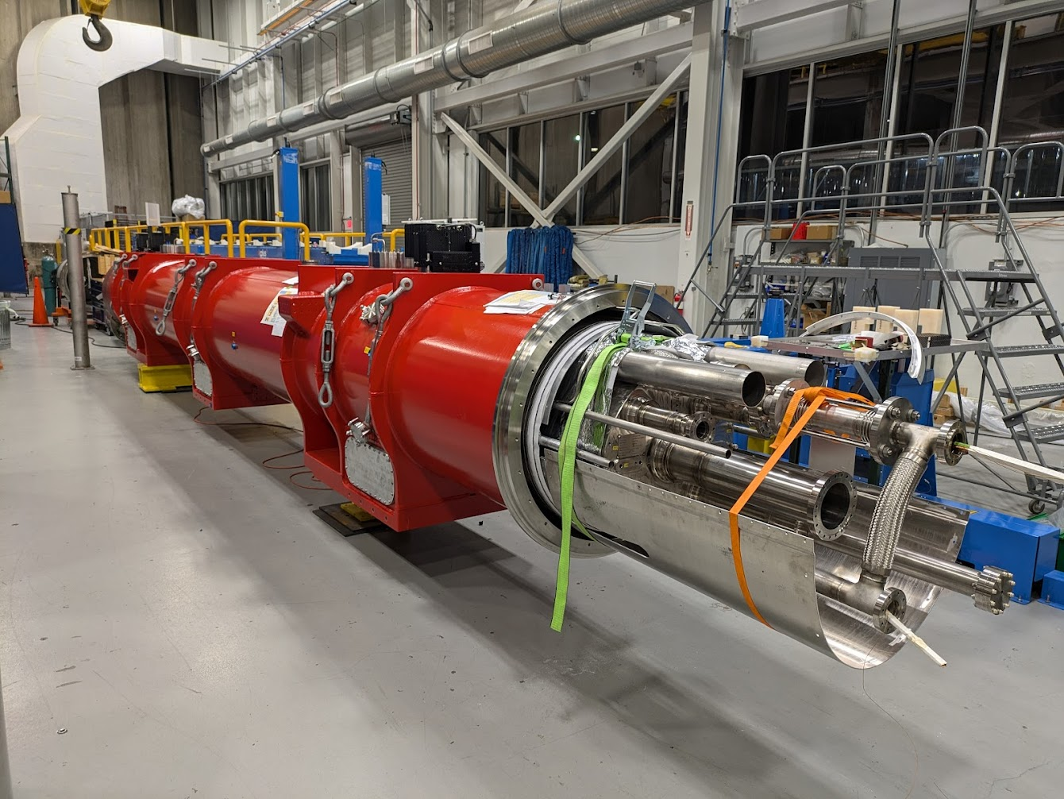
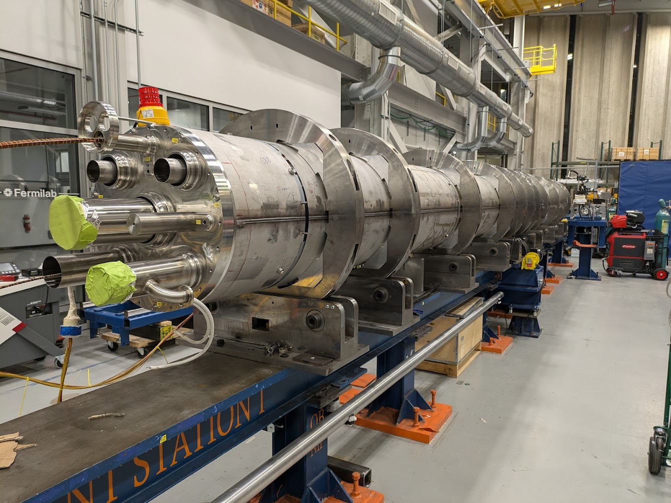
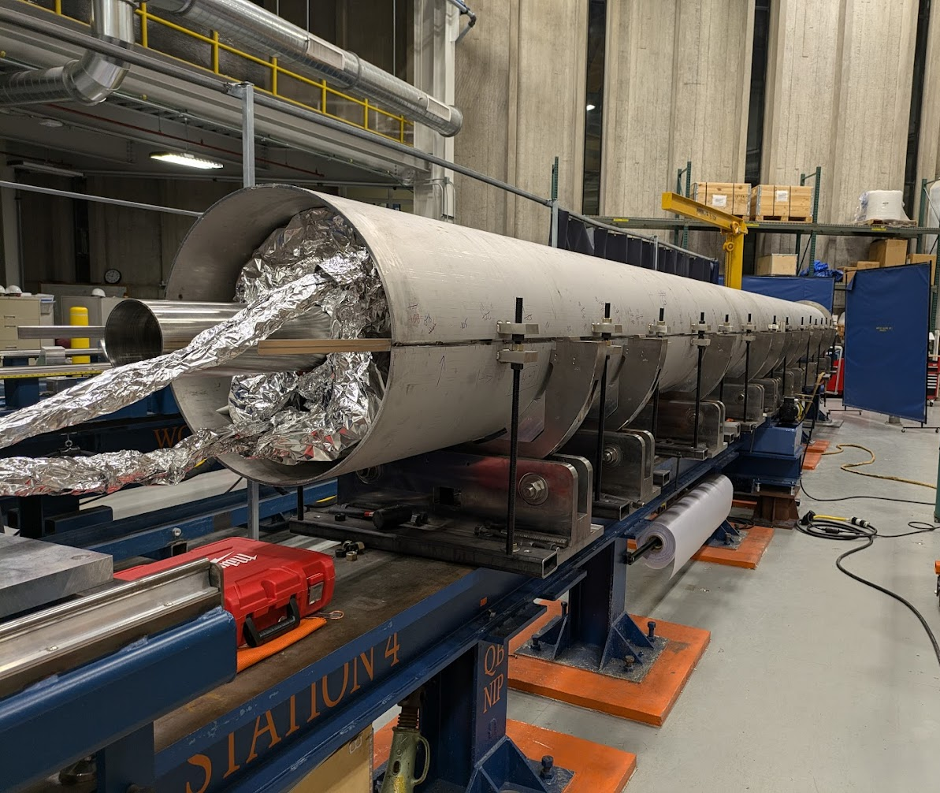
Cold Mass & Cryostat Assembly Status
CA01 accepted by CERN.
CA02 IB1 test completed, warm up in progress.
CA03 prep for combination pressure/leak test.
CM04 capillary tubes are next.
CM05 ready for longitudinal shell welding.
CM06 MQXFA13b has been shipped to FNAL
 | Qa | Qb | Weld | Cryo | Test | Ship
CA01
CA02
CA03
CA04
CA05
CA06
CA07
CA08
CA09
CA10
MQXFA04,MQXFA03
MQXFA05,MQXFA06
CA02, test stand
CA01, CERN
CA02, test
MQXFA010,MQXFA11
MQXFA14b,MQXFA8b
MQXFA07b,MQXFA15b
CA03, ICBA
CM04, ICBA
CM05, ICBA

Slide 7
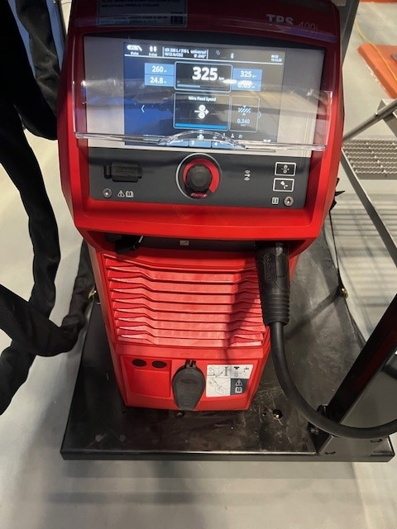
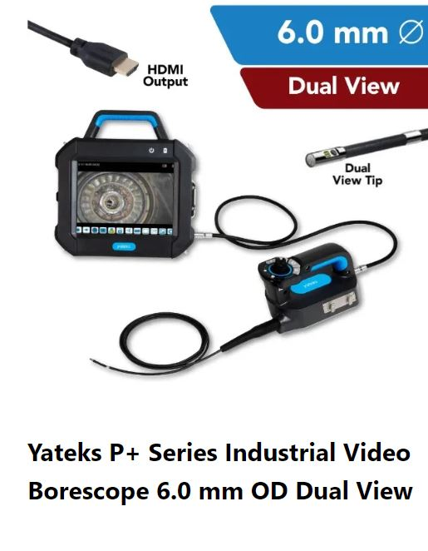
Welding is progressing normally
302.4.02 Cold Mass Assembly Fabrication
Bought new Fronius power supplies. They are better suited for the foreign weld wire (stable arc) & provides a data log.
Ultrasonic Test (UT) results have been exceptionally better since updates. CM-02 & CM-03 passed with minimum to no weld repairs.
Internal Weld Inspections are now completed with an inspection Borescope (newly purchased) by a Certified Weld Inspector (CWI).

Slide 8
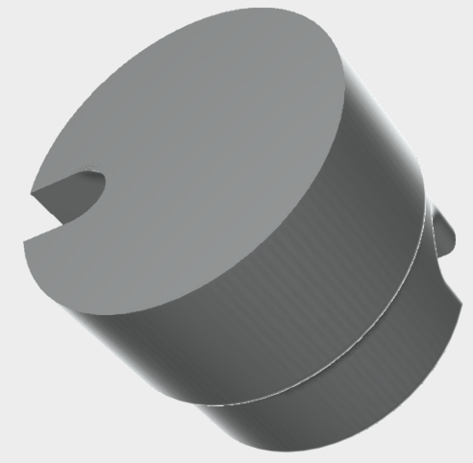
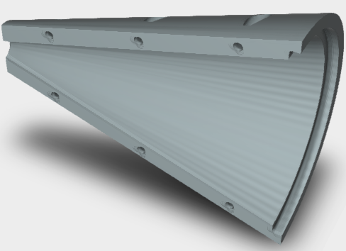
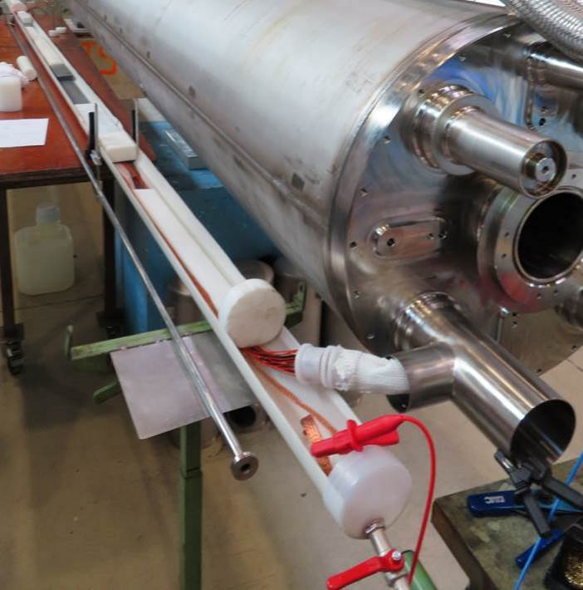
302.4.02 Cold Mass Assembly Fabrication
Cold Mass Lesson learned
Capillary tube – too many wires for tube diameter made it difficult to pull the wires through the 4 m long capillary causing the splice plug to be out of position in the cold mass tee.
Re-routed RTD instrumentation wires to reduce wire count in capillary tube.
Developed 3D printed tools to aid in wire alignment and wire pulling through the capillary tube.
Improved the wire splice robustness using barrel splice design, DocDb-4974.
Adopted CERN’s water hipot procedure to test wire insulation integrity.
splice plug
3D printed tools for wires

Slide 9
302.4.03 Cryo-Assemblies Fabrication
Bothe CA02 and CA03 installation went very well
Lesson learned from CA02 was implemented in CA03
Essentially no major travelled revision was required for CA03
FSI target installation method was optimized using surveyors
Final positioning of the CM inside the cryostat procedure has been fine tuned using surveyors' measurements
Combination pressure/leak test procedure has been developed with CERN and it has been approved both sides.
New pumping system has been procured and it is under installation
For CA02 still the leak test was not conclusive due to the contamination of the pumping system that was borrowed from the test facility

Slide 10
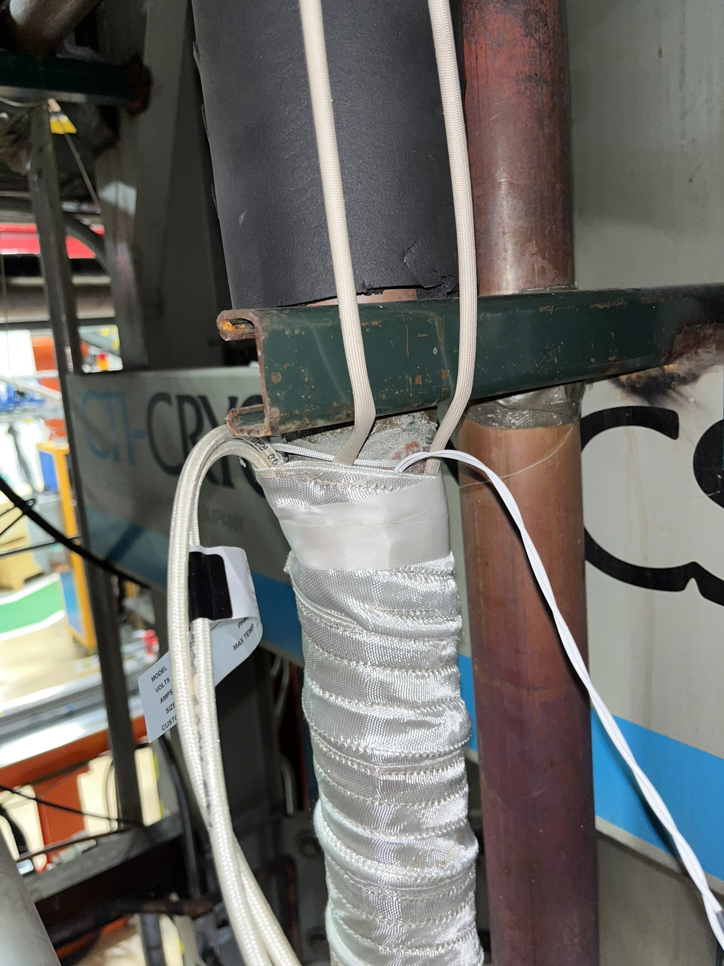
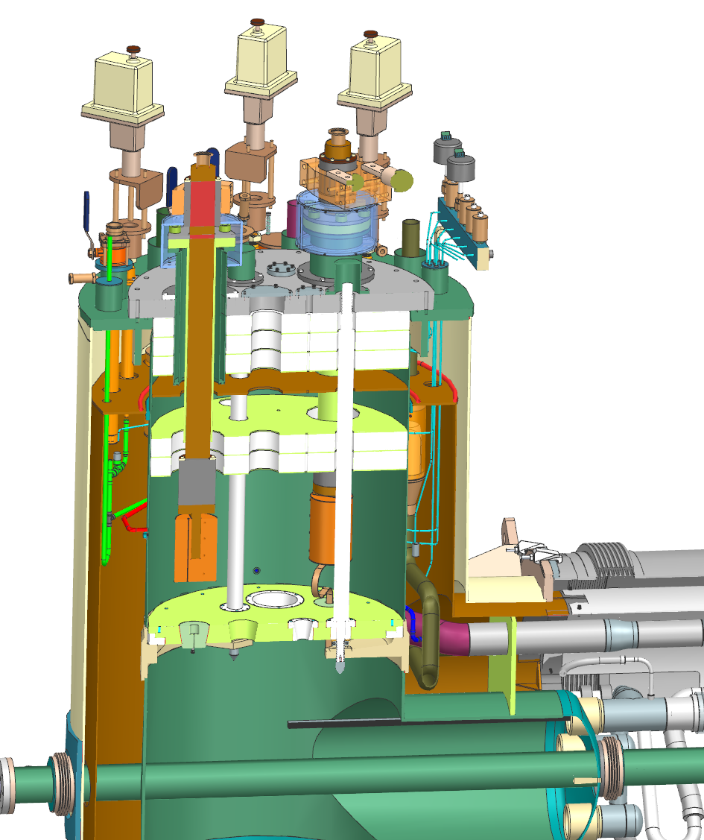
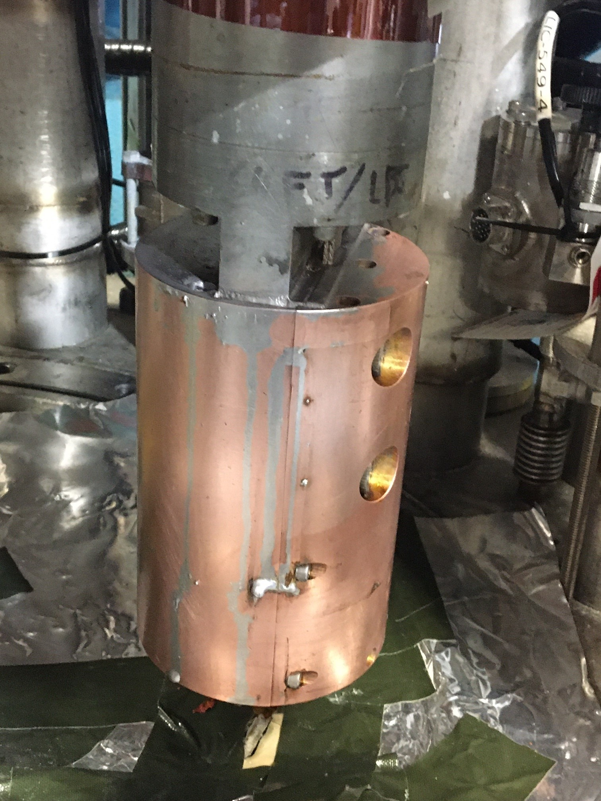
302.4.04 Cryo-Assemblies Horizontal Test
The second pre-series cryo-assembly CA02 test is almost complete; so far, the test is very successful though the cryogenic facility was not able to satisfy the requested LHe delivery capacity on time; contributed a lot of delay to finish the test
The test facility modifications/improvements were successfully completed
Added a heater to the He vapor suction line
New improved splice between the Power lead flag and the superconducting cable joint

Slide 11
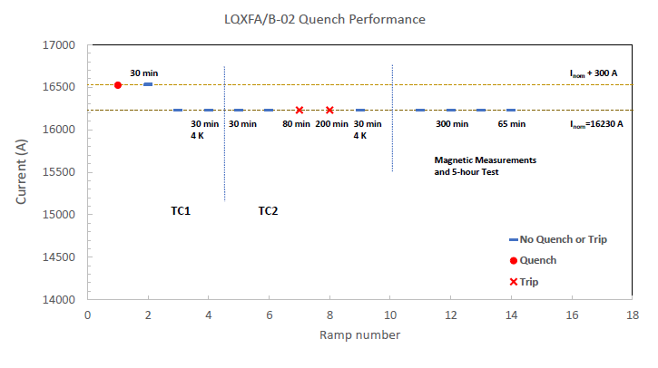
302.4.04 Cryo-Assemblies Horizontal Test
CA02 cold test results are satisfactory
Excellent vacuum pressure at cold 10⁻⁷ torr, no change while pressure increases
Only one spontaneous quench; two trips – PS phase back glitch
Holding current test up 300 min successful
Warm up is the last step

Slide 12
Documentation
Partial upload of the CM and Cryo-assembly fabrication travelers is ongoing since last year
Parts exchange document has been updated before the DOE review
7 seven cryostat kits are in house
Schedule is in-sync; the last of the cryostat kit will be delivered next year summer
Most of the Cold Mass parts are in house
There are only few items that needs attention, however so far, we had not experienced any shortage of parts

Slide 13
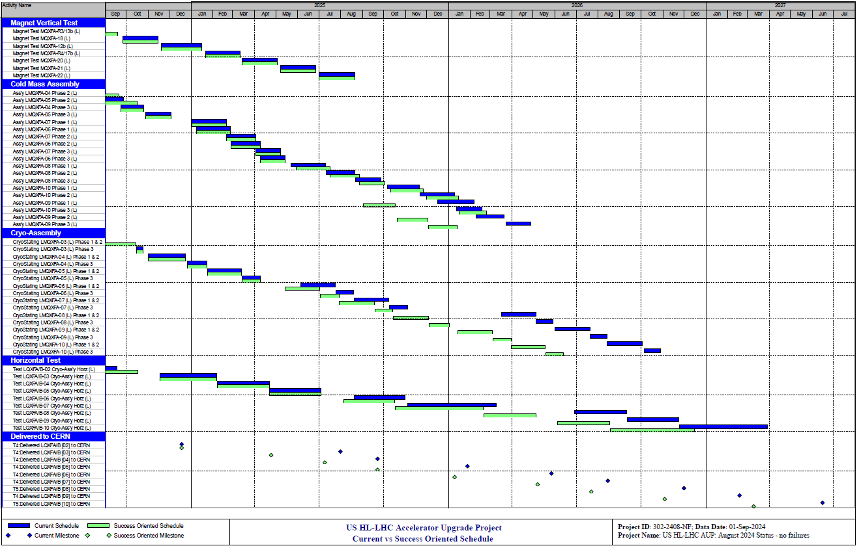
Success Oriented Schedule

Slide 14
Conclusions
Magnet tests are progressing well
CM03 is completed and CM04 and CM05 production is progressing well
CA03 fabrication is close to completion
CA02 test close to completion
Seven Cryostat kits are in house and the delivery schedule of the rest were updated recently

