Slide 1
RFD Crab Cavity Contribution from the U.S. Status, Issues and Delivery Dates
Leonardo Ristori – Fermilab
14th HL-LHC Collaboration Meeting – Genova, 7th October 2024

Slide 2
Outline
Scope
One Year in Summary
Succesful Qualification of First Pre-Series
Bare Cavity Fabrication
Issues with Processing and Rinsing
HOM Dampers Fabrication
Helium Tanks Integration a.k.a. Jacketing
Plans for Acceptance
Delivery Dates

Slide 3
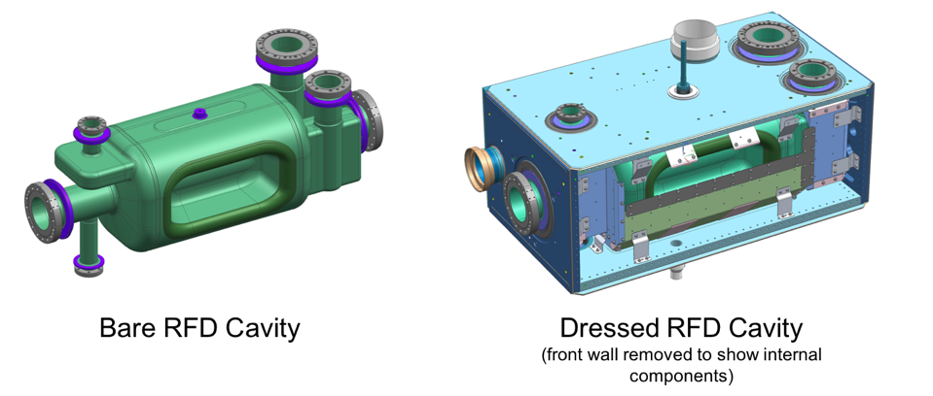
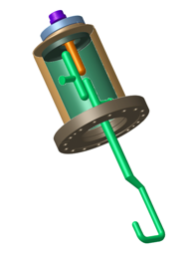
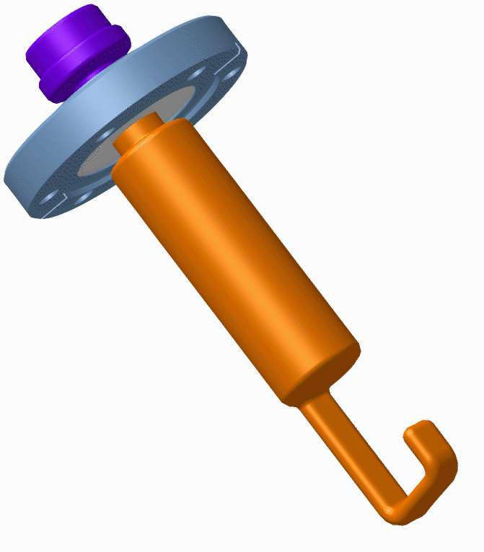
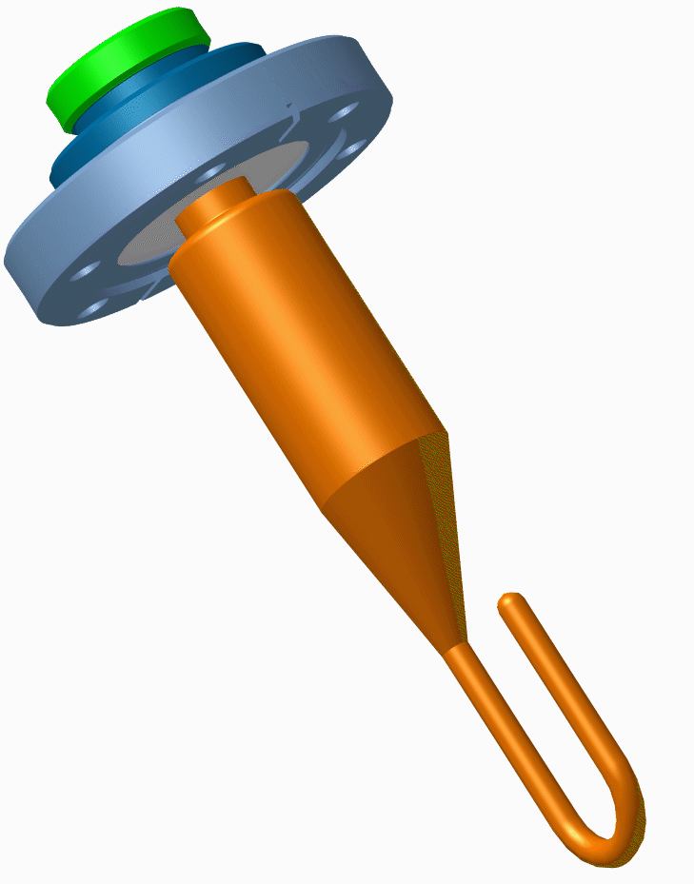
Scope and Deliverables
Higher-Order-Mode Dampers
(HOMs)
Project Scope includes 2 Prototypes + 2 Pre-Series + 10 Series
Deliverables: 10 qualified dressed cavities (mix of pre-series + series)
Bare Cavities: Fabrication + Processing in Industry; Intermediate Qualification at FNAL at 2K; re-processing (when necessary) in Industry; re-rinsing (when necessary) at JLAB
Jacketing: Magnetic Shields + Helium Tank in Industry
HOMs: H-HOM by JLAB; H-HOM FT, V-HOM, Pick-up by CERN
Dressed Cavities: re-rinse + Install HOMs + Final Qualification at JLAB at 2K
Transport to TRIUMF: Confirm performance at 2K, and acceptance by CERN

Slide 4
One Year in Summary
First prototype helium tank welded successfully at Zanon without surprises.
A total of 8 cold-tests were performed in the U.S. since October 2023.
2 Pre-Series Bare cavities (NRFD01 & NRFD02) were completed and processed at Zanon.
2 Series Bare Cavities (NRFD03 & NRFD04) being completed as we speak. Components formed succesfully for all series.
One Pre-Series cavity exceeded acceptance levels at bare stage, validating fabrication and processing at Zanon, and also HPR at JLAB.
Successful investigations uncovered and solved issues with processing and with HPR at Zanon.

Slide 5
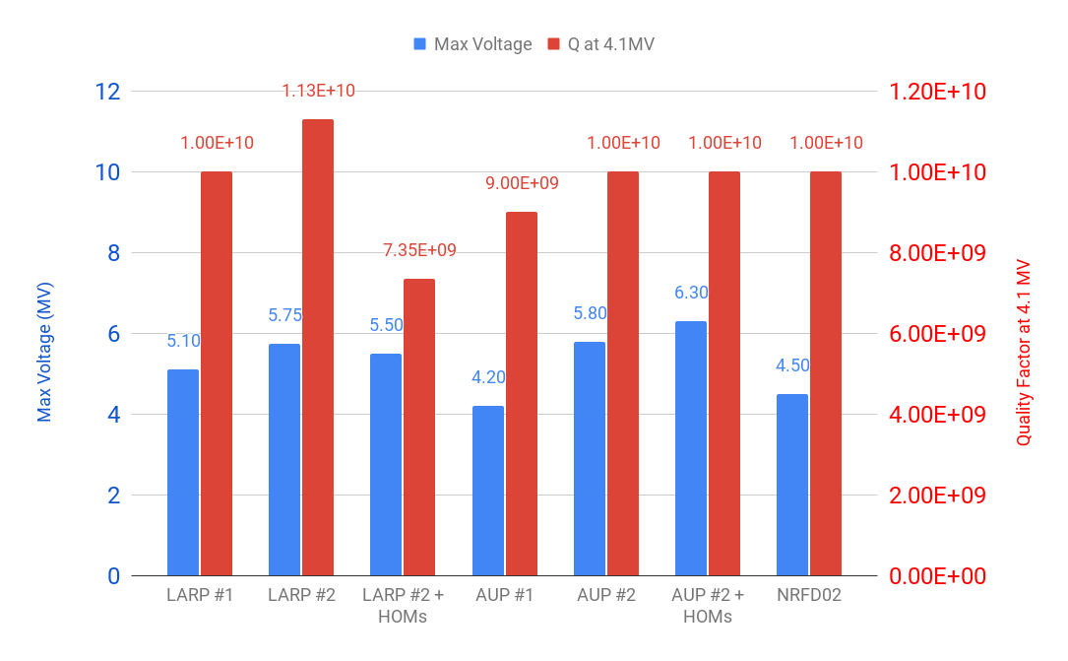
Cold Test Records Best Result for Each Cavity
From Prototype to Deliverable
Admin. Limit
Acceptance
2017 - 2019
28 Nov 2018
21 Apr 2021
25 Aug 2021
17 Aug 2023
26 Aug 2024

Slide 6
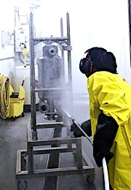
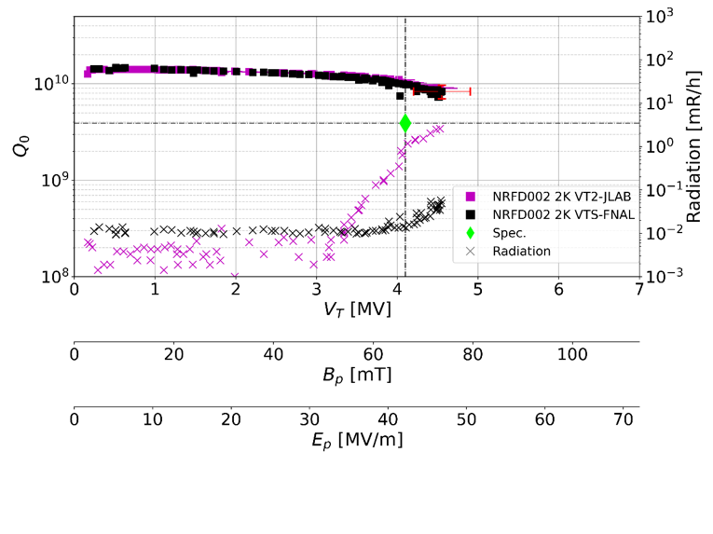
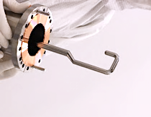
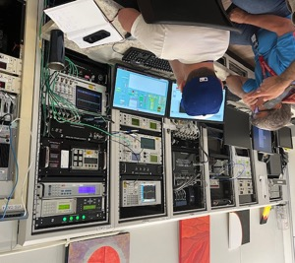
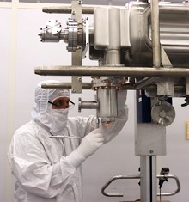
Pre-Series #2 (NRFD02) Test Results
→ See Talk by A. Castilla - JLAB
Performed 3 tests in total, always exceeding acceptance requirements, but with radiation onset (indicative of contamination). Onset level continued to improve after successive high-pressure rinses by JLAB.
Final test shows no radiation up to acceptance level.
Low field Q₀ is high: Chemistry by Zanon is successful.
Radiation onset is at high field: HPR and clean assembly by Jlab is successful.
Plot by A. Castilla
Admin. Limit
8/26/24: FNAL VTS Control Room
JLAB Cleanroom
Last 2 tests for Pre-Series Bare Cavity #2

Slide 7
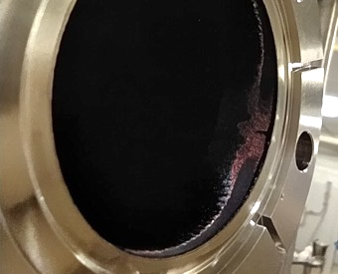
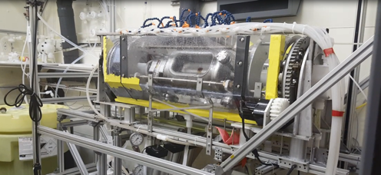
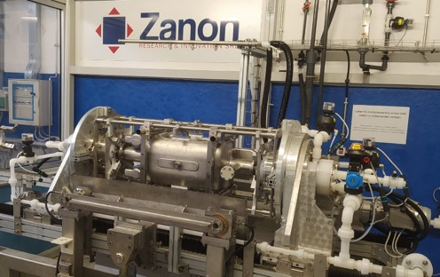
BCP Issues at Zanon
Courtesy of Zanon
Prototype #1 which exceeded acceptance (although marginally) was selected to validate chemistry at Zanon and subjected to a total of 3 bulk chemistries. Full consumption of Niobium material was observed in 2 locations. It is not useable in its current status.
The outcome of a detailed investigation was that although the removal in most cavity surfaces is very well controlled, the setup at Zanon did not have sufficient water cooling on the outside of cavity and the acid near the cavity flanges was reaching higher than optimal temperatures, causing excessive removal.
Tests were performed with the improved cooling and yielded positive results with variation of removal near flanges reduced by ~50%.
Prototype #1 after 3+ BCP cycles
BCP Setup at ANL
BCP Setup at Zanon

Slide 8
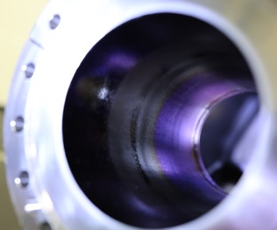
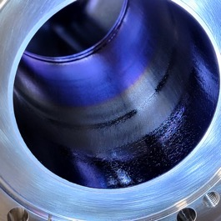
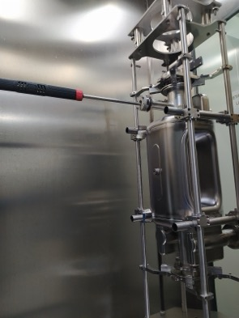
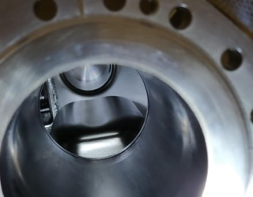
HPR Issues at Zanon
Courtesy of Zanon
Both pre-series cavities processed and rinsed at Zanon are showing localized discoloration (see pictures). Suspecting excessive and localized HPR pressure.
Thanks to recent validation at JLAB, we facilitated knowledge transfer to Zanon and modified the process to align as much as possible with JLAB.
Zanon introduced manual HPR of ports followed by the automatic process. Also parameters were modified to produce a faster feed speed and increased total rinse time.
Particle counts in cleanroom dropped by more than a factor of 10 and no discoloration is visible now.
Pre-Series #1 with internal discoloration
Manual HPR introduced at Zanon
No discoloration visible now

Slide 9
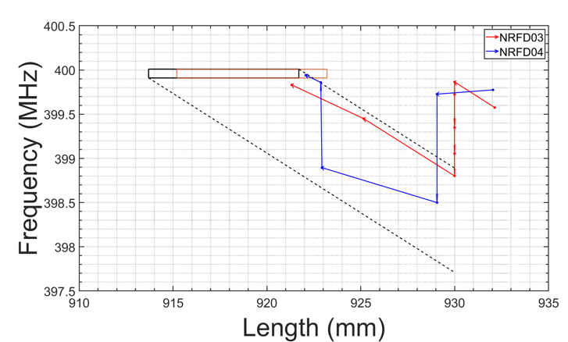
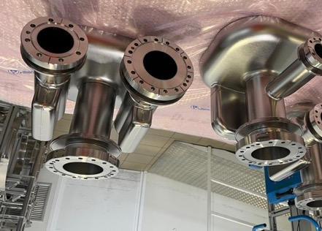
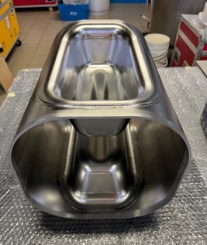
Cavity Fabrication Status at Zanon
→ See Talk by M. Narduzzi - FNAL
First two series NRFD03 & NRFD04 are undergoing trim-tune operations (see plot and pictures). Cavity length, cavity geometry, and frequency all need to be achieved at the end.
NRFD04 was presenting non-standard behavior after the first cut (frequency reduction after cut versus expected frequency increase). After reshaping, the following cut was as expected.
Final welds will be completed later this month.
All components for series cavities were produced in parallel. Deliveries are expected to ramp up dramatically in the next 6 months.
Plot by T. Posos
Some Components of Series #3 and #4 ready for trim-tuning

Slide 10
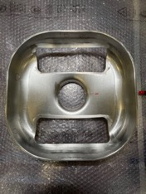
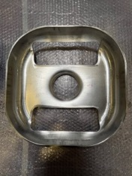
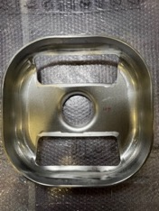
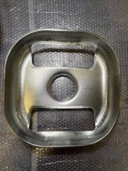
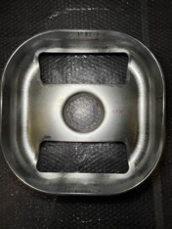
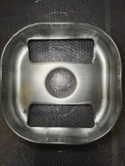
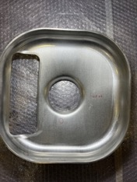
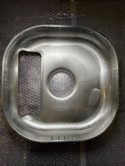
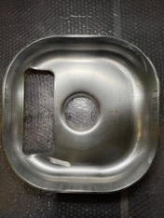
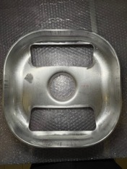
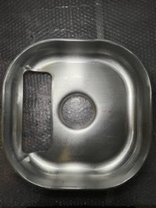
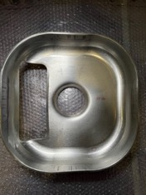
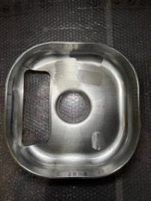
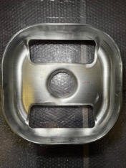
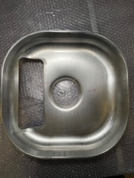
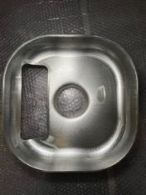
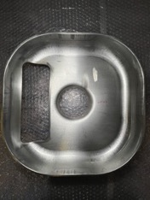
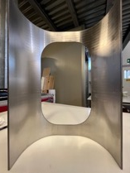
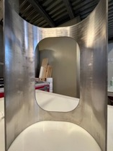
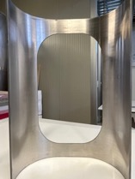
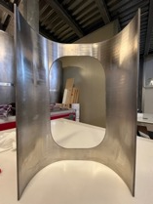
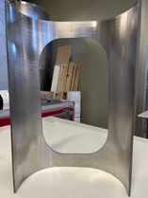
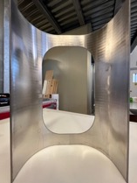
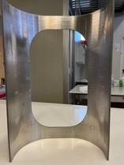
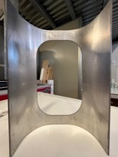
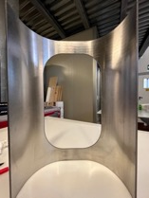
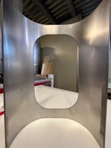
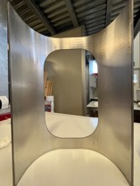
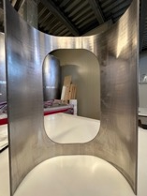
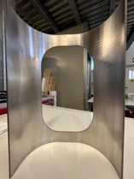
It Was a Year of Visual Inspections…

Slide 11
Fabrication Challenges at Zanon
M. Narduzzi – FNAL
Arguably this SRF cavity is one of the most complex to build and has some of the tightest tolerances compared to others.
Rework activities are often necessary to achieve requirements.
Geometrical tolerances on stamped/coined subcomponents (pole & waveguides in particular)
Complex EBW between Half Main Body sub-components and Waveguides Boxes-End Caps
Alignment between End Groups-Main Body during final EBW
Non straightforward behavior of cavity, and components during reshaping.
1
2
1
4
4
3
3
2

Slide 12
HOMs Fabrication at JLab
→ See Talk by N. Huque - JLAB
Prototypes
Pre-Series
PRR held in May 2022
Prototype: 3 sets (FY21/FY22) Complete (only 1 usable set)
Pre-Series: 3 sets (FY24) Complete but not deliverable
Reduced scope to only H-HOMs
Series: 10 sets (FY24/FY25)
Visual Test
Penetrant Test
Radiographic Test
Metallographic Test
Bend Test
Tensile Test
Visual Test
Penetrant Test
Radiographic Test
Metallographic Test
Quality of Hook/Tee EBW are improved (top right).
Pre-Series deviations are smaller than prototypes, which passed simulations and RF check.
All ceramic feedthroughs are now provided by CERN.

Slide 13
Production Status
N. Huque - JLab
Hooks/Tees
7 out of 10 complete
Hook and Tee Weldment
DN100 Brazements
5 out of 10 complete
DN40 Brazements
8 out of 10 complete
Inner Can Assembly
Final Assembly

Slide 14
Production Schedule
N. Huque - JLab
 |  | 2024 |  |  | 2025
 |  | Oct | Nov | Dec | Jan | Feb | Mar | Apr | May | Jun
HHOM 01 - 04 | Assembly
 | Testing
 | Acceptance
HHOM 05 - 07 | Assembly
 | Testing
 | Acceptance
HHOM 08 - 010 | Raw Material Procurement
 | Part Fabrication
 | Assembly
 | Testing
 | Acceptance
4
3
3

Slide 15
Prototype Jacketing at Zanon
→ See Talk by M. Narduzzi - FNAL
RFDP002 Successfully Jacketed
Welding of Proto #2 Helium Tank was completed without surprises and with ~zero frequency shift.
Cavity is at JLAB waiting for cleanroom equipment to be ready for HPR and preparations for cold test.
Magnetic measurements were completed, showing an attenuation factor of ~ 40x well above specification.
No changes foreseen for pre-series / series.
Magnetic Measurements
~400 mG
~10 mG
Welding of plates
Welding of fastener covers
Start of Assembly
Completed Assembly

Slide 16
Jacketing of Pre-Series + Series
Courtesy of Zanon
First two magnetic shield assemblies and all Titanium materials are in hand at Zanon.
Manufacturing drawings all approved.
Welding book still not approved, contingent on tests at CERN on bimetallic transitions.

Slide 17
Acceptance of RFD cavities
Acceptance Plan
Describes the process for acceptance between AUP and CERN, including OK to ship from CERN, and final checks at TRIUMF after receiving
Acceptance Criteria – Part A (at JLab)
All requirements from FRS will be verified with a test or a set of measurements during cavity production or during final tests at JLab.
Acceptance Criteria – Part B (at TRIUMF)
Series of tests/measurements to be carried out at TRIUMF under AUP supervision to confirm performance of cavities after shipment.
Revising to implement:
2K operation at TRIUMF
4.5 MV administrative limit.

Slide 18
Recommendations from DOE Review
July 2024
1. “Re-evaluate if the cavity re-processing procedure needs to include the 48h 120C bake by the end of CY24.”
Status: OPEN. Topic for discussion at this annual meeting.
2. “Evaluate if cavity High Pressure Rinse (HPR) procedures need to be adjusted to allow multiple re-rinse cycles without surface oxidation by the end of CY24.”
Status: ADDRESSED (CLOSURE by end of CY24). HPR Process at Zanon was adjusted to better align with the process at JLAB which has proven to be successful. First HPR cycle was performed, particle counts in cleanroom dropped by a factor of ~10. Cold tests later this month.
3. “Re-evaluate the required cavity re-rinsing rate, including potential impact on cost and schedule. Adjust the re-rinsing estimate, if necessary, by the end of CY24.”
Status: ADDRESSED (CLOSURE by end of CY24). Re-rinsing rate assumptions will be increased based on recent experience with 2 pre-series cavities. The scope increase will need to go through the monthly chance control board.

Slide 19
RFD Tests and Delivery Dates
Proto 2
PS 1
PS 2
Deliveries range from February – September 2025.
Delays since last update can be attributed to challenges with geometrical tolerances, managing NCRs according to QA plan, unexpected JLAB VTA shut-down.
Dates in red indicate conflict with JLAB shut-down.
Prototype estimated to arrive at TRIUMF in January 2025.
Pre-Series cavities estimated to arrive at TRIUMF shortly after.

Slide 20
Summary
Successful cold test of Pre-Series cavity, validating the materials, the fabrication, and the chemical processing for the deliverables.
Issues with processing and high-pressure rinsing appear to be addressed. Confirmations will come with tests in the upcoming months.
Completed the first helium tank welding without surprises. Cold tests to confirm in Dec-Jan. Zanon is ready for the next tanks.
Series cavities still at peak production, prioritizing quality, navigating through NCRs, slower than anticipated, but no showstoppers.
Horizontal HOM dampers are at peak production at JLAB with first deliveries in Spring 2025, in time for dressed cavity tests.
Acceptance Plan being slightly revised, to be validated with Prototype and executed with Pre-Series soon after.
We will entertain discussions in WP4 on HPR process, as recommended by the recent DOE review.
Deliveries of 10 cavities to TRIUMF range Jan-Sep 2025. We have consumed the float to ”late” deliveries.

Slide 21
THANK YOU FOR YOUR ATTENTION!
U.S. RFD Teams
Fermilab
RF/Mech Design, Procurements, Cold Tests
Leonardo Ristori, Paolo Berrutti, Manuele Narduzzi, Sasha Netepenko, Taha Posos, Colin Narug, Marilyn Wodzinsky
Jefferson Lab
HOM Dampers Fabrication and Cold Tests
Naeem Huque, Alex Castilla, Peter Owen
Old Dominium University
General Oversight and RF measurements
Jean Delayen, Subashini De Silva
SLAC National Accelerator Laboratory
RF Simulations
Alessandro Ratti, Zenghai Li

