Slide 1


AUP Cold Mass & Cryostat Assembly Production Challenges
Fred Nobrega – FNAL
HL-LHC AUP Cold Mass & Cryostat Assembly, L3/CAM
14th HL-LHC Collaboration Meeting
Genoa, Italy, October 7-10, 2024

Slide 2
Outline
Cold Mass (CM) - Cryostat Assembly (CA)
  Team
  Status
Achievements, Lessons Learned, DR’s
  Cold Mass
  Cryostat Assembly
Summary

Slide 3
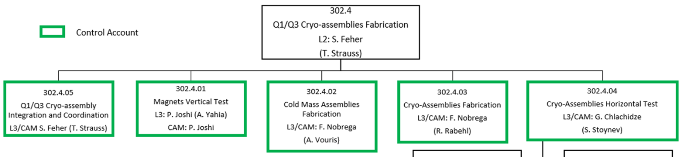
AUP Cold Mass & Cryostat Assembly Team
Experienced Team:
Sandor Feher
Thomas Strauss
Fred Nobrega
Antonios Vouris
Roger Rabehl
Charles Orozco
Rodger Bossert
Luke Martin
Charles Wilson
Anthony Lake
Scott Klema
Matthew Larson
Marlon Jamison
Deonte Davis
Robert Diamond
Oscar Madera
Thea Fisk

Slide 4
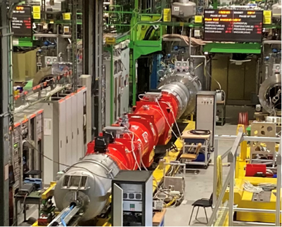
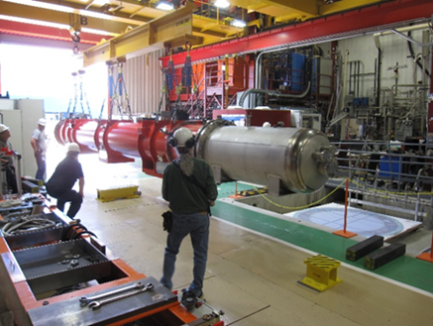
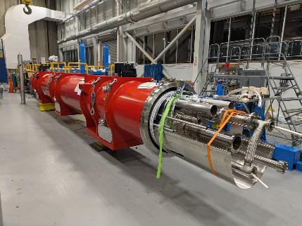
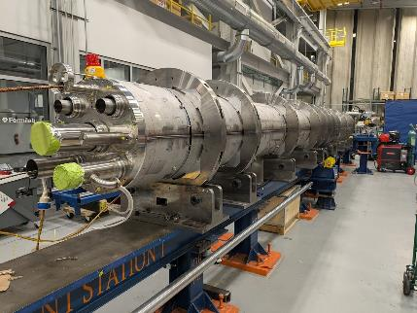
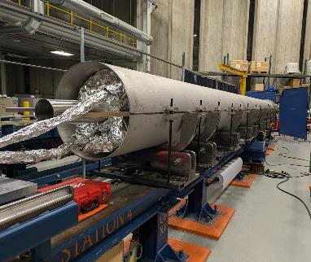
Cold Mass & Cryostat Assembly Status
CA01 accepted by CERN.
CA02 IB1 test nearly complete.
CA03 prep for combination pressure/leak test.
CM04 capillary tubes are next.
CM05 ready for longitudinal shell welding.
 | Qa | Qb | Weld | Cryo | Test | Ship
CA01
CA02
CA03
CA04
CA05
CA06
CA07
CA08
CA09
CA10
Within ICBA
Complete
In Progress
CA01, CERN
CA02, IB1 test stand
CA03, ICBA
CM04, ICBA
CM05, ICBA

Slide 5
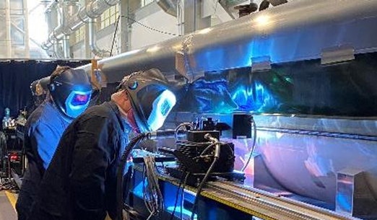
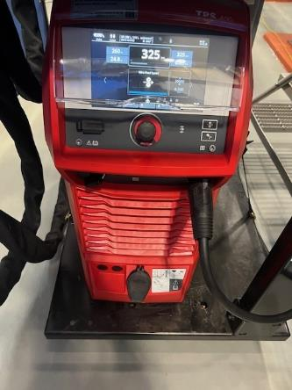
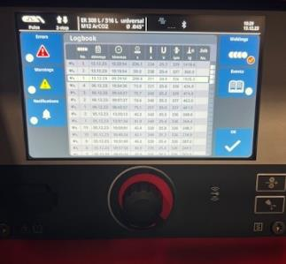
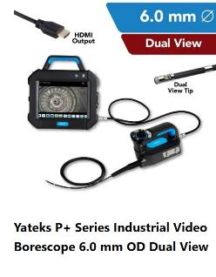
Cold Mass Achievements
  Purchased Fronius power supplies that provides stable arc and a data log. Used on CM03.
  Ultrasonic Test (UT) results have been exceptionally better since updates. CM-02 & CM-03 passed with minimum to no weld repairs.
  Internal Weld Inspections are now completed with an inspection Borescope by a Certified Weld Inspector (CWI).
Fronius Readout

Slide 6
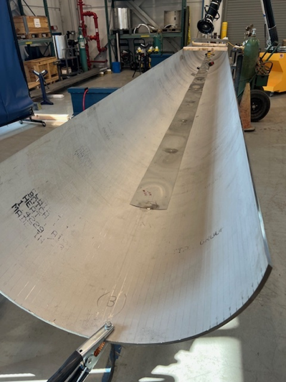
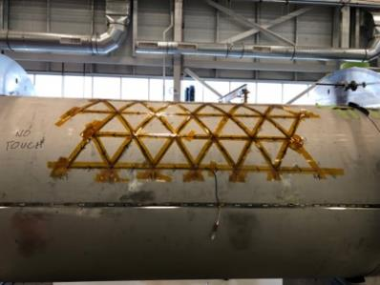
Shell Prestress Achievement
Shell design revised to add 2 mm SS shim between shell and magnets after CM01.
  The shim is used to reduce shell and coil pole stress increase during welding.
  First shims used on CM02 and were flat. Subsequent shims were rolled for ease of welding.
  Fiber optic strain gauge measurements showed shell stress reduction of 10 Mpa between CM01 and CM02.*
CM02 shell and shim
CM01 fiber optic
strain gauge
  * Ref: Fiber optics strain measurements during shell welding, Design Change Review of the Q1/Q3 Cold Mass, July 25th, 2022, M. Baldini, S. Krave

Slide 7
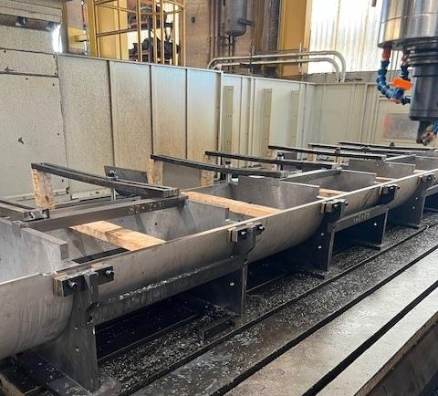
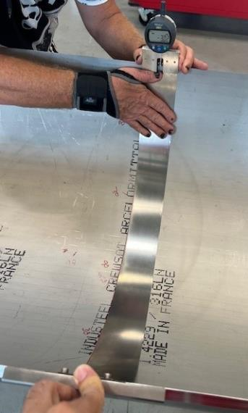
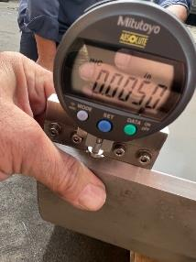
Cold Mass Lessons Learned
  Shell machining process updates resulting in consistent & accurate arc length dimensions.
  Using vertical mill with more rigid fixturing.
  New shell forming tooling has been incorporated.
  Adopted CERN’s shell inspection tool concept.
Shell Inspection
Shell Machining
Shell Inspection

Slide 8
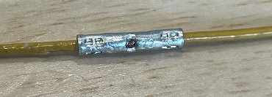
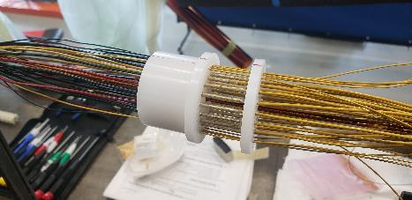
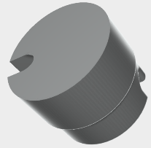
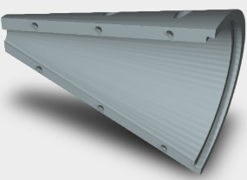
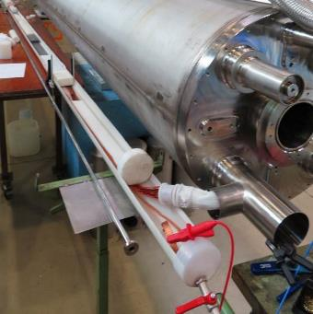
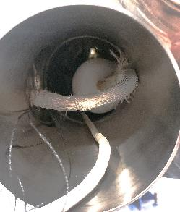
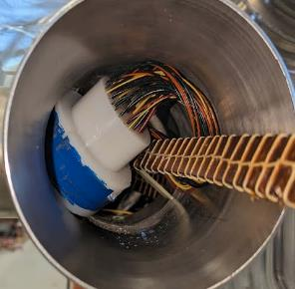
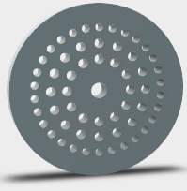
CM02 Lessons Learned
DR13416, DR13429, DR13481
  Capillary tube – too many wires for tube diameter made it difficult to pull the wires through the 4 m long capillary causing the splice plug to be out of position in the cold mass tee.
    Re-routed RTD instrumentation wires to reduce wire count in capillary tube.
    Developed 3D printed tools to aid in wire alignment and wire pulling through the capillary tube.
    Improved the wire splice robustness using barrel splice design, DocDb-4974.
    Adopted CERN’s water hipot procedure to test wire insulation integrity.
splice plug
Barrel Splice
3D printed tools for wires
Qa, Qb splice plug
Capillary Tube
Water Hipot
8

Slide 9
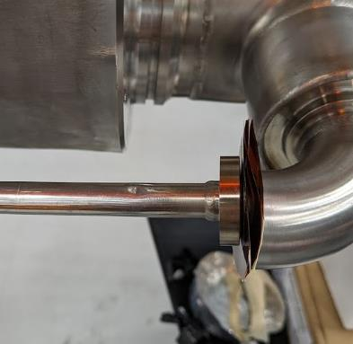
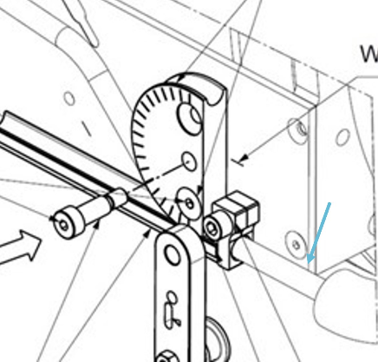
Dinged Capillary Tube, Lessons Learned DR13499
Edge weld was ground away cut to remove elbow.
Root cause: During the capillary bending of Qa bend #1, the tubing pressed into the edge of the bending tooling mounted to the cold mass slightly deforming the capillary tubing 0.5 mm. The edge weld of the elbow/tee was ground away to rework the wire bundle thereby making the nominal tee length slightly shorter. The effect of the shorter tee is misalignment of the capillary tube with the forming tooling.
Corrective action: Replace the capillary tube. Add relief to the tube forming tooling in the contact area.
Capillary tube and forming tooling interference.

Slide 10

Upper/Lower Shell Twist, CM04
Lessons Learned
Shell twist in free state caused at shell forming. Shells machined in constrained condition.
Impact → extra weeks for setting weld gap in CM04
Process and tooling change in CM05 implemented.
CM05 weld gap tooling

Slide 11
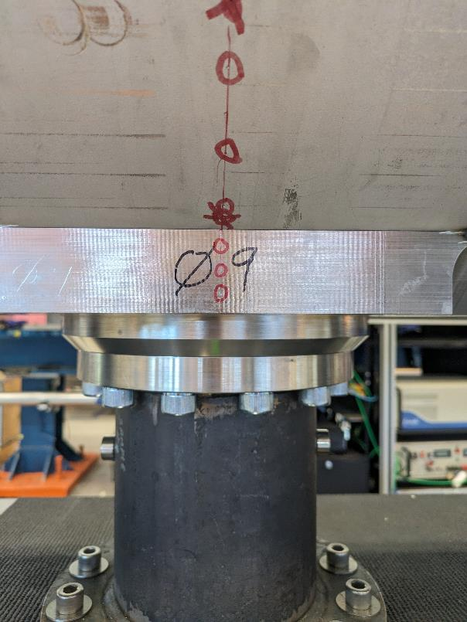
Alignment of Cold Mass to Saddle
Lessons Learned, DR13565
Root cause: Saddle missing metrology punch marks. Red line was used for alignment instead.
Corrective action: Revise cold mass traveler to verify the saddle has 3 punch marks and a scribe line prior to tack welding.
CM02
Saddle

Slide 12
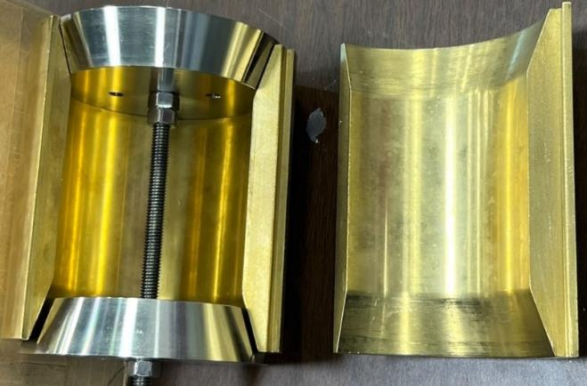
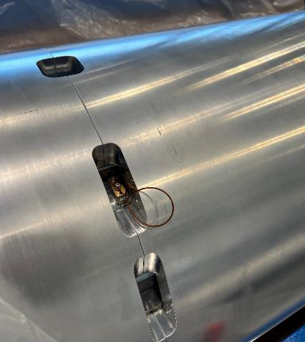
Cold Mass Lessons Learned
  Beam Tube flare flange weld tooling (heat sink)
    used to draw away heat & minimize weld distortion during welding of the beam tube
  Heat exchanger installation & gauges used to verify clearance through magnets during fabrication
  CERN RTD Mounting
    Magnets provided to FNAL with pre-drilled mounting holes for RTD’s
Beam Tube Heat Sink
CERN RTD’s Mounted
Welding Heat Sink Fixture

Slide 13
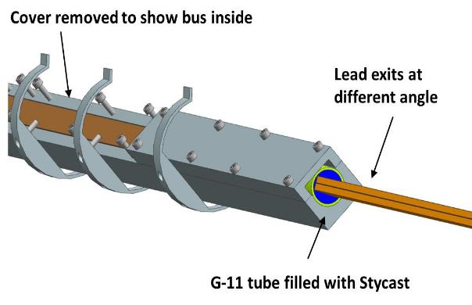
Bus Housing Assembled Upside Down DR13115
Bus and housing assembled upside down and inserted into CM02.
Corrective action: Removed bus with housing from cold mass, removed bus from housing, bus flipped over into the correct configuration, reassembled, and reinserted into CM02.

Slide 14
Cold Mass CM02 – CM05
Discrepancy Reports
DR# | Cause of Discrepancy | Result
13115 | LMQXFA-02: Bus and housing assembled upside down and inserted into CM02. | Removed bus with housing from cold mass, removed bus from housing, bus flipped over into the correct configuration, reassembled, and reinserted into CM02.
13416 | LMQXFA-CAP-02: The Qa IFS exit plug is in the pipe nozzle with approximately 6" of insulated wire bundle. | Remove and replace capillary tube and wire bundle.
13429 | LMQXFA-CAP-02: During Qa capillary tube wire removal (disassembly) MTF RTD wire insulation was damaged. | MTF RTD wires spliced with new wires and re-routed through the cold mass.
13481 | LMQXFA-CAP-02: During rework of the Qa capillary tube, the edge protection on the tee was removed resulting in wires rubbing on an unprotected pipe edge. | Qualified and implemented a wire repair procedure that included 150-200 um Kapton, 125 um S2 glass wetted with Araldite 2012 epoxy.
13499 | LMQXFA-CAP-02: During the capillary bending of Qa bend #1, the tubing pressed into the edge of the bending tooling mounted to the cold mass slightly deforming the capillary tubing. The nominal diameter of the tubing is 14 mm and the diameter of the deformed area is 13.5 mm. | The position of the capillary tube is determined by an elbow welded to a tee. The edge weld of the elbow/tee was ground away to rework the wire bundle thereby making the nominal tee length slightly shorter. The effect of a shorter tee means the capillary tube is slightly misaligned with the tube bend tooling and is pressing into the edge of the tooling. Replaced capillary tube. Added chamfer to the tooling.
13513 | LMQXFA-CAP-02: While hipot testing the bent CM02 Qa end capillary tube assemble, an arc hipot failure occurred at 3kV during the ramp to 5 kV. The capillary tube flange was not inside the 90 degree elbow and the entire assembly was electrically isolated from the cold mass. | Likely moisture (water, ethanol) in the tube assembly. Tube was dried out and hypot repeated, passed successfully about one week later.
13565 | LMQXFA-03: Alignment of the cold mass to the inspection station saddle is misaligned by 1.02 mm. The longitudinal tolerance is +/- 0.75 mm and therefore out of tolerance by 0.25 mm. | A meeting with Delio Ramos of CERN was held on 5/8/2024 to discuss the saddle out of position by 0.25 mm on CM03 with respect to the center saddle. Delio agreed to accept the 0.25 mm out of tolerance condition because the cold mass was very close (just under) to its nominal design length. Therefore, it still met the overall cold mass slot length.
13649 | LMQXFA-03: A crosscheck of the physical RTD location with annotation in the spreadsheet revealed that the order recorded for the CERN RTD is wrong on the spreadsheet. | Wrong notation of location on the electrical checkout spreadsheet during electrical checkout. The floor supervisor will perform an independent verification of the electrical spreadsheet after the RTD wire information is entered by the technician.

Slide 15
Cold Mass CM02 – CM05
Discrepancy Reports
DR# | Cause of Discrepancy | Result
13650 | LMQXFA-04: On review of physical sensor installed versus recorded data we found that for CM04 the installed sensor for the return end was removed after electrical checks had been completed and had been replaced with a new sensor and different wiring length. It is unclear at this point if the data recorded last matched the electrical spreadsheet recordings. | We performed measurements and the numbers did change. However, we were able to find a log from July with the correct checkout numbers, which had not been reported previously. The measurements are consistent with the log.
13657 | LMQXFA-05: We found that the RTD location as noted in the checkout 6.4 for MQXFA15 are reversed with the CM05 assembly. | Carrying over from the electrical spreadsheet there was no distinction between Qa and Qb end, so data was entered incorrectly. Electrical spreadsheet data in step 6.4 was updated.
13628 | LMQXFA-05: The position of the coils within magnet structure 07b is off centered by 6.7 mm towards the return end. The position of the coils within magnet 15 is 1.5 mm towards the return of the structure. The magnet structures are assembled with the RE facing each other at the center of the cold mass. The tooling used (alignment table) to precisely locate and position the magnets do not have adjustments features. The position of the coils within magnet structure 07b is off centered by 6.7 mm towards the return end. The position of the coils within magnet 15 is 1.5 mm towards the return of the structure. The magnet structures are assembled with the RE facing each other at the center of the cold mass. The tooling used (alignment table) to precisely locate and position the magnets do not have adjustments features. | Magnets 7b and 15 are on the alignment table with the beam tube and heat exchange pipes installed. Magnets are supported with roll-over rings which have several mm of gap on both sides of the rings. Using the magnet lifting beam, unload magnet 7b without lifting. Use pry bars on each side of the roll-over ring(s) and move magnet 7b approximately 5 mm away from magnet 15. Measure MCS and repeat metrology measurements.

Slide 16
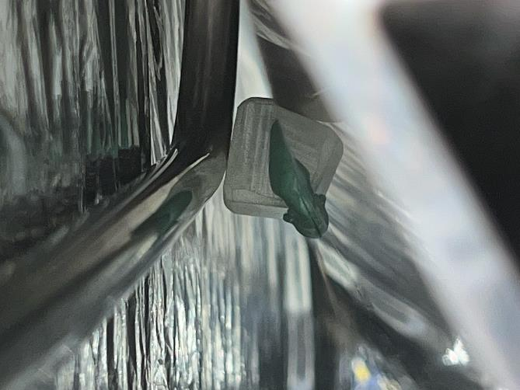
CA02 Capillary Stand Off, DR13526
The capillary tube flange was reworked on both ends, shortening the T, creating an interference with the capillary tube forming tooling, resulting in the capillary tube contacting the thermal shield.
Used Araldite1580 (green putty) to attach G-11 stand off from the thermal shield.
CA02 Capillary Stand Off

Slide 17
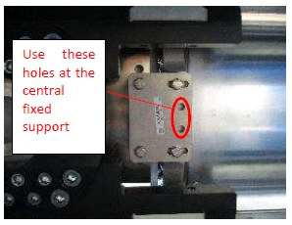
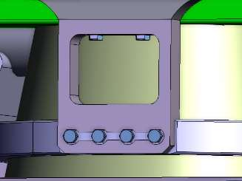
CA02 Thermal Shield Out of Position
Lessons Learned, DR13552
Thermal shield is located 4.5-5 mm too far towards the Non-IP end such that the thermal shield support pieces cannot be installed at the fixed support post.
Root cause: During setup, incorrect holes used on bracket to locate thermal shield.
New support piece fabricated.

Slide 18
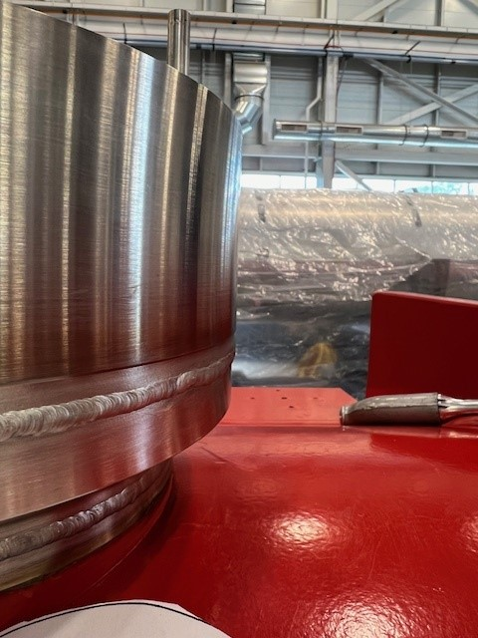
CA02 IFS Head to Flange Misalignment DR13575, DR 13584
Root cause: IFS Assembly was cut at weld due to incorrect wiring.
Corrective action: Wiring schematics were adjusted to correctly illustrate the orientation of the wiring.
Made wire solder connections using new IFS head and welded in place.
After welding there was a misalignment of the new IFS and the existing lower flange that was slightly distorted from the original weld.
The issue meets requirements of ASME B&PV Code Sect. VIII div.2 and can be operational at FNAL, however, it does not meet ISO requirements and escalated to an NCR (LHC-QQXFA-QN-0012 (ver.1).
CA02 IFS

Slide 19
Cryostat Assembly CA02 & CA03
Discrepancy Reports
DR# | Cause of Discrepancy | Result
13526 | Capillary stand off from cold mass outer surface. | Show picture
13527 | M2.5x8 screws are not torqued according to the torque spec outlined in the CERN procedure for FSI target installation. | Purchased an appropriately rated torque screwdriver.
13545 | At the center fixed support of the cold mass, three studs could not be tightened and spun when applying the tightening torque of 28 Nm | After discussion with CERN, the studs will be green puttied into the Cold Mass saddle threaded holes. The studs will be torqued after the putty has cured.
13552 | Thermal shield is located 4.5-5 mm too far towards the Non-IP end such that the thermal shield support pieces cannot be installed at the fixed support post. | Misread traveler, made new support pieces.
13575 | Qa IFS was wired in the wrong orientation, looking at the face from the top, it is wired in the bottom view. the head needs to be cut free and rewired and welded. head hclmqxf-e0048-06 000008 will be replaced with a new head. | Cut IFS weld and de-solder wires. Use new IFS feed through and solder wires.
13583 | During Post Weld electrical checkout, it was noted that the Qa end RTD location is mixed with respect to expectation. We identified the error occurred during the IFS repair and the Lead Side CERNOX and non-lead side CERNOX wire have been swapped, and existing on the temperature ports 2 & 1 instead of 1 & 2. | Mislabel of wire after multiple IFS repairs.
13584 | Welding IFS head to flange misalignment after wire repair in DR13575. | NCR (LHC-QQXFA-QN-0012 (ver.1)
13586 | LQb side PT100 on MQXFA05, Non-lead side ID P45727 was found unstable at about 50 Ohm resistance. | RTD is used only at FNAL for magnet delta-T monitoring during controlled cooldown/warmup, and there is a redundant PT sensor.
13681 | CA03, Continuity check of VT EE234 measured open. (IFS Qb end) | Cut IFS weld. Locate VT wire issue and repair. Use lessons learned from CA02.

Slide 20
Summary
Cold Mass and Cryostat Assembly activities are progressing steadily, with continuous improvements.
About half of the cold masses are complete or in progress.
Achievements include welding process and shell prestress.
There were many lessons learned and production challenges that included welding and capillary tube and IFS heads installation. Incorporating what we have learned and implementing corrective actions has help streamline the production process.

