Slide 1
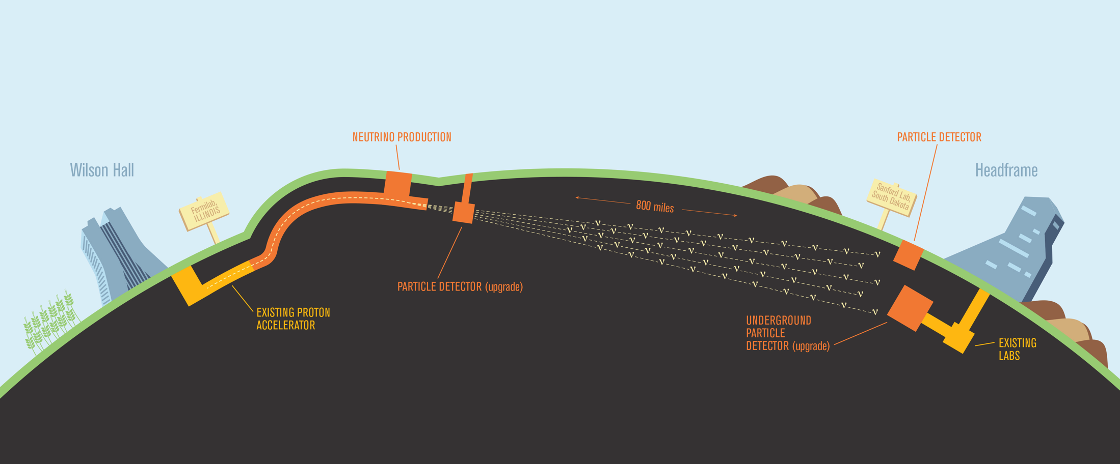
APA consortium
Justin Evans & Brian Rebel
30th September 2024
11th May 2012

Slide 2
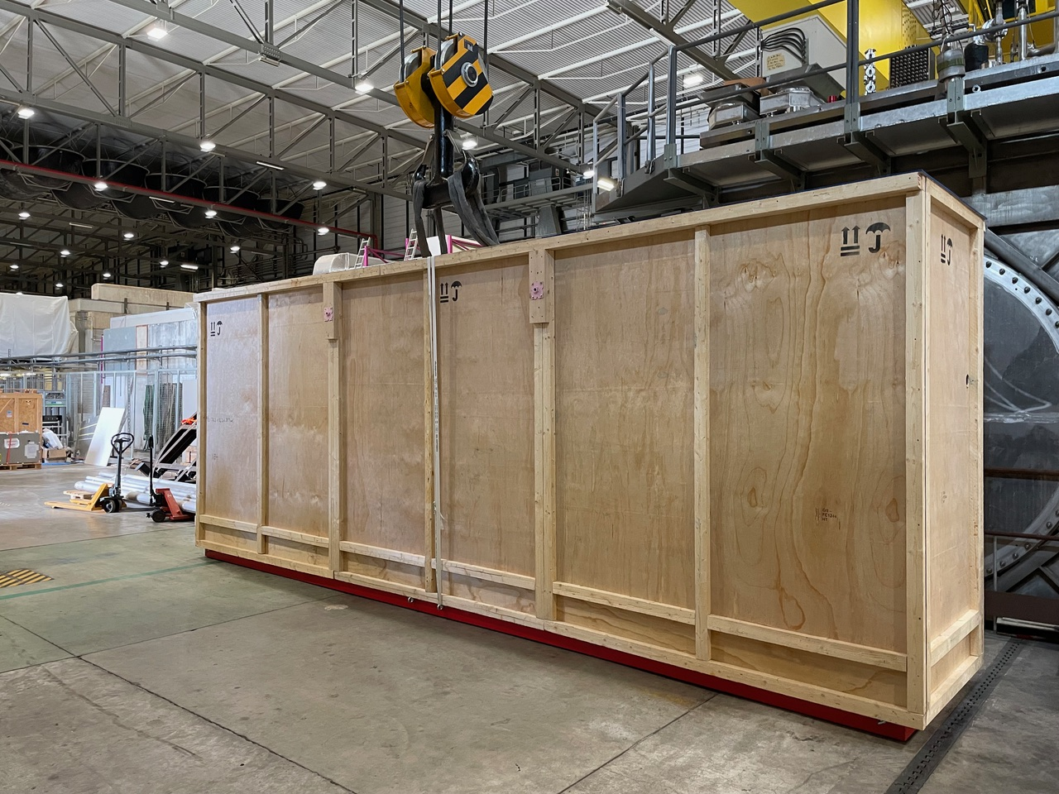
APA cold tests
APAs 14 and 15 arrived at CERN on Friday morning
These will now be tested in the cold box in the NP04 cleanroom
Pip Hamilton will be leading these activities
He will run a weekly meeting (available to all on Zoom) to report on the previous week’s activities and plan the next week’s activities
He will also hold a daily in-person tool-box meeting each morning to plan the day’s activities in EHN1

Slide 3
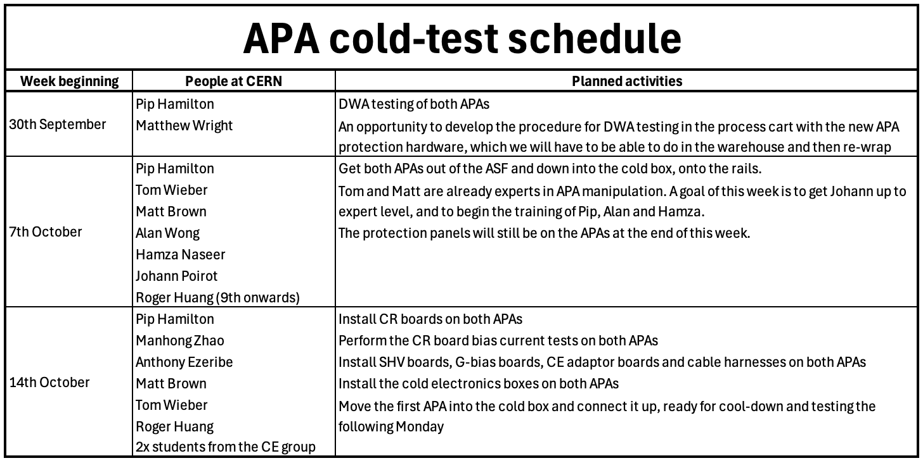
Planned activities

Slide 4
Planned activities
The first APA will be cooled down on Monday 21st October and tested that week
Until recently we thought the argon transfer from NP04 to NP02 would start this week, hence we would lose access, however this argon transfer has now been delayed
We now therefore have to plan activities for the weeks of 21st and 28th October, as well as assemble effort at CERN for these activities

Slide 5
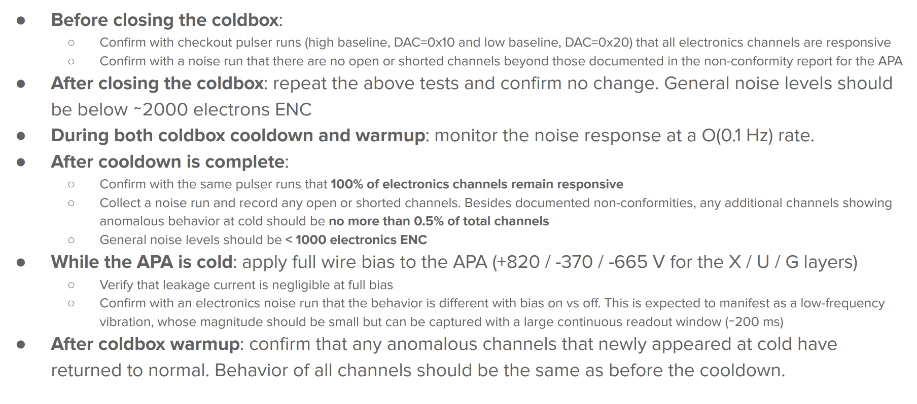
APA cold-box expectations
This slide from Roger Huang at the Santa Fe meeting nicely sets out our expectations

Slide 6
Updating procedures
These cold tests are an important opportunity for us to develop and refine our procedures
In particular, we are now working with new APA protection hardware
We must photograph and document all activities, and record all issues that arise
We will use this experience to update all our procedures with a view towards both future cold tests and to installation at SURF

Slide 7
PCBs
William & Mary will imminently ship the U and G wrap boards to Chicago for US APA 1
This will complete the board delivery for APA 1
Chicago already have head boards available through to APA 5
We are shipping one full set of wrap from Daresbury to Chicago to ensure that Chicago can work uninterrupted through the completion of APAs 1 and 4
Daresbury have around 10 APAs’s worth of boards in stock, hence this is not an issue
William & Mary will then provide 1 APA’s worth of wrap boards every month
APA 5 by 1st Nov, APA 6 by 1st Dec, etc
The UK will wrap boards for all US APAs (through to 14) to W&M by the end of this year
Prioritising the delivery of 026, 028, 040 and 042 boards, which will keep W&M running through the end of the year
All laser-etched cover boards for all US APAs (up to 14) will be delivered to Chicago (from Lancaster) by 10th October
It is vital that we inventory the boards at each site and ensure the database correctly reflects this inventory
All sites must record all shipments sent and received
All sites much use the Geometry Board Rejection form in the database if a geometry board is rejected and scrapped

