Slide 1
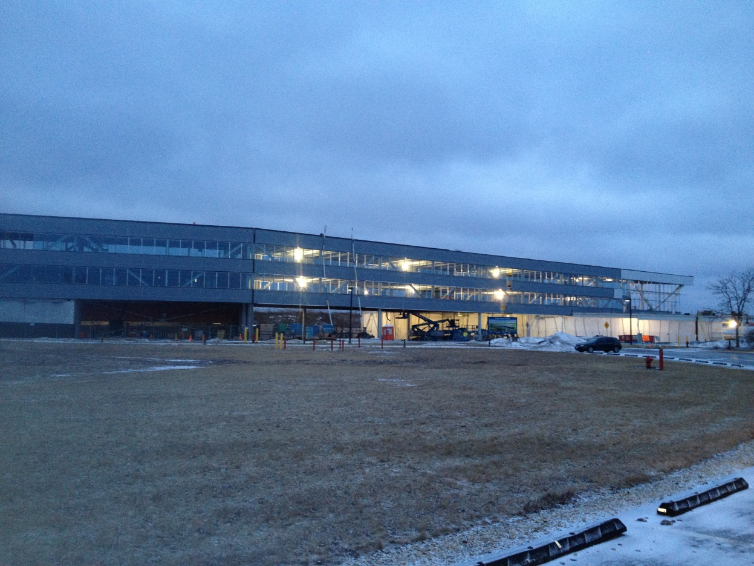
OTE Building PMG Report a/o March 25, 2013

Slide 2
Agenda
CDF D&D: C. Cooper
IARC Networking: C. Cooper
OTE Building Project: R. Merchut
Coordination
State Activities
Schedule
Fiscal
Summary Action Items

Slide 3
CDF Decommissioning and Preservation
Goal: Preserve CDF assets so they can potentially be used by ORKA
Solenoid
Mechanical systems
Electrical infrastructure
Scope of work
Remove tracking detectors and plug EM calorimeters
Remove electronics and cabling
Dismantle external muon systems
Return central spectrometer to collision hall to be ready for modification for future uses
Boundary conditions
Must be compatible with IARC
Coordinate future building needs
Complete work before beneficial occupancy
End of CY14

Slide 4
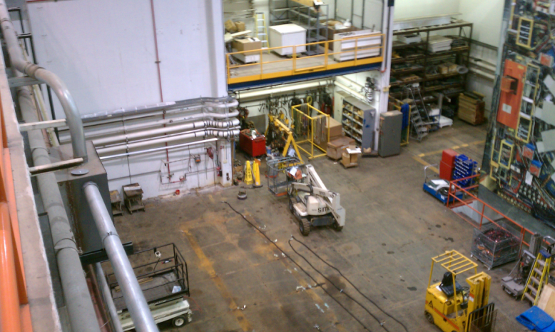
CDF Decommissioning Status
Ready for heavy lifting
NOvA FHEP removed in February
Assembly hall cleanup is complete
CDF display items moved to storage
NOvA near detector factory on east side
Ready to open 1200 ton shield door
Rate limiting factor is availability of labor
PPD Mechanical Group is oversubscribed
Rigging group working on MicroBoone
Techs on various IF projects
POs placed for contract techs and riggers
$200k M&S allocated
Includes $100k from buybacks and cancelled display project POs
Getting estimates for muon wall demolition
LBNE interested in steel for shielding
Circulating draft Statement of Work for comments

Slide 5
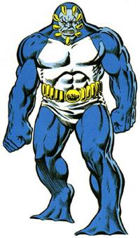
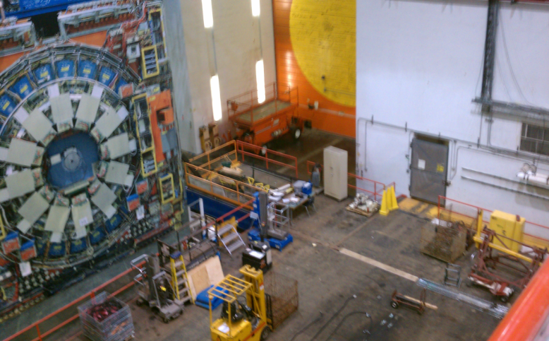
CDF Decommissioning Plan
FY13
Move north muon wall and central detector to assembly pit
Remove tracker
$200k budget is just enough based on planning exercise
This is base labor from estimate, i.e. zero contingency
Use summer labor to strip cables, electronics, etc.
Recover scintillators, PMTs for IF experiments
Can start muon wall demolition if other funds are available
FY14
Remove cable bridge
Demolish CMX arches
Demolish muon walls
Move to assembly pit if funds insufficient
Return spectrometer to collision hall
ORKA
Not CDF,
but an incredible simulation

Slide 6
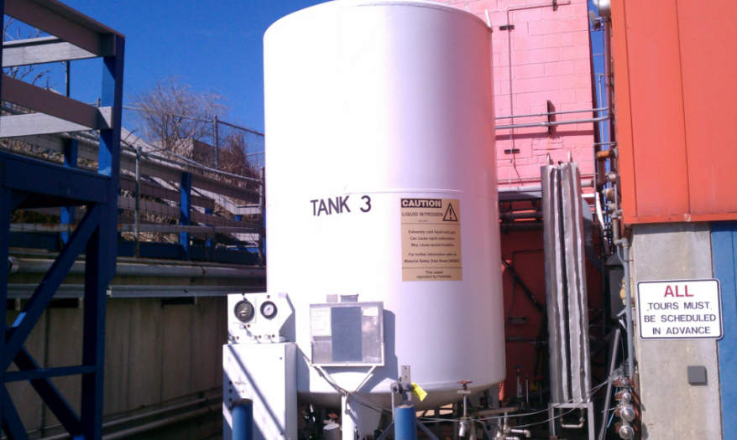
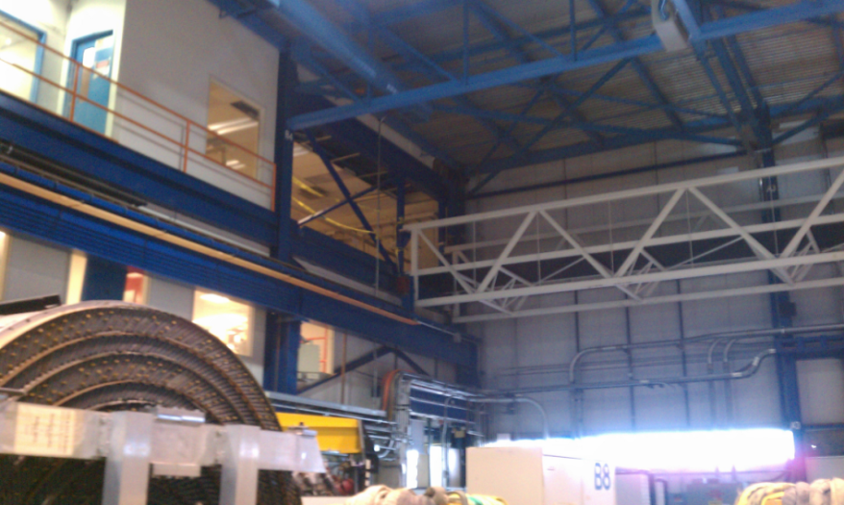
Future Use Activities
New discussions of removing gas shed, removing horizontal nitrogen Dewar, and moving vertical nitrogen Dewar (pictured)
Planning ICW upgrade
Considering best location for mechanical systems
Moving air handlers to roof may be less expensive and can add ~800 sq. ft. of usable space
OTE Associated work:
Build wall by bridge
Some minor painting
Temporary dust barrier in opening built between CDF and OTE

Slide 7
Outlook
On the edge for getting trackers out in FY13
Budget was $4M fully loaded with contingency
To be confident we will get the job done
Need at least $3M in FY14
Need greater access to FNAL technicians
Task managers and team leaders if we are relying on contract labor

Slide 8
OTE Outfitting GPP G13-211
FY 13: $2M for VoIP/networking & Contingency.
Develop Plan for moving ahead with VoIP/Networking w/out tenant layouts.
Discussions with CD to incorporate independent network underway.

Slide 14
IASU Update (IGPP)
Phase 2 scope approximately 85% complete.
CDF Coordination
Demolition for 1st floor OTE/CDF entrance complete.
CDF barrier to remain in place until OTE is environmentally enclosed & CDF protected from all dirt and dust.

Slide 15
OTE Project Status:
Shop drawing review continues
More than 235 RFI’s rec’d from contractor have been responded to.
Schedule Oversight on-going. Continue to work with contractor to provide coordinated information.
Safety procedures continue to be expanded as more subs come onto the project.
Change Control Board reviewing COR 122 for ceiling changes. (Change Request #3).

Slide 16
OTE Project Status:
LEED procedures & Action Plan implemented.
Contractor reporting 99% construction waste has been recycled.
On track to meet goal of 20% (by cost) of regionally manufactured materials.
On track to meet goal of 20% (by cost) of recycled content in materials used.

Slide 17
Continue to have 35-45 workers daily.
Exterior enclosure
Corrugated Metal Panels - 2nd & 3rd floor
1st floor framing started
Window framing & glazing
Roofing
MEP & FP pipe, raceways & ductwork hanging
Stairway #1
Interior Studs
Geothermal field

Slide 18
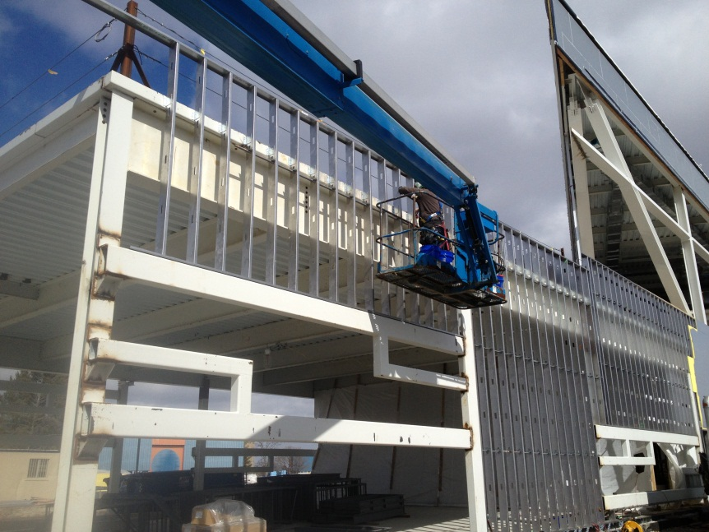
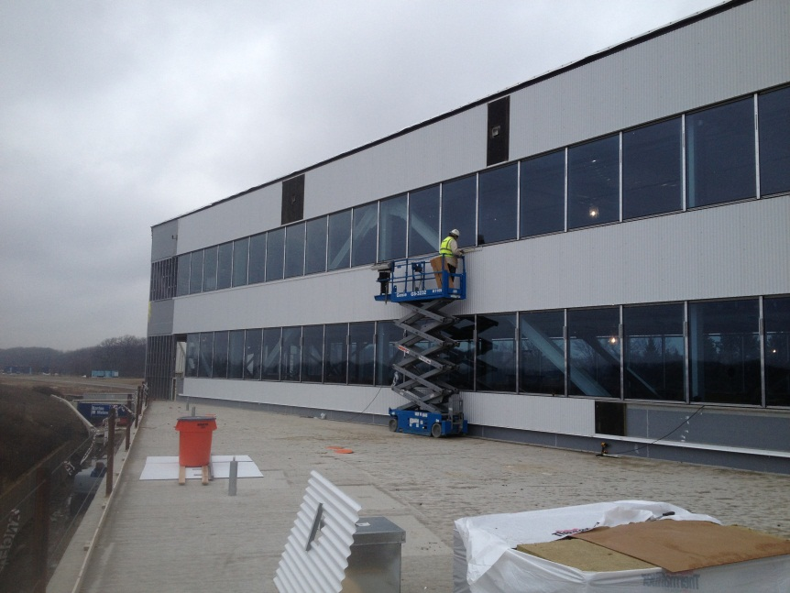
Exterior Enclosure

Slide 19
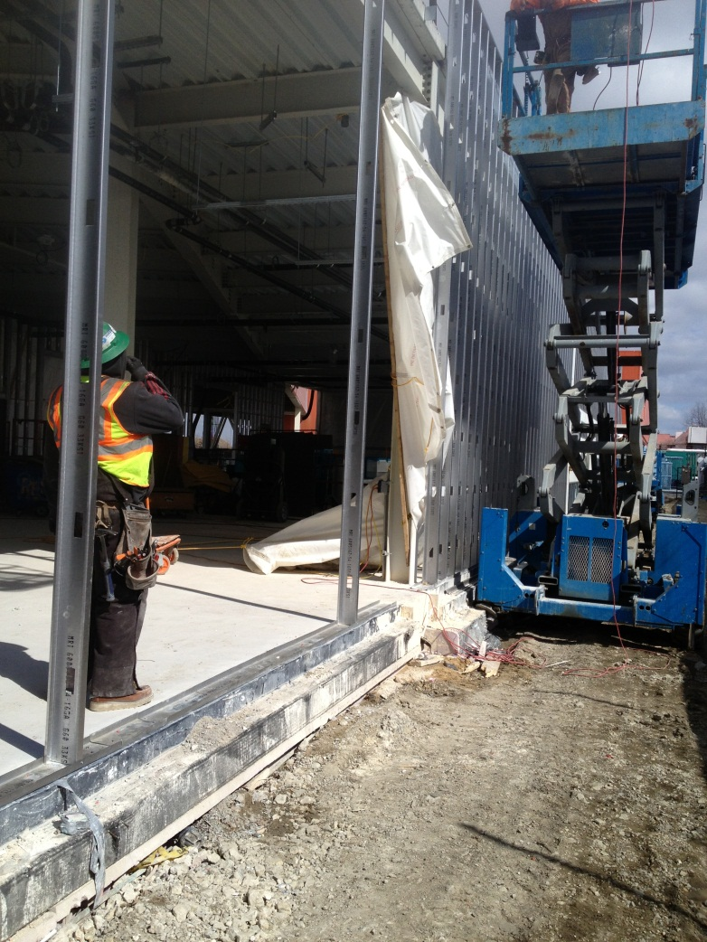
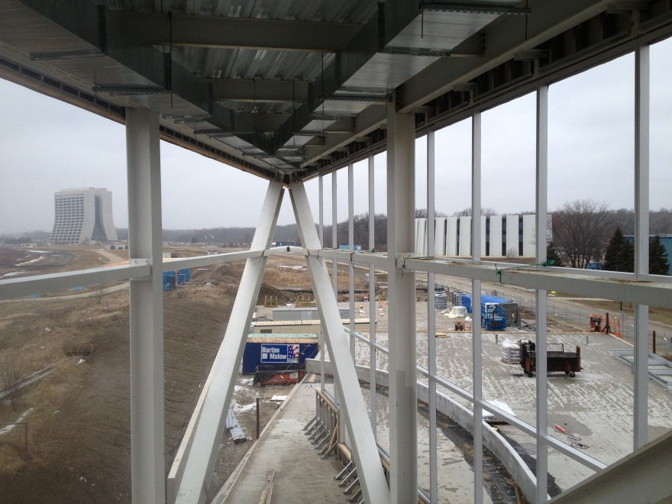
Enclosure

Slide 20
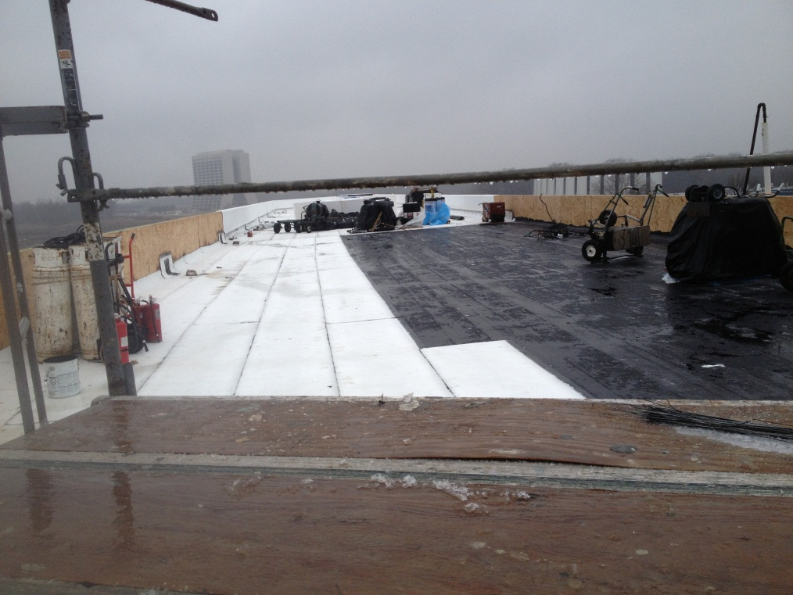
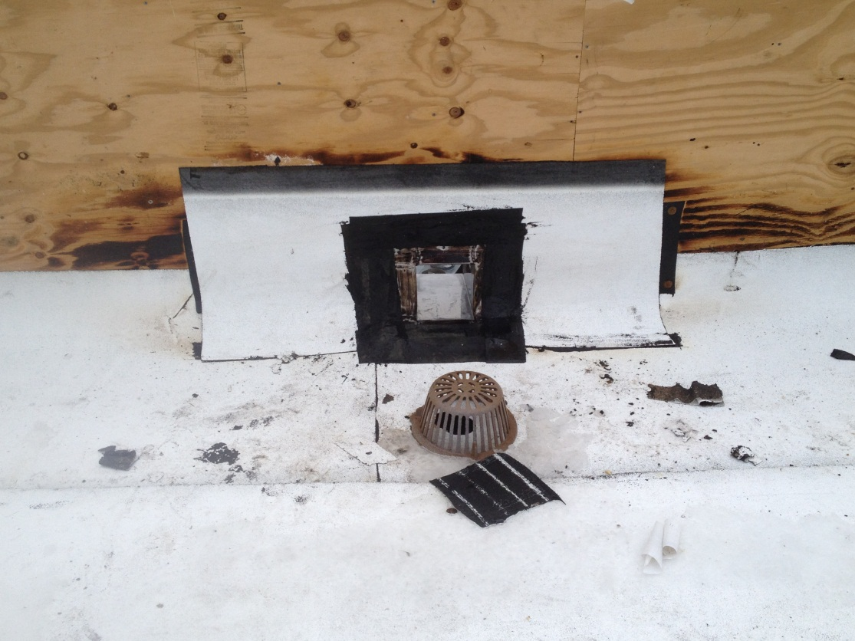
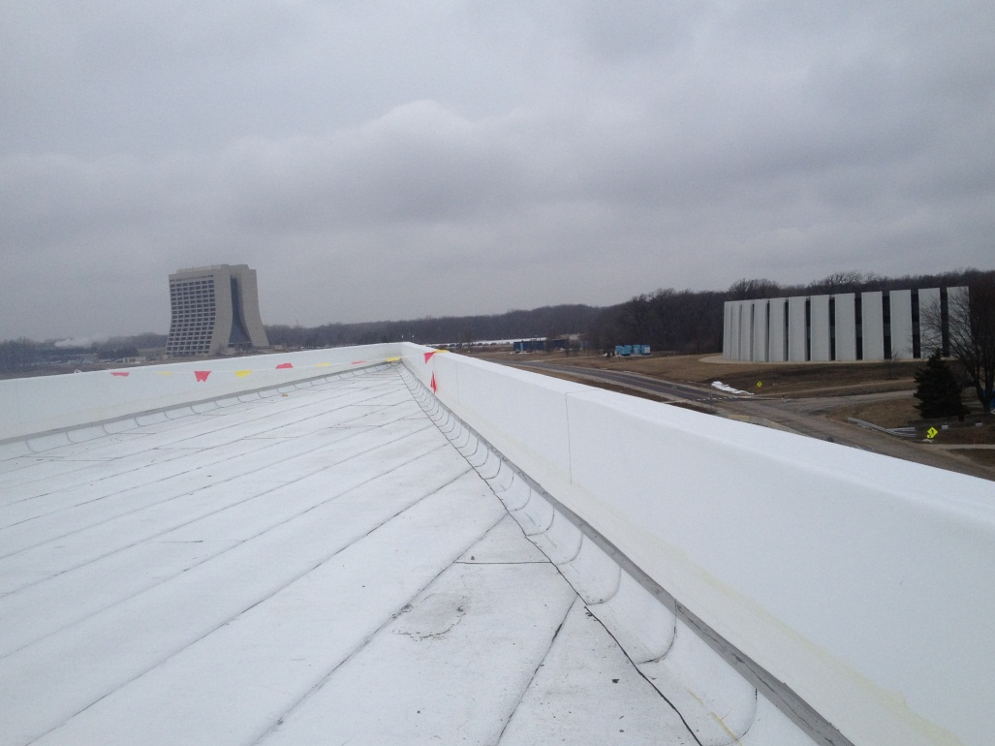
Roofing

Slide 21
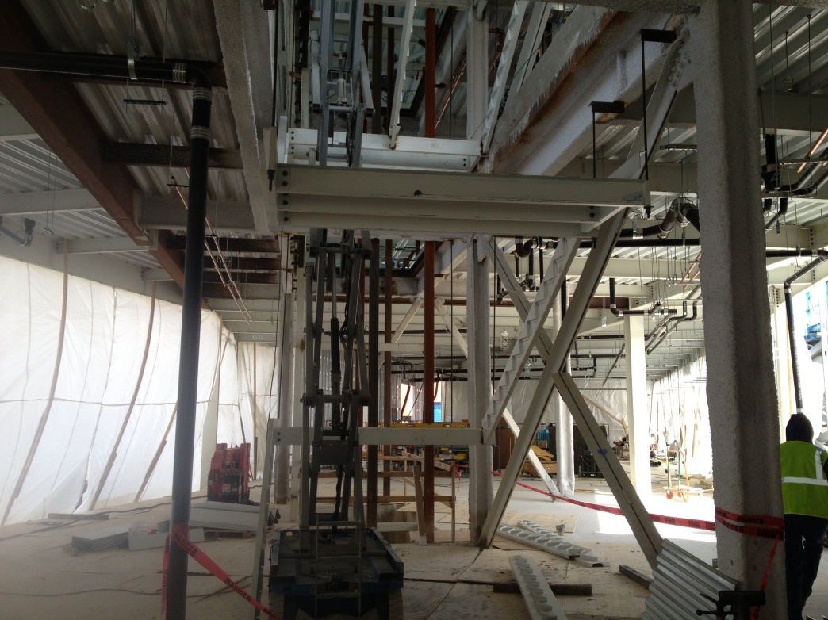
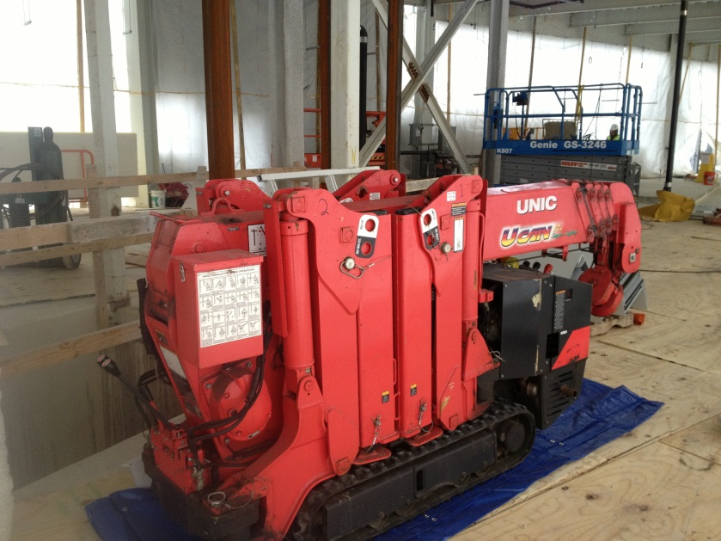
West Elevator & Stair

Slide 22
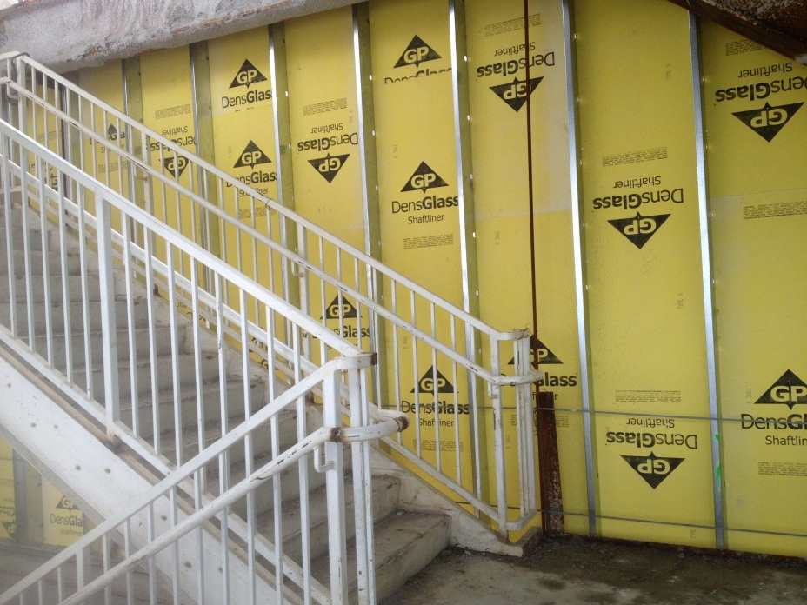
2-hour wall at CDF
2nd floor Conference Rm
East Stair

Slide 23
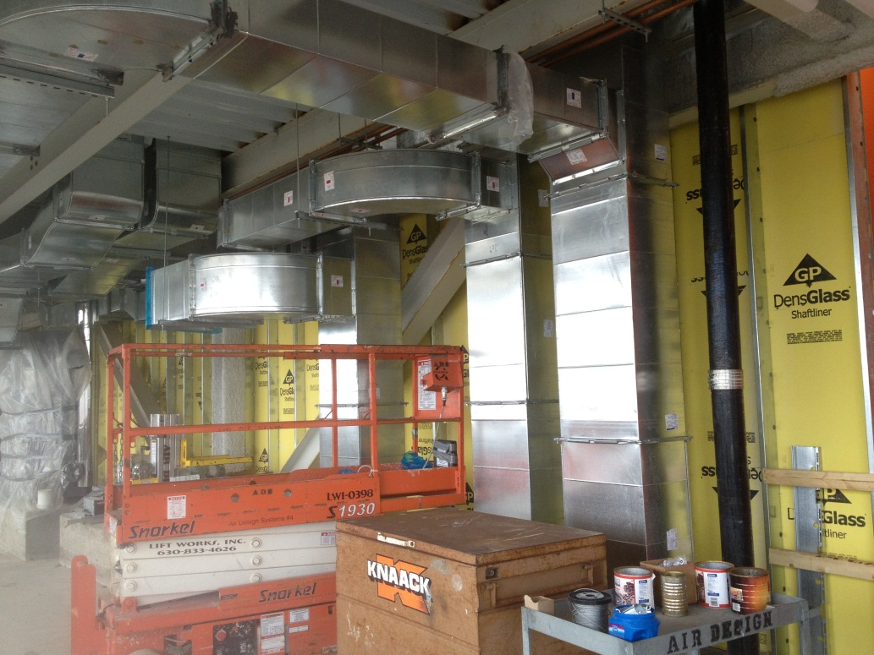
MEP

Slide 24
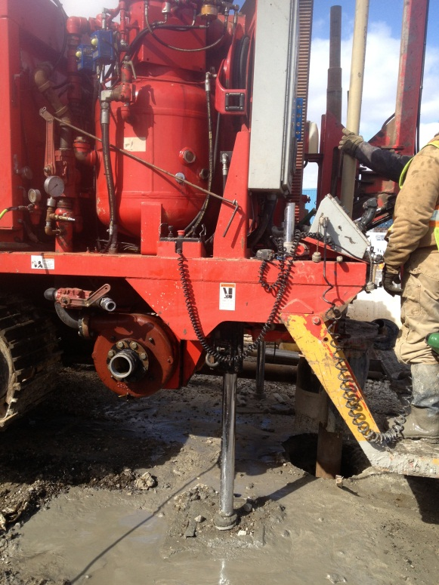
Geothermal

Slide 25
Two Week Look Ahead
Roofing on high & low roofs
Curtain wall framing.
Exterior panels 2nd & 3rd floor.
Glass installation 2nd & 3rd floor ribbon windows.
MEP, FP equipment & pipe runs
1st floor enclosure
West Stair
Geothermal

Slide 26
State DCEO Activities
DCEO quarterly report to State due 3/29/13 for quarter ending 2/28/13.
Project on schedule for grants to be 100% costed by 5/31/14 grant requirement.

Slide 27
Schedule Adjustments
No requested schedule adjustments.
MS 1 Bldg Shell Complete: 5/9/13*
MS 2 Substantial Completion: 11/5/13
(Project is fully costed at MS 2, retention remains)
MS 3, Project Complete: 1/29/14
*No cost COR 151 rec’s from BMC to extend MS-1 only to 6/19/13 under review.

Slide 28
BMC Schedule

Slide 29
Schedule

Slide 30
Schedule

Slide 31
Tracking Milestones
Project is fully costed at MS 2, retention remains

Slide 32
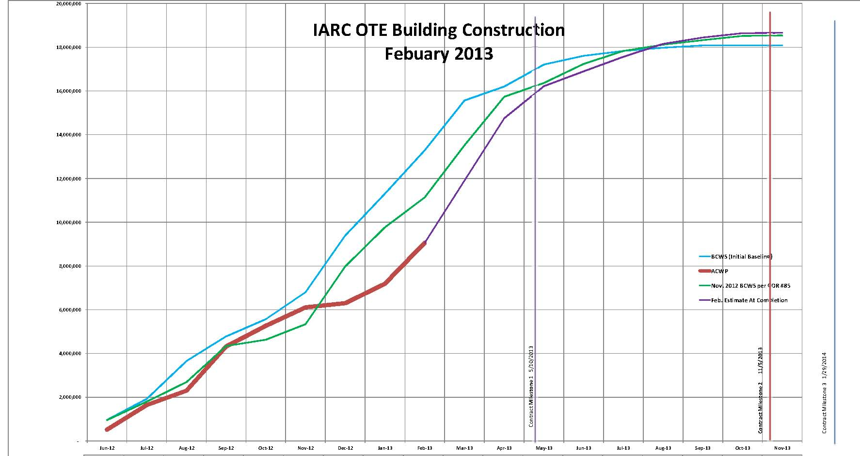
BMC Construction BCWS & ACWP

Slide 33
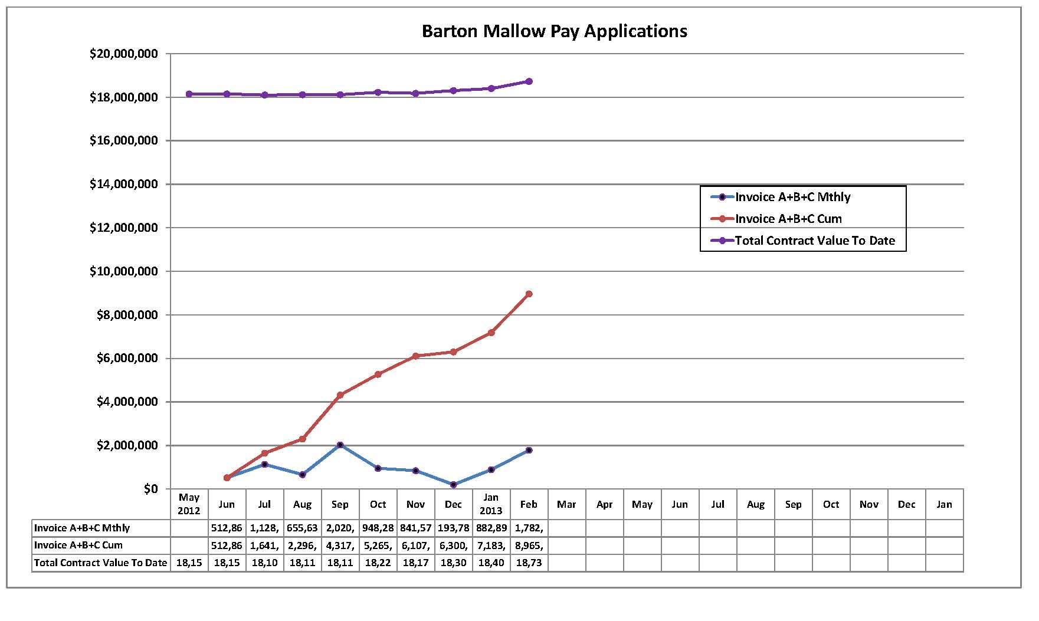
BMC Monthly Costing
Monthly Average to date: $996,215
Required Monthly Average to complete: $1,066,000

Slide 34
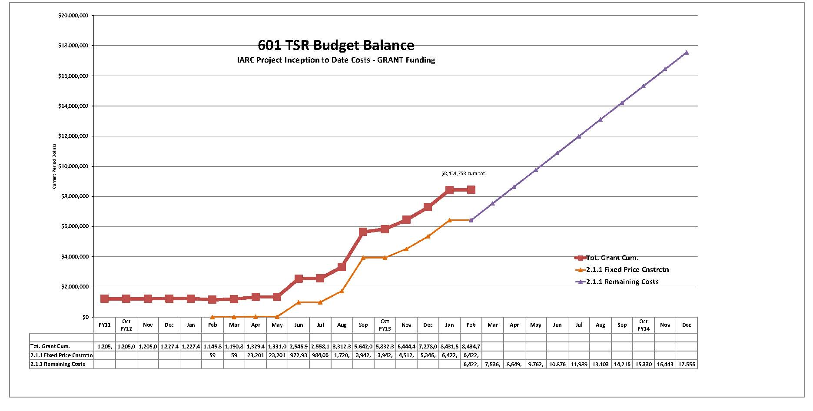
601 TSR Budget Balance
ALL Grant Costing w/ BMC Projection
NOTE: $1.8M BMC Feb pay request was not processed by end of month.

Slide 35
Financial

Slide 36
Financial – Estimated at Completion

Slide 37
Financial – Available Contingency
Feb ’13:
48% based on Cost
50% based on Time
(Does not include IGPP)

Slide 38
Contingency Management
Sources available to fund change orders:
IGPP;
De-scope from anticipated T&M work;
De-scope from A/E support work;
DOE backstop (GPP Outfitting project);
De-scope from main construction work (will not recover all funds);
Value engineering main construction work

Slide 39
Summary Action Items
Continue shop drawing & change order review, RFI responses
Continue construction coordination & oversight.
Continue schedule oversight
Initiate plan for engineering design Outfitting GPP.
Continue discussions with CD for VoIP, networking.

Slide 41
Backup

Slide 42
CDF Layout

