Slide 1
MQXFA magnet assembly and preload
P. Ferracin
on behalf of the MQXF collaboration
14th HL-LHC Collaboration Meeting
October 10th, 2024
Genova, Italy

Slide 2
Acknowledgements
US HL-LHC Accelerator Upgrade Project (AUP)
  BNL: M. Anerella, A. Ben Yahia, H. Hocker, P. Joshi, J. Muratore, J. Schmalzle, H. Song, P. Wanderer
  FNAL: G. Ambrosio, G. Apollinari, M. Baldini, J. Blowers, R. Bossert, R. Carcagno, G. Chlachidze, J. DiMarco, S. Feher, S. Krave, V. Lombardo, C. Narug, A. Nobrega, V. Marinozzi, C. Orozco, T. Page M. Parker, S. Stoynev, T. Strauss, M. Turenne, D. Turrioni, A. Vouris, M. Yu
  LBNL: D. Cheng, J. Doyle, P. Ferracin, L. Garcia Fajardo, M. Marchevsky, M. Naus, I. Pong, S. Prestemon, K. Ray, G. Sabbi, G. Vallone, X. Wang
  NHMFL: L. Cooley, J. Levitan, J. Lu, R. Walsh
CERN
  G. Arnau Izquierdo, A. Ballarino, M. Bajko, C. Barth, N. Bourcey, B. Bordini, T. Boutboul, B. Bulat, M. Crouvizier, A. Devred, S. Ferradas Troitino, L. Fiscarelli, J. Fleiter, S. Hopkins, K. Kandemir, M. Guinchard, O. Housiaux, S. Izquierdo Bermudez, N. Lusa, F. Mangiarotti, A. Milanese, A. Moros, P. Moyret, S. Mugnier, C. Petrone, J.C. Perez, H. Prin, R. Principe, Ki. Puthran, P. Quassolo, E. Ravaioli, P. Rogacki, S. Russenschuck, T. Sahner, S. Sgobba, S. Straarup, E. Todesco, J. Ferradas Troitino, G. Willering

Slide 3
Outline
Quick recall of “pole key issue” in A07-A08
  Longitudinal vs lateral pre-load
The A13-A17 case
Update of assembly - loading specs
Conclusions

Slide 4
MQXFA series magnet timeline and test status
After 4 series magnets in spec (A03-A06), two consecutive magnets (A07, A08) did not meet requirements
 |  | T0: aperture and cable selection
 |  |  |  |  |  |  |  |  |  |  |  |  |  |  |  | A03
 |  |  |  |  |  |  |  |  |  |  |  |  |  |  |  |  |  |  | A04
 |  |  |  |  |  |  |  |  |  |  |  |  |  |  |  |  |  |  |  |  | A05
 |  |  |  |  |  |  |  |  |  |  |  |  |  |  |  |  |  |  |  |  |  | A06
 |  |  |  |  |  |  |  |  |  |  |  |  |  |  |  |  |  |  |  |  |  |  | A07 (pole key)
 |  |  |  |  |  |  |  |  |  |  |  |  |  |  |  |  |  |  |  |  |  |  |  | A08 (pole key)
 |  |  |  |  |  |  |  |  |  |  |  |  |  |  |  |  |  |  |  |  |  |  |  |  |  | A10
 |  |  |  |  |  |  |  |  |  |  |  |  |  |  |  |  |  |  |  |  |  |  |  |  |  |  | A11
 |  |  |  |  |  |  |  |  |  |  |  |  |  |  |  |  |  |  |  |  |  |  |  |  |  |  |  |  | A8b
 |  |  |  |  |  |  |  |  |  |  |  |  |  |  |  |  |  |  |  |  |  |  |  |  |  |  |  |  |  | A13 (coil ends size)
 |  |  |  |  |  |  |  |  |  |  |  |  |  |  |  |  |  |  |  |  |  |  |  |  |  |  |  |  |  |  | A14b
 |  |  |  |  |  |  |  |  |  |  |  |  |  |  |  |  |  |  |  |  |  |  |  |  |  |  |  |  |  |  |  | A07b
 |  |  |  |  |  |  |  |  |  |  |  |  |  |  |  |  |  |  |  |  |  |  |  |  |  |  |  |  |  |  |  |  | A15
 |  |  |  |  |  |  |  |  |  |  |  |  |  |  |  |  |  |  |  |  |  |  |  |  |  |  |  |  |  |  |  |  |  | A17 (coil ends size)
 |  |  |  |  |  |  |  |  |  |  |  |  |  |  |  |  |  |  |  |  |  |  |  |  |  |  |  |  |  |  |  |  |  |  | A13b
2013 |  |  |  | … | 2017 |  |  |  | 2018 |  |  |  | 2019 |  |  |  | 2020 |  |  |  | 2021 |  |  |  | 2022 |  |  |  | 2023 |  |  |  | 2024 |  |  |  | 2025
Not within specifications
Within specifications

Slide 5
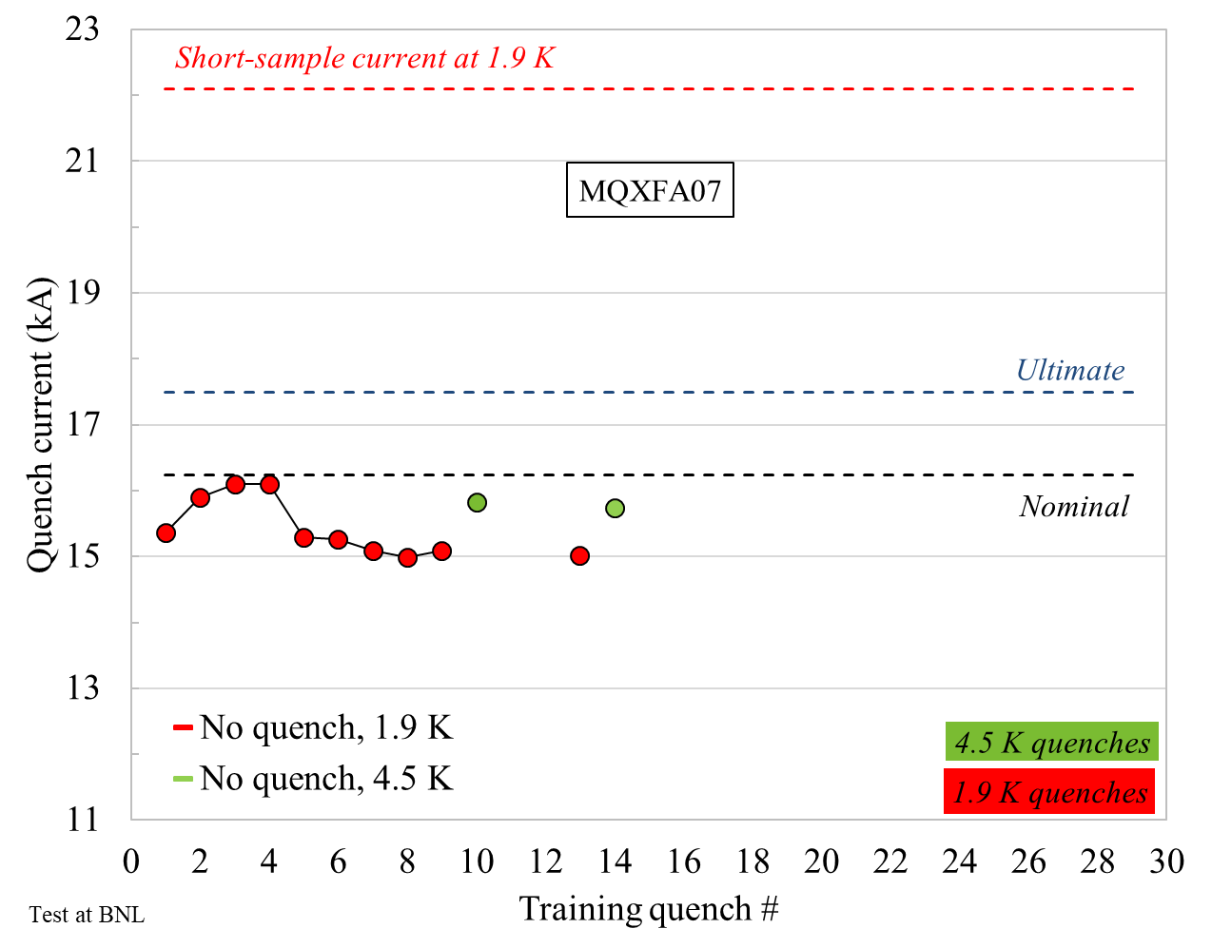
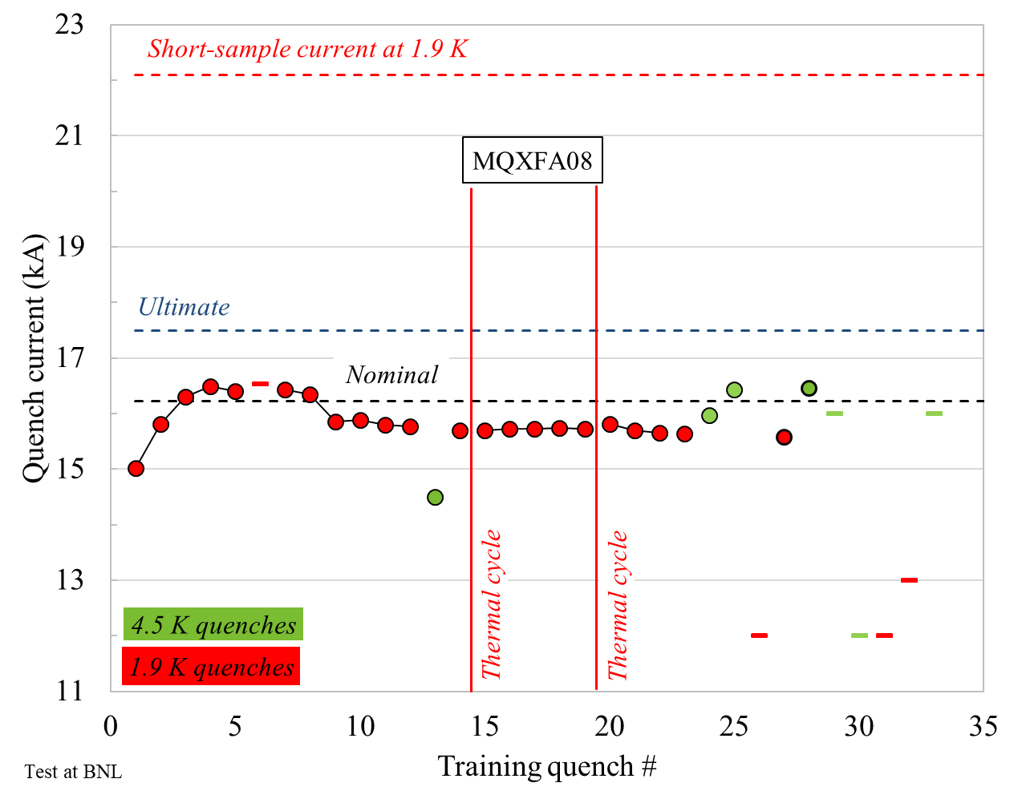
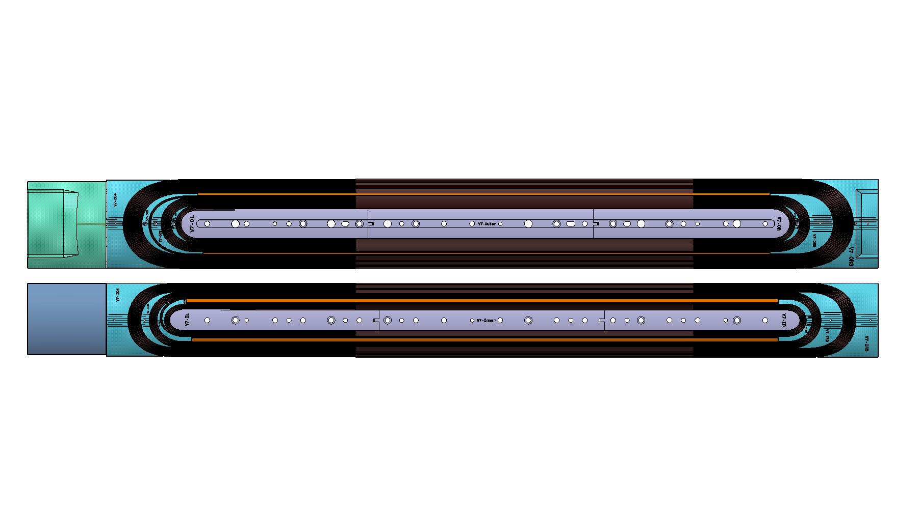
A07 and A08 test results
Both magnets with detraining after few quenches
Both magnets limited by one coil in same segment a3-a4
  Based on quench antenna signals: LE, where pole block turns go around the pole tip
LE
RE

Slide 6
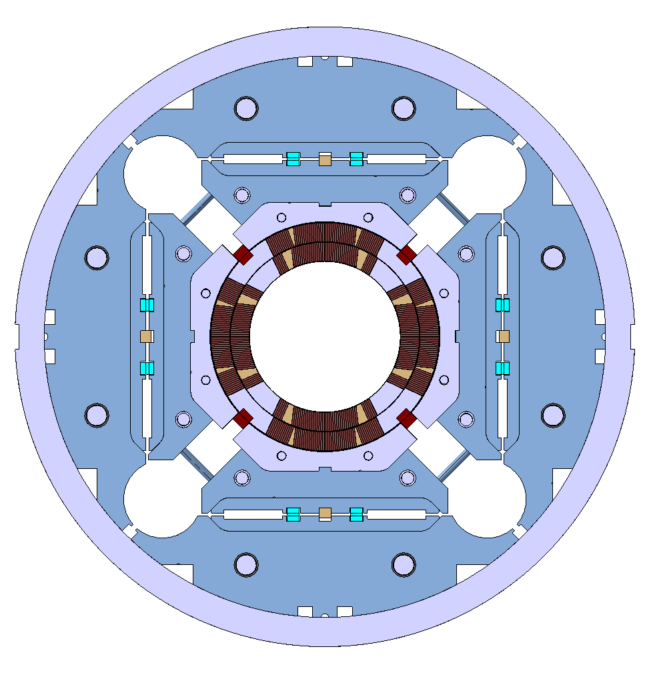
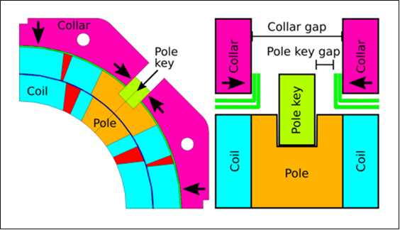
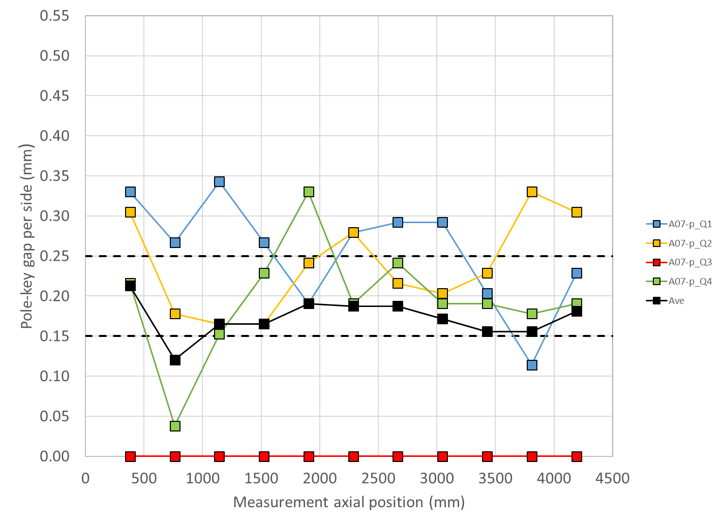
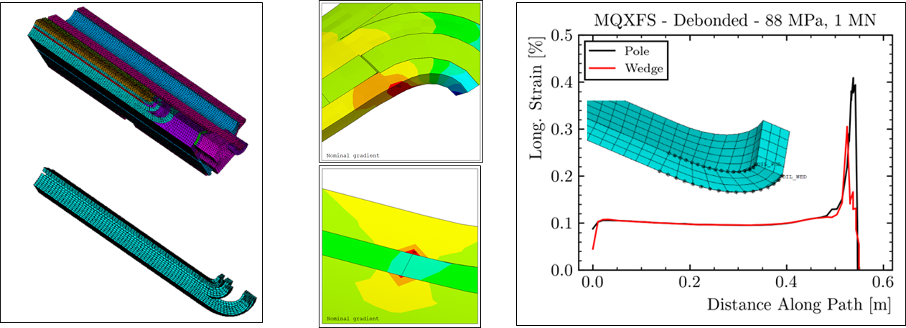
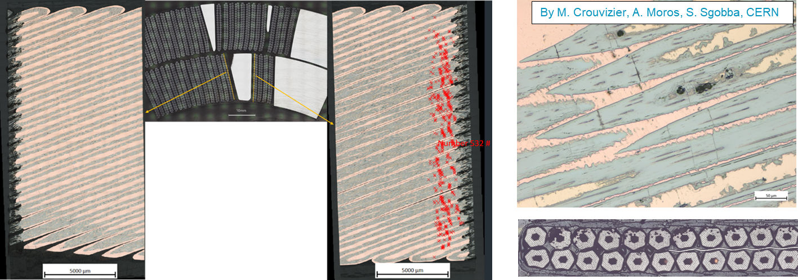
A07 and A08 investigation / analysis
Assembly data inspection: pole key locked in limiting quadrant
FE analysis: lack of azimuthal pre-stress → high strain in the LE
Metallurgical inspection: cracks close to wedge – end-spacer

Slide 7
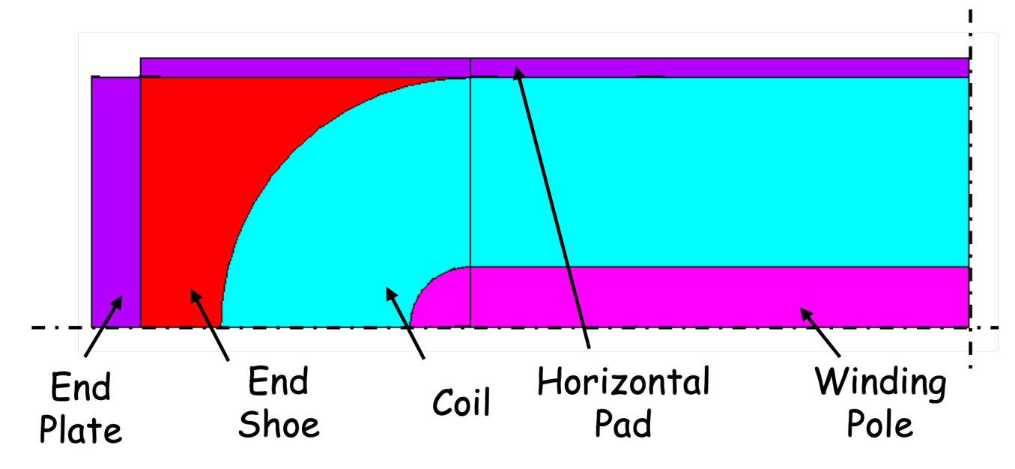
Longitudinal vs “lateral” pre-load
Simplified model:
  Racetrack coil with e.m. axial + lateral forces + axial + lateral pre-load
  Output: pole turn axial strain

Slide 8
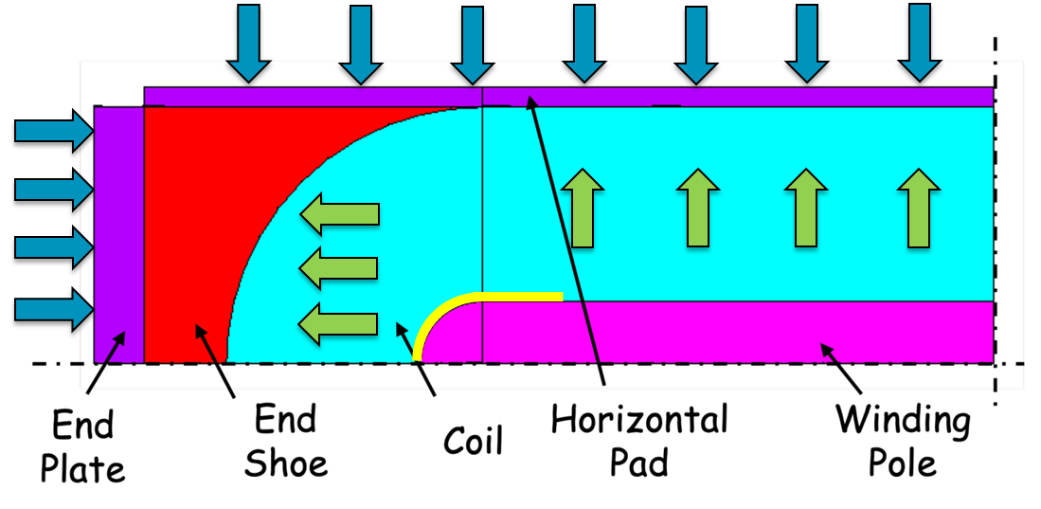
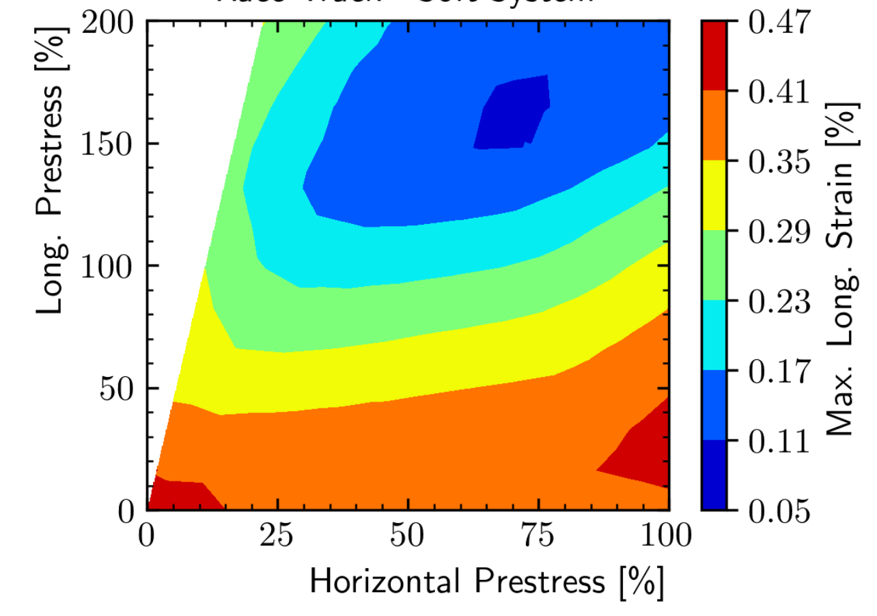
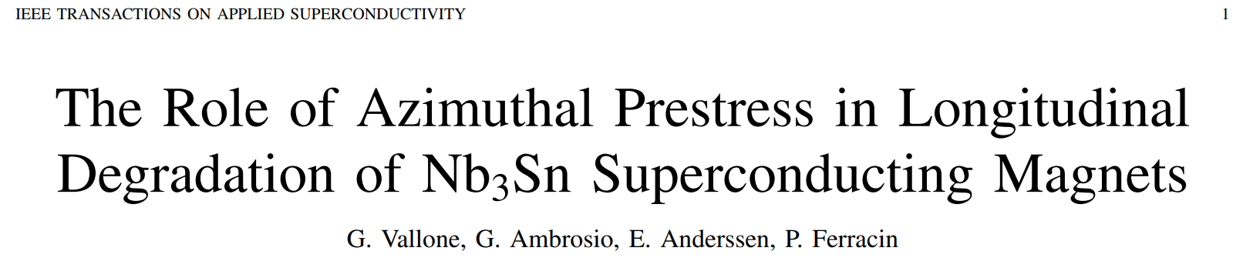
Longitudinal vs “lateral” pre-load
Low (blue area) axial strain with high pre-load both azimuthally and axially
Axial pre-load cannot minimize the axial strain without the “help” of azimuthal pre-load
…and vice versa

Slide 9
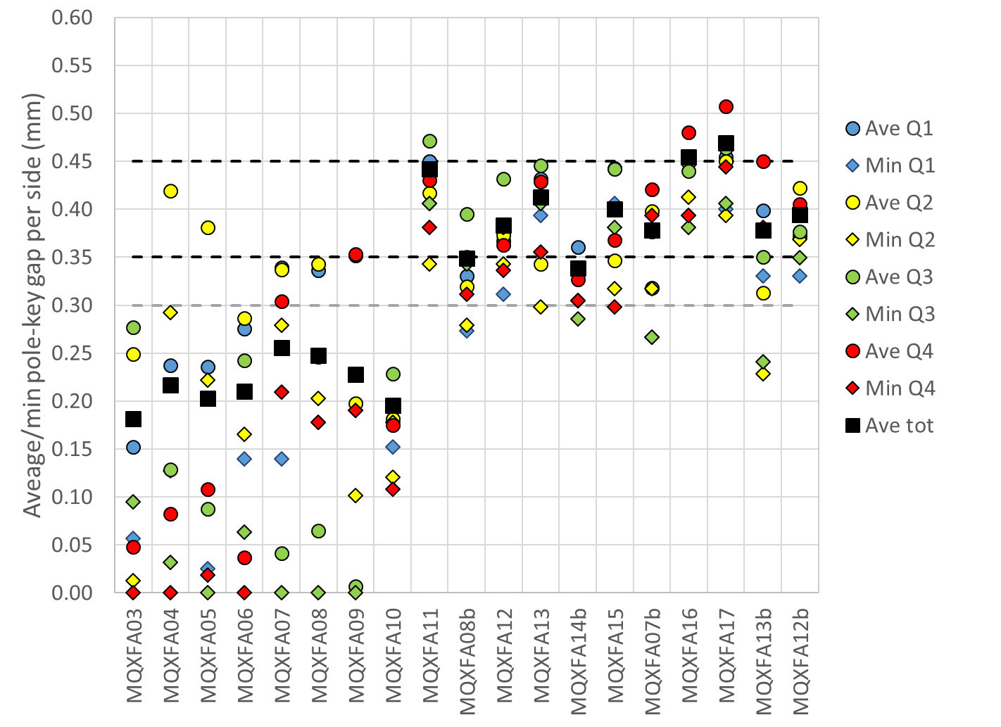
Corrective strategy post A07 and A08
New pole key gap spec defined → larger gap

Slide 10
MQXFA series magnet timeline and test status
After A07, A08, three magnet within specs
 |  | T0: aperture and cable selection
 |  |  |  |  |  |  |  |  |  |  |  |  |  |  |  | A03
 |  |  |  |  |  |  |  |  |  |  |  |  |  |  |  |  |  |  | A04
 |  |  |  |  |  |  |  |  |  |  |  |  |  |  |  |  |  |  |  |  | A05
 |  |  |  |  |  |  |  |  |  |  |  |  |  |  |  |  |  |  |  |  |  | A06
 |  |  |  |  |  |  |  |  |  |  |  |  |  |  |  |  |  |  |  |  |  |  | A07 (pole key)
 |  |  |  |  |  |  |  |  |  |  |  |  |  |  |  |  |  |  |  |  |  |  |  | A08 (pole key)
 |  |  |  |  |  |  |  |  |  |  |  |  |  |  |  |  |  |  |  |  |  |  |  |  |  | A10
 |  |  |  |  |  |  |  |  |  |  |  |  |  |  |  |  |  |  |  |  |  |  |  |  |  |  | A11
 |  |  |  |  |  |  |  |  |  |  |  |  |  |  |  |  |  |  |  |  |  |  |  |  |  |  |  |  | A8b
 |  |  |  |  |  |  |  |  |  |  |  |  |  |  |  |  |  |  |  |  |  |  |  |  |  |  |  |  |  | A13 (coil ends size)
 |  |  |  |  |  |  |  |  |  |  |  |  |  |  |  |  |  |  |  |  |  |  |  |  |  |  |  |  |  |  | A14b
 |  |  |  |  |  |  |  |  |  |  |  |  |  |  |  |  |  |  |  |  |  |  |  |  |  |  |  |  |  |  |  | A07b
 |  |  |  |  |  |  |  |  |  |  |  |  |  |  |  |  |  |  |  |  |  |  |  |  |  |  |  |  |  |  |  |  | A15
 |  |  |  |  |  |  |  |  |  |  |  |  |  |  |  |  |  |  |  |  |  |  |  |  |  |  |  |  |  |  |  |  |  | A17 (coil ends size)
 |  |  |  |  |  |  |  |  |  |  |  |  |  |  |  |  |  |  |  |  |  |  |  |  |  |  |  |  |  |  |  |  |  |  | A13b
2013 |  |  |  | … | 2017 |  |  |  | 2018 |  |  |  | 2019 |  |  |  | 2020 |  |  |  | 2021 |  |  |  | 2022 |  |  |  | 2023 |  |  |  | 2024 |  |  |  | 2025
Not within specifications
Within specifications

Slide 11
Outline
Quick recall of “pole key issue” in A07-A08
  Longitudinal vs lateral pre-load
The A13-A17 case
Update of assembly - loading specs
Conclusion

Slide 12
MQXFA series magnet timeline and test status
Two additional magnets, A13 and A17, did not meet specs
 |  | T0: aperture and cable selection
 |  |  |  |  |  |  |  |  |  |  |  |  |  |  |  | A03
 |  |  |  |  |  |  |  |  |  |  |  |  |  |  |  |  |  |  | A04
 |  |  |  |  |  |  |  |  |  |  |  |  |  |  |  |  |  |  |  |  | A05
 |  |  |  |  |  |  |  |  |  |  |  |  |  |  |  |  |  |  |  |  |  | A06
 |  |  |  |  |  |  |  |  |  |  |  |  |  |  |  |  |  |  |  |  |  |  | A07 (pole key)
 |  |  |  |  |  |  |  |  |  |  |  |  |  |  |  |  |  |  |  |  |  |  |  | A08 (pole key)
 |  |  |  |  |  |  |  |  |  |  |  |  |  |  |  |  |  |  |  |  |  |  |  |  |  | A10
 |  |  |  |  |  |  |  |  |  |  |  |  |  |  |  |  |  |  |  |  |  |  |  |  |  |  | A11
 |  |  |  |  |  |  |  |  |  |  |  |  |  |  |  |  |  |  |  |  |  |  |  |  |  |  |  |  | A8b
 |  |  |  |  |  |  |  |  |  |  |  |  |  |  |  |  |  |  |  |  |  |  |  |  |  |  |  |  |  | A13 (coil ends size)
 |  |  |  |  |  |  |  |  |  |  |  |  |  |  |  |  |  |  |  |  |  |  |  |  |  |  |  |  |  |  | A14b
 |  |  |  |  |  |  |  |  |  |  |  |  |  |  |  |  |  |  |  |  |  |  |  |  |  |  |  |  |  |  |  | A07b
 |  |  |  |  |  |  |  |  |  |  |  |  |  |  |  |  |  |  |  |  |  |  |  |  |  |  |  |  |  |  |  |  | A15
 |  |  |  |  |  |  |  |  |  |  |  |  |  |  |  |  |  |  |  |  |  |  |  |  |  |  |  |  |  |  |  |  |  | A17 (coil ends size)
 |  |  |  |  |  |  |  |  |  |  |  |  |  |  |  |  |  |  |  |  |  |  |  |  |  |  |  |  |  |  |  |  |  |  | A13b
2013 |  |  |  | … | 2017 |  |  |  | 2018 |  |  |  | 2019 |  |  |  | 2020 |  |  |  | 2021 |  |  |  | 2022 |  |  |  | 2023 |  |  |  | 2024 |  |  |  | 2025
Not within specifications
Within specifications

Slide 13
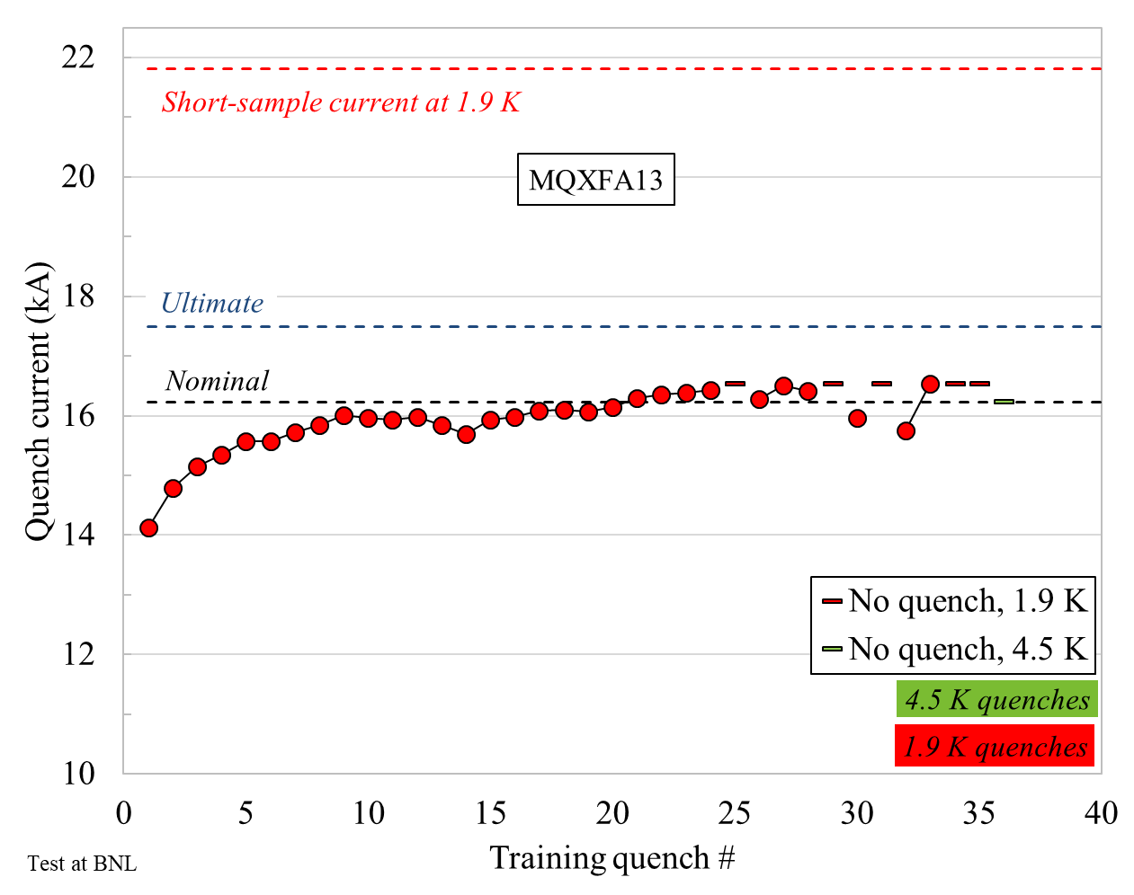
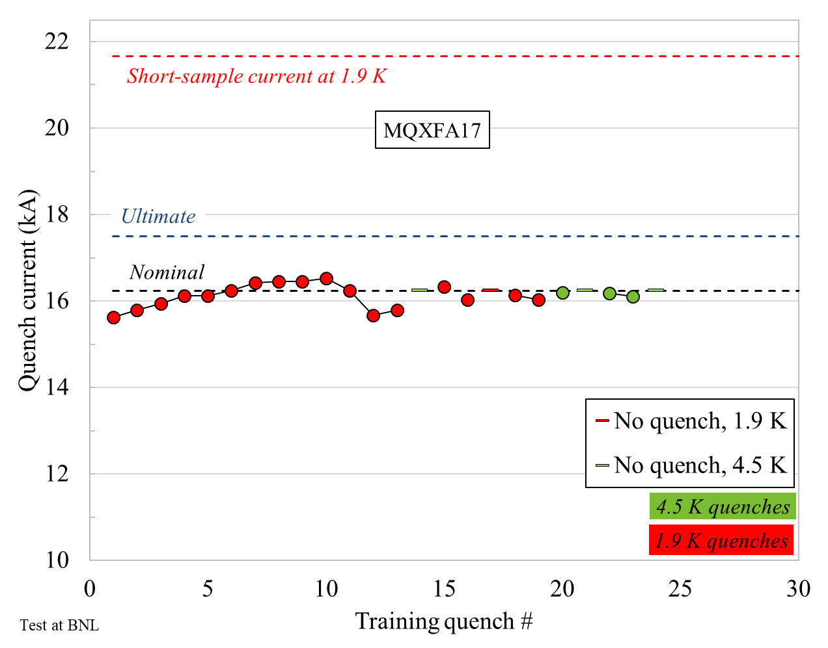
A13 and A17 test results
Both magnets with detraining
  Although, not as much as in A07-A08
Both magnets limited by the LE in the usual longitudinal location
  Cracks observed in coil 227 (A13), although not as many as in A07-A08
LE
RE

Slide 14
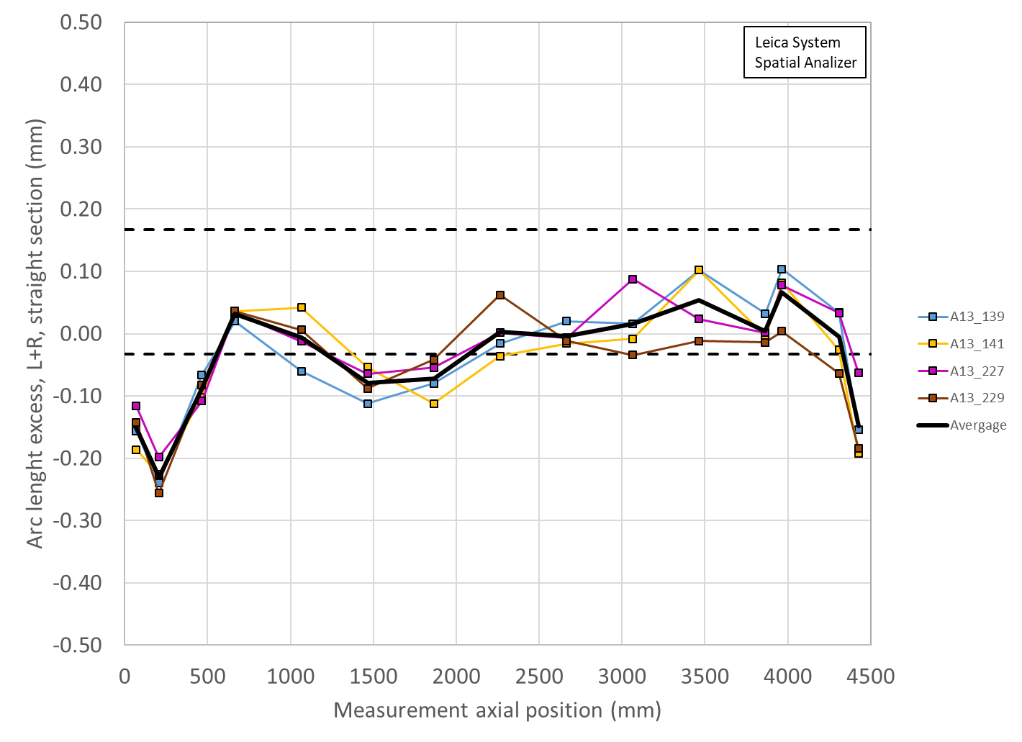
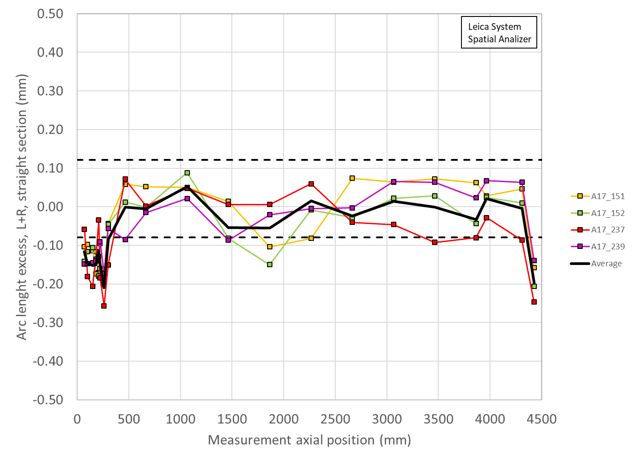
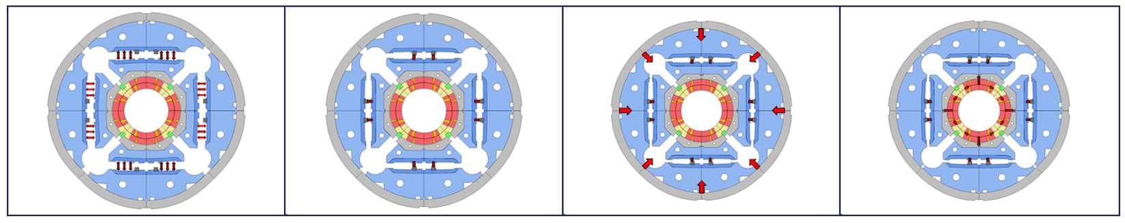
A13 and A17 investigation / analysis
Focus of the investigation: smaller coil size in the ends
  Observed in most of the coils
Azimuthal pre-load depends on loading key size + coil size → low azimuthal pre-load in the ends → low end support

Slide 15
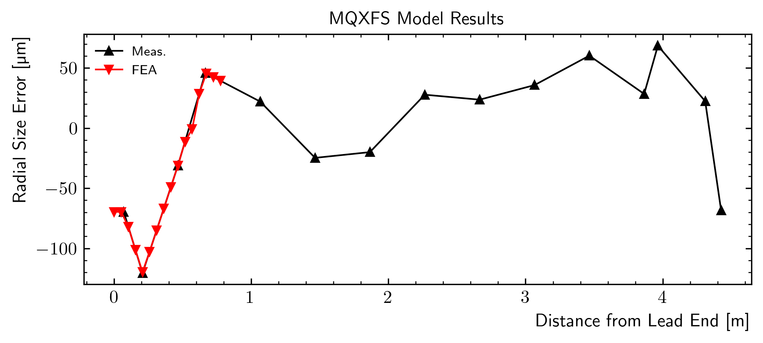
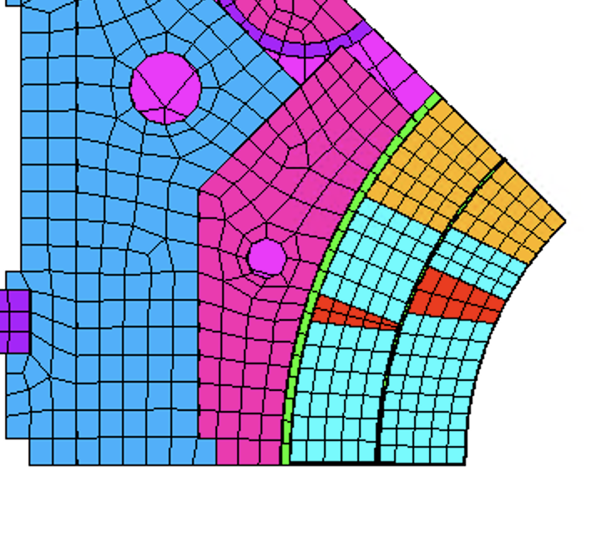
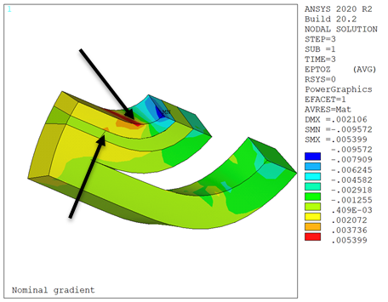
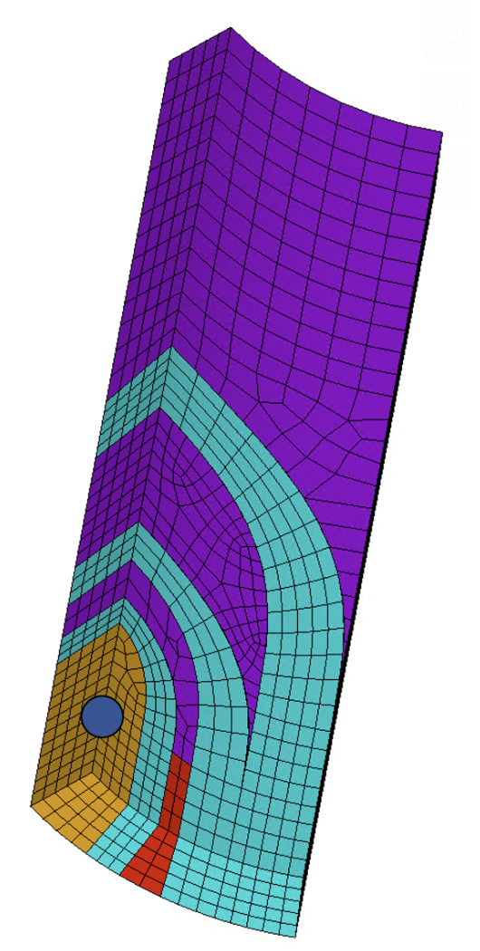
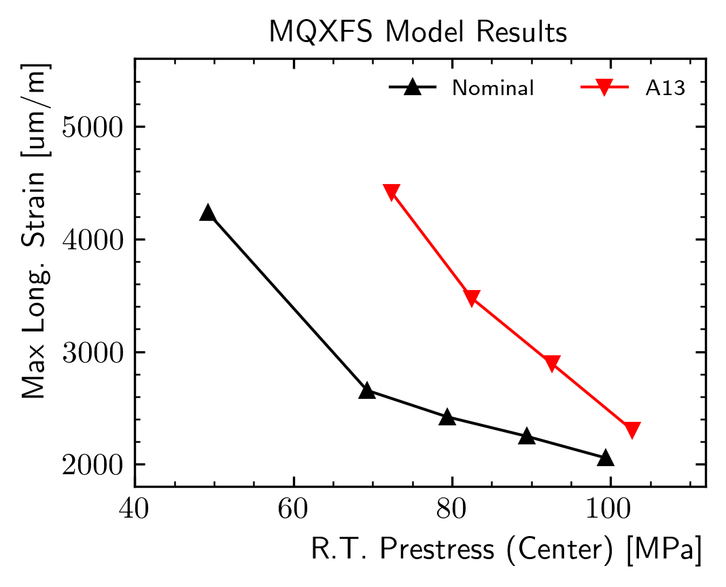
A13 and A17 investigation / analysis
FE analysis of the A13 case: real coil size implemented
For the same pre-stress in the straight section
  A smaller coil in the ends causes high strain in the end
Possible solutions
  1) Increase the pre-stress everywhere (“brute force”)
  2) Increase the pre-stress only where is needed (LE)
  3) all of the above

Slide 16
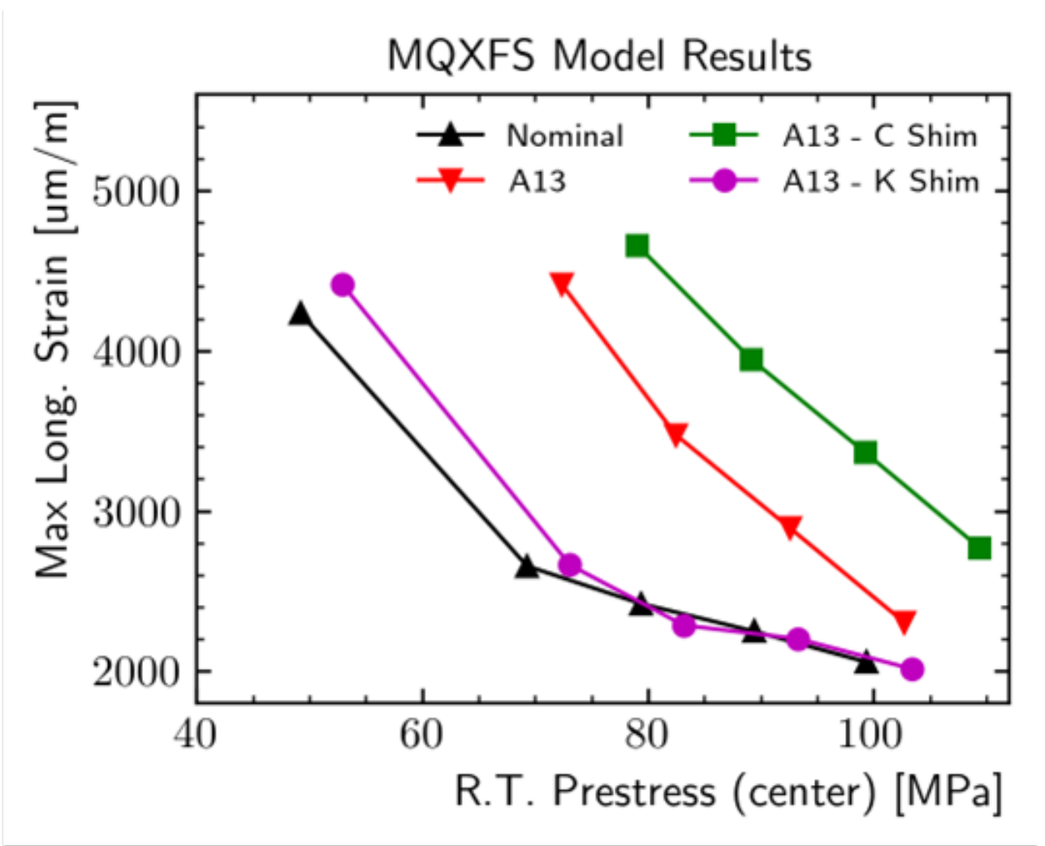
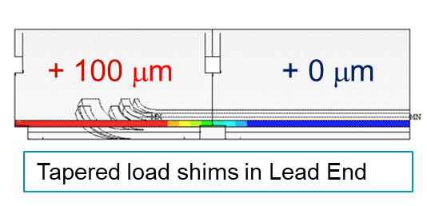
Corrective strategy post A13 and A17
Target an higher overall pre-load
  Same loading key size as best performing magnets (A14b and A05)
    Loading key of 13.80-13.85 mm
Insertion of tapered load shim (TLS)
  100 mm tapered after the critical zone

Slide 17
Outline
Quick recall of “pole key issue” in A07-A08
  Longitudinal vs lateral pre-load
The A13-A17 case
Update of assembly - loading specs
Conclusion

Slide 18
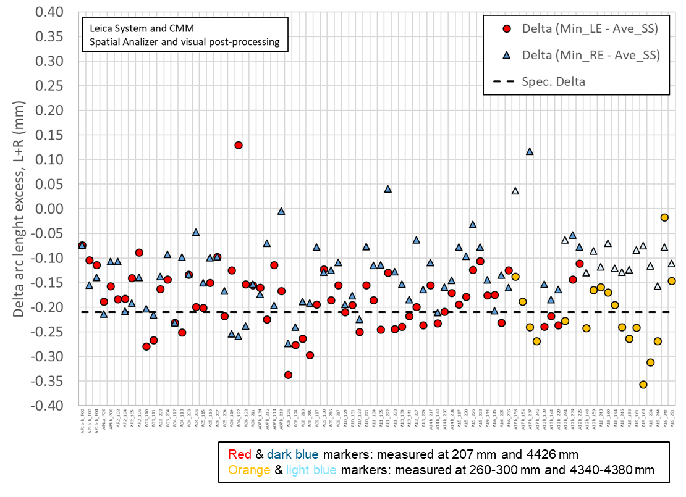
1: Coil selection
We measure and monitor coil size in the ends, in particular
  Δ (arc-length_{straight section} - arc-length_{LE})
We try to select coils without excessive Δ
  We will do FE analysis for using these coils with larger TLS

Slide 19
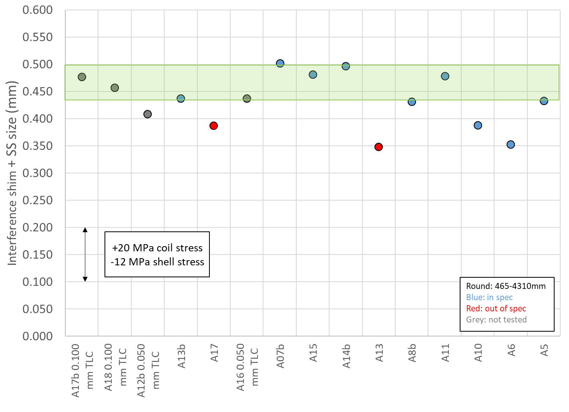
2: Overall pre-load
We increased the target coil pre-load (measured with strain gauges)
  from 80±8 MPa → 90±10 MPa
At the same time we target a loading shim size similar to A05 and A14b
  18.0-18.5 mm load key thickness
So pre-load not only based on strain gauges but also on loading key and coil sizes

Slide 20
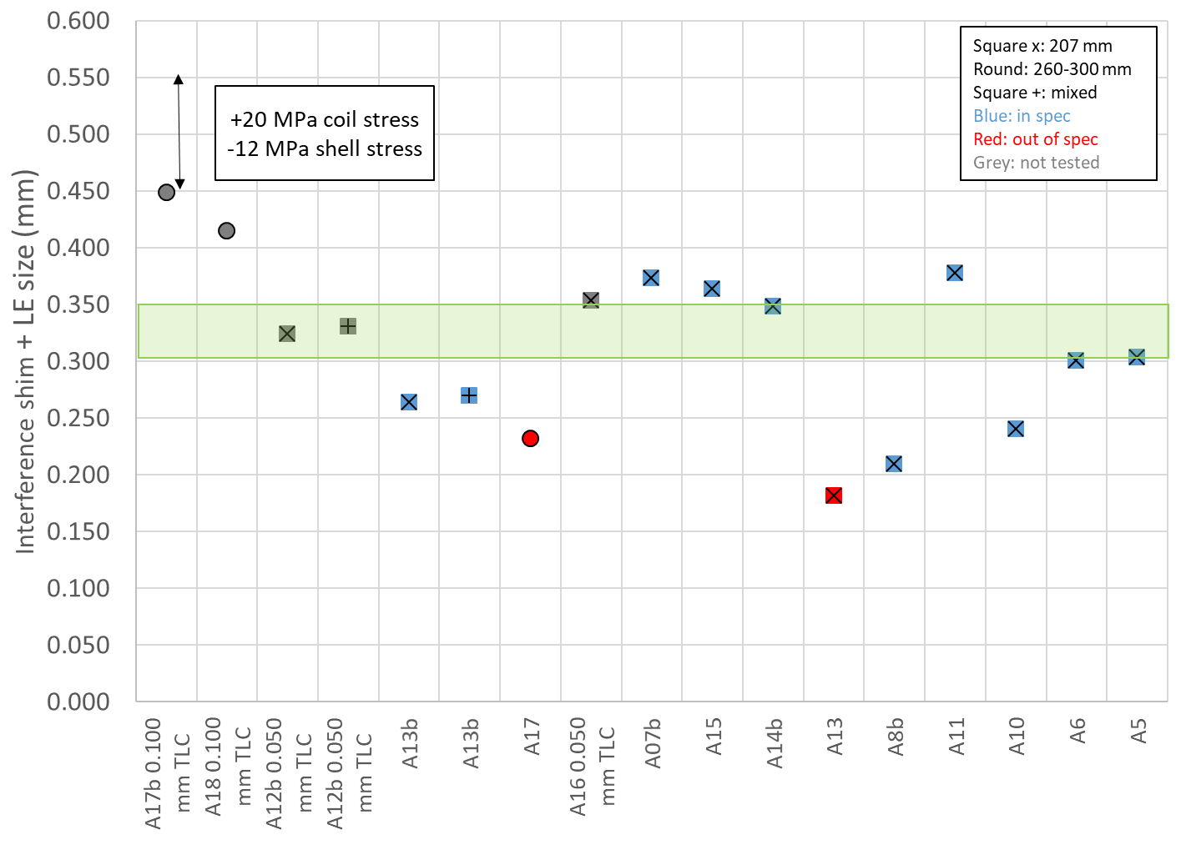
3: Pre-load of the LE
If average Δ(arc-length_{straight section} - arc-length_{LE}) is more than 0.150 mm (basically always)
  Insertion of 0.100 mm thick Tapered Load Shims (TLS) in the LE
  After checking with FE and real coil geometry that stress of coil and structure are within limits (see next slide)

Slide 21
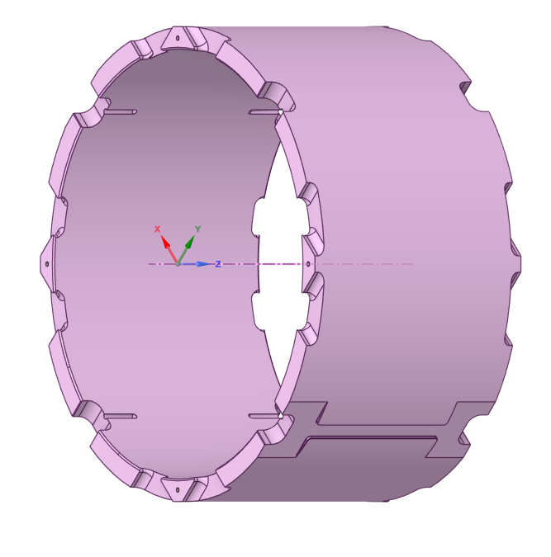
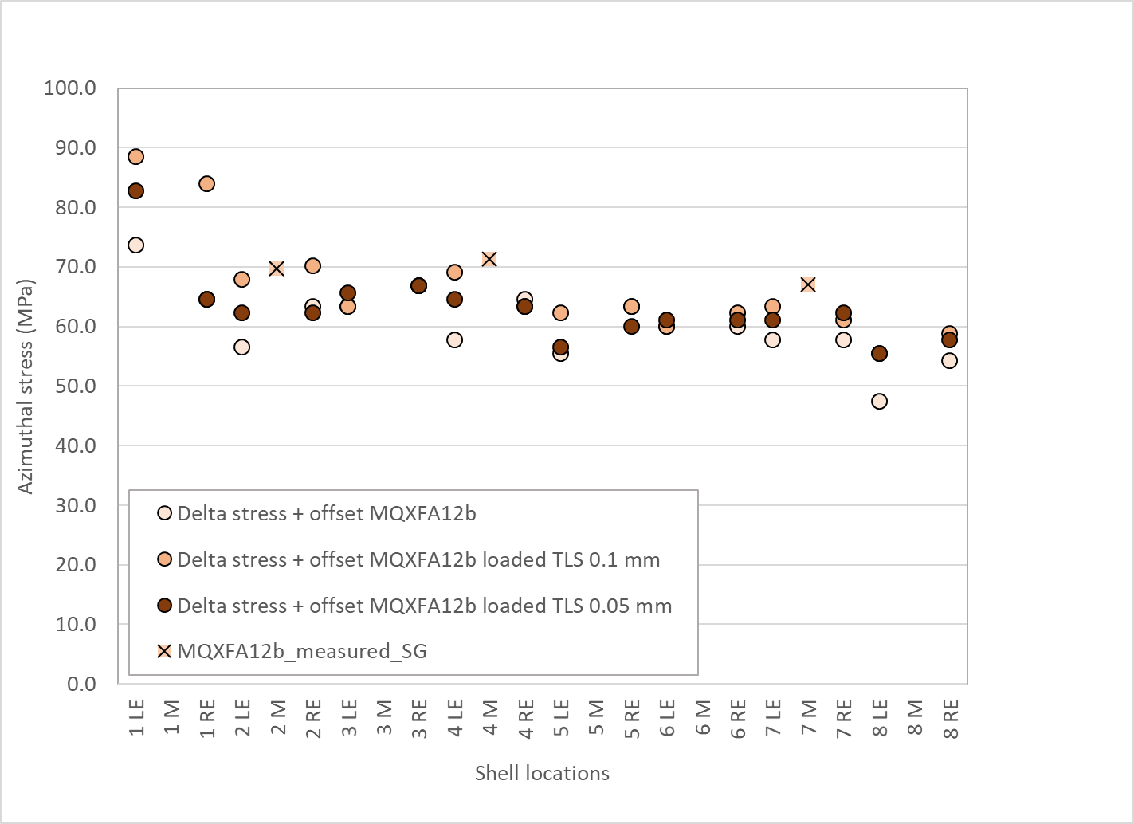
4: Stress limits
Measured stress limit in coil
  from ≤110 MPa → ≤ 120 MPa → ≤ 135 MPa
    Following the results from short model MQXFS07
Measured stress limit in shell 1 (TLS location): <80 MPa
  Very effective: use of shell OD variation (PI tape) to determine shell stress

Slide 22
Outline
Quick recall of “pole key issue” in A07-A08
  Longitudinal vs lateral pre-load
The A13-A17 case
Update of assembly - loading specs
Conclusions

Slide 23
Conclusions
So far 11 magnet met performance spec. and 4 magnets (A07-A08 and A13-A17) showed performance limitation
Investigation of possible design/fabrication/assembly weaknesses on going
Assembly-loading focus: uniform and sufficient azimuthal pre-load of the coil, including the ends
  Essential, together with the axial pre-load, to minimize strain in the ends
Two main issues identified: pole-key gap size, and coil size in the ends
Corrective strategies
  Increase of pole-key gap size
  Increase of overall pre-load levels, and use of additional tapered shims to compensate for coil size variations
Implemented in A18, A12b, and A16
  Test results coming soon…..

Slide 24
Appendix

Slide 25
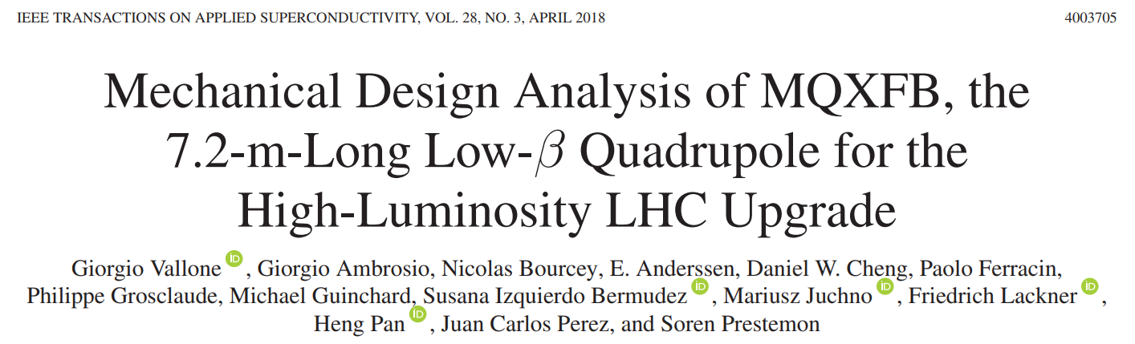
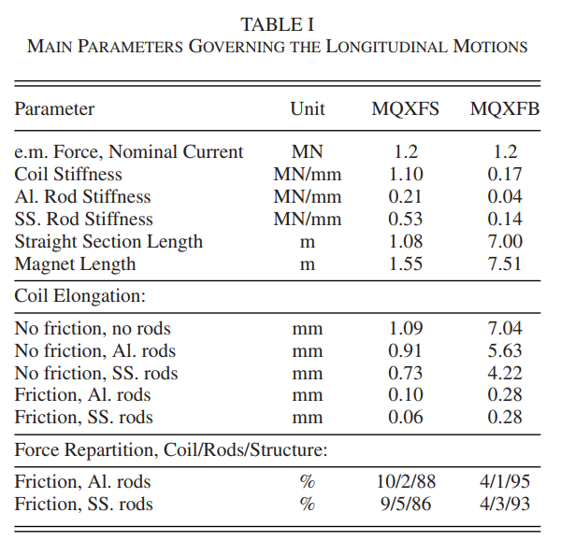
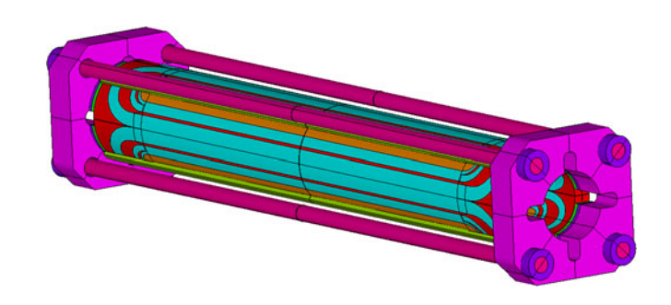
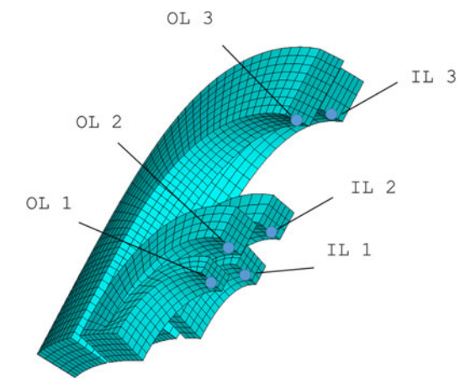
Longitudinal vs “lateral” pre-load
Impact (importance) of azimuthal pre-load on axial elongation of the coil
  Extensively studied in 3D with FE models

Slide 26
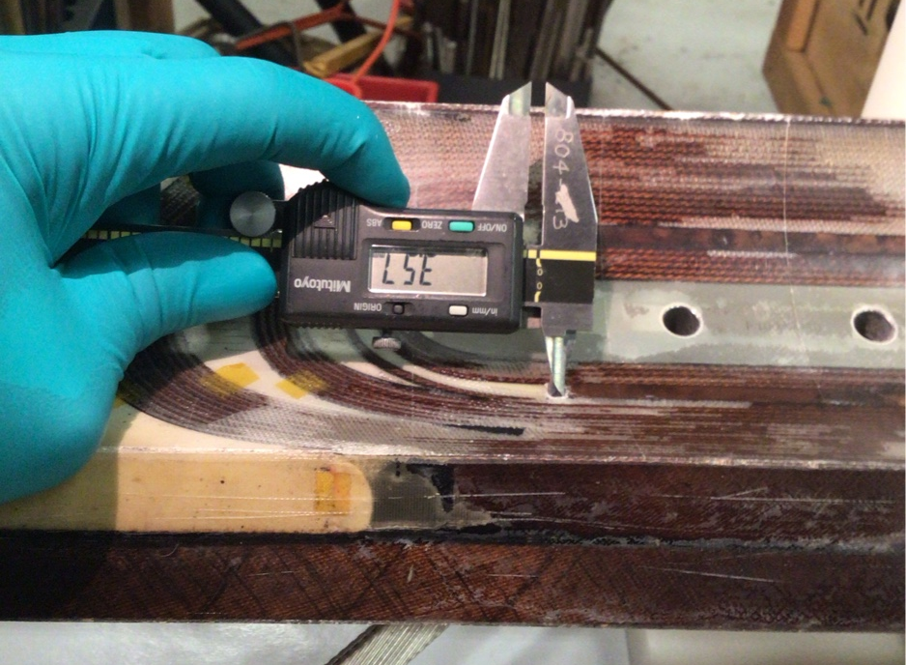
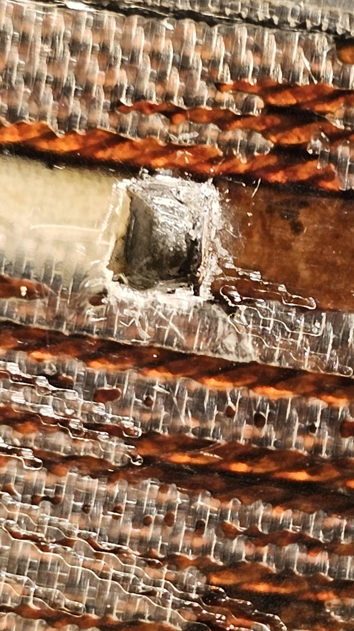
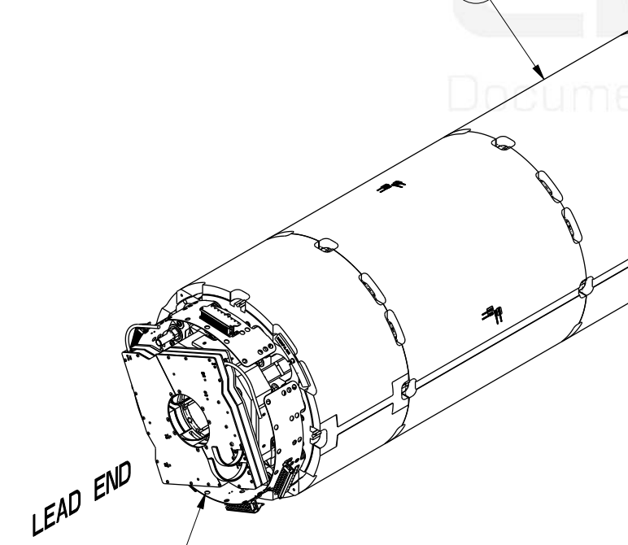
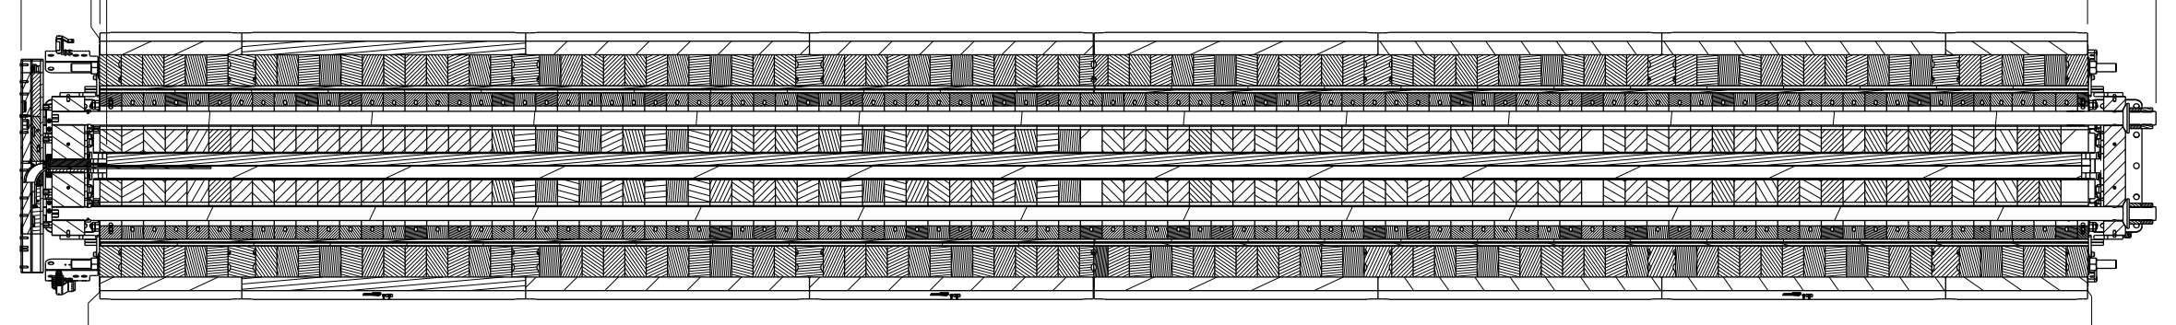
MQXFA “disease”: coil issue vs. pre-load issue
All the out-of-spec magnets limited by lead ends of 200 series coils
Investigation of possible “weaknesses”
Design
  Large gaps wedge to end spacer
    to accommodate Al-Br wedge expansion during HT
      Unlike Ti pole wedge, they remain open, and filled with fiber glass
  End shoe extension → less effective axial loading
  Different end-spacers geometry in LE vs RE
  Al shell segmentation aligned with wedge to end spacer transition → lower pre-load
Coil fabrication
  Differences/variation in wedge to end-spacer bonding strength (under investigation)
    Different impregnation process: vertical vs. tilted
  Difference in wedge to end-spacer gaps (under investigation)
  Coil size in the ends (being addressed with tapered shim)
Assembly
  Pole keys (addressed with new spec)
LE
RE

Slide 27
Corrective strategy post MQXFA13 and A17
Important caveat
  The “green zone” of loading shim + TLS is based on magnet which had an excellent training performance
  Not all the magnets below the green zone where out of spec → only A17, A13
  So, not a clear correlation but rather setting a minimum pre-load level below which we face a “risky” zone

Slide 28
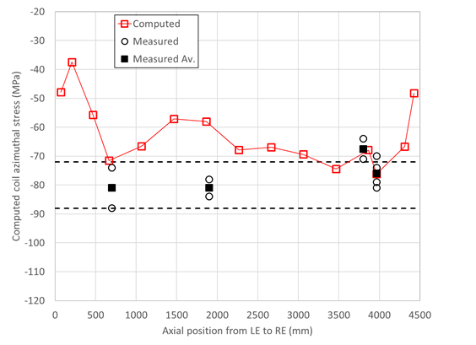
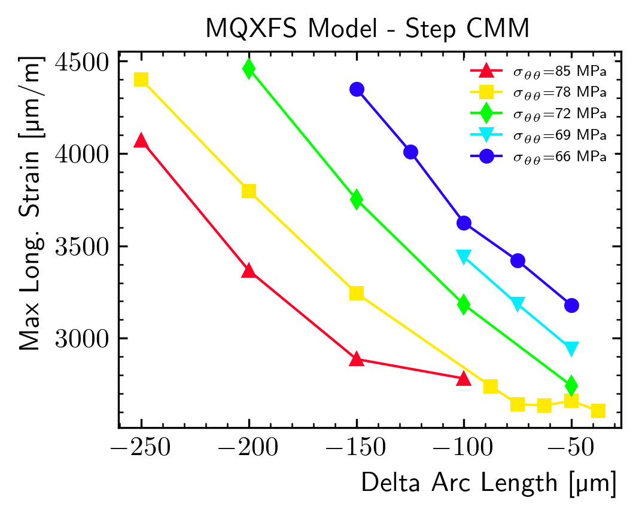
Critical / Safe Strain (for this kind of simulations)
Assuming MQXFA13 had 67 MPa average preload at RT in the straight section
  Based on coil CMM, 4 SGs, 3 FBGs
  Consistent with small key size: 13.72 mm
MQXFA13 aver.
Coil 227
MQXFA13 failure strain (for this kind of simulations) was:
~ 4800-5100 microstrain
MQXFA05 had 72 MPa average prestress in SS and 167 um Delta LE-SS:
  4000 microstrain
  (max Delta = 218 um)

Slide 29
Threshold Delta Arc Length
Assuming we can always preload magnet with average preload at RT in the straight section > 80 MPa
  Because we are computing min key-size shims for each magnet
The threshold for Critical DR:
Delta Arc-Length is: 210 um
for RT prestress > 80 MPa
80 MPa

Slide 30
Plans for Coils with Critical DR
If Delta arc-length is slightly above 210 um, disposition may be to set minimum magnet preload > 80+ MPa
If Delta arc-length is significantly above 210 um, disposition may be to use shims for loading keys in the ends

Slide 31
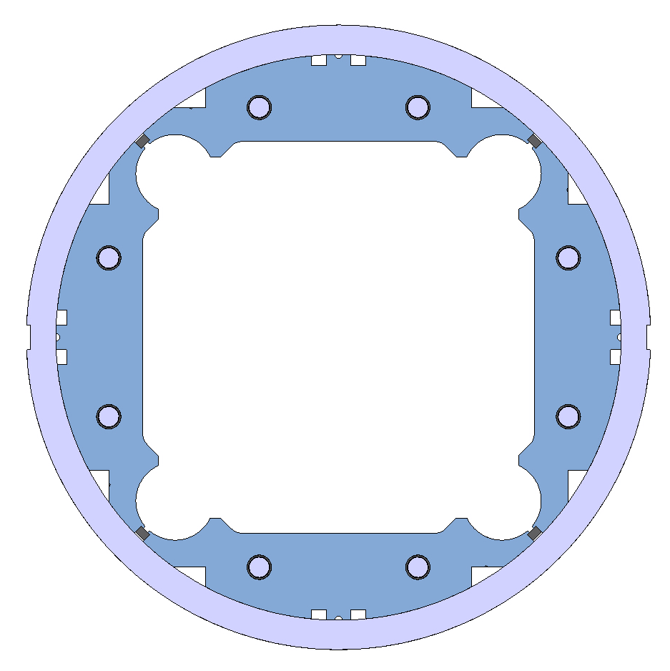
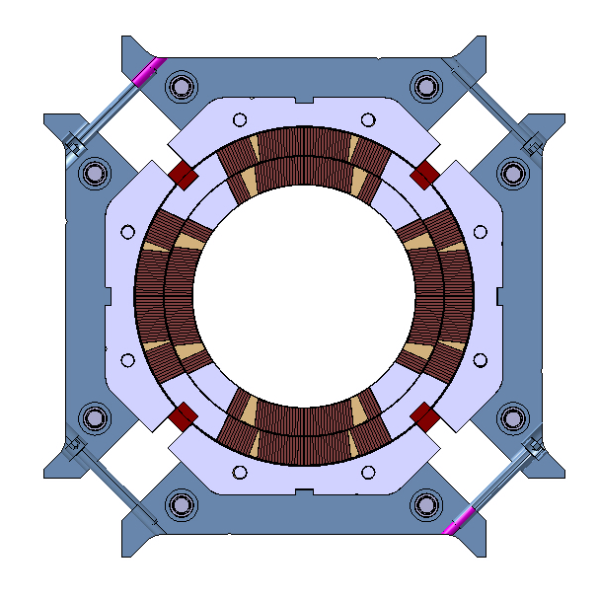
Introduction
List of specifications in “chronological” order
  From shell-yoke to coil-pack to magnet pre-load
Definition based on dimensional, magnetic, electrical, and strain measurements
  Some specs defined by “design and analysis” (example: peak stress)
  Some defined by experience from previous successful magnet (example: coil pack uniformity/squareness)

Slide 32
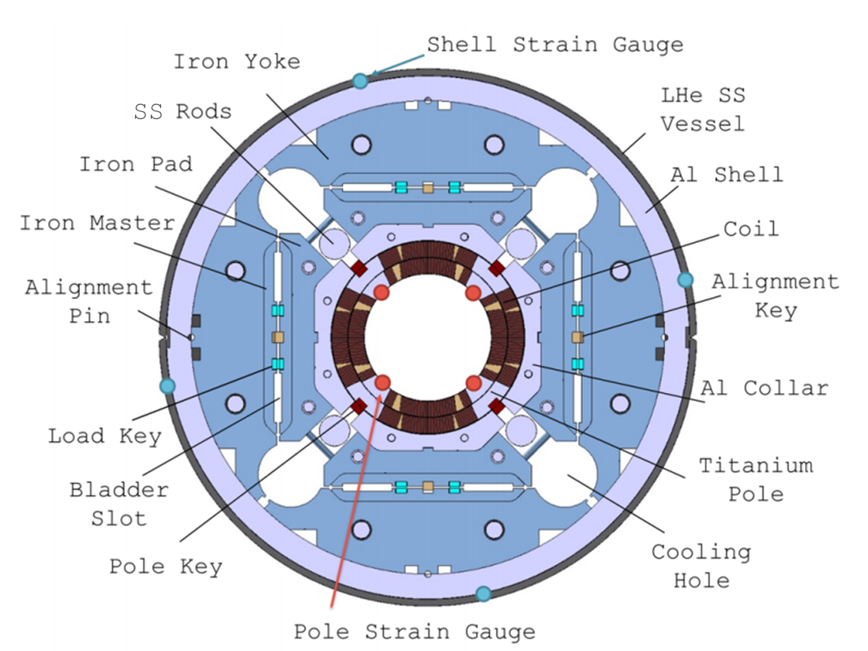
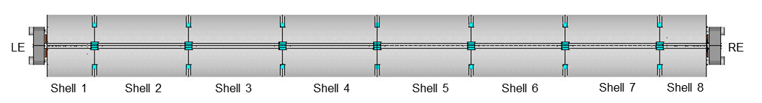
Introduction
On strain measurements….
  Strain gauge locations
    Shell: 3 axial location, 4 quadrants, azimuthal and axial
      Shell 2, shell 4, shell, 7
    Coil: 1 axial location, 4 coils (pole), azimuthal and axial
      Center of shell 7
    Axial rods: 1 axial location, 4 rods, axial
Shell gauges
Shell gauges
Shell and coil gauges

Slide 33
