Slide 1
Main Injector Shutdown Status
Denton Morris, Marty Murphy
AD/MI 0900 Meeting
September 27, 2024

Slide 2
Tunnel Work
MI-8 Collimator installation
All parts in on site
Jaws are at NWA being inspected and prepped for welding
Tunnel cable termination has started
RF Dual PA cavity upgrades (3 stations)
Electrical pulls are complete
Upgrading four modulators (one spare)
NOTE: Unable to test any RF until KRS pulsed power
and LCW returns. Then need ~3 weeks for testing
Adjusted MI-40 absorber room door
Chasing down compressed air leaks
Repairing ion pump cables
ISD will be installing test lighting in MI-8 and will be re-lamping
emergency exit, stairwells and tunnel location around MI
2
MI Department Meeting | D. Morris
10/2/2024

Slide 3
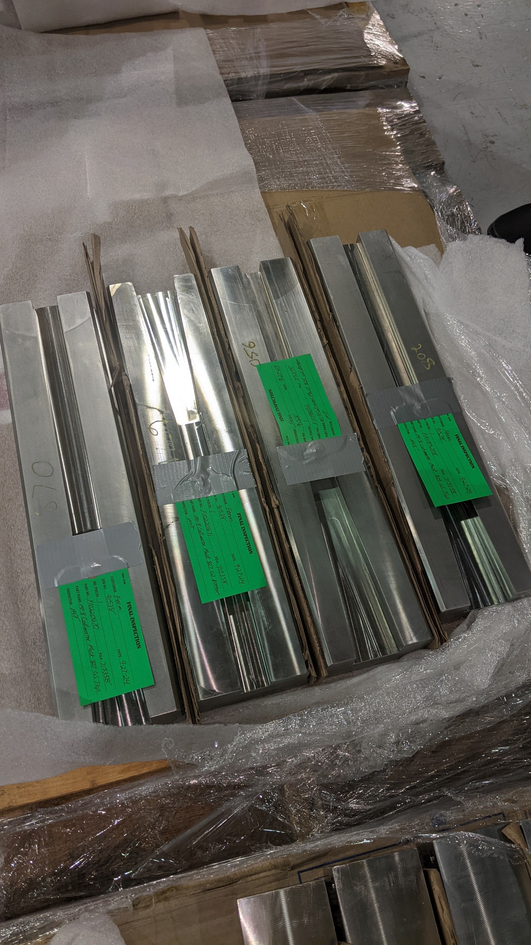
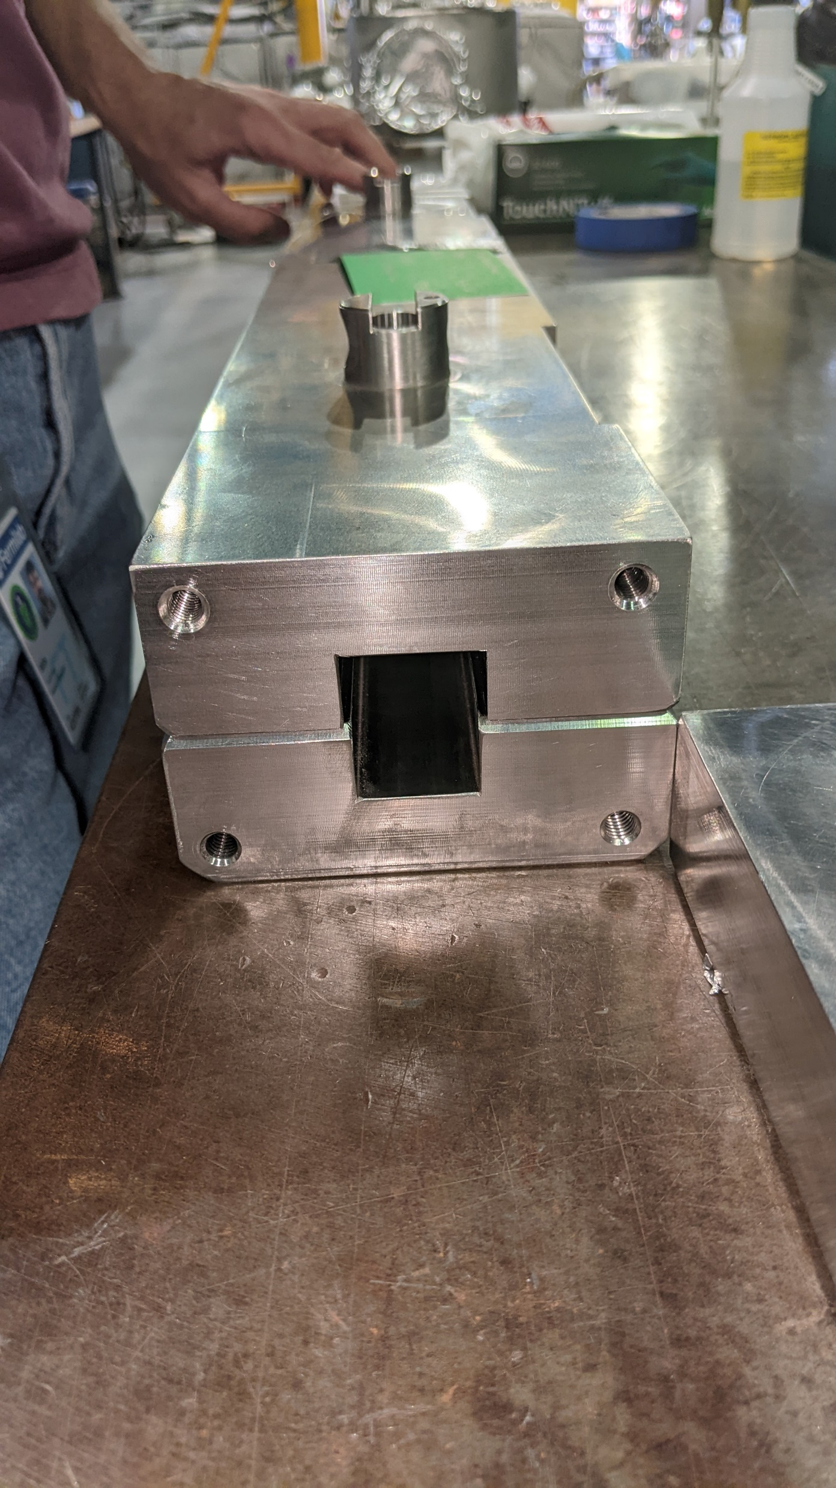
Tunnel Work
3
MI Department Meeting | D. Morris
10/2/2024

Slide 4
Tunnel Work
Still needing to be done:
332 dipole leak repair
Adjust aperture at 232
Move MI quads based on previous high field orbit
4
MI Department Meeting | D. Morris
10/2/2024

Slide 5
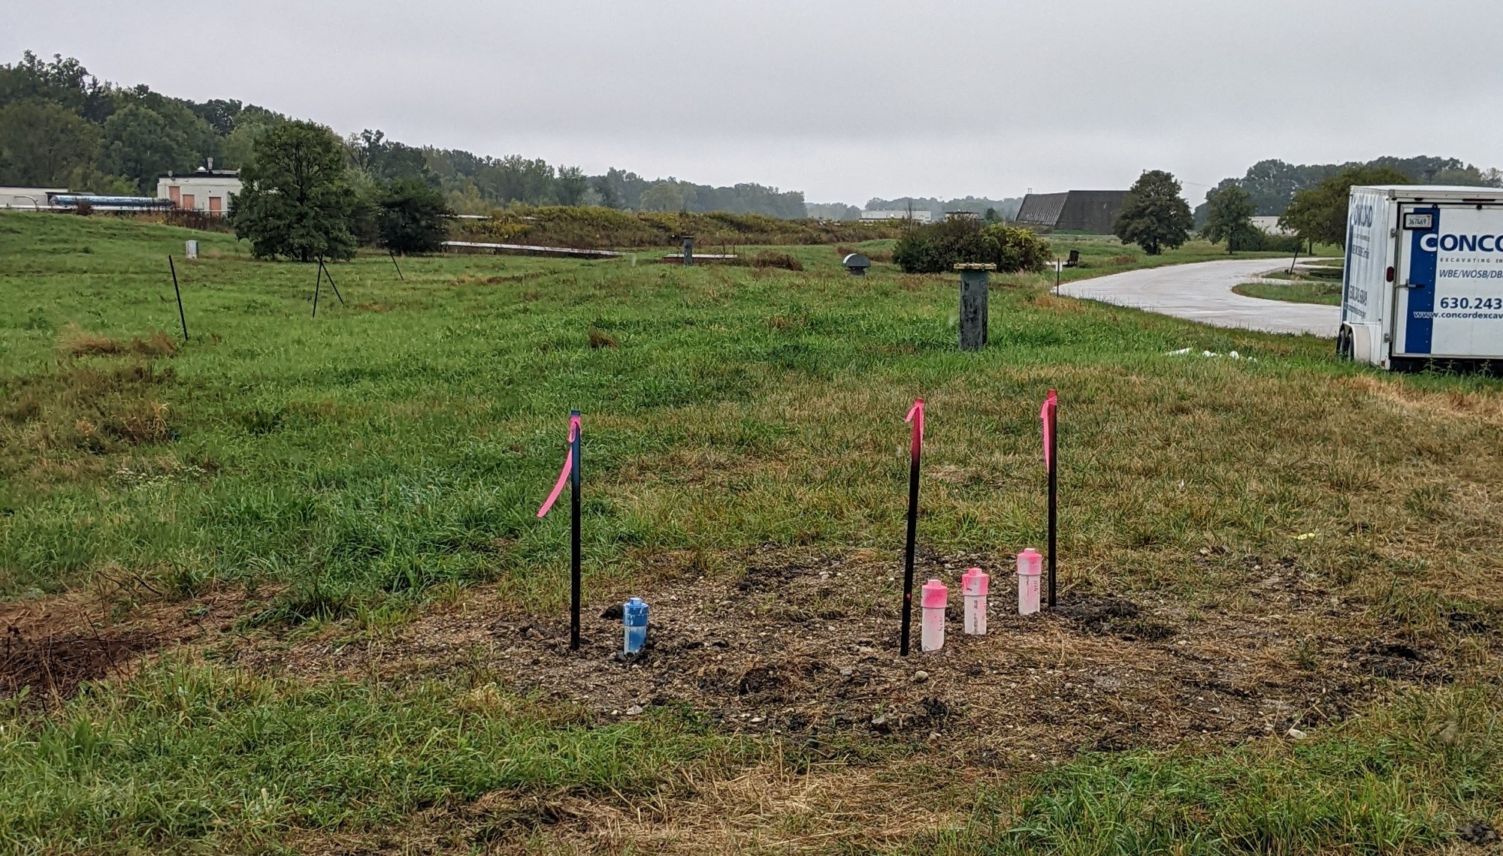
Upstairs Work
Main jobs:
Heat Exchanger cleaning: All heat exchanger cleaning in MI is completed
Investigating pitting and corrosion in end shells
Transformer/Switchgear PMs back to work at MI-8 and MI-10
Started a USI for the MI-8 berm
5
MI Department Meeting | D. Morris
10/2/2024

Slide 6
Conventional and Pulsed MI Power Outages
Please report any additional MI outages to the MCR.
6
MI Department Meeting | D. Morris
10/2/2024

