Slide 1
DAPHNE V3 Update
Jamieson Olsen, Miguelangel Marchan, Tom Deline, Jacques Ntahoturi, Terri Shaw, Dave Christian
3 October 2024

Slide 2
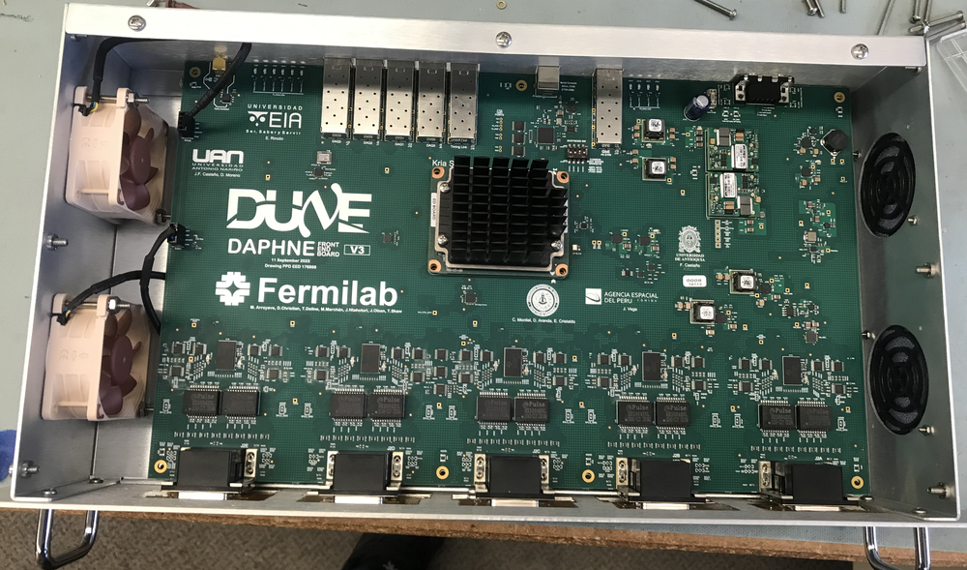

Slide 3
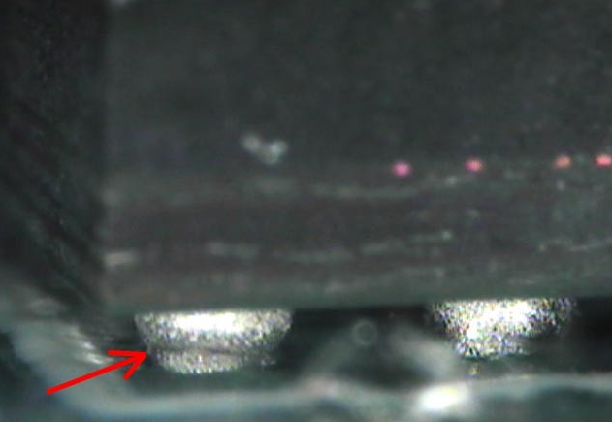
Prototype Run
Late 2023: 10 boards made in one run, no first articles.
Assembly vendor had issues with solder ball reflow
  “head in pillow” opens
The boards sent back for reflow January 2024
  Initially looked good, but found opens later in the data lines between AFE chips and FPGA
A few boards sent to another vendor to remove, clean pads, and replace some AFEs (BGA packages) August 2024
  Some connections were fixed, but we still have boards with open connections
  Bad connections may be on the Kria connector (also BGA)
We suspect bad solder paste/flux and bad temperature profile at assembly vendor is the cause.

Slide 4
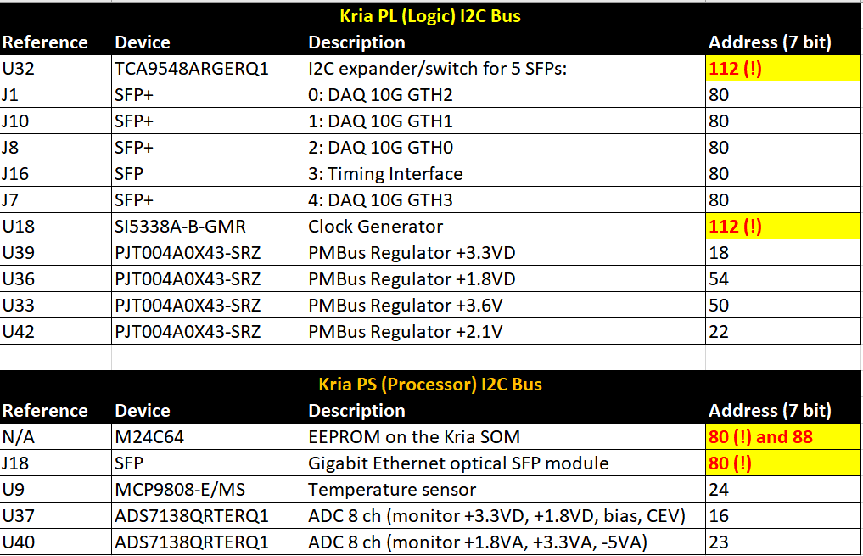
Recent I2C Issues
Two I2C buses on DAPHNE
Address conflicts with devices on both buses
PL (logic side)
  Conflict prevents reliable communication with the Clock Generator
  We need to configure Clock Generator to produce the reference clocks we need to test 10G DAQ link
  Cut traces to remove U32 switch from I2C bus
PS (processor side)
  Conflict prevents communication with EEPROM
  Cut traces to remove SFP switch

Slide 5
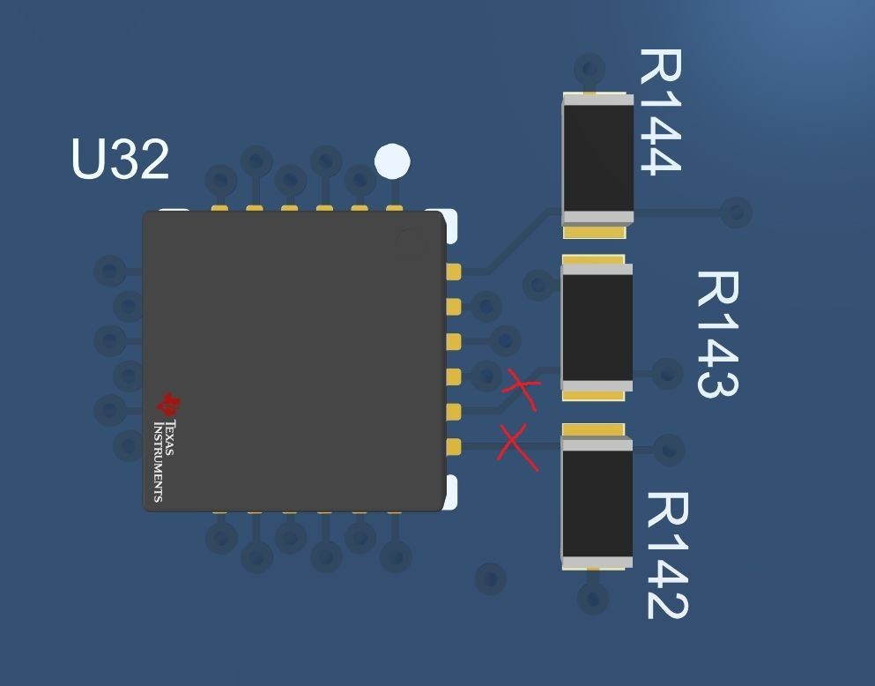
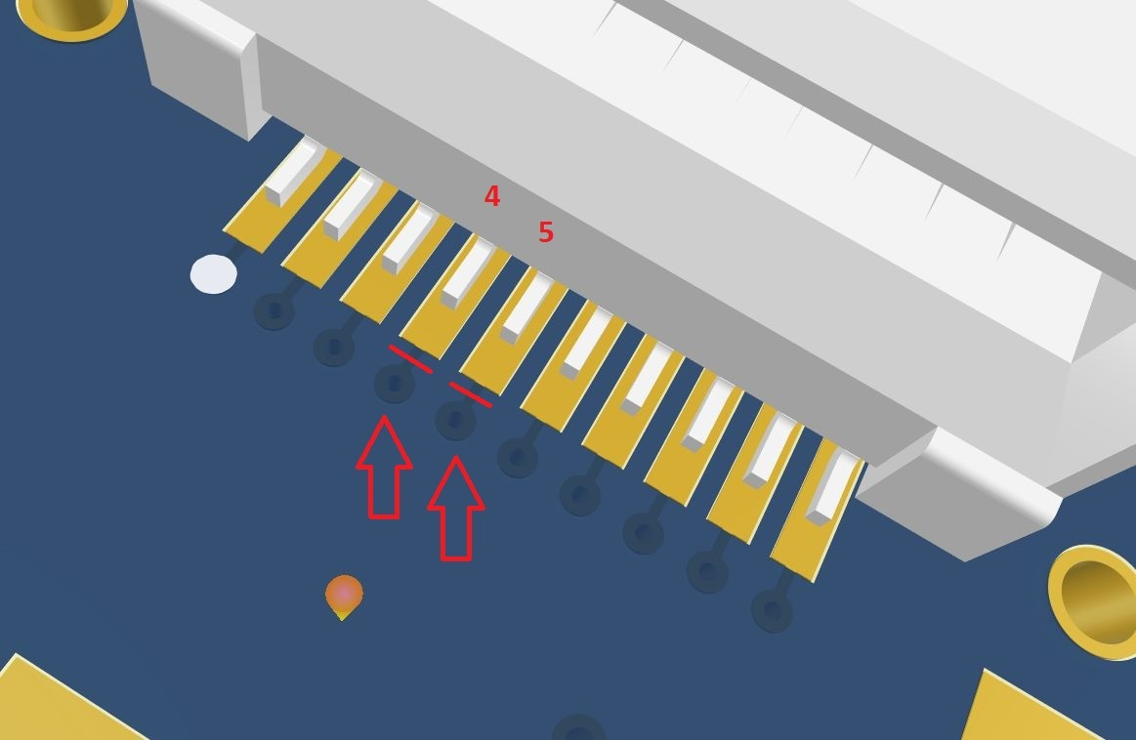
I2C Fix: Board Mods

Slide 6
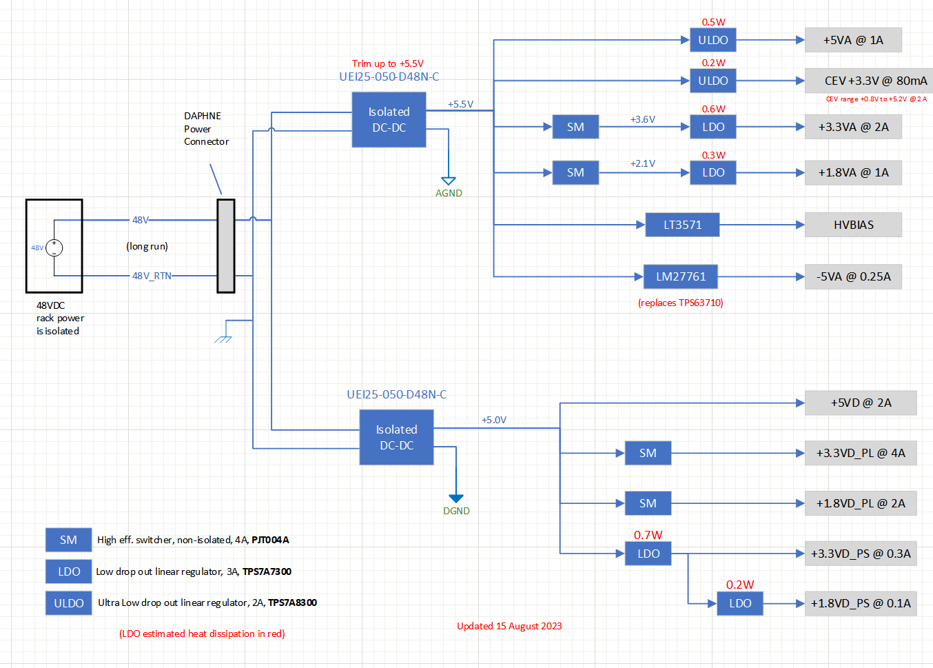
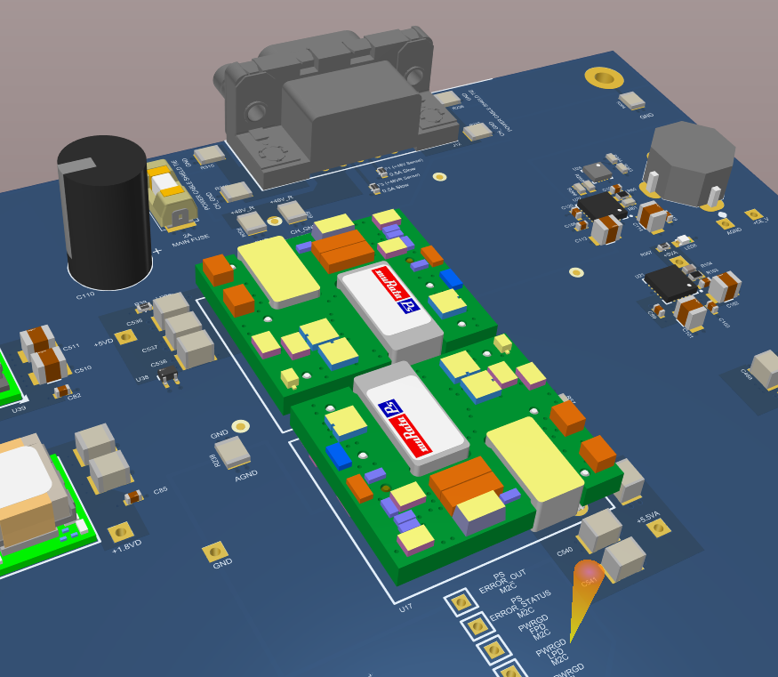
Power Supply Changes
Observed switching noise coming from the two isolated DC-DC converters
Replace them with shielded versions which are footprint compatible

Slide 7
Firmware Status
From the Kria processor we can communicate with all board level components (I2C + SPI)
  Many custom firmware blocks (PL) connected via AXI-LITE to processor (PS)
Timing Endpoint is working
Front End data deserialization and alignment is working
Input spy buffers are working
Self Triggered mode sender working in simulator + synth + implementation
10G Ethernet sender synth + implementation no issues
  Hardware testing after Clock Generator I2C issue is resolved
Timing constraints met

Slide 10
Software Status 1
On power up Kria loads U-BOOT from QSPI
U-BOOT then loads Petalinux from EMMC memory
Problem is U-BOOT is configured to assign a random Ethernet MAC address every time it starts
  We need static MAC address to get on the CERN network
  Cannot currently over-ride this and set a static MAC address
Jacques and Tom working on building new U-BOOT image that allows for changes
  Reprogram QSPI via JTAG cable and go

Slide 11
Software Status 2
10G Ethernet sender firmware requires software to configure it
  IP Bus commands over the network
This software runs on the Kria PS processor
Software builds OK
Very similar to WIB interface
Working with Adam Barcock @ STFC UK

Slide 12
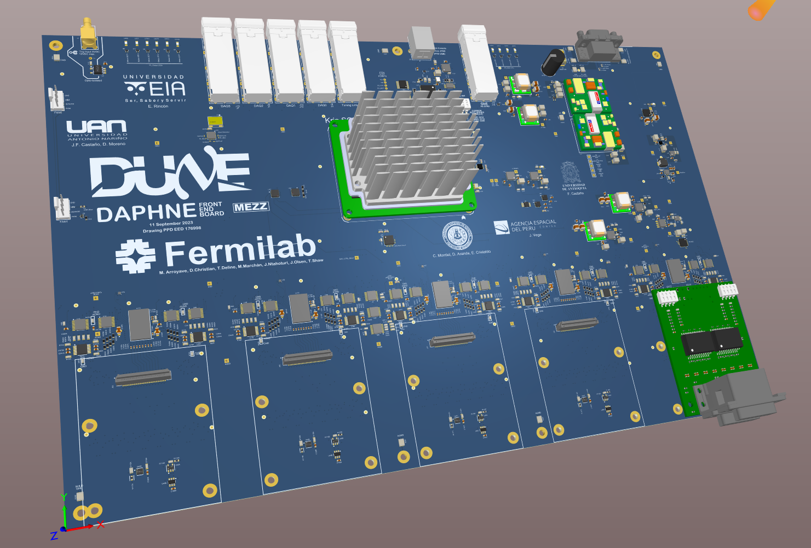

Slide 13
