Slide 1
Mu2e report
Tom Diehl (FNAL), Greg Rakness (FNAL)
Friday 9am AD meeting
04-Oct-2024
https://indico.fnal.gov/event/66459/

Slide 2
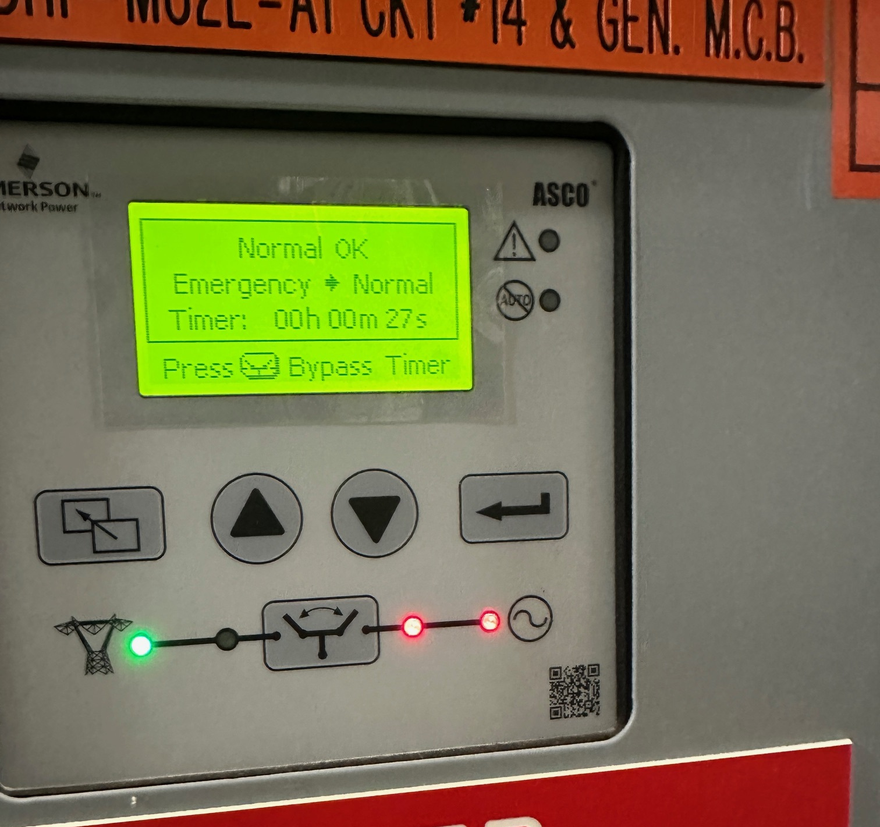
Some of the issues at Mu2e
Backup power
  Req submitted to replace MC1 Automatic Transfer Switch
    Context: ATS switches between primary power and backup power…
  Working with ISD to investigate ATS/generator at MC2 (Mu2e)
    Context: some loads did not receive power during last power outage…
Boxelder bugs
  We have started to see Boxelder bugs on the exterior of Lab 3
    Context: Lab 3 is where the tracker is being fabricated, and boxelder bugs poke holes in the tracker straws…

Slide 3
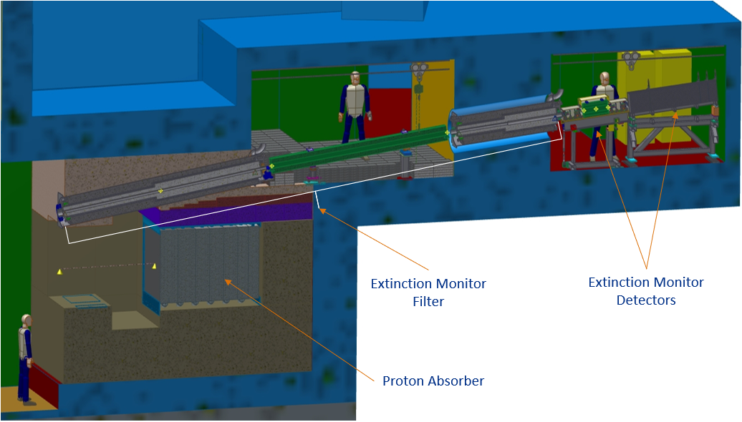
Mu2e Extinction Monitor
Downstream Collimator
Upstream Collimator
Extinction Monitor Filter needs to point at the Production Target

Slide 4
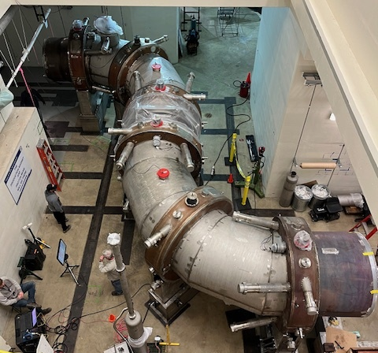
Mu2e physics process
The chain of solenoids is welded together to form the muon beamline
105 MeV electron
8 GeV protons
DS
PS
TSu
TSd
Production Target
Muons
Stopping Target
Calorimeter
Tracker

Slide 5
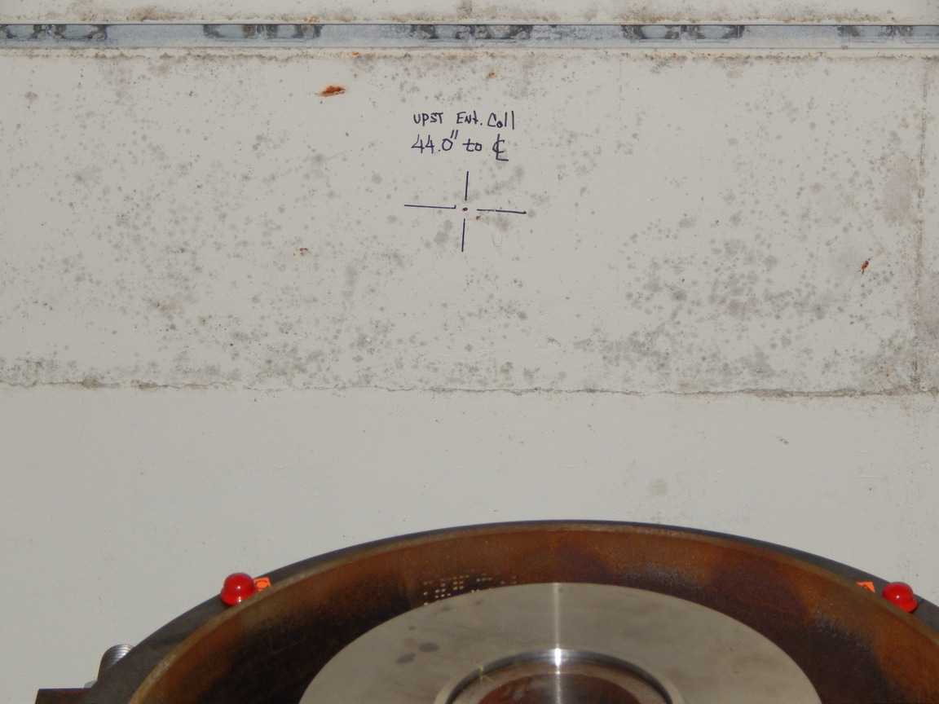
Some of the work at Mu2e (1/2)
The extinction monitor needs to point at the target...
… which depends on the location of the Production Solenoid
  (not in the building)
… which depends on the location of the upstream and downstream Transport Solenoids
  (yes in the building)
Alignment & Metrology made marks on wall for location of extinction monitor
Effectively, we have committed
to this location of the target…

Slide 6
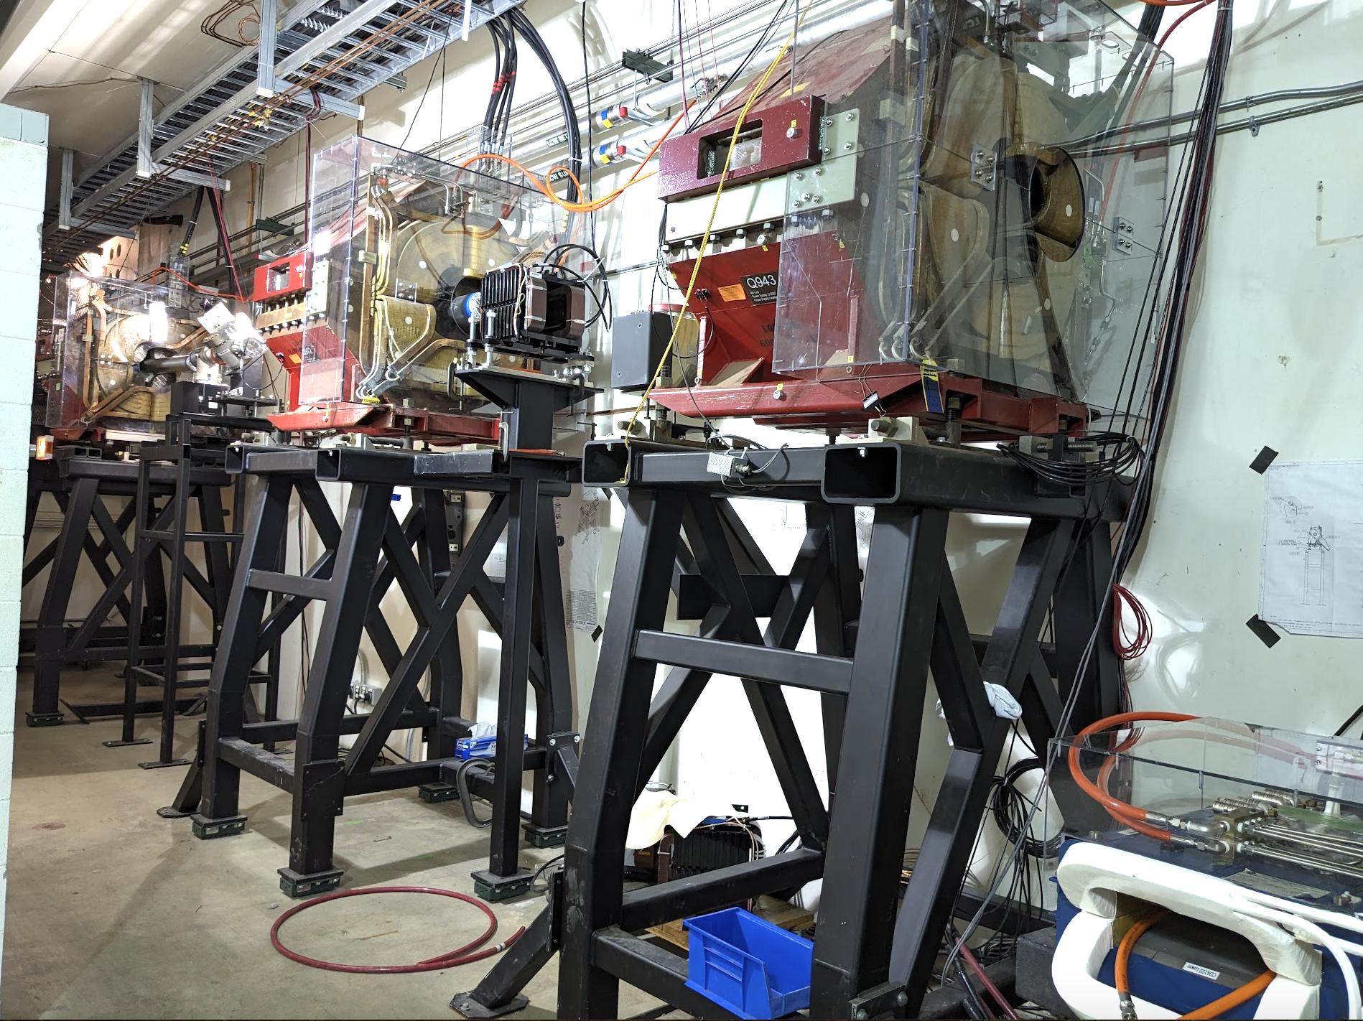
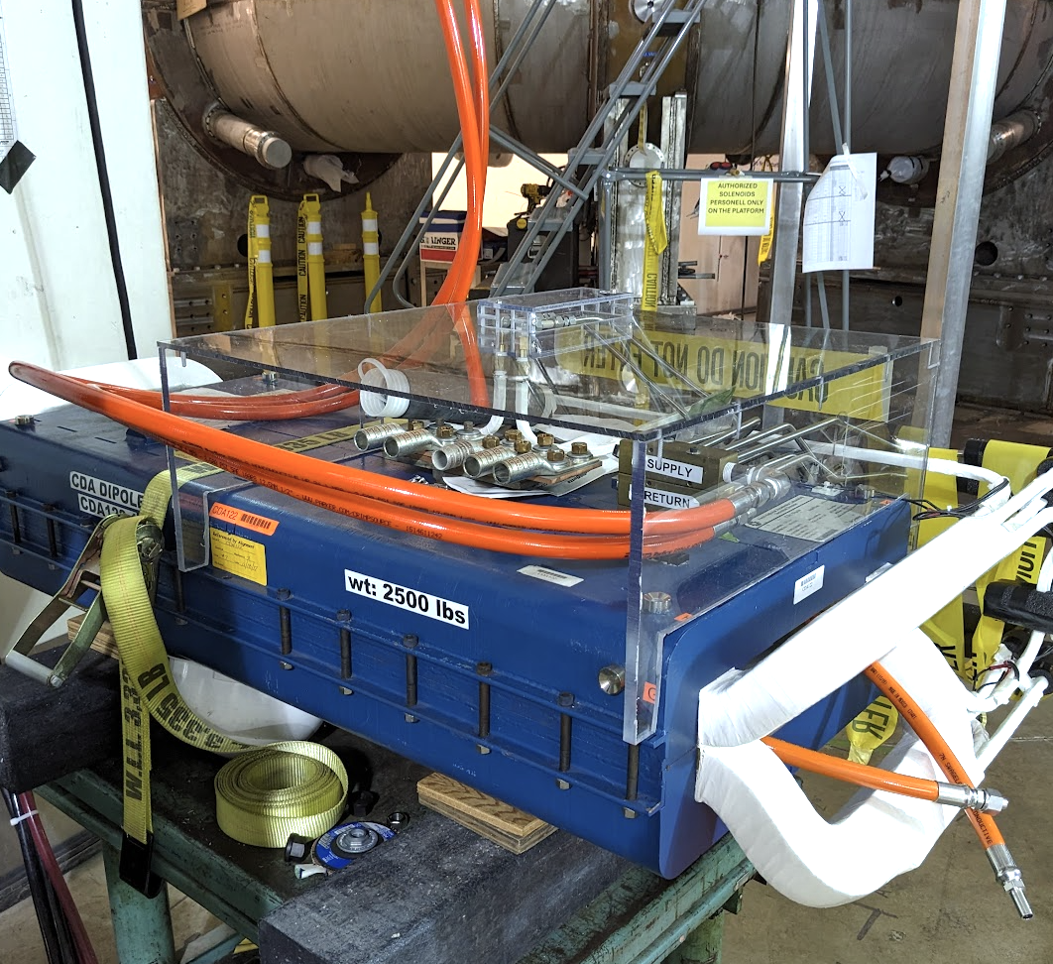
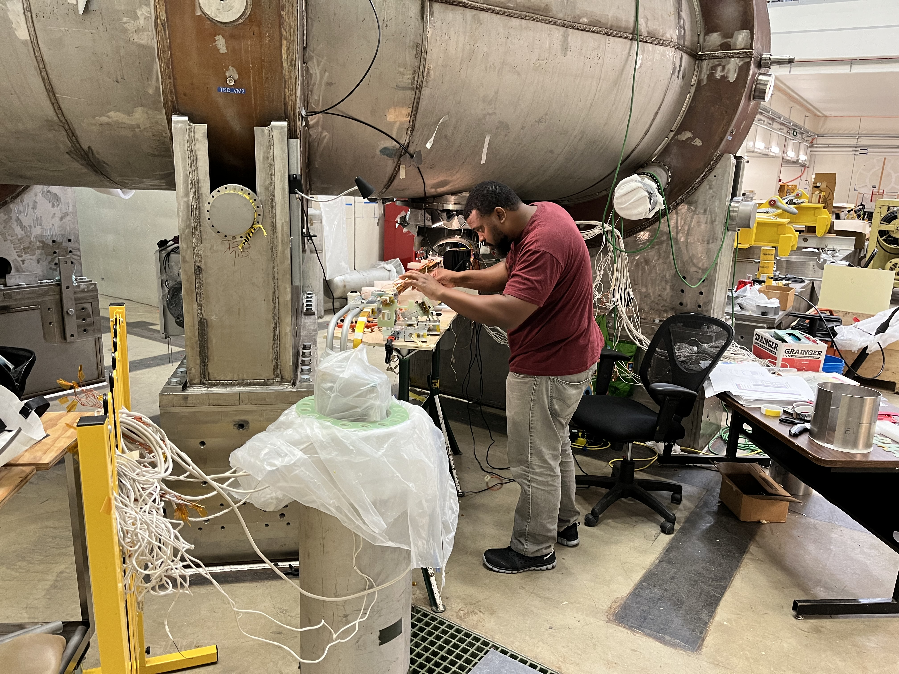
Some of the work at Mu2e (2/2)
Trims and CDA magnet moved
Connections ongoing from transfer lines to upstream and downstream
23-27 Sept: Mu2e collaboration mtg
  Many, many discussions

