Slide 1
Project Activities for MSD
Mayling Wong-Squires
AD Operations Friday 9am Meeting
4 October 2024

Slide 2
LBNF Fluids Updates Abhishek Deshpande, Alex Humenik
Design of the RAW water feedthroughs for the LBNF Target Hall Target Bunker in progress
PO# 718030 issued for the Horn Test Skid at MI-8.
Still undergoing reviews in procurement as it is >$250k.
After reviews, will be sent to vendors
Test setup has begun for the FC-40←> Opticool conversion
All environmental and Industrial Hygiene reviews complete.
Waiting for the HA to be approved.
LBNF Target Bunker RAW feedthrough design

Slide 3
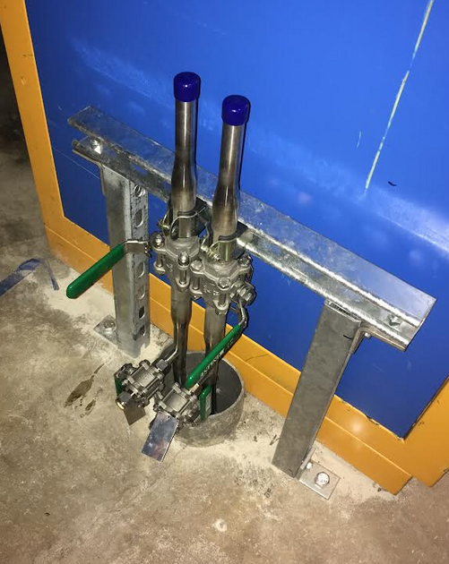
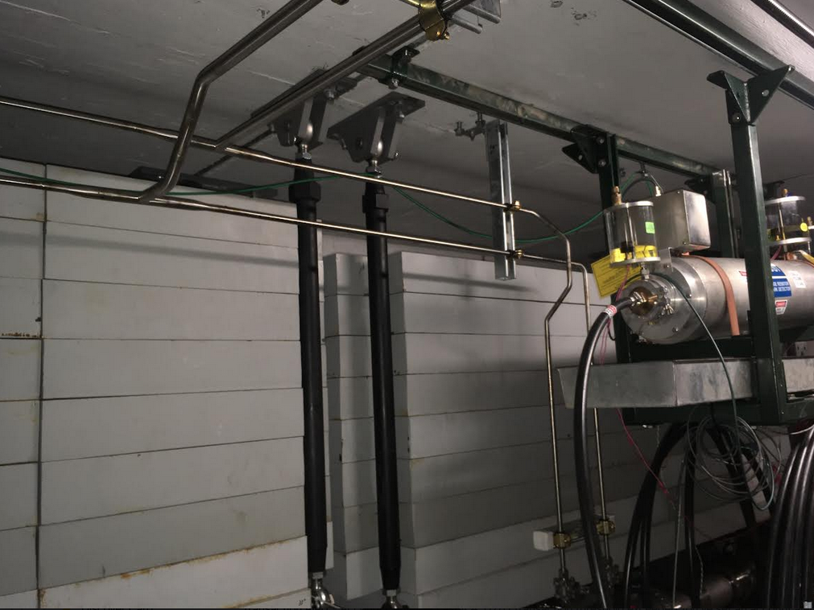
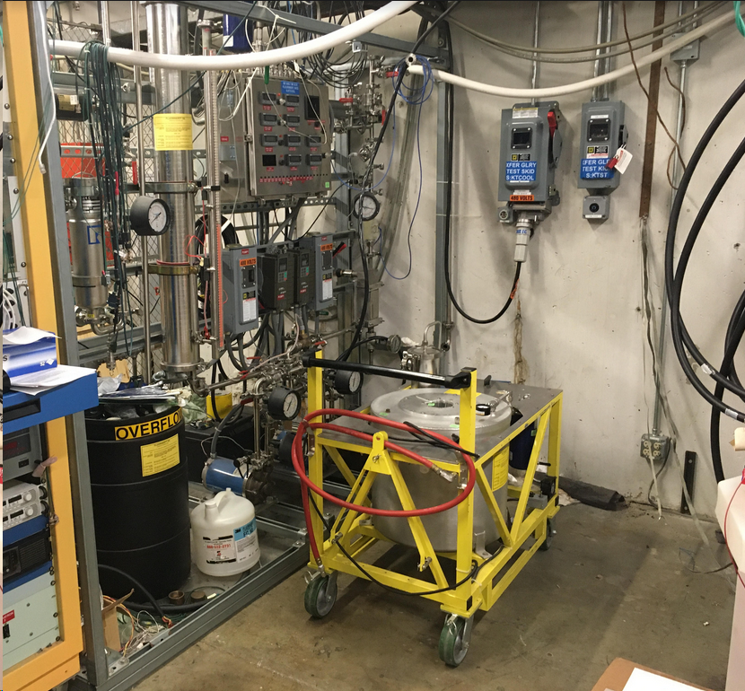
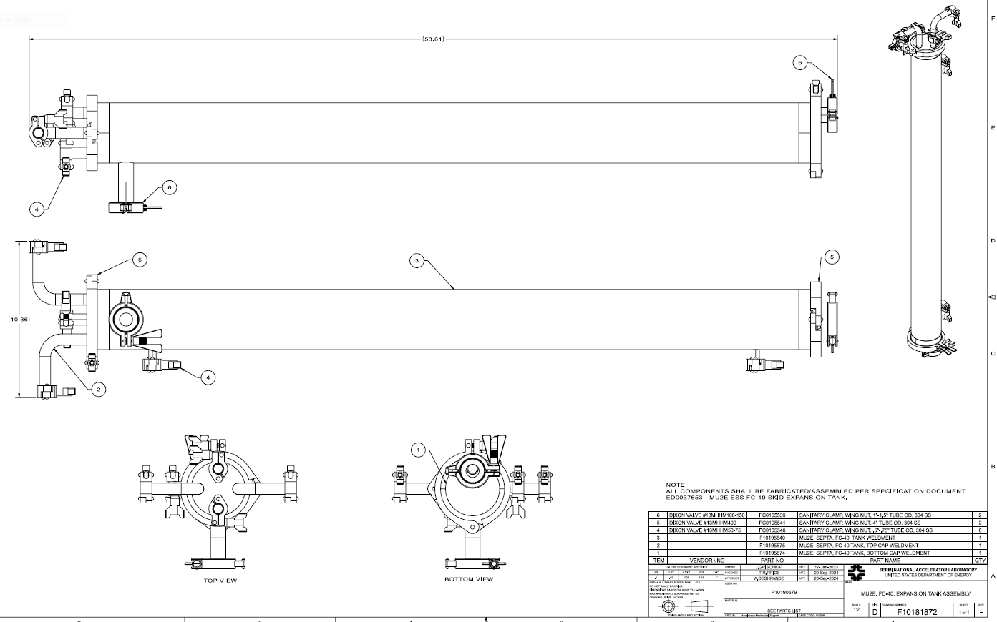
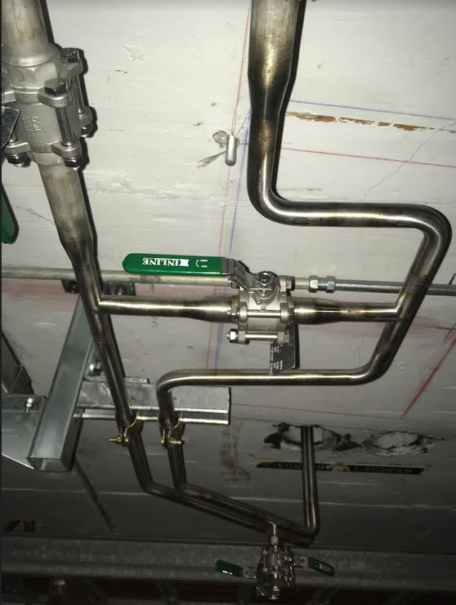
Mu2e Fluids Update Abhishek Deshpande
FC-40 piping in AP-30
Completed installation of tunnel piping for the Mu2E ESS FC-40 skid.
Creating parts lists and quotes for the Mu2E ESS FC-40 skid. Waiting for quotes on the expansion tank for the skid.
FC-40 piping in Delivery Ring
FC-40 piping in Delivery Ring
FC-40 cart stationed for draining/drying skid
ESS skid expansion tank

Slide 4
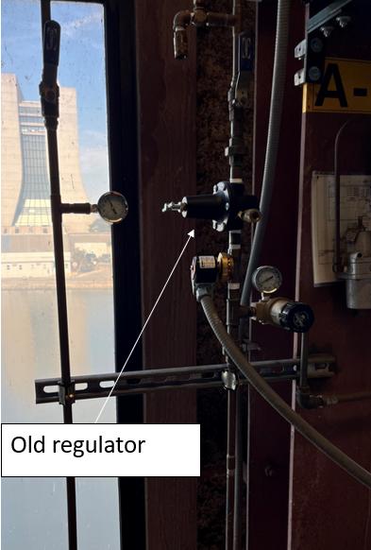
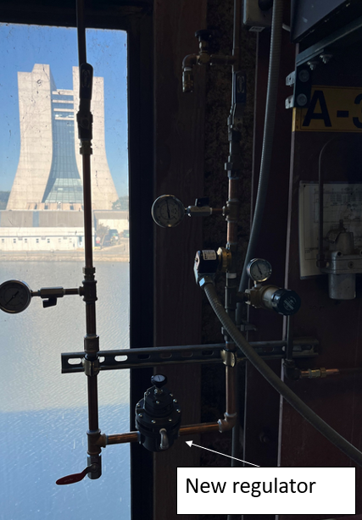
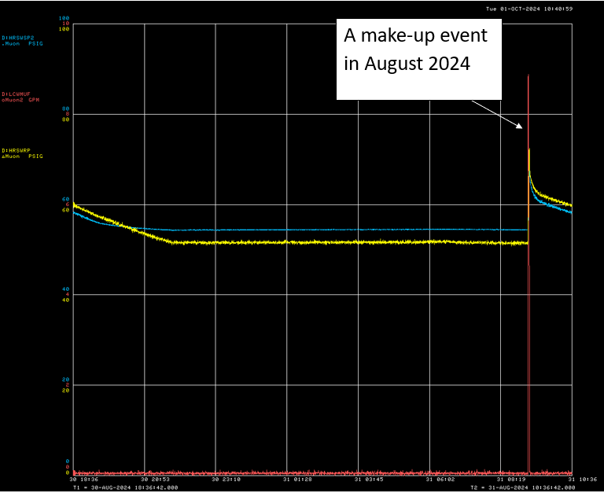
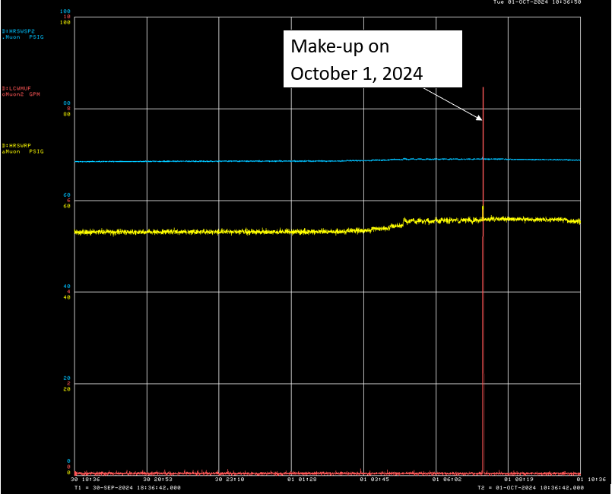
Mu2E Fluids Updates (cont’d)
LCW make-ups on Muon Campus used to cause pressure spikes in the HRS skid. These have been eliminated by adding a new regulator on N2 gas blanket on the system expansion tank at CUB.
Pressure spikes in Mu2E HRS skid eliminated

