Slide 1
Main Injector Shutdown Status
Denton Morris, Marty Murphy
AD/MI 0900 Meeting
October 4, 2024

Slide 2
Tunnel Work
MI-8 Collimator installation
All parts in on site
Jaws are at NWA being inspected and welded
Tunnel cable terminations inprogress
RF Dual PA cavity upgrades (3 stations)
Electrical pulls are complete
Upgrading four modulators (one spare)
NOTE: Unable to test any RF until KRS pulsed power
and LCW returns. Then need ~3 weeks for testing
Adjusted MI-40 absorber room door
Chasing down compressed air leaks
Repairing ion pump cables
ISD is installing test lighting in MI-8 and will be re-lamping
emergency exit, stairwells and tunnel location around MI
Move MI quads based on previous high field orbit
MI tunnel cleaning in progress
2
MI Department Meeting | D. Morris
10/4/2024

Slide 3
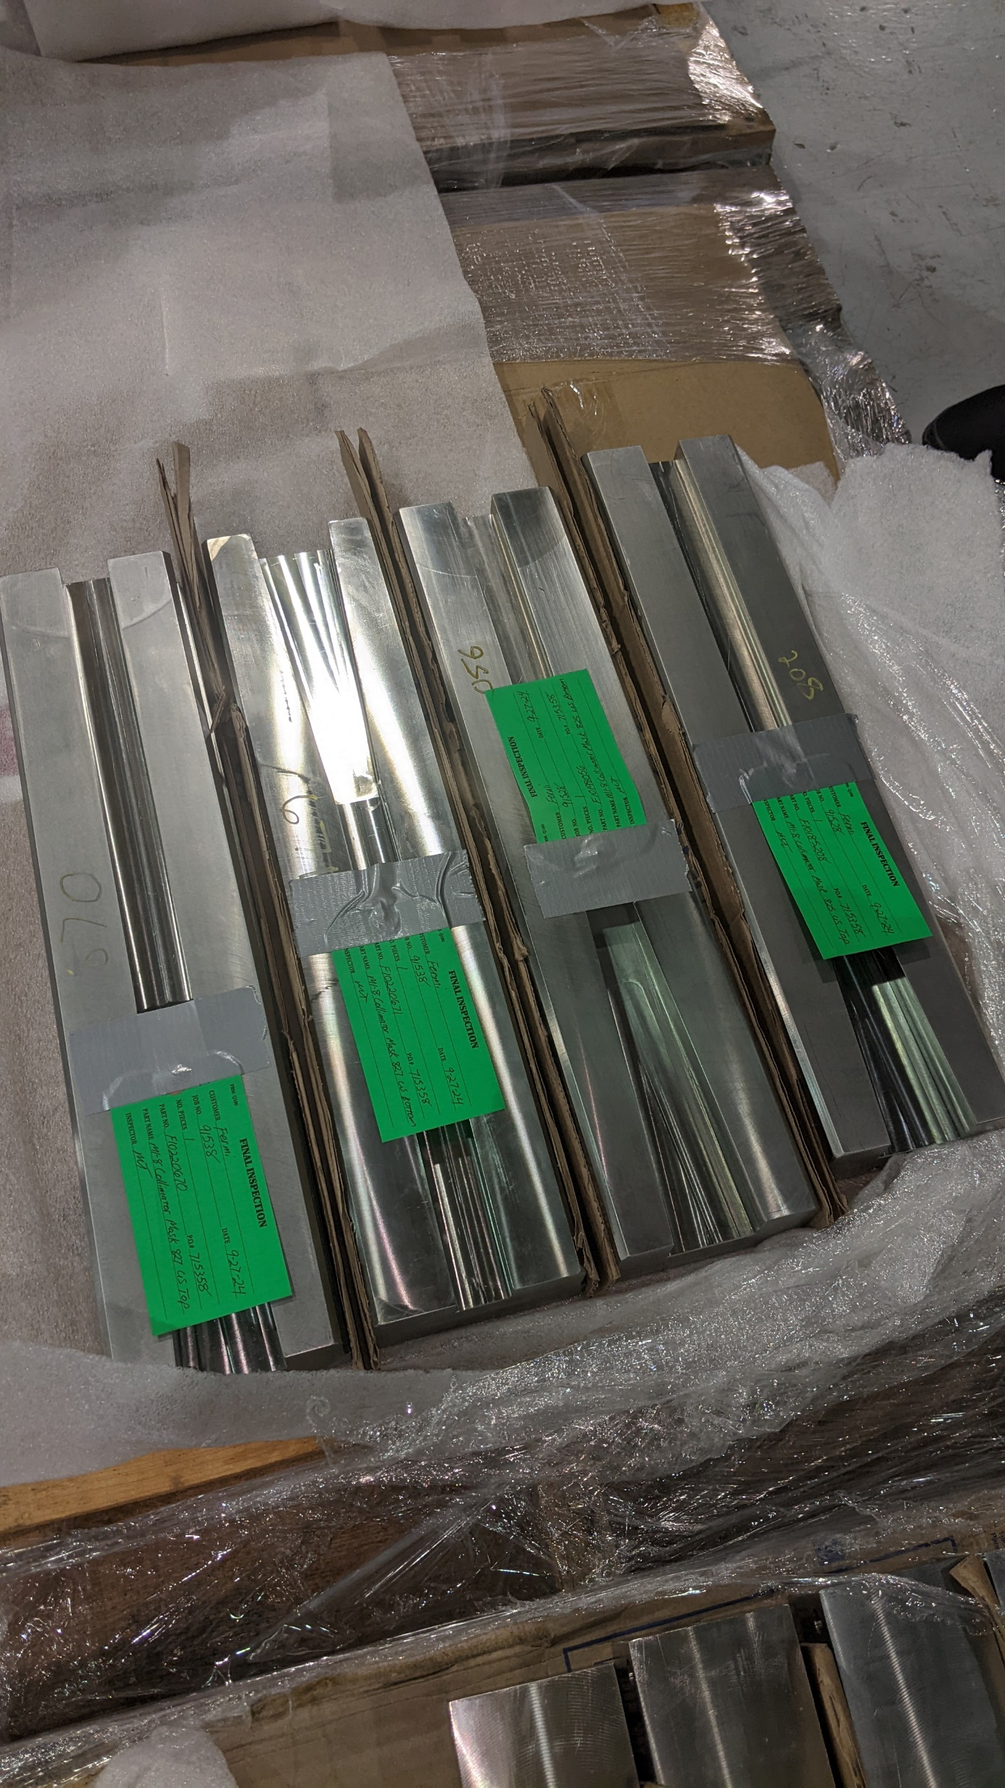
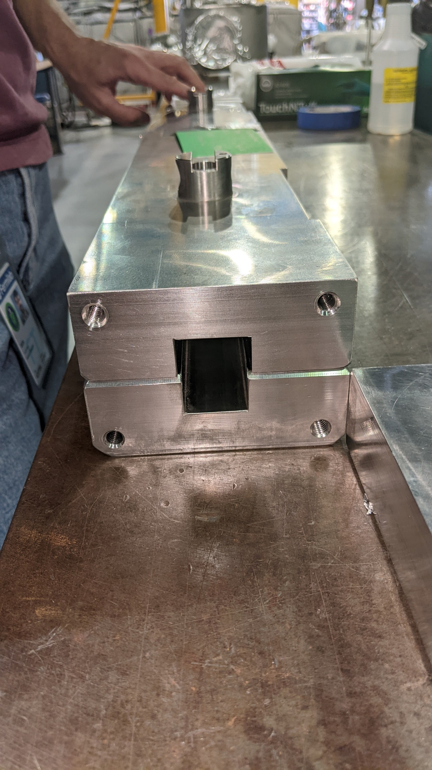
Tunnel Work
3
MI Department Meeting | D. Morris
10/4/2024

Slide 4
Tunnel Work
Still needing to be done:
332 dipole leak repair
Adjust aperture at 232
4
MI Department Meeting | D. Morris
10/4/2024

Slide 5
Conventional and Pulsed MI Power Outages
Please report any additional MI outages to the MCR.
5
MI Department Meeting | D. Morris
10/4/2024

