Slide 1
Muon Campus Shutdown Report
Jim Morgan
Friday 09:00 Shutdown Meeting
October 4, 2024

Slide 2
Muon Campus status
ESS2 is at NWA and has begun high voltage conditioning
Target voltage is 100 kV, is expected to take several weeks
Vacuum is presently around 1E-8 Torr
D30 downstream mechanical about to begin
Key Q205 part (mounting plate assembly) was received this week
Mu2e Extinction Collimators and magnet staked out by Alignment
Leaking Delivery Ring D5SD15 sextupole was replaced
Domestic water leaks near AP-0 adjacent to Transport berm
Muon LCW resistivity continues to be poor
BTW temperature problems was resolved last Friday
Attempted to begin Kirk Key Disconnect repair, had difficulties
Existing mounting holes for cylinders not sized properly and inconsistent
Hope to begin replacement of some power supply circuit breakers soon
Prototype ESS2 will need to be removed from DR prior to running beam
Related to buyback accounting between Mu2e Project and AD spares funds
Hope that operational ESS2 will be ready for installation in early November
Will evaluate options if operational ESS2 is delayed significantly
AP-0 A/C work paused, blamed on badging issues
Study – M1-M3 Optics
Study – Alternative M5 optics

Slide 3
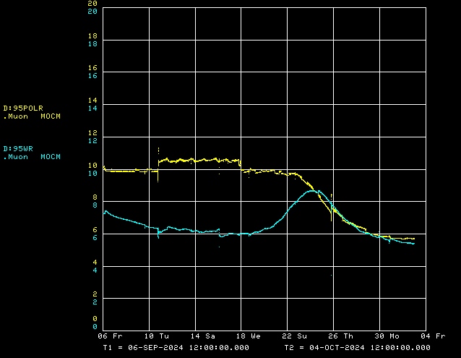
Muon LCW resistivity over the past four weeks
LCW polish resistivity
LCW resistivity

Slide 4
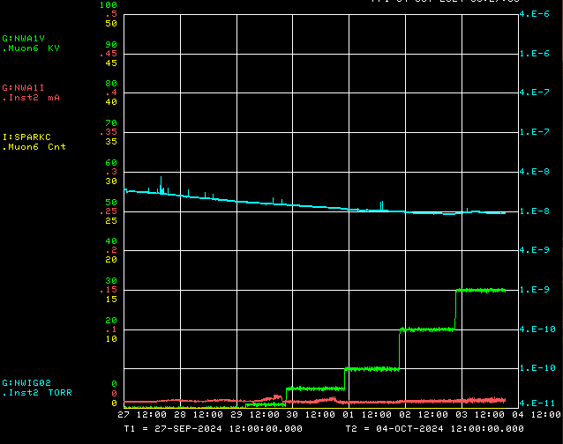
ESS2 conditioning at NWA
Vacuum
Voltage
Current
Spark Detector

Slide 5
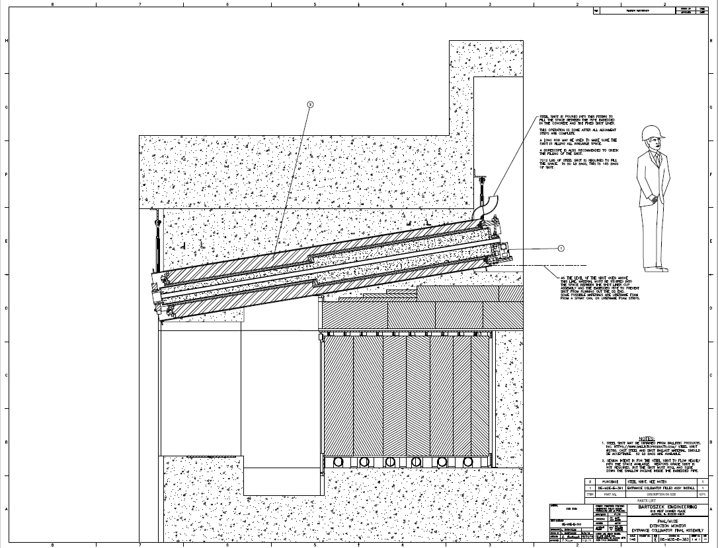
Mu2e upstream Extinction Monitor Collimator
Existing concrete
Concrete poured
after installation

Slide 6
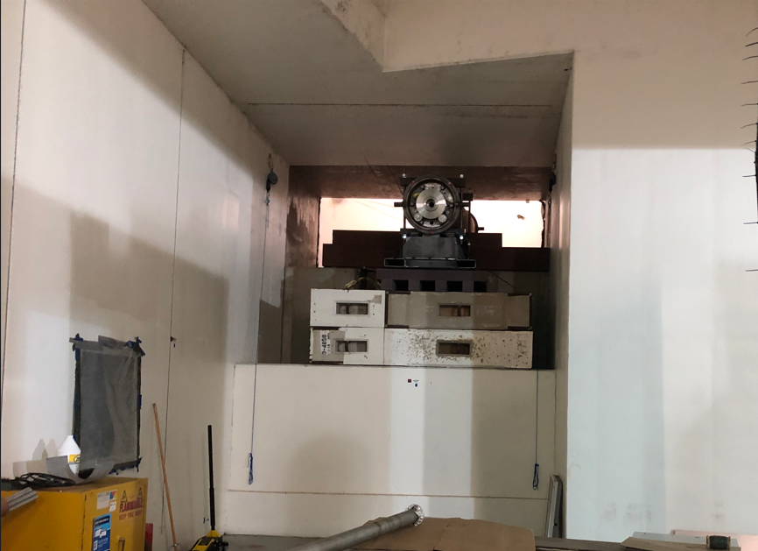
Upstream Extinction Monitor Collimator

Slide 7
Upcoming work
Main worklist items and other upcoming work
Repair Kirk Key hardware on disconnects, requires more modifications to disconnect
Replace several power supply circuit breakers and some primary wiring
Remove D40 shielding blocks for moving 8Q24’s in and out of tunnel
Install rad hard 8Q24 at Q205, send uninstalled 8Q24 to TD for rad hard water lines
Q205 vacuum pipe replacement to simplify vacuum connection to ELAM
Profilometer extraction profile monitor vacuum Tee installed upstream of ELAM
Unroll ELAM? (was rolled 24 mr to improve g-2 extraction trajectory)
Install additional steel shielding above ECMAG
Several alignment tasks including replacement Q205 and M4 WCM
Repair of domestic water line breaks near AP-0 may have disturbed Transport berm
Prepare to install Mu2e Extinction Monitor Collimator in Absorber area
M4 Final Focus vacuum installation, A/C dipole installation
ESS1 and ESS2 septum stand motion-control improvements
Hope to finish operational ESS2 and install it in tunnel late in shutdown
ESS2 (operational version)
Continue high voltage conditioning (duration ~4 weeks)
AP-0 A/C work paused again
Jerry is out of town this afternoon and through the weekend

