Slide 1
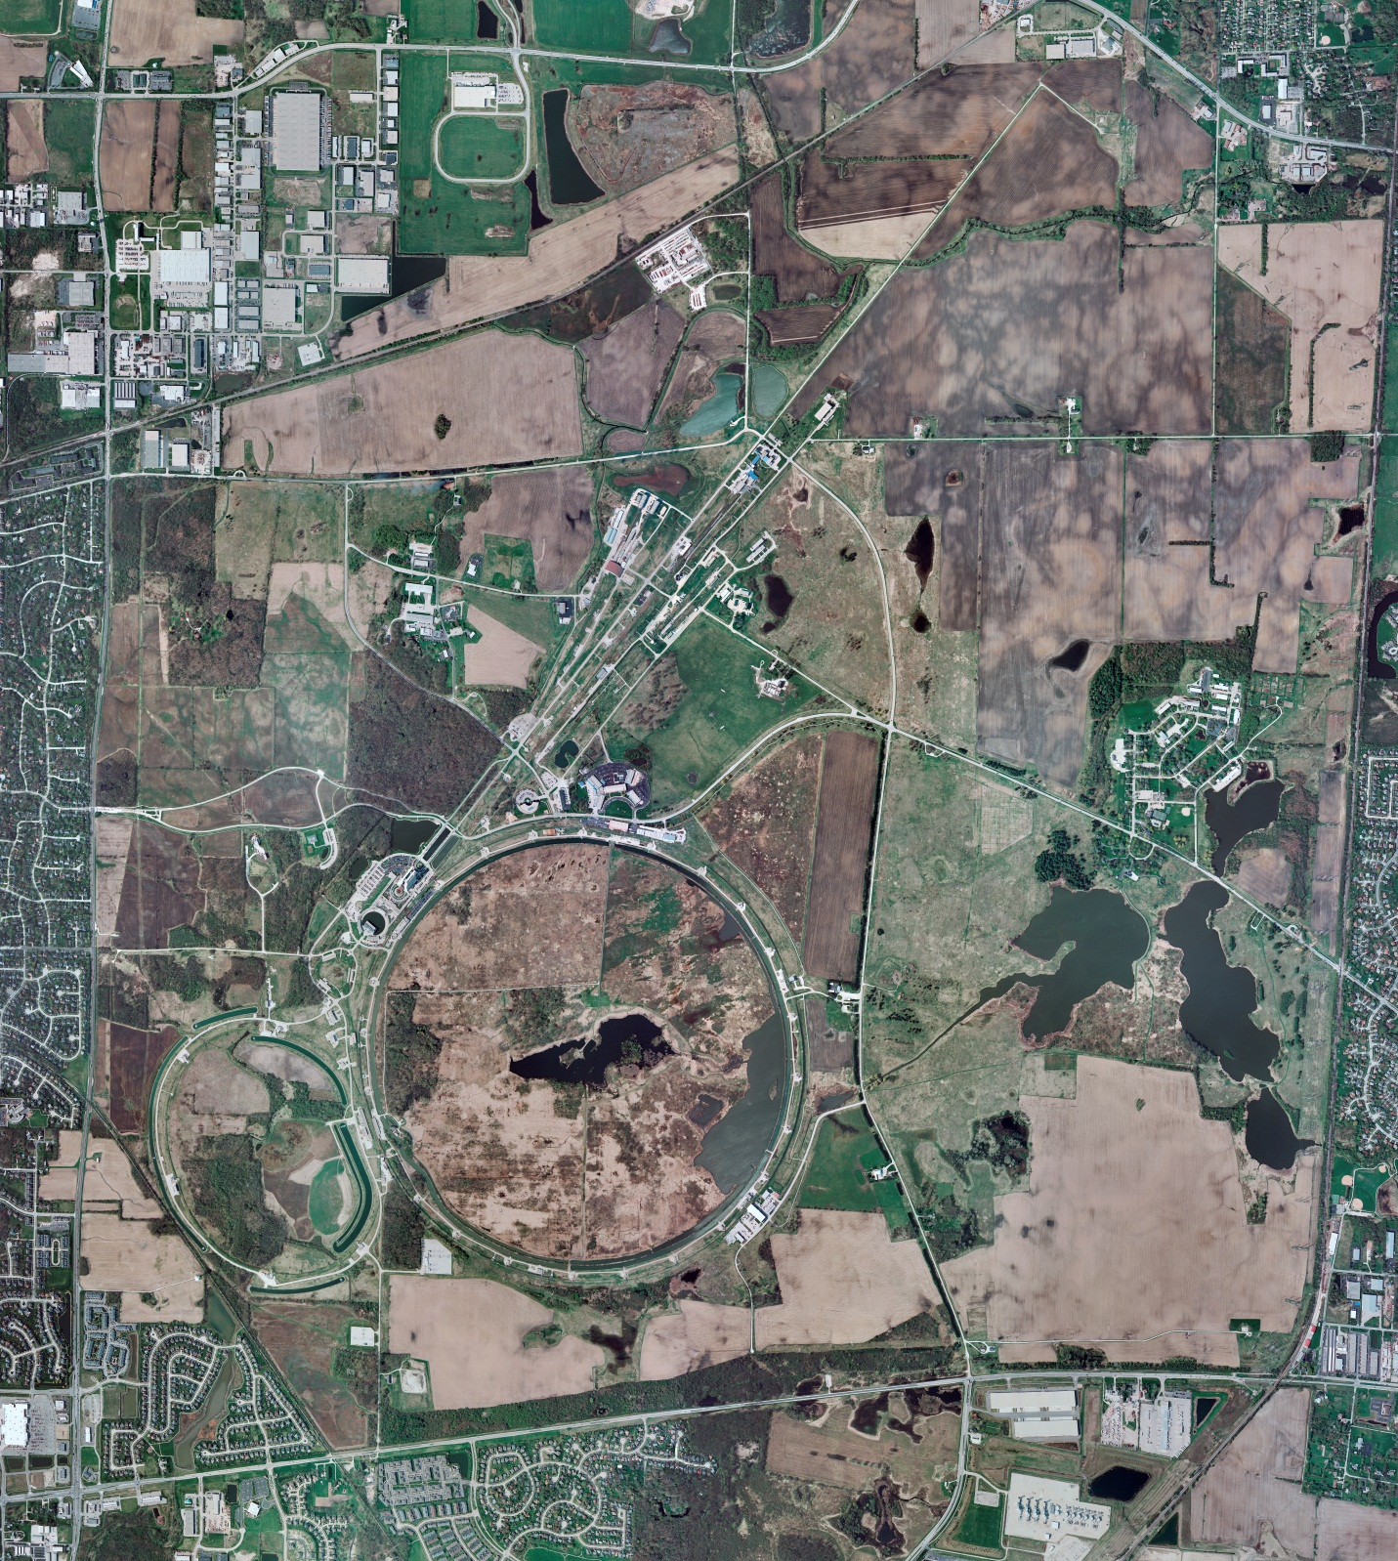
Helium Cryogenics
Status 10/4/2024 J.Makara
CMTF: SCP cold and running fine
CMTS: HECM31 running fine at 2 K, warmup to RT next week planned
PIP2IT: South Stand CM being modified for SSR2 pCM
North Stand CM empty
MCTF: cryo system cold
MDB/HTS: at RT
MDB/STC: at RT but will be cooled down soon
MDB Magnet: at RT
NML/FAST: Cryo system is shut down and isolated for extended shutdown period;
CC1: at RT
CC2: at RT
CM: at RT
IB1: cryo system running fine on CTi and ALAT CBXs.
Muon Campus: at RT with comprs off and system depressurized; LN2 system at RT; g-2 Expt Hall at ODH=0 (not ODH area)
Misc: …

