Slide 1


Measurement of ν_{µ} CC inclusive cross section and estimation of
2-particle 2-hole contribution
arxiv: 2410.05526
Complementary analysis arxiv: 2410.10222
Travis Olson
University of Houston
For the NOvA collaboration

Slide 2
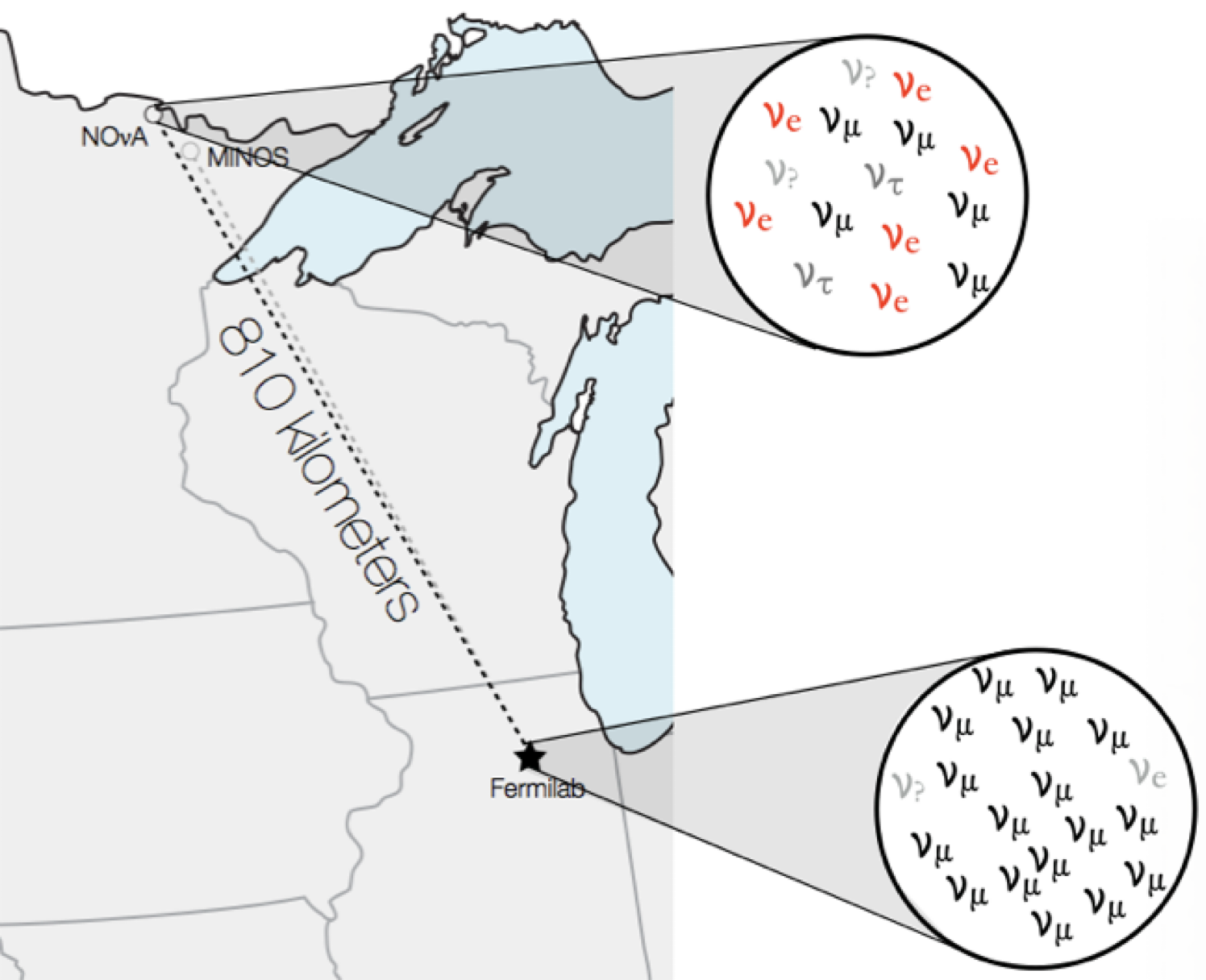
The NOvA experiment
NOvA is a long-baseline neutrino oscillation experiment
2 detectors: 14.6 mrad off-axis and 809 km apart
Designed to measure for ν_{μ} ν_{e} : detectors provide excellent imaging of both ν_{μ} and ν_{e} CC events
94% pure ν_{μ} , 5% ν_{μ} , and 1% ν_{e} + ν_{e} in neutrino mode
High neutrino flux at the Near Detector provides a rich dataset for cross-section measurements

Slide 3
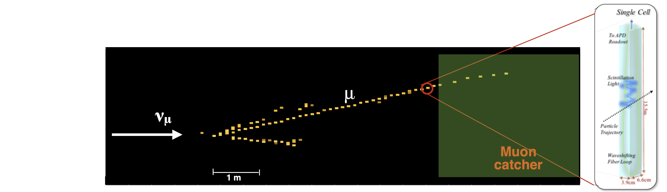
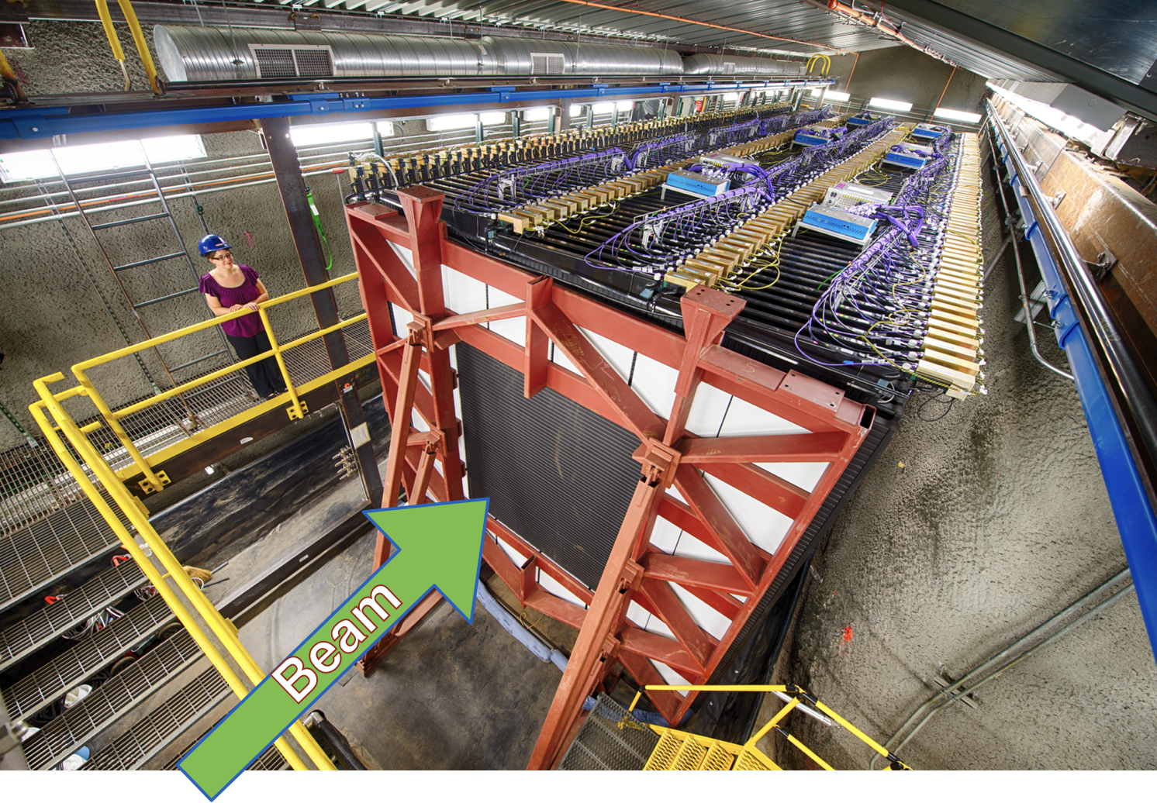
The NOvA near detector
The ND is 1 km from source,
underground at Fermilab.
PVC cells filled with liquid scintillator, 195 ton fully active mass and 98-ton downstream
muon catcher
Alternating planes of orthogonal views
Low-Z, fine-grained: Composition by mass:
C | Cl | H | O | Ti
67% | 16% | 11% | 3% | 3%

Slide 4
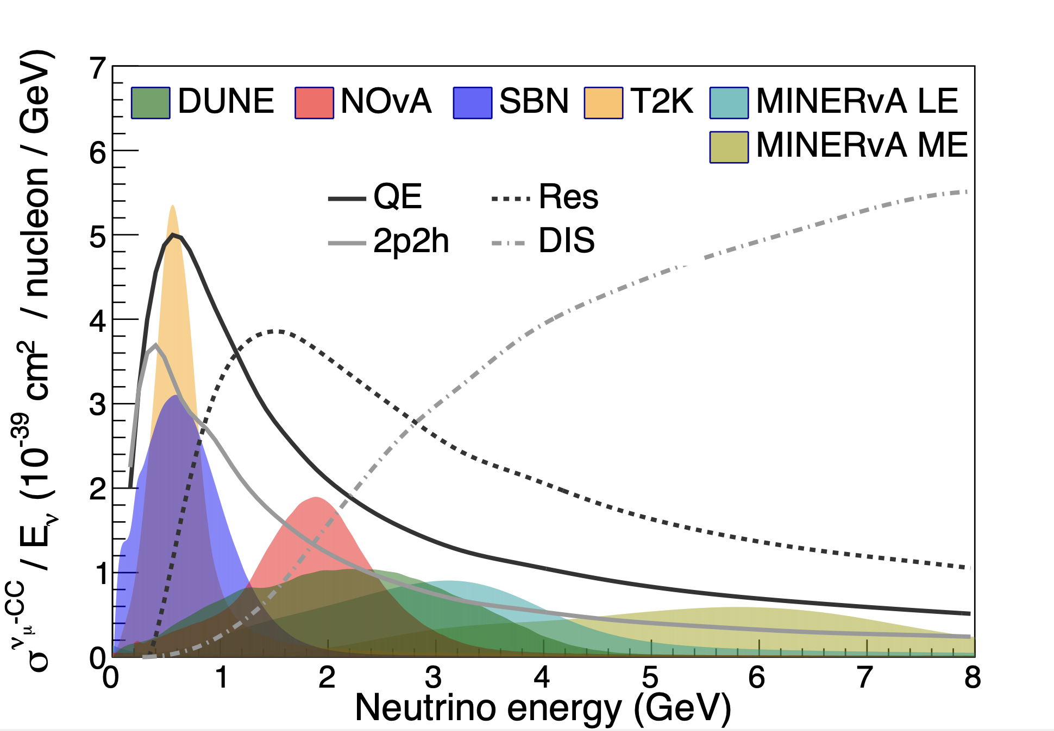
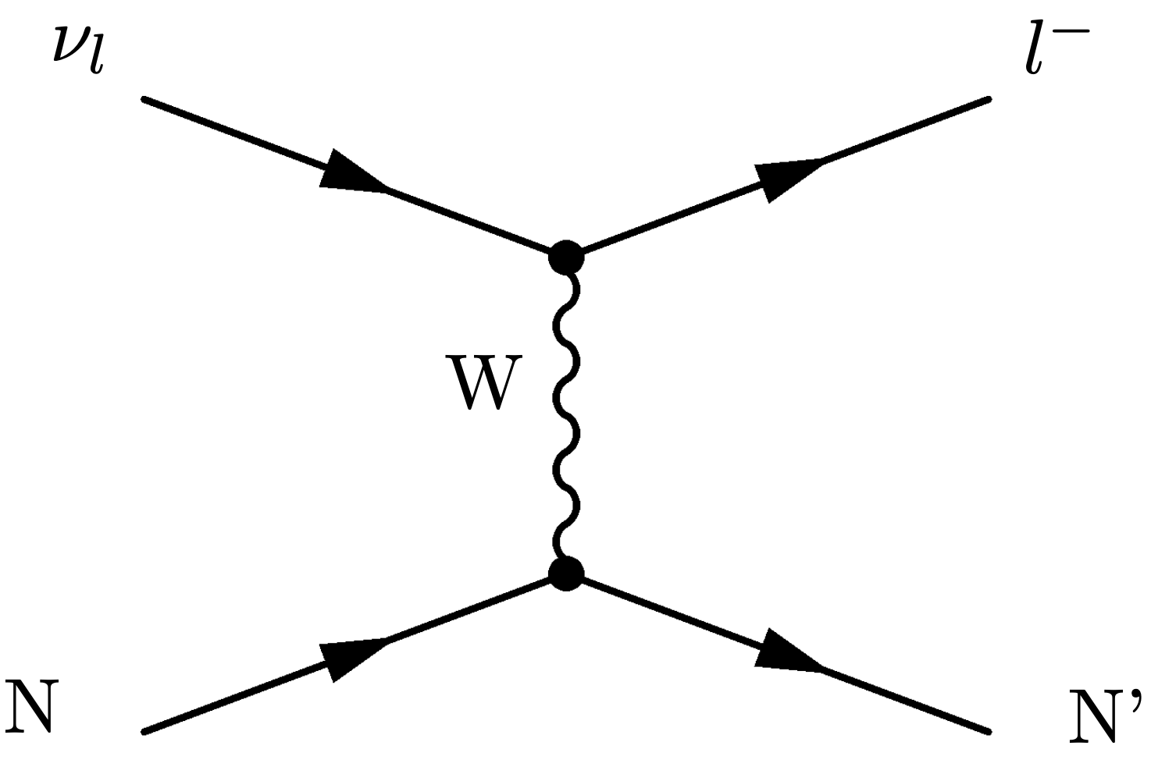
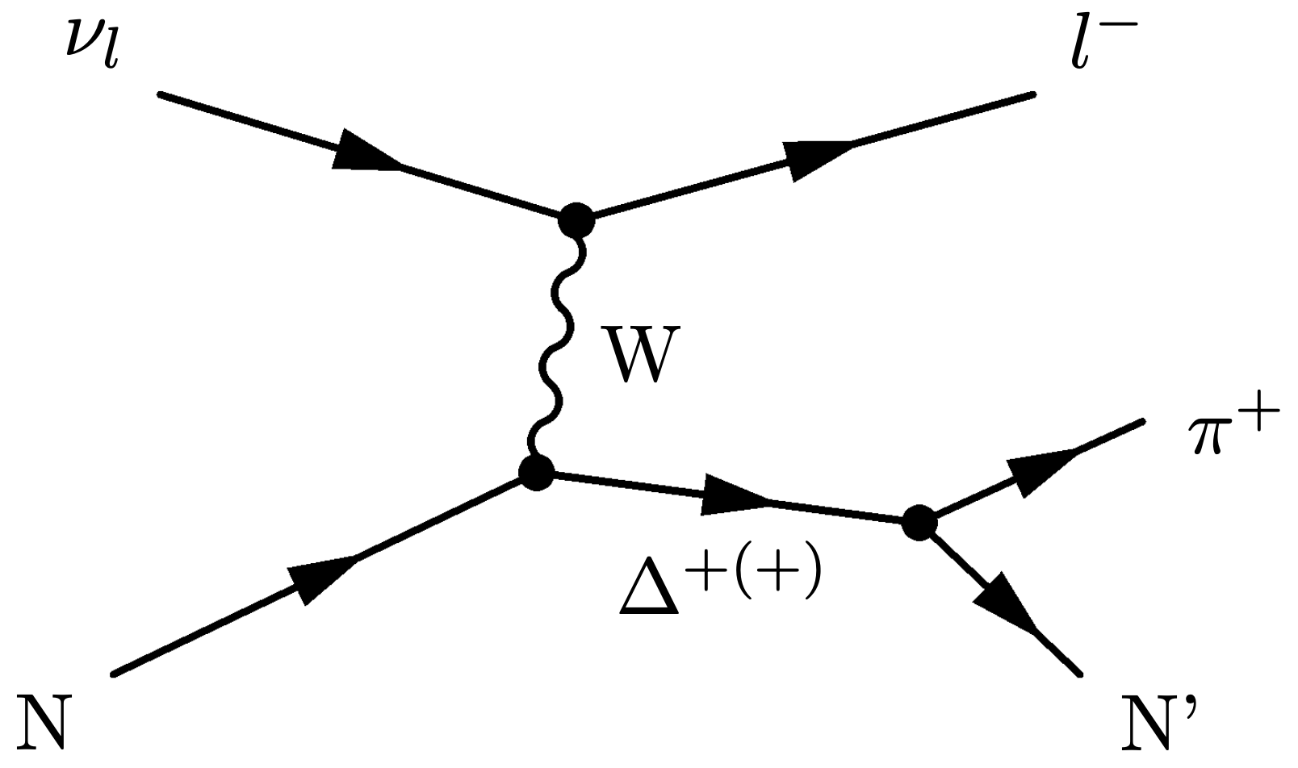
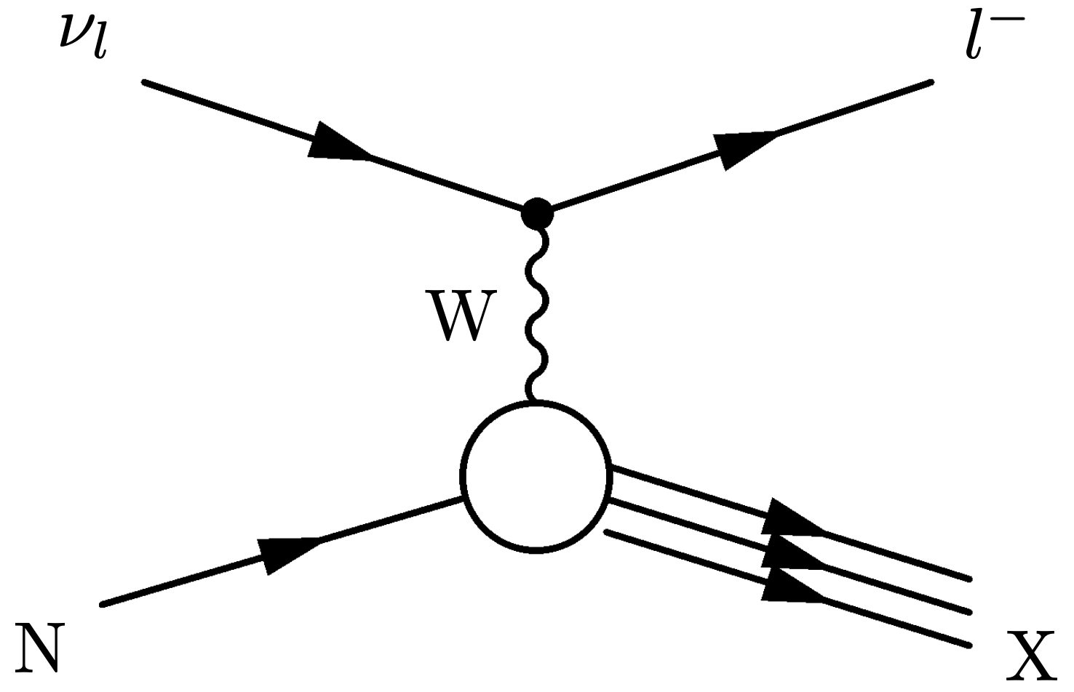
Neutrino-nucleon interactions
CC QE
CC Res
CC DIS
The transition region between interaction processes

Slide 5
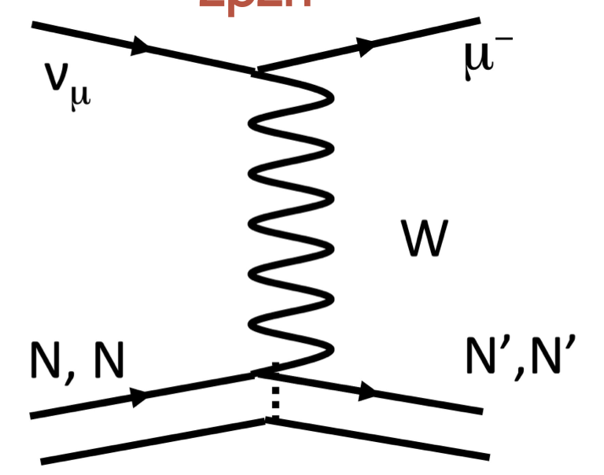
In a nuclear medium, neutrinos can interact with two nucleons
2-particle 2-hole processes:
2p2h is well know in nuclear scattering
Measuring 2p2h for neutrino experiments is challenging: unknown incoming beam, nuclear effects, etc.
Models for this process have large disagreements:
  NOvA-tunes
  GENIE Empirical MEC
  MINERvA-tunes
  SuSA-v2 model
  Valencia model

Slide 6
Cross-section model
Neutrino interactions are simulated using GENIE 2.12 2.12.2
ISI | QE | MEC | Res | DIS | FSI
RFG | L-S | Empirical | R-S | Pythia6 | hA
NOvA ND and external data are used to tune the model
Correct QE to account for low Q² suppression
Apply low Q² suppression to Res baryon production
Non resonant inelastic scattering (DIS) at W>1.7 GeV/c²) weighted up 10% based on NOvA ND data
“Empirical MEC” based on NOvA ND data for 2p2h
Our analyses are constructed to be insensitive to this tuning
Previous tune that was used in the NOvA 2019 analysis
Eur. Phys. J. C 80, 1119 (2020)

Slide 7
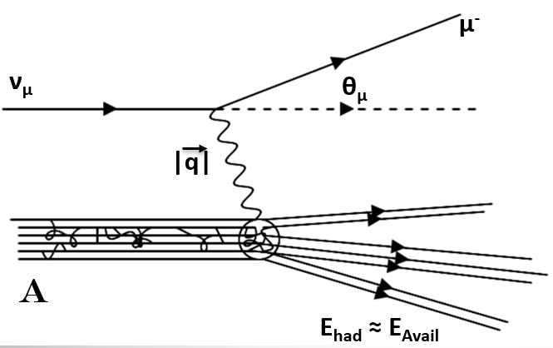
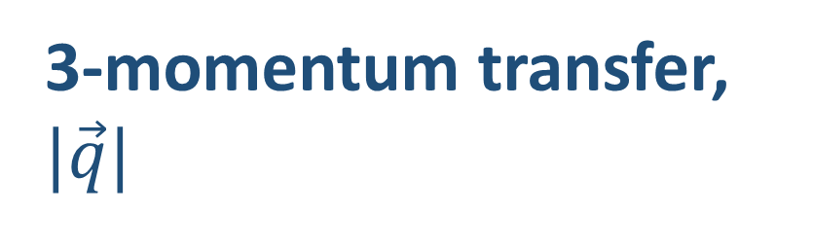
Analysis variables:
3-momentum transfer, $|\vec{q}|$
hadronic available energy, E_{avail}
Available energy:
Kinetic energy: p/π±
Total energy: π⁰/e/γ
(neglect neutron energy)

Slide 8
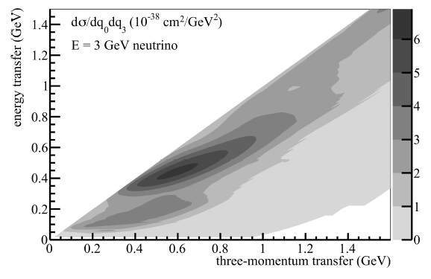
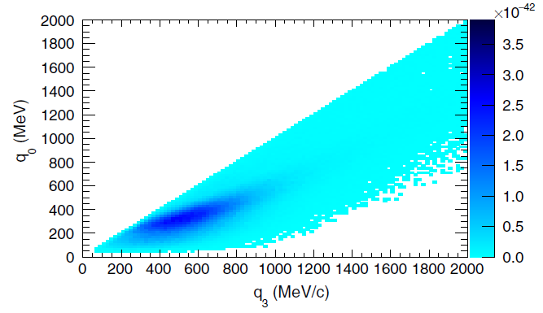
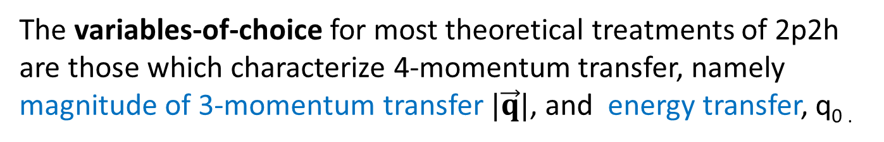
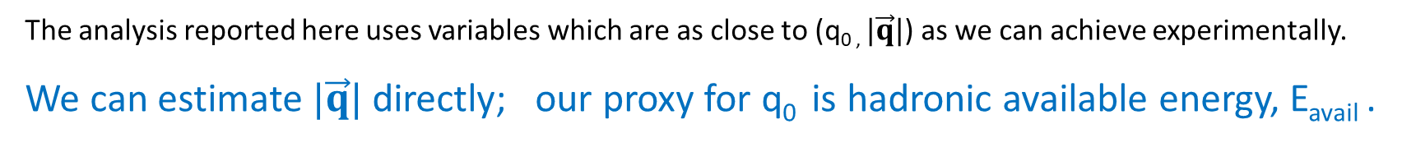
The variables-of-choice for most theoretical treatments of 2p2h
are those which characterize 4-momentum transfer, namely
magnitude of 3-momentum transfer $|\vec{q}|$, and energy transfer, q_{0 .}
R. Gran et al. (Valencia), Phys. Rev. D 88, 113007 (2013).
S. Dolan et al. (SuSAv2), Phys. Rev. D 101, 033003 (2020).
The analysis reported here uses variables which are as close to (q_{0 ,} $|\vec{q}|$) as we can achieve experimentally.
We can estimate $|\vec{q}|$ directly; our proxy for q₀ is hadronic available energy, E_{avail} .

Slide 9
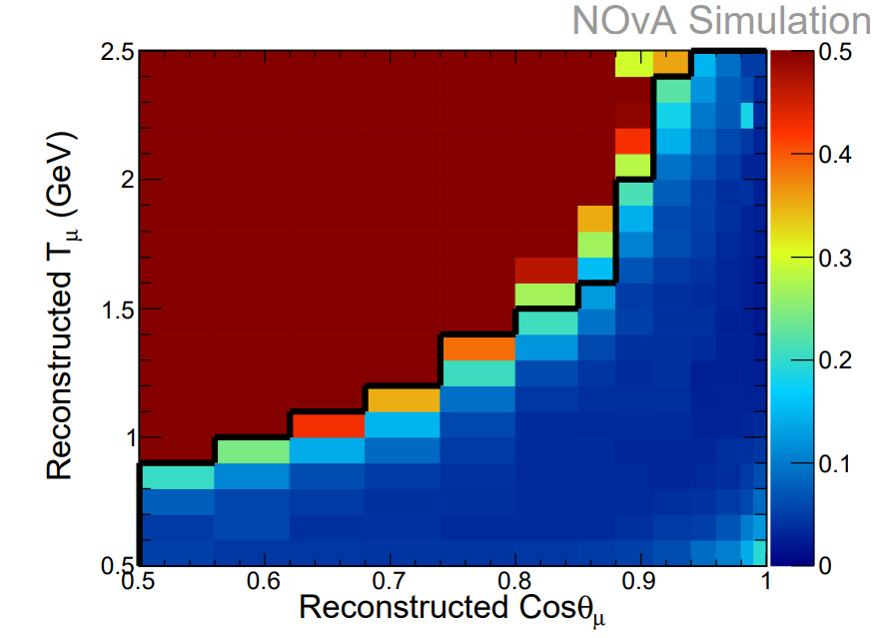
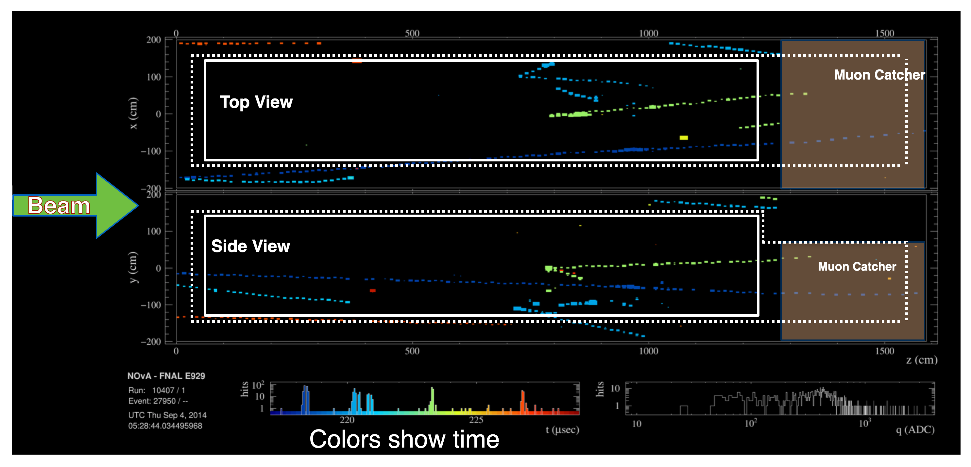
Signal definition:
The event is a true ν_{µ} CC interaction.
(Backgrounds = neutral currents, antineutrino events and electron neutrino events, etc)
The interaction occurred within the fiducial volume.
(270 cm in X by 270 cm in Y by 900 cm in Z)
Event muon kinematics satisfy criteria
that enhance selection efficiency and sample purity.
  True muon kinetic energy 0.5 GeV < T_{µ} < 2.5 GeV.
  True 0.5 < cos(θ_{µ}) and has an increasing cut off as T_{µ} increases.

Slide 10
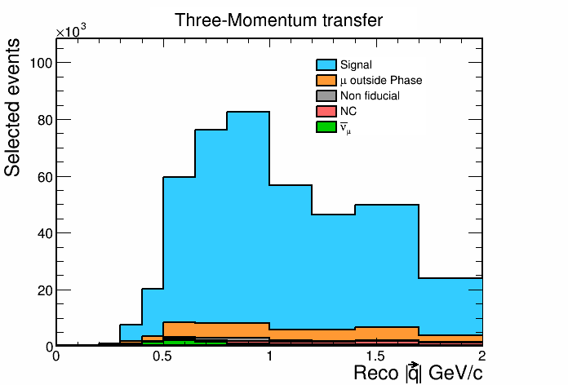

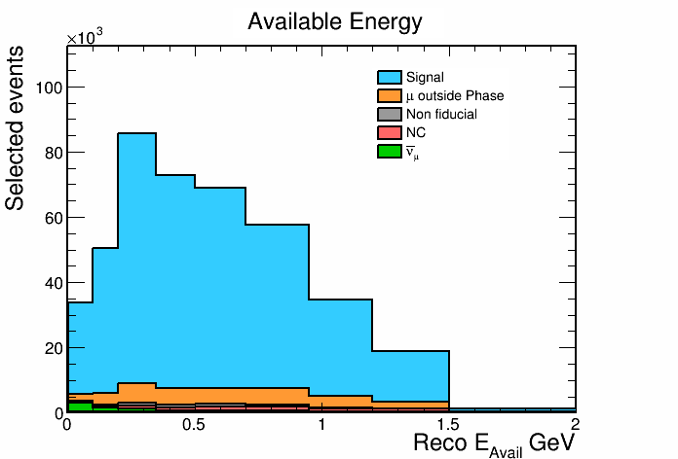
Background events in sample:
Process | Event fraction
Signal | 91.8%
Total background | 8.2%
Outside phase space | 3.7%
Non-fiducial | 1.8%
CC Anti-neutrino | 1.5%
Neutral current | 1.1%
Electron neutrino | 0.1%

Slide 11
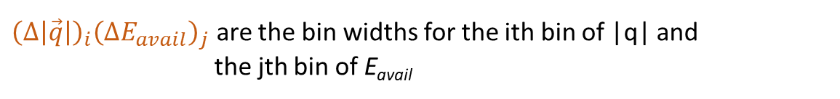
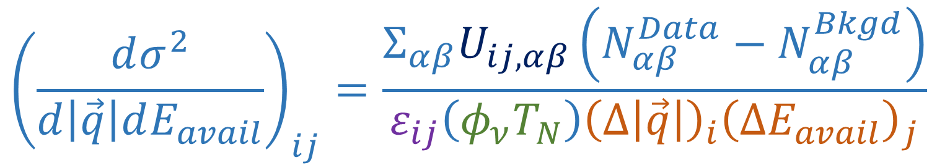
Double differential cross section in |q| and E_{avail}:
$${\left(\frac{dσ^{2}}{d\left|\vec{q}\right|dE_{avail}}\right)}_{ij}=\frac{Σ_{αβ}U_{ij,αβ}\left(N_{αβ}^{Data}−N_{αβ}^{Bkgd}\right)}{ε_{ij}\left(φ_{ν}T_{N}\right){\left(Δ\left|\vec{q}\right|\right)}_{i}{\left(ΔE_{avail}\right)}_{j}}$$
$N_{αβ}^{Data}−N_{αβ}^{Bkgd}$ is the selected data minus the estimated background in reco bins $αβ$
$U_{ij,αβ}$is unfolding matrix that maps bins of reco variables $αβ$ to bins of true variables ij
$ε_{ij}$ is the detection efficiency for bin ij
$φ_{ν}$ is the integrated neutrino flux
${\left(Δ\left|\vec{q}\right|\right)}_{i}{\left(ΔE_{avail}\right)}_{j}$ are the bin widths for the ith bin of |q| and the jth bin of E_{avail}
$T_{N}$ is the number of target nucleons

Slide 12
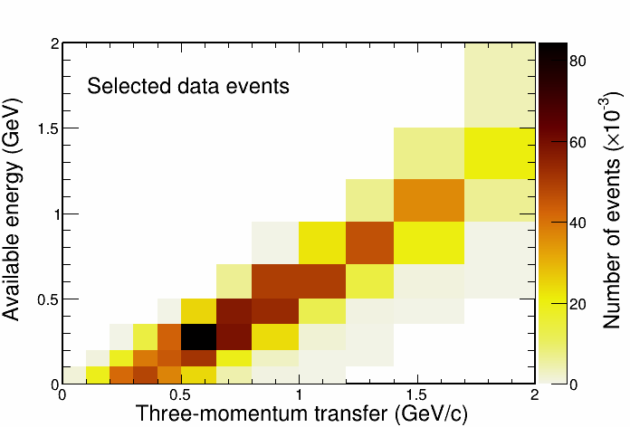
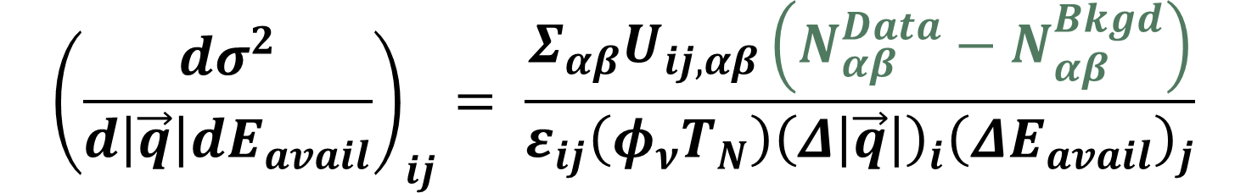
$${\left(\frac{dσ^{2}}{d\left|\vec{q}\right|dE_{avail}}\right)}_{ij}= \frac{Σ_{αβ}U_{ij,αβ}\left(N_{αβ}^{Data}−N_{αβ}^{Bkgd}\right)}{ε_{ij}\left(φ_{ν}T_{N}\right){\left(Δ\left|\vec{q}\right|\right)}_{i}{\left(ΔE_{avail}\right)}_{j}}$$
Almost 1 million selected neutrino events!

Slide 13
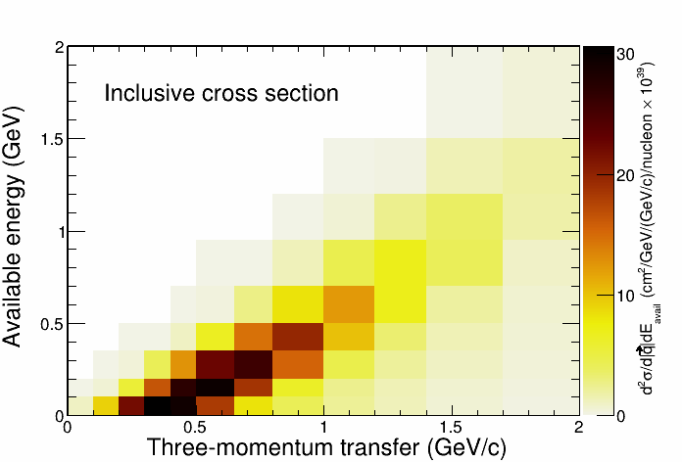
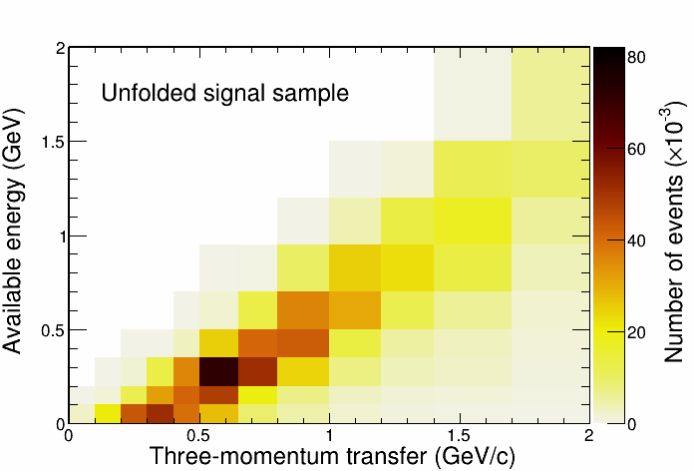
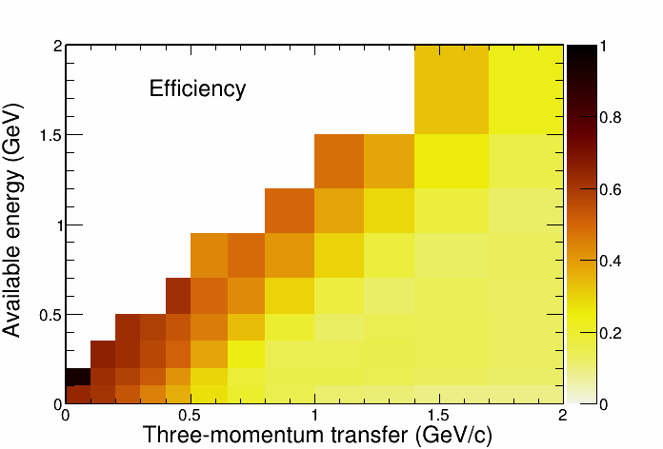
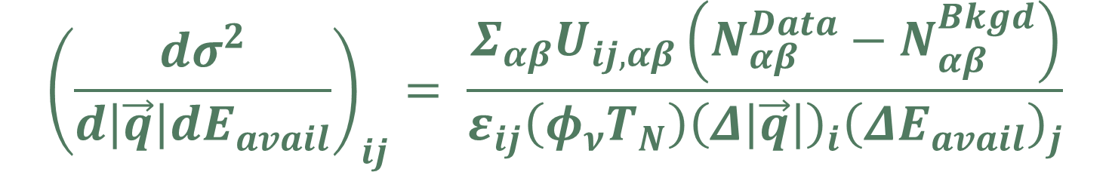
$${\left(\frac{dσ^{2}}{d\left|\vec{q}\right|dE_{avail}}\right)}_{ij}= \frac{Σ_{αβ}U_{ij,αβ}\left(N_{αβ}^{Data}−N_{αβ}^{Bkgd}\right)}{ε_{ij}\left(φ_{ν}T_{N}\right){\left(Δ\left|\vec{q}\right|\right)}_{i}{\left(ΔE_{avail}\right)}_{j}}$$
Unfolded data

Slide 14
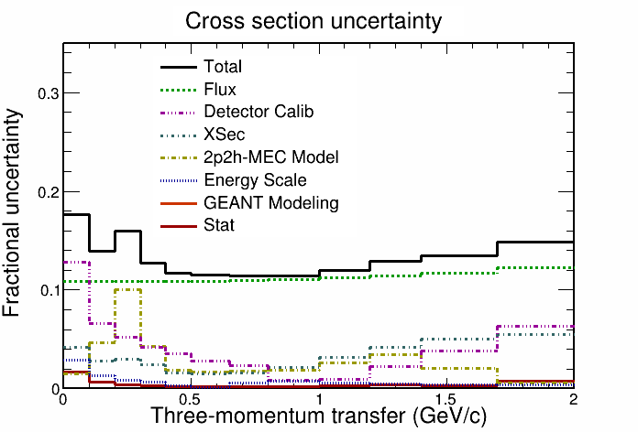
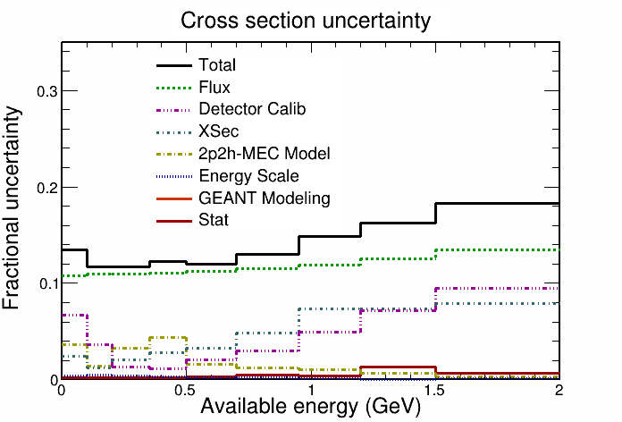
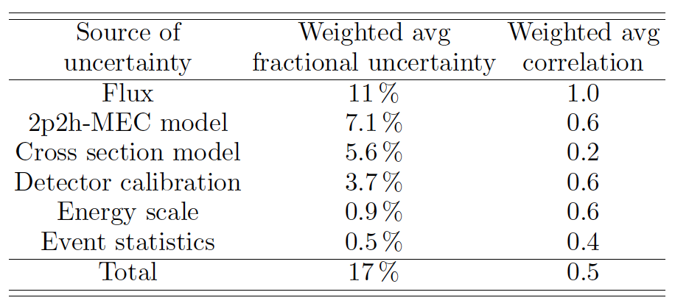
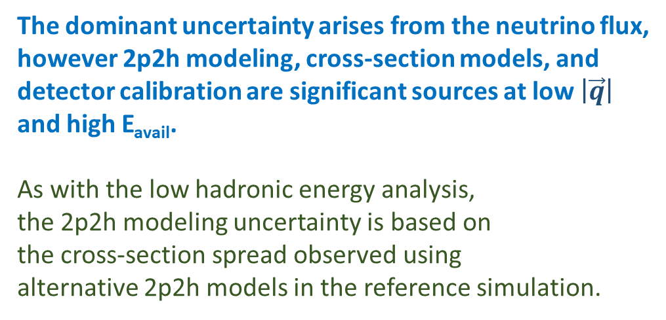
Cross-section Uncertainty:
The dominant uncertainty arises from the neutrino flux,
however 2p2h modeling, cross-section models, and
detector calibration are significant sources at low $\left|\vec{q}\right|$
and high E_{avail}.
As with the low hadronic energy analysis,
the 2p2h modeling uncertainty is based on
the cross-section spread observed using
alternative 2p2h models in the reference simulation.

Slide 15
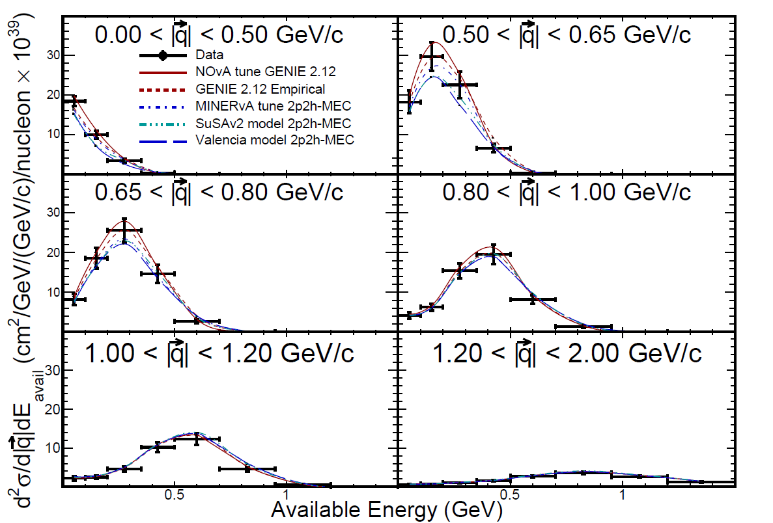
Cross section per analysis bins:
Cross section evolves in a regular way with increasing 3-momentum transfer.
Similar pattern reported previously by MINERvA:
PRL 116, 071802 (2016).

Slide 16
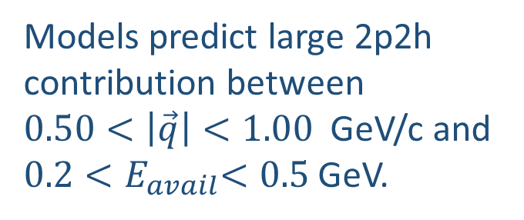
Cross section versus
2p2h models with GENIE 2.12:
Models predict large 2p2h contribution between
$0.50<\left|\vec{q}\right|<1.00$ GeV/c and $0.2{<E}_{avail}<0.5$ GeV.
NOvA tune 2p2h gives best description of data.
SuSAv2 and Valencia models
under-predict the data rate.

Slide 17
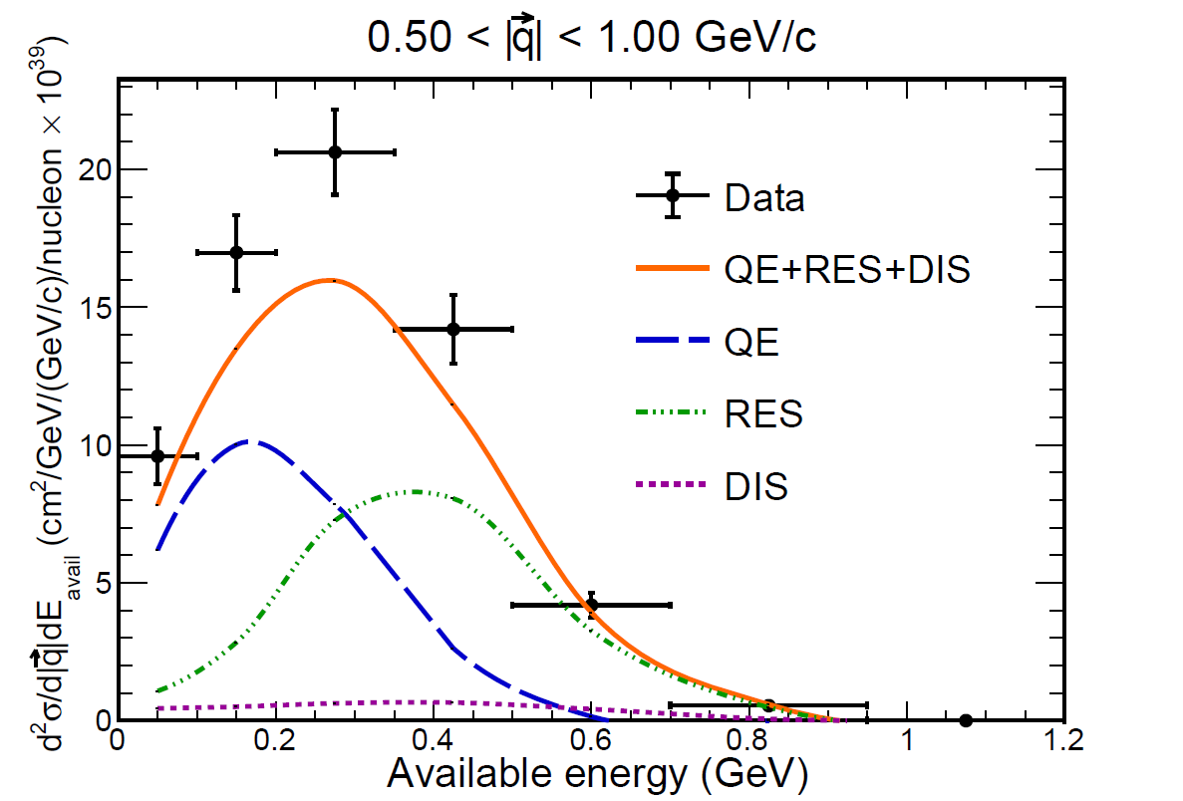
Data excess relative to neutrino-nucleon processes:
From electron nucleous scattering and theory 2p2h is expected to occur between QE and RES excitation.
The data does indeed show an excess in that region above expectation for ν_{μ} CC single-nucleon scattering.

Slide 18
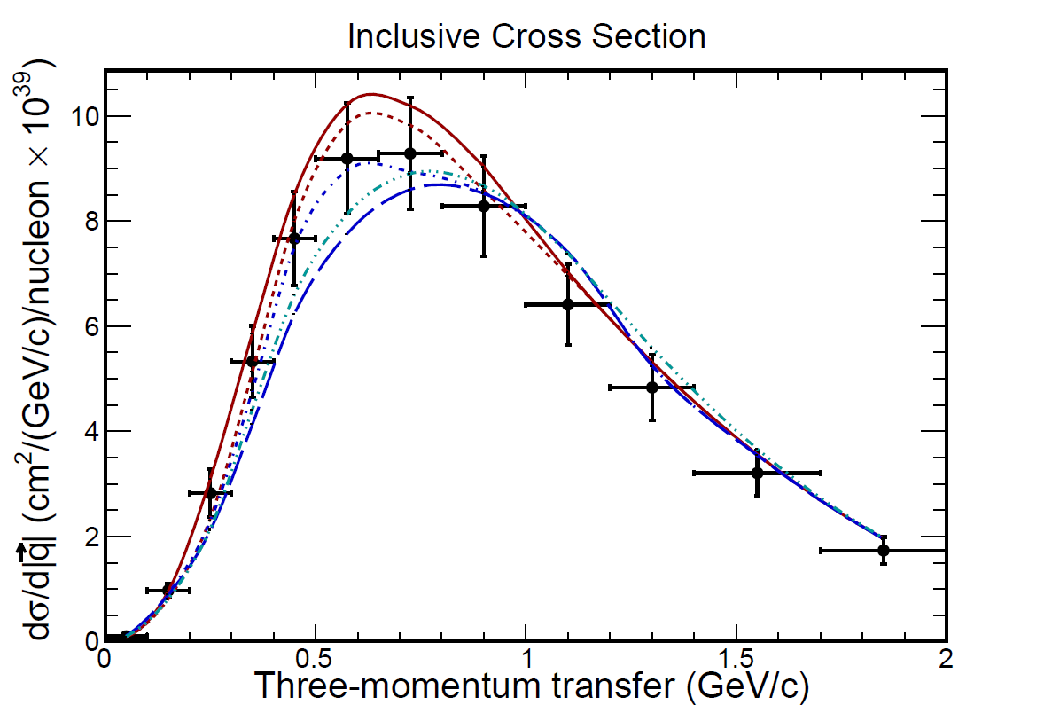
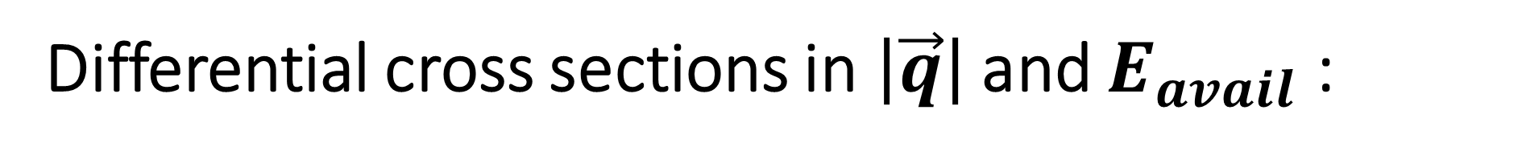
Differential cross sections in$\left|\vec{q}\right|$ and $E_{avail}$ :
Data comparison with models:
Better agreement with the data is obtained with NOvA tune and GENIE 2p2h than with theory-based models or the MINERvA tune.

Slide 19
χ² comparison of inclusive double-differential cross section using different 2p2h models within the GENIE framework:
Model | χ² NDF: 67
NOvA tune | 270 (218)
GENIE Empirical | 550 (493)
MINERvA tune | 746 (784)
SuSAv2 model | 766 (859)
Valencia model | 1501 (1748)
The values in parentheses are the shape-only χ2 calculations
The NOvA tune and GENIE empirical 2p2h give better agreement with the data than the theory-based models or the MINERvA tune.

Slide 20
Estimation of 2p2h contribution to CC inclusive scattering

Slide 21
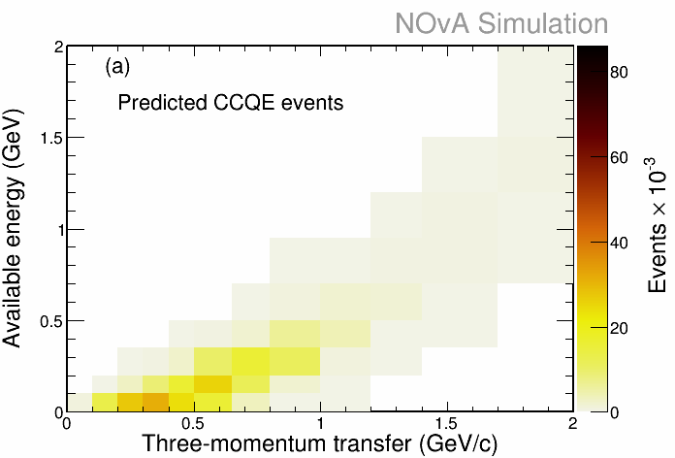
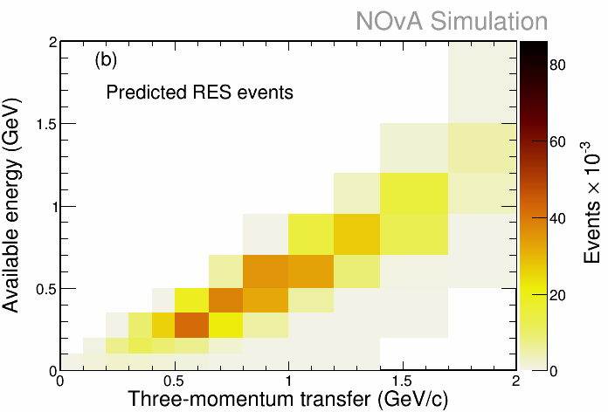
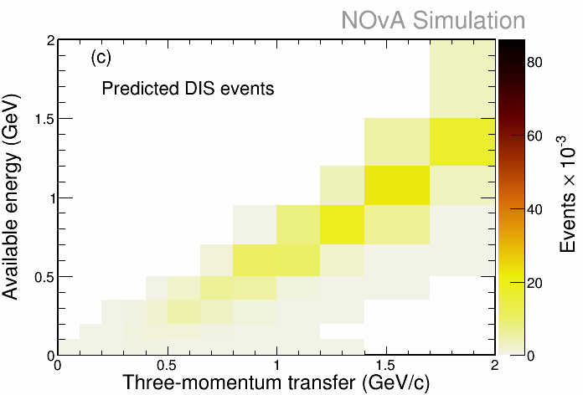
GENIE 2.12 based templates
are used to estimate distribution of CC 1p1h reactions:
QE
RES
DIS
Selected data
Template for CC coherent plus background is low population (not shown)
The data excess that lies above
the sum of 1p1h templates
is taken to be 2p2h.

Slide 22
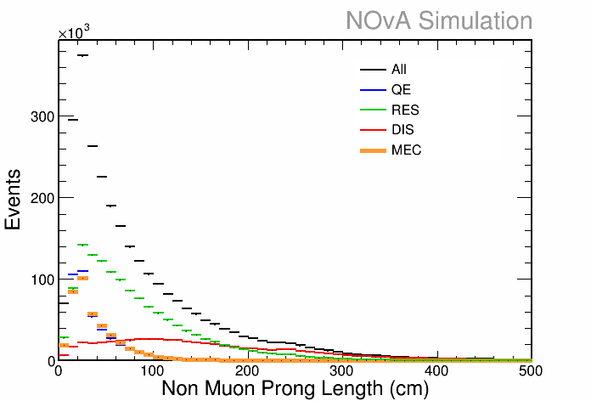
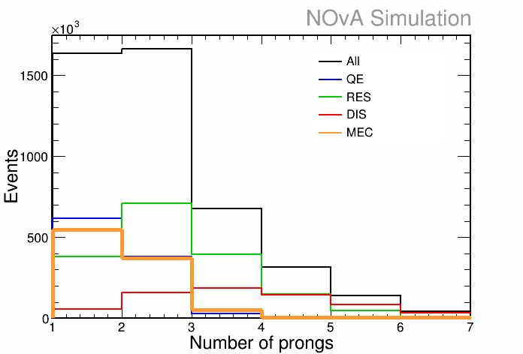
Control sample:
Select a subsample of events that have
1) A non-muon track of length > 100 cm
(Protons of CCQE and 2p2h almost
never reach that length)
or
2) Number of tracks + track-like clusters ≥ three
(CCQE and 2p2h almost never have 3 visible
tracks in NOvA ND)
2p2h almost never has 2 visible protons in NOvA ND
2p2h protons almost always shorter than 100 cm

Slide 23
The Control Sample contains RES and DIS events,
and is devoid of CCQE and 2p2h
The reference MC predictions for RES and DIS in the Control Sample are fit to
that sample, and the resulting normalizations are assigned to the inclusive RES and DIS templates.
The fit is carried out separately in regions (I) and (III) which are chosen to make optimal use
of the Control Sample: Region (I) is dominated by RES, while Region (III) has abundant DIS.
(I)
(II)
(III)
Template normalizations in Region (II)
are set to the averages of normalizations
for Regions (I) and (III).
The QE template is calculated using Llewellyn Smith formalism, relativistic Fermi gas nucleus with
high-momentum tail plus RPA correction.

Slide 24
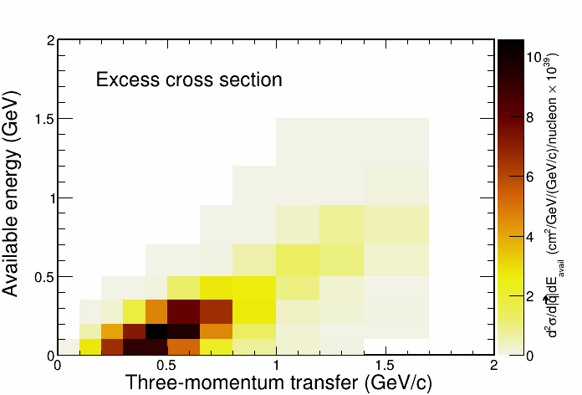
Estimated 2p2h cross section:
2p2h contribution is taken to be the data excess above the sum of the 1p1h templates.

Slide 25
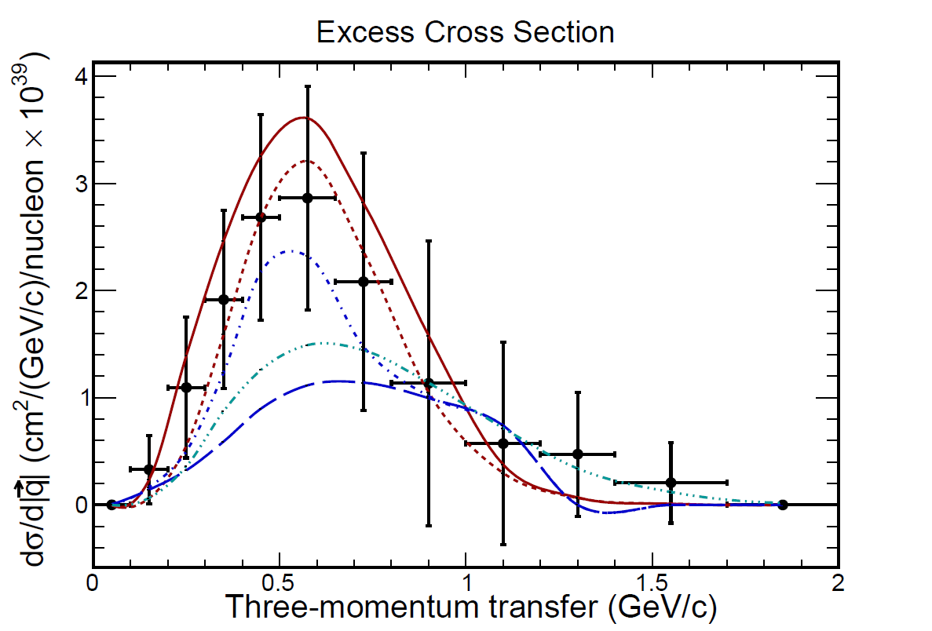
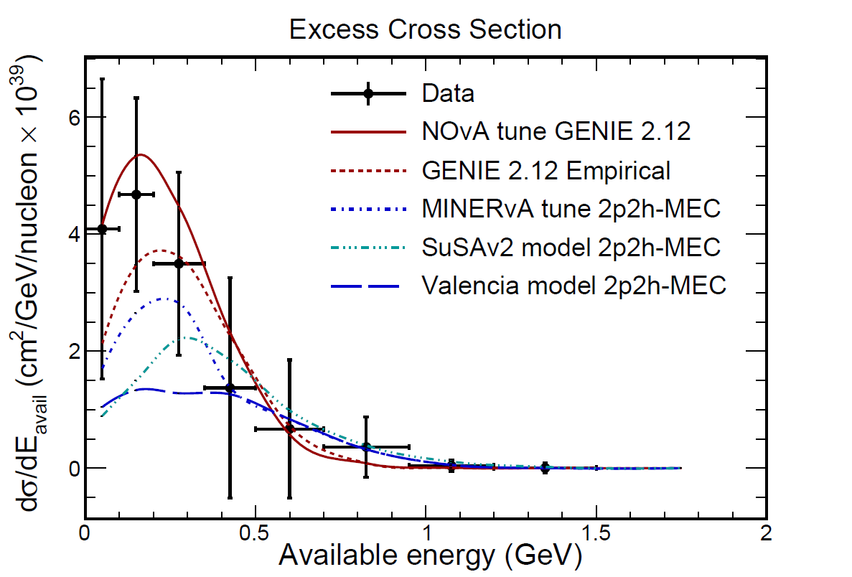

Differential cross sections in$\left|\vec{q}\right|$ and $E_{avail}$ :
Estimated 2p2h cross section

Slide 26
Excess cross section defines 2p2h active region of the measured ν_{µ} CC inclusive cross section:
χ² now focuses on the 2p2h active region of the inclusive sample.

Slide 27
χ² comparison of 2p2h models using active region of the ν_{µ} CC inclusive cross section:
Predictions for 2p2h models in GENIE 2.12 framework are compared to
ν_{µ} CC inclusive data in the active region using χ² with covariances.
Model | Χ² NDF:22
NOvA tune | 103 (81)
GENIE Empirical | 184 (167)
MINERvA tune | 84 (86)
SuSAv2 model | 176 (192)
Valencia model | 346 (391)
The values in parentheses are the shape-only χ2 calculations
Only the NOvA tune 2p2h describes the data.
The theory-based models give poor descriptions of the data.

Slide 28
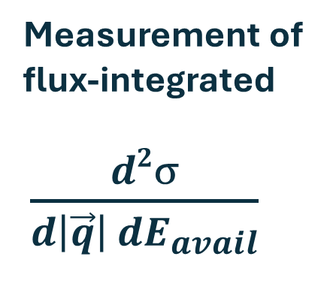
In conclusion:
We report a new high-statistics neutrino cross-section measurement at < E_{ν} > ≈ 1.9 GeV using the variables |three-momentum transfer| and available energy
arxiv: 2410.05526
Complementary analysis arxiv: 2410.10222
Measurement of
flux-integrated
$\frac{d2σ}{d\left|\vec{q}\right| dE_{avail}}$

Slide 29
Our analyses observes 2p2h
to have a significant presence:
Data excess relative to the expectation from scattering on single nucleons occurs in the transition region between CCQE and RES where 2p2h
is predicted to occur.

Slide 30
Model | Χ² NDF:22
NOvA tune | 103 (81)
GENIE Empirical | 184 (167)
MINERvA tune | 84 (86)
SuSAv2 model | 176 (192)
Valencia model | 346 (391)
In general, the theory based models
and the data tunes exhibit shortfalls
with predictions in bins of lower
3-momentum transfer and available energy.

Slide 32

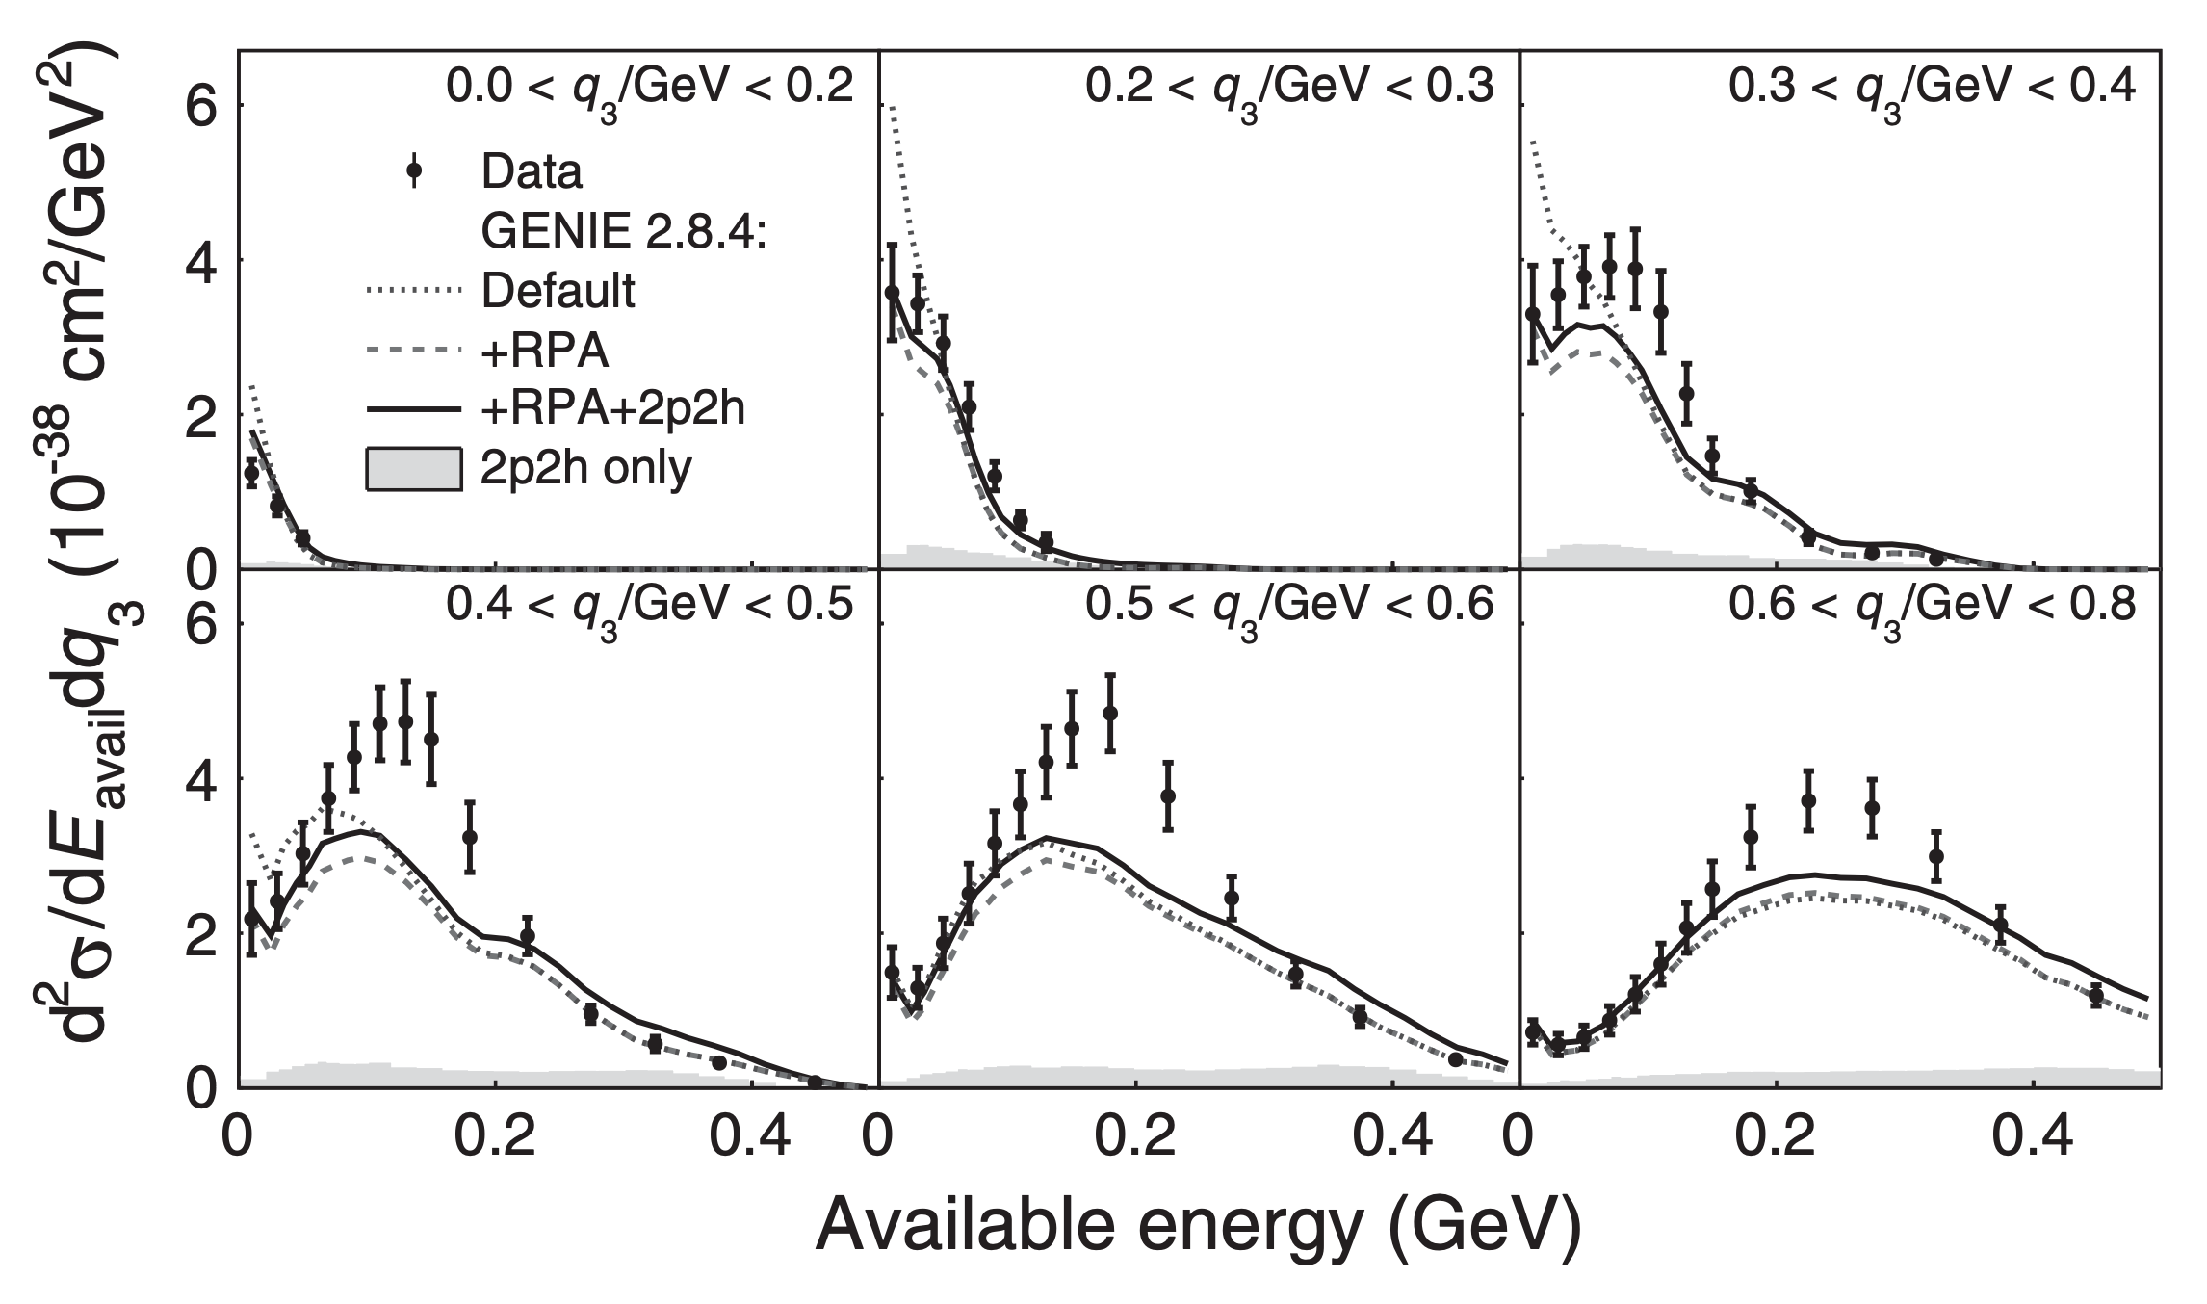
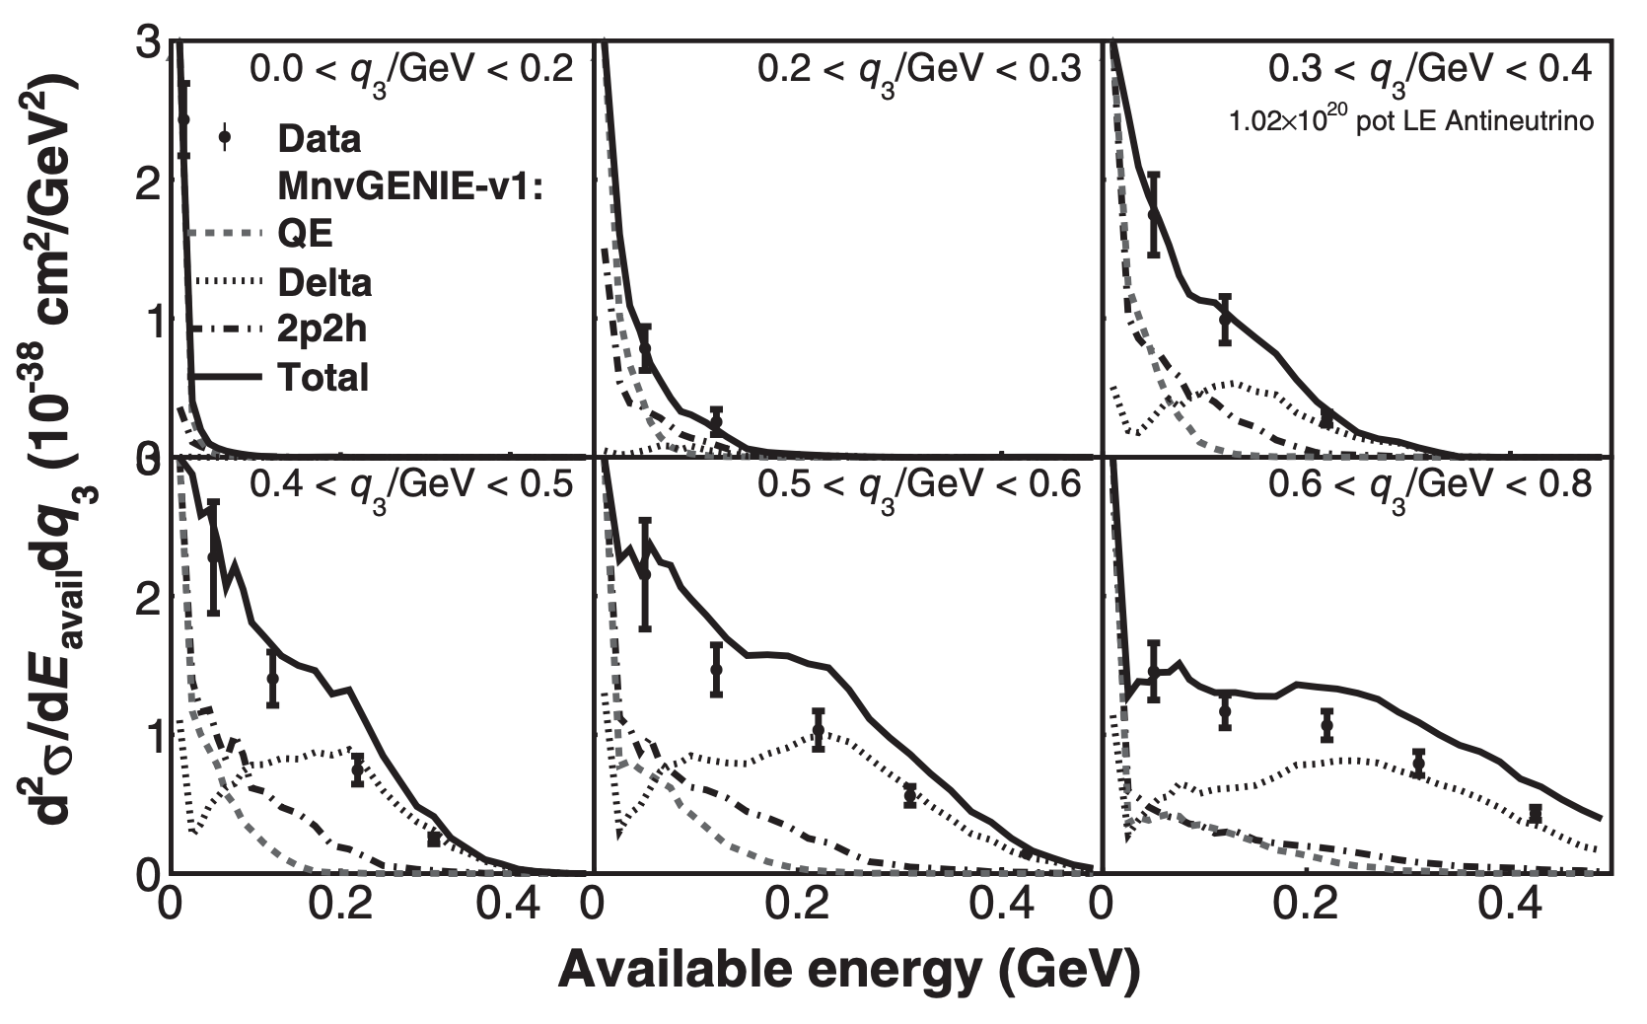
2p2h
Long standing efforts in the neutrino experiments to understand the 2p2h process
MINERvA pioneered measurements in kinematic regions with an enhanced population of multiproton final states.
No model describes the data
ν_{μ} - CC measurement compare with default GENIE 2.8
ν_{μ} - CC measurement compare to MINERvA-tune
Phys. Rev. Lett. 116, 071802
Phys. Rev. Lett. 116, 071802

Slide 33
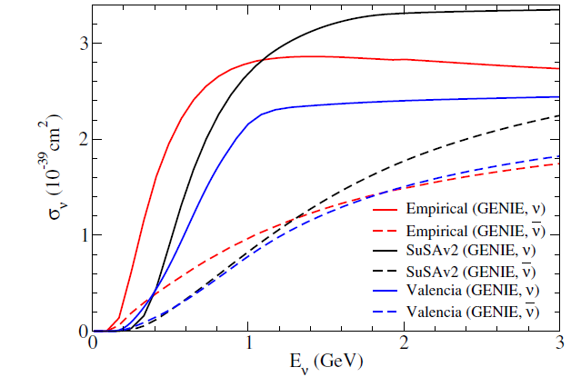
The 2p2h contribution to neutrino-nucleus charged-current scattering
has received abundant experimental attention in recent times:
MINERvA: Phys. Rev. Lett. 116, 071802 (2016), Phys. Rev. D 106, 032001 (2022).
T2K: Phys. Rev. D 98, 032003 (2018), Phys. Rev. D 108, 112009 (2023).
MicroBooNE: Phys. Rev. D 102, 112013 (2020), arXiv:2211.03734 (2022).
Phys. Rev. D 101, 033003 (2020).
The NOvA measurements probe 2p2h
with high statistics in the
neutrino energy range 1.0 < Ev < 3.0 GeV.
This range lies above the sub-GeV regime
examined by MiniBooNE, T2K, and MicroBooNE,
and on the lower edge of the
few-to-multi-GeV range studied by MINERvA.

Slide 34
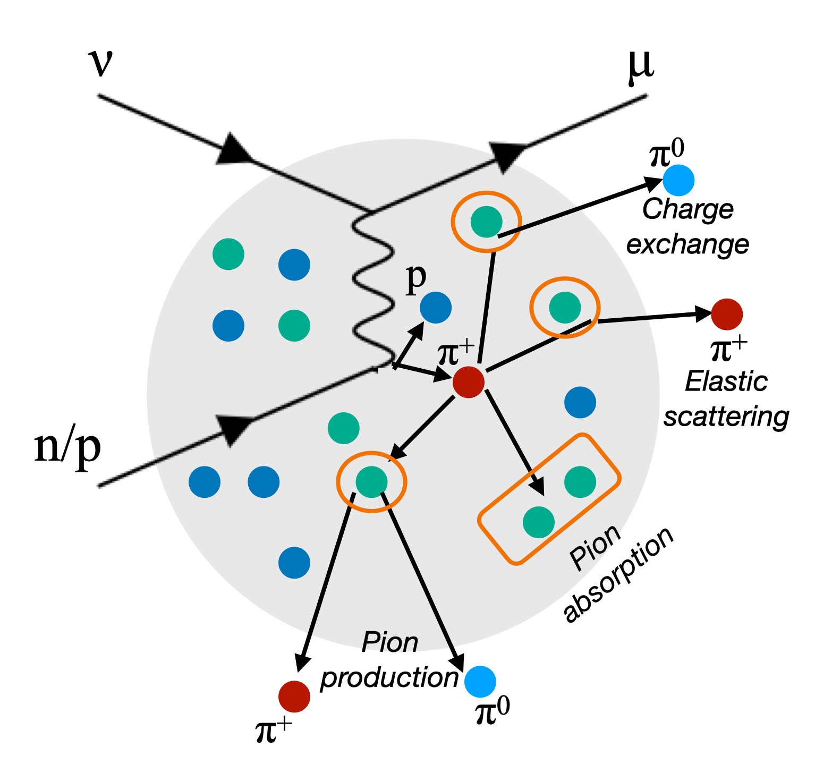
Nuclear effects
Nucleons on motion inside the nucleus (Fermi motion) and binding energy
Final State Interactions: additional hadrons, new hadrons, hadrons absorption, hadron kinematics change, etc.

Slide 35
NOvA exposure to NuMI beam
goal of running at 1MW in the next run
These analyses use 8.09 x 10²⁰ POT FHC data collected in the NOvA ND during the first couple of years
Near Detector exposure used in this analysis
Data collected in the NOvA ND so far:
26.76 x 10²⁰ POT of neutrino-mode data and 12.76 x 10²⁰ POT of antineutrino-mode
NuMI beam will aim 1MW in the next run!

Slide 36
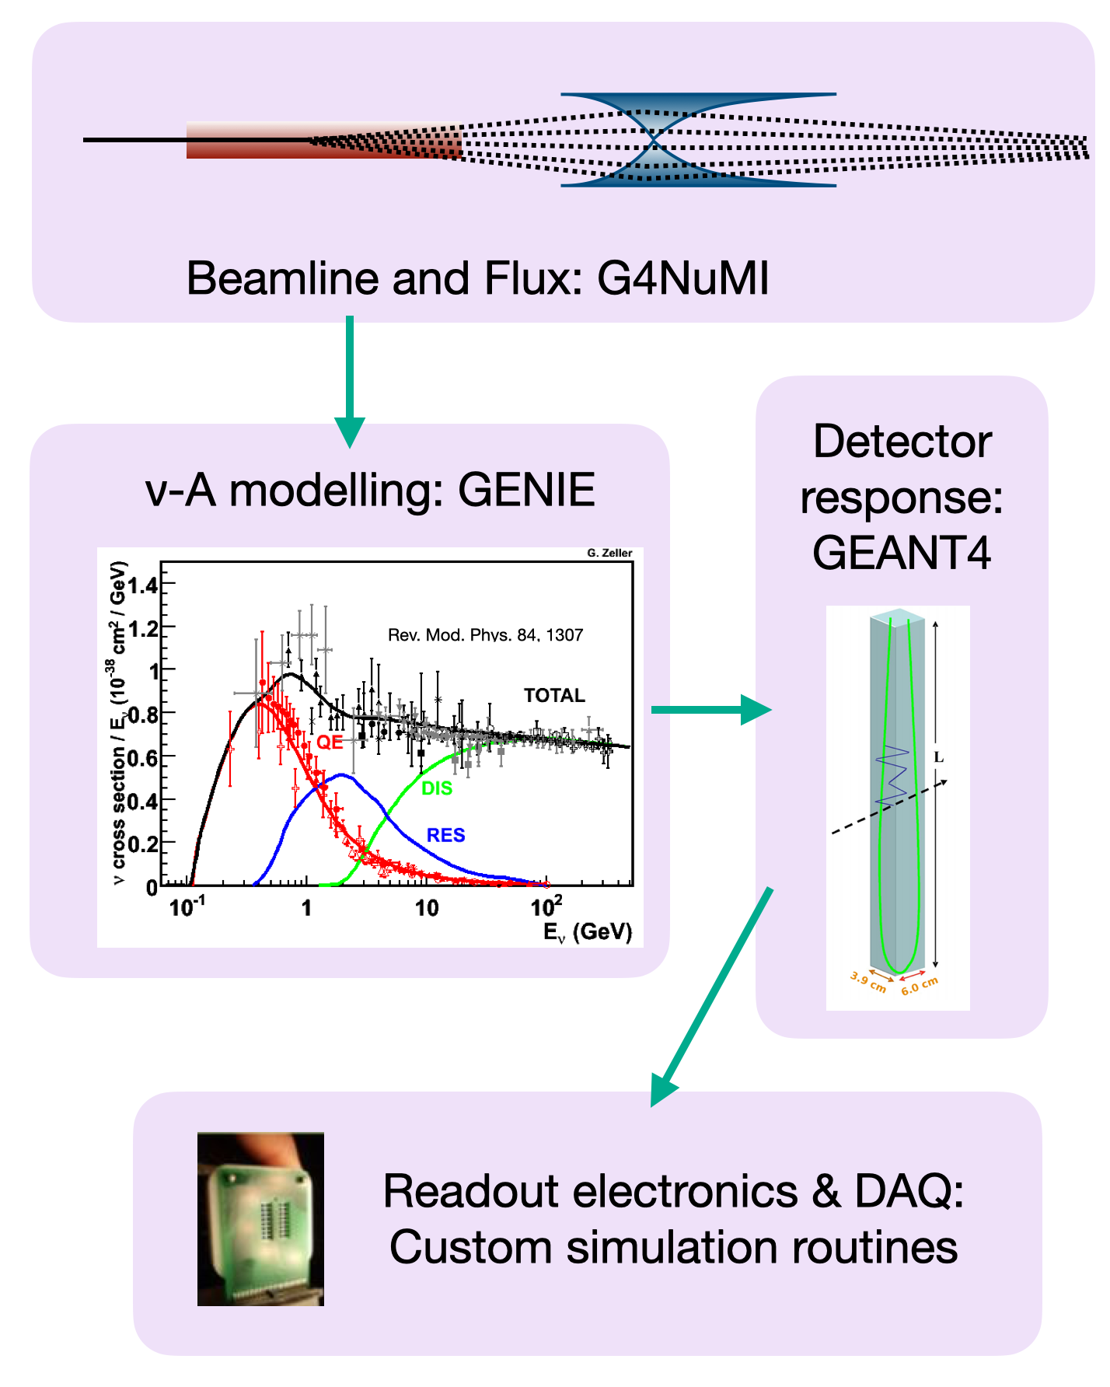
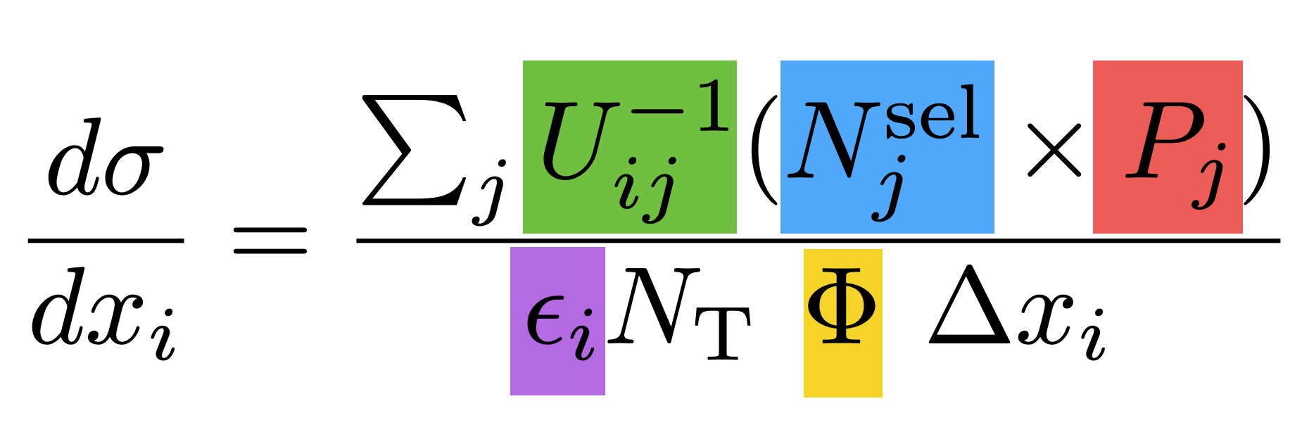
NOvA analysis
We rely on simulations for optimizing the selection, applying corrections for the background, smearing and efficiency and for the flux normalization

Slide 37


Muon identification
Muon ID calculated with a Boosted Decision Tree
Optimal cut value is determined to achieve the minimum shape systematic uncertainty on cross-section measurement
Sample has 97% purity and ~98% efficiency with respect to preselection
Cut value at 0.24
More details in Phys. Rev. D 107, 052011:
(Measurement of ν_{μ} - CC Inclusive Cross Section in the NOvA ND)

Slide 38



Analysis variables:
Neutrino energy: $E_{υ}$= $E_{μ}+E_{had}$
4-momentum transfer squared:
$Q^{2}=2∗E_{υ}∗\left(E_{μ}−P_{μ}∗{cos⁡(θ}_{υ})\right)−m_{μ}^{2}$
3-momentum transfer:
$$|\vec{q}|=\sqrt{Q^{2}+{(E_{υ}−E_{μ})}^{2}}$$
Available energy:
Kinetic energy: p/π±
Total energy: π⁰/e/γ
(neglect neutron energy)

Slide 39






Efficiency versus selections:
Selection sequence
Selection cut | Efficiency
All true signal | 100%
Quality | 99.9%
Track reconstruction (a) | 99.8%
Muon identification (b) | 85.3%
Vertex fiducial (c) | 82.3%
Muon containment (d) | 24.7%
Muon phase space (e) | 22.1%
Shower containment (f) | 18.7%

Slide 40

$${\left(\frac{dσ^{2}}{d\left|\vec{q}\right|dE_{avail}}\right)}_{ij}= \frac{Σ_{αβ}U_{ij,αβ}\left(N_{αβ}^{Data}−N_{αβ}^{Bkgd}\right)}{ε_{ij}\left(φ_{ν}T_{N}\right){\left(Δ\left|\vec{q}\right|\right)}_{i}{\left(ΔE_{avail}\right)}_{j}}$$
Unfolded data

Slide 41


$${\left(\frac{dσ^{2}}{d\left|\vec{q}\right|dE_{avail}}\right)}_{ij}= \frac{Σ_{αβ}U_{ij,αβ}\left(N_{αβ}^{Data}−N_{αβ}^{Bkgd}\right)}{ε_{ij}\left(φ_{ν}T_{N}\right){\left(Δ\left|\vec{q}\right|\right)}_{i}{\left(ΔE_{avail}\right)}_{j}}$$
Unfolded data

