Slide 1


HL-LHC Accelerator Upgrade Project
PMG #64
Giorgio Apollinari/Gianluca Sabbi/Vito Lombardo
Project & Deputy Project Managers
PMG – Oct 15th, 2024

Slide 2

Plans for Today
AUP Status – Apollinari/Sabbi/Lombardo
  Funding
  HiLumi Collaboration Meeting
  Technical Performance on 302.3 and 302.4
Status of 302.2 – Baldini/Ambrosio
Next PMG:
  Planned for Tue. Nov 19th

Slide 3

Project Manager Summary Assessment and Funding
AUP is fully funded at the rebaseline TPC level ($266M)
FY24-FY26 are “Carry-forward years”, with FNAL funds supporting activities at BNL and LBNL, if necessary
  No transfer to BNL expected.
  Completed a $2M transfer of funds from FNAL to LBNL.
    Further BCRs and Manual EAC adjustment might require additional corrections.
  Followed on monthly basis, might be impacted by future BCRs
 | Funding Received to Date | ACWP+OC to date | Remaining Funds at CD-4 (Based on BAC) | Remaining Funds at CD-4 (Based on EAC)
BNL | 45,541 | 36,931 | 2,267 | 2,274
LBNL | 46,634 | 43,460 | -707 | -713
Updated Aug 2024

Slide 4

14th HiLumi Collaboration Meeting

Slide 5
General Comments and Personal Impressions
Modification of CERN LS3 Schedule
Impression of a “Phase Change” in CERN-AUP relations
  Public Comments on 10 vs 11 AUP acceptable magnets
    Based on 2 QH situation in one magnet of LQXFAB-01. Comment is formally correct, but we believe one of the QH can be repaired with a simple pin replacement (failure probably introduced during cryoassembly construction), making the magnet formally acceptable
  Comments on (lack of) usability of RFD cavities if all approvals (WPS, etc.) are not in place before construction starts
    CERN cavity group massively invoking Safety Requirements in ways not experienced in known SRF endeavors (XFEL, PIP-II, ESS, SNS,..)
    Behavioral change between daily CM meetings and formal Steering Meeting
  Inconclusive Steering Meeting on one of the most critical items brought up for discussion (Threshold vs Objective KPPs)
    Little progress on CERN side to AUP proposal
    “Homework” has been re-assigned by the CERN HiLumi leader
This PM left the 14th CM with the conviction that continuous and attentive Management (at all levels) will be necessary in the course of AUP to CD-4

Slide 6
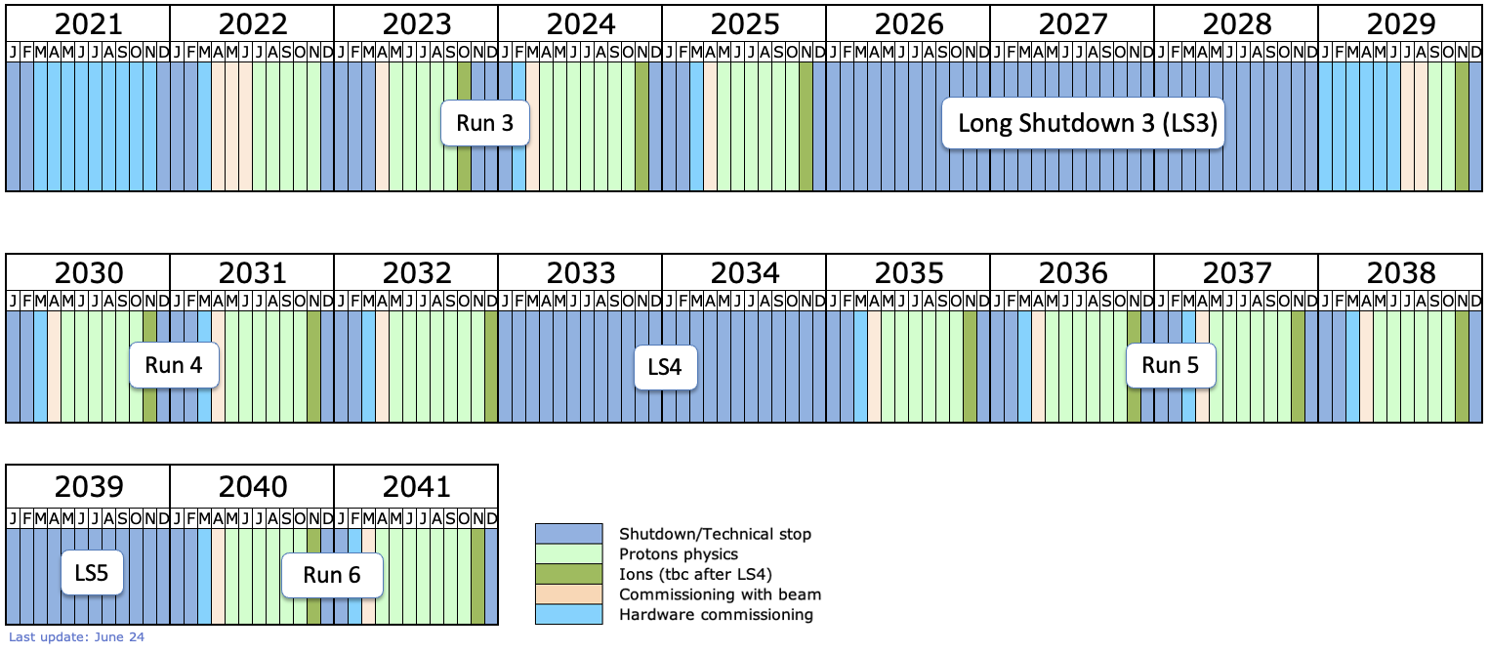
Schedule Update
LS4 will be one year shifted
Planned LS3 interventions still exceed LS3 length [47 months]
➔ Further Optimization needed!!!
PMG Meeting 10/15/2024

Slide 7
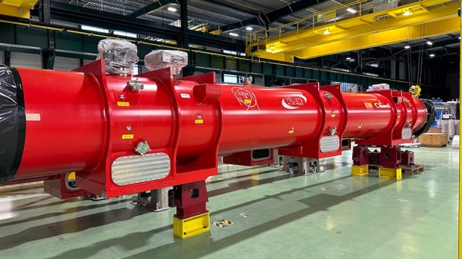
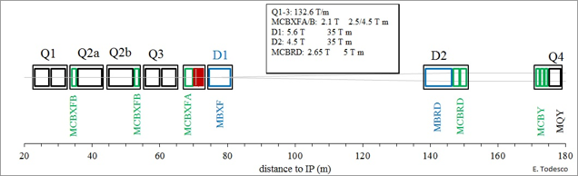
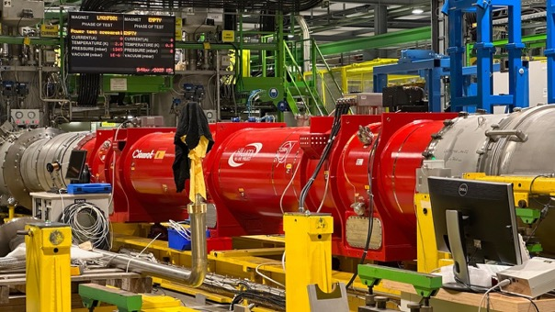
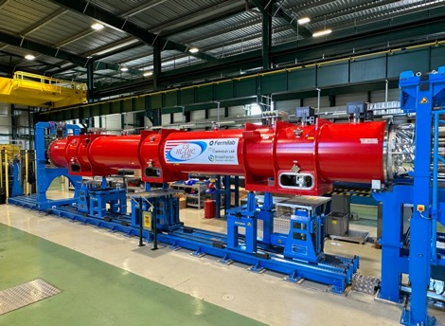
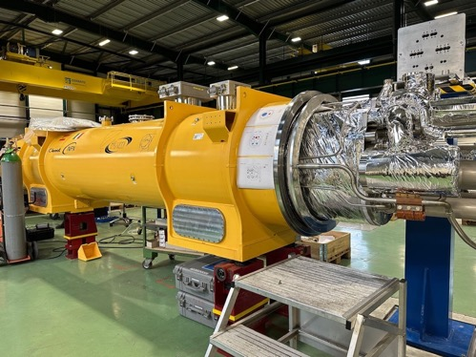
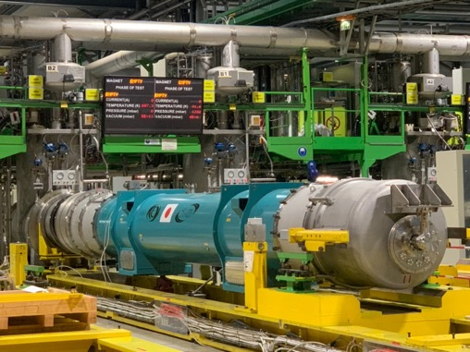
Magnet Validation for IT-String
Being tested @ FNAL;
Expected @ CERN by
November 2024
PMG Meeting 10/15/2024

Slide 8
DOE IPR Review – July 2024
Successful completion of July ’24 IPR Review
4 Recommendations
  3 “Technical” Recommendation on Crab Cavities
  1 “Management” Recommendation:
  Review and document the criteria by which the decision will be made to exercise scope contingency. Update all project planning as needed based on this review. Complete by the end of October 2024.
First pass at Criteria shared with IPT(DOE) on 9/16, and with CERN on 10/4

Slide 9
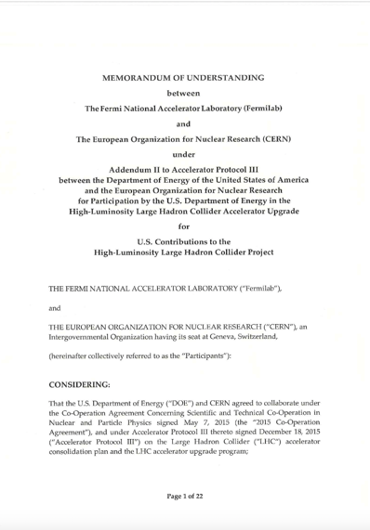
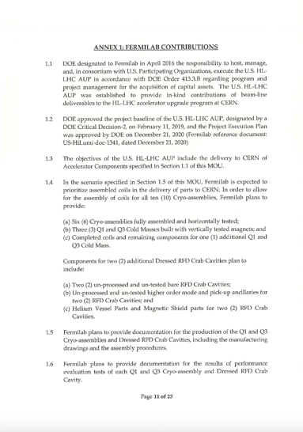
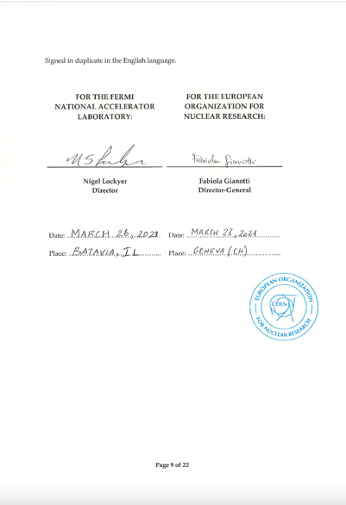
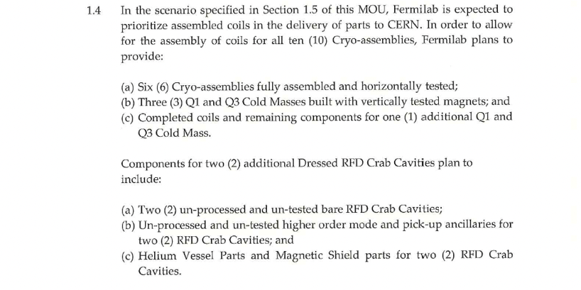
AUP Q1/Q3 and RFD Cavities Deliverables
Objective and Threshold KPPs
10 Q1/Q3 Cryoassemblies
(8 Operations + 2 Hot Spares)
10 RFD Dressed Cavities
(8 Operations + 2 Hot Spares)
HL-LHC AUP Project aims at Objective KPPs
Availability of funds is critical to meeting Objective KPPs

Slide 10
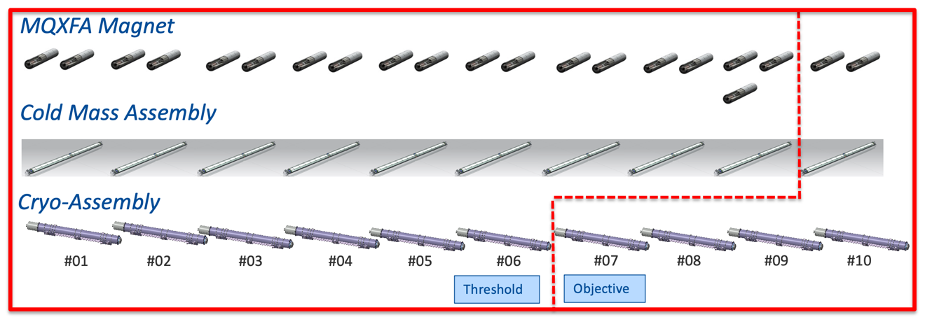
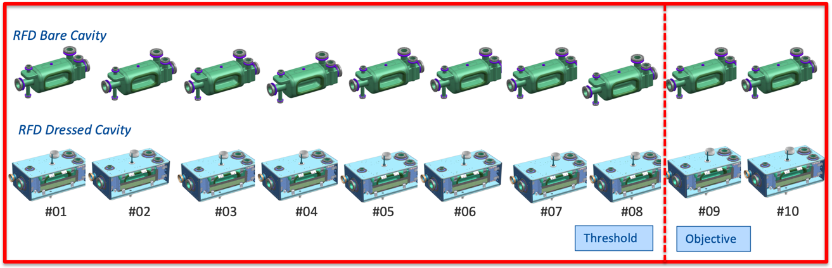
Threshold vs. Objective KPPs

Slide 11
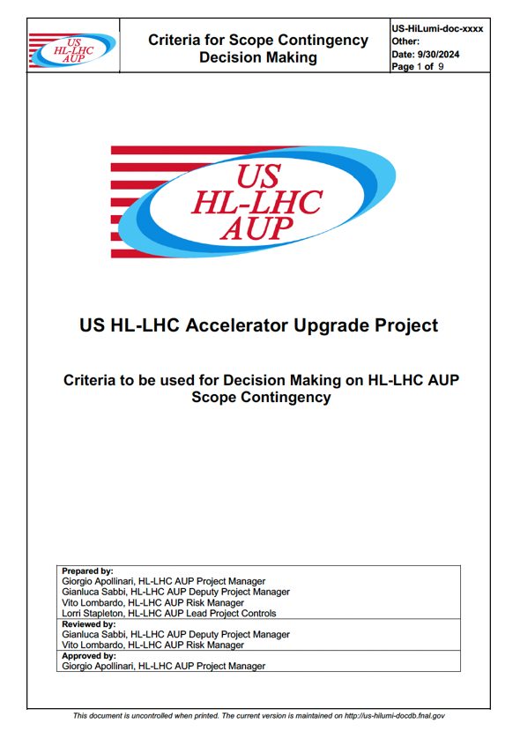
Objective vs. Threshold KPPs
Criteria for Decision Making
Criteria to trigger discussion with CERN on scope Reduction:
  Based on decreasing contingency performance
Criteria to execute scope Reduction:
  Based on preserving success for overall HL-LHC endeavor

Slide 12
Trigger Criteria
Excessive Decrease in Contingency can jeopardize achievement of final goals.
AUP strives to maintain C.L. for Risk Coverage at the 90% level.
Criteria #1: Discussions with CERN on Scope Reduction to recover Scope Contingency will be triggered by 3 consecutive reporting periods with a Confidence Level to cover extant Risks at - or below - 75%.
Criteria #2: Any Scope Reduction must ensure that capabilities and resources exist at other participating Labs (most notably CERN) to complete HL-LHC per approved design.
Criteria #3 (almost a Corollary to Criteria #2): Any Scope Reduction will prioritize execution in the US of Hard Scope* over Soft Scope*.

Slide 13
Comments on Execution Criteria
CERN can test AUP Cryoassemblies and has demonstrated so in the recent past (LQXFAB-01)
For operation maintenance purposes, CERN is committed to acquire the capability to assemble AUP Cold Masses and Cryoassemblies.
  In addition, CERN has designed the Cryoassembly and the tooling for it.
Today (and before AUP CD-4), CERN is not equipped and does not have the tooling to assemble AUP Magnets.

Slide 14
Cryo-Module Tests at CERN
For AUP cost reduction benefits, it is appropriate to interact today about the possibility for AUP cryomodule tests at the CERN Testing Facilities (following a mutually approved Test Plan based on LQXFAB Acceptance Criteria) as early as LQXFAB-04 or LQXFAB-05.
  Cost reduction: Cost in US reduced, facilitating achieving ”nuts & bolts” deliverables
  Scheduling: AUP perceives an advantage for CERN to receive LQXFAB CryoAssemblies at earlier times. As part of the HiLumi Collaboration, AUP knowledgeable personnel (scientists) will be present to help resolving any issues that might arise and requires AUP input on a timely fashion during the test.
No delivered AUP untested cryomodule will contain un-trained magnets (see 1TC Decision below)

Slide 15
Outcome of AUP-CERN Steering Committee on Obj. vs. Thr. KPPs
Non-decisional at this time
  WP3 (E.T.) complained that “request for help” should have started “from the bottoms up” at CERN
  No counter-proposal from CERN
  CERN WP3 acknowledge that the HiLumi leader asked for impact at CERN of additional US tests in SM18 and cost estimate, but that the estimate was not ready at this Steering Committee meeting
  CERN HiLumi Leader suggested a convergence by end of November.
Punted on the Threshold vs. Objective KPP discussion and resolution with CERN.

Slide 16
Magnets Vertical Test Decision
MQXFA Magnets vertical test is a critical QC step in the execution of the AUP Project
“Demonstration of stable performance following a thermal cycle” (Memory) was a critical early demonstration at the beginning of the MQXF magnets construction
  Since the beginning of the AUP projects, all magnets have been tested vertically through 2 Thermal Cycles, and – again – horizontally in the final cryostat through 2 thermal cycle.
Early in the AUP planning - due to financial constraints - a total of ~5 MQXFA magnets were planned to be inserted in cryostats without a Vertical Test.
  Experience is indicating that the risk of not testing a magnet vertically has not decreased substantially as production progressed
  The re-assembly of an LQXFA/B Cryostat was introduced in the AUP Baseline to mitigate risks due to untested magnets

Slide 17
Magnet Vertical Test Decision (cont.)
Observation that all magnets that failed a vertical test were identified in the 1st Thermal Cycle (TC1) and all of them could be repaired.
Magnet | Number of quenches in TC1 | Number of quenches in TC2 | Comments
MQXFA03 | 10 | 0
MQXFA04 | 6 | 0
MQXFA05 | 8 | 0
MQXFA06 | 20 | 0 | Training at 4.5 K up to quench#12
MQXFA07 | 14 | N/A
MQXFA07b | 0 | 1 | 4 trips and 1 quench at 4.5 K in TC2
MQXFA08 | 18 | 5 | 2 quenches in superconducting leads during TC1; issue with splice to top-head fixed before TC3
MQXFA08b | 6 | 2
MQXFA10 | 19 | 0
MQXFA11 | 14 | 0
MQXFA13 | 32 | N/A
MQXFA13b | 16 | 0 | 1 trip
MQXFA14b | 5 | 1
MQXFA15 | 2 | 1 | 3 trips
MQXFA17 | 21 | N/A | 2 trips
Summary w/o re-assemblies:
TOTAL # of quenches | 169 | 7 | Min: 2 Max: 32
Average # of quenches/test | 14 | 0.8
Average Qh Good: ~10
Average Qh Bad: ~21
(?therapeutic obstinacy?)

Slide 18
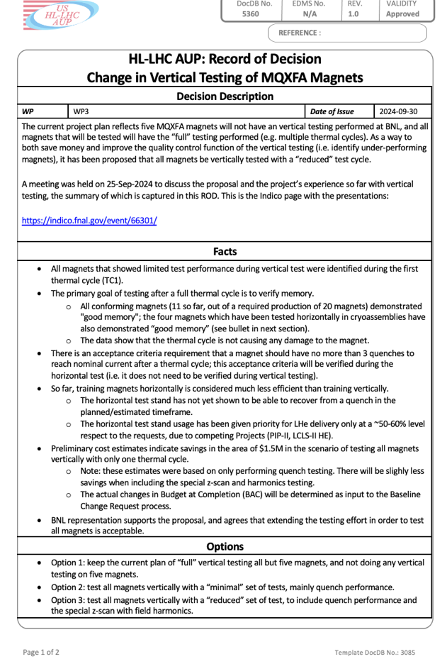
Magnet Vertical Test Decision (cont.)
Decision: Test all remaining MQXFA Magnets vertically through only TC1 and reduce number of magnetic measurements at BNL. Also avoid “therapeutic obstinacy”.
  Pros:
    Reduce considerably risks for LQXFA/B, eliminating the necessity to carry forward a cryomodule re-assembly in the baseline schedule
    Reduces costs and anticipates schedule
  Cons:
    Training memory establishment delayed from Vertical Test to LQXFAB Horizontal Test

Slide 19
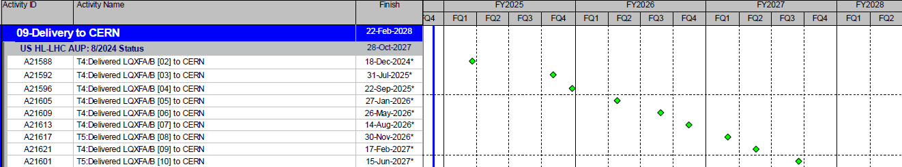
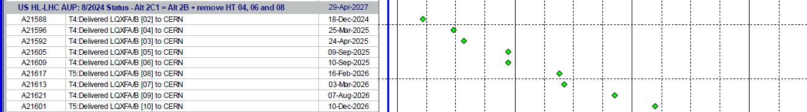
Preliminary Impact Assessment of ROD
Present Baseline
(with magnet failures)
Plan with 1TC and
04-06-08 at CERN

Slide 20
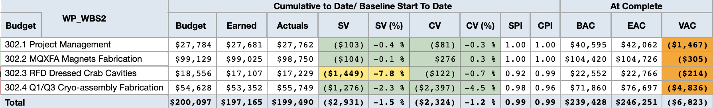
Cost Performance Report (Aug 2024)
Aug 2024 Status (after Rebaseline):
  SPI = 0.99, CPI = 0.99
Total Project Cost (TPC): $266.0M
Budget At Completion (BAC): $239.4M
Estimate at Completion (EAC): $246.2M
ETC_{EAC} (EAC-ACWP): $46.8M
Contingency_{EAC} (TPC – EAC): $19.7M
% Spent: 81.0%
Aug. ‘24 Risks C.L. Coverage: ~80%
Contingency as % work-to-go: 56.9% (on BAC)
42.2% (on EAC)

Slide 21
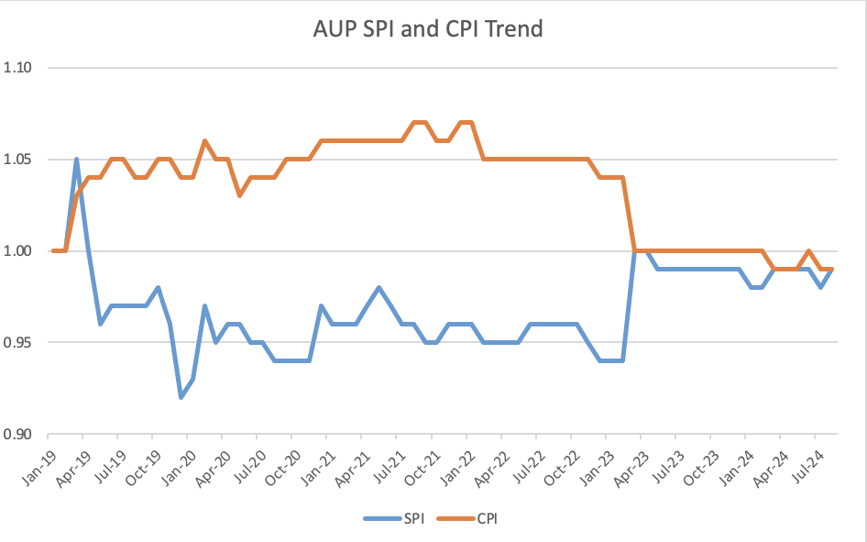
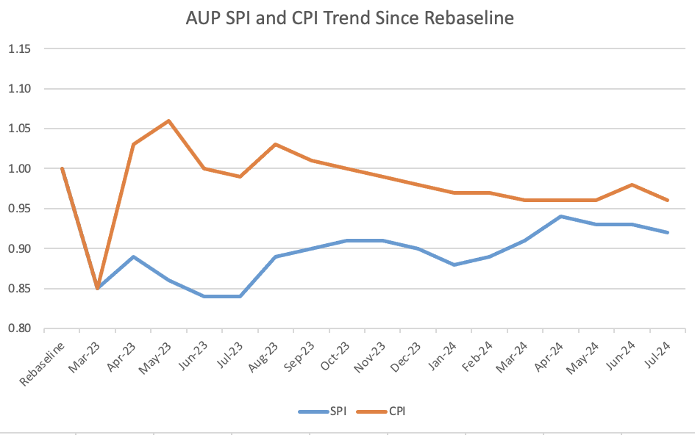
CPI and SPI Historical Performance
For several CAs, SPI and CPI performance can be clouded by large portion of effort completed.
  CPI/SPI from Rebaseline (Mar. ‘23) plotted as well

Slide 22
BCRs approved/considered in Aug-Sep. 2024 CCBs
BCR # | Description | Cost ($k) | Sch. (days)
368 | Update on CM/CA Labor Hours | 831k | 0
366 | Added one coil to maintain yield assumption | 192k | 0
342 | PO for RFD Magnetic Shield and He Jackets | -890k | 0
Manual Adjustment (~4.8M$ in Aug. ‘24) includes:
  ~989k$ for Horizontal Testing adjustments in CA03-10
  ~700k$ for LOE adjustments from difference between PMB and working Schedule
  ~352k$ for rework one additional magnet to maintain yield assumptions
  ~908k$ Vertical Test to maintain yield assumptions

Slide 23
(Short) Technical Status

Slide 24
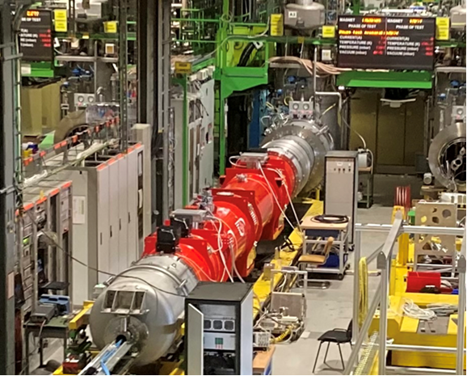
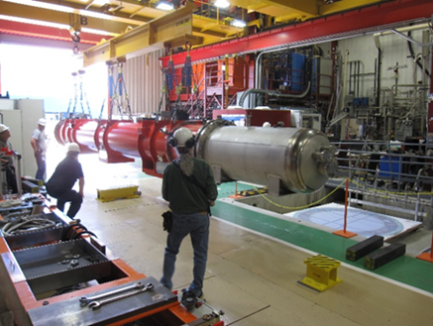
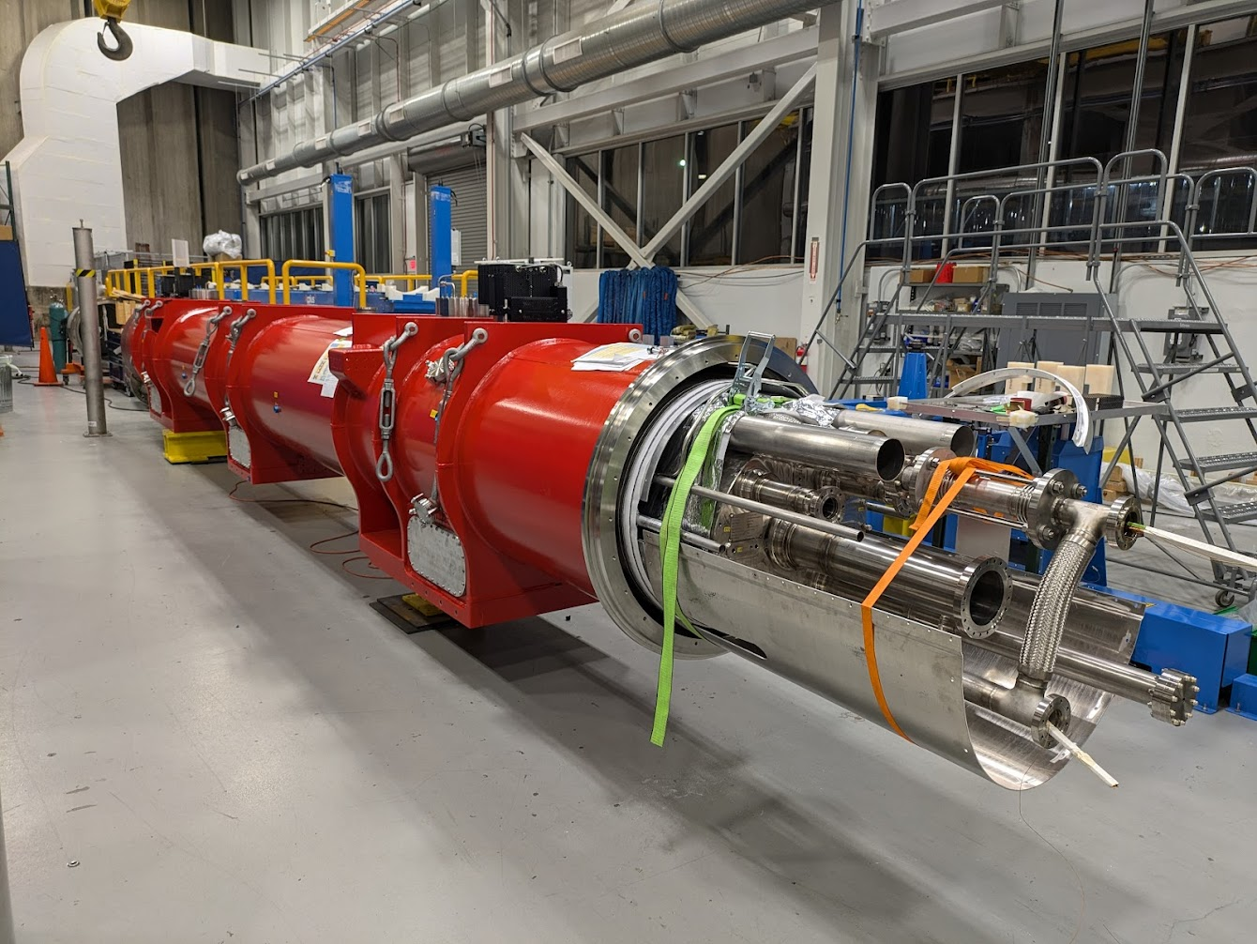
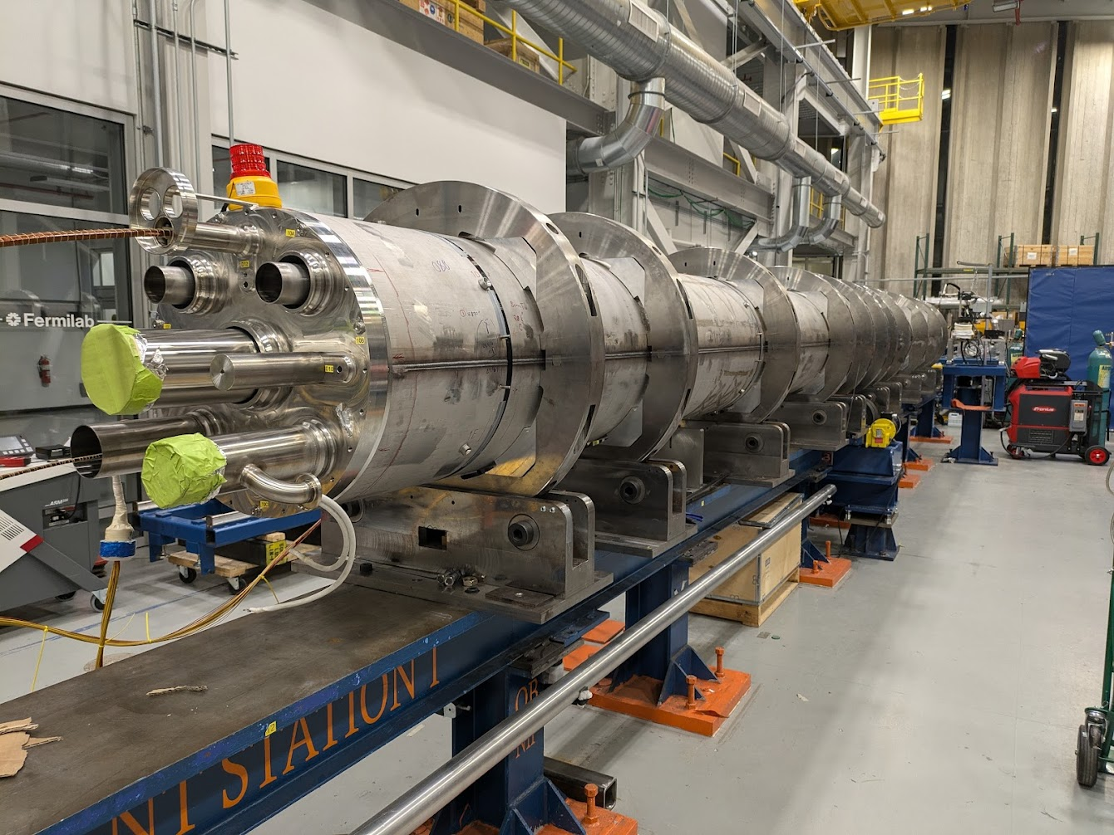
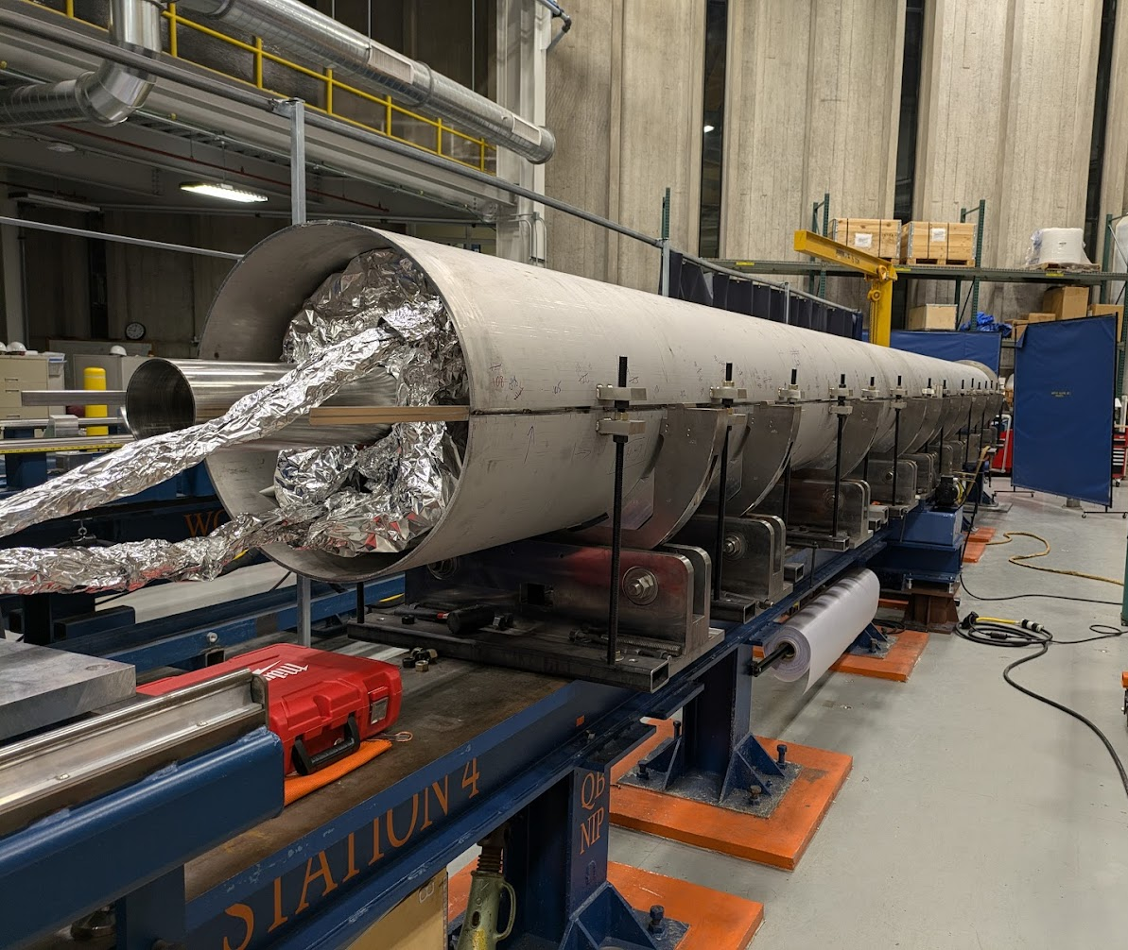
302.4 - Cold Mass & Cryostat Assembly Status
S. Feher
CA01 accepted by CERN.
CA02 IB1 test completed, warm up in progress.
CA03 prep for combination pressure/leak test.
CM04 capillary tubes are next.
CM05 ready for longitudinal shell welding.
CM06 MQXFA13b has been shipped to FNAL
 | Qa | Qb | Weld | Cryo | Test | Ship
CA01
CA02
CA03
CA04
CA05
CA06
CA07
CA08
CA09
CA10
MQXFA04,MQXFA03
MQXFA05,MQXFA06
CA02, test stand
CA01, CERN
CA02, test
MQXFA010,MQXFA11
MQXFA14b,MQXFA8b
MQXFA07b,MQXFA15b
CA03, ICBA
CM04, ICBA
CM05, ICBA

Slide 25
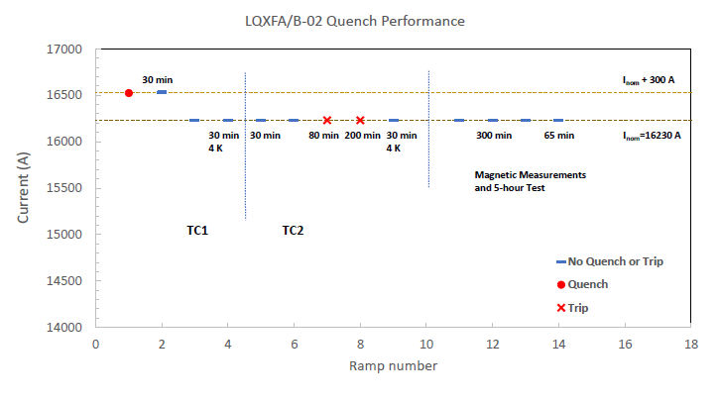
302.4 - LQXFAB-02 Test Status
S. Feher
LQXFAB-02 cold test results are satisfactory
  Excellent vacuum pressure at cold 10⁻⁷ torr
  Only one spontaneous quench; two trips – PS phase back glitch
  Holding current test up 300 min successful
  To execute Pressure/Leak test at FNAL before shipment to CERN planned for Nov. 18th

Slide 26
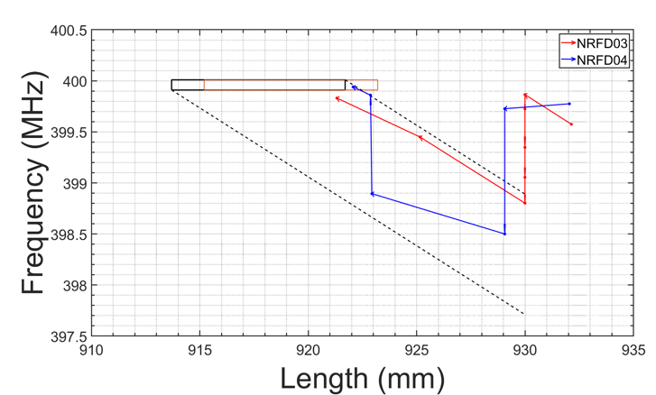
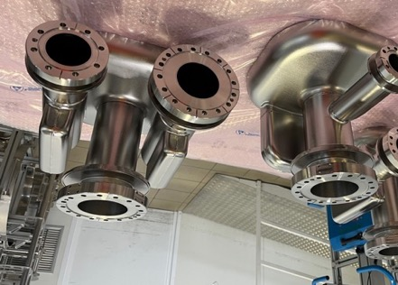
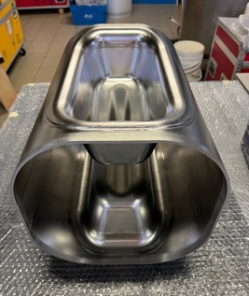
302.3 - Cavity Fabrication Status at Zanon
L. Ristori
First two series NRFD03 & NRFD04 are undergoing trim-tune operations (see plot and pictures). Cavity length, cavity geometry, and frequency all need to be OK
NRFD04 was presenting non-standard behavior after the first cut (frequency reduction after cut versus expected frequency increase). After reshaping, the following cut was as expected.
Final welds will be completed later this month.
All components for series cavities were produced in parallel. Deliveries are expected to ramp up dramatically in the next 6 months if approvals can be obtained.
Created team lead by J. Blowers to follow-up on CERN approvals
Plot by T. Posos
Some Components of Series #3 and #4 ready for trim-tuning

Slide 27
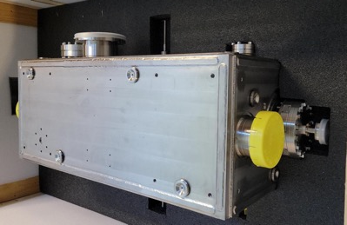
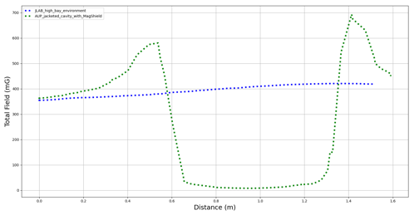
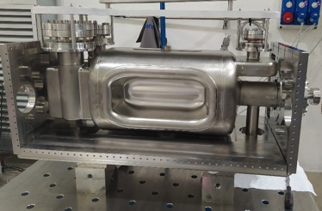
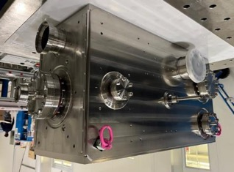
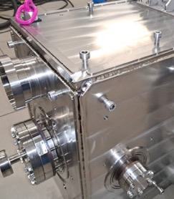
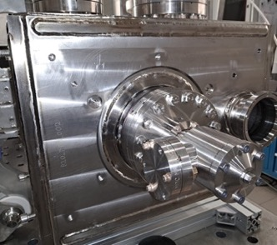
302.3 - Prototype Jacketing at Zanon
L. Ristori
RFDP002 Successfully Jacketed
Welding of Proto #2 Helium Tank was completed without surprises and with ~zero frequency shift.
Cavity is at JLAB waiting for cleanroom equipment to be ready for HPR and preparations for cold test.
Magnetic measurements were completed, showing an attenuation factor of ~ 40x well above specification.
No changes foreseen for pre-series / series.
Magnetic Measurements
~400 mG
~10 mG
Welding of plates
Welding of fastener covers
Start of Assembly
Completed Assembly

