Slide 1
Dr. Piermaria oddone farewell symposium
The Fermi Site Office
US Department
of Energy
June 13, 2012

Slide 2
Famous Oddones Through History
Oddone Frangipane
Roman Aristocrat
Oddone Eugenio Maria
Prince of Savoy

Slide 3
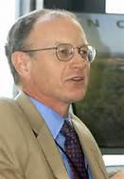
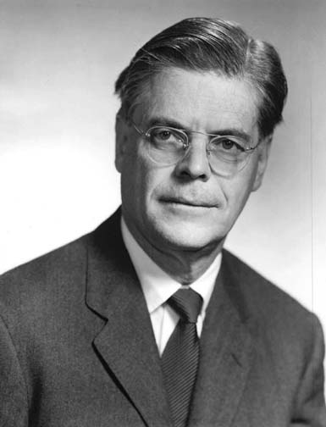
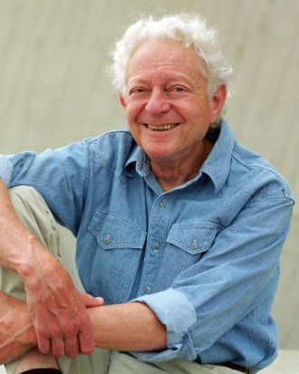
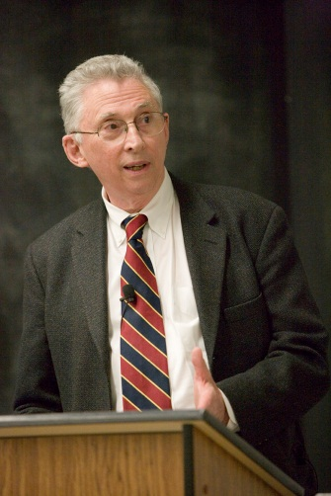
Pier’s “Family” Tree…
Michael Witherell
Robert Wilson
Leon Lederman
John Peoples
Notes:
Comes from good stock.

Slide 4
pier’s impressive legacy
Piermaria Oddone
Significant contributions to Higgs Boson discovery
Conclusion of 28 great years of Tevatron operations
Partnership with the State of Illinois to build IARC.
Chartered course for Intensity Frontier
Conceptualized the Muon Campus Concept
DECam, MINERvA, US CMS, NOvA, Microboone, Mu2e, G-2, LBNE
Record Beam Power and Protons-on-Target for neutrino studies
Notes:
LHC Remote Operations Center Partnership
Strong relationship with DOE, the Community and HEP
Guiding NOvA and the CMS Upgrade
Implementing Community Advisory Board Meetings

Slide 5
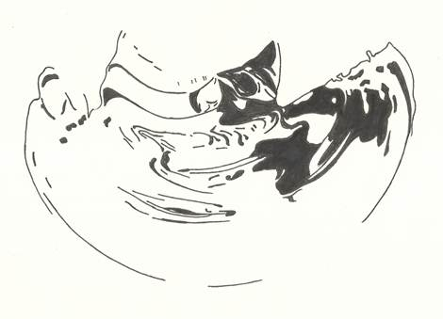
Sometimes things may appear unclear

Slide 6
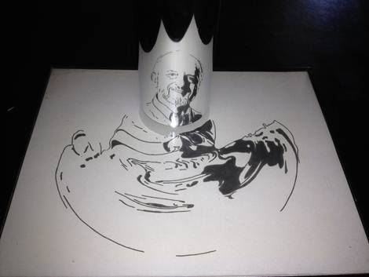
But with time and the right perspective... greatness is revealed

Slide 7
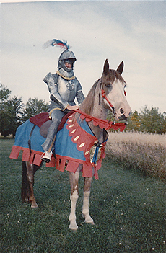
It’s clear pier comes from “noble” lineage

Slide 8
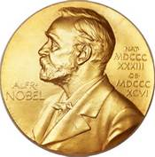
And we believe pier will continue to have “nobel” impact

Slide 9
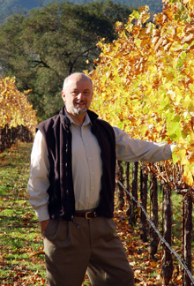
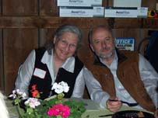
All the best pier and barbara
Notes:
Wine Making

