Slide 1
Muon Accelerators for the Next Generation of High Energy Physics Experiments
JP.Delahaye/SLAC on behalf of
M. Palmer, Director, U.S. Muon Accelerator Program
and the MAP collaboration effort:
Labs: ANL, BNL, FNAL, JLAB, LBNL, ORNL, SLAC
Universities: Chicago, Cornell, IIT, Princeton, UC-Berkeley, UCLA, UC-
Riverside, UMiss
Companies: Muons, Inc; Particle Beam Lasers

Slide 2
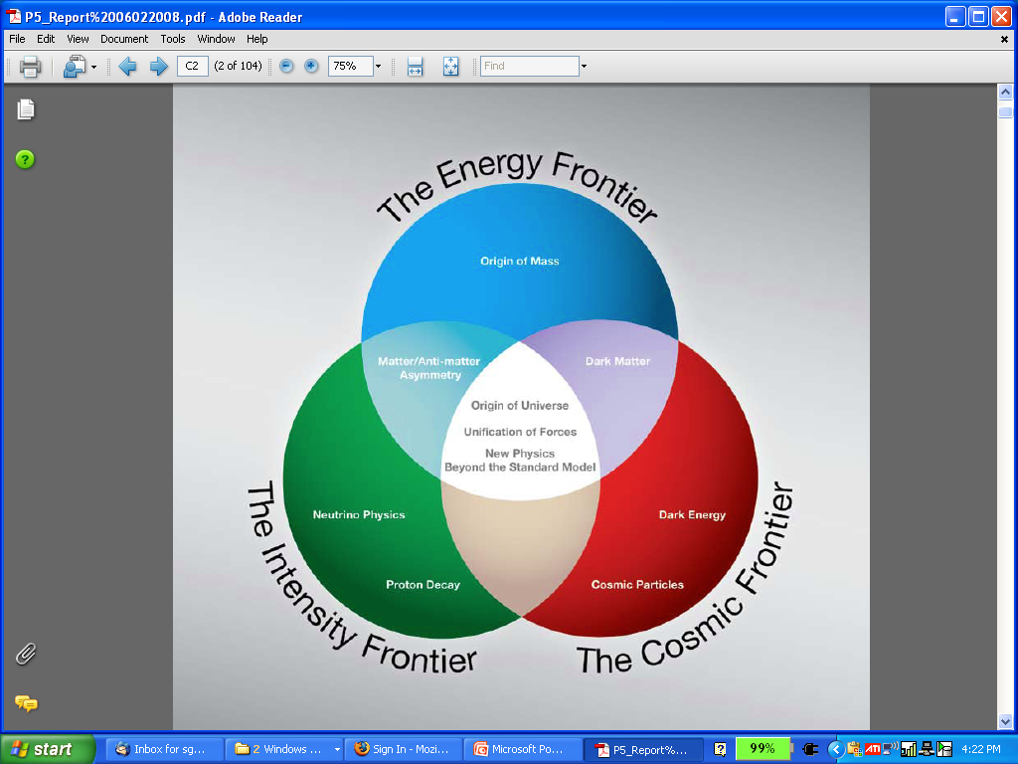
The Aims of the Muon Accelerator Program
  Muon accelerator R&D is focused on developing a facility that can address critical questions spanning two frontiers…
  The Intensity Frontier:
  with a Neutrino Factory producing well-characterized ν beams for precise, high sensitivity studies
  The Energy Frontier:
  with a Muon Collider capable of reaching multi-TeV CoM energies
  and
  a Higgs Factory on the border between these Frontiers
The unique potential of a facility based on muon accelerators is physics reach that SPANS 2 FRONTIERS

Slide 3
The Physics Motivations
μ – an elementary charged lepton:
  200 times heavier than the electron
  2.2 μs lifetime at rest
Physics potential for the HEP community using muon beams
  Provides equal fractions of electron
  and muon neutrinos at high intensity
  ideal for neutrino oscillations studies
    (the Neutrino Factory concept)
  As with an e⁺e⁻ collider, a μ⁺μ⁻ collider offers a precision probe of fundamental interactions
  Large coupling to the “Higgs mechanism”
    Precision Higgs width determination by g-2 precision beam energy measurement

Slide 4
Muon Accelerator Physics
Large muon mass strongly
suppresses synchrotron
radiation
  a Muons can be accelerated &
  stored using rings at much
  higher energy than electrons
  Colliding beams of higher
  quality due to reduced
  beamstrahlung
Novel technology with major technical challenges
  Muon beams produced as tertiary beams
  Large transveres and longidunial emittances: 6D cooling!
  Short muon lifetime
    Fast acceleration and limited storage time of a muon beam
    Collider a a new class of decay backgrounds must be dealt with
:
Beamstrahlung in
any e+e- collider
δE/E ∝ γ²

Slide 5
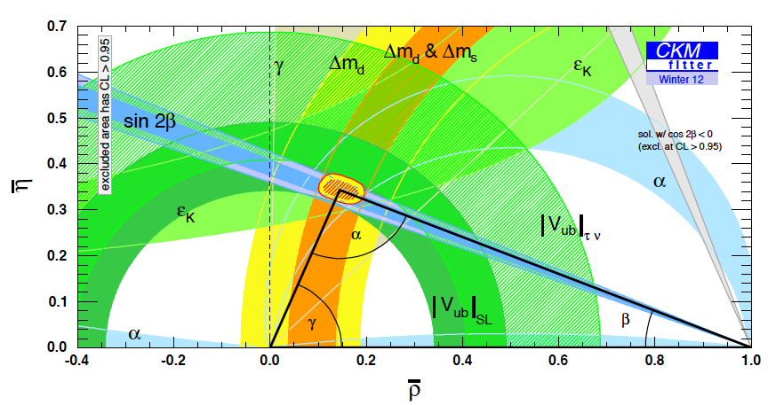
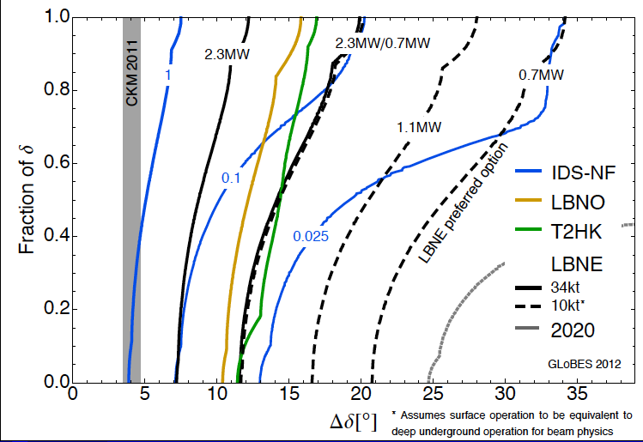
Neutrinos: outstanding Physics
In neutrino sector critical to understand:
  δ_{CP}
  The mass hierarchy
  θ₂₃ = π/4, θ₂₃ < π/4 or θ₂₃ > π/4
  Resolve LSND and short baseline experimental anomalies
  And continue to probe for signs new physics
CP violation physics reach of various facilities (compared to CKM matrix)
P. Huber
IDS-Neutrino Factory
0.025 IDS-NF:
700kW target,
no cooling,
2×10⁸ s running time
10-15 kTon detector
P. Coloma, P. Huber, J. Kopp, W. Winter

Slide 6
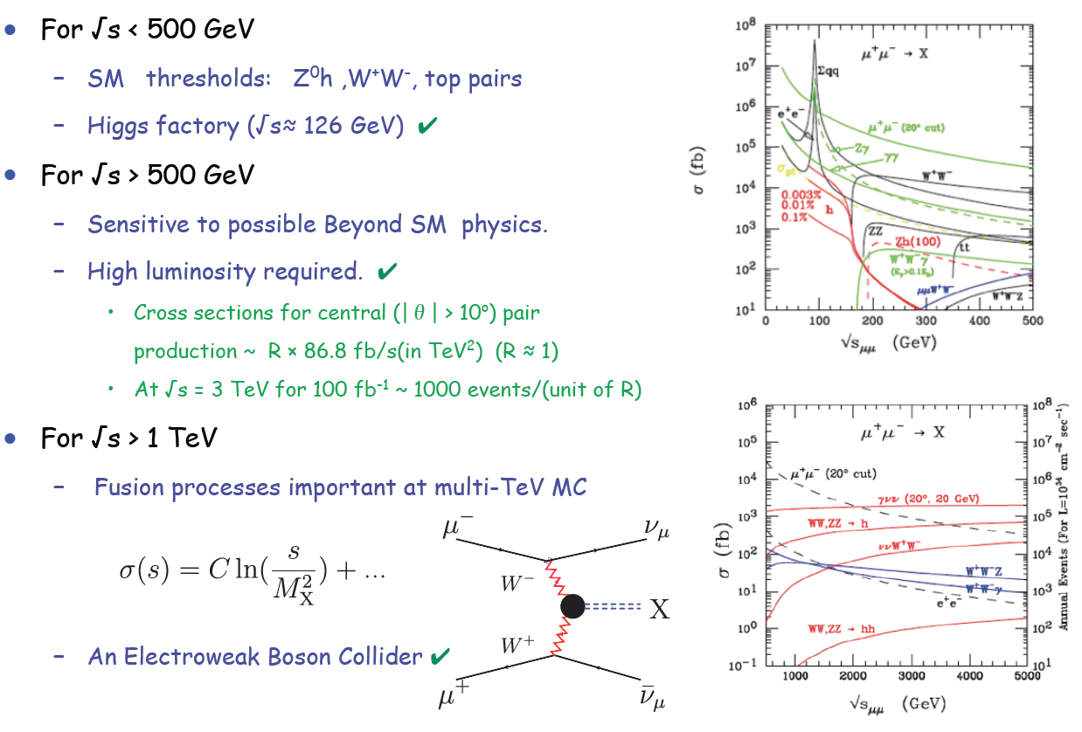
Muon Collider Reach
E. Eichten

Slide 7
Muon Accelerators
And Potential Staging Steps
Program Baselines

Slide 8
Muon Collider Concept
Muon Collider Block Diagram
Proton source:
For example PROJECT X at 4 MW, with 2±1 ns long bunches
Goal:
Produce a high intensity μ beam whose 6D phase space is reduced by a factor of ~10⁶-10⁷ from its value at the production target
Collider: √s = 3 TeV
Circumference 4.5km
L = 3×10³⁴ cm⁻²s⁻¹
μ/bunch = 2x10¹²
σ(p)/p = 0.1%
ε_{⊥N} = 25 μm, ε_{//N}=72 mm
β* = 5mm
Rep. Rate = 12 Hz

Slide 9
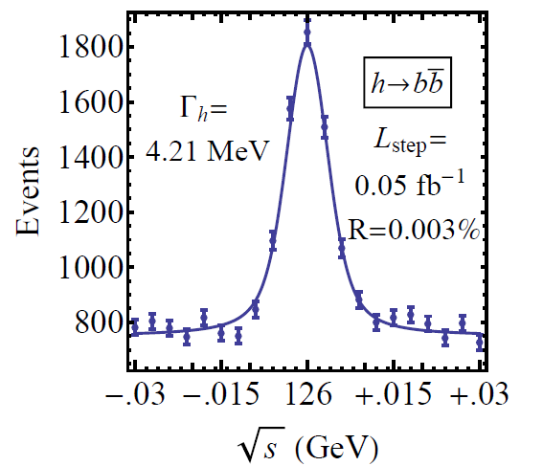
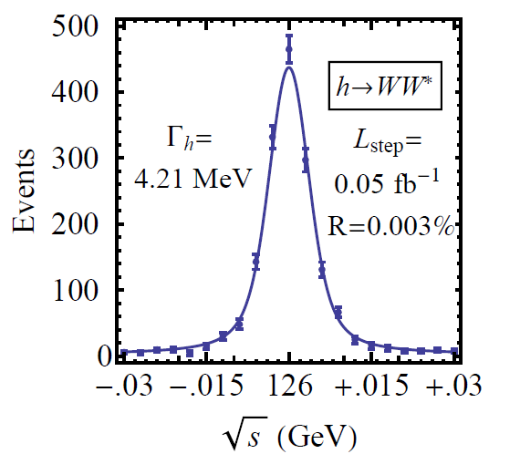
126 GeV Higgs Factory
s-channel coupling of Muons to HIGGS with high cross sections:
Muon Collider of with L = 10³² cm⁻²s⁻¹ @ 63 GeV/beam (50000 Higgs/year)
Competitive with e+/e- Linear Collider with L = 2. 10³⁴ cm⁻²s⁻¹ @ 126 GeV/beam
Sharp resonance: momentum spread of a few × 10⁻⁵
Precision energy measurement provided by g-2 effect and residual polarization in muon beams
Han and Liu
hep-ph 1210.7803
Reduced cooling:
ε_{⊥N} =0.3π⋅mm⋅rad,
ε_{||N} =1π⋅mm⋅rad
Major advantage for Physics of a μ⁺μ⁻ Higgs Factory: possibility of direct measurement of the Higgs boson width (Γ~4MeV FWHM expected)

Slide 10
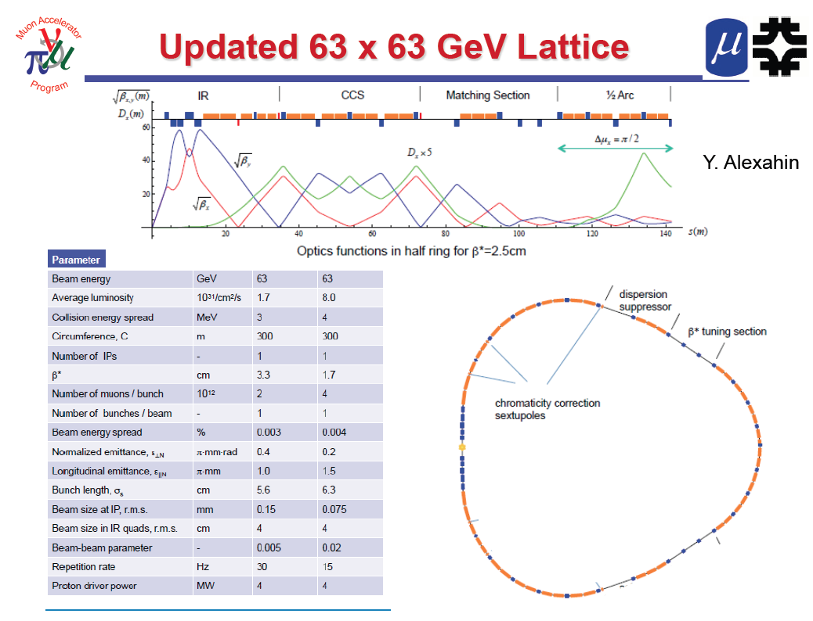
One IP in
the latest
design

Slide 11
Multi-TeV Collider – 1.5 TeV Baseline
Y. Alexahin
Parameter | Unit | Value
Beam energy | TeV | 0.75
Repetition rate | Hz | 15
Average luminosity / IP | 10³⁴/cm²/s | 1.1
Number of IPs, N_{IP} | - | 2
Circumference, C | km | 2.73
β* | cm | 1 (0.5-2)
Momentum compaction, α_{p} | 10⁻⁵ | -1.3
Normalized r.m.s. emittance, ε_{⊥N} | π⋅mm⋅mrad | 25
Momentum spread, σ_{p}/p | % | 0.1
Bunch length, σ_{s} | cm | 1
Number of muons / bunch | 10¹² | 2
Number of bunches / beam | - | 1
Beam-beam parameter / IP, ξ | - | 0.09
RF voltage at 800 MHz | MV | 16
Larger chromatic function (Wy) is corrected first with a single sextupole S1, Wx is corrected with two sextupoles S2, S4 separated by 180° phase advance.

Slide 12
Muon Collider - Neutrino Factory Synergies
NEUTRINO FACTORY
ν Factory Goal:
O(10²¹) μ/year
within the
accelerator
acceptance
Share same complex
MUON COLLIDER

Slide 13
A Staged Muon-Based Neutrino and Collider Physics Program
The plan is conceived in four stages.
The “entry point” for the plan is the nuSTORM Facility proposed at Fermilab, which can advance SBL oscillation physics by making the definitive measurements regarding the existence of light sterile neutrinos. Secondly, it can provide an unprecedented program of ν interaction physics important in itself and to the long-baseline oscillation program. Finally, it can serve as an R&D platform for demonstration of accelerator capabilities pre-requisite to the later stages.
A stored-muon-beam Neutrino Factory can take advantange of the large value of θ₁₃ to make definitive measurements of neutrino oscillations and their possible violation of CP symmetry.
Thanks to suppression of radiative effects by the muon mass adnn the m²_{lepton} proportionality of the s-channel Higgs couling, a “Higgs Factory Muon Collider can make uniquely precise measurements of the 126 GeV boson recently discovered at the LHC.
An energy-frontier Muon Collider can perform unique measurements of Terascale physics, offering both precision and discovery reach.

Slide 14

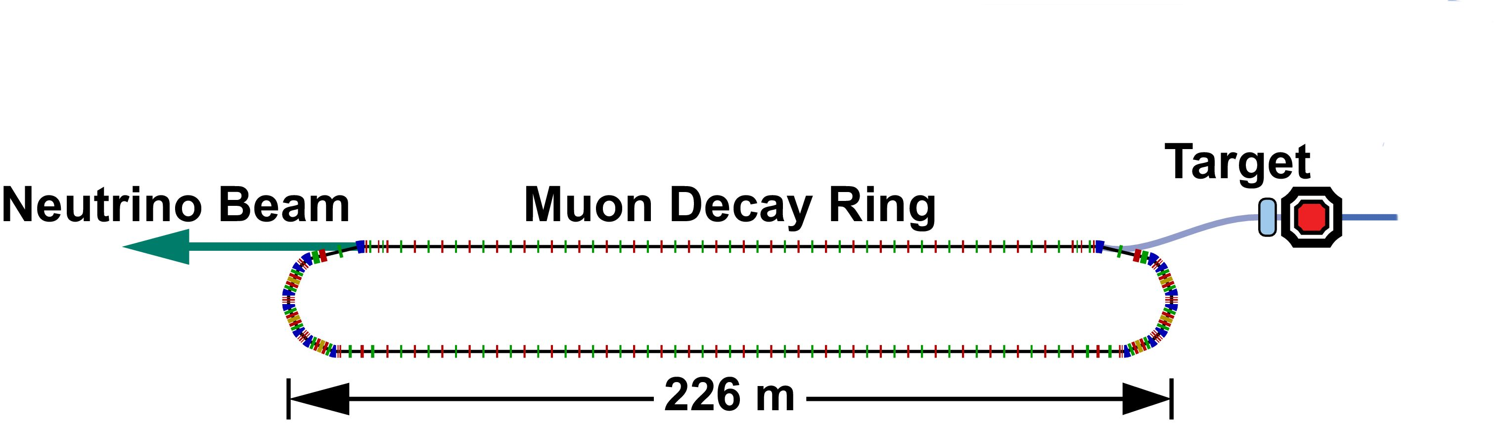
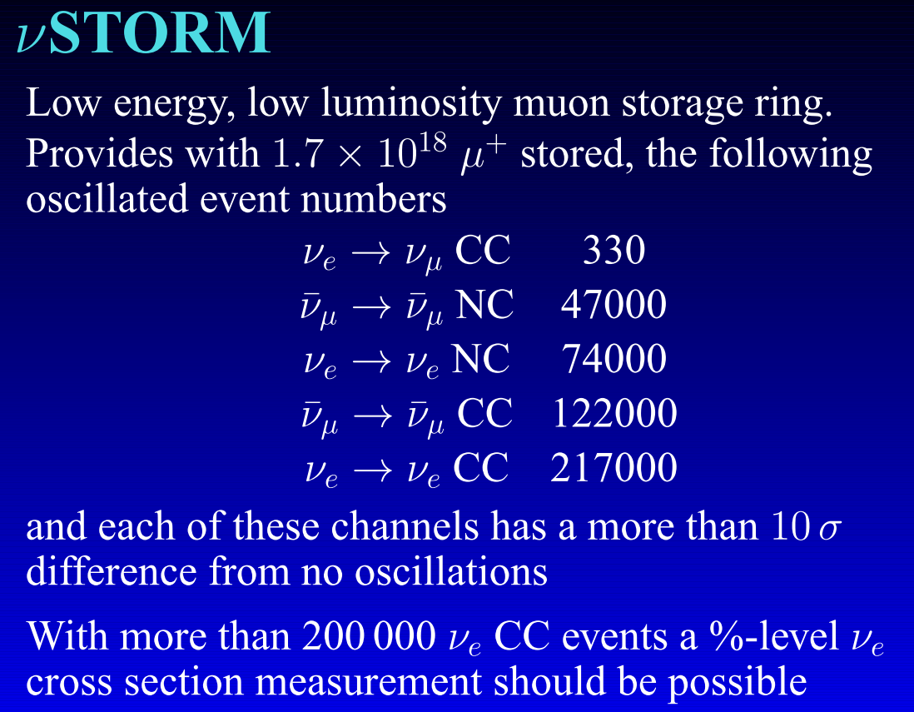
NuSTORM: Neutrinos from Stored Muons
Fermilab P-1028
3.8 GeV/c
stored μ
A.Bross
An entry-level NF?
200kW
DOES NOT
Require the
Development of
ANY
New Technology
Stage I approval requested at last weeks
Fermilab PAC meeting
NuSTORM Workshop held Sept 21-22 @ FNAL:
(https://indico.fnal.gov/conferenceDisplay.py?confId=5710)

Slide 15
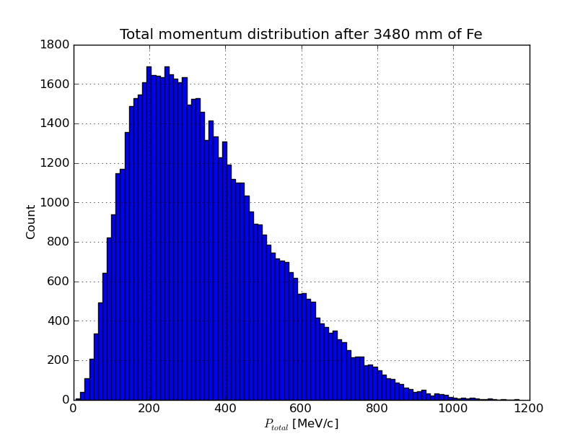
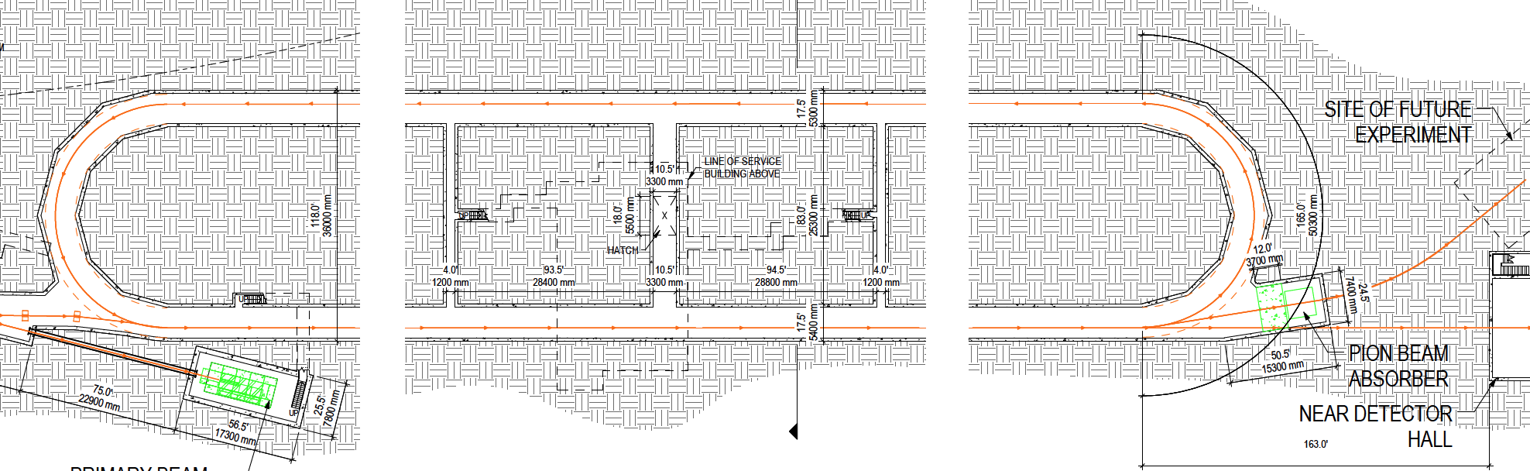
nuSTORM as an R&D platform
A high-intensity pulsed muon source
100<p_{μ}<300 MeV/c muons
  Using extracted beam from ring
  10¹⁰ muons per 1 μsec pulse
Beam available simultaneously with
physics operation
  Sterile ν search
  ν cross interaction physics program
nuSTORM also provides the
opportunity to design,build&test:
  decay ring instrumentation (BCT, momentum spectrometer, polarimeter) to measure & characterize the circulating muon flux
  6D cooling of high intensity muon beam

Slide 16
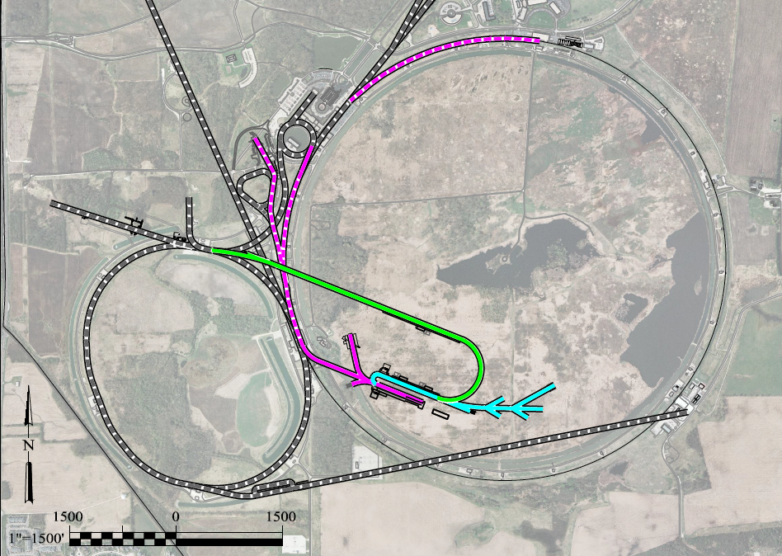
A Muon Accelerator Facility for Cutting Edge Physics on the Intensity and Energy Frontiers
based on Project X Stage II
To Far Detector at
SURF/Sanford (1300km)
LBNE
Buncher/
Accumulator
Rings & Target
RLA to 63 GeV +
300m Higgs Factory
5GeV
Neutrino Factory
Decay Ring:
Front End+4D+6D
Project X
Stage III
Linac + RLA
to ~ 5 GeV
Project X
Stage II
Project X
Stage I
νSTORM + Muon Beam
R&D Facility

Slide 17
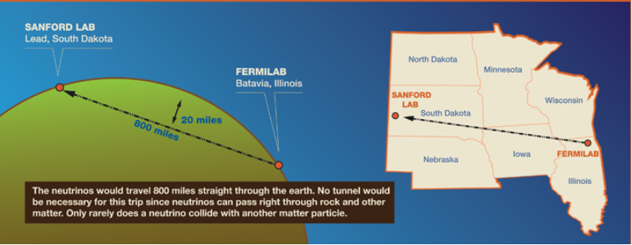
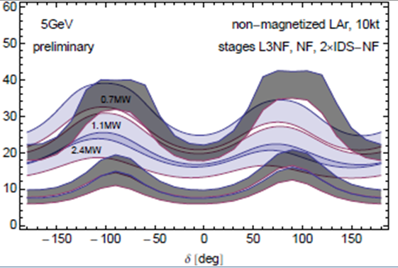
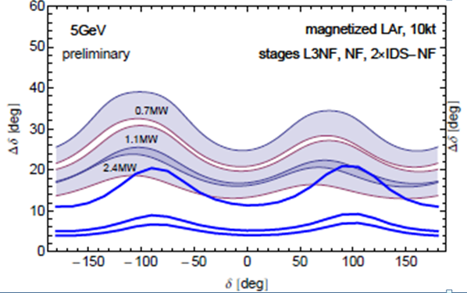
A Staged Neutrino Factory with far detector at SANFORD (LBNE)?
a 1 MW, no muon cooling
a 3 MW, with cooling
a 4 MW, with cooling
What if we were able to have a magnetized LAr detector?
LBNE
Gray bands represent range of possible
detector performance per arXiv:0805.2019
Neutrino Factory
Plots assume
100 kt-years
Plots courtesy of P. Huber

Slide 18
Neutrino Factory Staging (MASS)
Preliminary Staging Plan Based on
Project X Phase 2
* supports multiple detector technologies

Slide 19
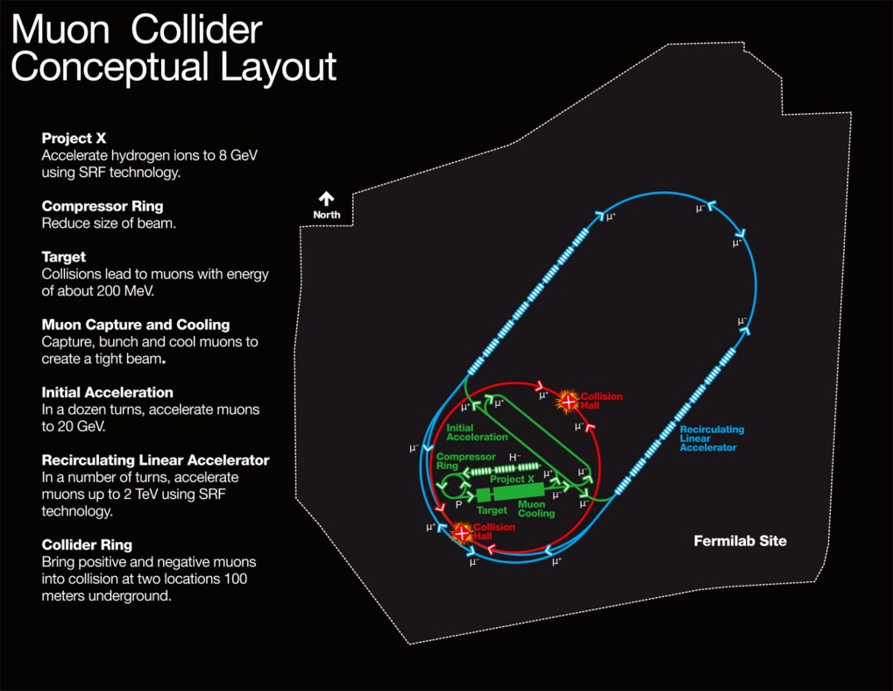
MAP Designs for a Muon-Based Higgs Factory and Energy Frontier Collider
Exquisite Energy
Resolution
Allows Direct
Measurement
of Higgs Width
Site Radiation mitigation with depth and lattice design: ≤ 10 TeV

Slide 20
The MAP Feasibility Assessment
Feasibility Assessment: Phase I
FY13 − FY15:
Identify baseline design concepts
Identify high leverage alternative concepts
Identify key engineering paths to pursue:
  RF
  High Field Magnets
Develop critical engineering concepts (eg, 6D Cooling Cell)
Support major systems tests
  MICE Step IV
  MICE RFCC construction & testing
Feasibility Assessment: Phase II
FY16 − FY18:
Technical demonstration of critical baseline concepts
  eg, 6D Cooling cell
Pursue high leverage alternative concepts
Assess technical and cost feasibility of baseline concepts
Support major systems tests
  MICE Step V/VI
  6DICE planning
Beyond the
Feasibility Assessment
FY19 ➔
Plan contingent on the feasibility assessment!
Can we launch the design effort towards a staged implementation of a NF & MC?
Advanced systems tests
  6DICE?
  Support Physics?

Slide 21
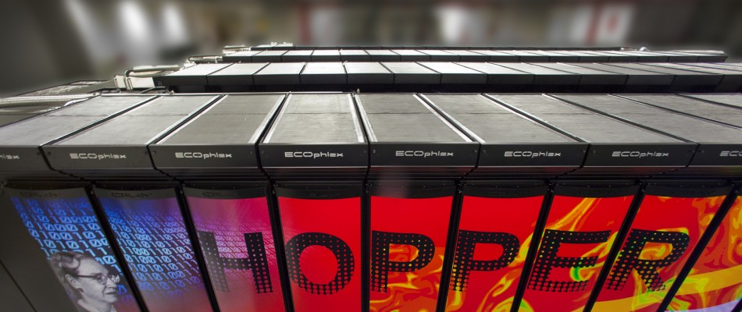

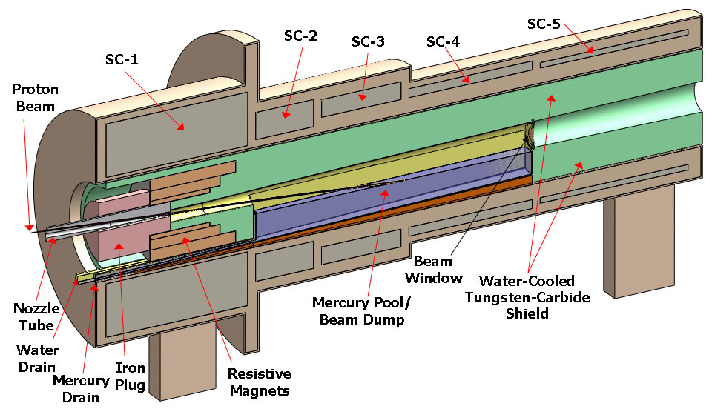
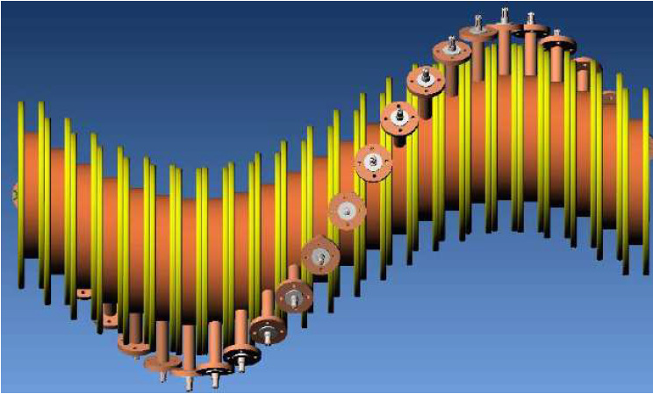
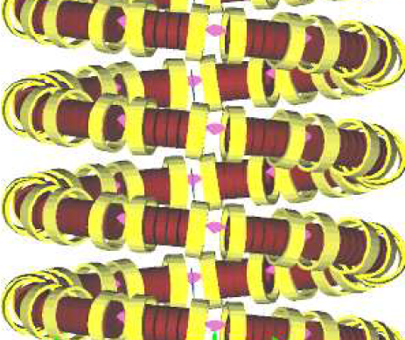
Recent Progress: MAP Design & Simulation
MAP Design Efforts
Program Baselines
Staging Study (MASS) Contributions
High Performance Computing
Code Parallelization (G4Beamline, ICOOL)
  Performance improvements > 10⁴
Enables Multi-Objective Parallel Optimization of Accelerator Designs
Liquid Hg Jet Target
Cooling
Channel
Concepts
HCC
Guggenheim
Capture Solenoid (15-20T):
~3 GJ large aperture magnet

Slide 22
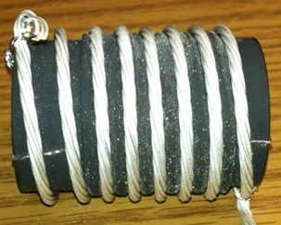
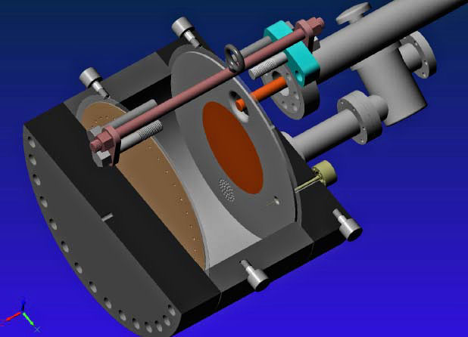
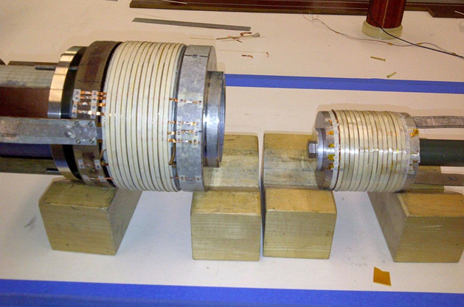
MAP: Recent Technology Highlights
Successful Operation of 805 MHz “All Seasons” Cavity in 3T Magnetic Field under Vacuum
MuCool Test Area/Muons Inc
World Record
HTS-only Coil
15T on-axis field
16T on coil
PBL/BNL
Demonstration of High Pressure RF Cavity in 3T Magnetic Field with Beam
Extrapolates to
μ-Collider Parameters
MuCool Test Area
Breakthrough in HTS Cable Performance with Cables Matching Strand Performance
FNAL-Tech Div
T. Shen-Early Career Award
The Path to a Viable
Muon Ionization
Cooling Channel
1% Dry Air (0.2% O2) in GH2
Pure GH2
1% Dry Air
(0.2 % O2)
in GH2 at
B = 3T
~50X reduction in
RF power dissipation
E₀ = 25 MV/m

Slide 23
The Muon Accelerator Program Timeline
At Fermilab, critical physics production could build on Phase II of Project X

Slide 24
Some Thoughts…
The unique feature of muon accelerators is the ability to provide cutting edge performance on both the Intensity and Energy Frontiers
  This is well-matched to the direction specified by the P5 panel for Fermilab
  The possibilities for a staged approach make this particularly appealing in a time of constrained budgets
  νSTORM would represent a critical first step in providing a muon-based accelerator complex
World leading Intensity Frontier performance could be provided with a Neutrino Factory based on Project X Phase II
  This would also provide the necessary foundation for a return to the Energy Frontier with a muon collider on U.S. soil
A Muon Collider Higgs Factory
  Would provide exquisite energy resolution to directly measure the width of the Higgs. This capability would be of crucial importance in the MSSM doublet scenario.
  The first collider on the path to a
  multi-TeV Energy Frontier machine?

Slide 25
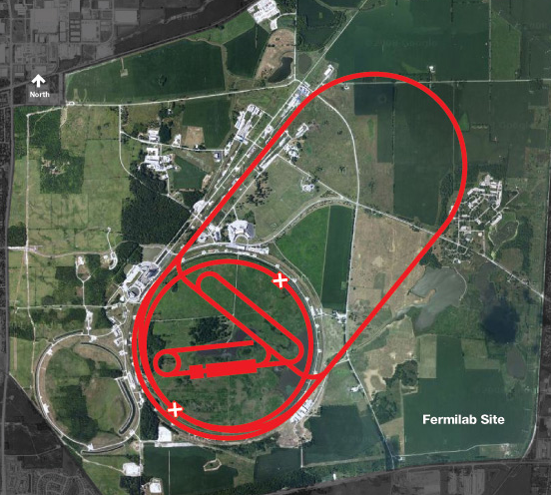
Conclusion
Through the end of this decade, the primary goal of MAP is demonstrating the feasibility of key concepts needed for a neutrino factory and muon collider
a Thus enabling an informed decision on the path forward for the HEP community
Muon Collider Concept
A challenging, but promising, R&D program!

