Slide 1

The Road to the
Intensity
Frontier
Symposium in honor of Pier Oddone
B. Fleming
June 13, 2013
Breaking new ground….

Slide 2
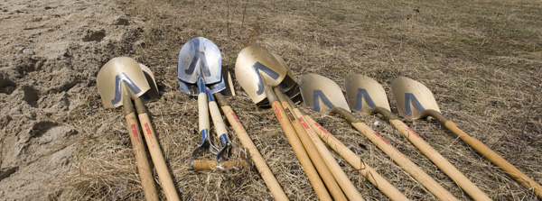
ν ground!

Slide 3
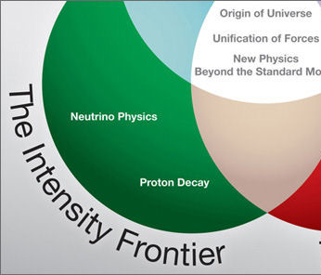
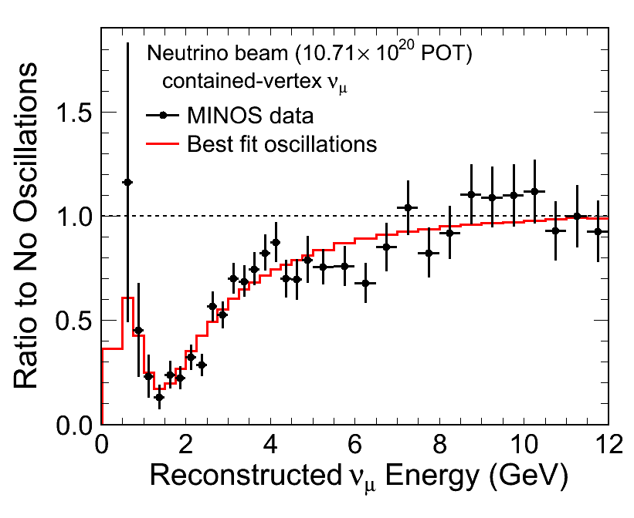
Welcome to the Precision World of Neutrino Oscillations
MINOs defined the gold standard disappearance experiment with two identical detectors
  Δm², Δm², θ₁₃, sin²2θ₂₃, sin²2θ₂₃(beam+ atmospheric)
MINOs -> MINOs +

Slide 4
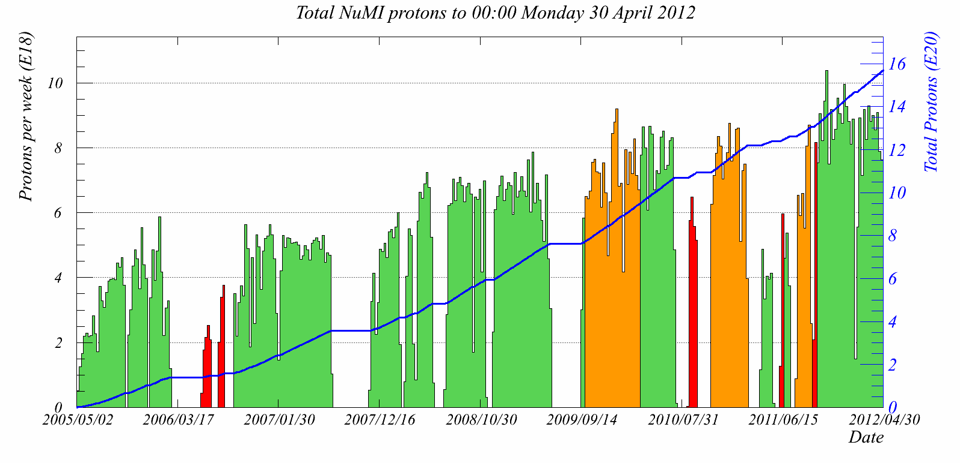
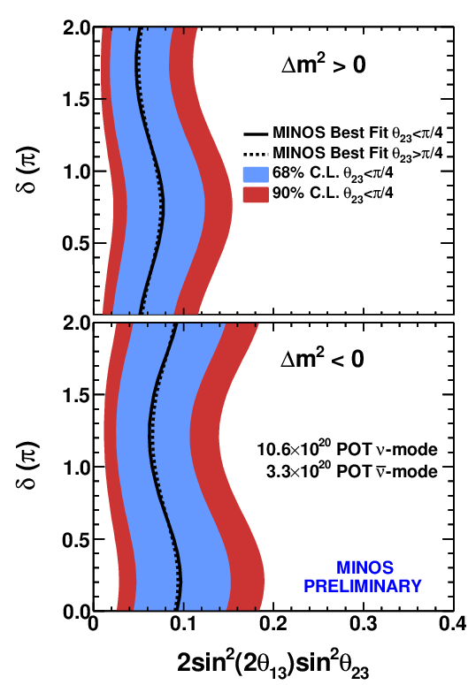
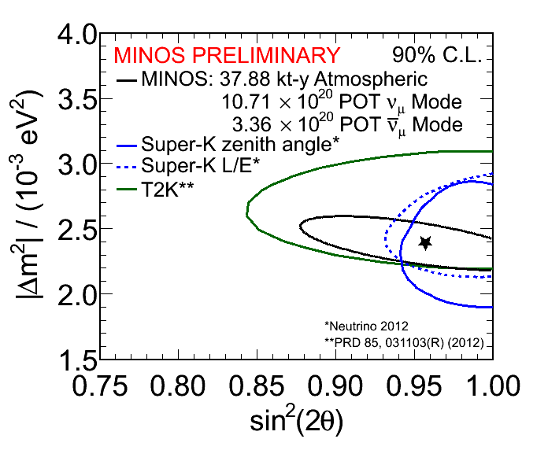
sin²2θ₁₃
Best ν beam in the world
(NH, δ_{CP}=0) 0.051^{+0.038}_{-0.030}
θ₂₃ NON MAXIMAL??
2 flavor

Slide 5
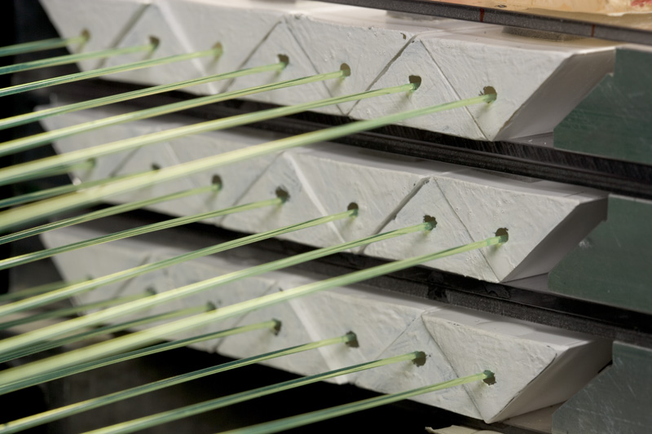
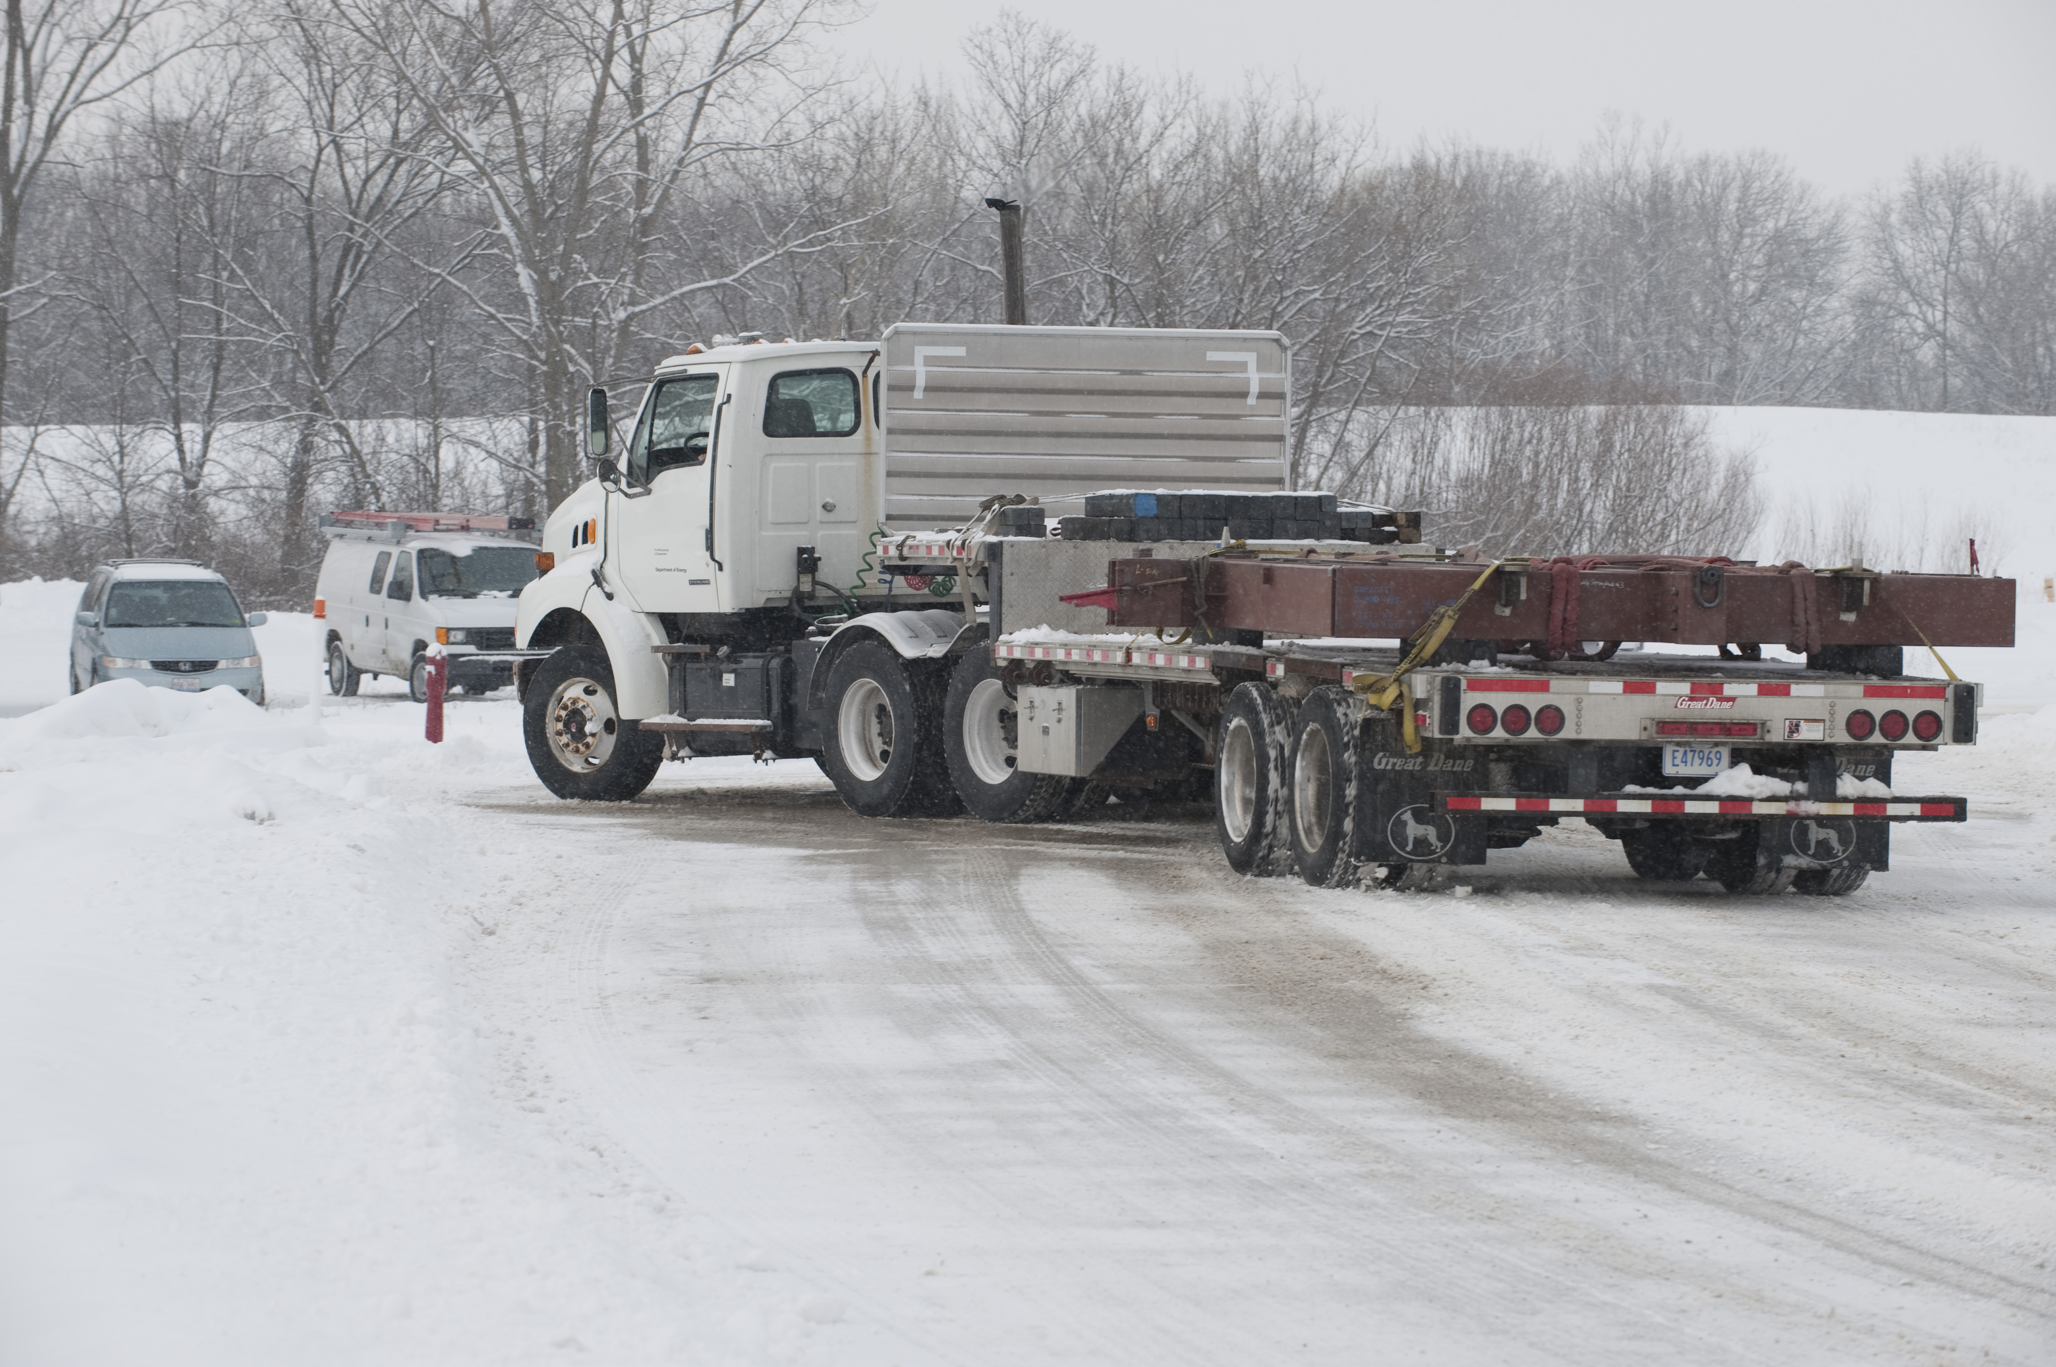
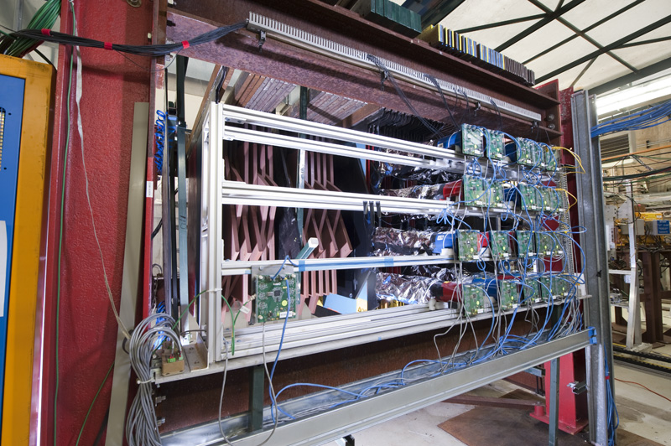
MINERvA
Precision neutrino cross section measurements
June 2006: DOE CD-0
November 2009: Data taking begins
May 2013: First physics papers
MINERvA moving to NuMI

Slide 6
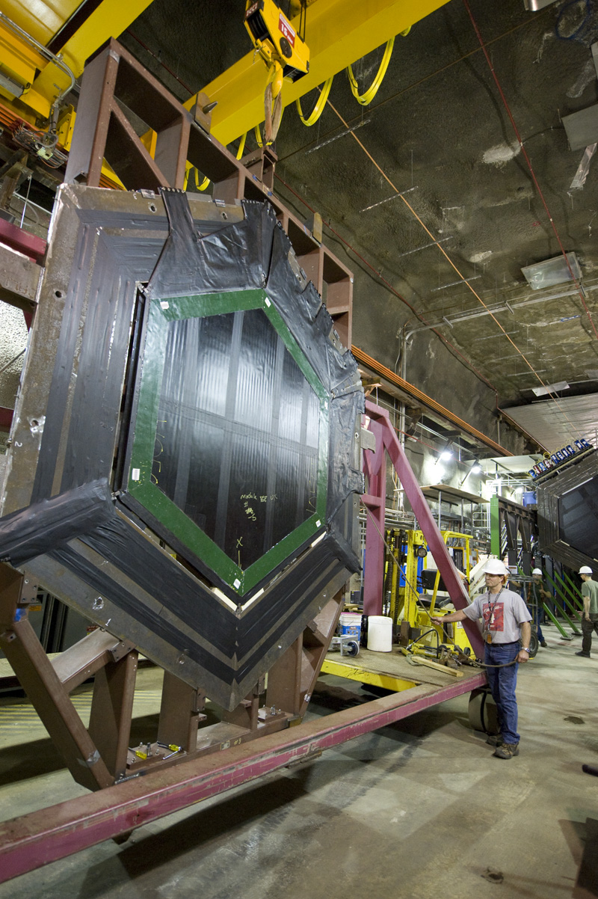
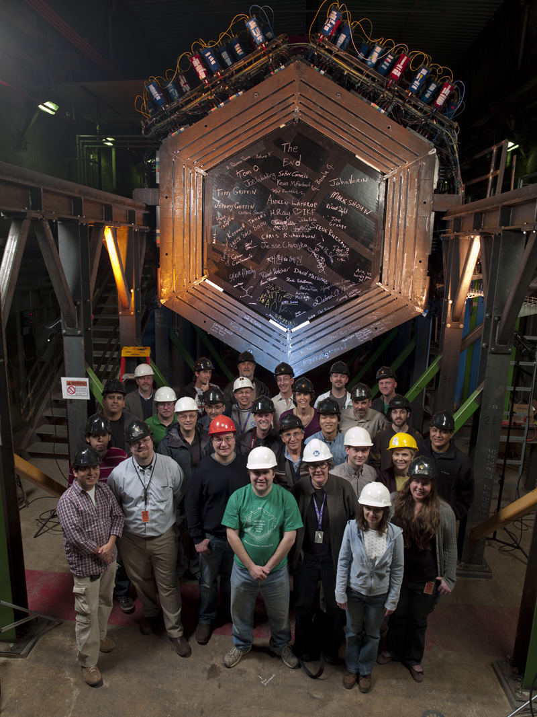
MINERvA planes under construction to last plane in place -- 2010

Slide 7
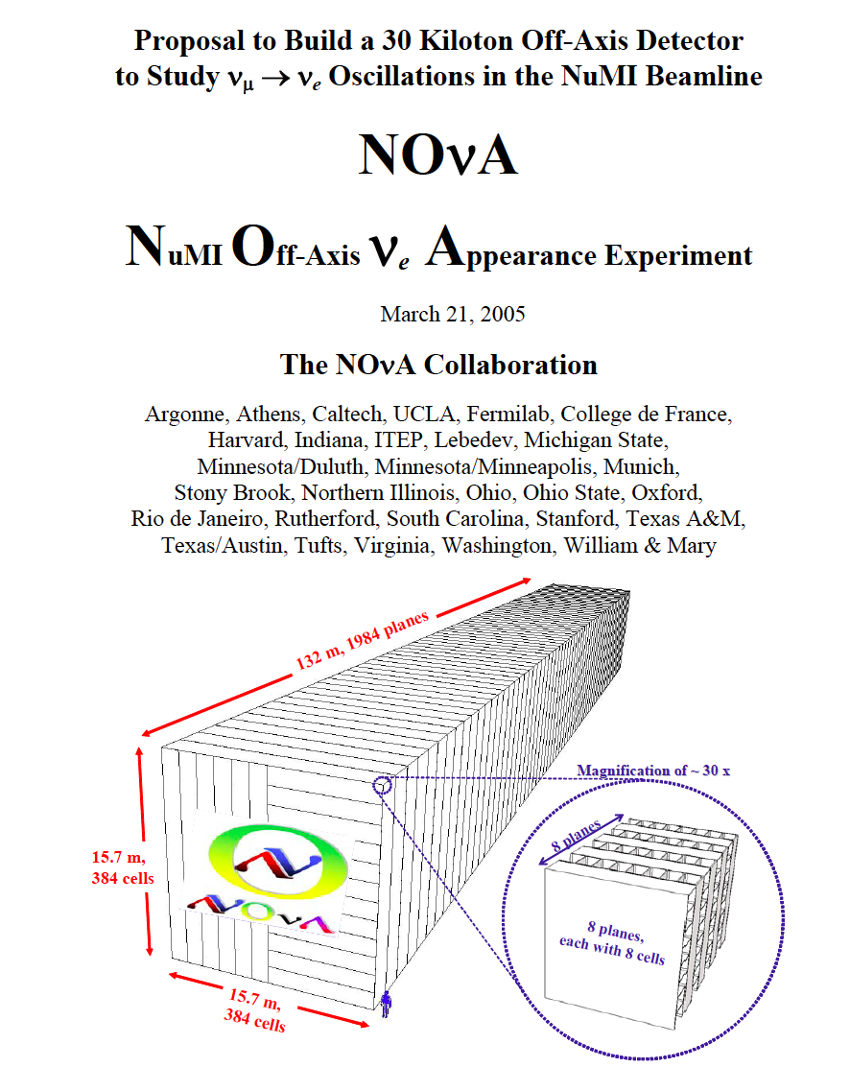
2005
2006
2007
2008
2009
2010
2011
2012
2013
March 2005: NOvA Proposal

Slide 8
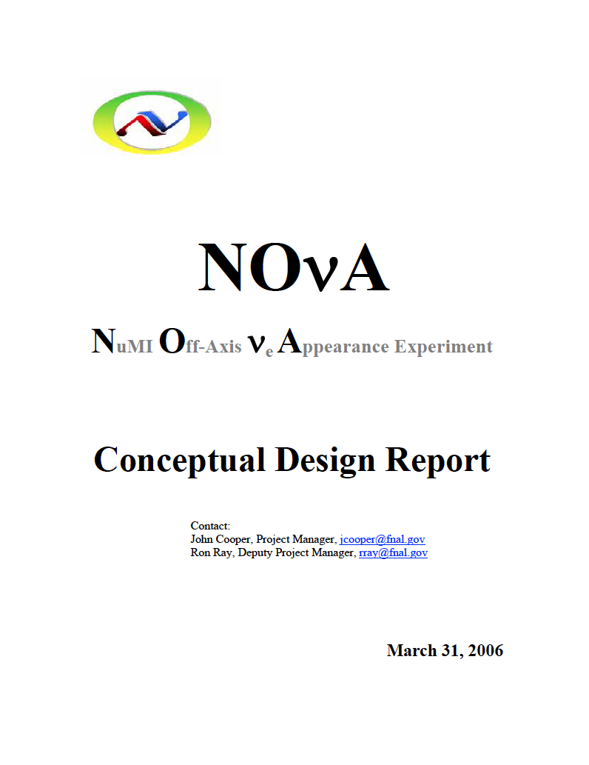
2005
2006
2007
2008
2009
2010
2011
2012
2013
March 2006: NOvA Conceptual Design

Slide 9
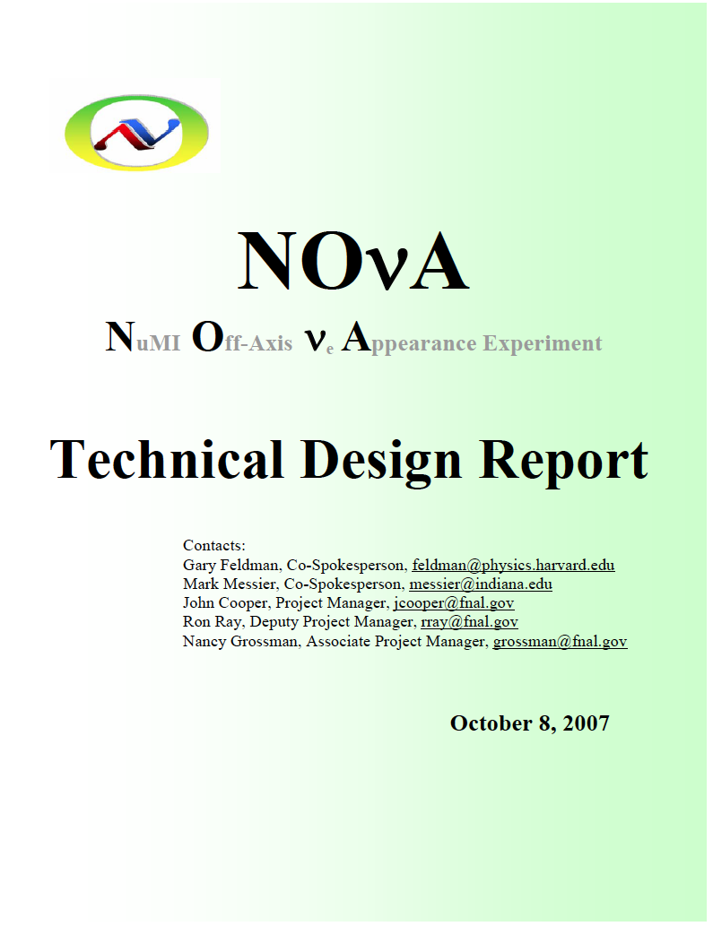
2005
2006
2007
2008
2009
2010
2011
2012
2013
October 2007 : NOvA Technical Design

Slide 10
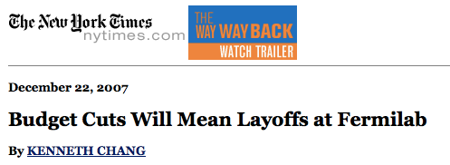
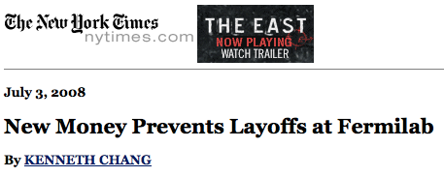
2005
2006
2007
2008
2009
2010
2011
2012
2013
January 2008 - July 2007: “Black Monday”

Slide 11
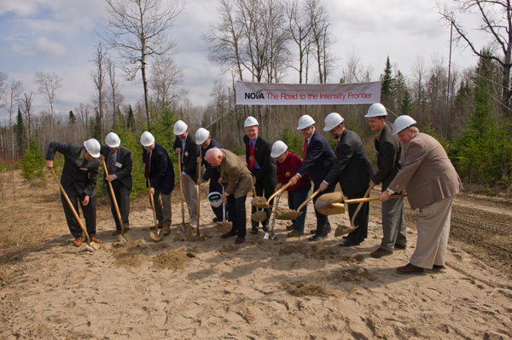


2005
2006
2007
2008
2009
2010
2011
2012
2013
May 1, 2009: Ground breaking at Ash River

Slide 12
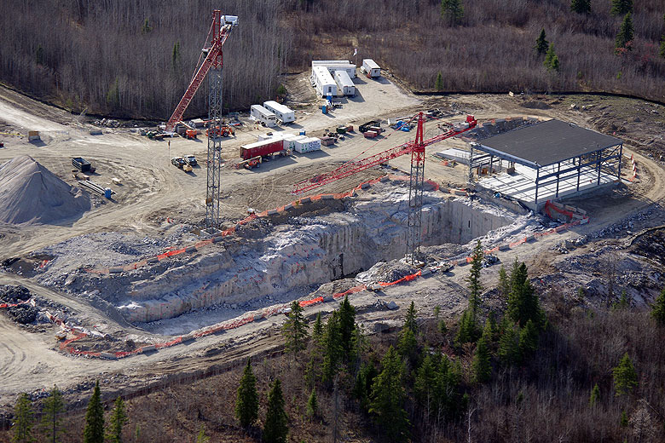
2005
2006
2007
2008
2009
2010
2011
2012
2013
May 1, 2009: Ground breaking at Ash River

Slide 13
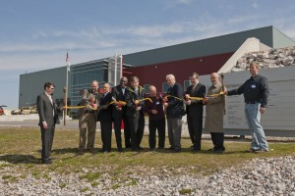
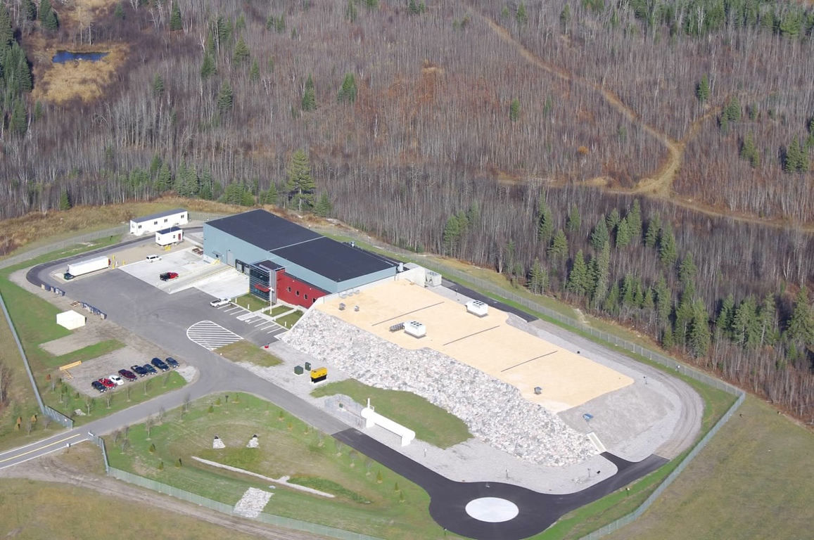
2005
2006
2007
2008
2009
2010
2011
2012
2013
April 2012: Dedication of Ash River Lab

Slide 14
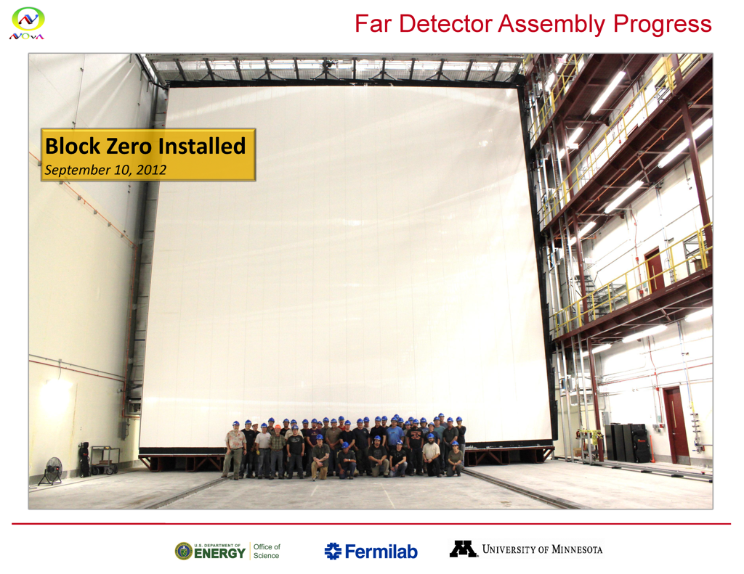
2005
2006
2007
2008
2009
2010
2011
2012
2013
September 2012: First NOvA Block

Slide 15
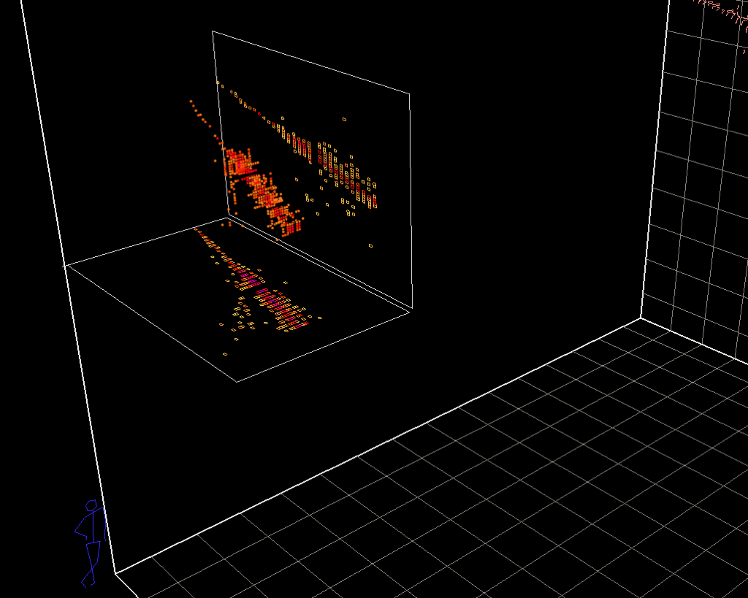
2005
2006
2007
2008
2009
2010
2011
2012
2013
March 2013: First events

Slide 16
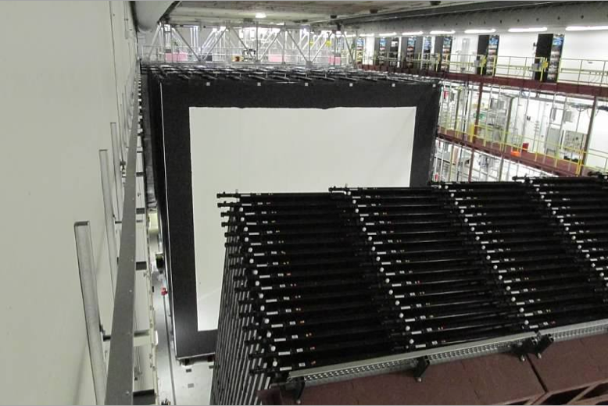
2005
2006
2007
2008
2009
2010
2011
2012
2013
June 2013: First kiloton complete

Slide 17
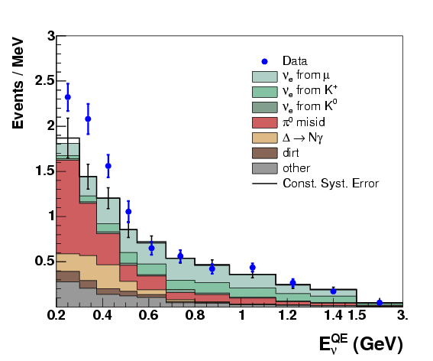
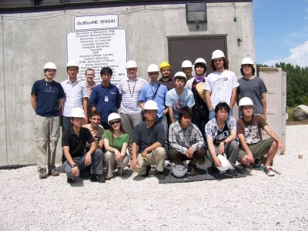

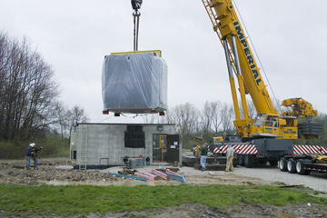

Low energy excess results from MiniBooNE
2007
New experiments on the BNB
SciBooNE

Slide 18
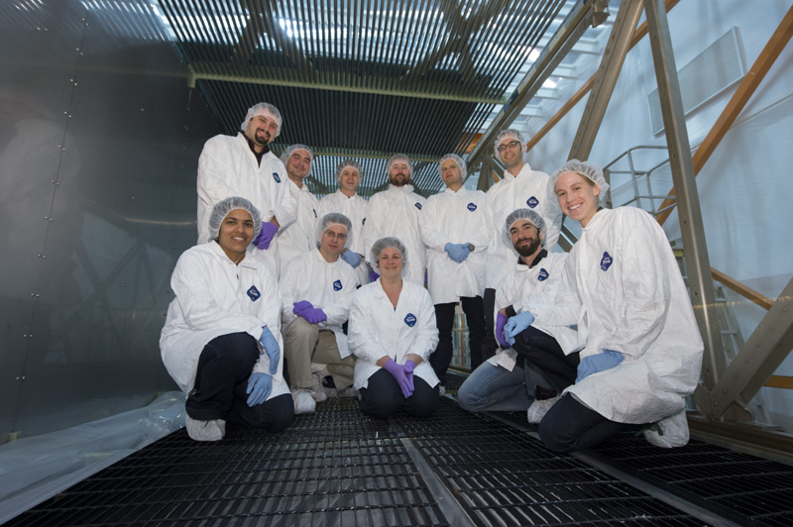
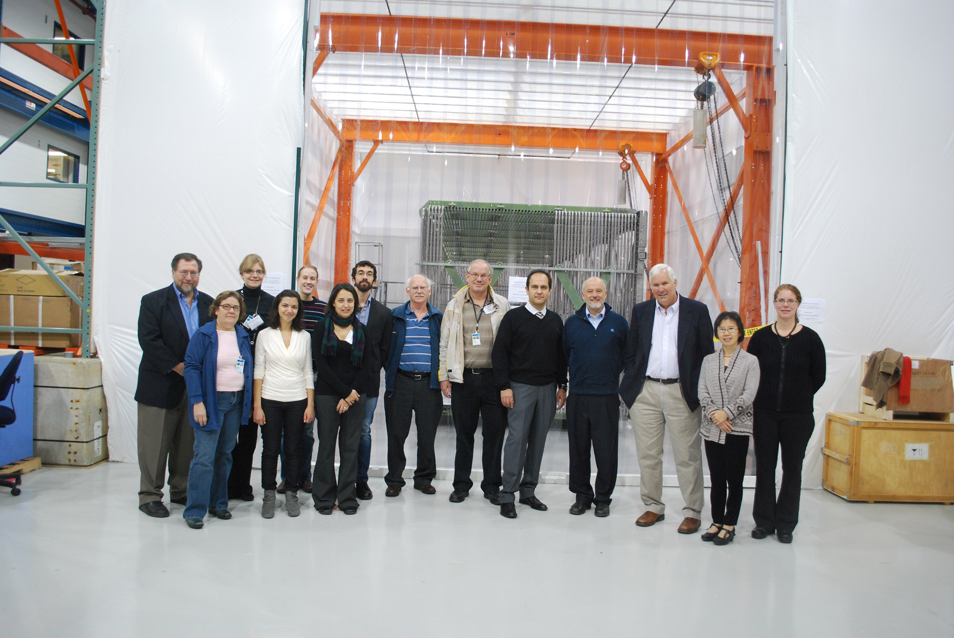
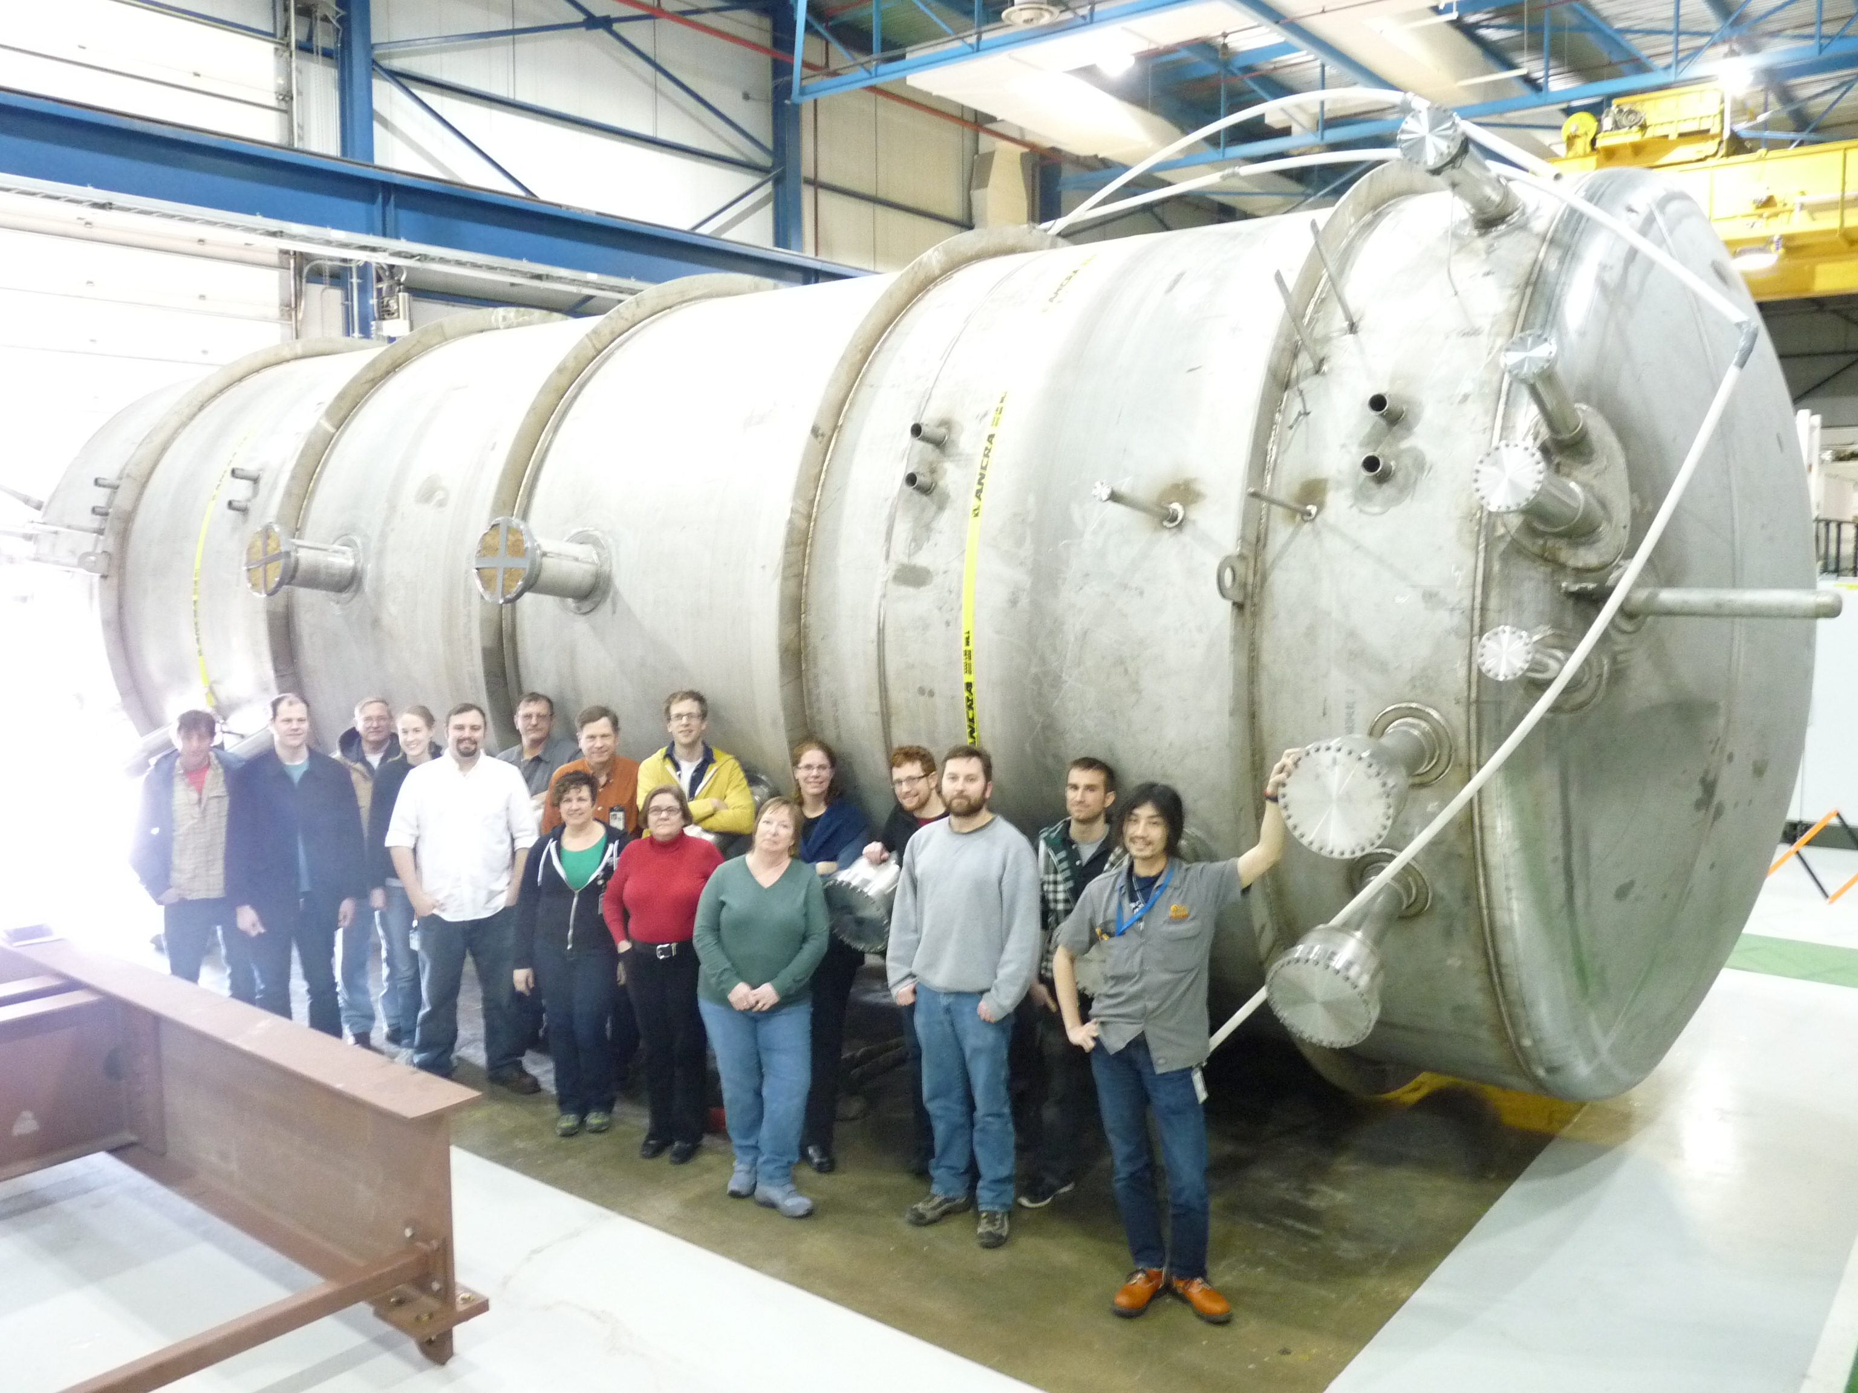
MicroBooNE
Stage 1 approval 2008
CD-0: 2009
Construction begins 2011
Data taking 2014

Slide 19
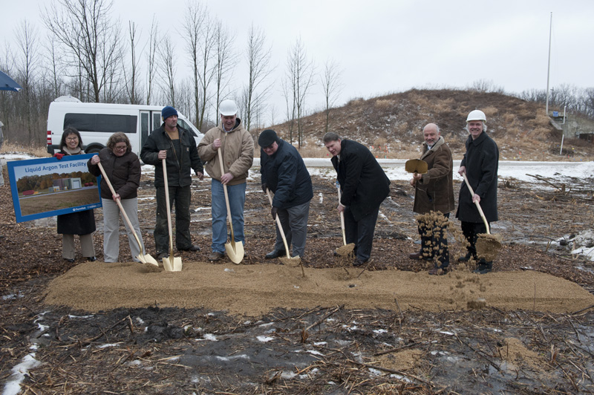
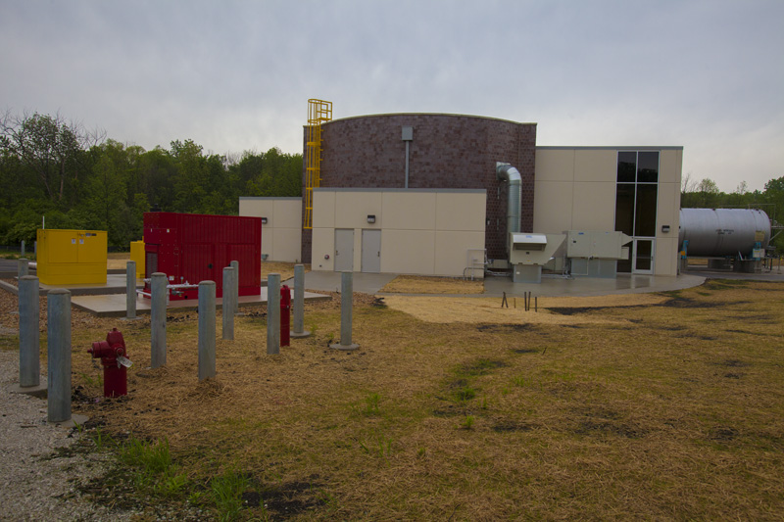
Liquid Argon Test Facility – GroundBreaking
2012
Artist Rendering
May 2013

Slide 20
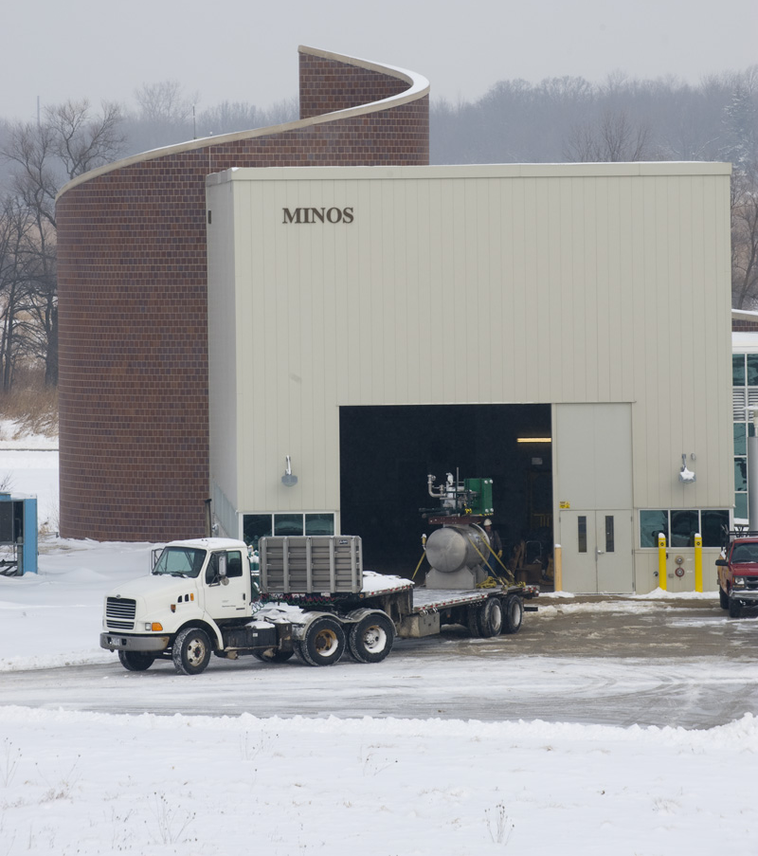
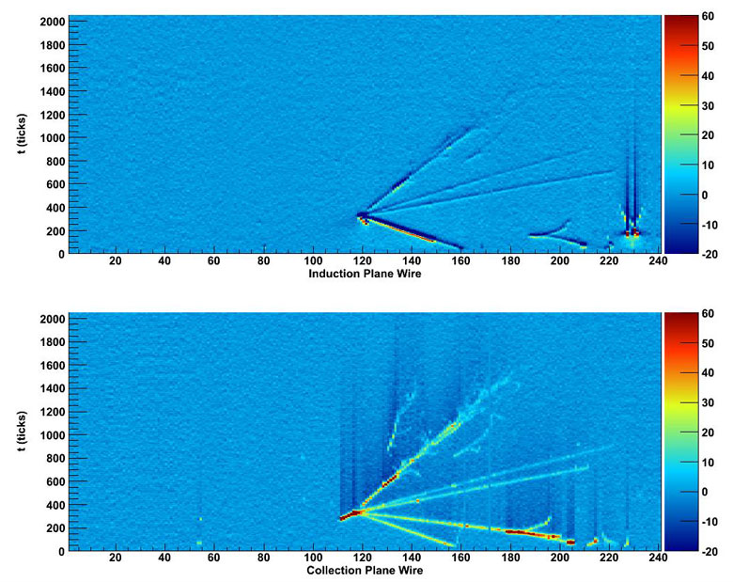

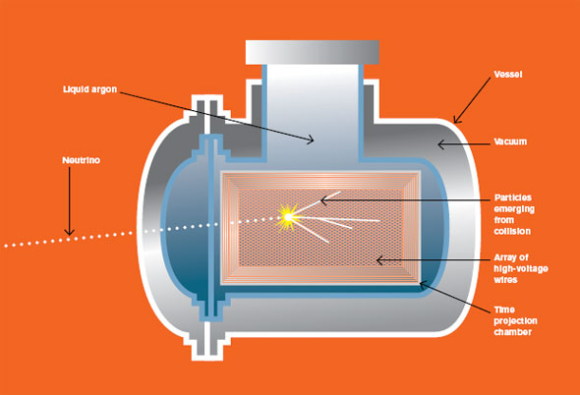
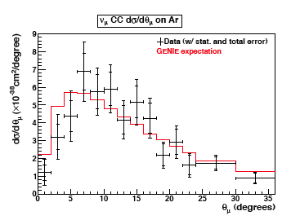
Liquid Argon TPC R&D
ArgoNeuT
Fermilab Holiday card
ArgoNeuT (T962)
going underground
2009
Data taking, 2009-2010
Neutrino cross section
measurement, 2012

Slide 21
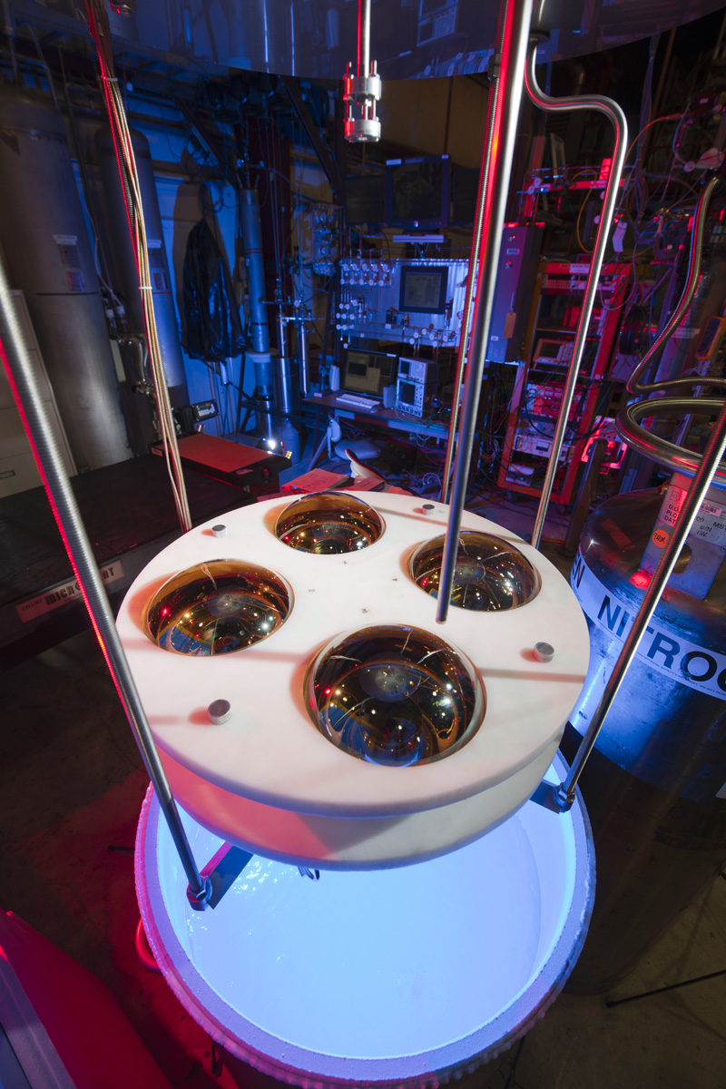
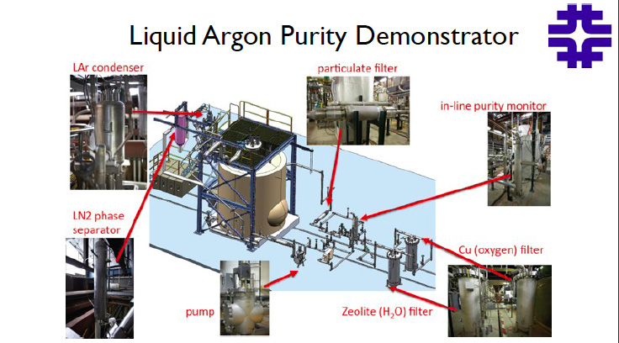
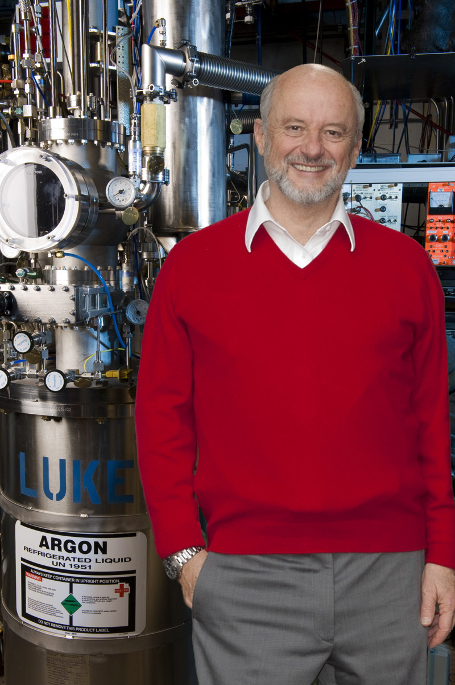
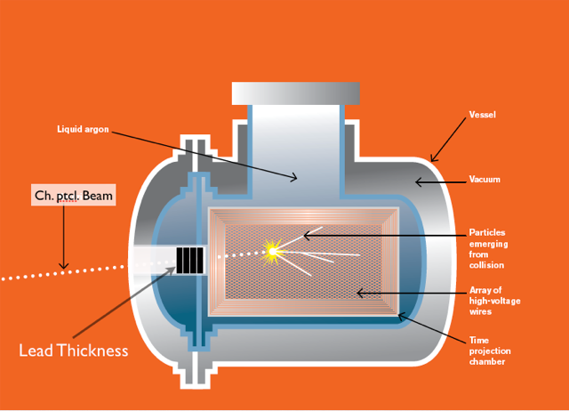
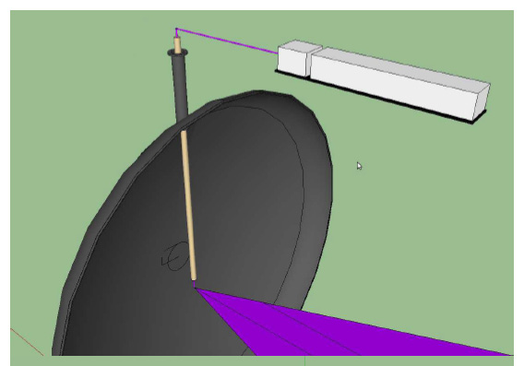
Liquid Argon R&D
Light collection in uB
Materials Test Stand
LArIAT
MicroBooNE Laser calibration

Slide 22
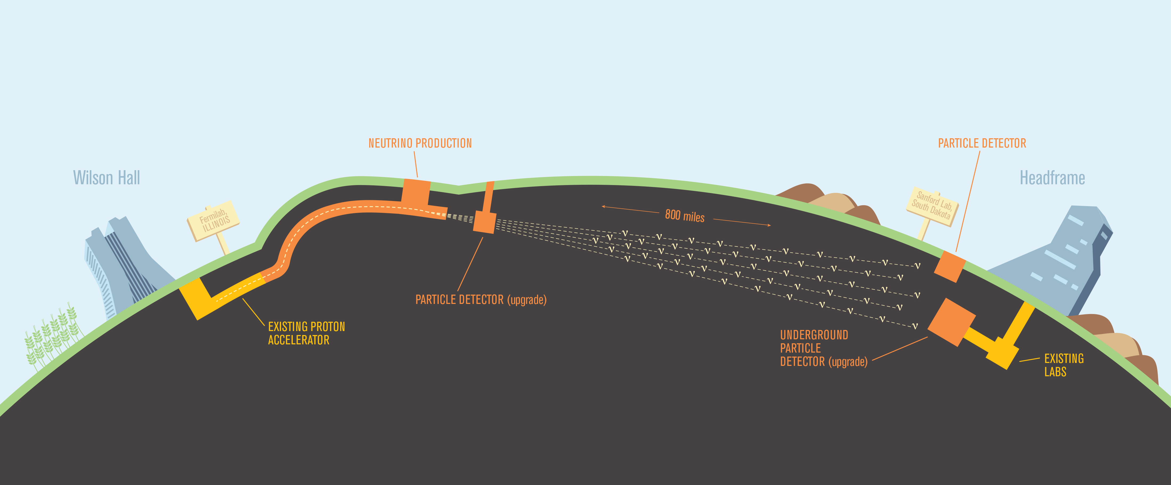
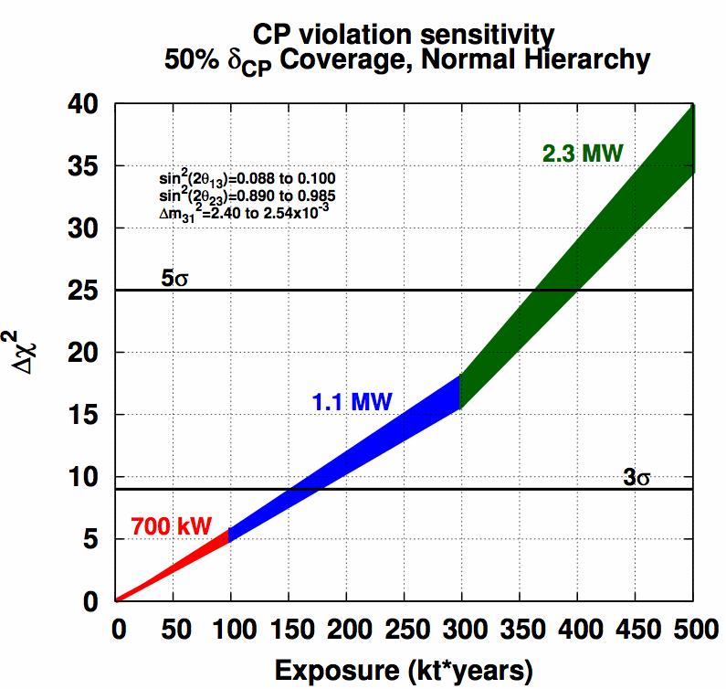
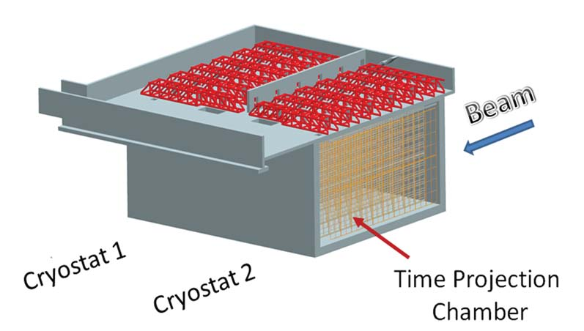
Long Baseline Neutrino Experiment -- LBNE
FNAL/BNL LBL study 2005
LBNE CD-0 2010
LBNE CD-1 2012

Slide 23
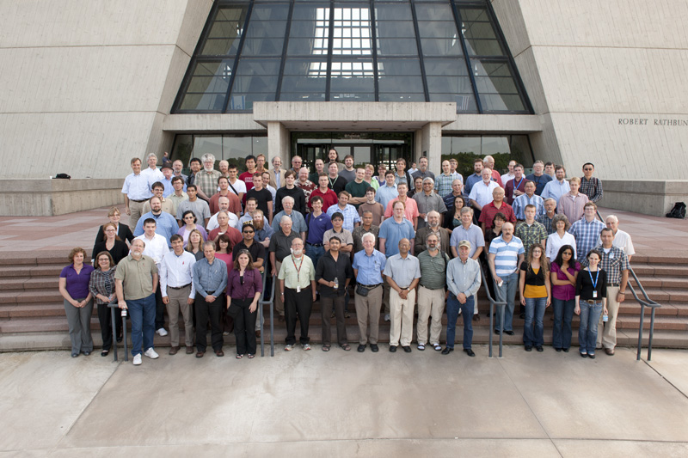
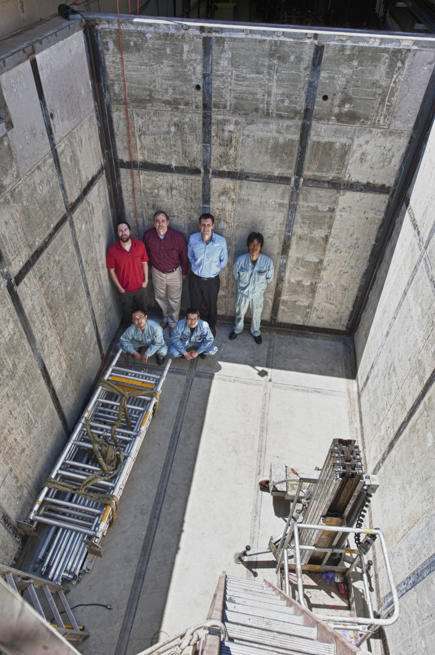
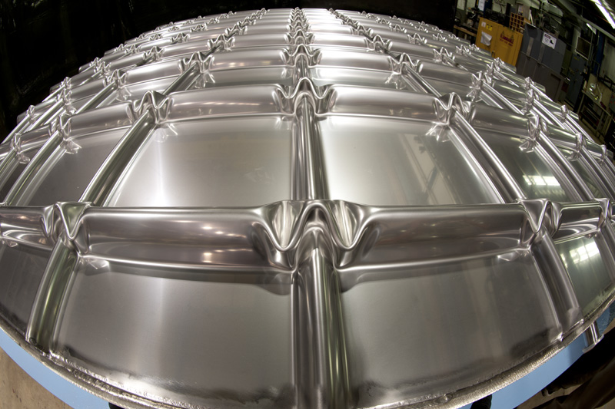
Design and development en route to LBNE

Slide 24
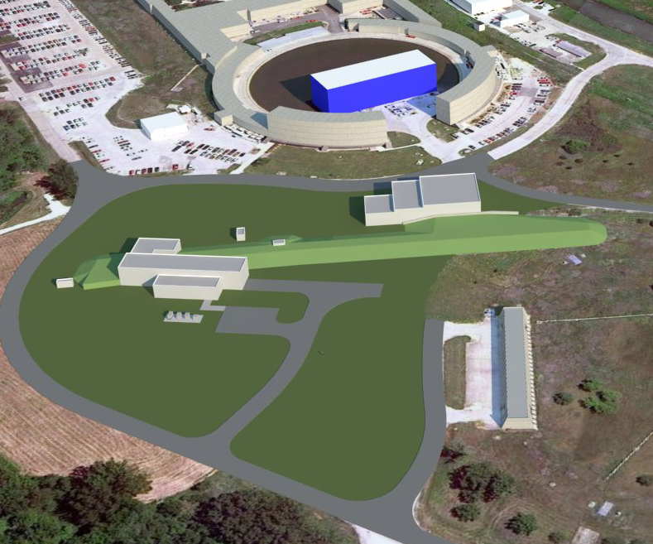
The Muon Campus: g-2 and mu2e

Slide 25
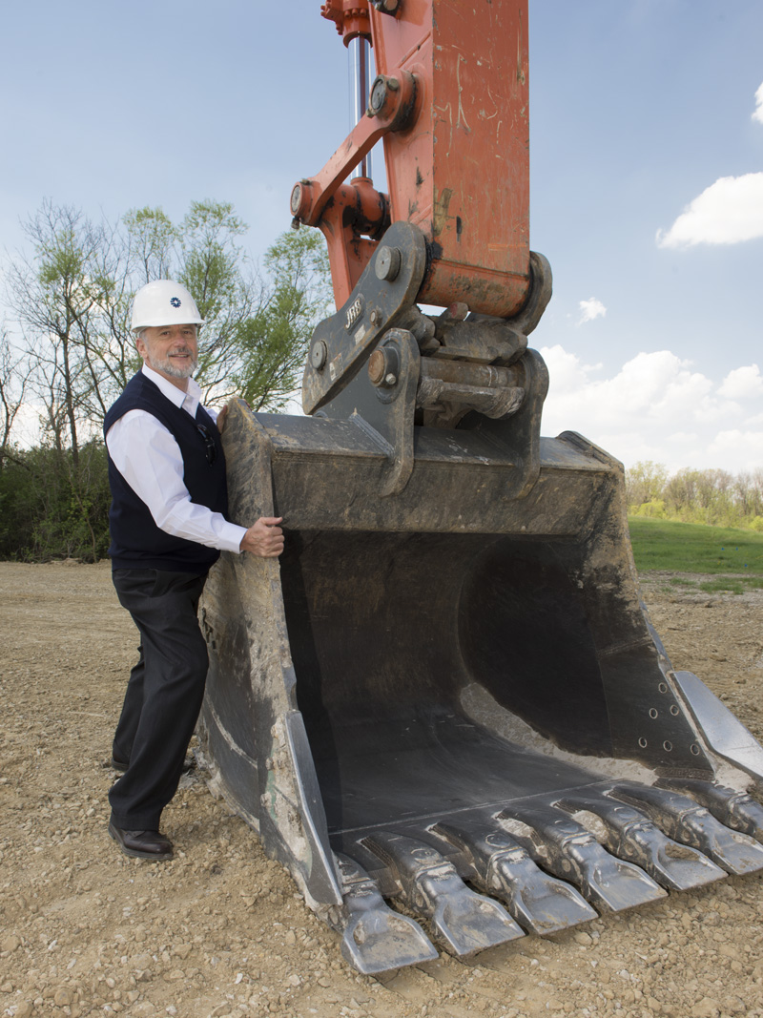
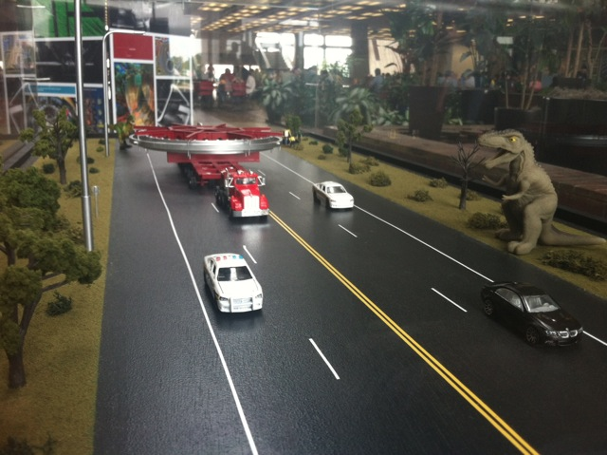
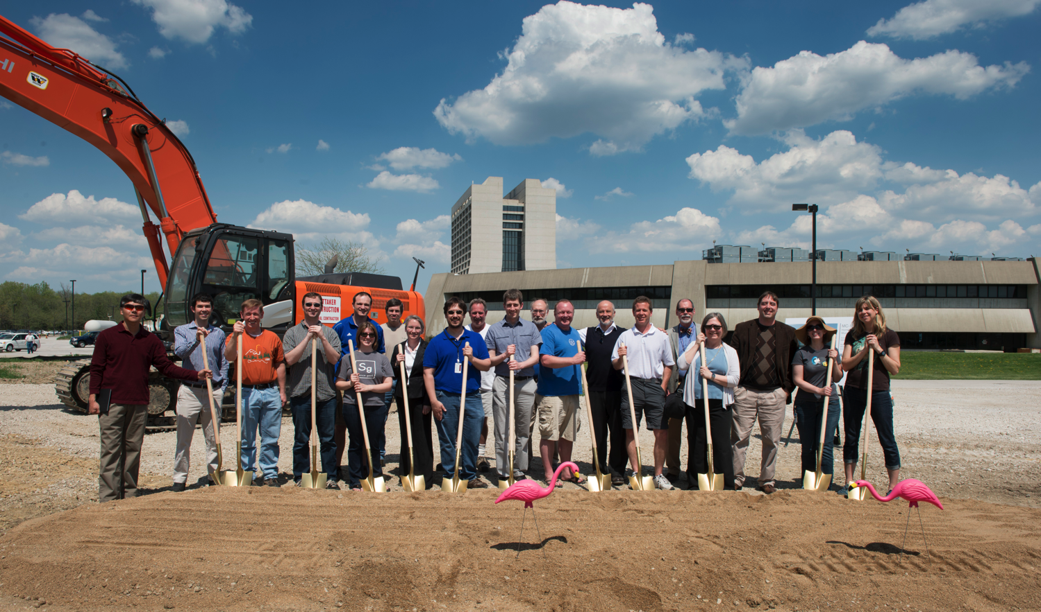
Muon g-2 milestones
January 2011: Stage 1a approval granted
September 2012: CD0 granted
May 8, 2013: Muon Campus groundbreaking
June 16, 2013: storage ring magnet leaves BNL

Slide 26


Slide 27


Beyond: Project X

Slide 28

Many Thanks to Pier for
Breaking (a lot of!)
New Ground!

