Slide 1
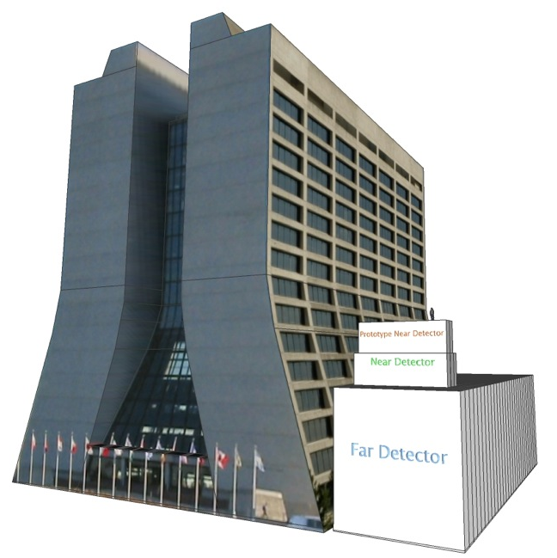

The NOνA
Experiment
Martin Frank
University of Virginia
on behalf of the
NOνA Collaboration
46th Fermilab
Users Meeting
June 12th, 2013
image courtesy of M. Muether
Notes:
Basic NOvA Explanation

Slide 2
Physics
NOνA:
  NuMI: Neutrinos at the Main Injector (ν_{μ})
  Off-Axis: monoenergetic beam (2 GeV)
  ν_{e} Appearance
Physics Goals:
  measure θ₁₃, θ₂₃, Δm²₃₂
  resolve θ₂₃ octant
  measure δ_{CP}
  CP-violating phase angle
  resolve mass hierarchy

Slide 3
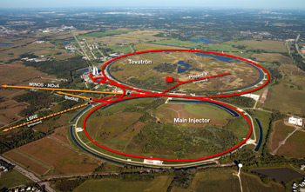
NuMI Beamline
NuMI Beam
Main Injector
Fermilab
NuMI: Neutrinos at the Main Injector
Beam delivered to several neutrino experiments since 2005:
  MINOS, MINERνA, and ArgoNeut
Beam upgrade work since May 2012:
  increase beam power from 300 kW to 700 kW
  upgrade graphite target and magnetic focusing horns
Beam returns at the end of this month (June 2013)!
Notes:
2 horns allow us to tune energy of beam
don’t list all the beam improvements

Slide 4
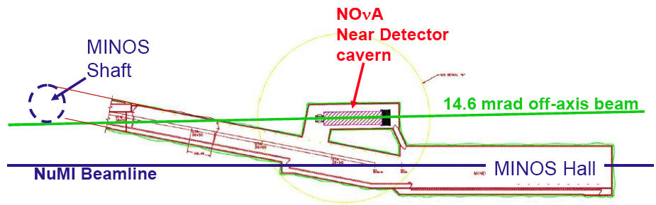
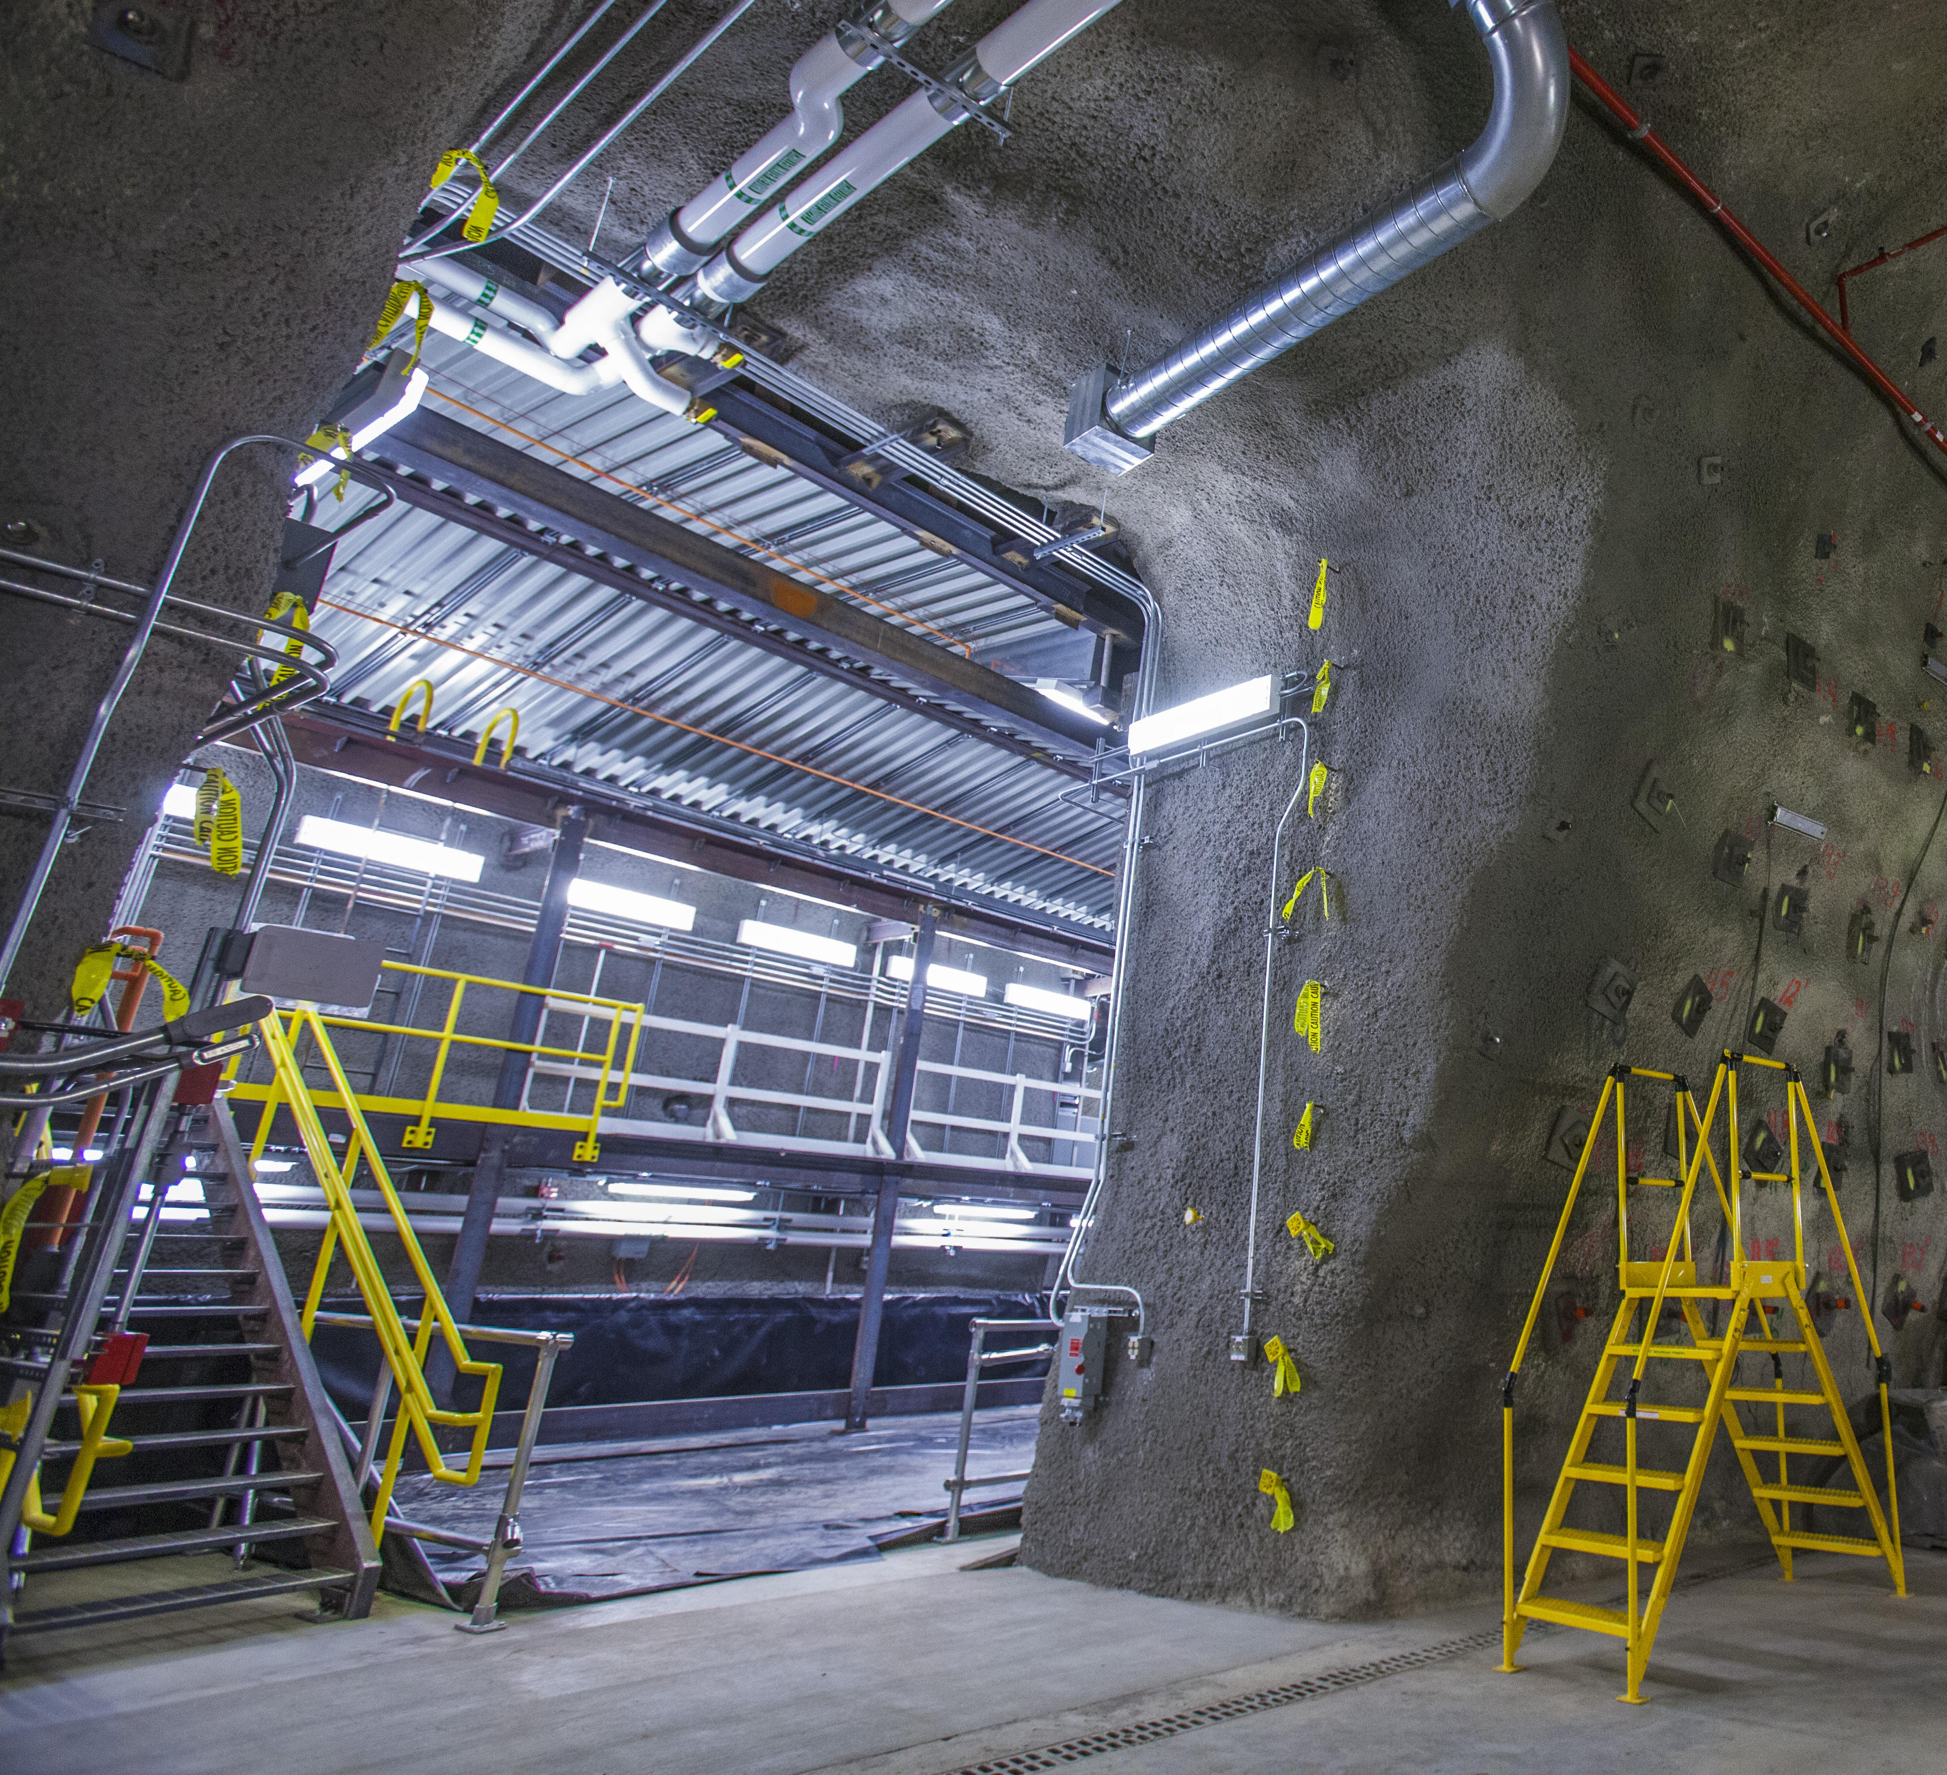
Near Detector Status
105m underground
Cavern Completed!
Received Beneficial Occupancy in May.
Assembly starts this month (June).
Outfitting during summer and fall.
Start data taking with half of the detector in December.
Near Detector Cavern
MINOS Tunnel

Slide 5
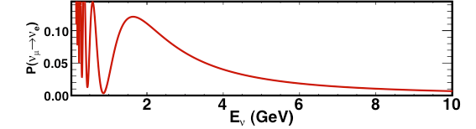
The Beam
Ash River
Baseline (L = 810 km)
  The neutrino beam
  travels from here (Fermilab)
  to Ash River, MN through
  the earth’s crust.
NuMI
810 km
(e.g. MINOS)
Fermilab
  Longest baseline
  experiment!
Energy (E_{ν} = 2 GeV)
  We can achieve a narrowly distributed neutrino energy by placing the far detector 14.6 mrad off the beam axis.
  This is also the ν_{μ} → ν_{e} oscillation peak.

Slide 6
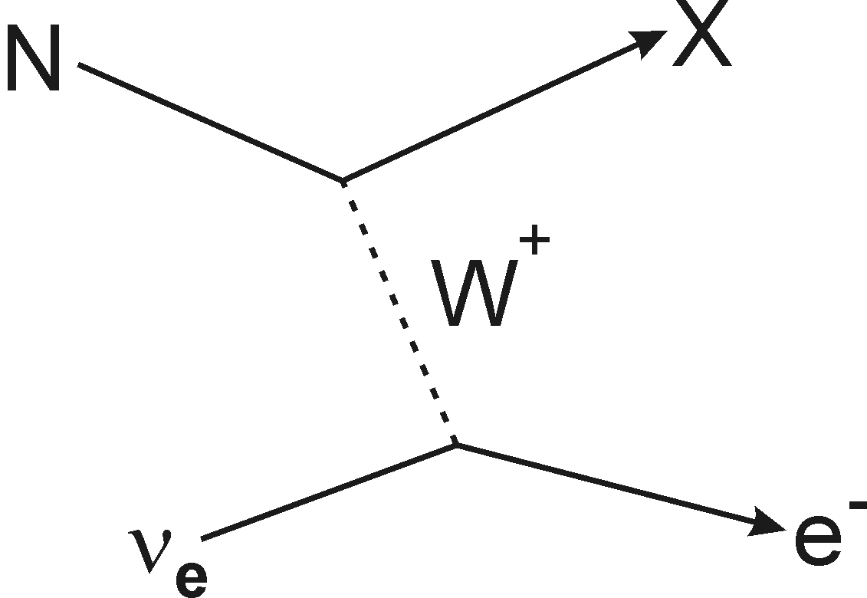
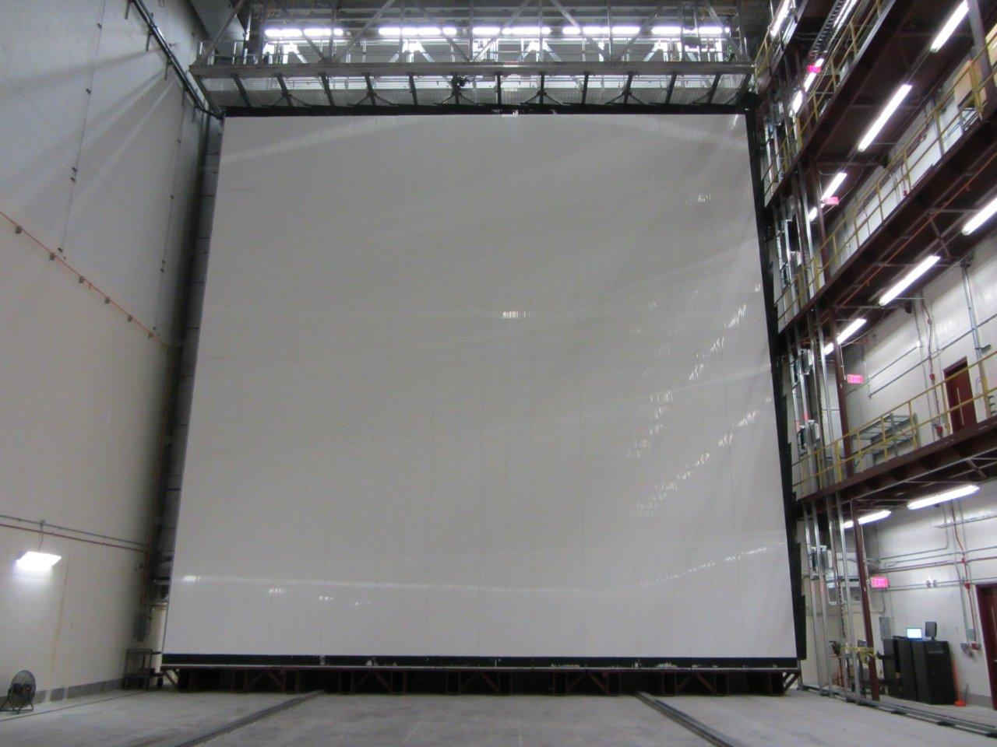
Detector
4 cm
charged-current
interaction
“Fully” Active Detector
PVC extrusions (long tubes)
filled with liquid scintillator
provide a radiation length
of ~ 40 cm.
2 GeV muon travels 10 m!
Each extrusion contains one loop of wavelength-shifting fiber.
We want to detect
weakly-interacting
electron neutrinos (ν_{e}).
This requires:
  large detector mass
  good electromagnetic (EM) shower resolution
15 m
1 Channel

Slide 7
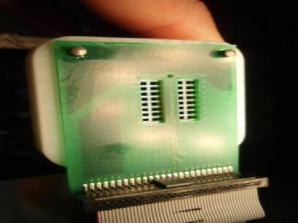
Detector
“Fully” Active Detector
PVC extrusions (long tubes)
filled with liquid scintillator
provide a radiation length
of ~ 40 cm.
2 GeV muon travels 10 m!
Each extrusion contains one loop of wavelength-shifting fiber.
32 channels are read out by one avalanche photo-diode (APD).
Avalanche
Photo-Diode
15 m
32 channels → 1 module
×32
32 Channels

Slide 8
Detector
15 m
12 modules → 1 (x- or y-) plane
32 planes → 1 block
15 m
×12
First Block Placed:
September 2012
384 Channels (plane)
12,288 Channels (block)
Martin Frank
8
University of Virginia

Slide 9
Far Detector (14 kilotons)
First Block
Placed: September 2012
Filled: January 2013
Instr.: May 2013
344,064 Channels

Slide 10
FD fully instrumented in Aug 2014
Beam Returns
We reach 5σ only after
1 year of running!
This is not
the run plan.

Slide 11
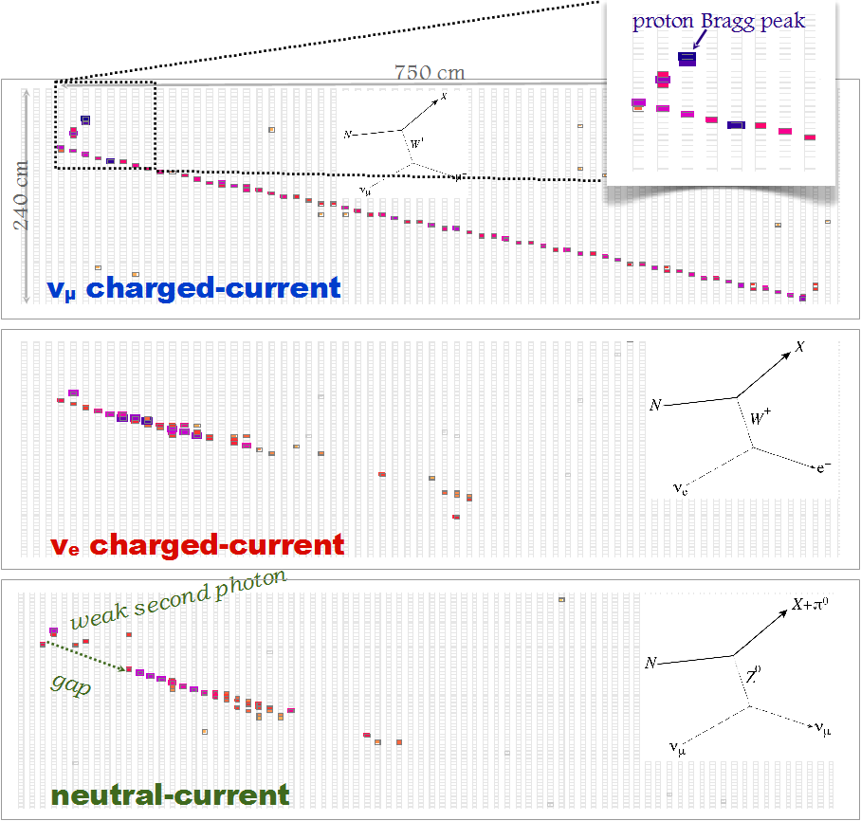
Simulated Event Signatures
ν_{μ} charged-current
long muon track
short proton track
ν_{e} charged-current
single EM shower
neutral-current with π⁰ final state
multiple EM showers
gaps near vertex
Notes:
note that they are blown up events and that this is not the entire detector!

Slide 12
First Far Detector Cosmic Ray Data
xz-view
reconstructed muon track
yz-view
first instrumented kiloton

Slide 13
ν_{e} Selection
3 years of running in neutrino mode:
Neutral
Current
ν_{μ}
Backgrounds
Signal ν_{e}
Beam ν_{e}
We designed a suite of particle ID techniques:
  ANN: Likelihood ratios for particle hypotheses.
  LEM: Matching to MC library events.
  BDT: Boosted decision tree on simple
  reconstructed quantities.
The plots on the right show promising
ν_{e} signal/background separation.

Slide 14
Extracting Nature’s Parameters
≈
_
+
+
± neutrino mode
± anti-neutrino mode
×
_
The NOνA baseline (L = 810 km) and neutrino beam energy (E = 2 GeV) place our detector at the first ν_{μ} → ν_{e} oscillation peak.
sin²2θ₁₃: the leading term in this equation has already been measured and it is large!
sin²θ₂₃: we can glean information about the θ₂₃ octant from the leading term.
δ_{CP}: using the measured value of θ₁₃, we can determine the CP-violating phase angle.
mass hierarchy: depending on the sign of Δm²₃₁ ~ Δm²₃₂, the oscillation probability is either enhanced or suppressed. This difference can be determined by comparing neutrino running with anti-neutrino running.
Notes:
say out: “CP-violating phase angle”
read mass hierarchy explanation

Slide 15
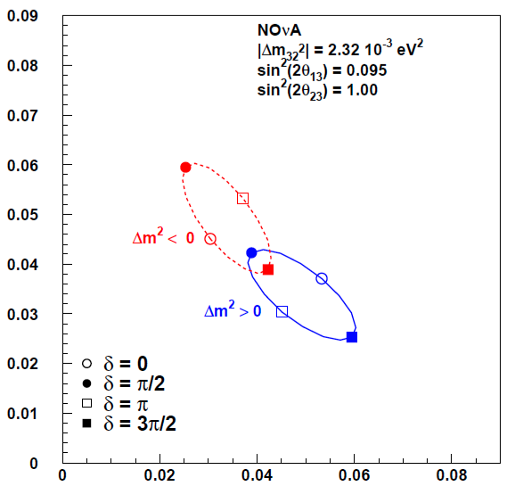
Physics Reach (Bi-probability Plots)
Using the previous equations, we can calculate the neutrino and anti-neutrino appearance probabilities.
Assume that NOvA would measure where the orange arrows point (best case scenario).
The bold and dotted lines show the 1 and
2 σ contours that we could achieve with:
3 years neutrino running plus 3 years anti-neutrino running
θ₂₃ = 45°
Δm² > 0

Slide 16
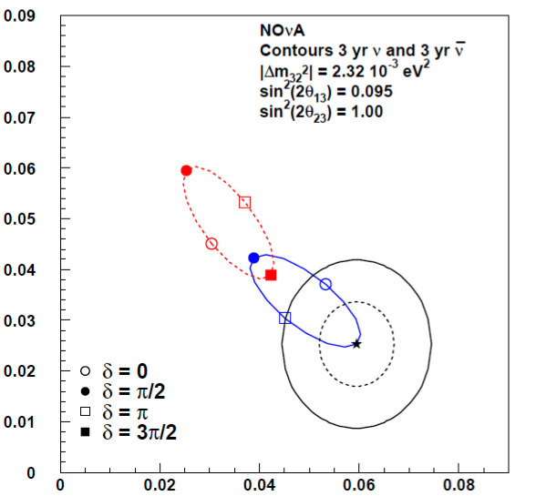
Physics Reach (Bi-probability Plots)
Using the previous equations, we can calculate the neutrino and anti-neutrino appearance probabilities.
Assume that NOvA would measure where the orange arrows point (best case scenario).
The bold and dotted lines show the 1 and
2 σ contours that we could achieve with:
3 years neutrino running plus 3 years anti-neutrino running
θ₂₃ = 45°

Slide 17
Mass Hierarchy and δ_{CP} Sensitivity
Given the bi-probability plots from the previous slides and using latest analysis framework, we can determine how sensitive we will be to resolve the:
  Mass Hierarchy (even better with T2K)
  CP-violating phase angle (δ_{CP})
Results from full simulation, reconstruction, and selection!
First glimpse at (δ_{CP})!

Slide 18
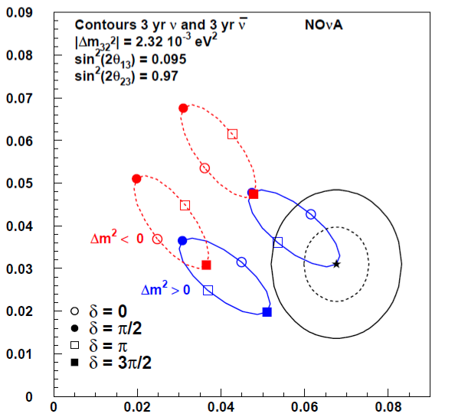
Physics Reach (θ₂₃ Octant)
We know that sin²(2θ₂₃) is close to unity, but what octant does θ₂₃ fall in?
  θ₂₃ > 45°
  θ₂₃ < 45°
The probability ellipses are given for both scenarios separated by the green dotted line.
θ₂₃ > 45°
θ₂₃ < 45°

Slide 19
θ₂₃ Octant Sensitivity
Given the bi-probability plots, we can calculate how sensitive we will be to the θ₂₃ octant:
  θ₂₃ > 45° (upper octant)
  θ₂₃ < 45° (lower octant)
θ₂₃ > 45°
θ₂₃ < 45°

Slide 20
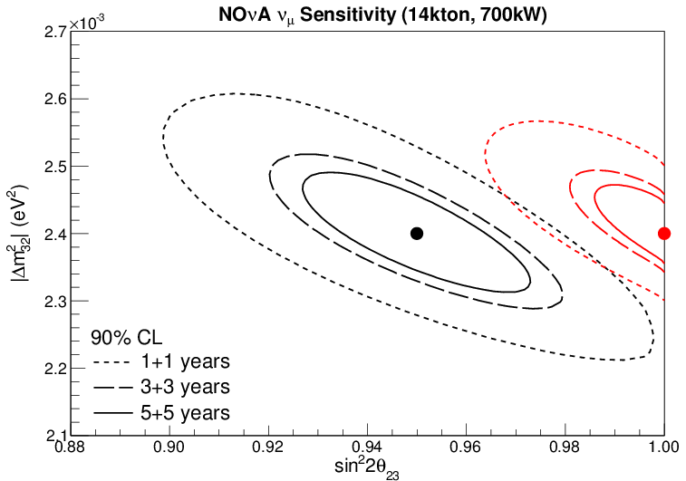
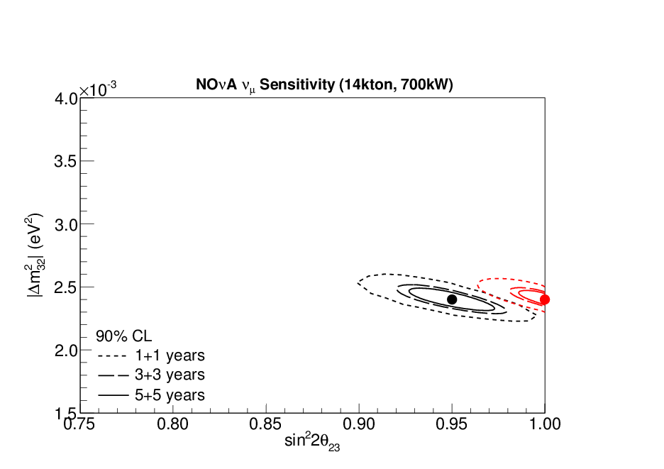
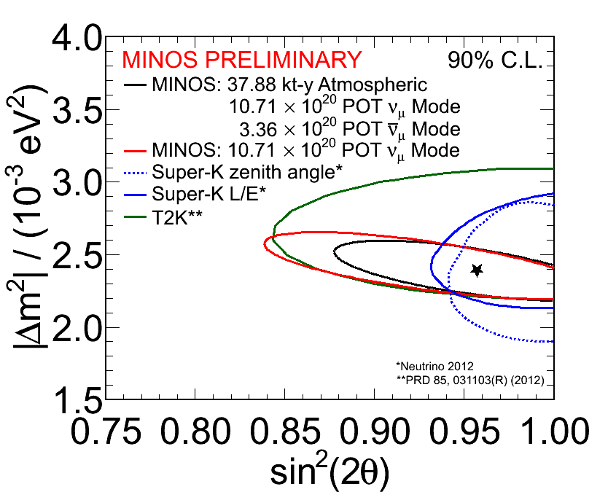
Precision Measurements
NOvA Sensitivity
MINOS
best fit
Measure θ₂₃, Δm²₃₂ to the few percent level
using ν_{μ} disappearance:

Slide 21
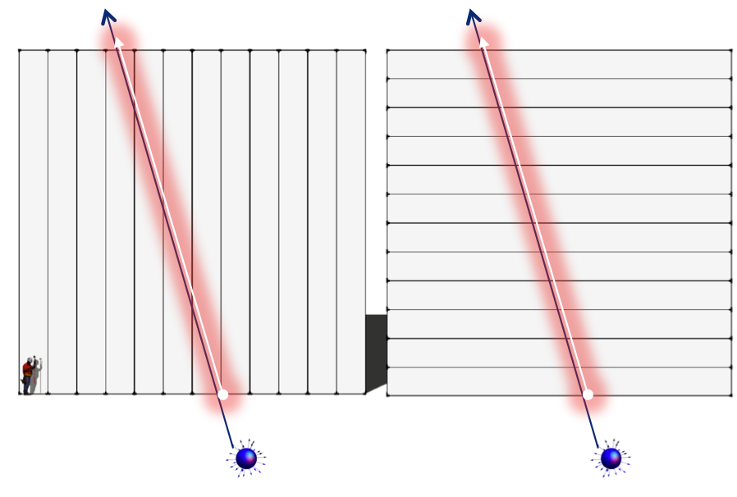
Exotic Searches
Because the NOvA detector is so large and highly-segmented, it lends itself to exotic searches:
Magnetic Monopoles
  would be highly ionizing or slow moving particles.
  The NOvA detector is favorable because of its large surface area and its surface location.
  The plot on the right shows the monopole phase space we have access to.
Supernovae
  have a large neutrino shockwave.
WIMP
  highly energetic neutrinos
  coming from the sun
Using the Near Detector:
  Neutrino Magnetic Moment
  Dark Sector
  NOνA: 4168 m²
  MACRO: 3482 m²
  SLIM: 427 m²
  OHYA: 2000 m²
magnetic
monopole
Notes:
Mention that the large detector volume gives us the edge in monopole searches
Mention that there are other searches as well (e.g. Hidden Sector)

Slide 22
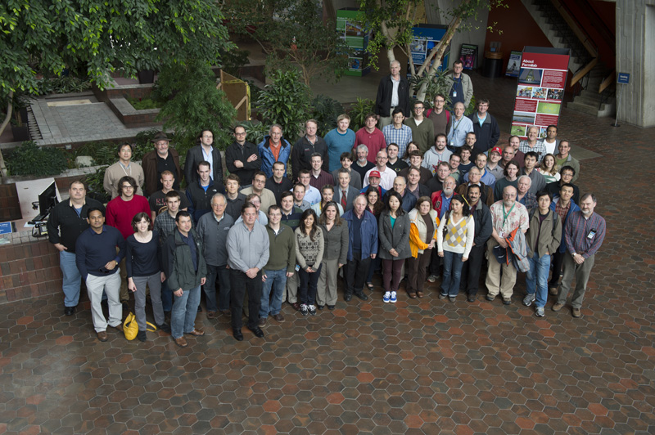







Summary
Thanks to the NOvA Project!
Far Detector construction half way complete with first kiloton fully instrumented and construction progressing quickly.
NuMI beam return is imminent!
Our analysis framework is ready to try to pin down the mass hierarchy and the θ₂₃ octant, and have the first glimpse at δ_{CP}.
We will use our detector as an eye to the universe and are excited about what we might learn.
Please see the 5 NOvA posters this evening for more detail.
We do not only have a massive detector, but also a massive collaboration of dedicated people!
180+ scientists and engineers
from 35 institutions from 7 countries

