Slide 1
Muon g-2 at Fermilab
Peter Winter (for the E989 collaboration)
Argonne National Laboratory

Slide 2
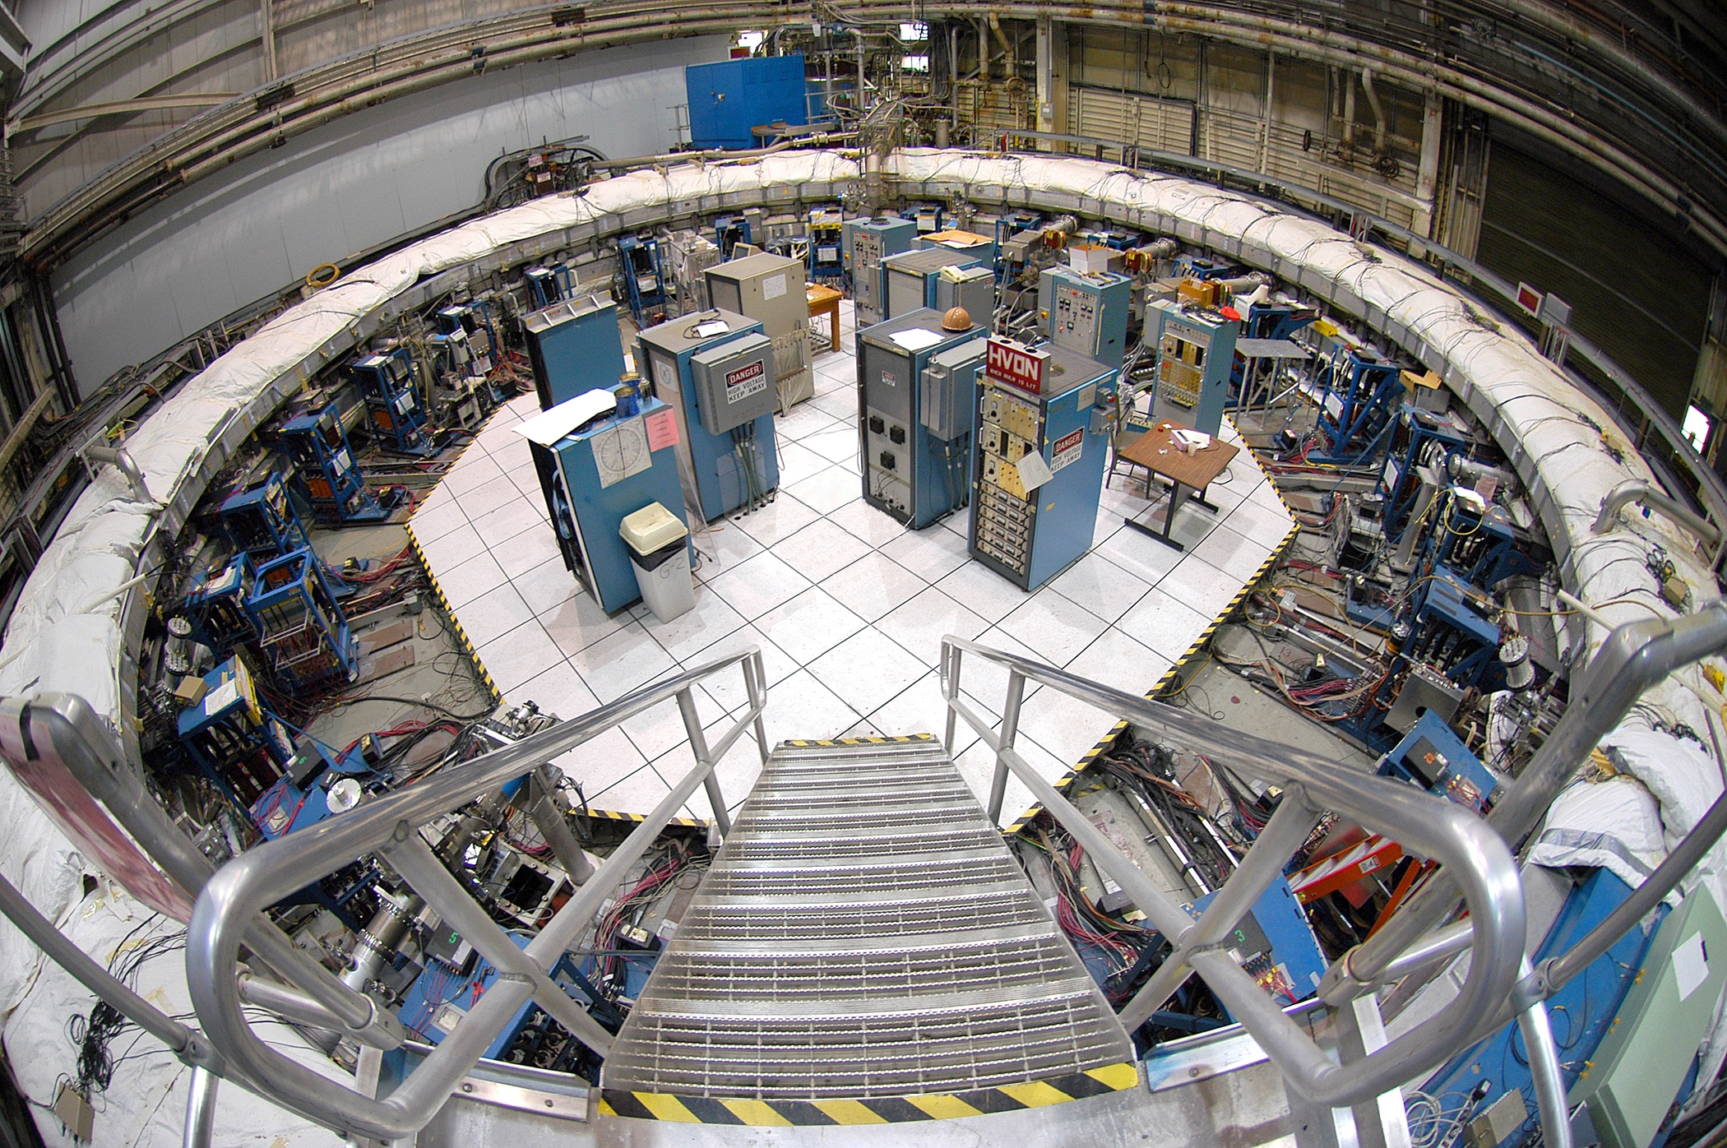
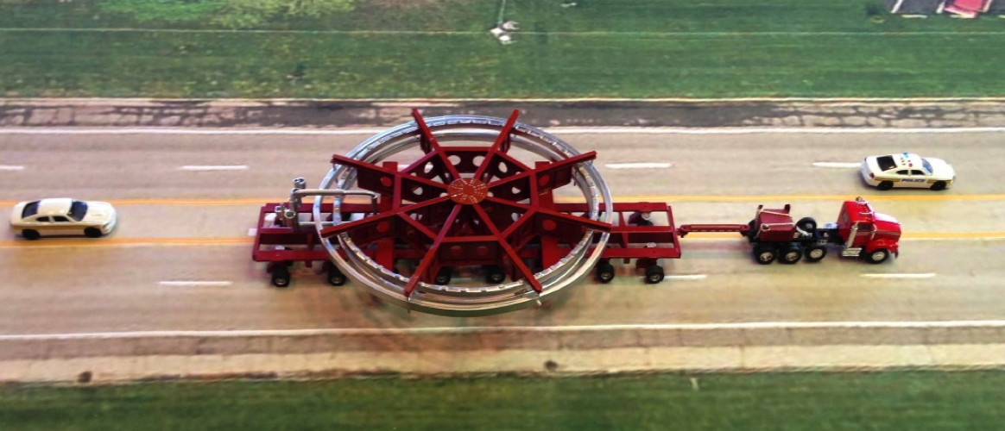
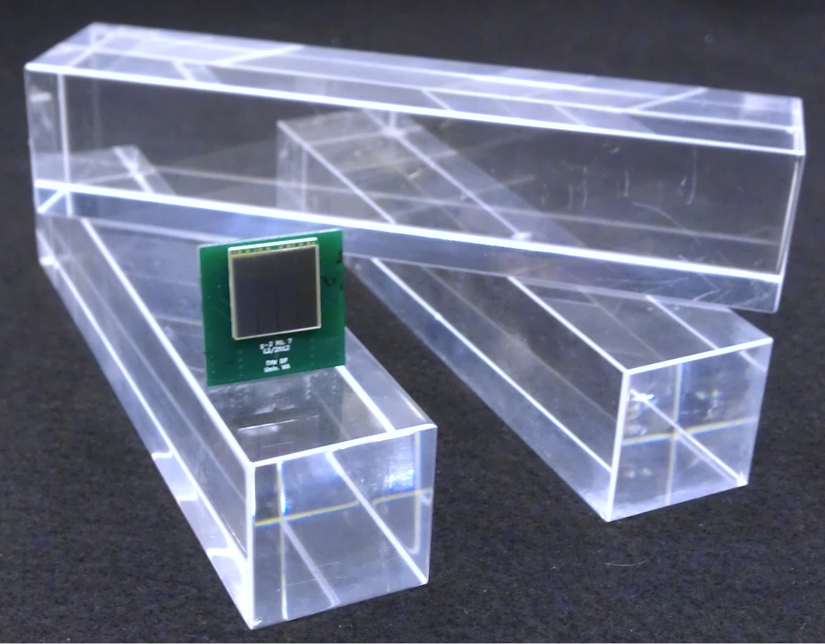
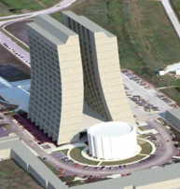
Outlook
Motivation
Experimental technique
Muon g-2 at Fermilab
Closing remarks
Let’s enter the stage of g-2...

Slide 3
g-2 on the Standard Model blackboard
π
π
μ
γ
μ
Z
π
π
B
Weak
Had VP
Had LbL
QED
Had VP
Known well beyond current experimental precision
Known slightly better than current experimental precision – needs work
Anomalous magnetic moment: a_{μ} = (g_{μ}-2)/2
a_{μ}^{Expt.} = a_{μ}SM + a_{μ}^{New Physics}
Enhanced sensitivity (m_{μ} / m_{e})² ≈ 43,000 !
Muon lives long enough (2.2 μs) !

Slide 4
Hadronic vacuum polarization
Challenging but can link to experimental data!
γ
h
μ
μ

Slide 5
Hadronic vacuum polarization
Challenging but can link to experimental data!
γ
h
e⁺
γ
h
μ
μ
e⁻

Slide 6
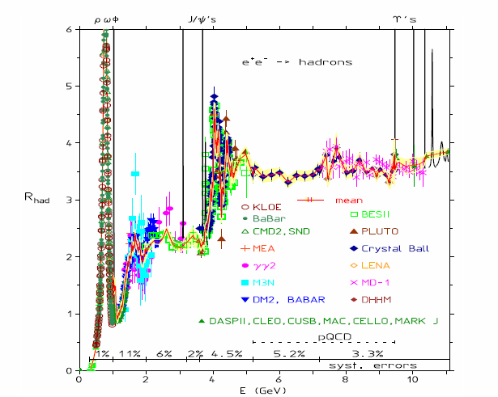
Hadronic vacuum polarization
A lot of precision data already available from many experiments
Future improvements from VEP-2000, KLOE, BaBar, Belle, BES-III, ...

Slide 7
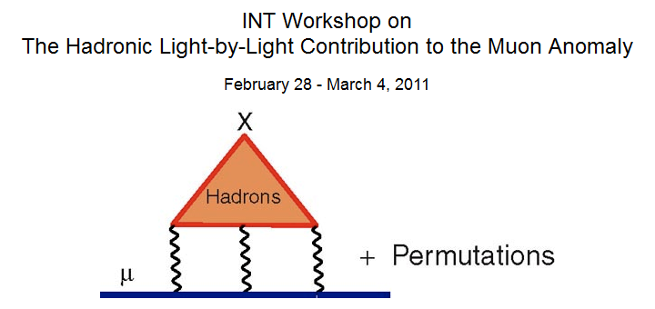
Hadronic Light-by-Light
Needs to be evaluated by theory
Model dependent calculations
Lattice-QCD is progressing (both for HVP and HLbL)
Had LbL
Hadronic contributions to the muon anomalous magnetic moment:
Strategies for improvements of the accuracy of the theoretical predictions
Mar 31 - Apr 4, 2014
Coordinater: F. Jegerlehner

Slide 8
Current status of a_{μ} in Standard Model
 | Value (x 10⁻¹¹)
QED | 116 584 718.951 ± 0.009 ± 0.019 ± 0.007 ± 0.077
HVP (lo) | 6949 ± 42
HVP (ho) | -98.4 ± 0.7
HLBL | 105 ± 26
EQ | 154 ± 1
Total SM | 116 591 802 ± 49
a_{μ}^{Expt.} - a_{μ}SM = (260 ± 78) x 10⁻¹¹ (3.3 σ)
New E989 experiment will reduce experimental uncertainty by a factor of 4 to 16 x 10⁻¹¹ (0.14 ppm)
If current discrepancy remains this would yield >5σ
Together with theory improvements could give >8σ

Slide 9
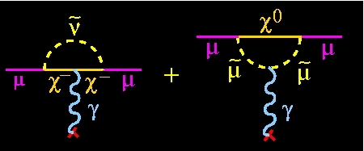
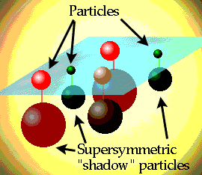
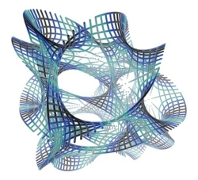
What about the new physics?
One example: SUSY
difficult to measure at LHC
Another example: Universal Extra Dimensions
a_{μ}(UED) ≈ -13 × 10⁻¹¹

Slide 10
Outlook
Motivation
Experimental technique

Slide 11
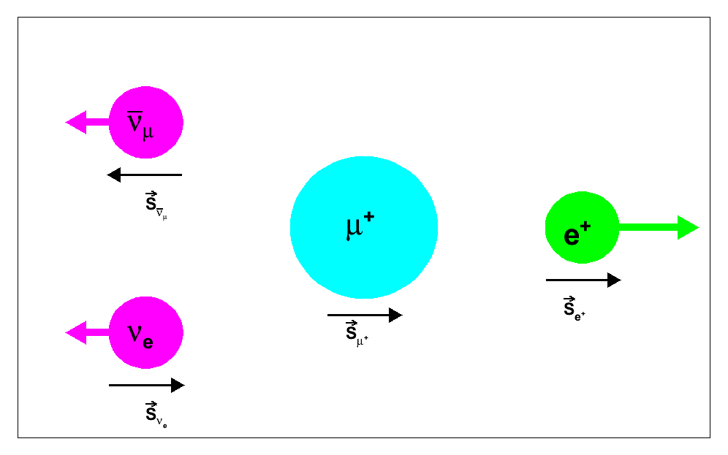
Two important ingredients
Polarized muons from pion decay
ν π⁺ μ⁺
Muon decay is self-analyzing
High energy electron
μ → e ν ν
μ
ν
γ_{α}(1-γ₅)
ν
e

Slide 12
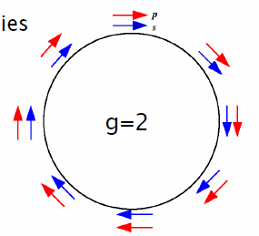
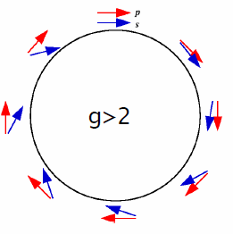
Muons in a storage ring
Cyclotron frequency ω_{C}
Spin precession frequency ω_{S}
ω_{a} = ω_{S} – ω_{C} = e/m a_{μ} B

Slide 13
Muons in a storage ring
ω_{a} = e/m a_{μ} B
Measuring the anomalous moment a_{μ} requires both
the spin precession frequency ω_{a}
the magnetic field B
ω_{a}/ω_{p}
We can rewrite this to:
a_{μ} =
μ_{μ}/μ_{p} – ω_{a}/ω_{p}
ω_{p}: Proton Larmor frequency measured in the same B field
ω_{a}: Spin precession frequency measured with decay positrons
μ_{μ}/μ_{p}: Ratio known from muonium hyperfine measurement

Slide 14
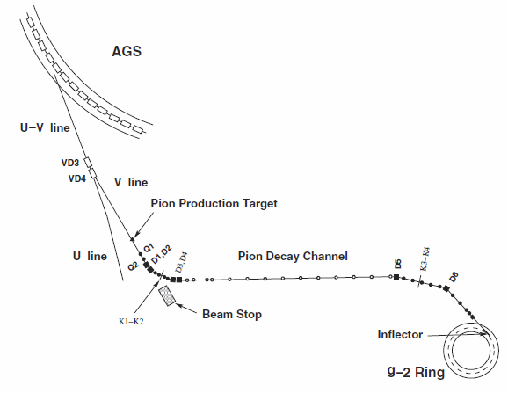
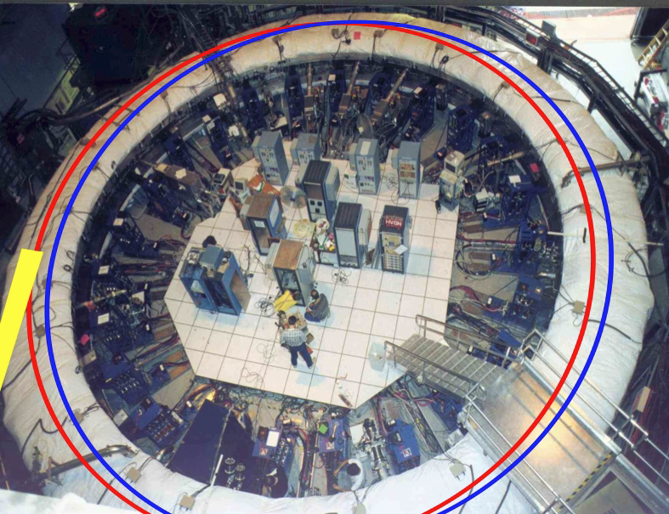
Muon injection and kicker
BNL E821
Need field free region for muon injection

Slide 15
Muon injection and kicker
Need to kick muons to bring on stable orbit

Slide 16
Vertical focusing with electrostatic quadrupoles
Term vanishes at magic momentum!
E field introduces new term
Solution Magic momentum with γ = 29.3 (p = 3.09 GeV/c)
So far we have polarized stored muons in the ring.
But how are we going to measure ω_{a} and B at Fermilab?

Slide 17
Outlook
Motivation
Experimental technique
Muon g-2 at Fermilab

Slide 18
Roadmap from BNL E821 to E989 at Fermilab
Bring storage ring from Long Island to the Midwest
Use Fermilab infrastructure to get 20 times more muons for statistical error of 0.1 ppm
Upgrade and build new systems to reduce systematics to 0.07 ppm for both ω_{a} and B
Overall improvement by factor of 4 to 0.14 ppm

Slide 19
Transporting the ring to Fermilab
E821 at BNL a few years ago

Slide 20
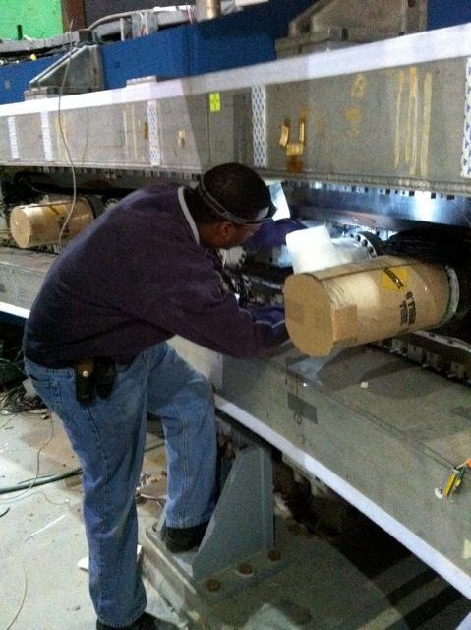
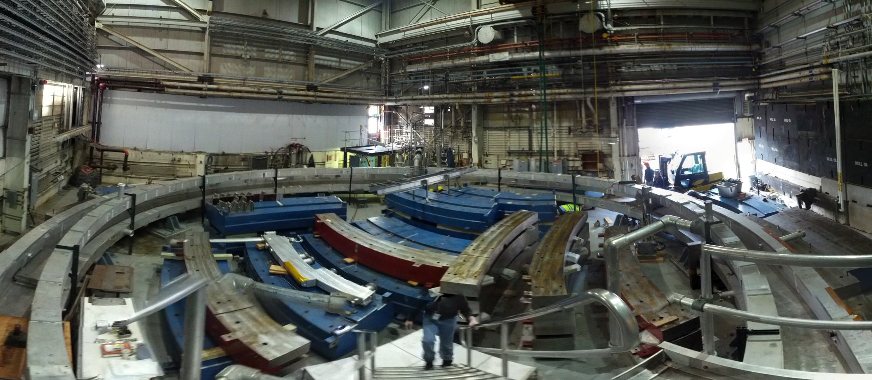
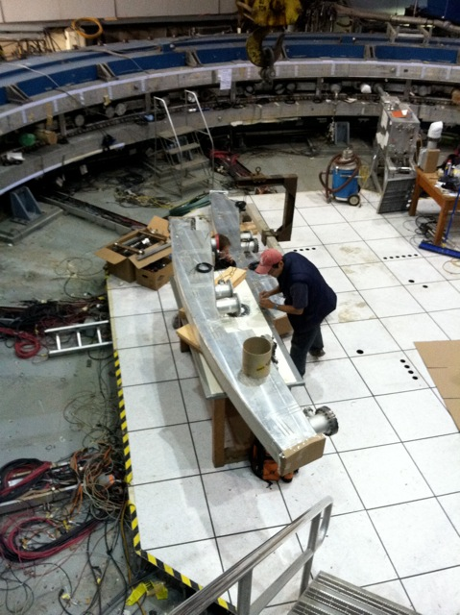
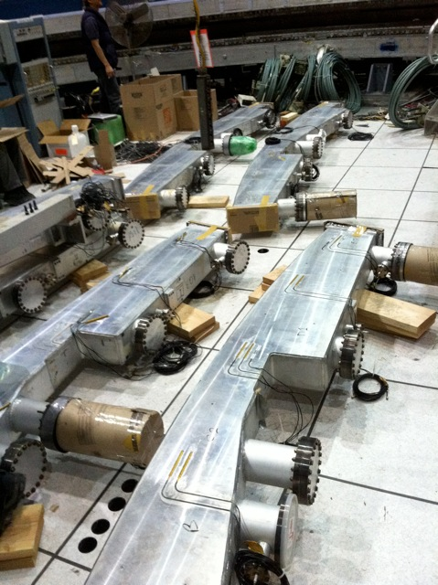
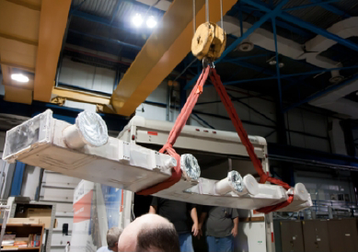
Transporting the ring to Fermilab
A few months ago

Slide 21
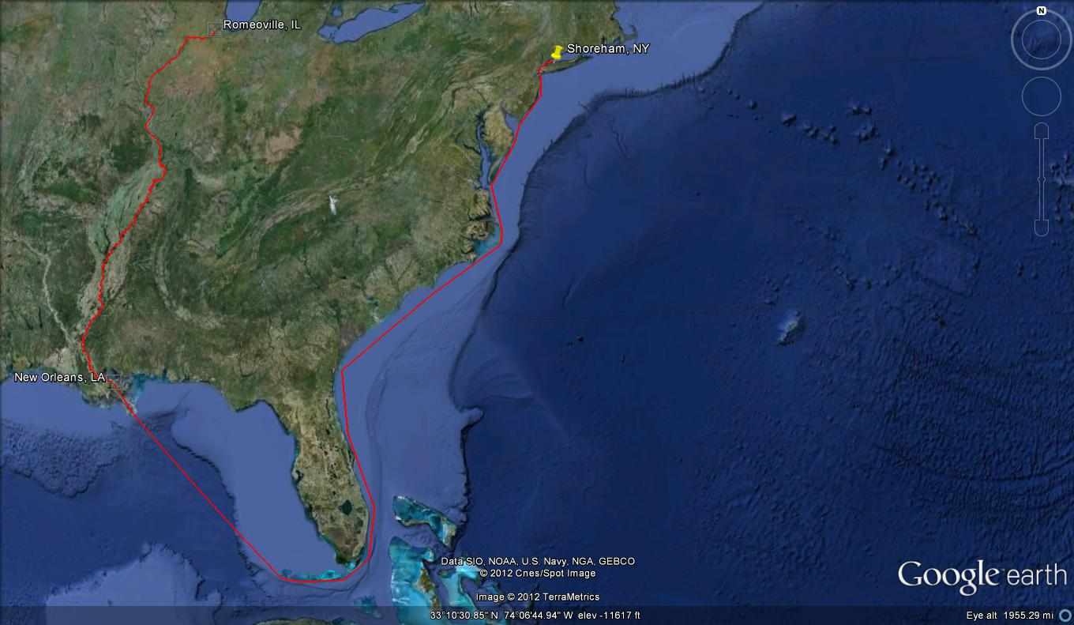
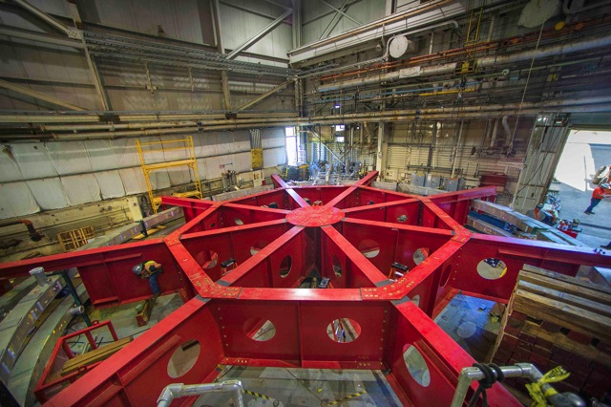
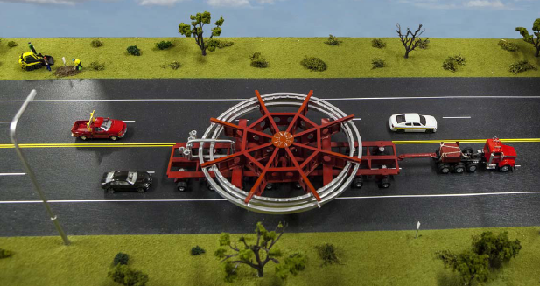
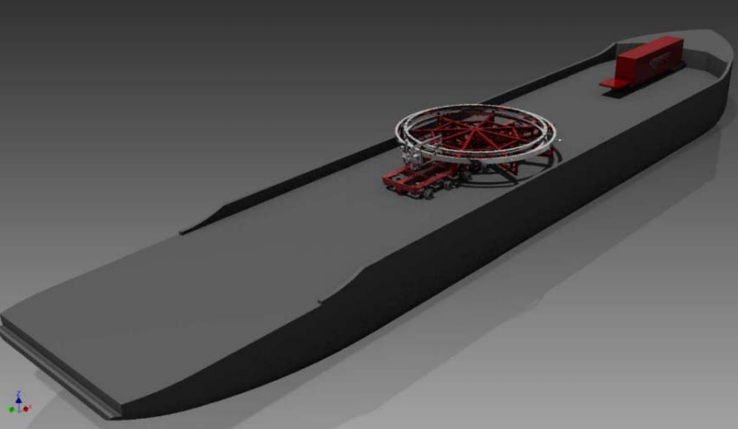
Transporting the ring to Fermilab
A few days ago

Slide 22
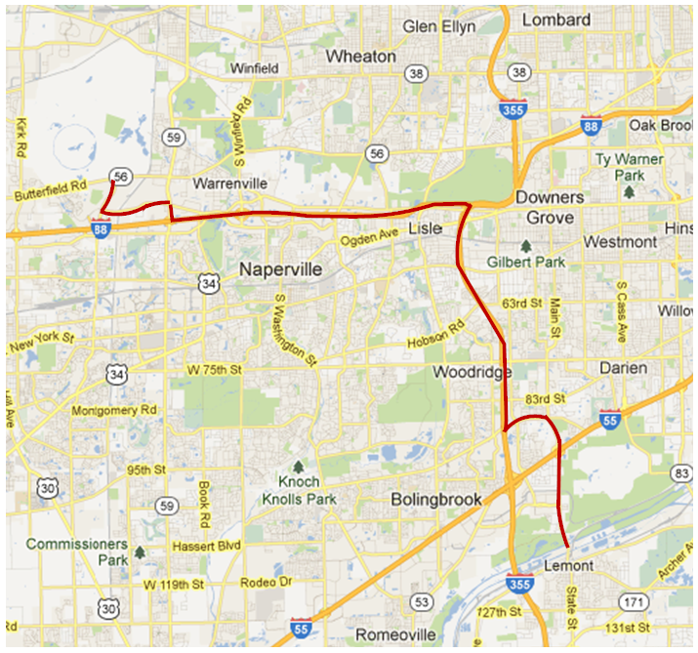
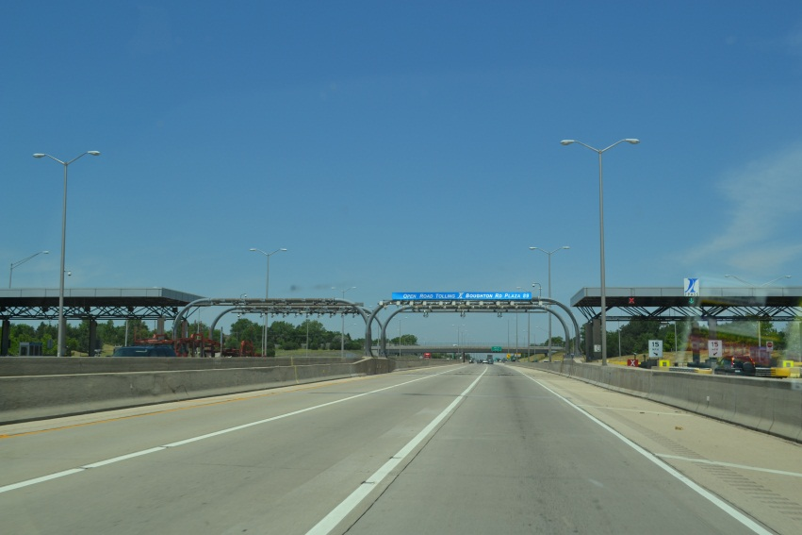
Transporting the ring to Fermilab

Slide 23
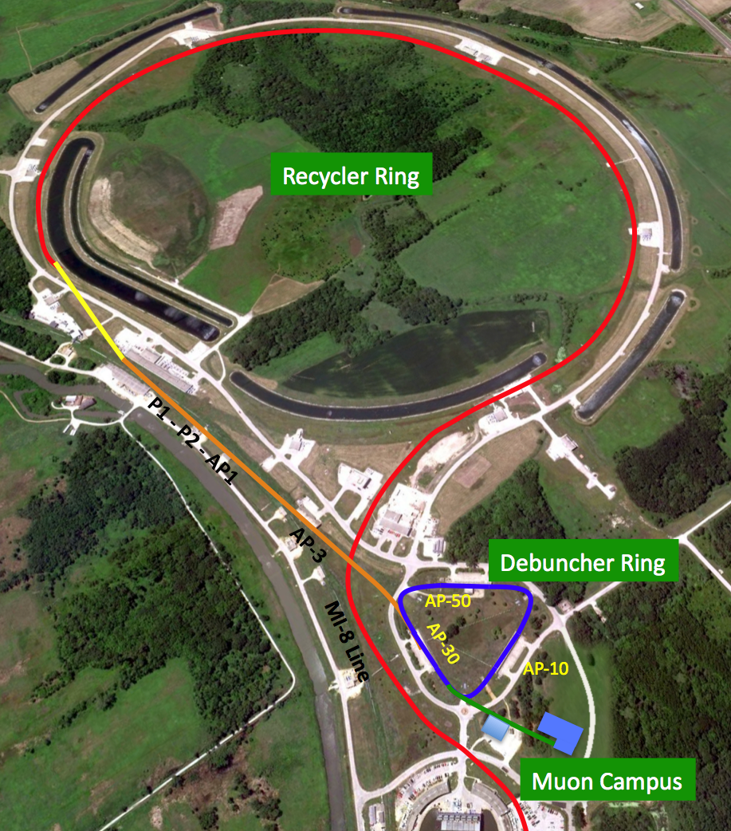
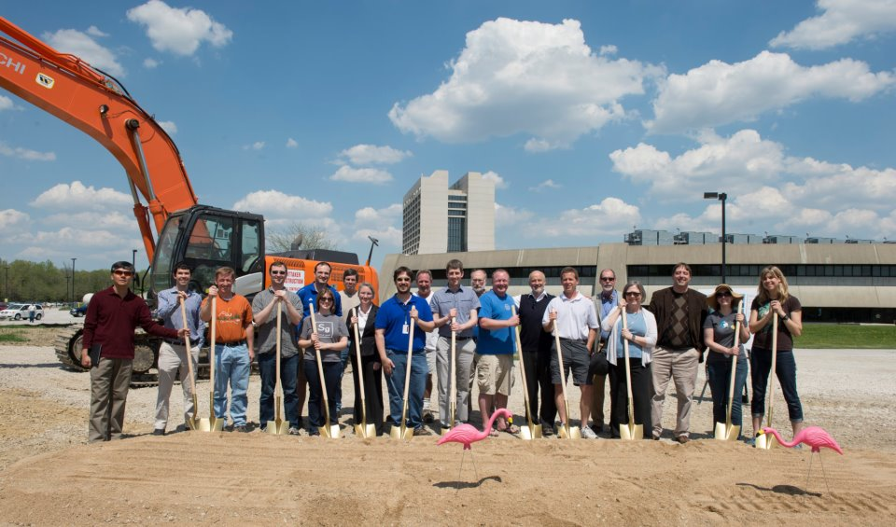
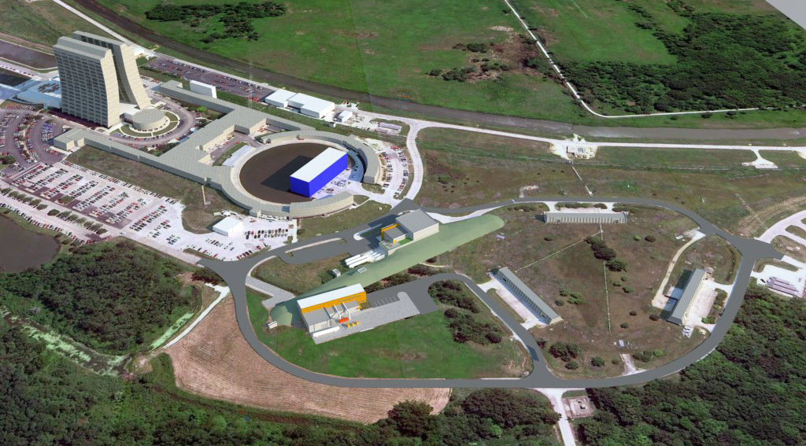
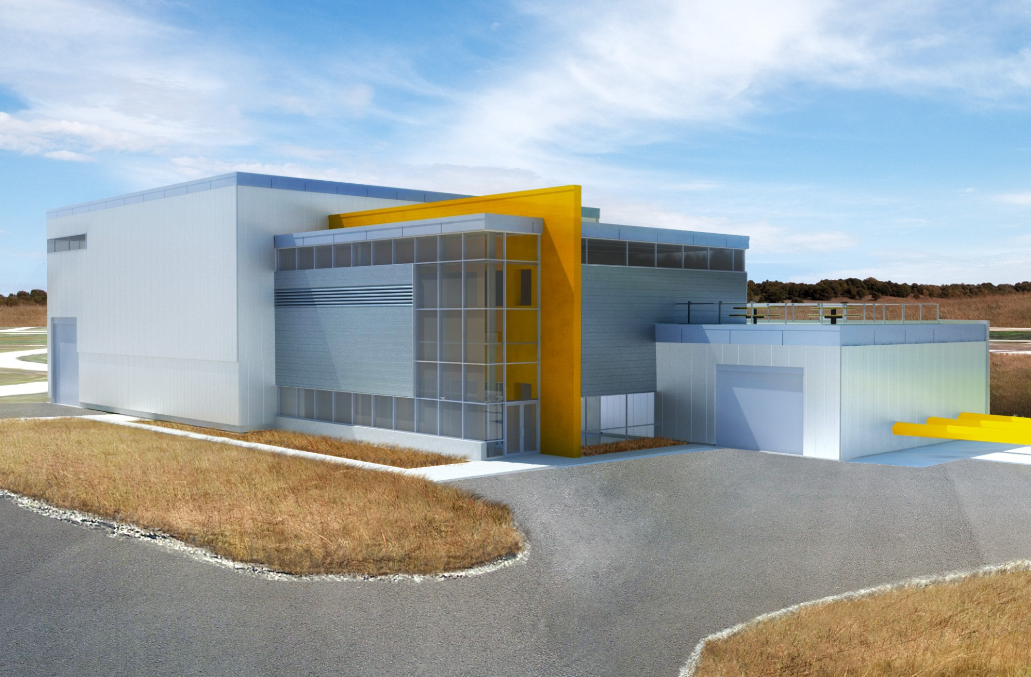
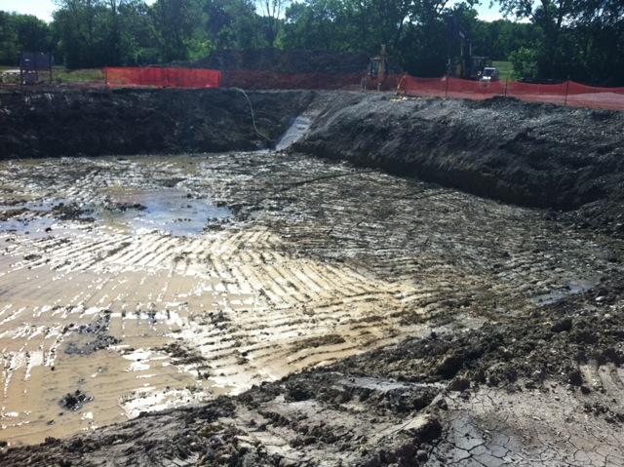
Fermilab accelerator improvements
Recycler RF to meet g-2 and mu2e requirements
Delivery ring for custom muon beams
New tunnel to muon campus
...
Recycler Ring
Delivery Ring
g-2
Mu2e

Slide 24
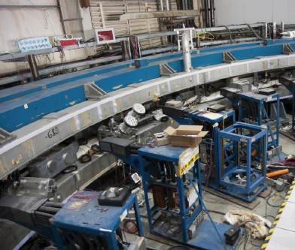
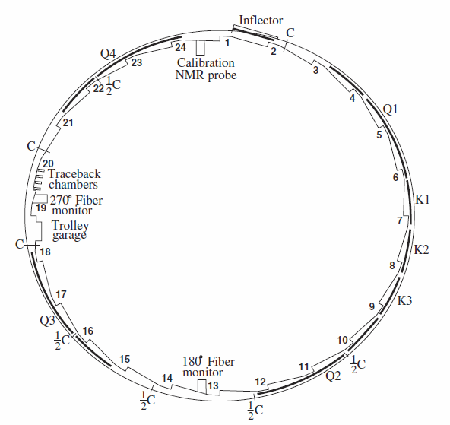
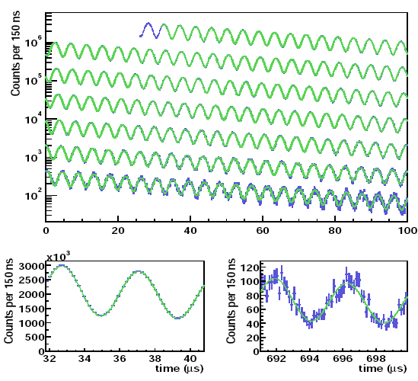
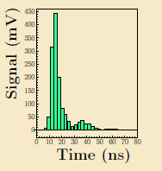
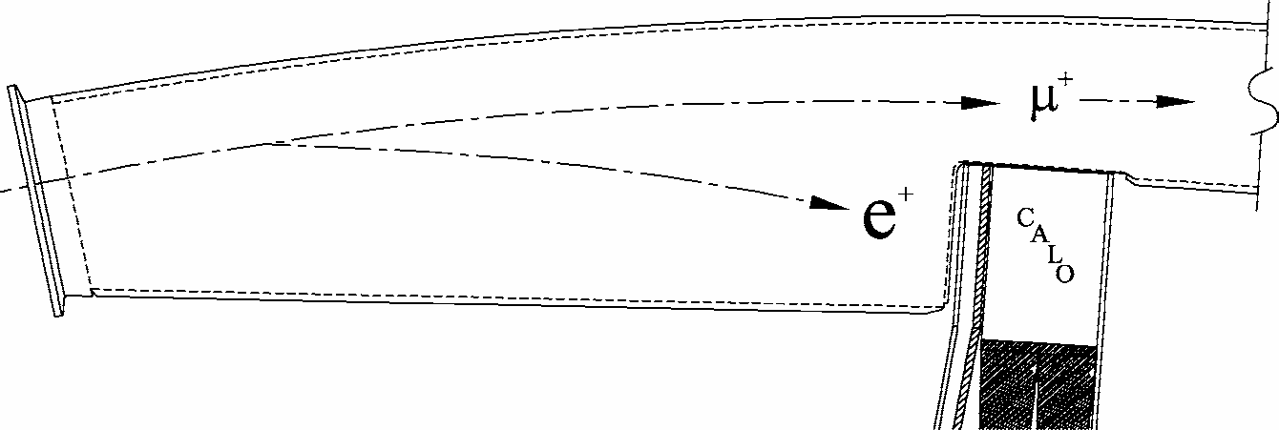
Measuring the spin precession frequency ω_{a}
24 calorimeter stations
Scallop vacuum chamber
Full waveform digitized
Fit time spectrum of positrons with E > 1.8 GeV

Slide 25
Improvements for measurement of ω_{a}
New kicker to increase muon storage and better beam dynamics
Upgrade quadrupoles for better beam dynamics
Two in-vacuum straw trackers for measuring beam motion and muon EDM
New 500 MSPS digitization and DAQ
...
Let me just highlight a few...

Slide 26
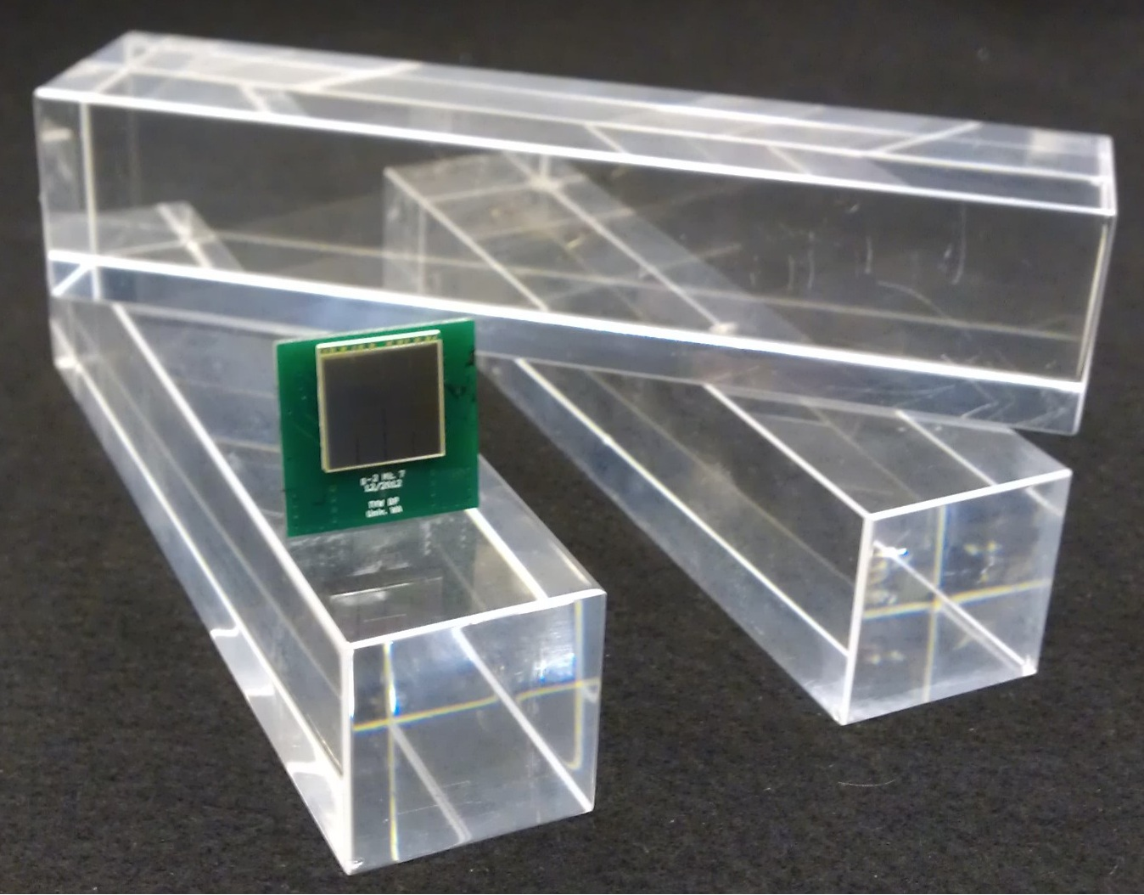
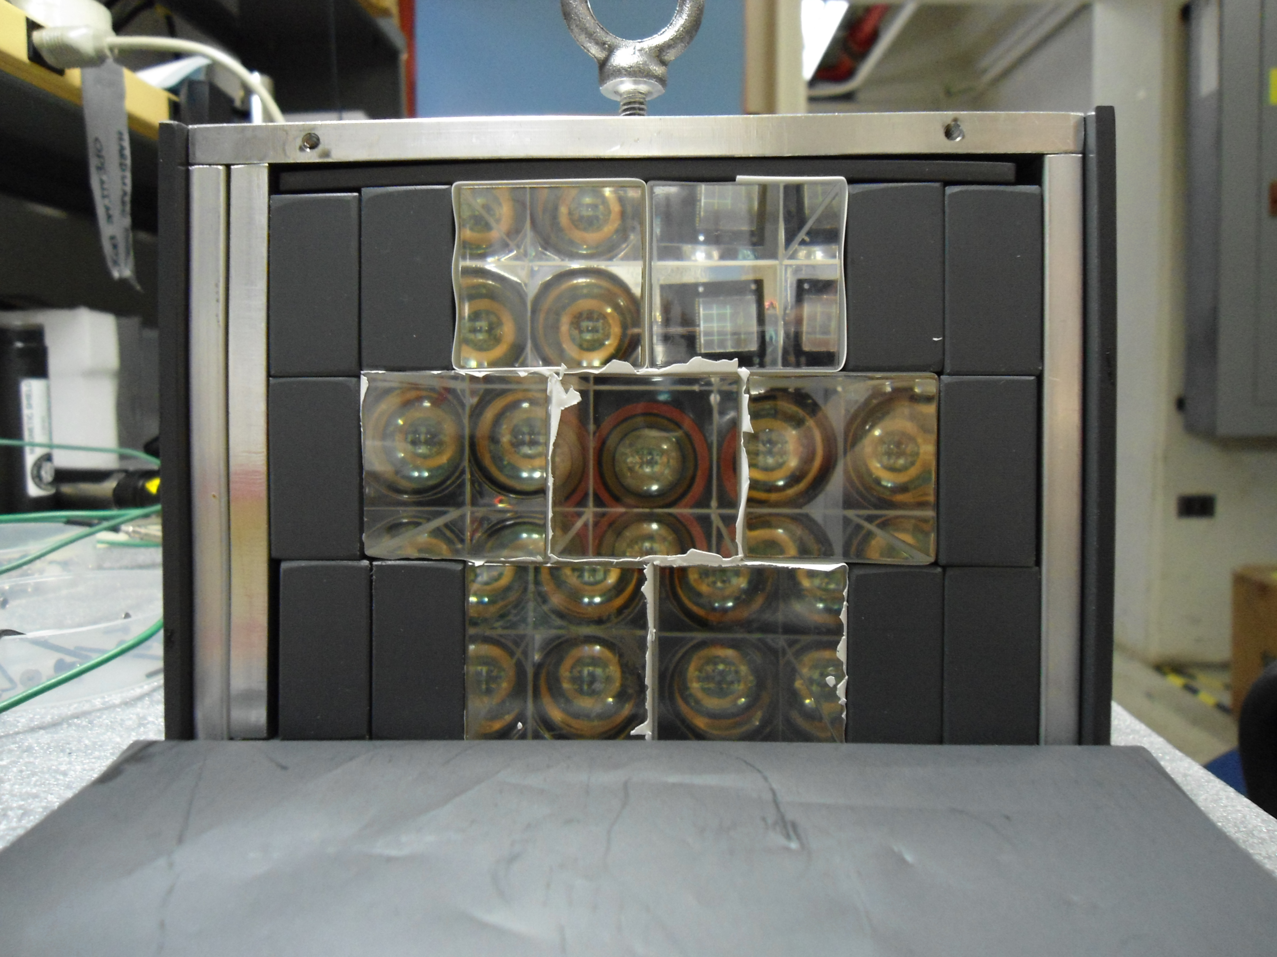
New calorimeter: PbF₂ Cerenkov with SiPM
Size | 2.5 x 2.5 cm
Thickness | 14 cm (> 15 X₀)
Segmentation | 6 x 9
Radiation length | 0.93 cm
Moliere radius R_{M} | 2.2 cm
Moliere radius R_{M} (Cerenkov) | 1.8 cm
PbF2 is dense
Segmentation helps with pileup
SiPM operate in magnetic fields
Need very stable bias voltage
Test setup at FTBF

Slide 27
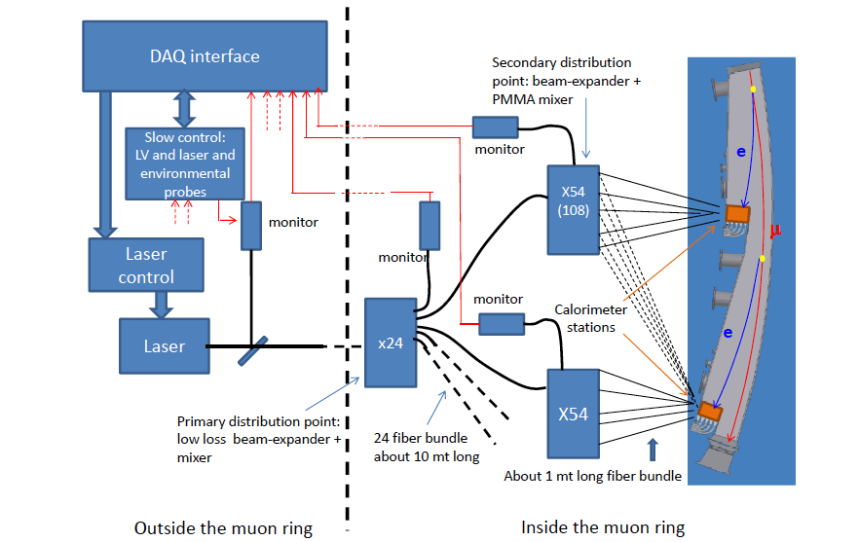
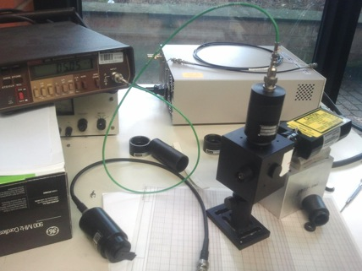
New laser calibration to monitor calorimeter gain
Gain stability and monitoring is crucial for the experiment
Italian collaborators have started a design of a laser calibration system for the 1300 calorimeter crystals
Lab tests at INFN

Slide 28
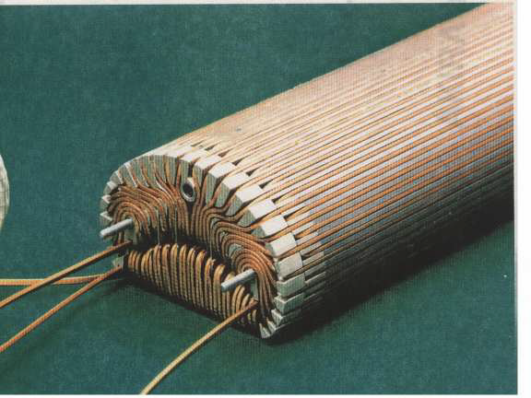
New inflector could be a game changer
Beam
Current inflector is the default option but has low transmission due multiple scattering and small aperture
A new inflector with larger, open aperture could give up to 4x more stored muons
New UK collaborators could have a large impact realizing this opportunity

Slide 29
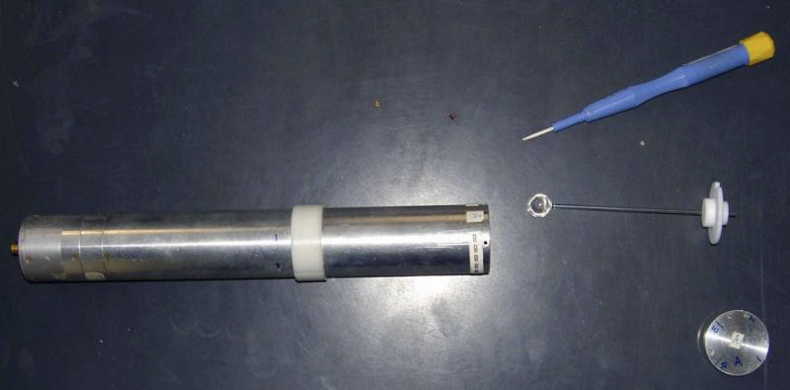
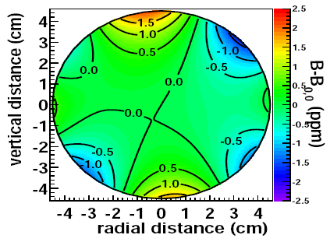
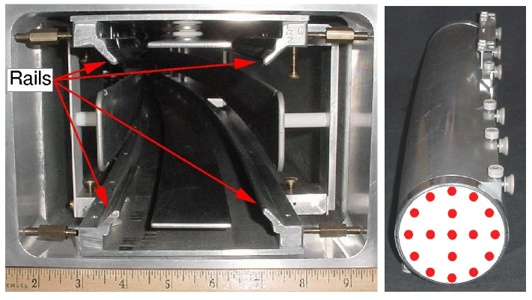
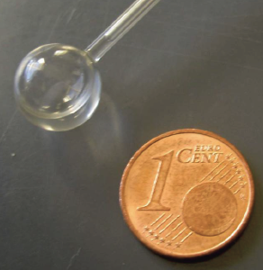
Measuring the B field
Absolute calibration probe
360 fixed NMR probes
17 NMR probes on trolley to
take map at 6000 azimuthal
locations

Slide 30
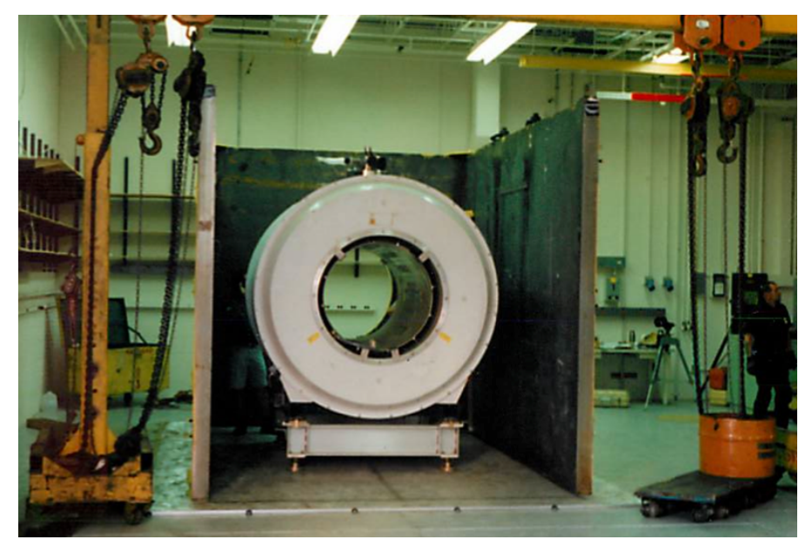
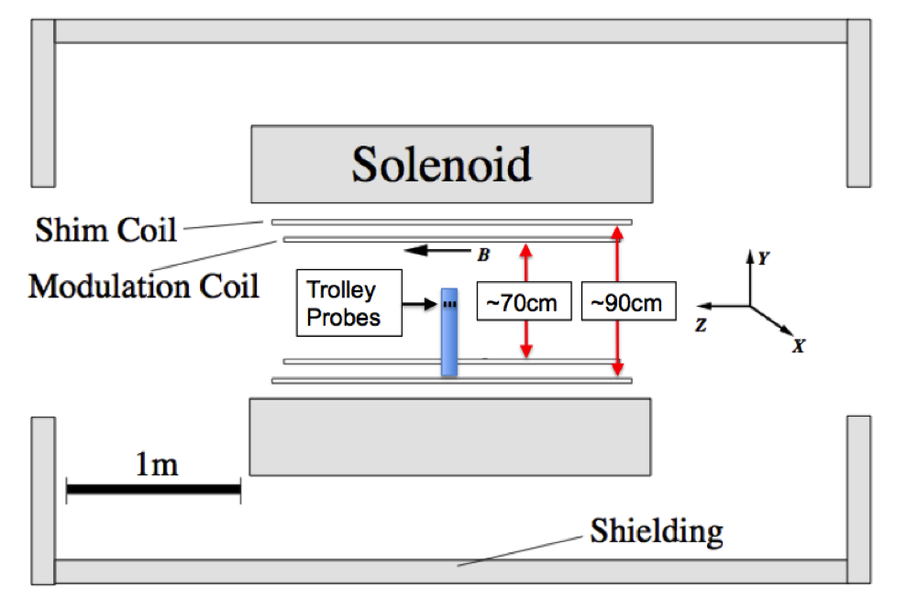
Improvements for measuring the B field in E989
Refurbish most of the existing NMR probes and equipment
Add full waveform digitization of NMR signal
Improve homogeneity of field with passive and active shims
Better temperature control in new building
Careful studies of systematic uncertainties with homogeneous and stable solenoid test magnet shipped to FNAL

Slide 31
Outlook
Motivation
Experimental technique
Muon g-2 at Fermilab
Closing remarks

Slide 32
The E989 collaboration
16 international institutions from
7 countries
13 universities in US
3 national labs
150+ collaborators
Former E821 members and lots of new collaborators

Slide 33
Summary
Future E989 result will improve uncertainty by a factor of 4 to 0.14 ppm
Many upgrades in accelerator, beamlines and detectors
Active collaboration with balanced mix of former E821 and new members
Textbook experiment with a well motivated physics case complementary to direct searches of BSM

Slide 34
But now let’s get back to moving the ring
http://muon-g-2.fnal.gov/bigmove/

