Slide 1
Introduction
Alan Bross
October 17th, 2024

Slide 2
Plastic scintillator
Fermilab has been producing plastic scintillator for close to 25 years
However, fundamental R&D on the process has not happened for over 10 years
And issues have come up that indicate that a fresh look is urgently needed
Areas to explore
Polymer
US supplied material is not meeting spec & by a large margin.
Find new source and test
Cladding
Recent MC studies indicate that small changes in reflectivity can have big impact on LY
Potentially 2-3X increase in light yield can be obtained for extruded scintillator
TiO₂ cladding yields ~ 90% reflectivity in wavelength region of interest. New coatings (paints) achieve > 98%
Tooling
Recent measurements on extruded scintillator produced outside the US indicated that better control on the WLS fiber channel dimensions can improve light yield by 1.5X without the need for optical coupling fluid.
A detailed investigation in all these areas will not only yield much higher quality scintillator with extended functionality but can also help solve (or at the very least reach an understanding) of the ageing problem seen in the mu2e scintillator.

Slide 3
The Polymer

Slide 4
Summary: Polymer Ageing?
Note: New 665 (2024)
looks good.

Slide 5
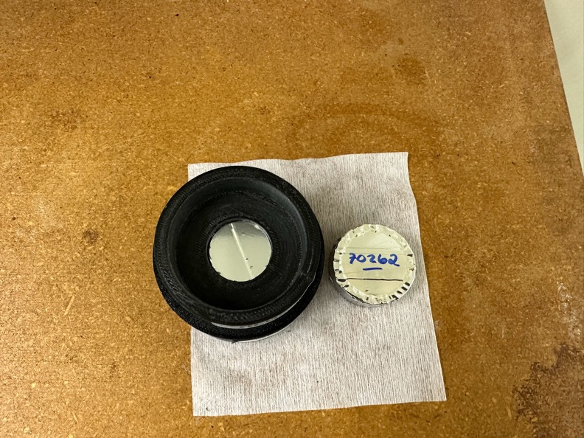
Scintillator light yield
In 1999 we made scintillating pellets for D0
Same “process” as for extrusion
We still have some
Made casting and compared scintillation light yield to reference

Slide 6
Light yield from 25-year-old scintillating pellets
To first order
25-year-old material
is the same

Slide 7
Conclusion so far: Polymer does not age, certainly not enough to account for losses seen in mu2e CRV extrusions*
*Will revisit after Sam’s talk.

Slide 8
Alternative cladding: To date, the best paint we have produced is BN+PTFE

Slide 9
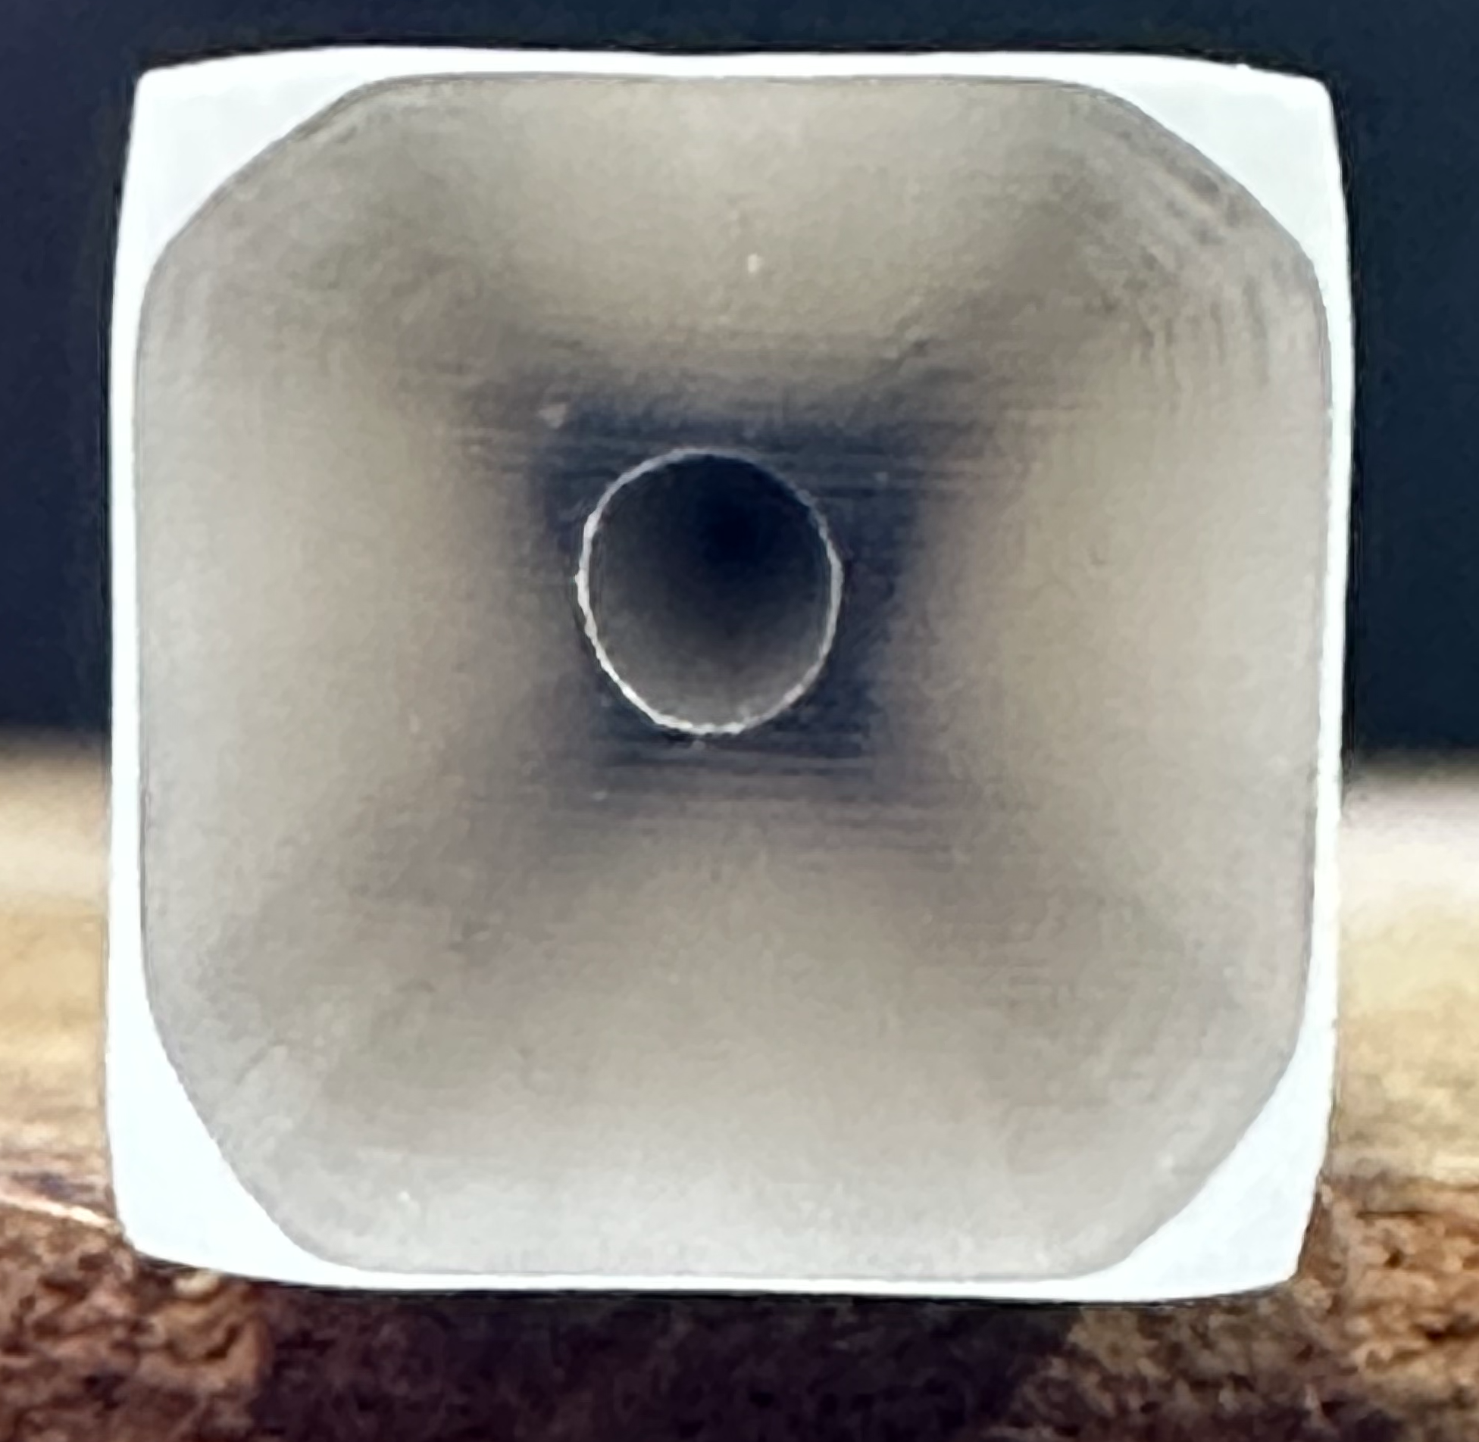
Tooling
The tooling used for the Canadian part produces a much more precise part than the tooling procured locally and used at Fermilab.
In the process of procuring new tooling using some of the design features shown in the Canadian tooling
New Jersey Precision Technologies
Preliminary design under review
We are also going to contract with PIEP, Innovation in Polymer Engineering, Universidade do Minho, Portugal to produce an OpenFoam model for the tooling and simulate flow dynamics before we cut metal.

Slide 10
A work on Taita 808 vs. Amsty 665
The optical properties of 808 look better than even the best 665.
Light yield measurements vary (5-20% improvement with 808). Working on this.
From the cosmic-test setup (probably best methodology) currently see ~ 12% improvement
Questions?

