Slide 1
FD1 TBFC Beam Mounted Divider Board
Bo Yu
Oct. 15, 2024

Slide 2
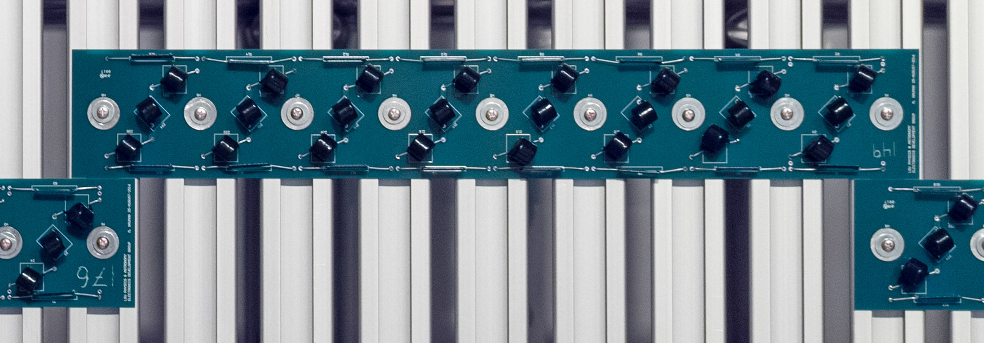
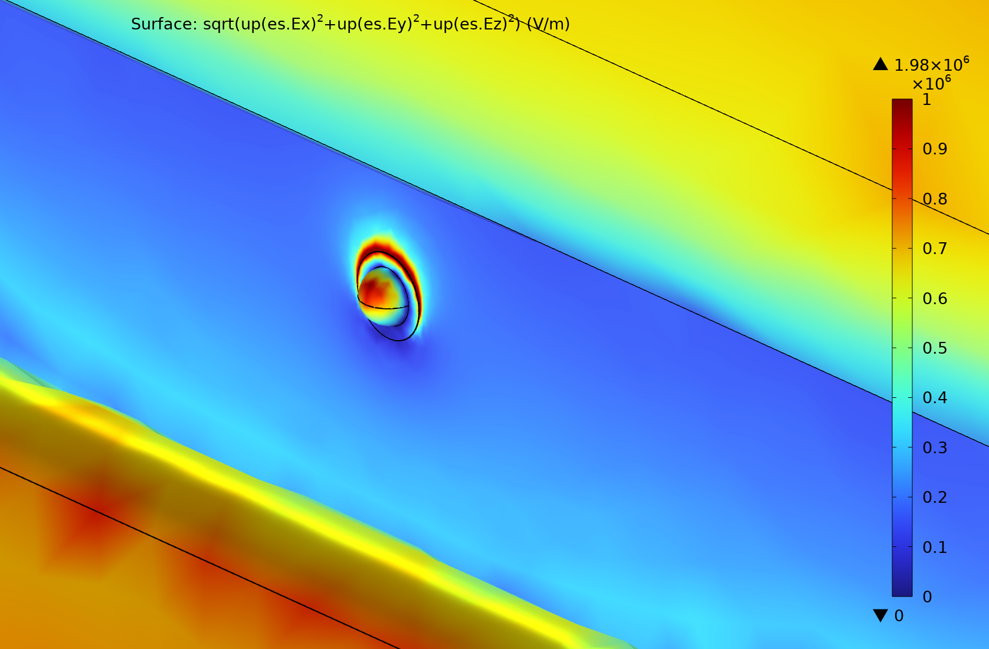
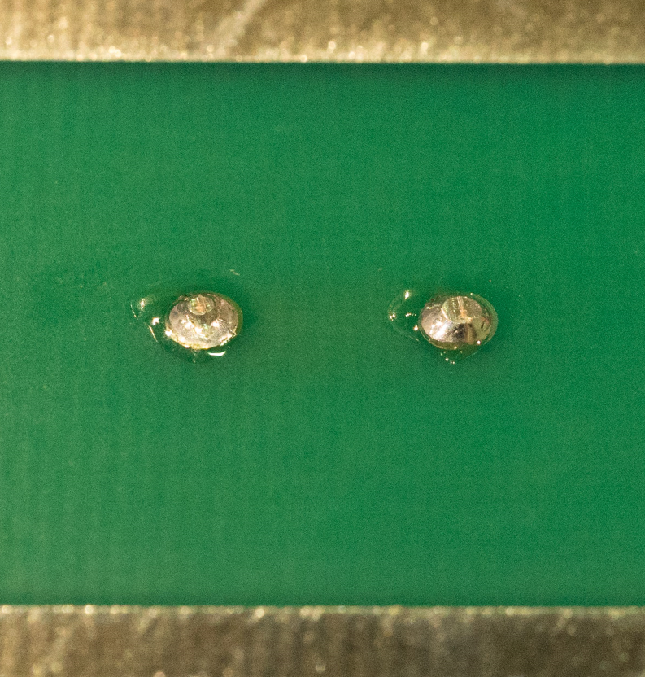
Current HD VDBs
Current VDBs are mounted directly on the inside face of the FC profiles using a set of slip nuts.
The two leads on the middle MOV between each node are exposed to the cryostat wall between the gap of each profile pair.
These leads must have rounded solder bumps to avoid excessive high E field.
This complicates the VDB assembly and requires stringent inspection on the solder bumps.
The same VDBs are used for all FC modules (200 top/bottom, 48 end wall versions).

Slide 3
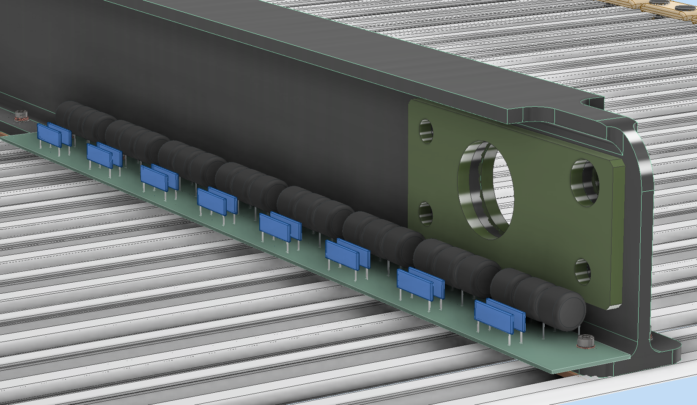
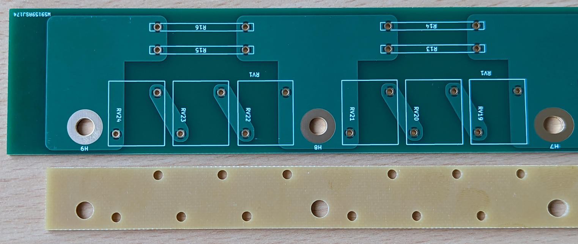
A Value Engineering Idea: I-beam Mounted VDBs
For FD1 TBFC modules, instead of mounting the VDBs directly on the FC profiles, mount them to the side of one of the I-beams using the existing two-hole slip nuts holding the profiles to the I-beam.
This would eliminate more than 1/3 of the slip nuts used in the TBFC modules, therefore simplify the installation of the VDBs.
Adjacent VDBs are mounted on alternating sides of the same I-beam.
A FR4 spacer strip is added between the VDB and the FRP I-beam to encapsulate the MOV solder bumps.

Slide 4
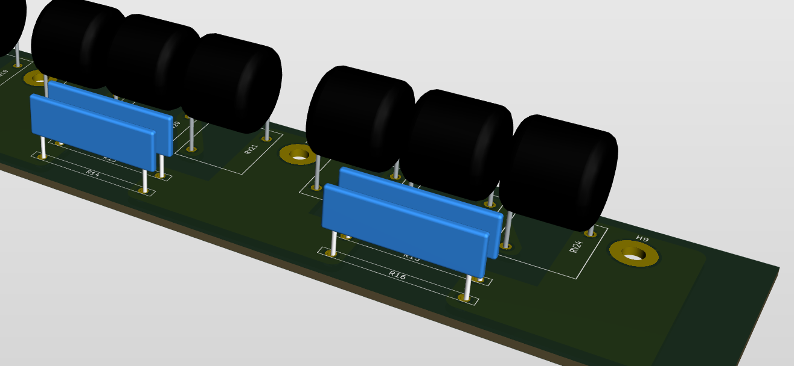
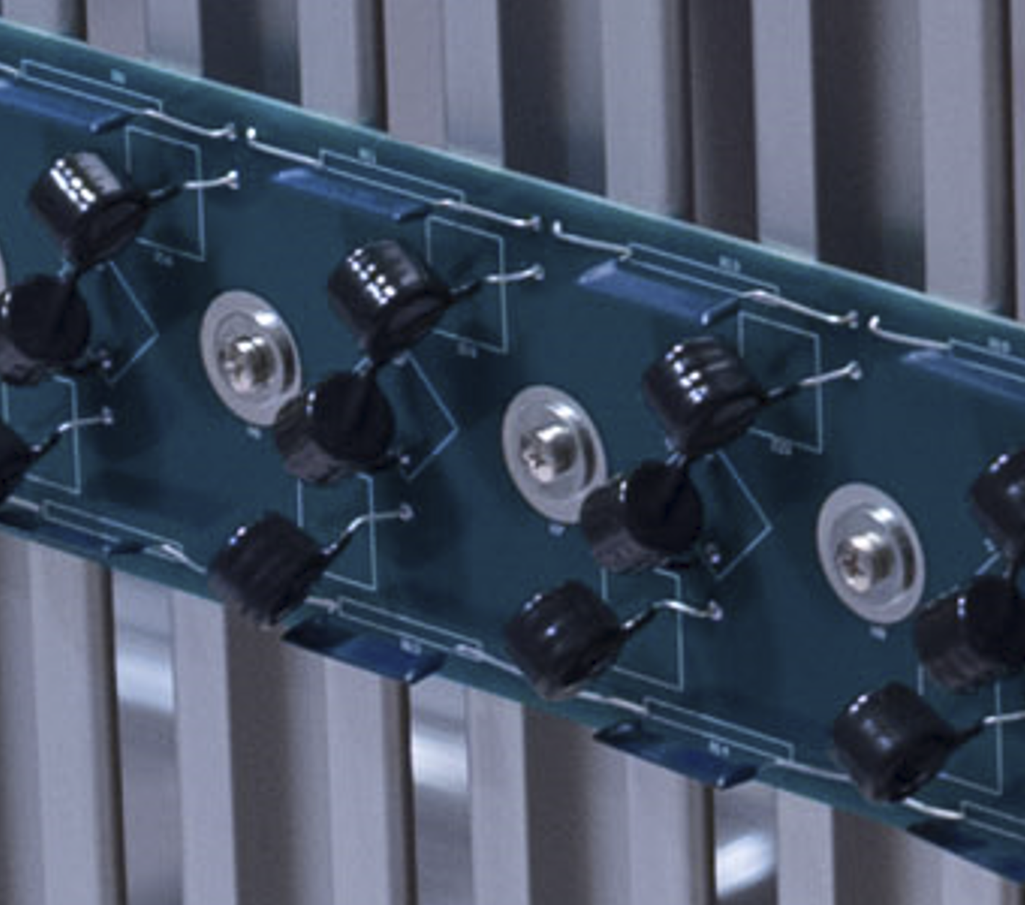
Eliminating Exposed High Field Spots
The solder bumps of the MOV leads now sit over the flange of the I-beam (1/4” thick FRP) therefore pose no breakdown risk. The solder bumps of the resistor leads are above the FC profiles of the same potentials. As a result, this design largely eliminates the need to make good hemispherical solder joints for the components.
The leads of components are all short and straight. There is no need to pre-form the leads.
Can use ERZ-V14D182CS, which is significantly cheaper than ERZ-V14D182.
The leads on most components in the current design need to be bent before soldering

Slide 5
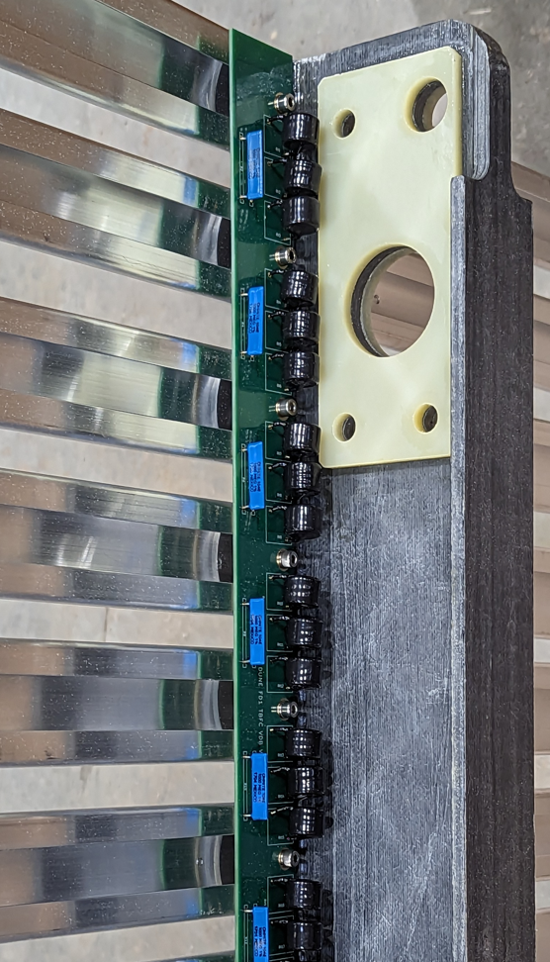
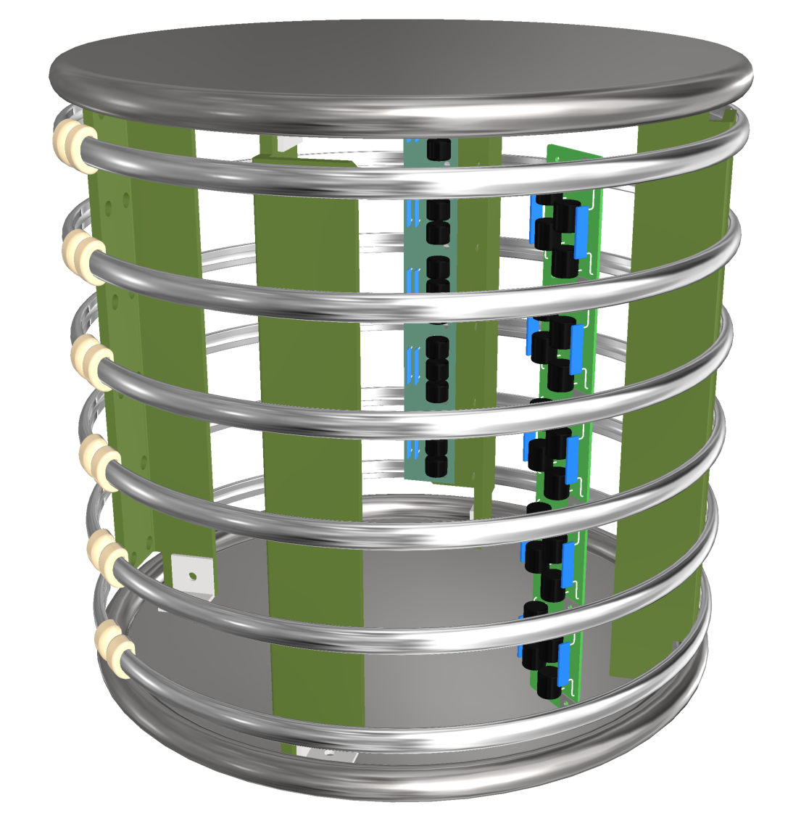
Mechanical and Electrical Trials
The new VDB samples have been trial fitted to a spare NP04 FC I-beam at CERN and repeated at UMN on their FC assembly table. The UMN team liked the new VDB design and said it is easier to install.
A shortened section of this VDB has been tested in the 50L cryostat as part of a small field cage test using the FD2 thin profiles. The setup was biased to an external E field about double that expected in FD2 without issues.
This VDB design is different from those installed in NP02.

Slide 6
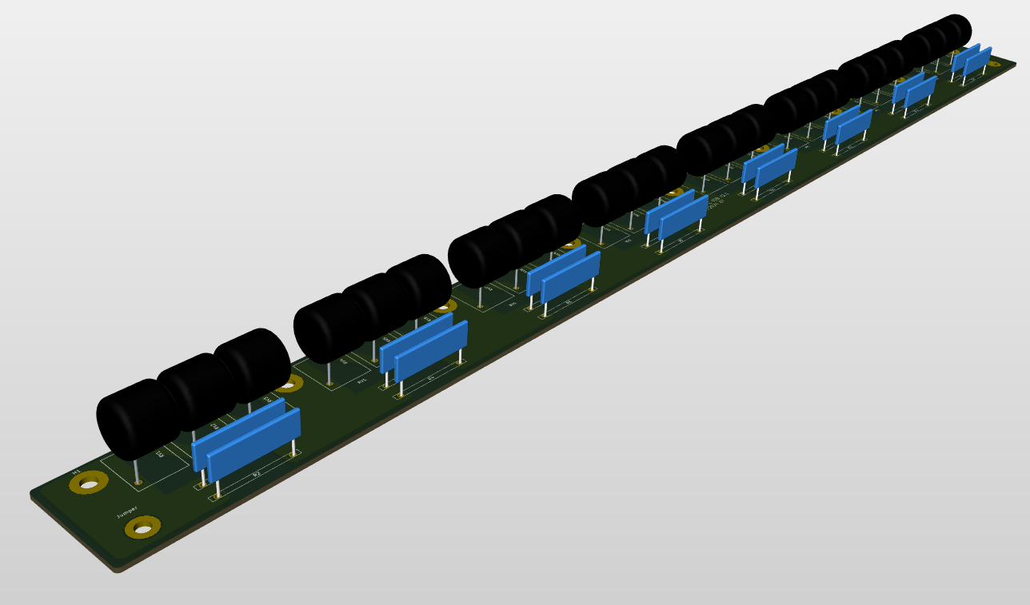
Adding Redundancy to the VDB Chain
As a lesson learned from SBND, we are also implementing redundancy to the electrical contacts of the VDB chain:
Added one extra hole (backup contact) on the ends of the VDB board.
Jumper wires with ring lugs to connect the adjacent VDB backup contacts

Slide 7
Summary
We have developed a new HD VDB design for the top/bottom FC modules that is cheaper to fabricate, assemble and install.
Use lower cost components
No need to bend the leads of the R & MOV components
Not require hemispherical solder bumps
Eliminate 1/3 of the slip nuts needed for the FC module
Added redundancy feature to improve reliable HV operation
Prototypes have been trial fitted mechanically and HV tested at higher equivalent voltages than expected in FD1 operation
This new mounting scheme does not apply to the end wall FC modules. Nevertheless, we will implement similar redundant electrical contacts at the VDB ends.
We seek EB/TB endorsement of this new design for FD1 T/B FC modules.

