Slide 1
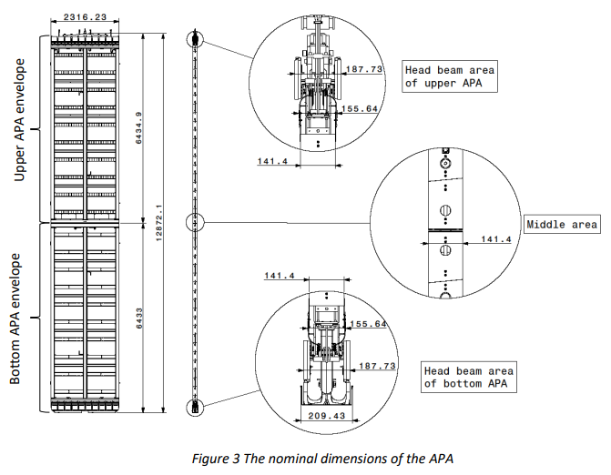
Increased Distance Between APA Foot Tubes in APA Pair
KDZ
October 16, 2024
FD1 TB
Introduction
A 6mm increase in the distance between APA foot tubes has been implemented.
Details of this were presented at workshops and two previous technical boards.
Two interface drawings were recently updated and uploaded to EDMS 2088738 v.6 (APA and HV Interface Document)

Slide 2
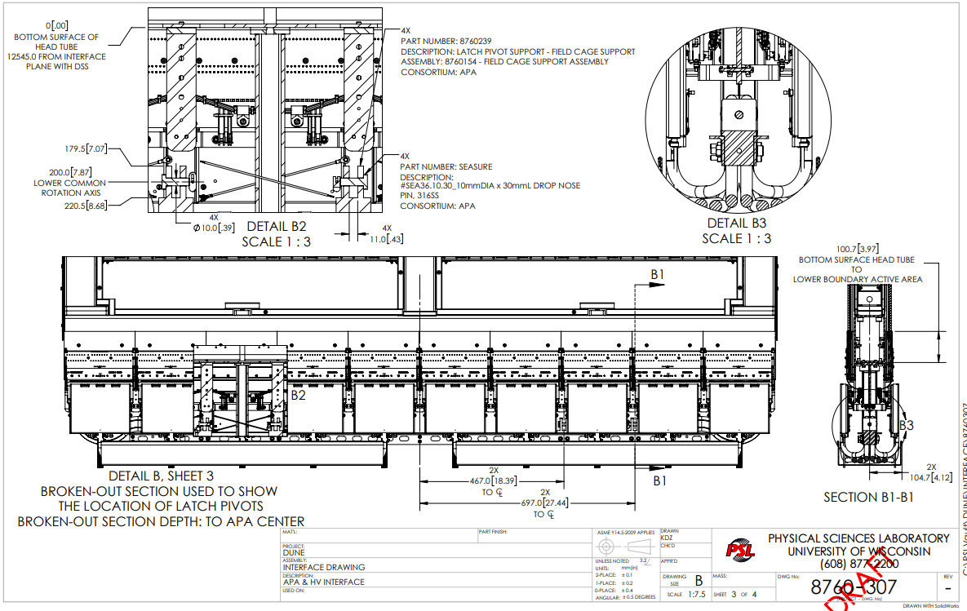
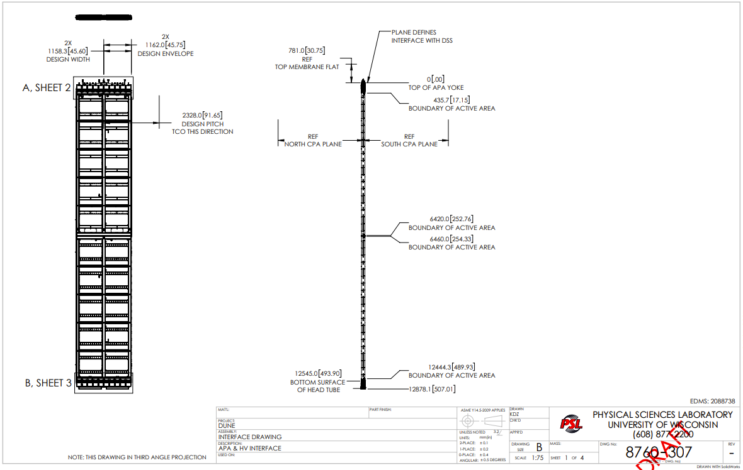
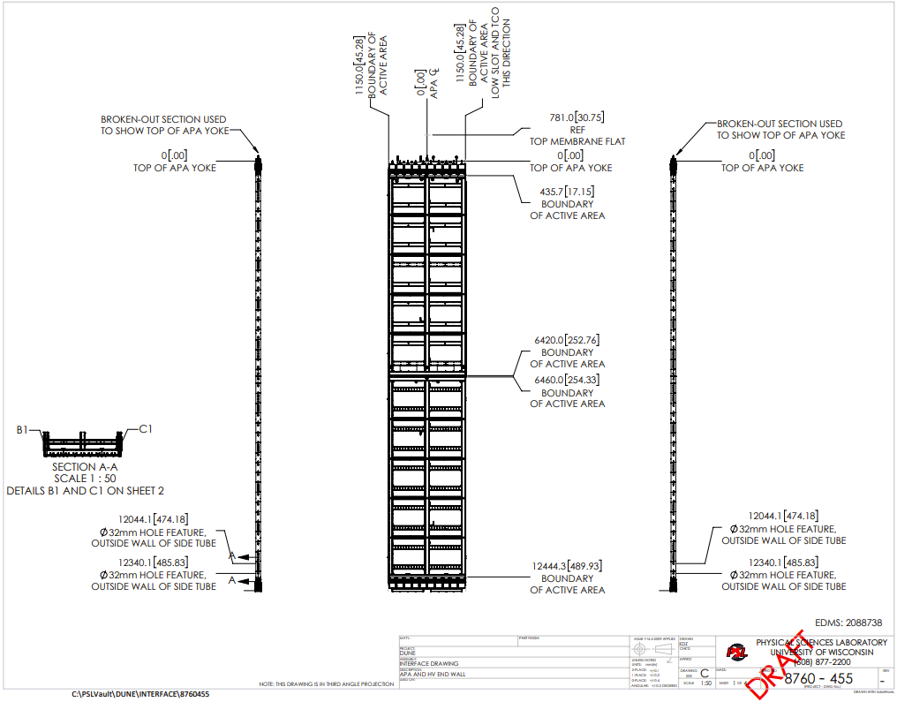
Implementation
The additional 6mm is added by lowering the Lower (Bottom) APA
And keep the Upper APA position, its yoke and all the rest unchanged
HV consortium has graciously agreed to allow this proposal to be made (within reason) with the understanding that said proposal won’t affect the HV design.
Checks of clearance to cold box and TCO threshold show no signs of issue.
FD1 APA and HV Interface Control Document
https://edms.cern.ch/document/2088738/6

Slide 3
Other Consortium Models
HV recently posted a new model which is being reviewed.
Asking the group today if there are other models which have been updated recently that should be checked?

