Slide 1
FD-HD Plan for Production Readiness Reviews
Eric James
FD-HD Technical Board Meeting
October 16, 2024

Slide 2
PRR Preparations
Resolve as best possible any open PDR or FDR recommendations (some recommendations are left as “for future” when these reviews are closed out)
Make sure that all models and drawings are “final” and in the released state in EDMS
Any post-PRR changes require approval of Technical Board and FDC Executive Board
Make sure that all interface documents are up-to-date and in the released state in EDMS

Slide 3
PRR Preparations
Compliance Office Mechanical and Electrical approvals for the system must be in place prior to start of review
Approved grounding and shielding plan should be in place prior to start of review (exceptions may be granted in some specific cases)
Pointers to documents posted in EDMS should be provided (all documents should be in the released state)

Slide 4
Document List

Slide 5
Document List

Slide 6
Document List

Slide 7
Kick-off Meeting

Slide 8
Kick-off Presentation
Sample Presentation Link

Slide 9
Question and Answer
Answers should note when documentation has been updated to avoid review recommendations that will require follow-up

Slide 10
End Game
Once questions have been answered, committee will finalize report
Recommendations will be uploaded into SharePoint for tracking.
Recommendations must be addressed prior to review closeout, which is used to authorize start of procurement and/or construction activities

Slide 11
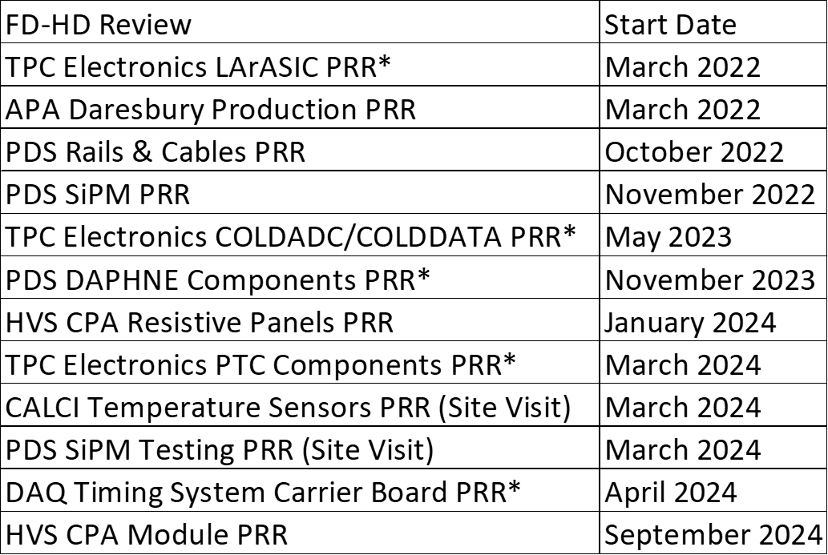
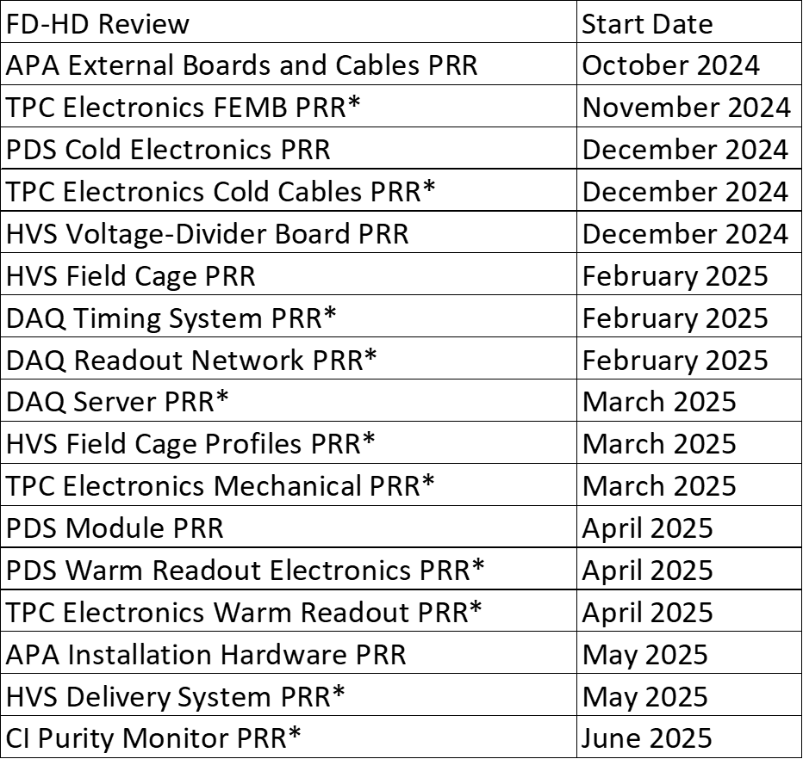
FD-HD Production Readiness Reviews
Past/Ongoing
Future
* Shared with FD-VD

