Slide 1
MQXFA16 with TLS magnet specifications
P. Ferracin, D. Cheng, J. Doyle, L. Garcia Fajardo, S. Prestemon, K. Ray, G. Sabbi, M. Solis, G. Vallone, X. Wang
on behalf of the MQXF collaboration
MQXFA Spec meeting
October 18th, 2024
LBNL, Berkeley, CA, USA

Slide 2
Outline
Introduction
Shell-yoke sub-assembly specs
Coil-pack sub-assembly specs
Magnet assembly and loading specs
Assembled magnet specs

Slide 3
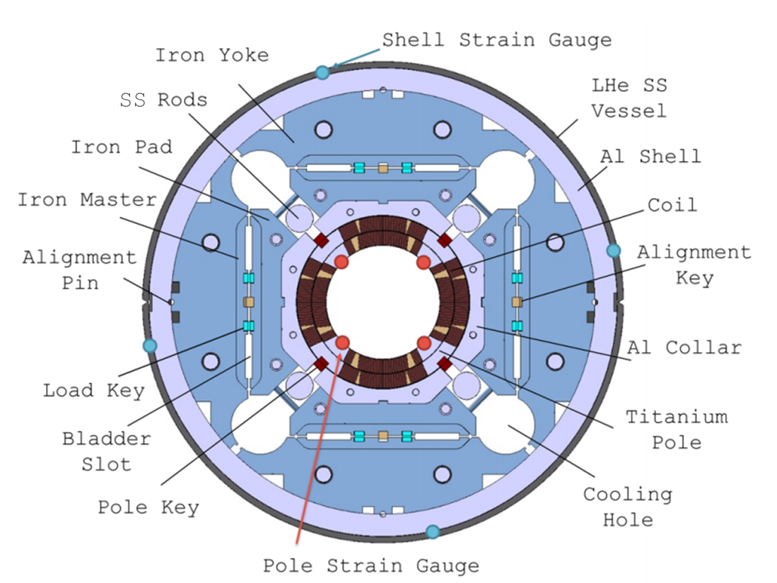
Introduction

Slide 4
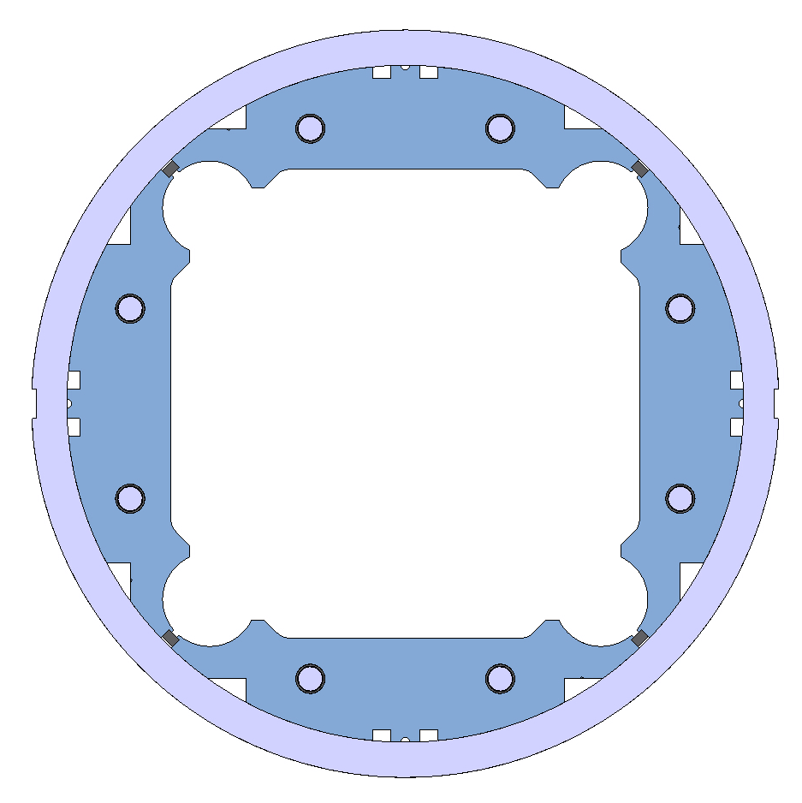
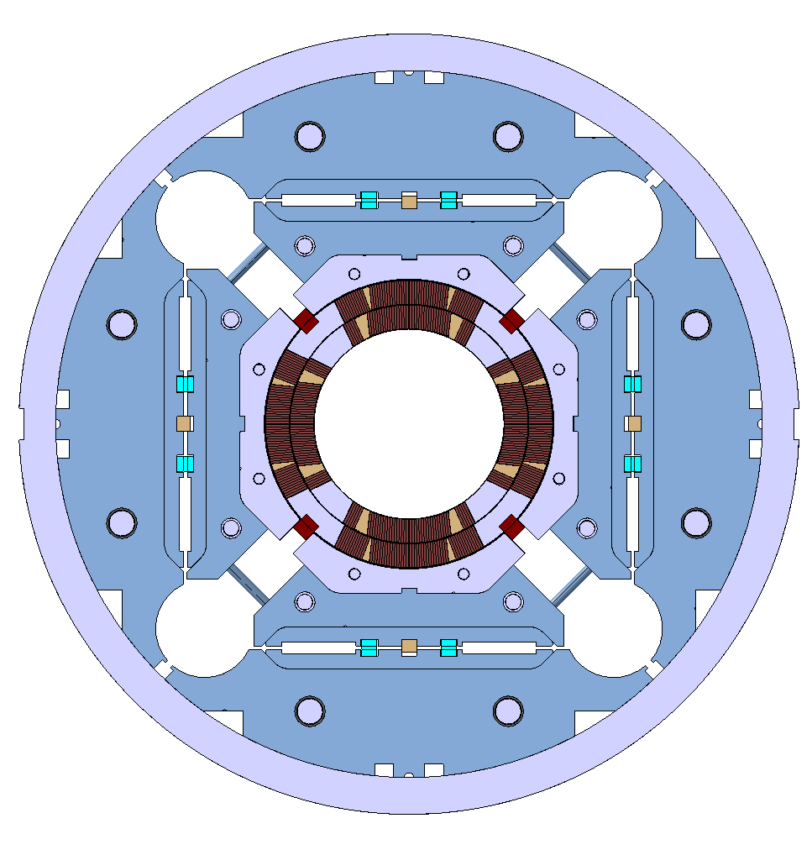
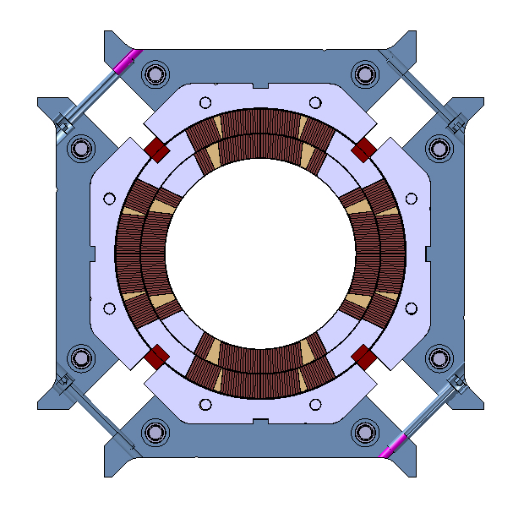
Introduction
List of specifications in “chronological” order
  From shell-yoke to coil-pack to magnet pre-load
Definition based on dimensional, magnetic, electrical, and strain measurements
  Some specs defined by “design and analysis” (example: peak stress)
  Some defined by experience from previous successful magnet (example: coil pack uniformity/squareness)

Slide 5
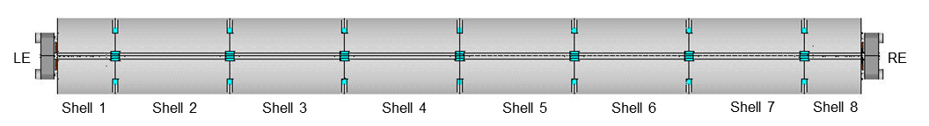
Introduction
On strain measurements….
  Strain gauge locations
    Shell: 3 axial location, 4 quadrants, azimuthal and axial
      Shell 2, shell 4, shell, 7
    Coil: 1 axial location, 4 coils (pole), azimuthal and axial
      Center of shell 7
    Axial rods: 1 axial location, 4 rods, axial
Shell gauges
Shell gauges
Shell and coil gauges

Slide 6
Introduction
On strain measurements….
  Six fiber optic gauges installed on Q1 and Q2:
    Three azimuthal (Z-gauges)
    Three axial gauges (T-gauges)
  They are located at three positions along the coils:
    700 mm
    1900 mm
    3800 mm
Sensor 5: 700-T
Sensor 3: 1900-T
Sensor 1: 3800-T
LE
RE
Sensor 6: 700-Z
Sensor 4: 1900-Z
Sensor 2: 3800-Z

Slide 7
Outline
Introduction
Shell-yoke sub-assembly specs
Coil-pack sub-assembly specs
Magnet assembly and loading specs
Assembled magnet specs

Slide 8
Shell-yoke sub-assembly
Half-length module assembled vertically
  Yoke stacks insertion
  Bladder operation
    Insertion of yoke key with 0.100 mm interference
    yokes locked and shell pretensioned
Shell strain measured during/after bladder operation
Check proper reading from strain gauges and size of shells and yokes

Slide 9
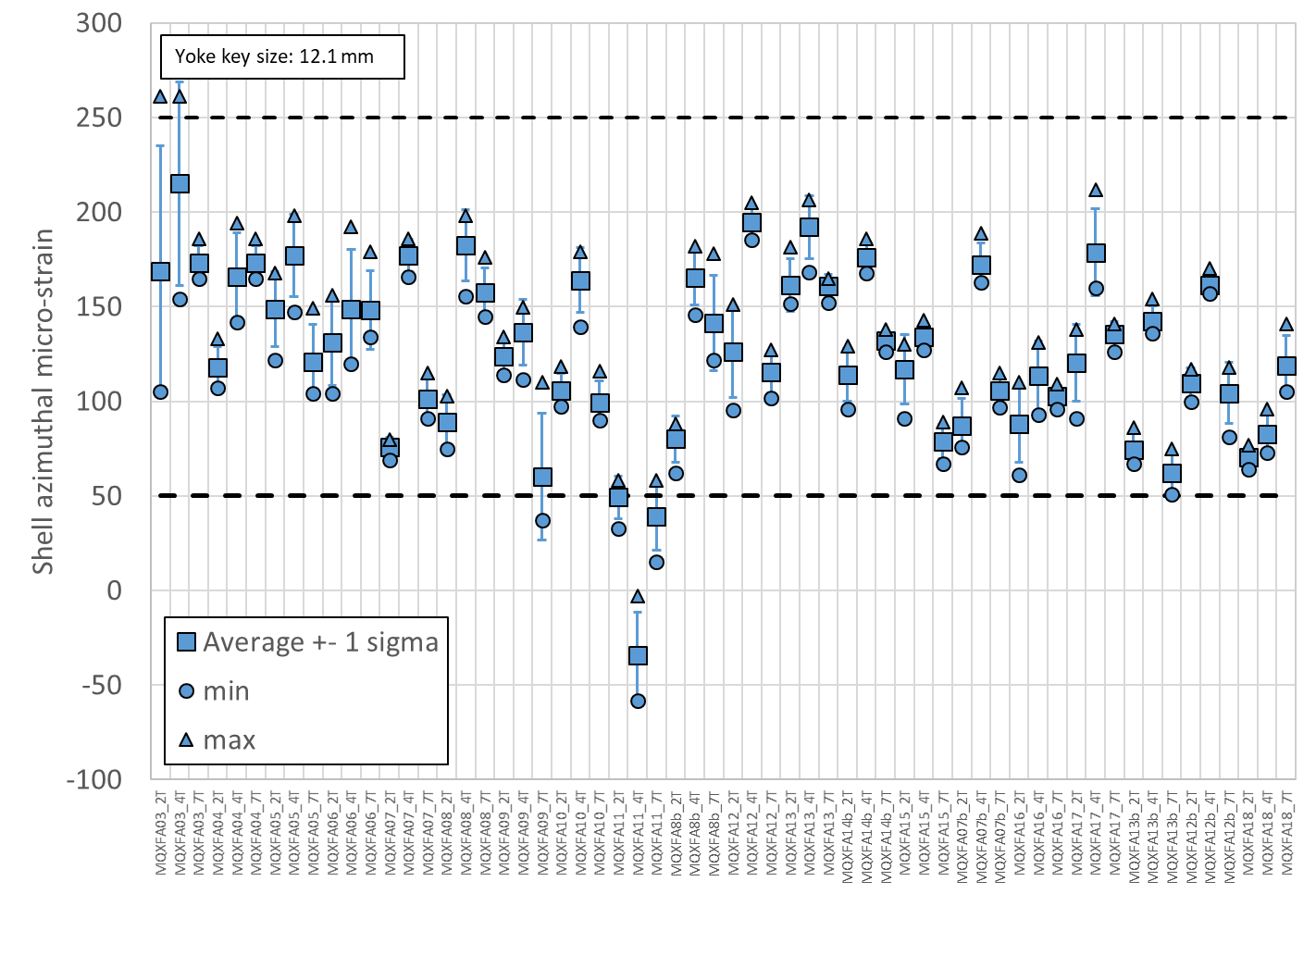
Shell-yoke sub-assembly
Specification
For the shell azimuthal strain after shell-yoke sub-assembly:
  The shell strain in the azimuthal direction after shell-yoke sub-assembly shall be within +50/+250 micro-strain
One gauge per quadrant on 3 shells

Slide 10
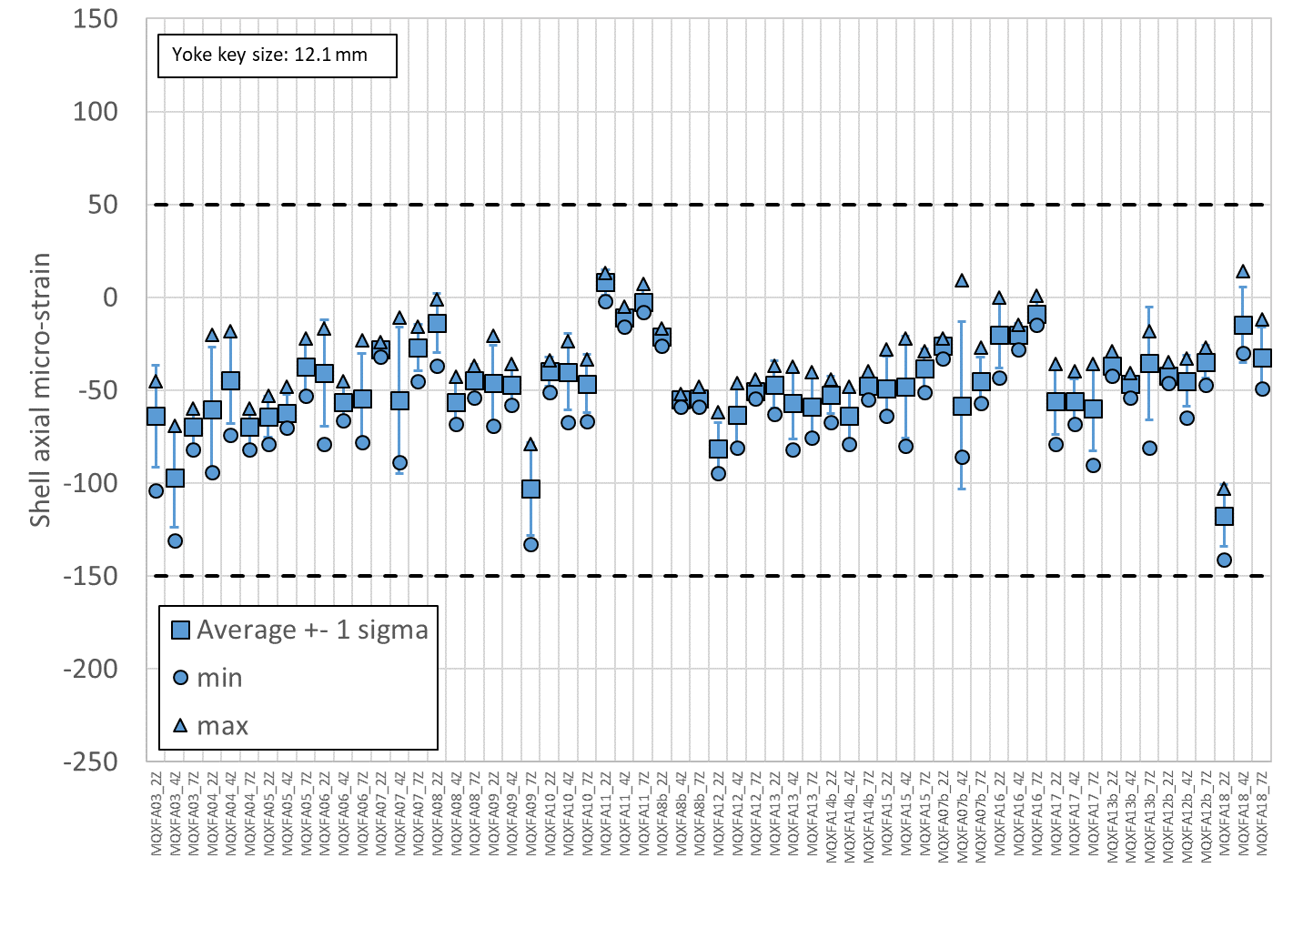
Shell-yoke sub-assembly
Specification
For the shell axial strain after shell-yoke sub-assembly:
  The shell strain in the axial direction after shell-yoke sub-assembly shall be within -150/+50 micro-strain
One gauge per quadrant on 3 shells

Slide 11
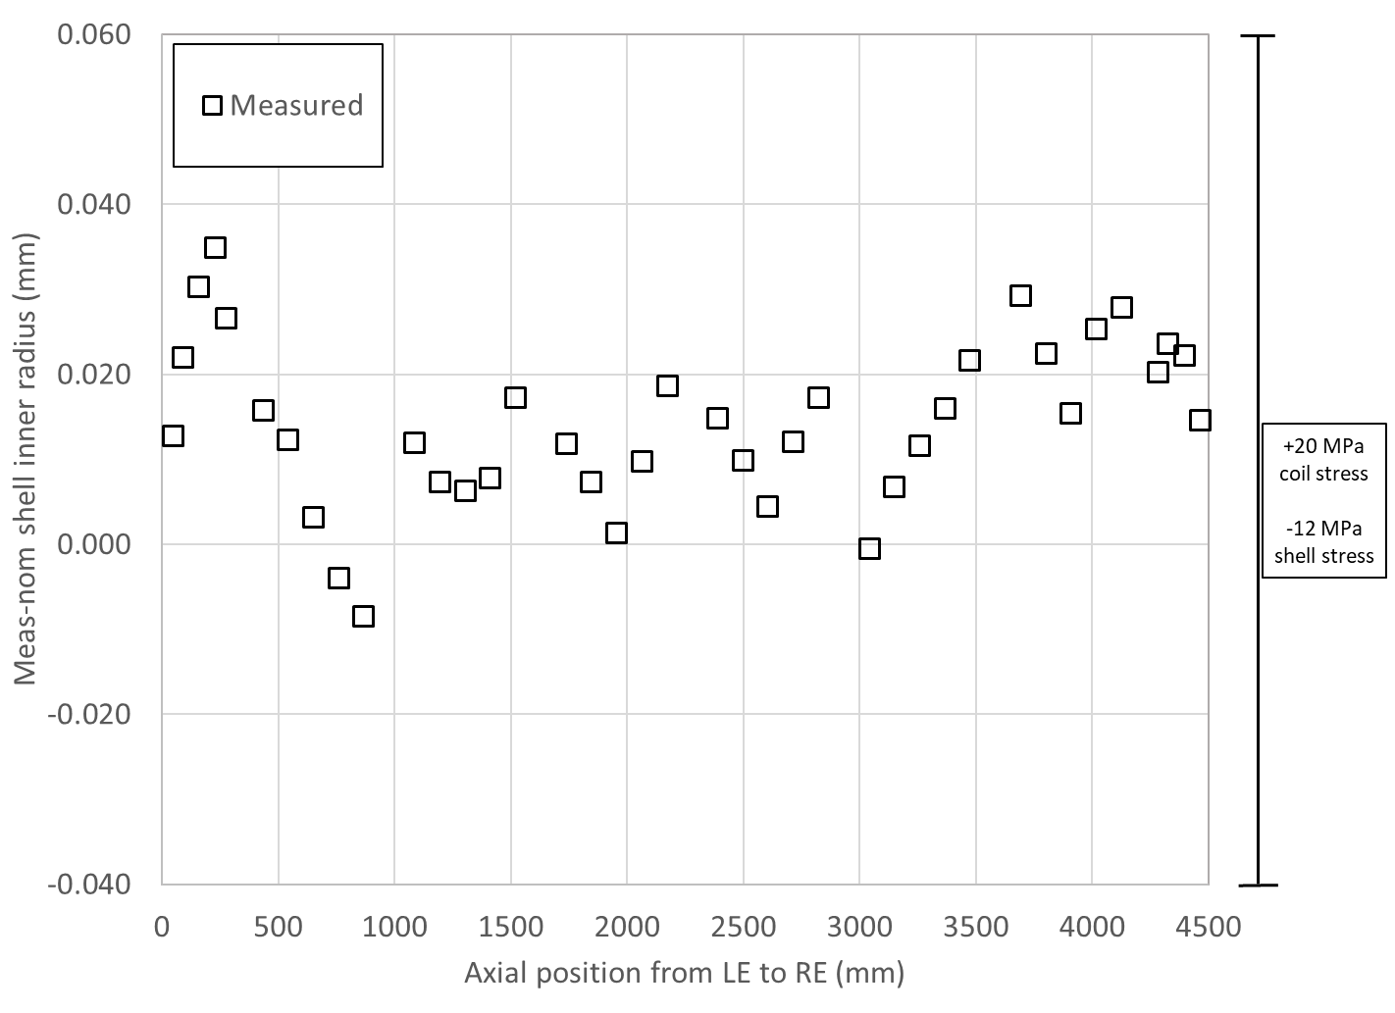
Shell inner radius dimensions and sensitivity analysis
Coil stress variation due to shell dimensions: ± 4 MPa

Slide 12
Shell-yoke sub-assembly
1 mm axial protrusion yoke stacks from shell edges on the bottom (from tooling)
  Bottom → center of the magnet
    Yoke to yoke contact guaranteed when 2 modules are combined
After insertion of yoke key → dimensional measurements
  Protrusion of the yoke stacks on the RE and LE
  Size of yoke cavity
Check of yoke, stacks, and shell dimensions

Slide 13
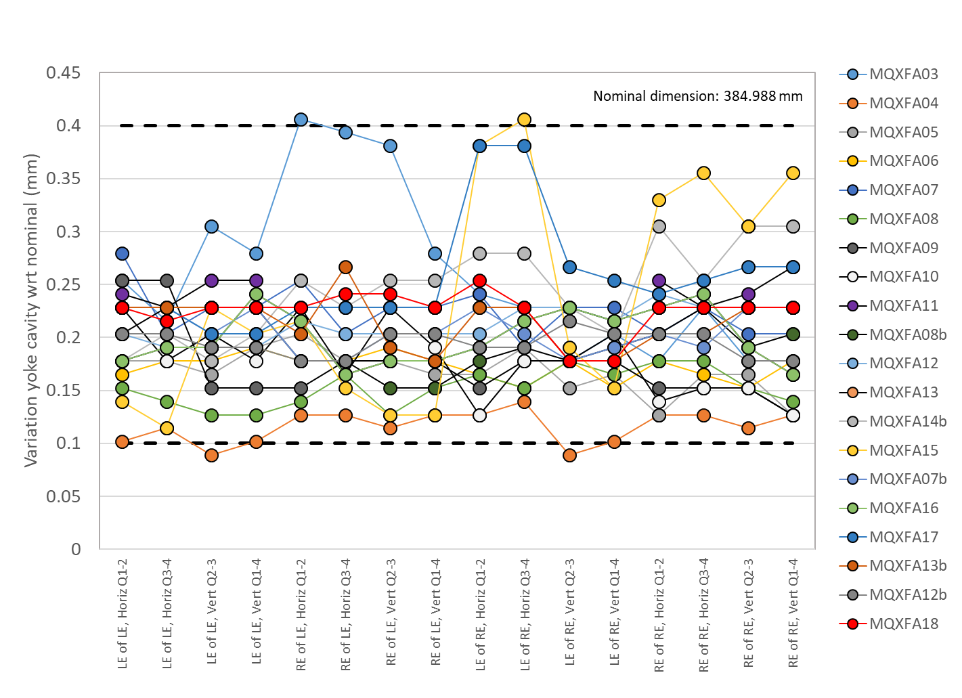
Shell-yoke sub-assembly
Specification
For the yoke cavity size after shell-yoke sub-assembly:
  The variation of yoke cavity dimension with respect to nominal shall be within +0.100/+0.400 mm
Two horizontal and two vertical measurements taken on both side of the two modules

Slide 14
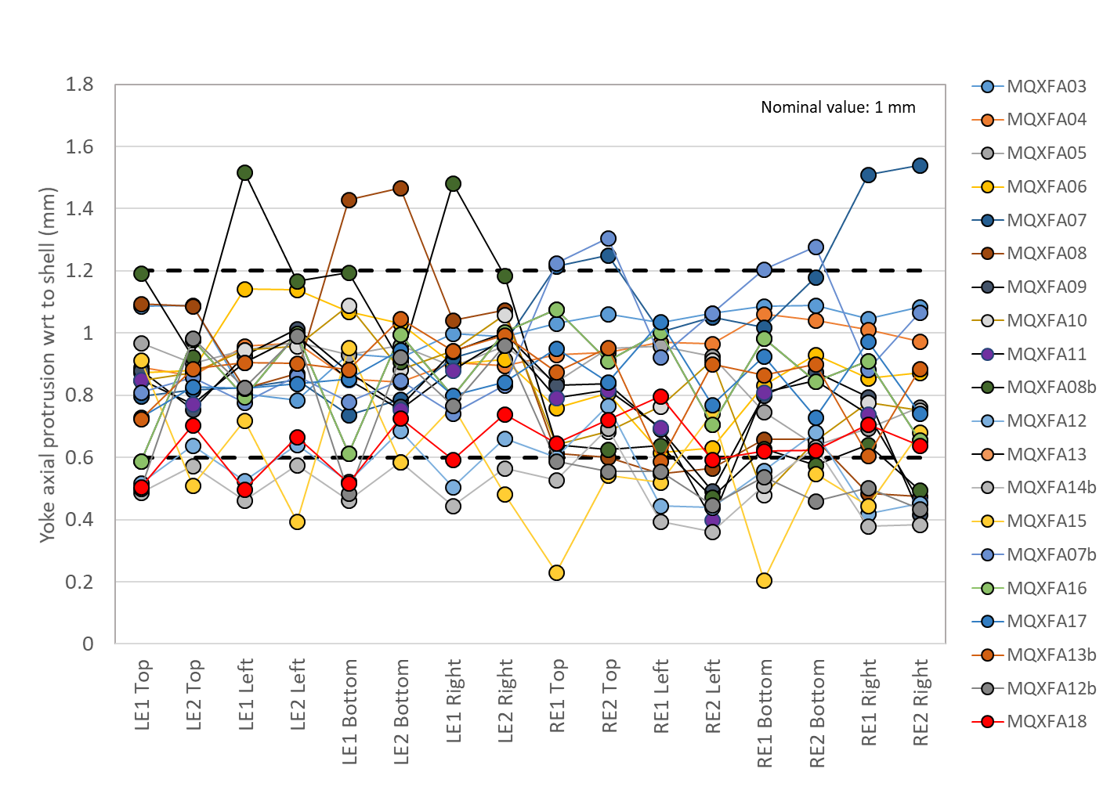
Shell-yoke sub-assembly
Specification
For the yoke protrusion with respect to the shell:
  The yoke protrusion with respect to the shell shall be within +0.600/+1.200 mm
Two measurements are taken per each quadrant on the “coil end” side of each module

Slide 15
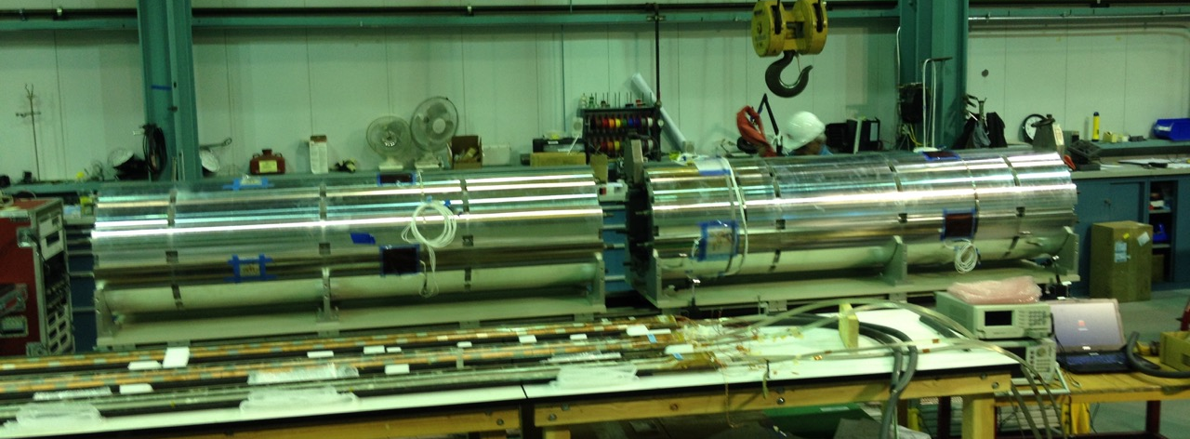
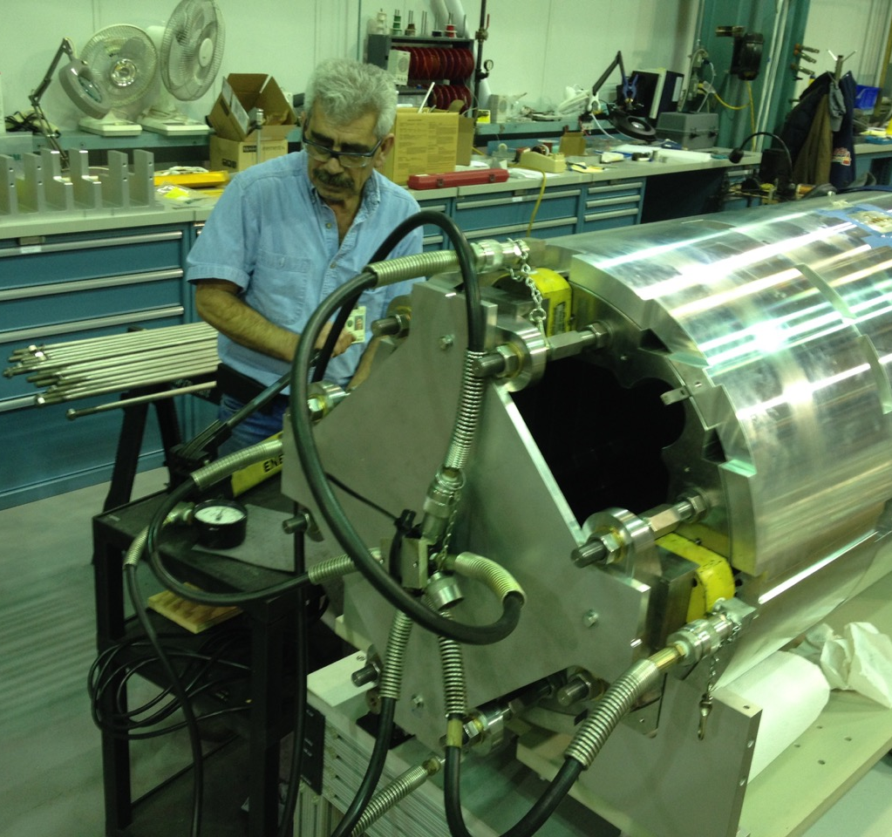
Shell-yoke sub-assembly
When both half-length sub-assembly modules are joined together, the short yoke tension rods are replaced with full-length ones.
For the pre-tension of the full-length tie rods of the yoke:
  The piston (RSM 200 cylinder with effective area of 4.43 in²) shall be pressurized to 4100 ± 200 PSI and the nuts shall turned to contact.

Slide 16
Shell-yoke sub-assembly
The shell-yoke sub-assembly straightness is monitored by measuring
  vertical and horizontal absolute position of fiducial in the
    mid-plane shell cut-outs (one side, either left of right from the lead end view)
    and in the top shell cut-outs.
  Measurements are taken in 7 longitudinal locations (in between shell segments).
The fiducials are placed in contact with the yoke laminations, which are accessible through the cut-outs.

Slide 17
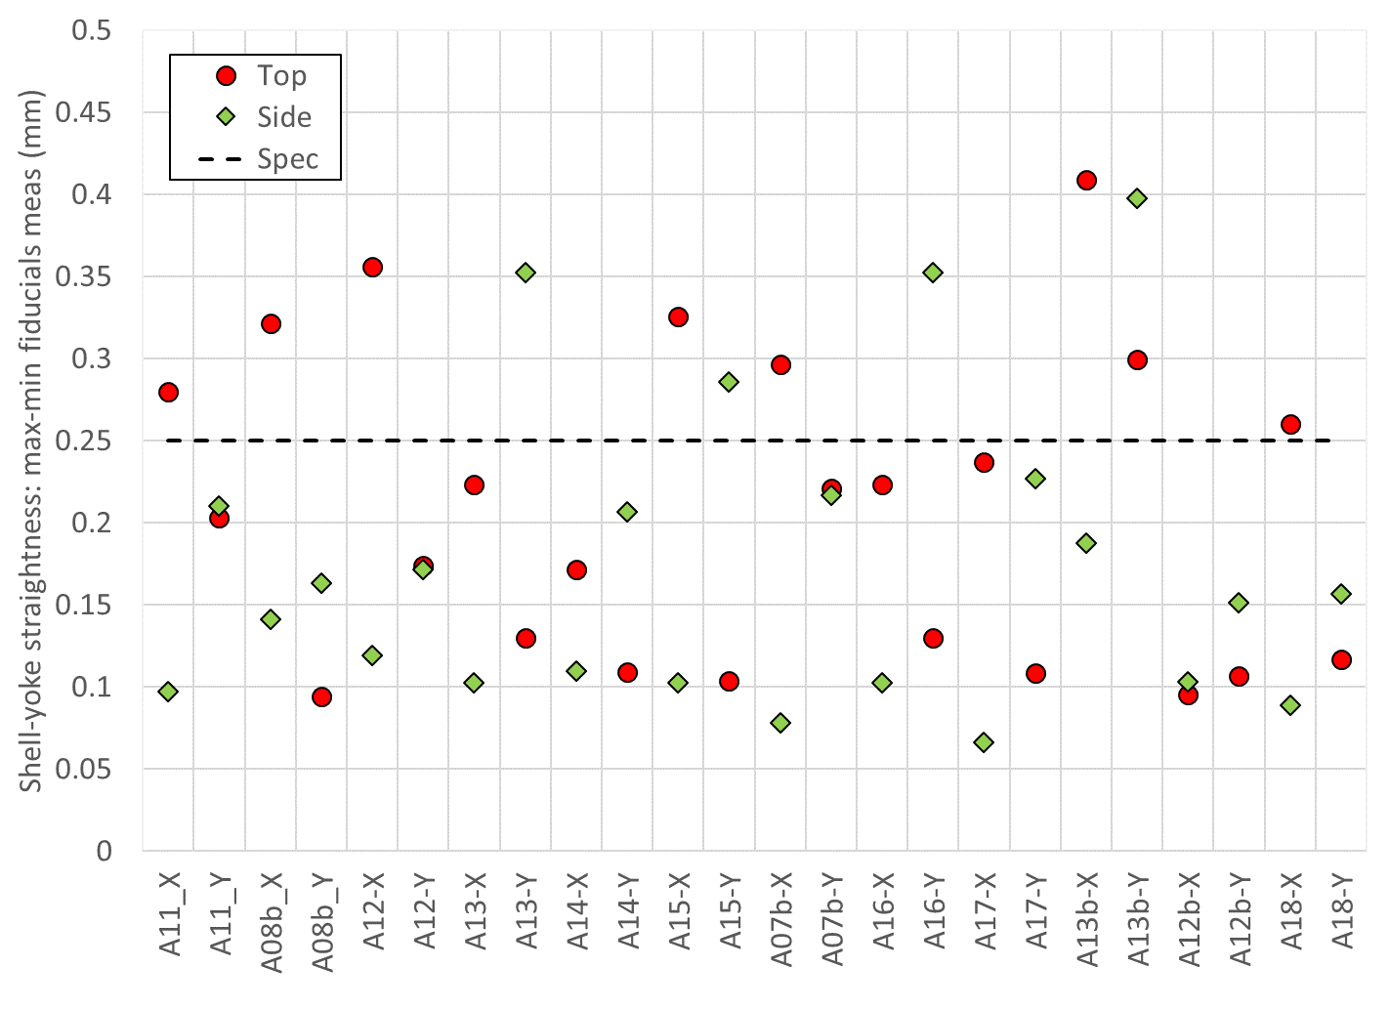
Shell-yoke sub-assembly
Specification
For the straightness of the shell-yoke sub-assembly, the following specifications are set:
  The maximum spread (max – min) of the vertical and horizontal position of the fiducials in the top shell cut-outs along 7 longitudinal locations shall be ≤ 0.250 mm.
  The maximum spread (max – min) of the vertical and horizontal position of the fiducials in one side of the mid-plane shell cut-outs along 7 longitudinal locations shall be ≤ 0.250 mm.

Slide 18
Outline
Introduction
Shell-yoke sub-assembly specs
Coil-pack sub-assembly specs
Magnet assembly and loading specs
Assembled magnet specs

Slide 19
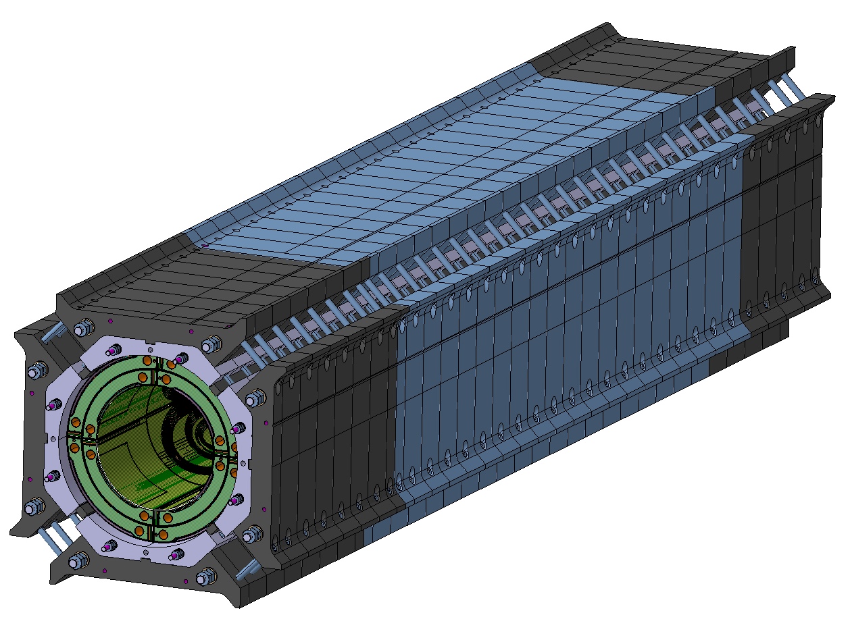
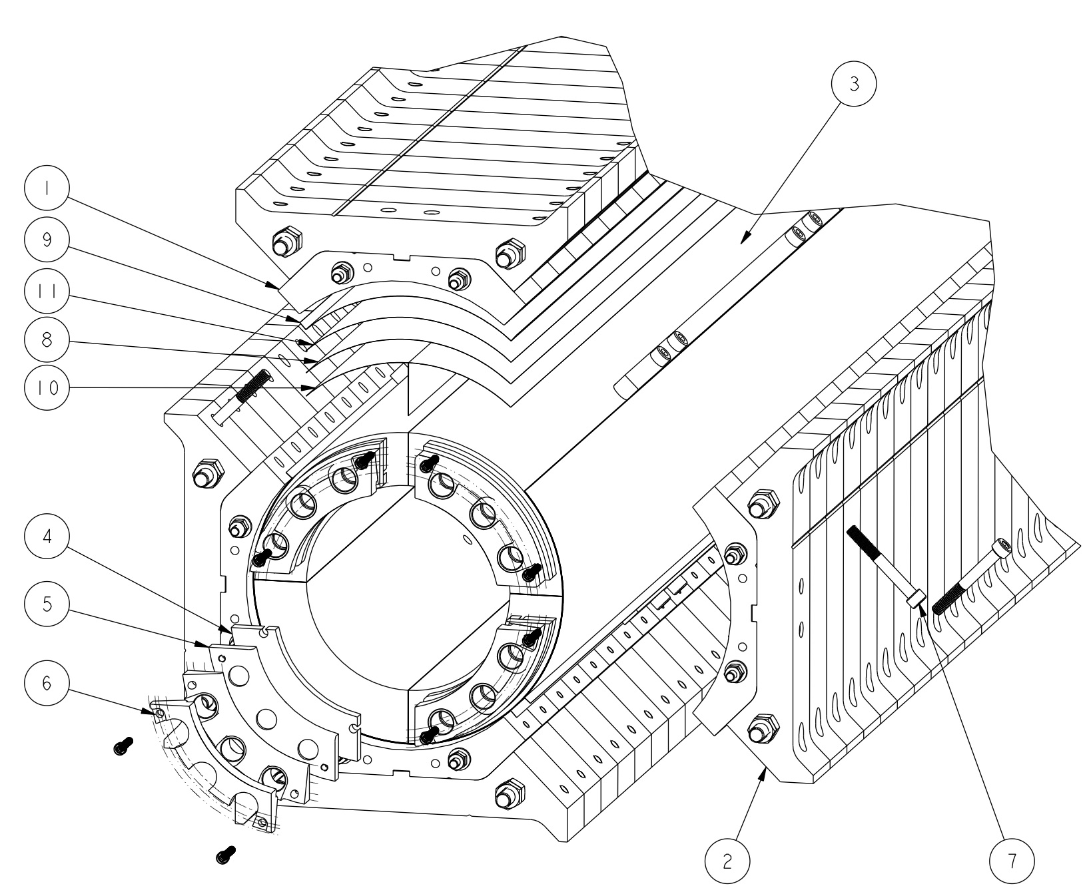
Coil-pack sub-assembly
Assembly of the coils, collars and pads
Starts by placing the bottom pad-collar stack, then the two-side pad-collar stacks, and the top
What we monitor (with specs)
  Insulated Coil OR and radial shims
  Dimensional uniformity and squareness
  Pole key gap
  Field quality
  Electrical integrity
Subscale version, identical design as MQXFA

Slide 20
Coil-pack sub-assembly
Coil OR and radial shims
Nominal radial gap coil to collars
  0.624 mm (GPI + radial shims)
Final layers of radial shims depend on
  Coil size: larger/smaller coils after mid-plane shimming can be compensated by less/more radial shims
  Missing shims for “LQ effect”
    0.125 remove from radial shims
So, from 0.624 mm to 0.500 mm

Slide 21
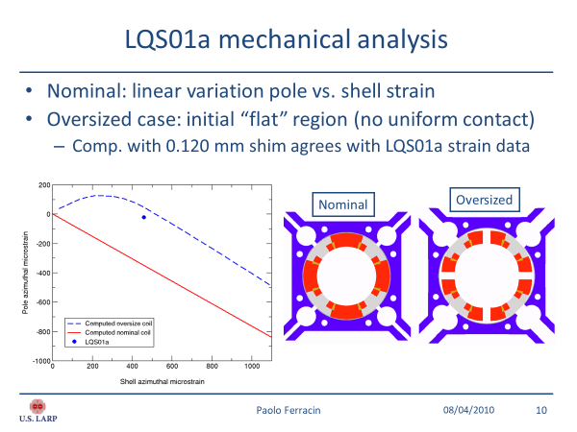
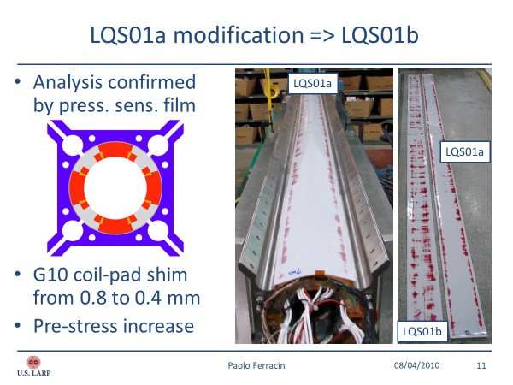
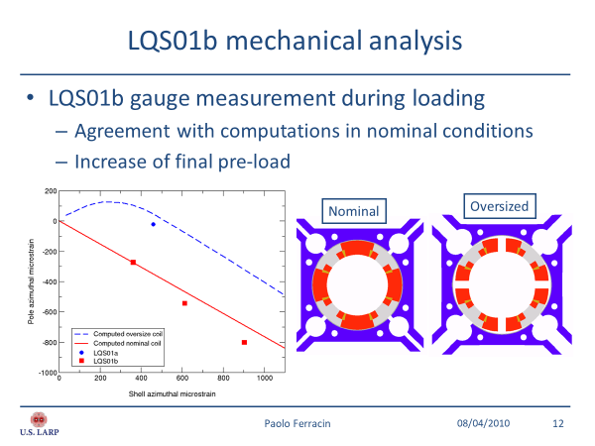
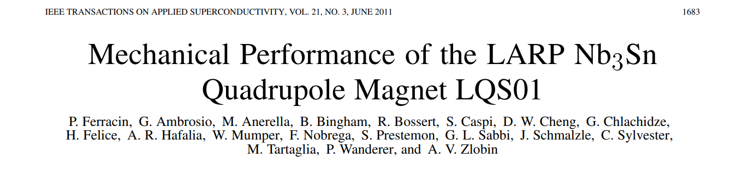
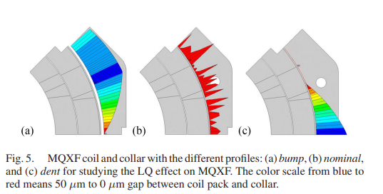
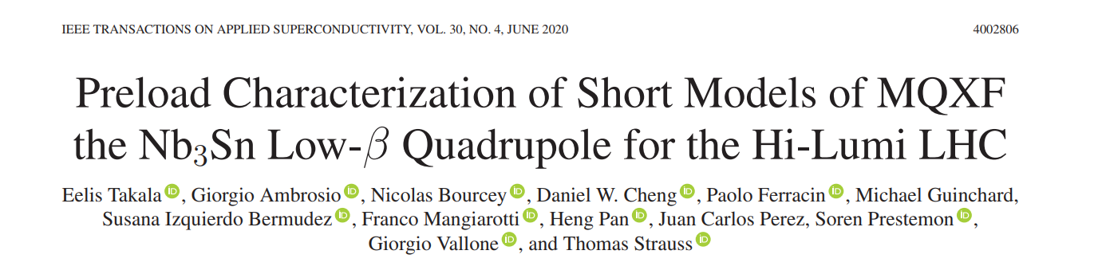
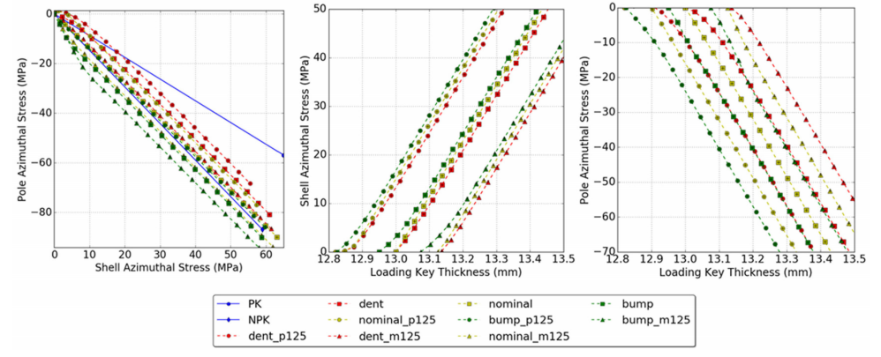
Coil-pack sub-assembly
“LQ effect”

Slide 22
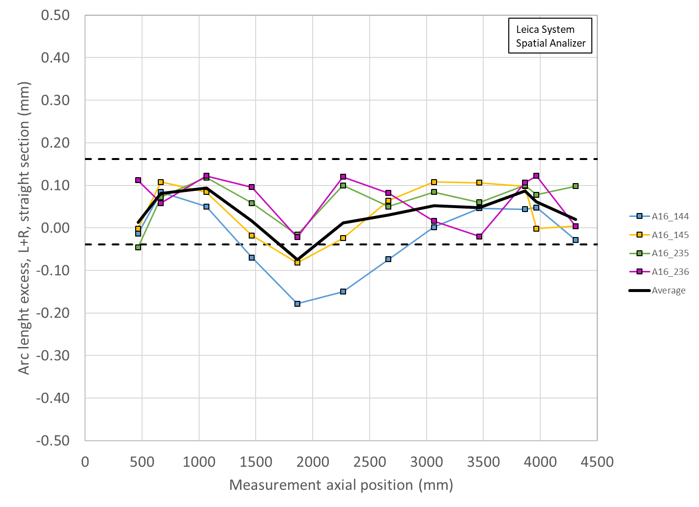
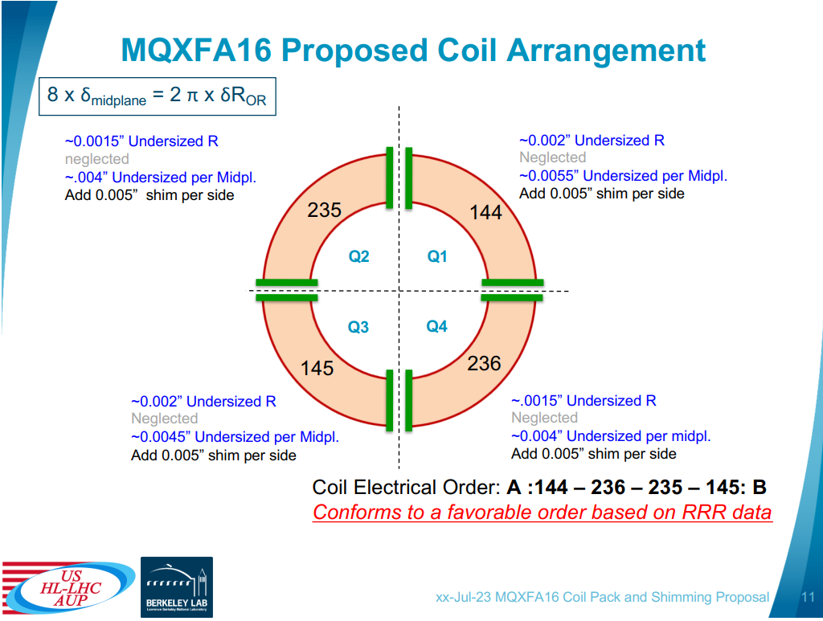
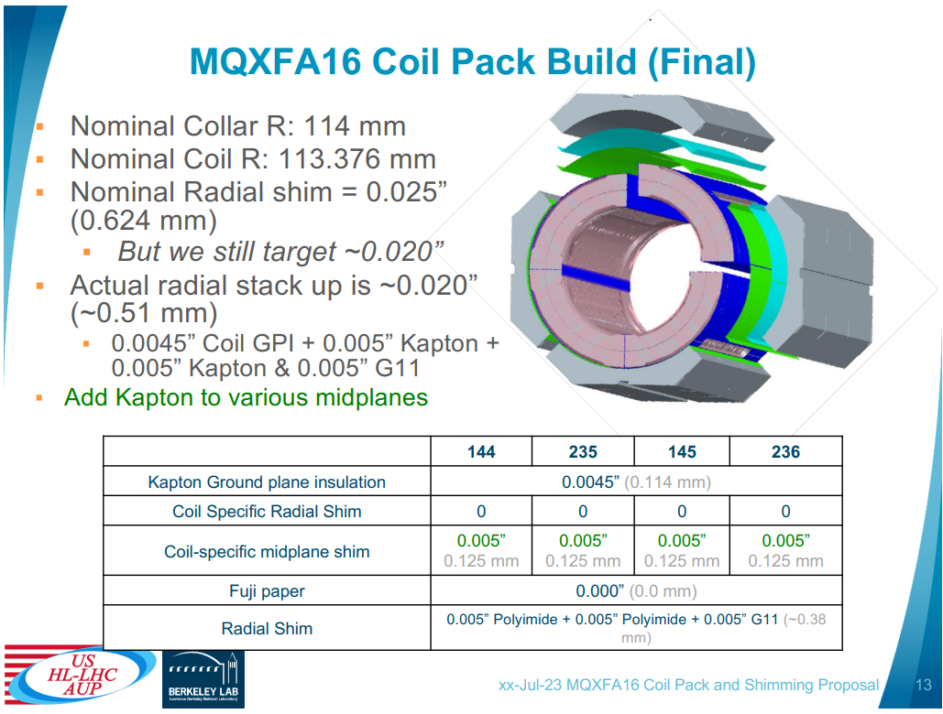
Coil-pack sub-assembly
Specification
For the gap between collars and insulated coils
  The variation along the longitudinal direction of the gap between collars and insulated coils, considering for each z location the average among the four coils, shall be -0.125 mm -0.100 / +0.050 mm.

Slide 23
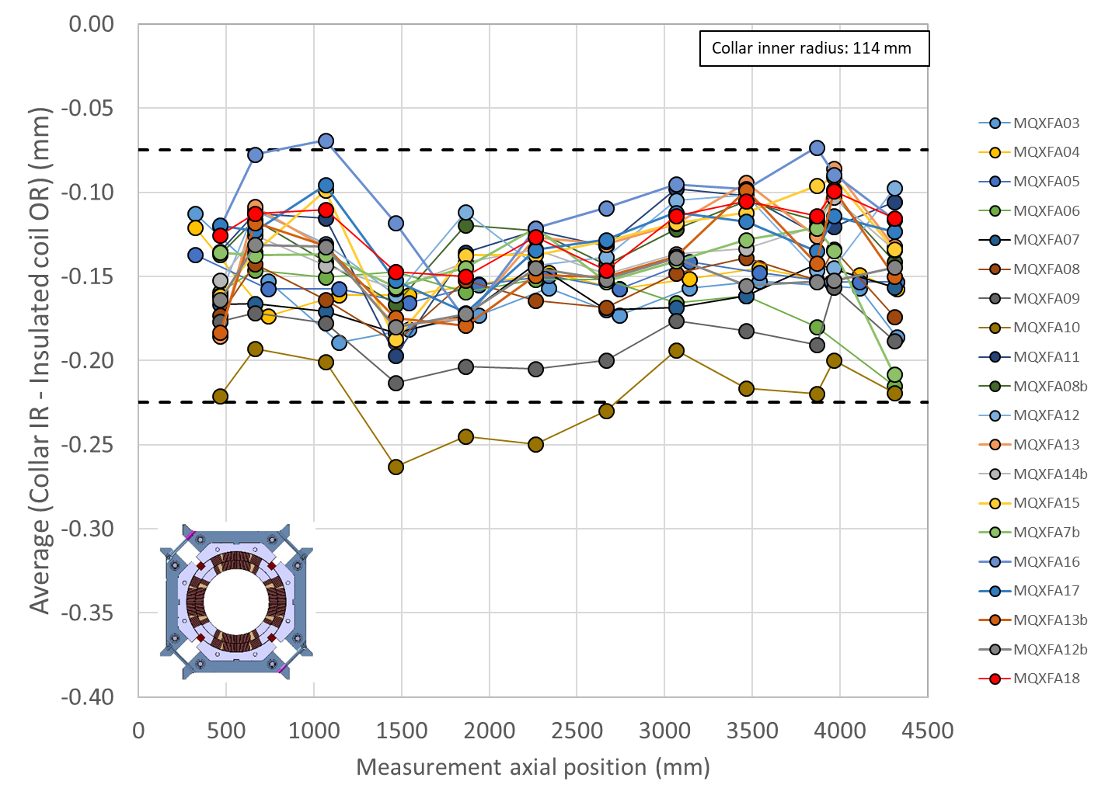
Coil-pack sub-assembly
Specification
For the gap between collars and insulated coils
  The variation along the longitudinal direction of the gap between collars and insulated coils, considering for each z location the average among the four coils, shall be -0.125 mm -0.100 / +0.050 mm.
Insulated coil OR based on coil dimensions meas. and mid-plane shims
  ΔR_{coil} = (arc_length_excess + 2*midplane_shim) *2/π

Slide 24
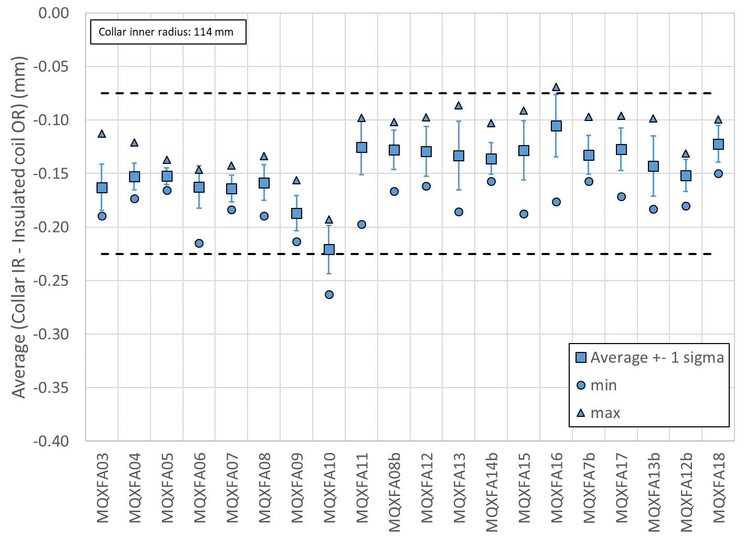
Coil-pack sub-assembly
Specification
For the gap between collars and insulated coils
  The variation along the longitudinal direction of the gap between collars and insulated coils, considering for each z location the average among the four coils, shall be -0.125 mm -0.100 / +0.050 mm.
Insulated coil OR based on coil dimensions meas. and mid-plane shims
  ΔR_{coil} = (arc_length_excess + 2*midplane_shim) *2/π

Slide 25
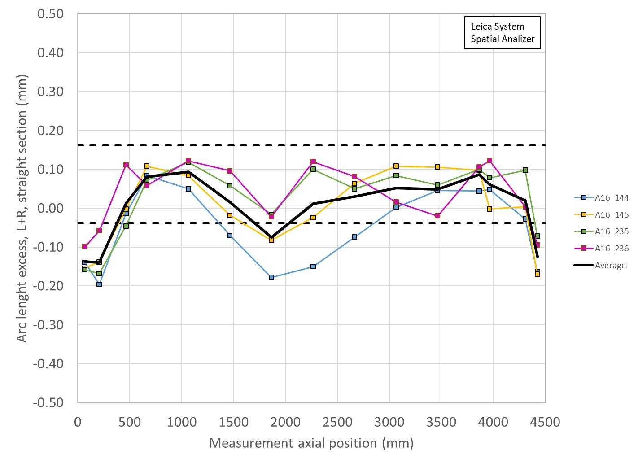
A16 shimmed arch length (including ends)

Slide 26
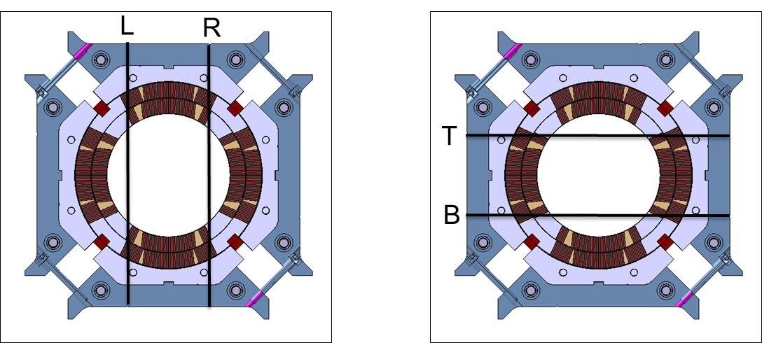
Coil-pack sub-assembly
Coil pack dimensional measurements
Coil pack dimensions measured on 11 locations
  Two horizontal and two vertical meas.
Uniformity
  The difference of the average of the two meas. in each cross-section with respect to the average of the entire coil pack
Squareness
  The difference of the of the two meas. in each cross-section.

Slide 27
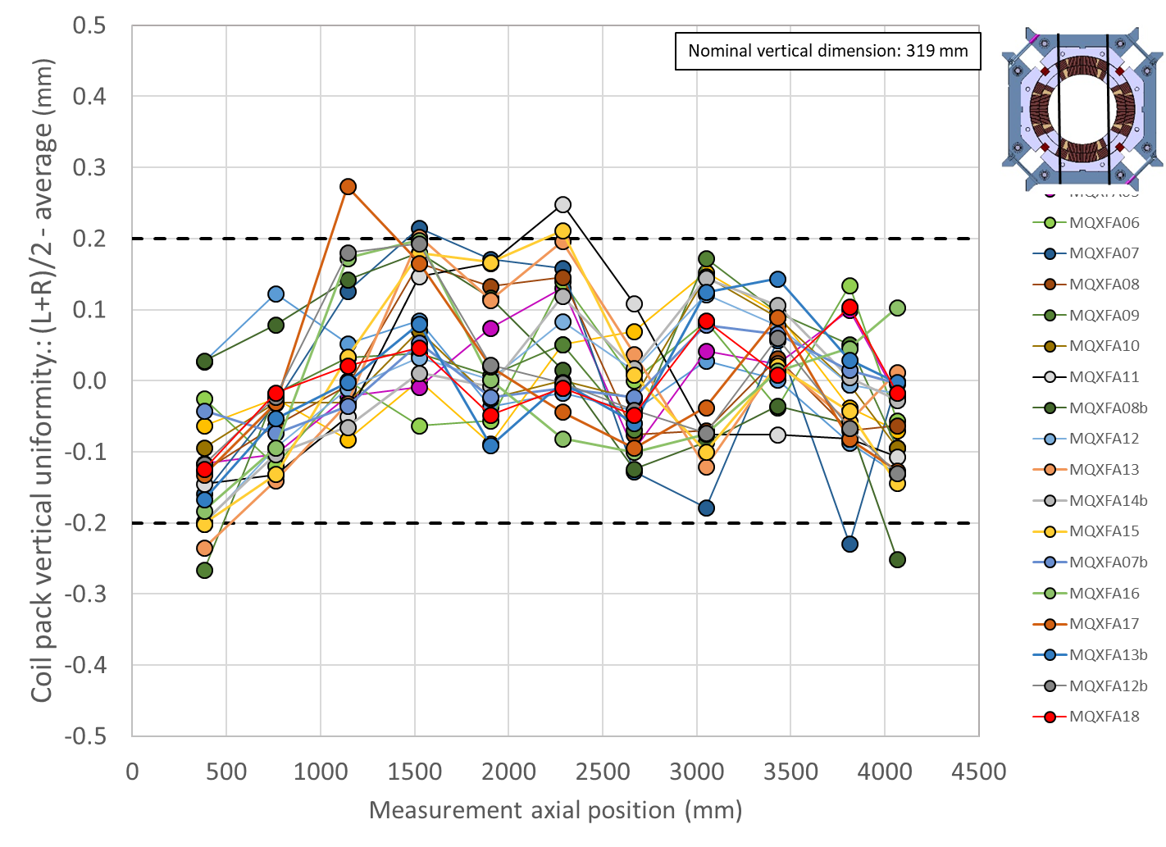
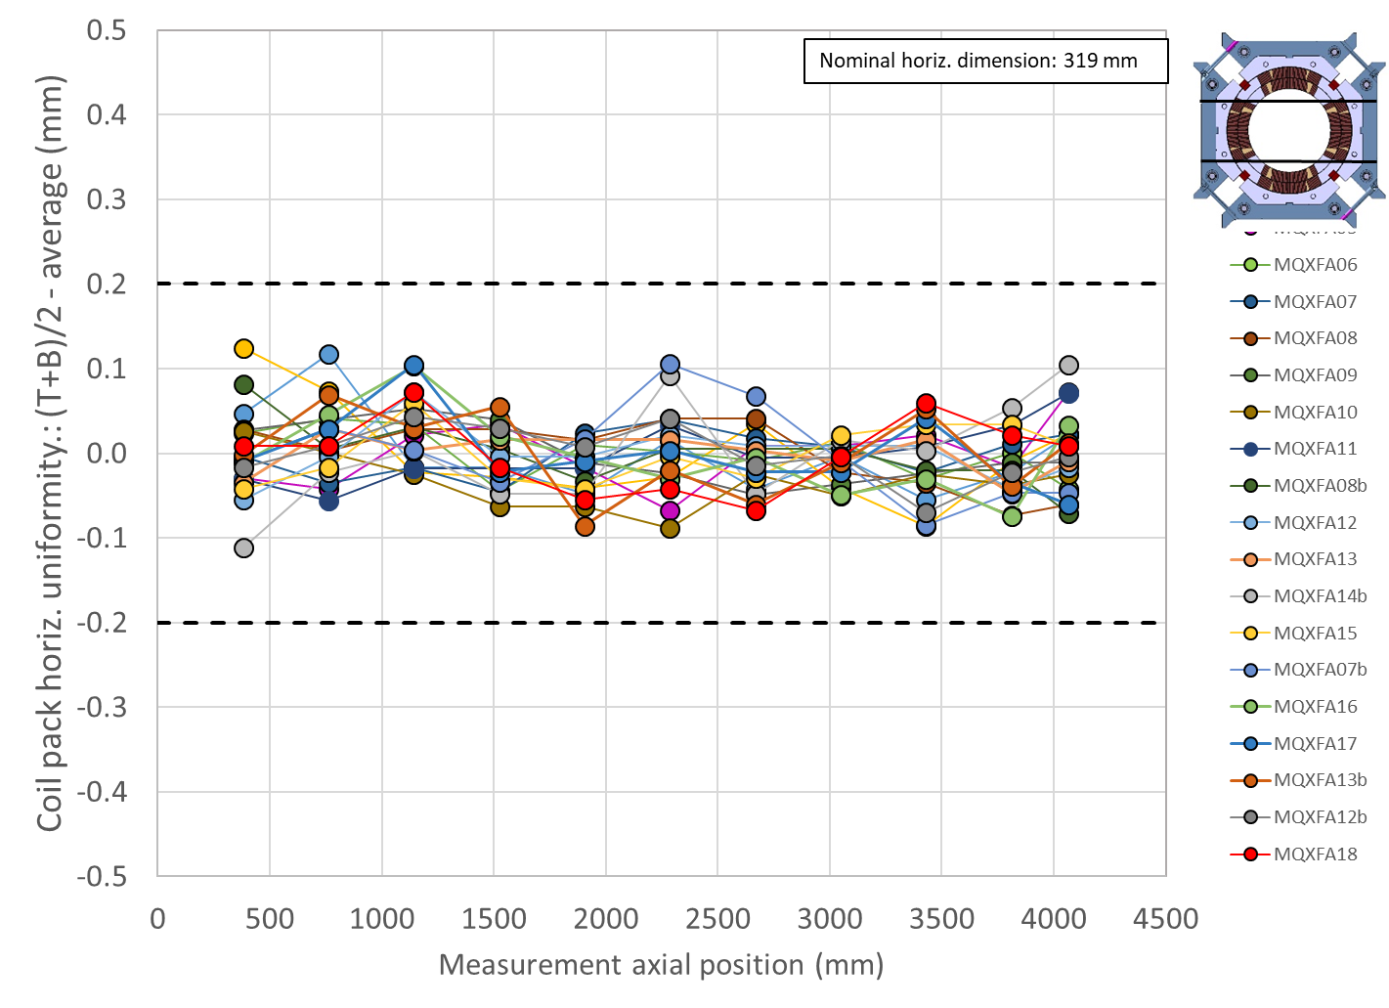
Coil-pack sub-assembly
Specification
For the coil-pack uniformity:
  The uniformity of the vertical and horizontal dimensions along the z axis shall be within ±0.200 mm

Slide 28
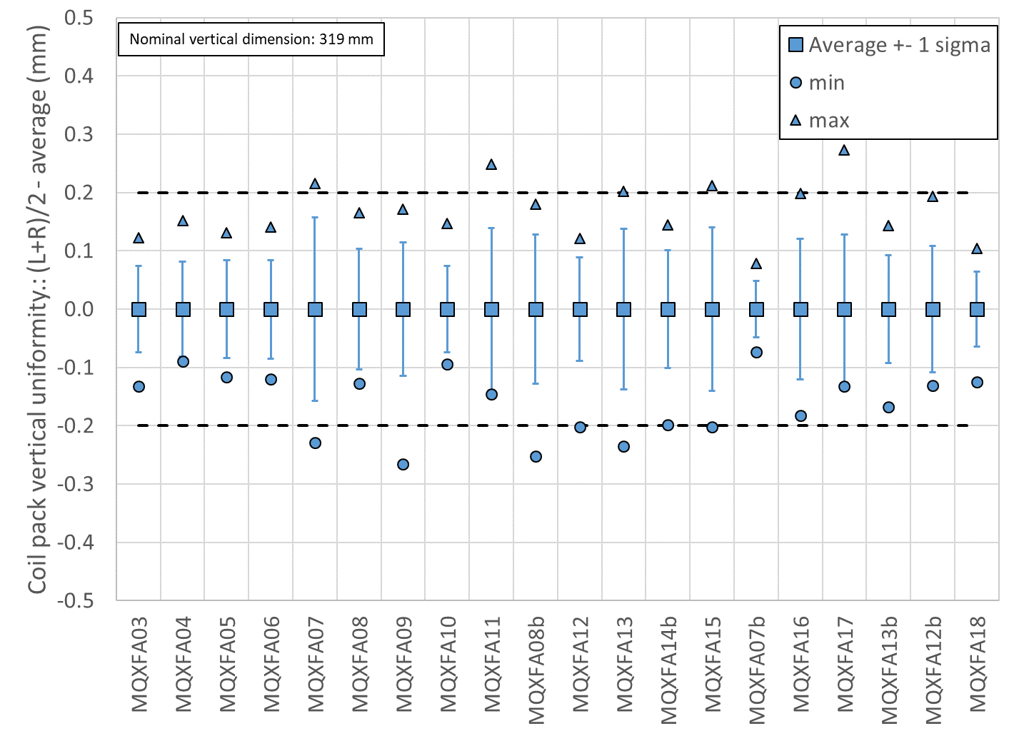
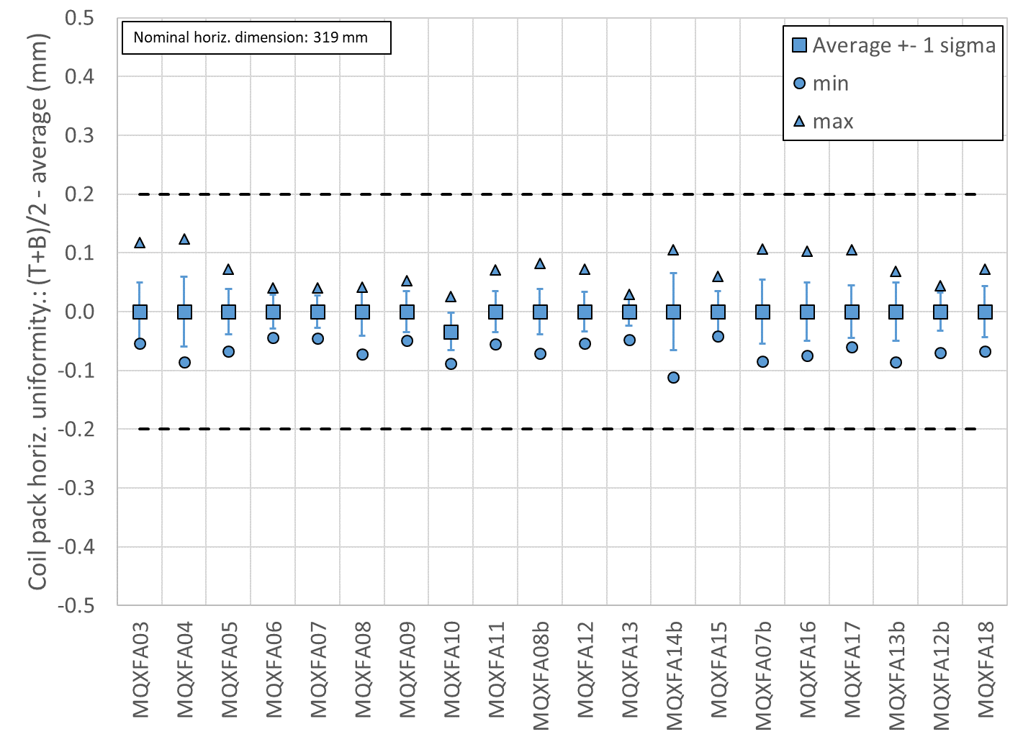
Coil-pack sub-assembly
Specification
For the coil-pack uniformity:
  The uniformity of the vertical and horizontal dimensions along the z axis shall be within ±0.200 mm

Slide 29
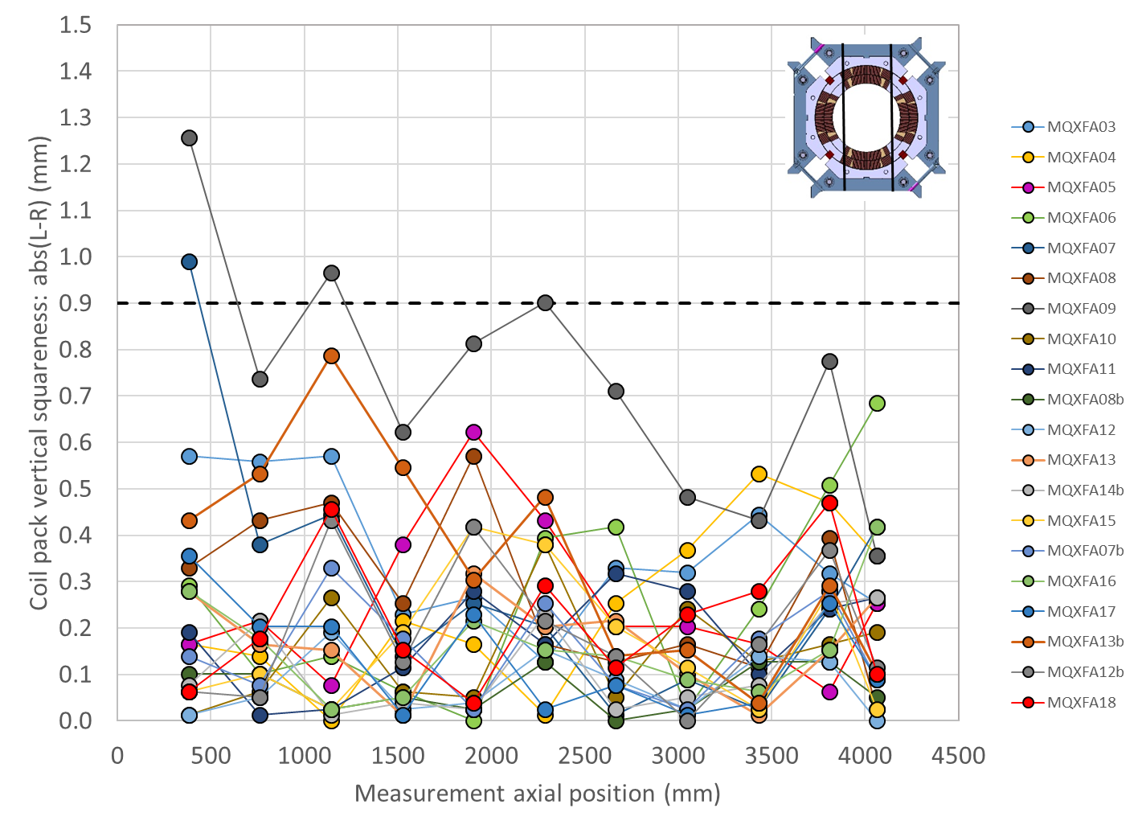
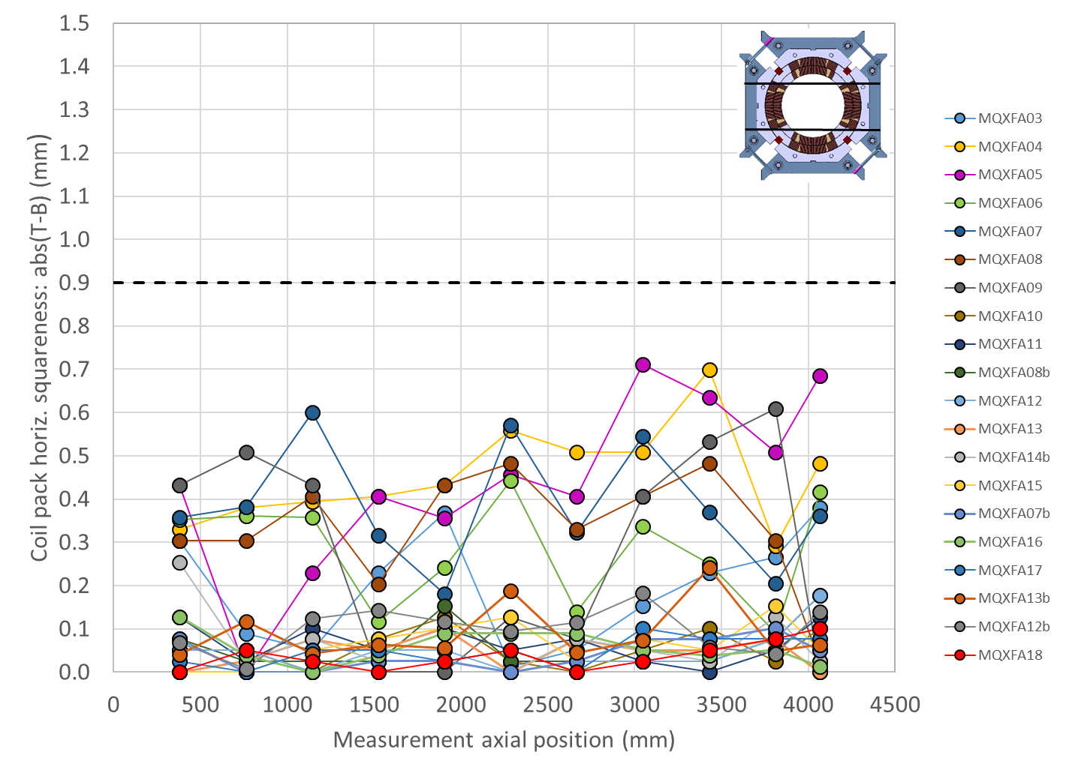
Coil-pack sub-assembly
Specification
For the coil-pack squareness:
  The squareness of the vertical and horizontal dimensions along the z axis shall be within +0.900 mm

Slide 30
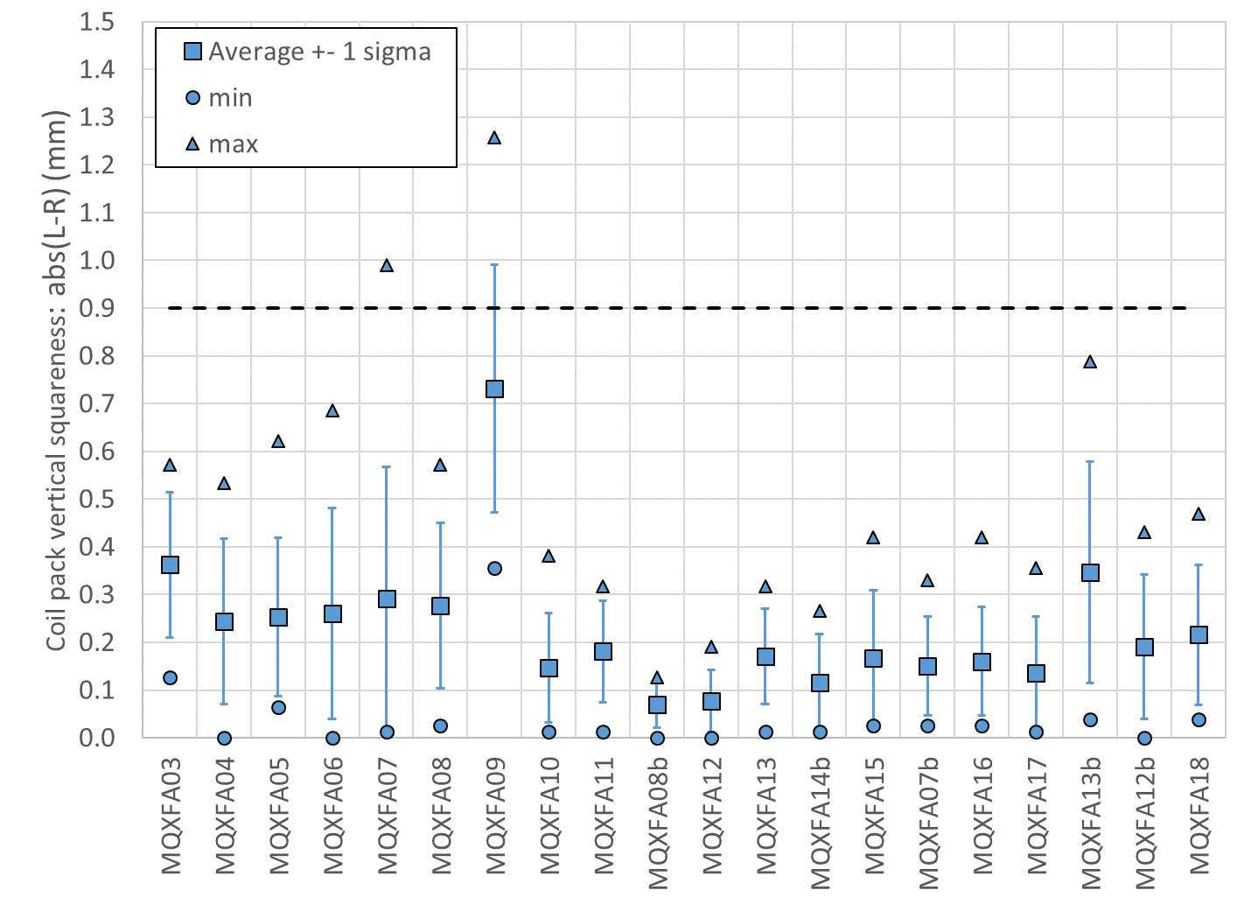
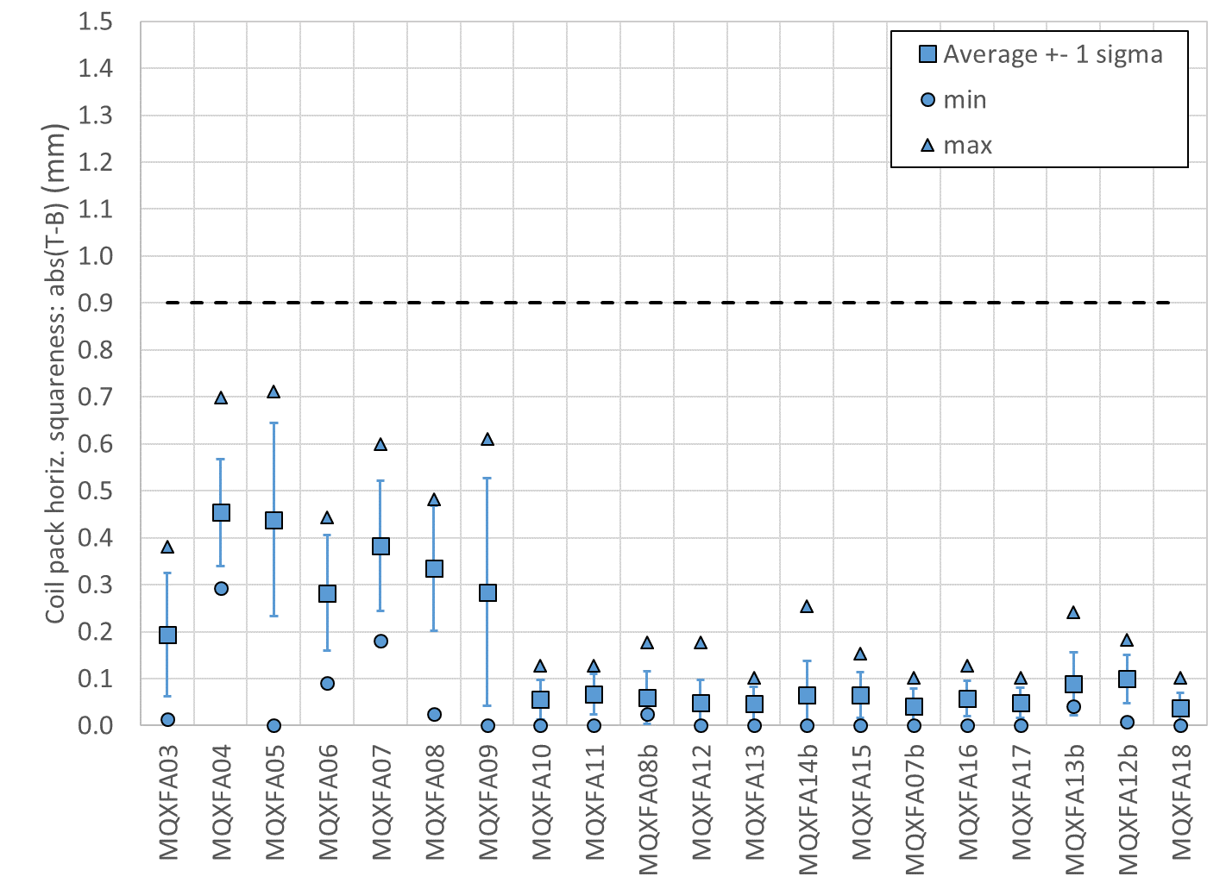
Coil-pack sub-assembly
Specification
For the coil-pack squareness:
  The squareness of the vertical and horizontal dimensions along the z axis shall be within +0.900 mm

Slide 31
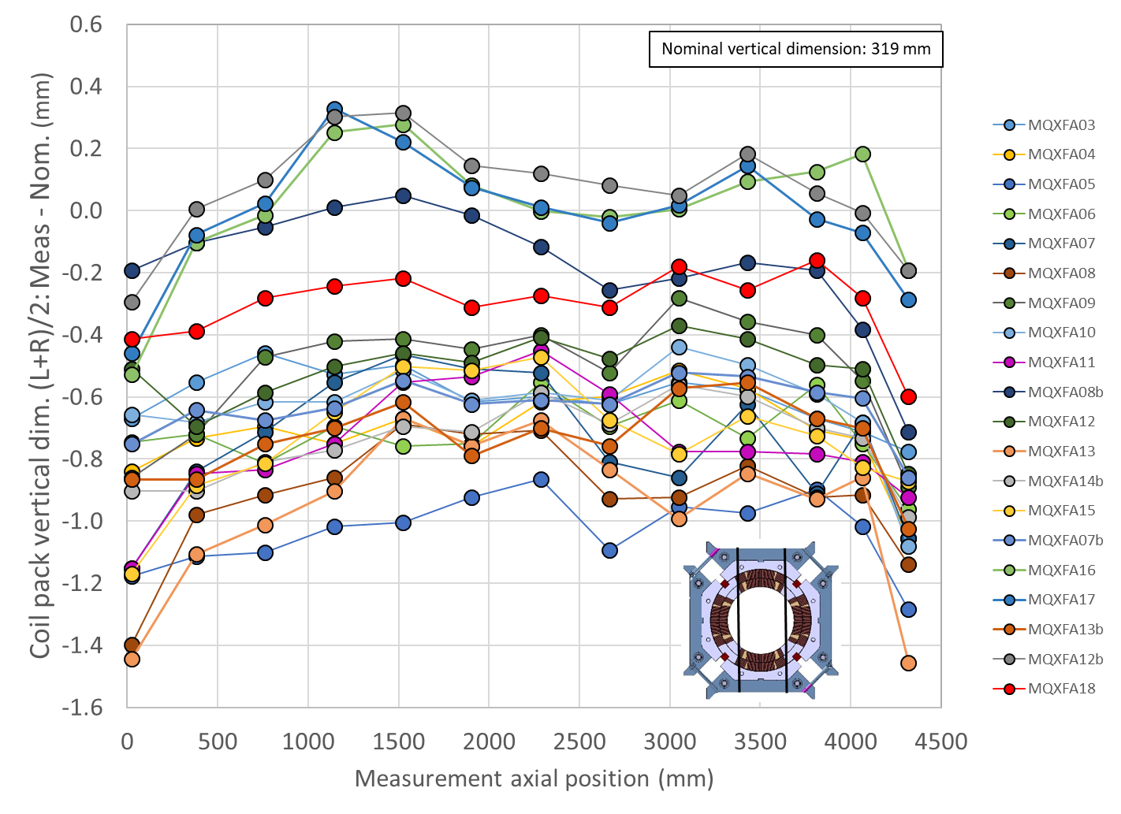
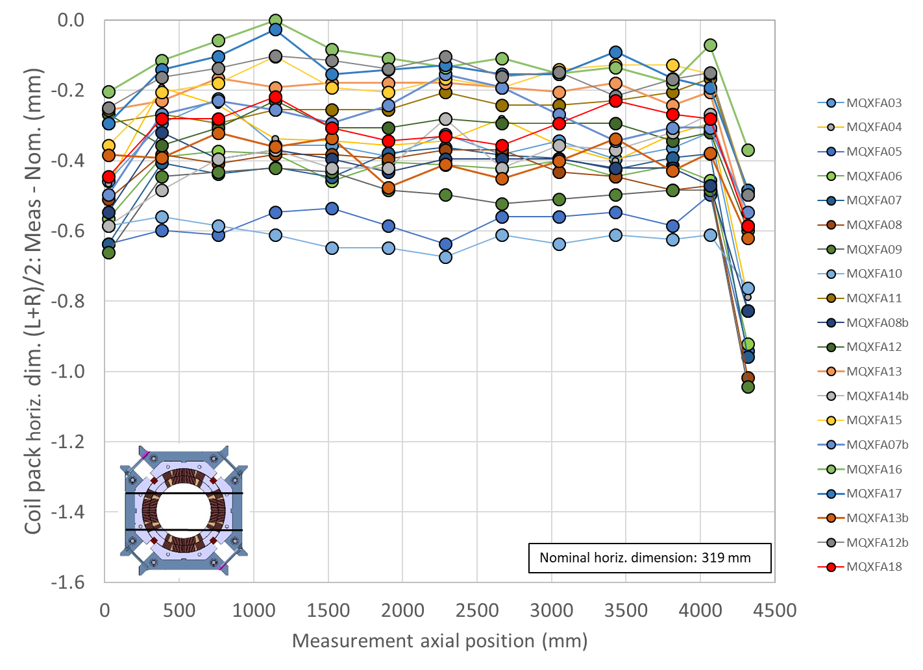
Coil-pack vertical and horizontal dimension

Slide 32
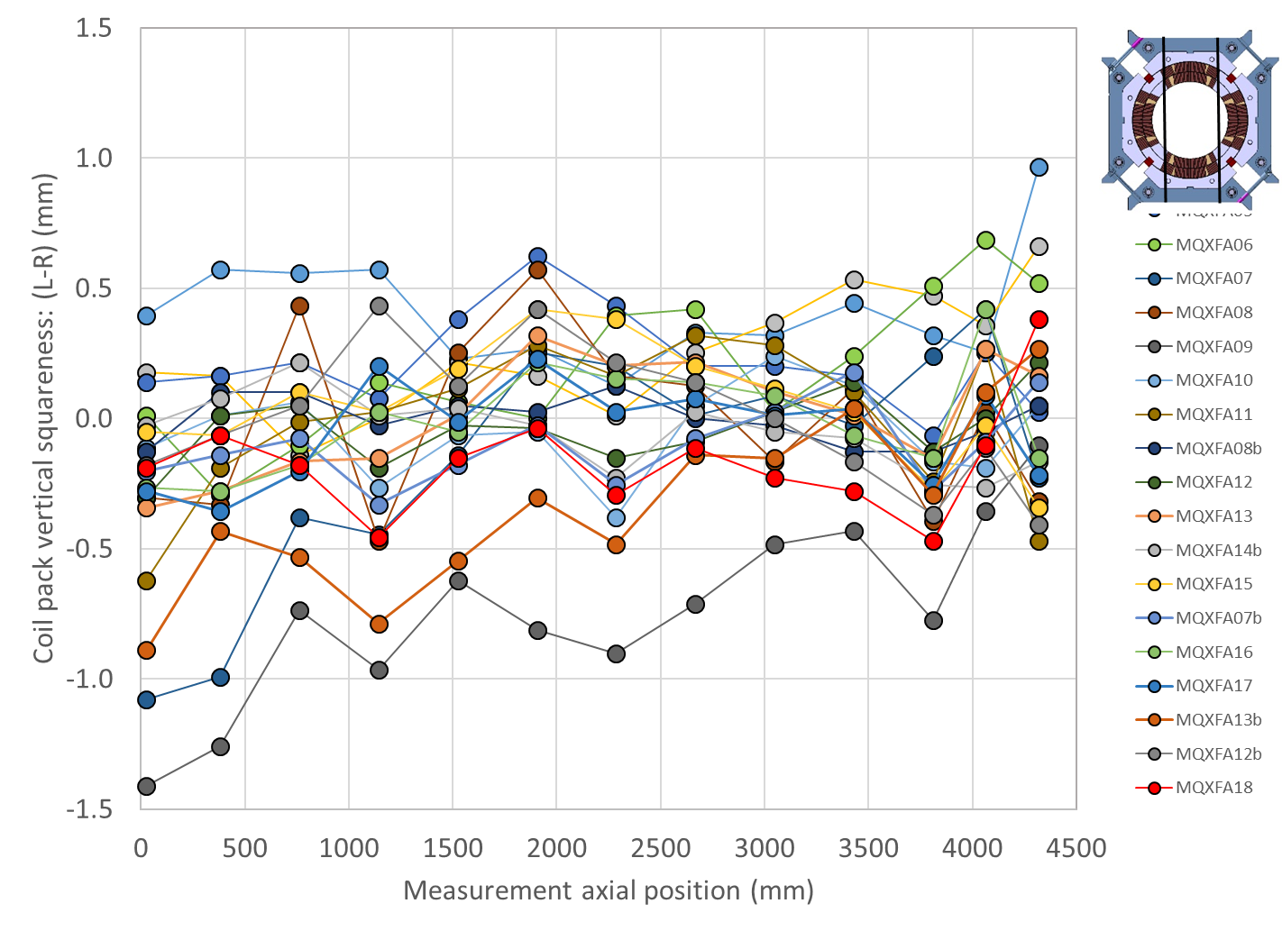
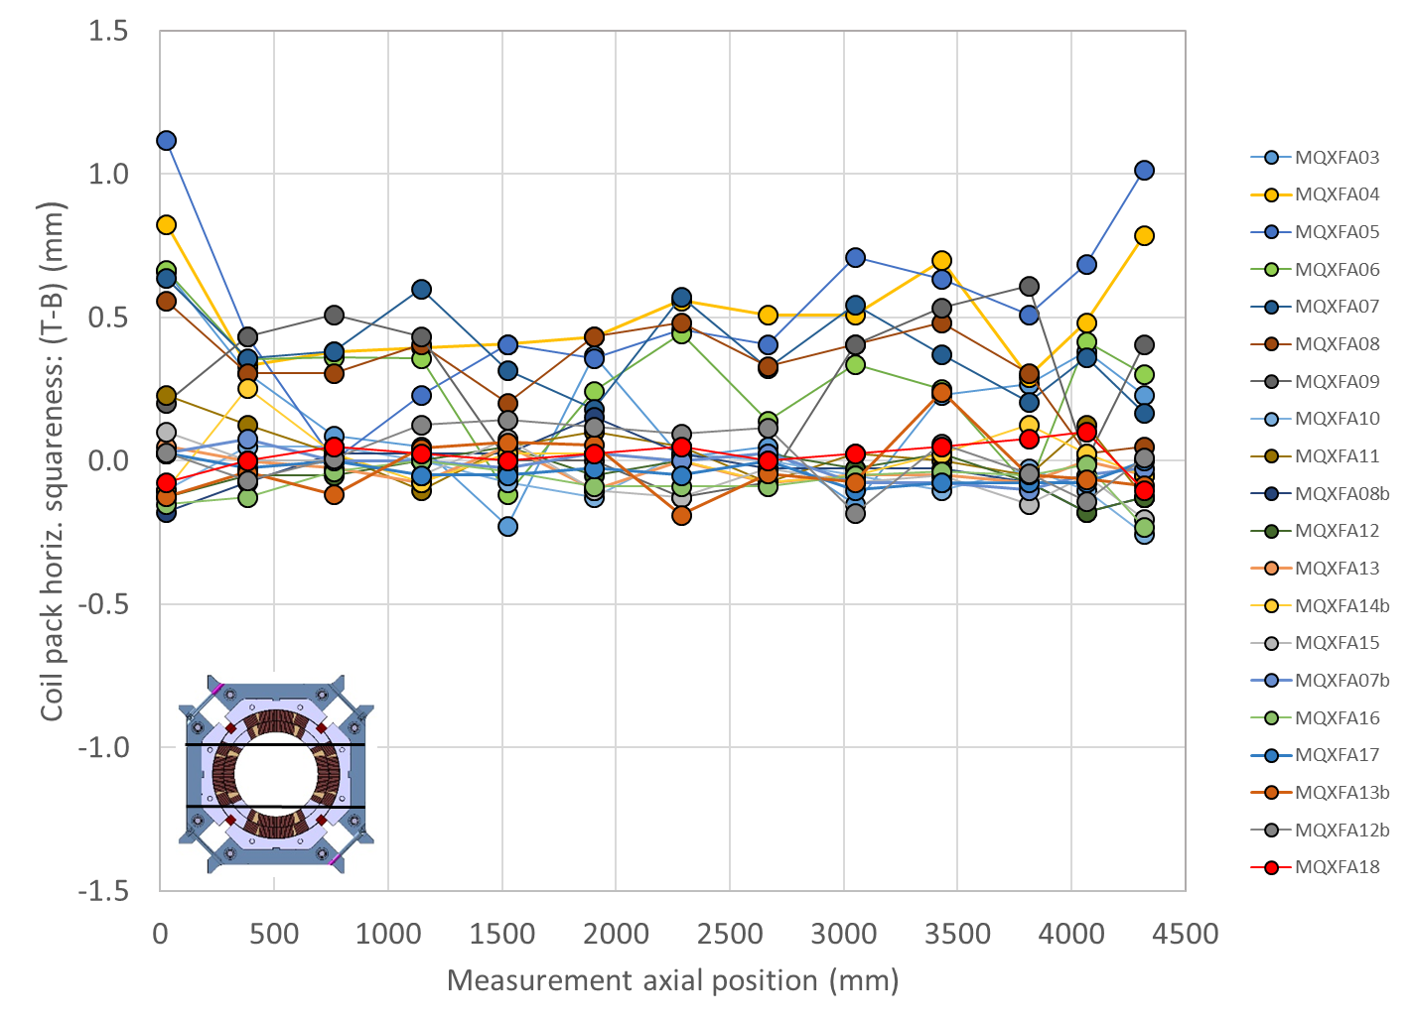
Coil-pack vertical and horizontal squareness

Slide 33
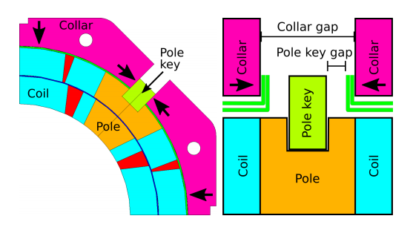
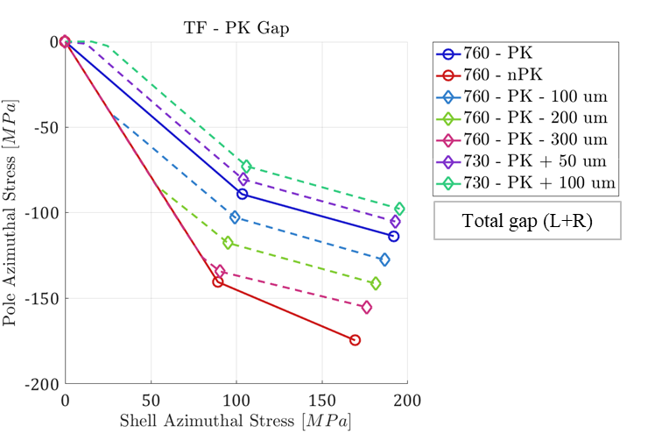

Coil-pack sub-assembly
Pole key gap
According to computations, a gap of 0.200 mm per side at the end of coil-pack bolting → contact collar to pole-key at 1.9 K.
  1.9 K, no force interception and azimuthal alignment between collars and coil guaranteed
By E. Takala

Slide 34
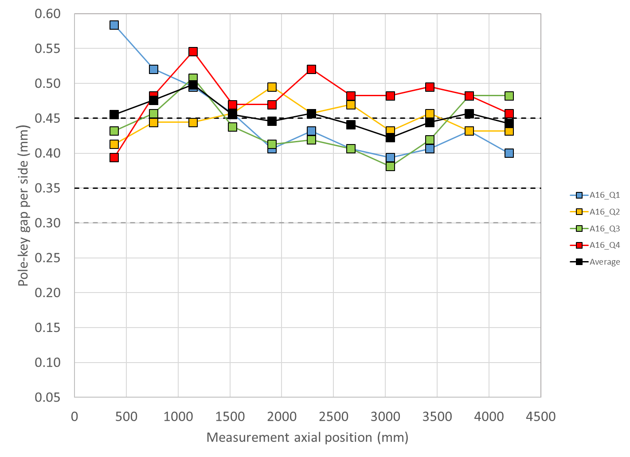
Coil-pack sub-assembly
Specification
For the pole key gap, the following specifications are set:
  The pole key gap, average per side and all quadrants, shall be +0.400 ±0.050 mm in each longitudinal locations.
  The minimum pole key gap, average per side, shall be ≥0.300 mm in each quadrant and in each longitudinal location.

Slide 35
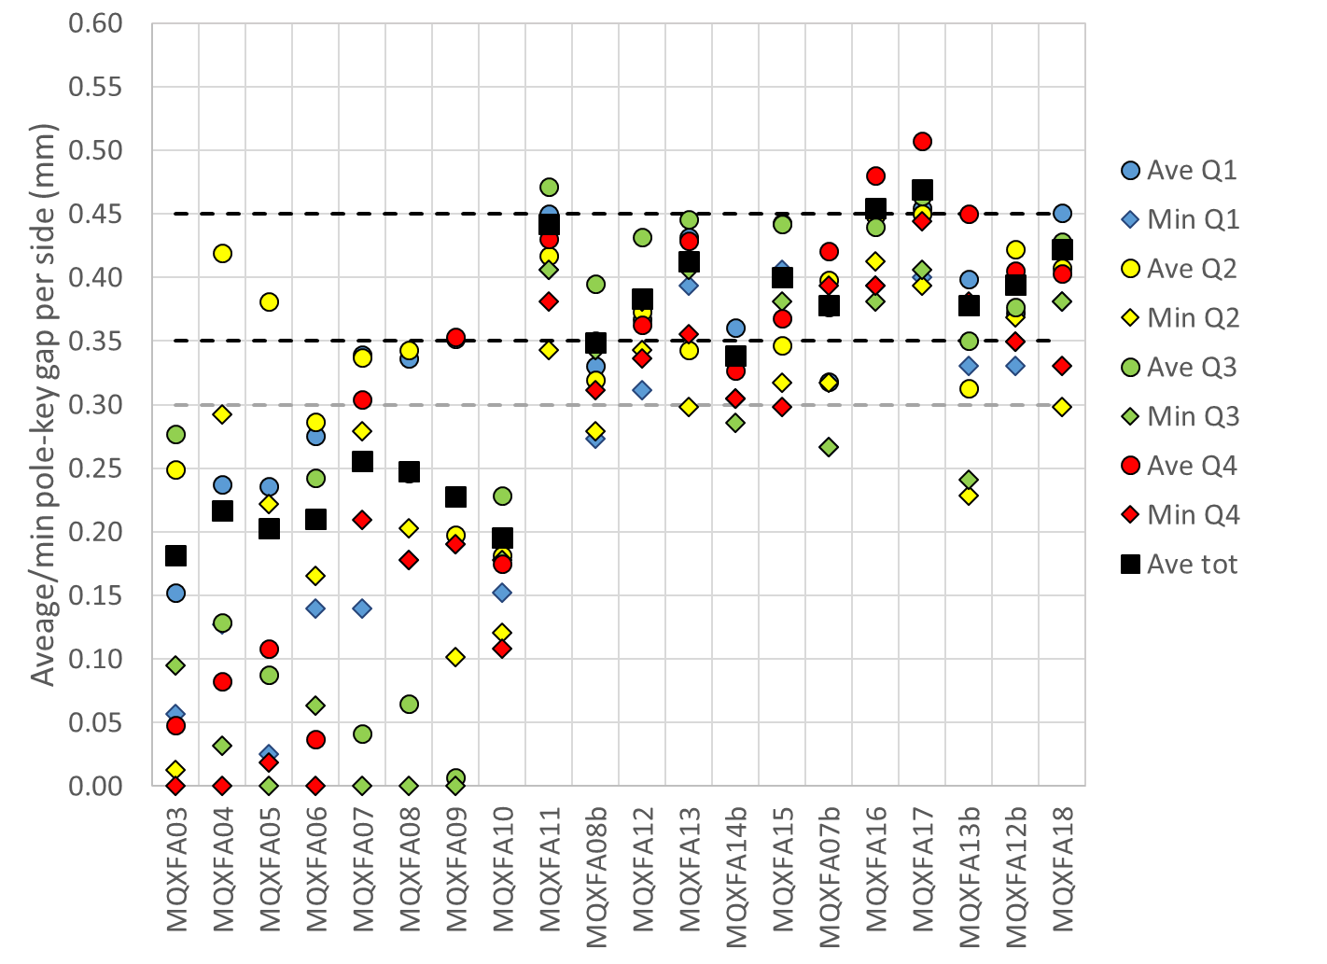
Coil-pack sub-assembly
Pole key gap
Overview plot
  Ave tot: average along length and among quadrants
  Ave: average along length
  Min: local minimum

Slide 36
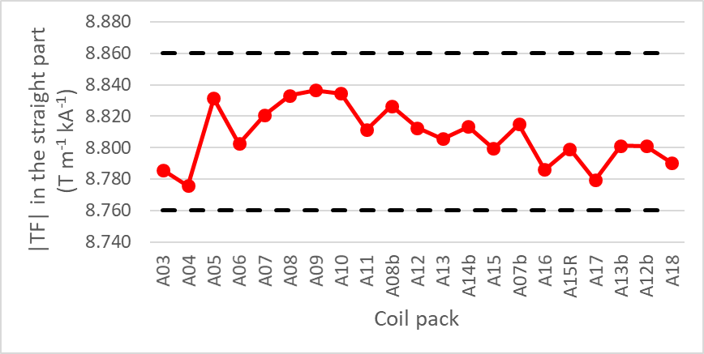
Coil-pack sub-assembly
Specification
For the main field transfer function, :
  The absolute value of the main field transfer function averaged over the straight part of the coil pack shall be within +8.760 T/(m kA) and +8.860 T/(m kA).
Data were taken using a 110 mm long rotating coil

Slide 37
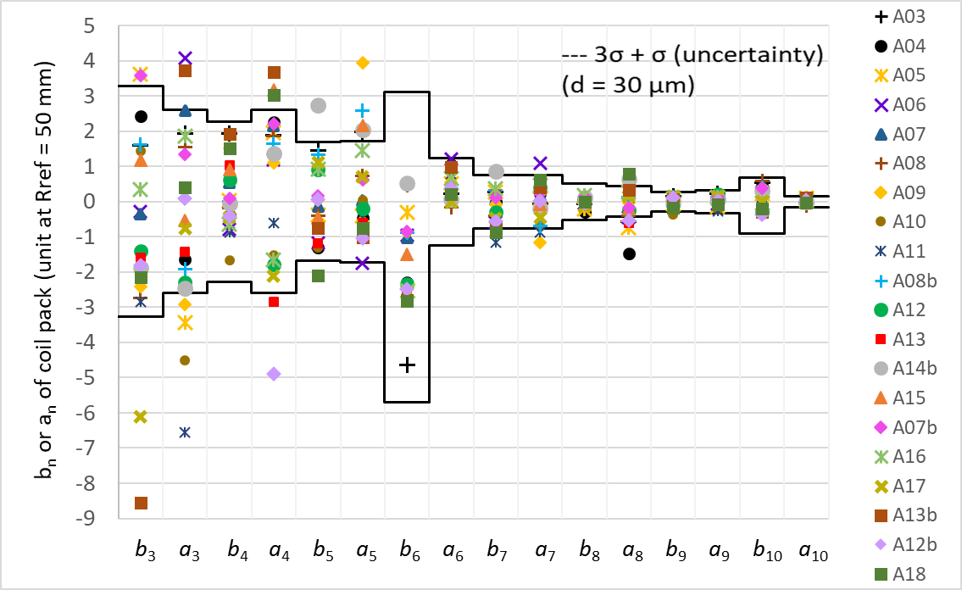
Coil-pack sub-assembly
Target
For the field errors, :
  The field errors in units averaged in the straight part of the coil pack with a reference radius of 50 mm should be within the upper and lower bounds determined according to the Triplet Field Quality Table in Table 1 of [8]
    A systematic component (0.9 units) associated with assembly and cooldown for b6 are considered.
[8] ACCEPTANCE CRITERIA PART A: MQXFA MAGNET, US-HiLumi-doc-1103
Data were taken using a 110 mm long rotating coil

Slide 38
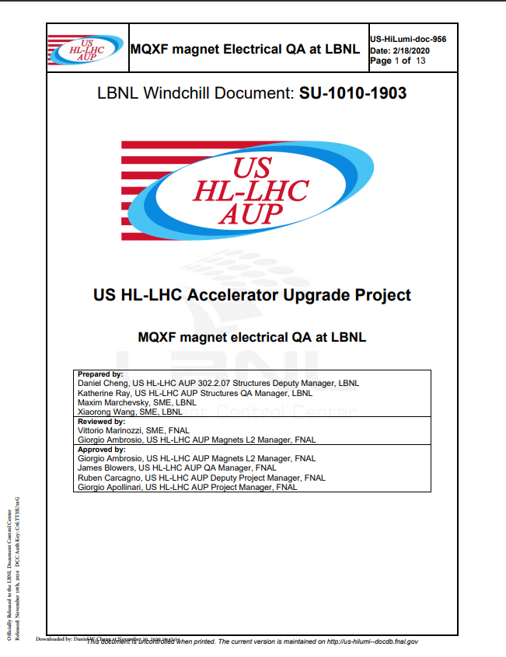
Coil-pack sub-assembly
Specification
For the electrical tests of the coil pack:
  1. Resistance check with hand-held multimeter
    a. Coil to structure
    b. Coil to coil
    c. Coil to PH
  2. Hipot.
    Individual coil to structure, 3680 V.
  3. Impulse test up to 2500 V, Direct- and Reversed-polarity.
    a. 1000 V, 1500 V, 2000 V, 2500 V

Slide 39
Outline
Introduction
Shell-yoke sub-assembly specs
Coil-pack sub-assembly specs
Magnet assembly and loading specs
Assembled magnet specs

Slide 40
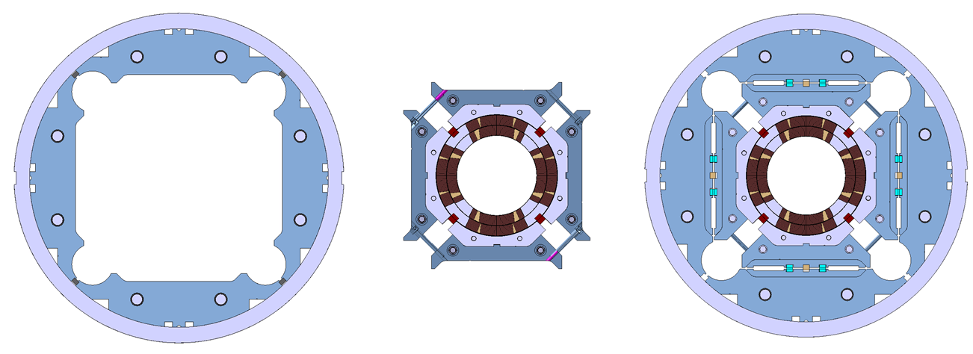
Magnet assembly and loading
Assembly-loading sequence
The coil-pack slid inside the shell-yoke
Master keys and bladders inserted
Axial loading rig is attached to the axial rods
Bladders inflated → the load keys shimmed
In parallel, the axial rods pre-tensioned.

Slide 41
Strain gauges A16 TLS
After the A16 loading, all electrical gauges where removed
For the A16 TLS, strain gauges were re-mounted in shells 2, 4 and 7 (except the sensors in the bottom location). Strain gauges where mounted in shell 1, in the four locations
Since the magnet was already loaded at room temperature, the new gauges only measured the delta during the TLS operation

Slide 42
Target loading key shim
For final loading key shim size reached during the pre-load operations, the following target is set:
At the end of the pre-loading operation, the sum of the loading shim size and the coil-pack radial dimension deviations in straight section, LE and RE shall be within the range achieved in magnets MQXFA14b and MQXFA05
  If, with such load key shim targets, the coil stress measured in 2+ strain gauges during the loading or during bladder inflation indicate that the coil stress may reach values above the coil stress spec. during subsequent loading steps or at the end of the loading, priority should be given to keeping the coil stress within the specs.

Slide 43
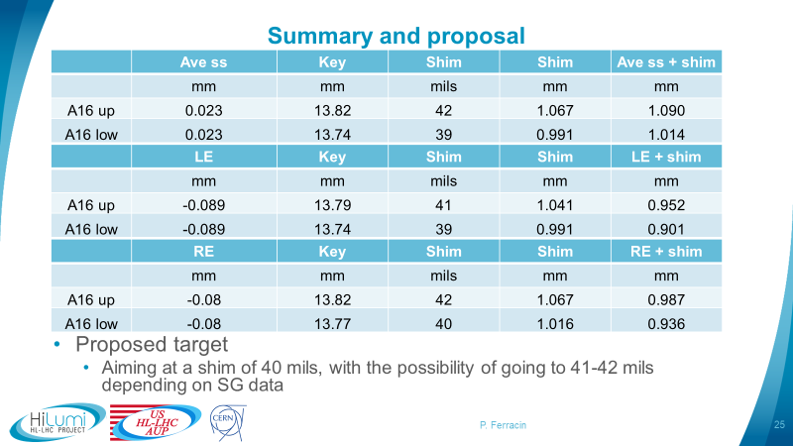
A16 loading shim proposal

Slide 44


Key-shim size vs. bladder pressure

Slide 45


Key-shim size vs. bladder pressure

Slide 46



Interference shim + coil size

Slide 47
Magnet assembly and loading
Specifications
For the pre-load operation sequence:
  The loading operation shall follow the sequence described below:
    Pre-load axial rods with average to a measured of strain ~50 µε
    Apply 50% azimuthal pre-load
    Apply 50% axial pre-load
    Apply 100% azimuthal pre-load
      This step shall include the insertion of 0.100 mm thick Tapered Load Shims (TLS) in the LE if
        CMM measurements of the coils size indicates that the average arc-length of the 4 coils is smaller by more than 0.150 mm in the 260-300 mm location from the LE with respect to the average straight section arc- length
        Mechanical analysis with TLS and measured coil dimensions indicated that the coil stress and shell stress are within the spec limits.
        0.050 mm thick Tapered Load Shims (TLS) may be used if i or ii are not met and with L2 permission.
    Apply 100% axial pre-load

Slide 48


Magnet assembly and loading
Specifications
For the pre-load operation sequence:
  The loading operation shall follow the sequence described below:
    Pre-load axial rods to a measured average of ~50 µε
    Apply 50% azimuthal pre-load
    Apply 50% axial pre-load
    Apply 100% azimuthal pre-load
    Apply 100% axial pre-load

Slide 49
Magnet assembly and loading
Specifications
For the pre-load operation sequence:
  The loading operation shall follow the sequence described below:
    Pre-load axial rods with average to a measured of strain ~50 µε
    Apply 50% azimuthal pre-load
    Apply 50% axial pre-load
    Apply 100% azimuthal pre-load
      This step shall include the insertion of 0.100 mm thick Tapered Load Shims (TLS) in the LE if
        CMM measurements of the coils size indicates that the average arc-length of the 4 coils is smaller by more than 0.150 mm in the 260-300 mm location from the LE with respect to the average straight section arc- length
        Mechanical analysis with TLS and measured coil dimensions indicated that the coil stress and shell stress are within the spec limits.
        0.050 mm thick Tapered Load Shims (TLS) may be used if i or ii are not met and with L2 permission.
    Apply 100% axial pre-load

Slide 50

FE analysis with real coil and TLS

Slide 51
Magnet assembly and loading
Specifications
For the pre-load targets at the end of the pre-load operations, the following specifications are set:
  The target average measured stress on coils, shells and rods at the end of the loading (after at least 24 h) shall be
    Shells 2-7 average azimuthal stress: +58 ± 6 MPa
    *Shell 1 average azimuthal stress: <80 MPa
    Coil (winding pole) average azimuthal stress: -90 ± 10 MPa
    Rod average strain: +950 µε ± 95 µε
For the maximum stress reached during the pre-load operations:
  During the entire pre-load operation, the maximum compression measured on each coil shall never exceed -135 MPa
*For shell 1, the stress limit is determined assuming an increase of shell tension of 85 MPa during cool-down, and computing with a 3D mechanical finite element model the stress in the edge of the tack-welding groove, which shall be within the allowable limits with a load factor of at least 1.2.

Slide 52
Magnet assembly and loading
Specifications (shells)
For the pre-load targets at the end of the pre-load:
  The target average measured stress on coils, shells and rods at the end of the loading (after at least 24 h) shall be
    Shell average azimuthal stress: +58 ±6 MPa
Channel | SC02TT | SC02RT | SC02BT | SC02LT | Average
Preload (end) | 64 | 67 | 68 | 62 | 65
Overnight (end) | 64 | 66 | 67 | 61 | 65
Delta TSL | -3 | -2 |  | -1 | -2
Channel | SC04TT | SC04RT | SC04BT | SC04LT | Average
Preload (end) | 65 | 59 | 63 | 63 | 63
Overnight (end) | 65 | 58 | 63 | 63 | 62
Delta TSL | -1 | -2 |  | -1 | -1
Channel | SC07TT | SC07RT | SC07BT | SC02LT | Average
Preload (end) | 68 | 69 | 68 | 64 | 67
Overnight (end) | 68 | 68 | 67 | 64 | 67
Delta TSL | -3 | -1 |  | -1 | -2
Channel | SC01TT | SC01RT | SC01BT | SC01LT | Average
Delta TSL | 0 | -1 | 0 | 0 | 0

Slide 53


Magnet assembly and loading
Specifications (shells)

Slide 54

Magnet assembly and loading
Specifications (shells)

Slide 55



Magnet assembly and loading
Specifications (shells)

Slide 56




Shells during TSL insertion

Slide 57



A16
Shell dimension and shell stress measurements

Slide 58
Magnet assembly and loading
Specifications
For the pre-load targets at the end of the pre-load operations, the following specifications are set:
  The target average measured stress on coils, shells and rods at the end of the loading (after at least 24 h) shall be
    Shells 2-7 average azimuthal stress: +58 ± 6 MPa
    *Shell 1 average azimuthal stress: <80 MPa
    Coil (winding pole) average azimuthal stress: -90 ± 10 MPa
    Rod average strain: +950 µε ± 95 µε
For the maximum stress reached during the pre-load operations:
  During the entire pre-load operation, the maximum compression measured on each coil shall never exceed -135 MPa
*For shell 1, the stress limit is determined assuming an increase of shell tension of 85 MPa during cool-down, and computing with a 3D mechanical finite element model the stress in the edge of the tack-welding groove, which shall be within the allowable limits with a load factor of at least 1.2.

Slide 59
Magnet assembly and loading
Specifications (coils)
For the pre-load targets at the end of the pre-load:
  The target average measured stress on coils, shells and rods at the end of the loading (after at least 24 h) shall be
    Coil (winding pole) average azimuthal stress: -90 ± 10 MPa
Channel | CQ1T | CQ2T | CQ3T | CQ4T | Average
Preload (end) | -91 | -96 | -82 | -73 | -86
Overnight (end) | -91 | -94 | -81 | -71 | -84
Channel | CQ1-700Ts | CQ2-700Ts | CQ1-1900Ts | CQ2-1900Ts | CQ1-3800Ts | CQ2-3800Ts | Average
Preload (end) |  | -150 | -94 |  | -76 | -101 | -106
Overnight (end) |  | -149 | -93 | -159 | -74 | -99 | -115

Slide 60
Magnet assembly and loading
Specifications (coils)
For the pre-load targets at the end of the pre-load:
  The target average measured stress on coils, shells and rods at the end of the loading (after at least 24 h) shall be
    Coil (winding pole) average azimuthal stress: -90 ± 10 MPa
No electrical SG data in coils during TSL, and fibers readings were off when the magnet arrived
Channel | CQ1T | CQ2T | CQ3T | CQ4T | Average
Preload (end) | -91 | -96 | -82 | -73 | -86
Overnight (end) | -91 | -94 | -81 | -71 | -84
Channel | CQ1-700Ts | CQ1-1900Ts | CQ1-3800Ts | CQ2-700Ts | CQ2-1900Ts | CQ2-3800Ts
Preload (end) | -104 | -98 | -83 | -93 | -97 | -91
Overnight (end) | -108 | -98 | -83 | -93 | -96 | -91
Average
-95
-95
Channel | CQ3-700Ts | CQ3-1900Ts | CQ3-3800Ts | CQ4-700Ts | CQ4-1900Ts | CQ4-3800Ts
Preload (end) |  | -101 |  | -98 |  | -87
Overnight (end) |  | -100 |  | -98 |  | -90

Slide 61



Magnet assembly and loading
Specifications (coils)
For the pre-load targets at the end of the pre-load:
  The target average measured stress on coils, shells and rods at the end of the loading (after at least 24 h) shall be
    Coil (winding pole) average azimuthal stress: -90 ± 10 MPa

Slide 62


Magnet assembly and loading specifications (coils)

Slide 63

Magnet assembly and loading specifications (coils)

Slide 64



A16
Coil arc length and coil stress measurements
Computed on SG loc = -84 MPa

Slide 65


A16 transfer function

Slide 66
Magnet assembly and loading
Specifications
For the pre-load targets at the end of the pre-load operations, the following specifications are set:
  The target average measured stress on coils, shells and rods at the end of the loading (after at least 24 h) shall be
    Shells 2-7 average azimuthal stress: +58 ± 6 MPa
    *Shell 1 average azimuthal stress: <80 MPa
    Coil (winding pole) average azimuthal stress: -90 ± 10 MPa
    Rod average strain: +950 µε ± 95 µε
For the maximum stress reached during the pre-load operations:
  During the entire pre-load operation, the maximum compression measured on each coil shall never exceed -135 MPa
*For shell 1, the stress limit is determined assuming an increase of shell tension of 85 MPa during cool-down, and computing with a 3D mechanical finite element model the stress in the edge of the tack-welding groove, which shall be within the allowable limits with a load factor of at least 1.2.

Slide 67
Magnet assembly and loading
Specifications (coils)
For the maximum stress reached during the pre-load operations:
  During the entire pre-load operation, the maximum compression measured on each coil shall never exceed -135 MPa
Peak stress on coils (MPa)
Electrical SGs
CQ1 | CQ2 | CQ3 | CQ4
-112 | -104 | -124 | -111
FBGs
CQ1-700 | CQ2-700 | CQ3-700 | CQ4-700 | CQ1-1900 | CQ2-1900 | CQ3-1900 | CQ4-1900 | CQ1-3800 | CQ2-3800 | CQ3-3800 | CQ4-3800
-112 | -136 | -126 | -108 | -116 | -154 | -128 | -116 | -106 | -104 | -100

Slide 68
Magnet assembly and loading
Specifications (coils)
For the maximum stress reached during the pre-load operations:
  During the entire pre-load operation, the maximum compression measured on each coil shall never exceed -135 MPa

Slide 69

Magnet assembly and loading
Specifications (coils)

Slide 70
Magnet assembly and loading
Specifications
For the pre-load targets at the end of the pre-load operations, the following specifications are set:
  The target average measured stress on coils, shells and rods at the end of the loading (after at least 24 h) shall be
    Shells 2-7 average azimuthal stress: +58 ± 6 MPa
    *Shell 1 average azimuthal stress: <80 MPa
    Coil (winding pole) average azimuthal stress: -90 ± 10 MPa
    Rod average strain: +950 µε ± 95 µε
For the maximum stress reached during the pre-load operations:
  During the entire pre-load operation, the maximum compression measured on each coil shall never exceed -135 MPa
*For shell 1, the stress limit is determined assuming an increase of shell tension of 85 MPa during cool-down, and computing with a 3D mechanical finite element model the stress in the edge of the tack-welding groove, which shall be within the allowable limits with a load factor of at least 1.2.

Slide 71


Magnet assembly and loading
Specifications (rods)
No rod data during TSL
For the pre-load targets at the end of the pre-load:
  The target average measured stress on coils, shells and rods at the end of the loading (after at least 24 h) shall be
    Rod average strain: +950 µε ±95 µε
Channel | ROD1 | ROD2 | ROD3 | ROD4 | Average
Preload (end) | 915 | 951 | 959 | 947 | 915
Overnight (end) | 909 | 937 | 951 | 941 | 909

Slide 72

Magnet assembly and loading
Sensitivity analysis
However, stress is measured only in one location
To estimate the stress in the coil along the length
  Sensitivity analysis: coil and shell stress vs coil size
    Assumption: stress given by average coil size → coils view a single cylinder (no pole key)

Slide 73
Magnet assembly and loading
Specifications
For the pre-load targets at the end of the pre-load operations, the following specifications are set:
  The target average measured stress on coils, shells and rods at the end of the loading (after at least 24 h) shall be
    Shells 2-7 average azimuthal stress: +58 ± 6 MPa
    *Shell 1 average azimuthal stress: <80 MPa
    Coil (winding pole) average azimuthal stress: -90 ± 10 MPa
    Rod average strain: +950 µε ± 95 µε
For the maximum stress reached during the pre-load operations:
  During the entire pre-load operation, the maximum compression measured on each coil shall never exceed -135 MPa
*For shell 1, the stress limit is determined assuming an increase of shell tension of 85 MPa during cool-down, and computing with a 3D mechanical finite element model the stress in the edge of the tack-welding groove, which shall be within the allowable limits with a load factor of at least 1.2.

Slide 74


OD Measurements

Slide 75

Delta stress during pre-load from OD measurements

Slide 76
Shell strain after shell-yoke sub-assembly
Offset: 100 ustrain

Slide 77


Final stress from OD measurements + offset
100 µε for A16

Slide 78

Average azimuthal stress

Slide 79

Magnet assembly and loading
Sensitivity analysis
+0.100 mm of coil outer radius increase
  -20 MPa of coil stress variation
  +12 MPa of shell stress variation
+0.100 mm of total coil arc-length increase (0.050 per mid-plane)
  -13 MPa of coil stress variation
  +8 MPa of shell stress variation
FE values confirmed in short models, like MQXFS4
By E. Takala

Slide 80
Magnet assembly and loading
Specifications
For the maximum coil size (arc length) variation along the coil length:
  Average coil size (arc length) after shimming shall range within ±100 µm with respect to average coil size measured in strain gauge location.

Slide 81
Magnet assembly and loading
Sensitivity analysis
However, stress is measured only in one location
To estimate the stress in the coil along the length
  Sensitivity analysis: coil and shell stress vs coil size
    Assumption: stress given by average coil size → coils view a single cylinder (no pole key)

Slide 82
Magnet assembly and loading
Sensitivity analysis
+0.100 mm of coil outer radius increase
  -20 MPa of coil stress variation
  +12 MPa of shell stress variation
+0.100 mm of total coil arc-length increase (0.050 per mid-plane)
  -13 MPa of coil stress variation
  +8 MPa of shell stress variation
FE values confirmed in short models, like MQXFS4
By E. Takala

Slide 83
Outline
Introduction
Shell-yoke sub-assembly specs
Coil-pack sub-assembly specs
Magnet assembly and loading specs
Assembled magnet specs

Slide 84

Assembled magnet specifications
Coil aperture
Requirement R-T-01
  The minimum free coil aperture at room temperature after coil bumpers installation, magnet assembly and preload shall be 146.7 mm. This guarantees an annulus free for HeII of minimum thickness 1.2 mm, average thickness larger or equal to 1.5 mm
    Note: Due the presence of strain gauges and the wires the last Pion location cannot be confirmed

Slide 85

Assembled magnet specifications
OD
Requirement R-T-02
  The MQXFA nominal outer diameter without preload is 614 mm. The MQXFA outer diameter best-fit after assembly and preload shall not exceed 615 mm

Slide 86

Assembled magnet specifications
Straightness
The magnet straightness is monitored by measuring
  vertical and horizontal absolute position of fiducial in the
    mid-plane shell cut-outs (both sides, left and right from the lead end view)
    and in the top shell cut-outs.
  Measurements are taken in 7 longitudinal locations (in between shell segments).
The fiducials are placed in contact with the yoke laminations, which are accessible through the cut-outs.

Slide 87

Assembled magnet specifications
Straightness
For the straightness of the magnet, the following specifications are set:
  The maximum spread (max – min) of the vertical and horizontal position of the fiducials in the top shell cut-outs along 7 longitudinal locations shall be ≤ 0.250 mm.
  The maximum spread (max – min) of the vertical and horizontal position of the fiducials in both sides of the mid-plane shell cut-outs along 7 longitudinal locations shall be ≤ 0.250 mm.

Slide 88



Assembled magnet specifications
Cooling channels/passages
Requirement R-T-06 and R-T-08
  The minimum diameter of the MQXFA yoke cooling channels that will provide an adequate gap around the heat exchanger tubes is 77 mm
  The MQXFA shall have provisions for the following cooling passages:
    (1) Free passage through the coil pole and subsequent G-11 alignment key equivalent of 8 mm diameter holes repeated every 50 mm;
    (2) free helium paths interconnecting the four yoke cooling channels holes; and
    (3) a free cross-sectional area of at least 150 cm2
FNAL’s HX bore gauge in Q1 and Q2 cooling holes were used

Slide 89

Assembled magnet specifications
Splices and coil/heaters hipot
Requirement R-T-14 and R-T-15
  Splices are to be soldered with CERN approved materials.
  Voltage Taps: the MQXFA magnet shall be delivered with three redundant (3x2) quench detection voltage taps located on each magnet lead and at the electrical midpoint of the magnet circuit; and two (2) voltage taps for each internal MQXFA Nb3Sn-NbTi splice. Each voltage tap used for critical quench detection shall have a redundant voltage tap
Requirement R-T-16
  The MQXFA magnet coils and quench protection heaters shall pass the hi-pot test specified in Table 3 before cold test.

Slide 90
Assembled magnet specifications
Radiation resistance and interface specs
Requirement R-T-20
  All MQXFA components must withstand a radiation dose of 35 MGy, or shall be approved by CERN for use in a specific location as shown in MQXFA Materials List [EDMS 1786261].
  The MQXFA magnets shall meet the interface specifications with the following systems: (1) other LMQXFA Cold Mass components; (2) the CERN supplied power system; (3) the CERN supplied quench protection system, and (4) the CERN supplied instrumentation system. These interfaces are specified in Interface Control Document [25].

Slide 91

Assembled magnet specifications
Field quality
Objective Requirement MQXFA-R-O-02
  The field errors in units averaged in the straight part of the coil pack with a reference radius of 50 mm should be within the upper and lower bounds determined according to the Triplet Field Quality Table in Table 1 of [8]
    A systematic component (0.9 units) associated with assembly and cooldown for b6 are considered.
[8] ACCEPTANCE CRITERIA PART A: MQXFA MAGNET,
US-HiLumi-doc-1103

Slide 92

Assembled magnet specifications
Field quality coil pack vs after loading

Slide 93


Assembled magnet specifications
Field quality
Objective Requirement MQXFA-R-O-01
  The positions of the local magnetic center and magnetic field angle are measured along the magnet axis with values obtained by averaging sections ≤ 500 mm. In each section, the local magnetic center is to be within ±0.5 mm from the magnet magnetic axis both in horizontal and in vertical direction. The local magnetic field angle in each section is to be ±2 mrad from the average magnetic field angle of the whole magnet, with the exception of the first measurement in the connection side where field angle is affected by magnet leads.
Magnetic center in the horizontal direction
Magnetic center in the vertical direction

Slide 94

Assembled magnet specifications
Field quality
Objective Requirement MQXFA-R-O-01
  The positions of the local magnetic center and magnetic field angle are measured along the magnet axis with values obtained by averaging sections ≤ 500 mm. In each section, the local magnetic center is to be within ±0.5 mm from the magnet magnetic axis both in horizontal and in vertical direction. The local magnetic field angle in each section is to be ±2 mrad from the average magnetic field angle of the whole magnet, with the exception of the first measurement in the connection side where field angle is affected by magnet leads.

Slide 95

Assembled magnet specifications
Field quality
For the main field transfer function, the following specifications are set:
  The absolute value of the main field transfer function averaged over the straight part of the coil pack shall be within +8.810 T/(m kA) and +8.910 T/(m kA).
Data were taken using a 110 mm long rotating coil

Slide 96

Assembled magnet specifications
Magnet length
For the total length, the following specifications are set:
  The total magnet length after loading at room temperature shall be 4906.7 ±3.5 mm
Measurement: 4909.6 mm

Slide 97
Appendix

Slide 98


Slide 99


MQXFA12b – End Shell Qualification
G. Vallone, G. Ambrosio, D. Cheng, P. Ferracin, L. Garcia Fajardo, J. Herrera
July 31, 2024
For discussion

Slide 100



Introduction
Tapered loading keys increase the stress in the short shells at the magnet ends
With the nominal coil size, these were designed to have a ~20% margin with the MQXFAP1b target prestress level (130 MPa at cold on the central shell)

Slide 101


MQXFA12b – Loading
SG were removed after full loading
  We do not have a ‘precise’ measurement on the shell stress, just an estimate
Measured stress: 86 MPa
  This is 10% higher w.r.t. the ‘nominal’ value from the model (77.8 MPa)
  Seems an offset: 11 MPa delta

Slide 102

Shell Stress - Cool-Down, Measured
We can reasonably assume a central shell stress ~140 MPa at cold
  10 MPa stress increase with respect to the AP1b case
  Not sure what happened on A15, but seems an outlier (but we better not be in that situation)

Slide 103

Shell Stress - Cool-Down, Delta
Delta shell (central) around 80 MPa

Slide 104
Shell Stress - End
FE results:
  Delta shell (central) = 70 MPa (vs 80 MPa measured)
  Delta shell (end) = 87 MPa
  End shell stress, best estimate after cooldown:
    86 (measured) + 87 = 173 MPa

Slide 105



Required Stress
Max long strain < 3000 um/m means end shell stress after cooldown larger than 140/150 MPa
  This means > 50/60 MPa at room temperature
  Shim might not be necessary at all in this case
    Unexpected, the measured strain was higher than expected

Slide 106


Shell Stress – Limiting Locations
Triangle
Weld block
Weld strip
Three dangerous locations identified with FE analysis
Limiting point:
  ‘Weld strip’ cut-out, on the magnet end side

Slide 107



Crack Size for Grade IV Analysis
ASTM B594-19
Inspection Class | Calibration Block (mm) | Allowable Critical Flaw Size (mm)
AAA | 0.4 | < 0.90
AA | 1.19 | < 2.67
A | 1.98 | < 4.44
B | 3.18 | < 7.12
Actual Inspection
Design Criteria with Single Discontinuity
Design criteria:
  Assume that a crack whose area is equal to the reference calibration block one (D), will be critical for an a/c ratio of 0.2 and propagate to a round crack
  In other words, assume: $\text{2}\text{a}\text{=2}\text{c}\text{=2.24}\text{D}$
  AA inspection performed on MQXFA shells: 2a<2.67 mm

Slide 108



Fracture Limits
First letter stress direction, second the crack direction
  Shell is from FRISA
  Either CR or CL for us
  Assuming 21.4 MPa m^.5

Slide 109


Crack Analysis – Interaction Integral Method
‘Design criteria’ crack analysis performed with weight functions
  Pre-computed ‘influence coefficients’ of the separation forces on a crack in any region
  K1c=24 MPa m2, K1 ~24*0.8=19.2 MPa m2 (load factor = 1.25)
Here we compute K1 on a real crack, on the short shell submodel
  Global model: 133 MPa after cooldown stress on the central shell
  Two most dangerous cases: edge and corner crack

Slide 110

FEA – a/c Dependence
Not a strong influence of a/c
  Due to the rapid decreasing stresses?
  For this case we might just consider the

Slide 111


Angle Dependence – Edge Crack
Crack inclination changes K1
Worst case ~ +30 degrees
  K1 = 16.7 MPa m^.5
-45

Slide 112


Load Factor Analysis
A12b
Assuming 2a = 1.2 mm, the load margin is ~ 1.10
  Small but >1
Removing the tapered key we go to ~1.25

Slide 113

Dye Penetrant Inspection
Impossible to test a relevant specimen unless we introduce a real crack (fatigue testing?)
Literature: POD ~ 85% for 1 mm cracks
  Reference:
    https://www.afgrow.net/applications/DTDHandbook/pdfs/Sec3_1_0.pdf

Slide 114
Conclusion
With no inspection, would suggest to change/remove the tapered key
  It might not be necessary for this magnet, if we trust the strain gauge measurements
  At least half, to have a load factor > 1.2
With dye penetrant inspection, depends on what detection probability we are willing to accept

