Slide 1
TMS magnetic field studies
Marco Oriunno, 11/01/2024

Slide 2
Configurations Analyzed
Ansys Maxwell, 2024R1
Python scripts written to fully automate the pre-processing: run quickly many variants, reduce errors
All geometries are full depth (six in total)
CDR stack 40/60, gap=40
PDR stack 40/60
bridge, gap=40
links, gap=40
bridge, gap=50
links, gap=50
PDR stack 50/34/8, gap=50

Slide 3
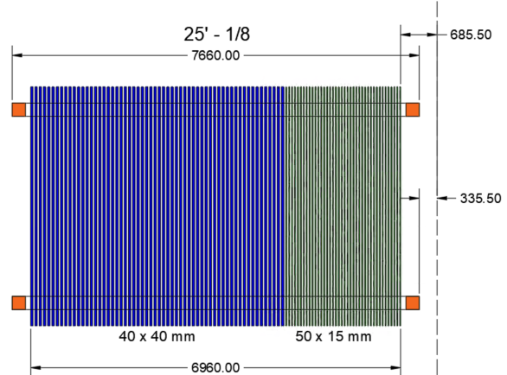
CDR and PDR steel stacks
CDR and PDR (first version)
PDR (last version)

Slide 4
CDR, ¼ symmetry

Slide 5
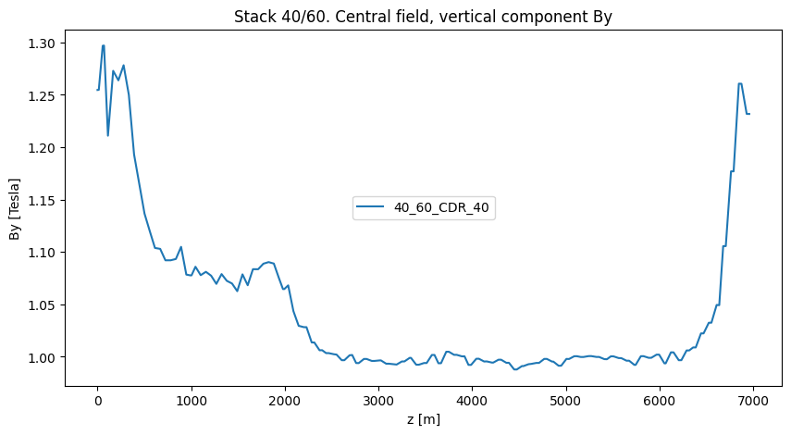
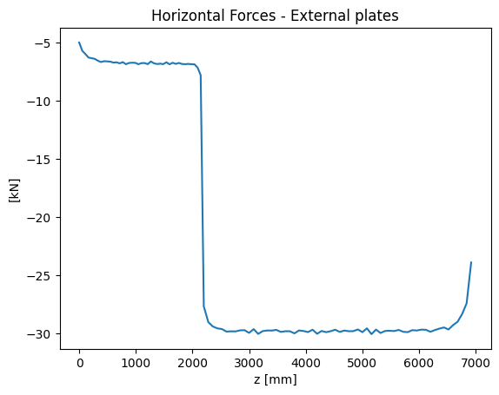
CDR 60/40

Slide 6
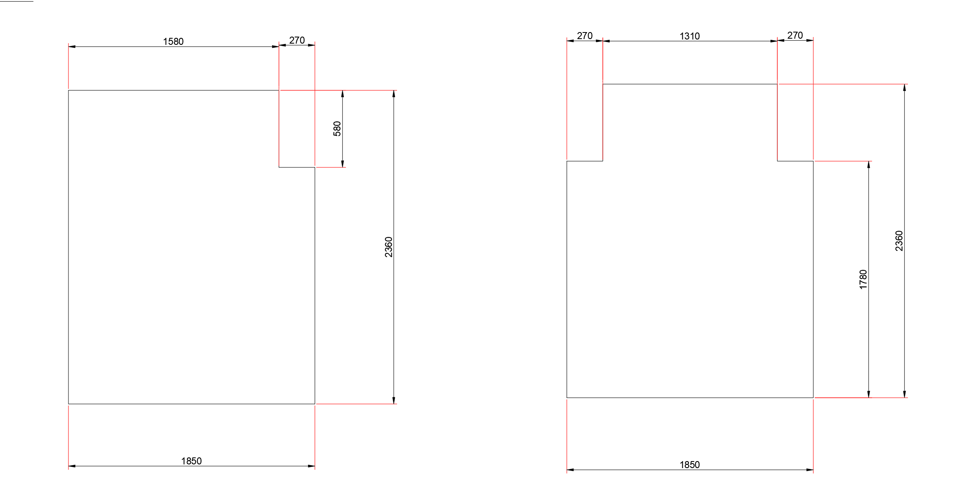
PDR, ¼ symmetry

Slide 7
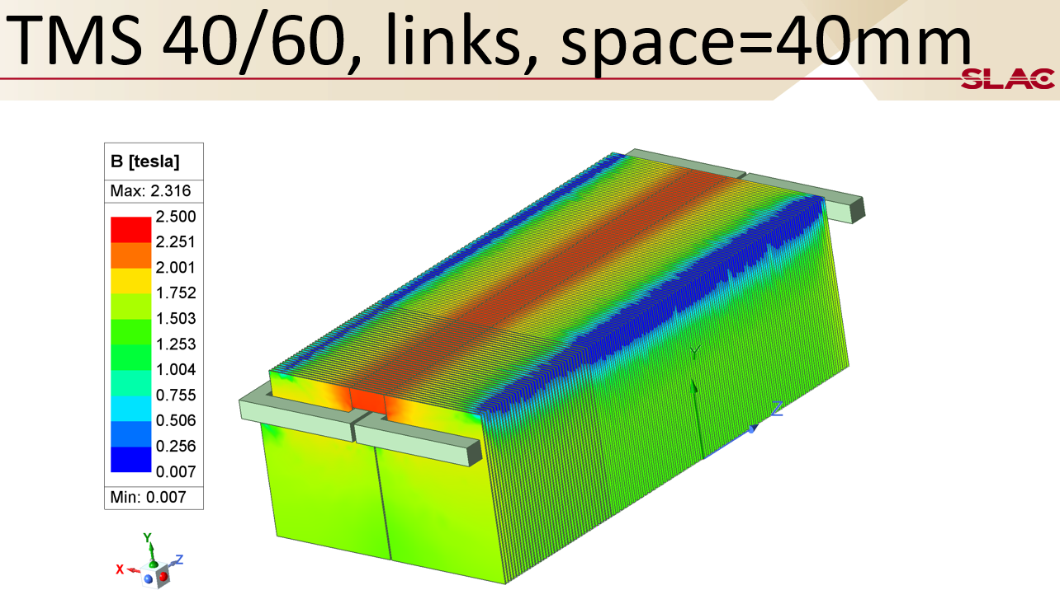
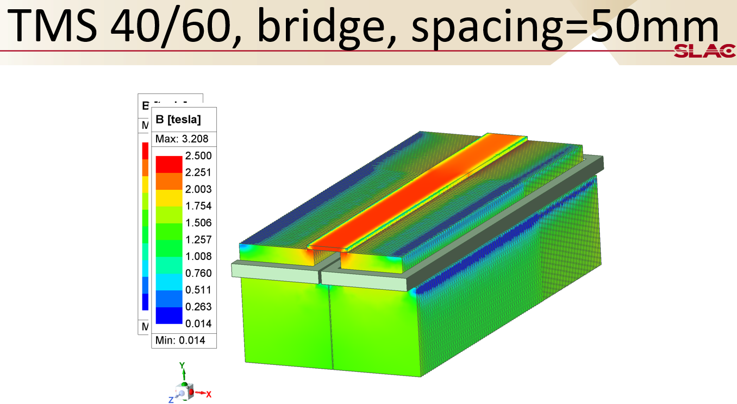
Stack 40/60 with bridge or links

Slide 8
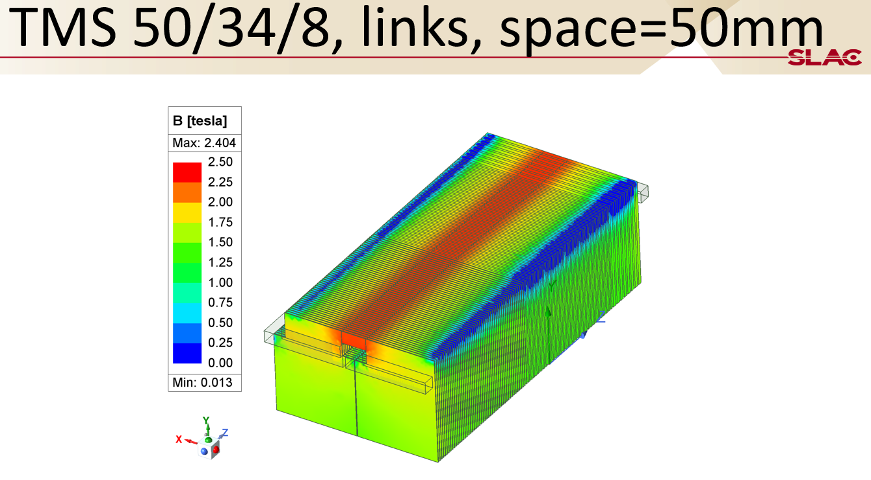
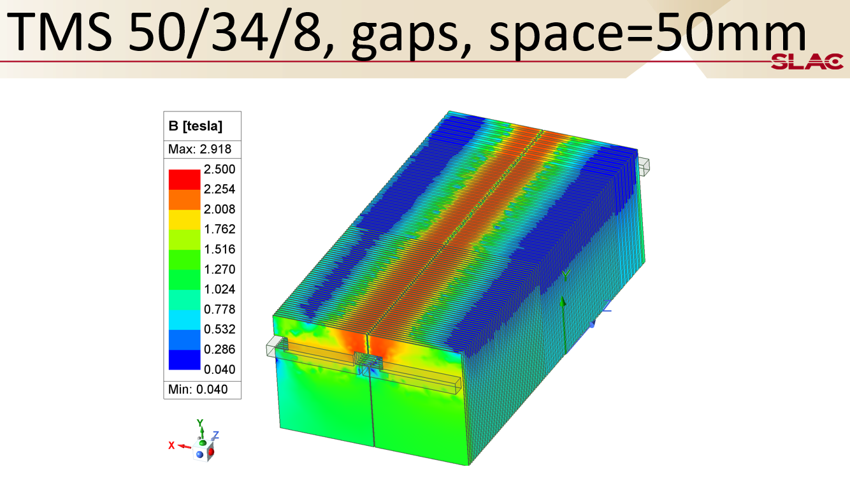
Stack 50/34/8 bridge or links

Slide 9
Stack 40/60 summary

Slide 10
Stack 50/34/8

Slide 11
All confogurations

Slide 12
Summary
One quarter, full stack-depth analysis
Rapid modeling powered by Python
Benchmark with CDR: difference < 15% on By and forces
The 50/34/8 stack with 30kA.turns has 20% margin over 1T
With the full depth of the stack in the simulation, the links show a more uniform field than the bridge

Slide 13
Spare Slides

Slide 14
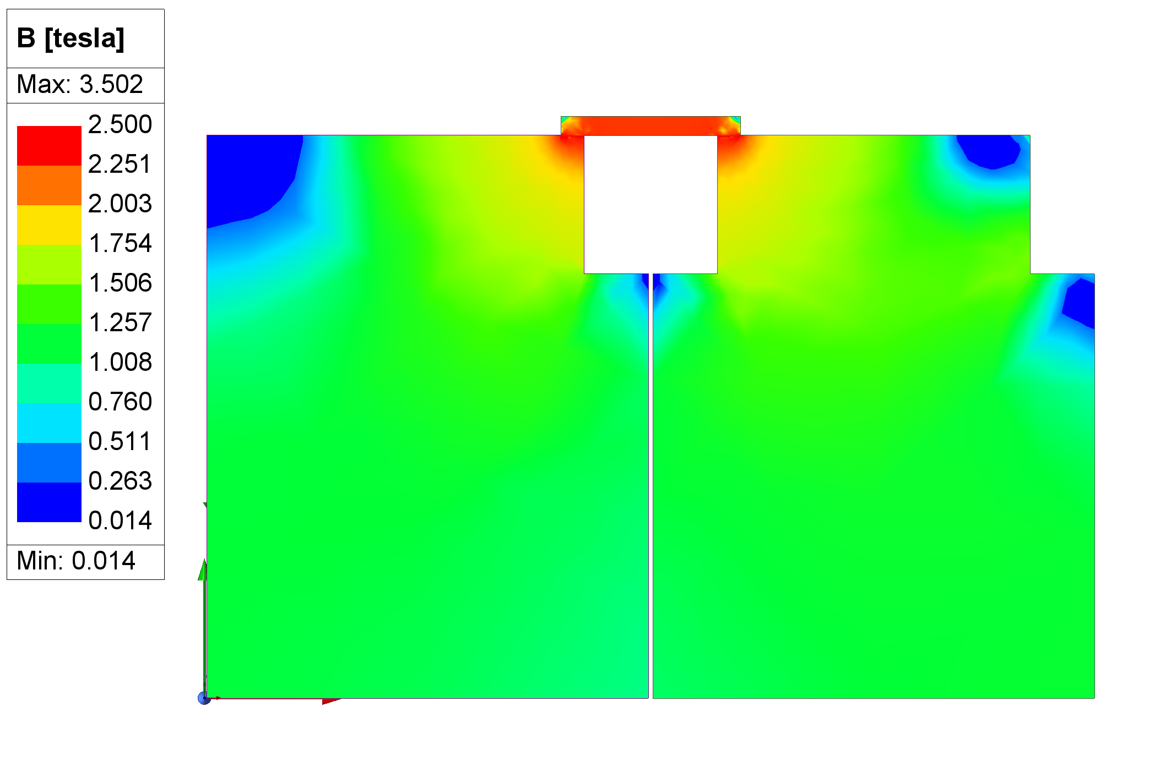
Compariosn 80mm plate

Slide 15
CDR 60/40

Slide 16
TMS 40/60, links, spacing=50mm

Slide 17
TMS 40/60, bridge, spacing=40mm

Slide 18
TMS 40/60, links, space=40mm

Slide 19
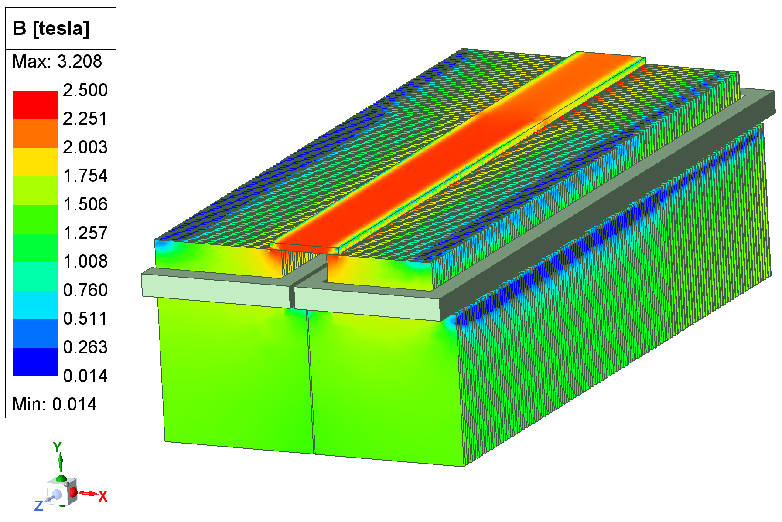
TMS 40/60, bridge, spacing=50mm

Slide 20
TMS 50/34/8, bridge, space=50mm

Slide 21
TMS 50/34/8, links, space=50mm

Slide 22
TMS 50/34/8, gaps, space=50mm

