Slide 2
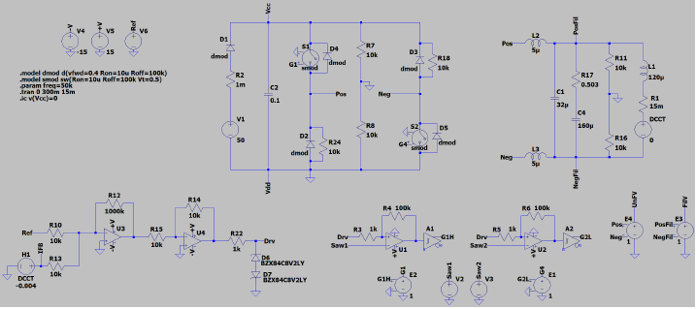
RF Bias power supply prototyping
The current bias supplies are based on thyristor technology.
Switchmode supplies offer improvements in efficiency at a lower cost.
Switchmode supplies are typically unipolar.
The addition of a 2-Quadrant H-Bridge power stage allows the voltage to be inverted.

Slide 3
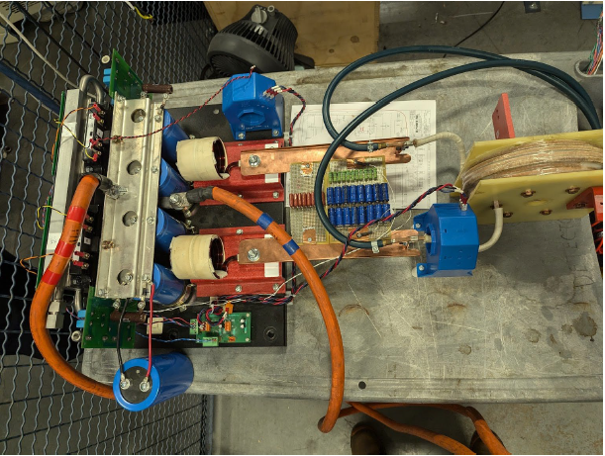
RF Bias power supply prototyping
Test stand at ORNL.
Made from spare parts for ORNL power supplies.
Current is limited to 500 A (need 2500 A).
H-Bridge
DCCT

Slide 4
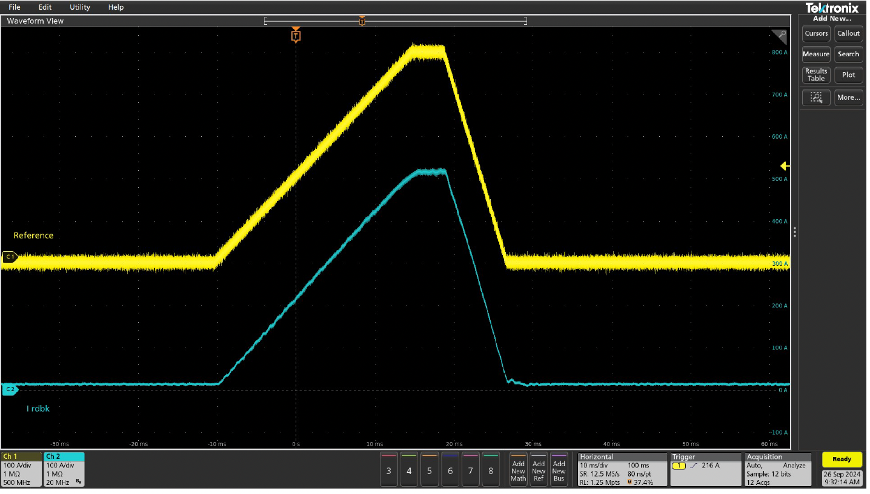
RF Bias power supply prototyping
Waveform shows a ramp
37 ms total time
Demonstrates that an H-bridge can be used with a switchmode supply to drive a ramp down.
Next steps:
Continue developing the prototype to ensure it meets all required operating parameters (ripple, regulation, ramp rate, repetition rate, etc.).
Build a higher power prototype.
Reference
DCCT

Slide 5
Thank you.
Questions?

