Slide 1
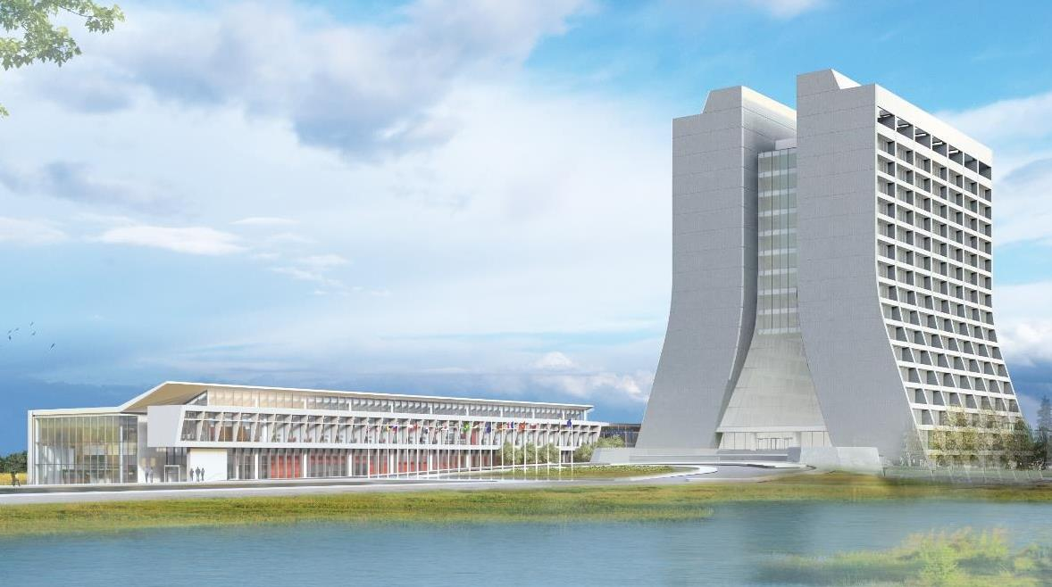
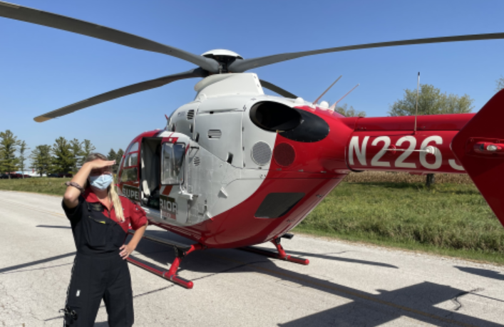
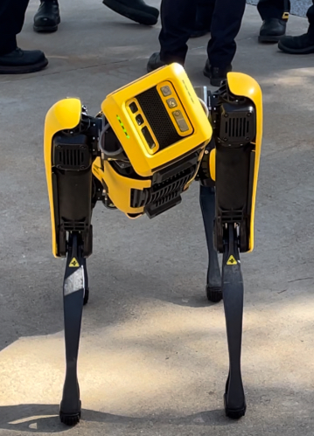
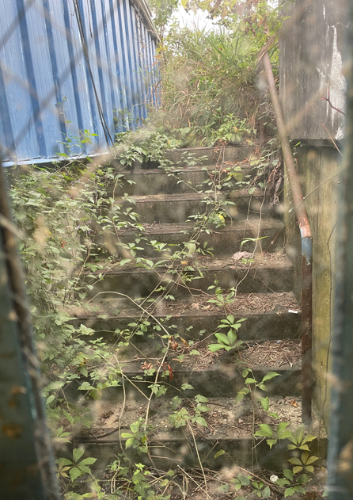
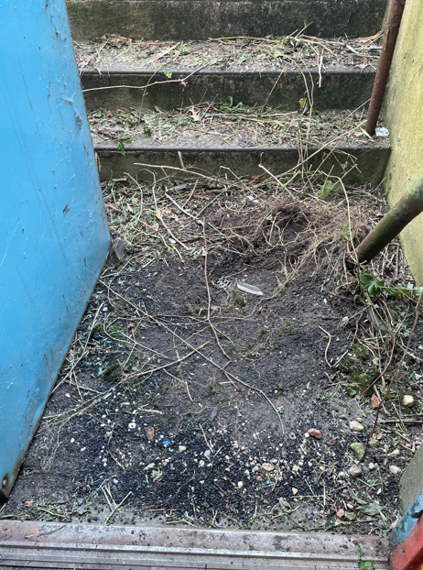
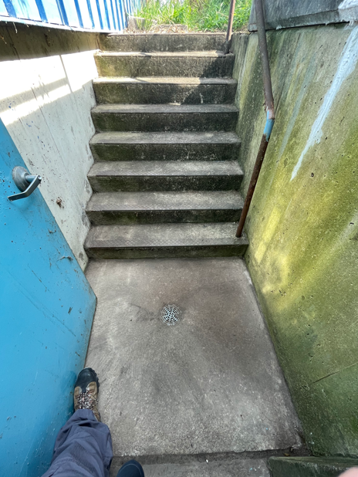
Infrastructure Services Division Updates
Pressing Issues / Special Topic:
NS3 – Roof is now watertight, a couple of weeks for the flashing to start. Next up is painting and installing new doors and frames.
Work Order information – picture, location, and concern
Noteworthy Items: Another water main break – thank you for the calls yesterday.
Mechanical and Utility Outages: Slide #4 – See slide
Active Projects and Contractors Onsite: Slide #5 & #6 – See slides
Safety Related: Access points - working to move through some entrances to clean up the access. Also Safety and Security has been working some great demos for staff to witness.

Slide 2
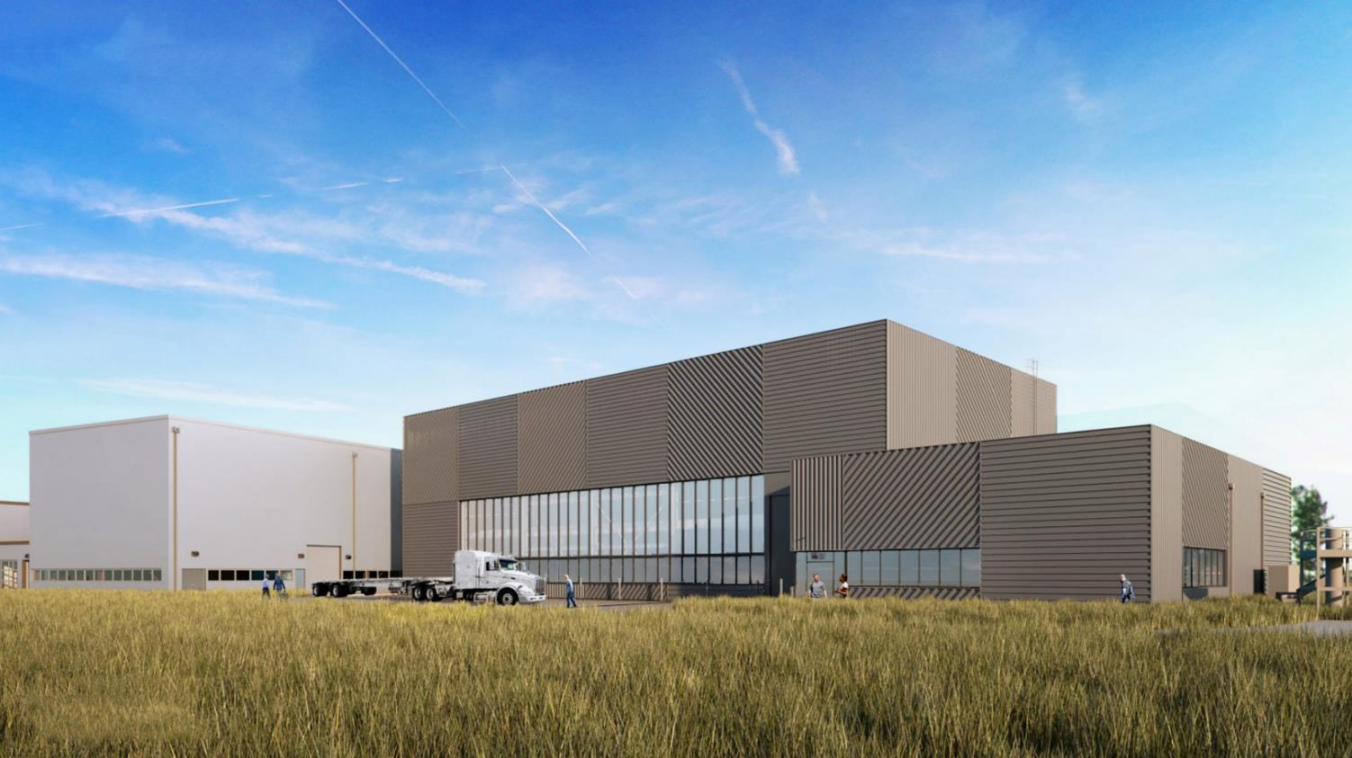
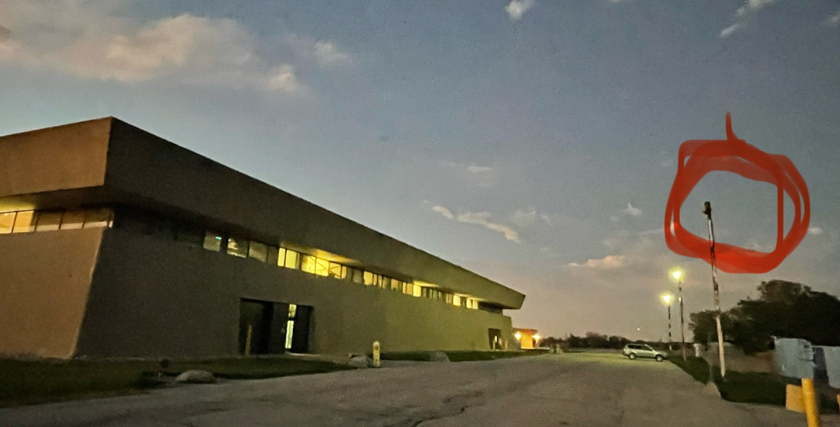
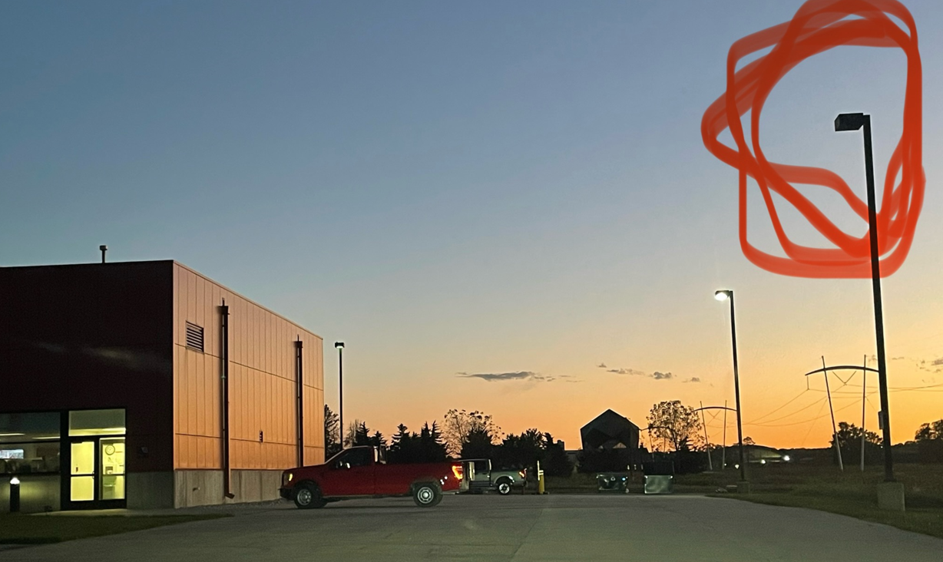
Special Topic:
NS3 roof - completed and doors and painting happening next.
Work Order Information
Task Code - if programmatic
Starting to perform night light checks as the days are getting shorter. Night shifters, if you see lights out, please share.

Slide 3
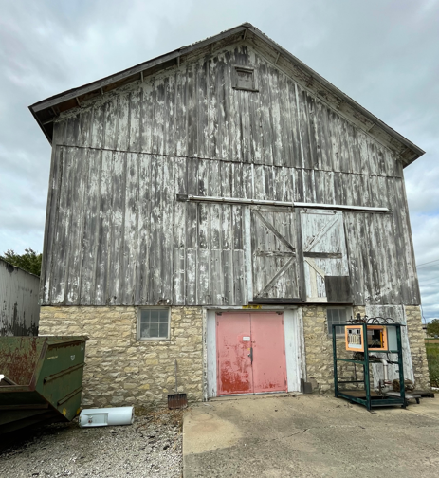
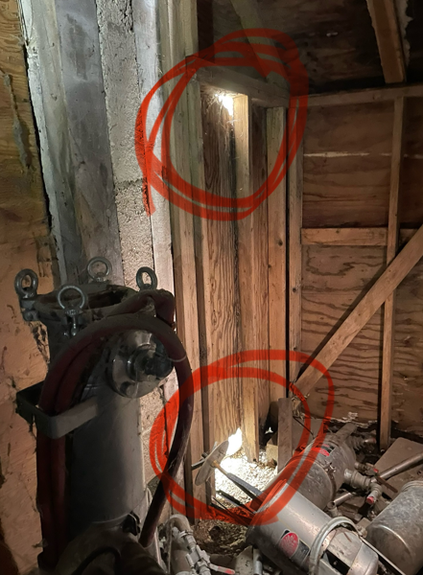
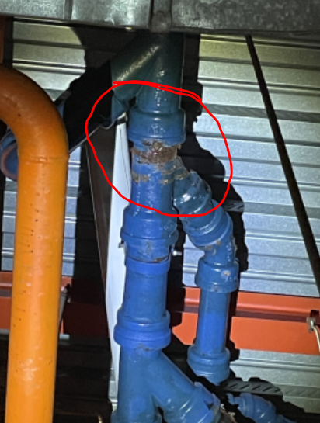
Noteworthy Items
NML – Bad Sanitary Line – Cast iron piping failure – Emergency Work
C-0 Floors – Abatement – The abatement – complete
Discovery Road – Painting project for the buildings on discovery road is in the planning phase. Req/SOW turned and being reviewed.
Old/Unused Equipment – Working on Roof Cleanups and MMR’s for stuff around the buildings. Planning with departments on getting items not needed off the roof. In Process and ongoing.
Service Agreement – Verifying AD/ISD equipment is moving along nicely at about 42% of roughly 8000-line items. In Progress ⬆ 12%
Thank you, Dan, for walking me through your process for inspections
Site 67 – is getting some love currently
New Roofs
HAB - almost complete - Super Close
Minos - is prepping (Emergency Roof on high bay in progress),
Village Gym/Fuel Station - are next up and just waiting on different phases of the projects to firm up dates.
Minos – Emergency Roof – In review process. In Progress
NS3 – Emergency Roof – In review process. Super close – only tin left

Slide 4
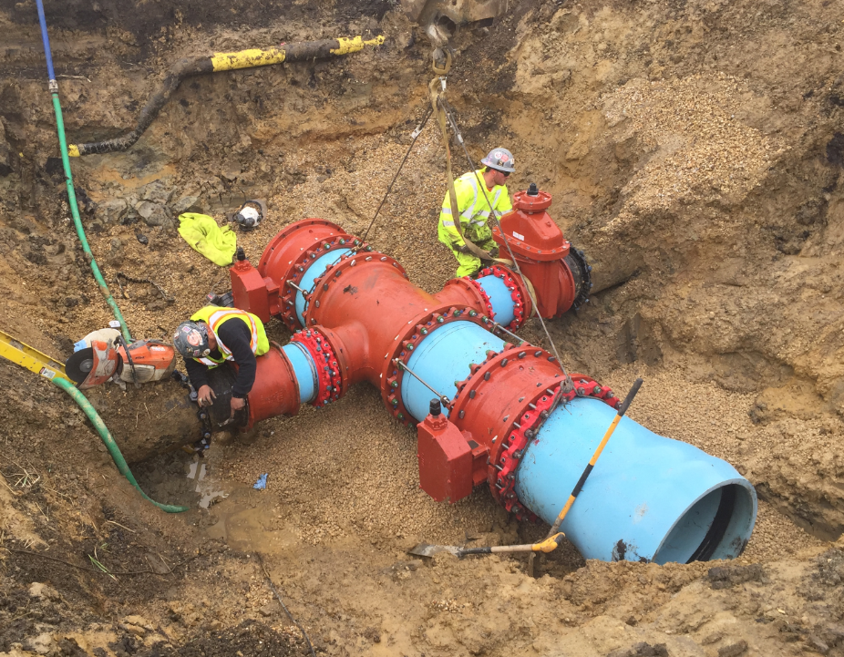
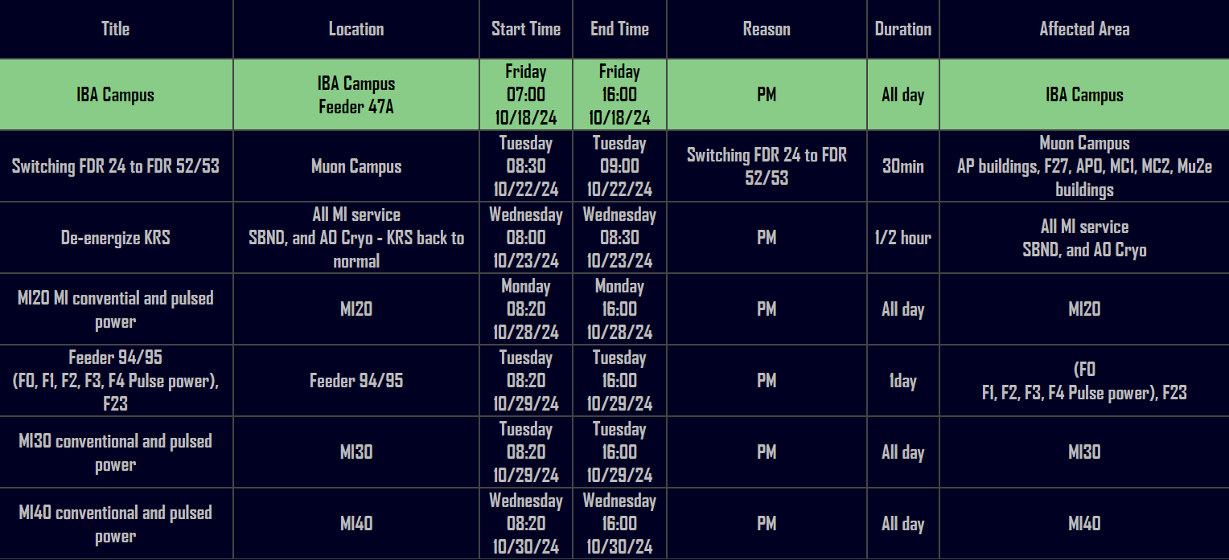
Planned Power Outages
Current Outage Schedule is populated.
Shutdowns are being scheduled for May/June.
Mechanical and Utility Outages

Slide 5
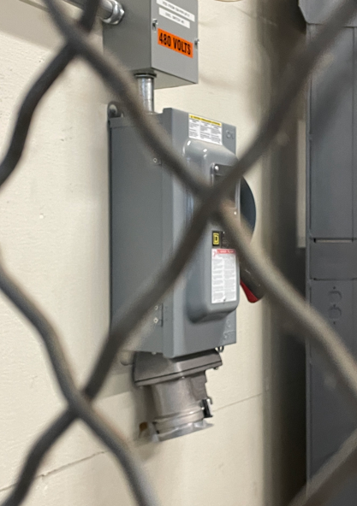
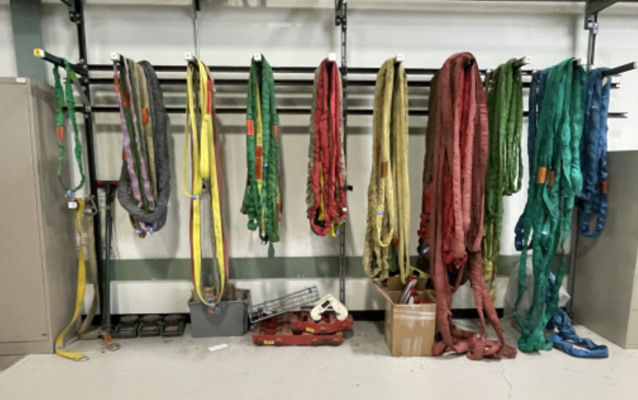
Active Projects still in motion and Contractors on Site
AD Projects:
EV Charging – Working on paths forward with welding connections and step-down transformer solution. In Process
Slings PMs – Thank you Dan for working through the AD process of PM handling. ✅
Door EOL Replacements – Requisition for 13 doors on the EOL list is in progress. Plus 4 others on a fast track working with Scott on locations like SWA, ME7, & AP0, MT Worm. No Change – Awaiting Approval
Office Refurbishing – TGC-113/SEA-212 Approved, XGE-106/TGC-109 Approved, XGC-129/XGW-114 Approved, XGE-124/TGS-125 Approved, WGW-106/XGW-108 Approved, XGW-107 Approved, Building Req’s now – no change
Wooden Stair Replacement – project starting to be looked at replacing as many as we can.
Exterior Ladder EOL replacements – Currently 24 ladders are targeted. SOW is being developed. Approved, will move forward.
AD Elevator/Dumbwaiter Maintenance – Larger Plan being developed
- SSB Dumbwaiter – Still being evaluated for a safety plan – terminology about
confined space concerns.

Slide 6
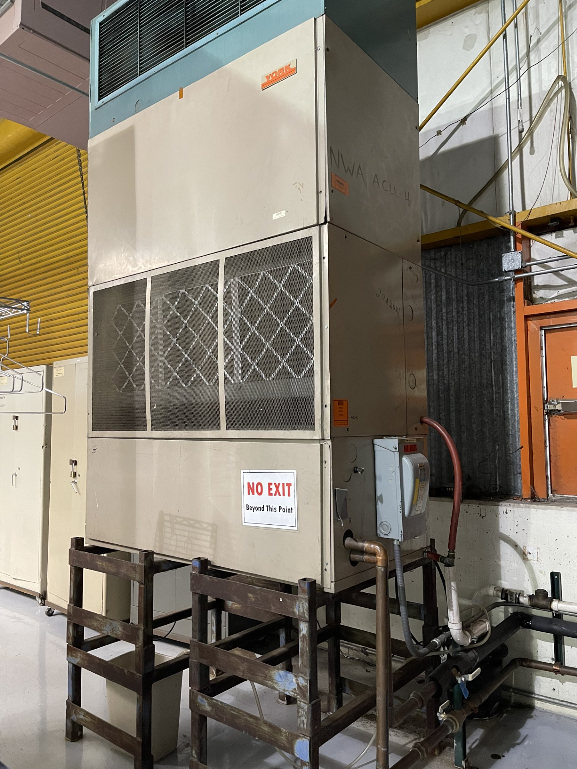
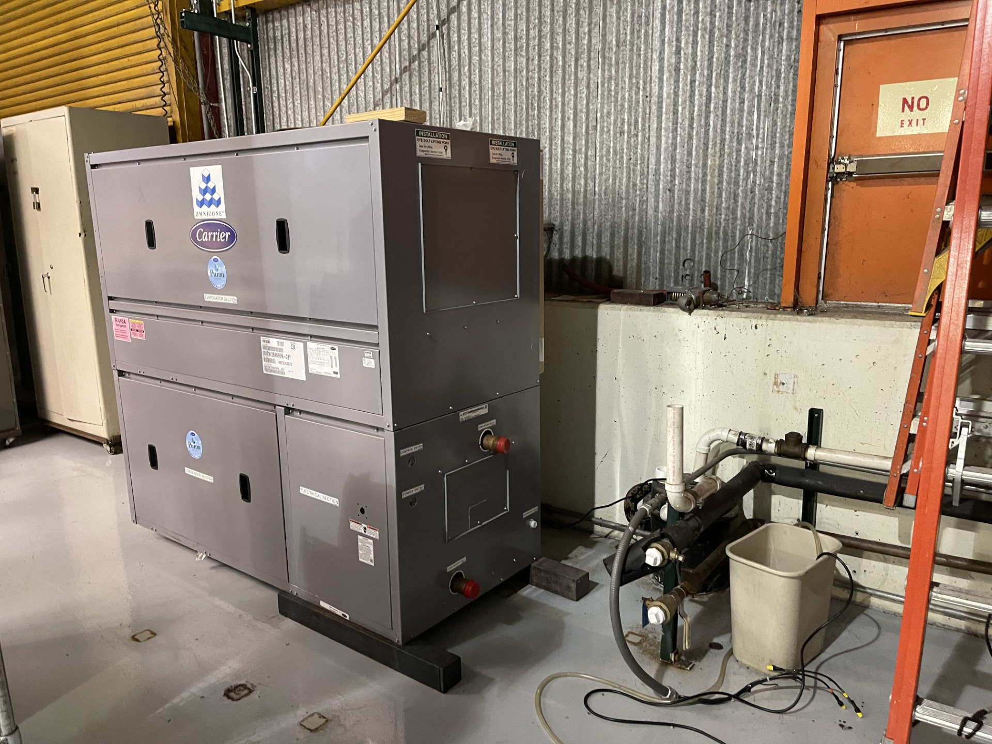
Active Projects still in motion and Contractors on Site
AD Projects:
NTF Safety Project – Area scanned and ready to schedule the rail install. Working with ECS on HA
Potential next Projects – A0 cleanroom sanitary line replacement (performed walkdown and waiting on quote), MI Building Concrete Coatings, C0 Service Building (in beginning phase). – No Change
Lighting Work/Upgrades – CMTF have been halted due to other lab priorities - Received new scheduling information from CMTF and working the FPCs to see if we can work into the schedule.
Foundation Leaks – MT6/MC2/Wilson Hall – In procurement.
Electrification Project – In Motion – walks have been happening with team from Engineering.
NWA & NS4 – Various work orders are being handled/planned/scheduled.
And More…

