Slide 1
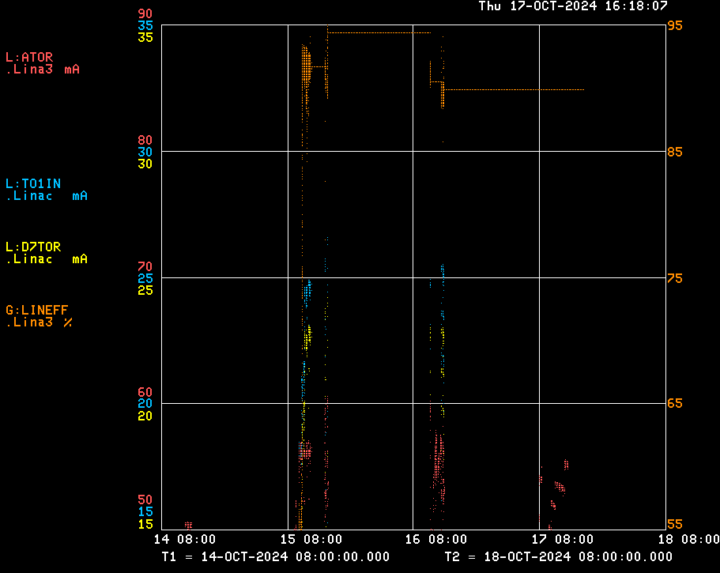
Linac/Preacc Operation (Oct 11 – Oct 17, 2024)
Notable Events:
Studies beam to Linac! D7TOR 22.7 mA, 92% efficiency
Various PLC issues after network storm Monday
Source A sparking issues all week → pulling & cleaning source
Wednesday Night LLRF issue @ LE Stations – cause unknown
Future Concerns:
LRF2 driver will need to be swapped before HEP
Watching LRF skid resistivities, but things are improving
KRF5 phase is still not regulating well
May swap to Source B, has its own issues

