Slide 1
Project Activities for MSD
Mayling Wong-Squires
AD Operations Friday 9am Meeting
13 September 2024

Slide 2
LBNF Primary Vacuum and Magnet Installation Kevin Duel, Ty Funk, Jason Morin, Kathrine Laureto, Scott Oplt, Will Derylo, Dan Vrbos
Magnet Installation
Preparing for installation plan preliminary peer review on Tuesday 10/22 (equipment, procedures, etc)
Installation procedures written for dipoles, quads, and correctors
Corrector magnet stand drawings updated for prototype procurement
Screw jacks for dipole prototype req submitted
NuMI quad magnet retrieval procedures drafted
~9 NuMI quads will be re-purposed for LBNF
Primary Beam Enclosure dipole stand design drawings in progress, engineering note updated and awaiting review
Primary Vacuum
Kicker ceramic beam tube TiN coating
Waiting for 12” long tube samples from vendor
Drawings and models for relocation of MI/RR components in progress
Updating magnet models and drawings with new beam tube design

Slide 3
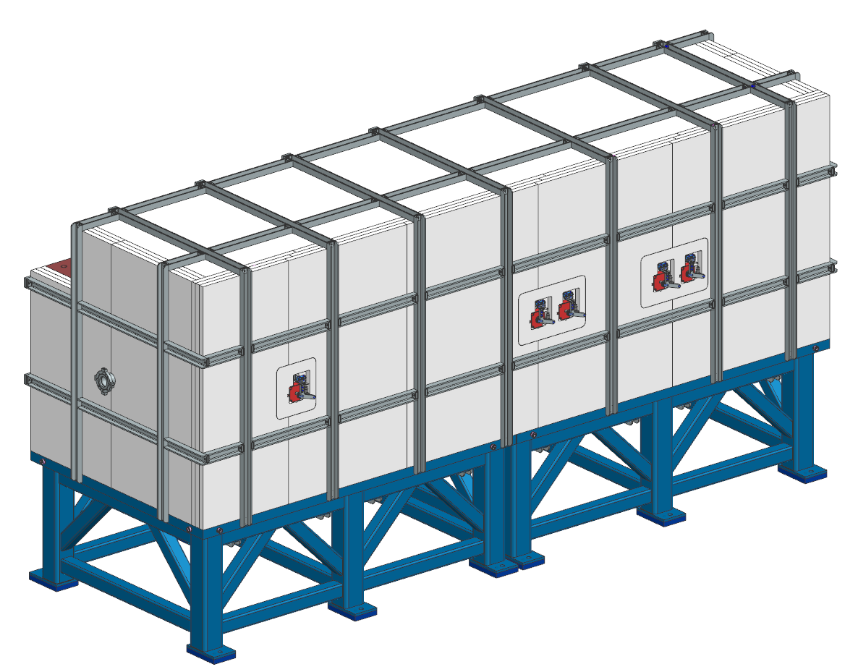
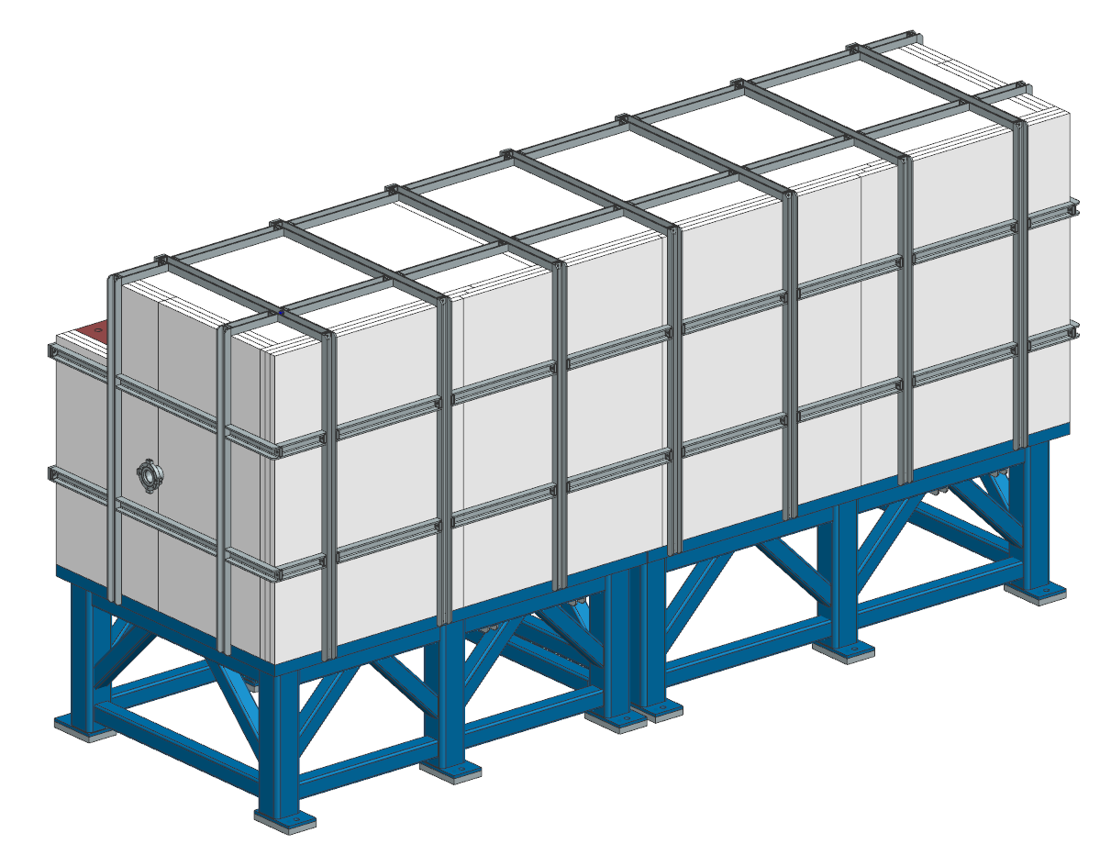
PIP-II BTL Collimators Bob Donahue
PRR deliverables are complete
Engineering note approved and released
All drawings released
Procurement packages identified
PRR deliverables in progress
Writing Statement of Work (SOW) for each procurement
Horizontal collimator
Vertical collimator

