Slide 1
Muon Campus Shutdown Report
Jim Morgan
Friday 09:00 Shutdown Meeting
October 18, 2024

Slide 2
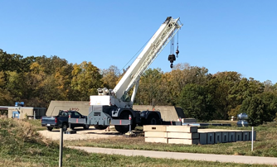
Muon Campus status
ESS2 has been high voltage conditioning at NWA
Beneficial spark on Sunday, good progress since then
Current draw improved dramatically after spark
D30 downstream mechanical work in progress
D40 blocks removed and Forklift lowered Thursday
Grinding with rad tech coverage today, welding on Monday
Forklift required for Q205 removal temporarily moved from MI-8
Another domestic water leak north of AP-0, will need berm topo after repairs
Muon Campus Feeder 24 power outage this morning
Rapid increase in upstream AP-30 and MI-8 sump activity on Wednesday
Muon LCW resistivity continues to be poor
Attempted to begin Kirk Key Disconnect repair, had difficulties
Existing mounting holes for cylinders not sized properly and inconsistent
Hope to begin replacement of some power supply circuit breakers soon
Prototype ESS2 will need to be removed from DR prior to running beam
Related to buyback accounting between Mu2e Project and AD spares funds
Still hope that operational ESS2 will be ready for installation late this month
AP-0 A/C work paused, blamed on badging issues
Study – M1-M3 Optics
Study – Alternative M5 optics

Slide 3
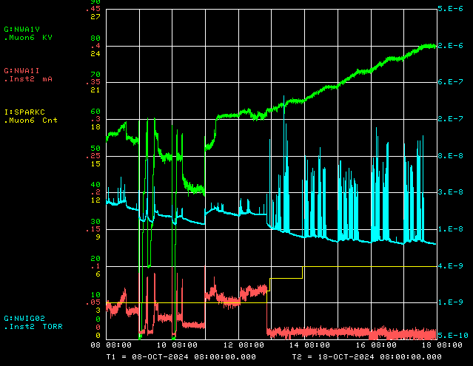
ESS2 conditioning at NWA
Operational Voltage
Voltage
Vacuum
Spark Detector
Current

Slide 4
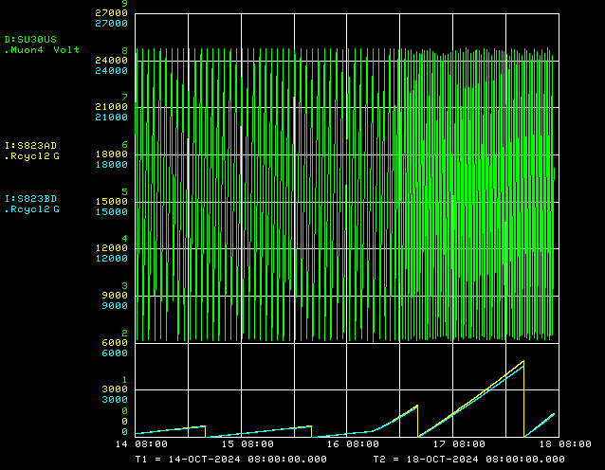
Upstream AP-30 and MI-8 sump activity

Slide 5
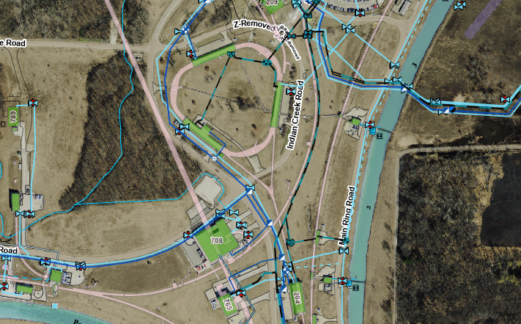
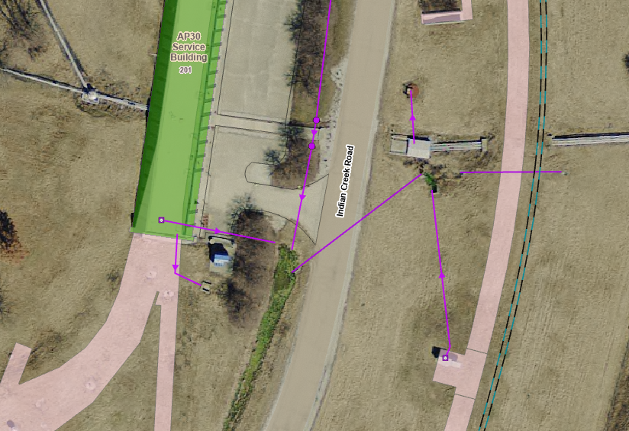
Location of upstream AP-30 and MI-8 sumps
Tunnel ceiling leak

Slide 6
Upcoming work
Main worklist items and other upcoming work
Repair Kirk Key hardware on disconnects, requires more modifications to disconnect
Replace several power supply circuit breakers and some primary wiring
Install rad hard 8Q24 at Q205, send uninstalled 8Q24 to TD for rad hard water lines
Q205 vacuum pipe replacement to simplify vacuum connection to ELAM
Profilometer extraction profile monitor vacuum Tee installed upstream of ELAM
Unroll ELAM? (was rolled 24 mr to improve g-2 extraction trajectory)
Install additional steel shielding above ECMAG
Several alignment tasks including replacement Q205 and M4 WCM
Repair of domestic water line breaks near AP-0 may have disturbed Transport berm
Prepare to install Mu2e Extinction Monitor Collimator in Absorber area
M4 Final Focus vacuum installation, A/C dipole installation
ESS1 and ESS2 septum stand motion-control improvements
Hope to finish operational ESS2 and install it in tunnel prior to turn-on
Second Muon Campus Feeder 24 outage planned for Tuesday
ESS2 (operational version)
Continue high voltage conditioning at NWA
Deliver to tunnel in late October or early November?
AP-0 A/C work paused again (18 months since start)

