Slide 1
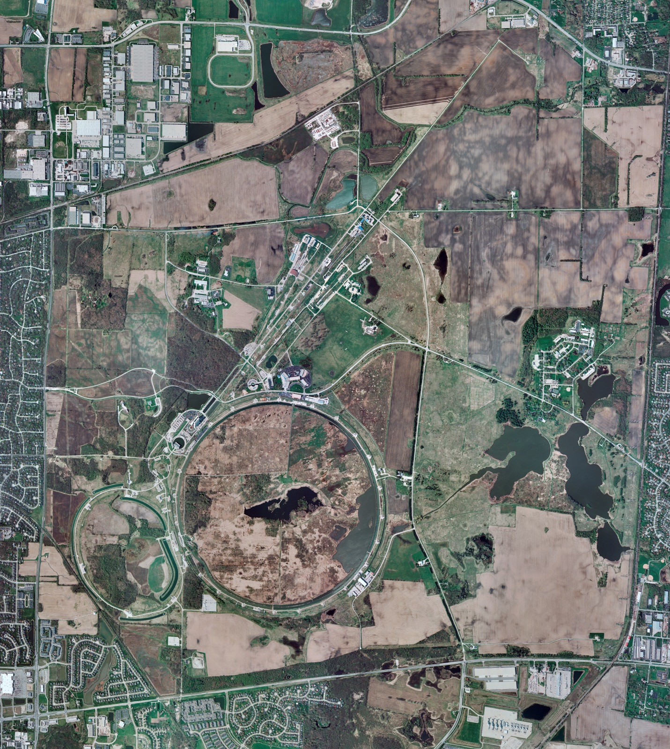
Helium Cryogenics
Status 10/18/2024 J.Makara
CMTF: SCP cold and running fine
CMTS: HECM26 installation work in progress
PIP2IT: South Stand CM being modified for SSR2 pCM
North Stand CM empty
MCTF: cryo system cold w/ 3 comprs and 2 Fridges running fine
MDB/HTS: at RT
MDB/STC: at RT for SSR2 cavity swap
MDB Magnet: at RT
NML/FAST: Cryo system is shut down and isolated for extended shutdown period;
CC1: at RT
CC2: at RT
CM: at RT
IB1: cryo system shut down and warmed up for planned 8-hr power outage and subsequent multi-week maintenance period
Muon Campus: at RT with comprs off and system depressurized; LN2 system at RT; g-2 Expt Hall at ODH=0 (not ODH area)
Misc: …

