Slide 1
302.4.01 Magnets Vertical Test at BNL Weekly Status
Febin Kurian
21-Oct-2024

Slide 2
MQXFA18-Quench Summary so far
Spontaneous quench test program at 1.9K; Ramp to 16530 A
(Q1= Coil 160, Q2=Coil 246, Q3=Coil 243, Q4= Coil 154)

Slide 3
MQXFA13b-Quench Location so far

Slide 4
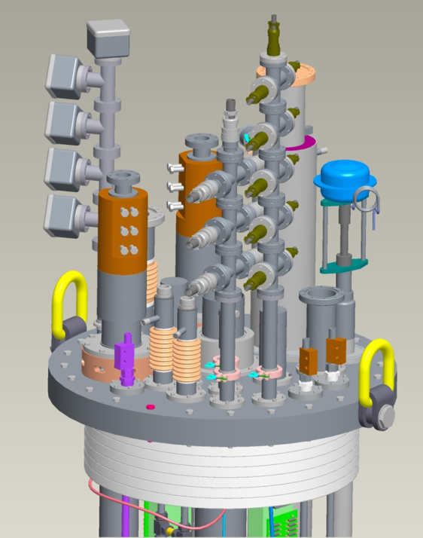
Second Top Hat Repair
Target Voltages
V taps– 1940 V
Heaters– 2300V
Status as of June’24
Heaters
HTR1-- Failed @1.31kV
HTR2-- Failed @1.69kV
HTR3-- Failed @1.74kV
HTR4-- Failed @1.67kV
Voltage taps
VT1-- passed
VT2-- passed
VT3-- Failed @ 1.72kV
VT4-- Failed @ 1.93kV
VT5-- Failed @ 1.31kV
VT6-- passed

Slide 5
CRYOGENIC STATUS
Some challenges after a planned power shut-down in the building,
But Cryo-systems are all back online.
AUP test is expected to go unimpacted.
CTI 4000 system status
Running
Linde 1610 system status
Running
Installation of new liquefiers
Progressing

