Slide 1
Muon Campus Shutdown Report
Jim Morgan
Friday 09:00 Shutdown Meeting
October 25, 2024

Slide 2
Muon Campus status
ESS2 has been high voltage conditioning at NWA
Reached target voltage of 90 kV on Thursday
Finishing with several days at operational voltage of 86 kV
D30 downstream mechanical work in progress
Short delay due to problem with parts for special Q205 vacuum pipe
Old Q205 has been removed, new rad hard Q205 being readied for installation
Need to return forklift to MI-8 Line for Collimator work
Muon Campus Feeder 24 power outage Tuesday morning
Increased upstream AP-30 and MI-8 sump activity continued
Another domestic water leak north of AP-0, will need berm topo after repairs
Muon LCW resistivity continues to be poor
Attempted to begin Kirk Key Disconnect repair, had difficulties
Existing mounting holes for cylinders not sized properly and inconsistent
Replacement of some power supply circuit breakers awaiting electricians
Prototype ESS2 will need to be removed from DR prior to running beam
Related to buyback accounting between Mu2e Project and AD spares funds
Operational ESS2 expected to be ready for transport to tunnel next week
AP-0 A/C work paused, blamed on badging issues
Study – M1-M3 Optics
Study – Alternative M5 optics

Slide 3
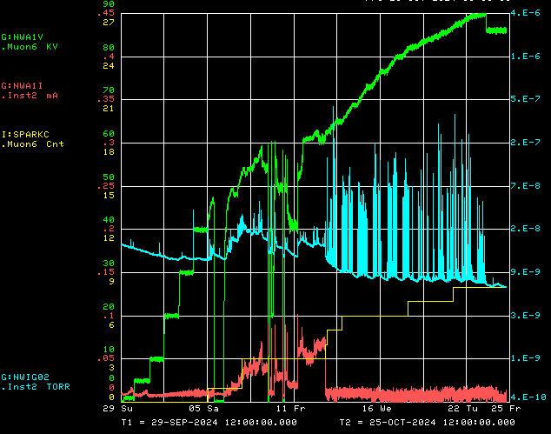
ESS2 conditioning at NWA
Operational Voltage
Voltage
Vacuum
Spark Detector
Current

Slide 4
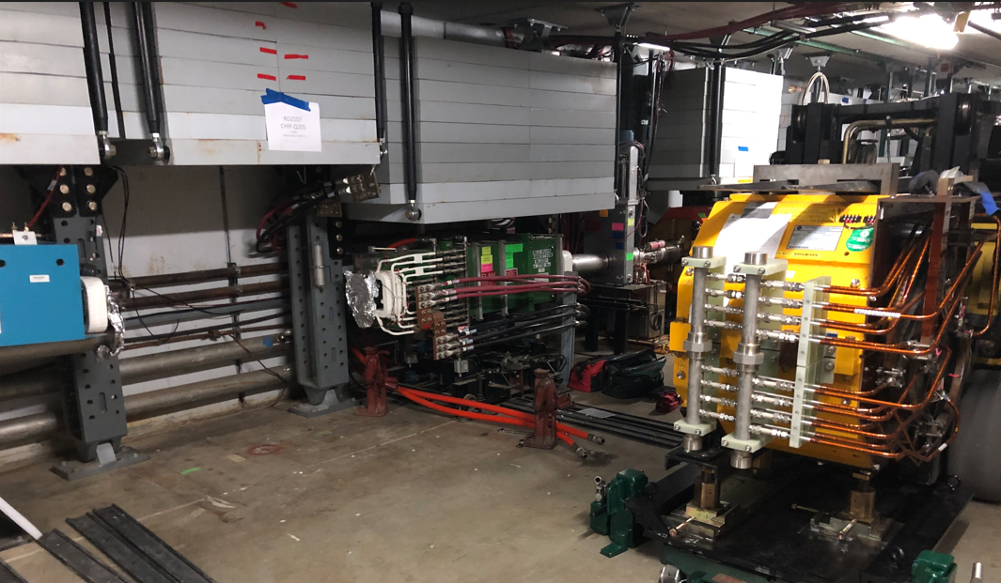
Q205 rad hard quad swap

Slide 5
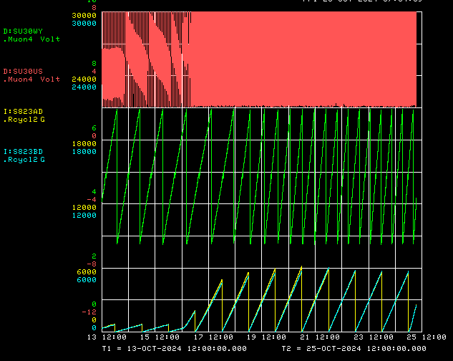
Upstream AP-30 and MI-8 sump activity
AP-30 upstream sump
Transport “Y” sump
MI-8 828 “A” sump
MI-8 828 “B” sump

Slide 6
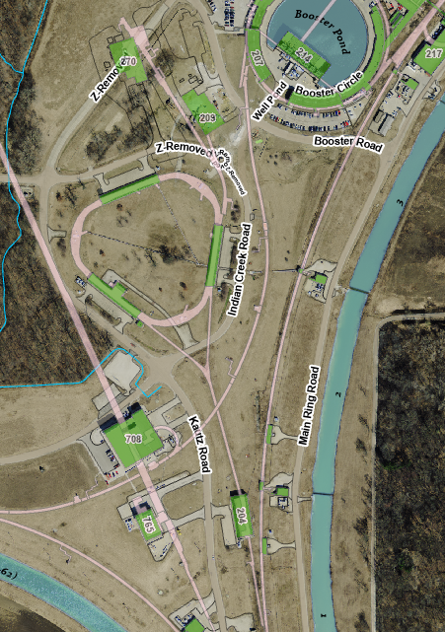
Location of Muon Campus sump pumps
Currently has level monitor
Currently does not have monitor
MI-8 sumps
MI-8 823 sump

Slide 7
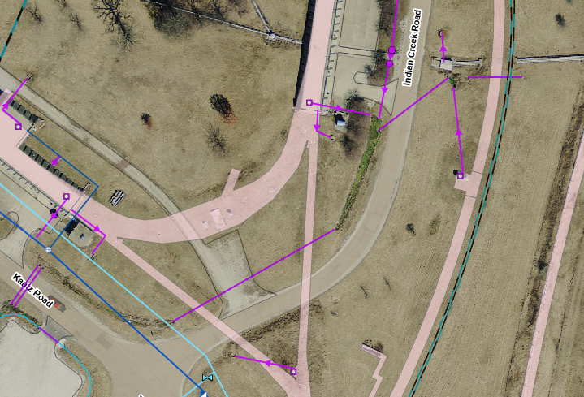
Location of upstream AP-30 and MI-8 sumps
Old “Reverse
Injection
Line” sump
Upstream AP-30 sump
discharge to header
In tunnel
Sump discharge
MI-8 823 sump
Minimal flow
from ditch
Transport “Y” sump

Slide 8
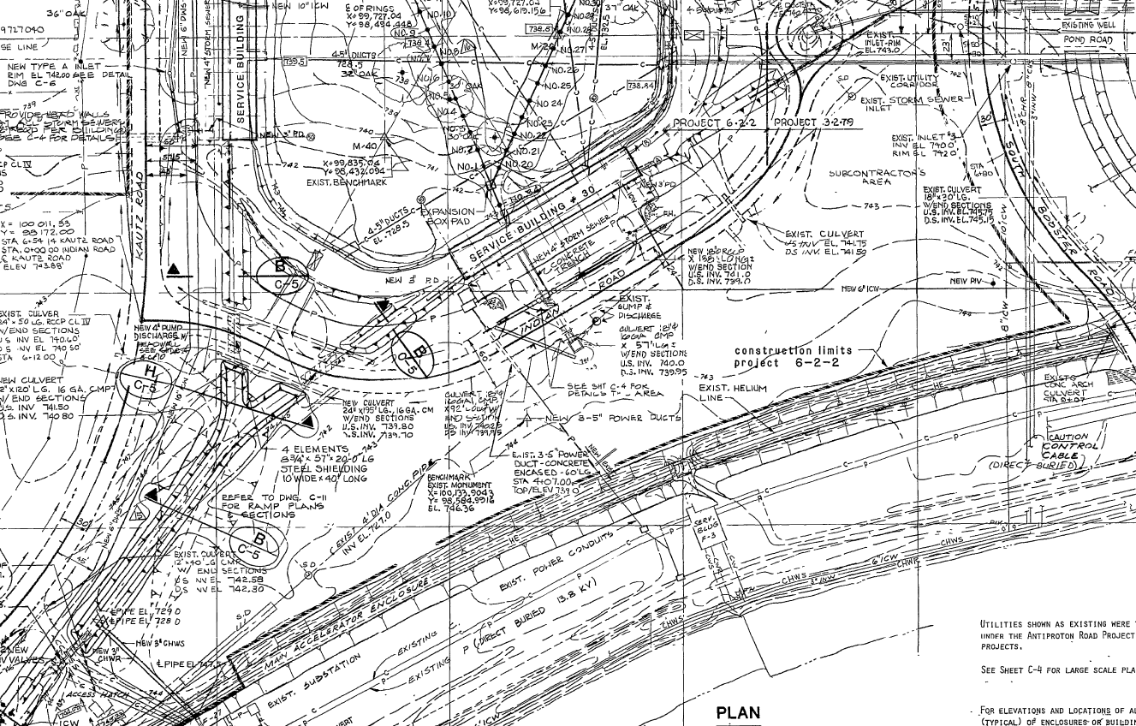
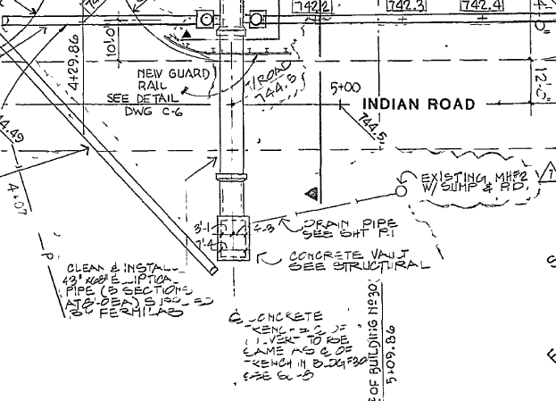
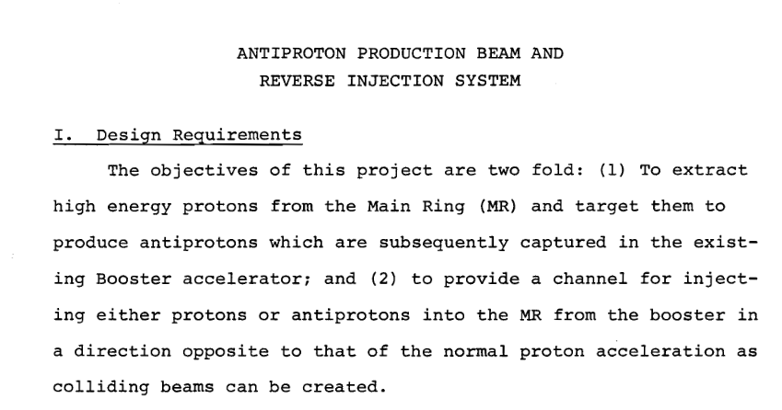
Reverse Injection Line that predated Antiproton Source

Slide 9
Upcoming work
Installation of ESS2 (operational version) and rad hard Q205
High voltage conditioning at NWA scheduled to end Monday
Prototype ESS2 will be uninstalled in D30 and prepared for transport to A0
Delivery of Operational ESS2 from NWA to tunnel scheduled for next Wednesday
Install rad hard 8Q24 at Q205, send uninstalled 8Q24 to TD for rad hard upgrade
Q205 vacuum pipe replacement to simplify vacuum connection to ELAM
Profilometer extraction profile monitor vacuum Tee installed upstream of ELAM
Unroll ELAM? (was rolled 24 mr to improve g-2 extraction trajectory)
Other upcoming work
Install additional steel shielding above ECMAG
Several alignment tasks including replacement Q205 and M4 WCM
Repair of domestic water line breaks near AP-0 may have disturbed Transport berm
ESS1 and ESS2 septum stand motion-control improvements
Repair Kirk Key hardware on disconnects, requires more modifications to disconnect
Replace several power supply circuit breakers and some primary wiring
Prepare to install Mu2e Extinction Monitor Collimator in Absorber area
M4 Final Focus vacuum installation, A/C dipole installation
More Muon Campus Feeder 24 outages planned over the next two months
AP-0 A/C work paused again (18 months since start)

