Slide 1
In the Hall at Mu2e
(The loading dock is 25% full)
Tom Diehl (FNAL), Greg Rakness (FNAL) and various others
Friday 9am AD meeting
25-Oct-2024
https://indico.fnal.gov/event/66658/

Slide 2
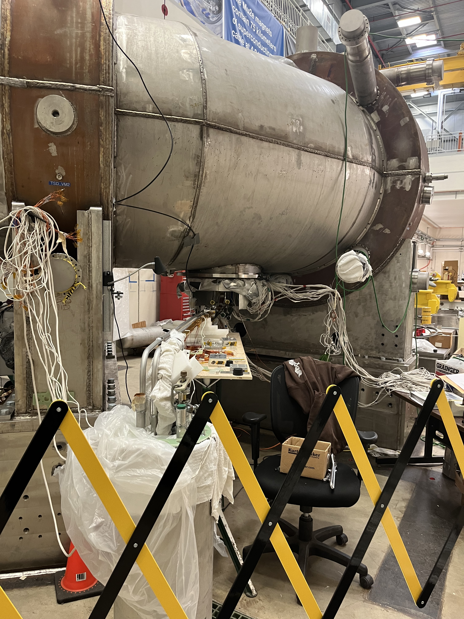
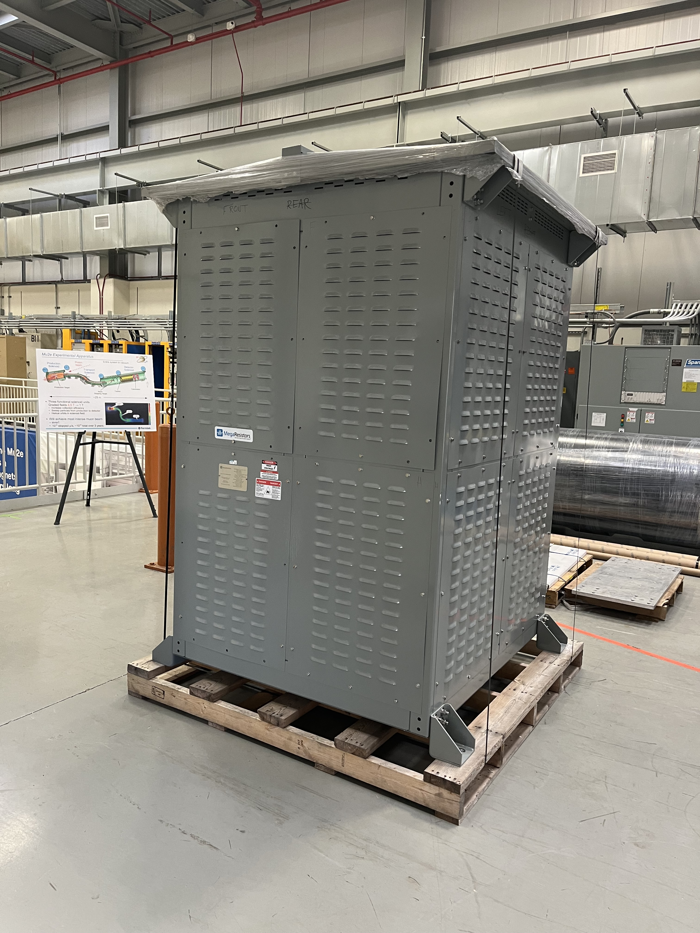
Some of the ongoing work at Mu2e
Connecting the TSu and TSd superconducting wire and vacuum lines is in process
Leak-testing vacuum from Power Supply Room all the way down…
Changing out of a couple thousand washer sets in dump resistors is in process

Slide 3
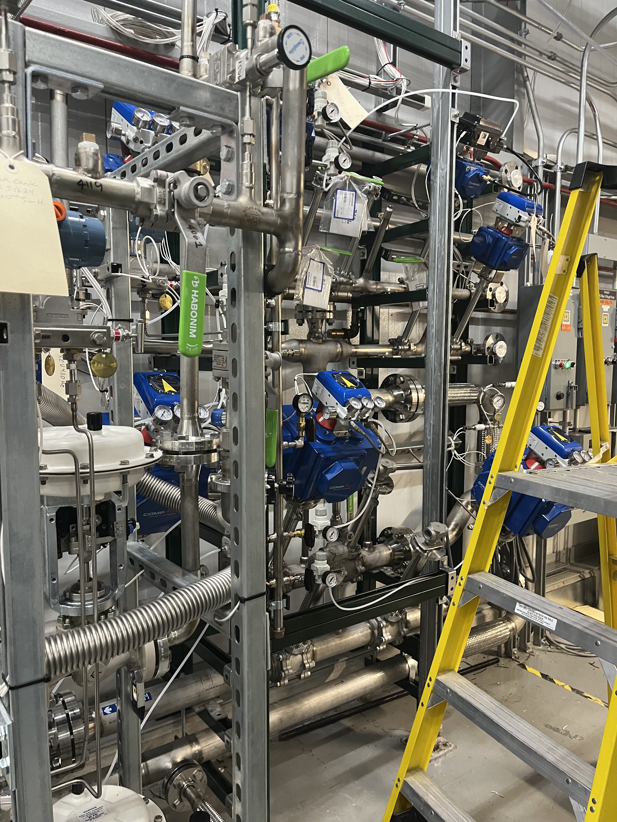
Some of the ongoing work at Mu2e
Power Supply Room west wall: vacuum system artwork is becoming ever more abstract

Slide 4
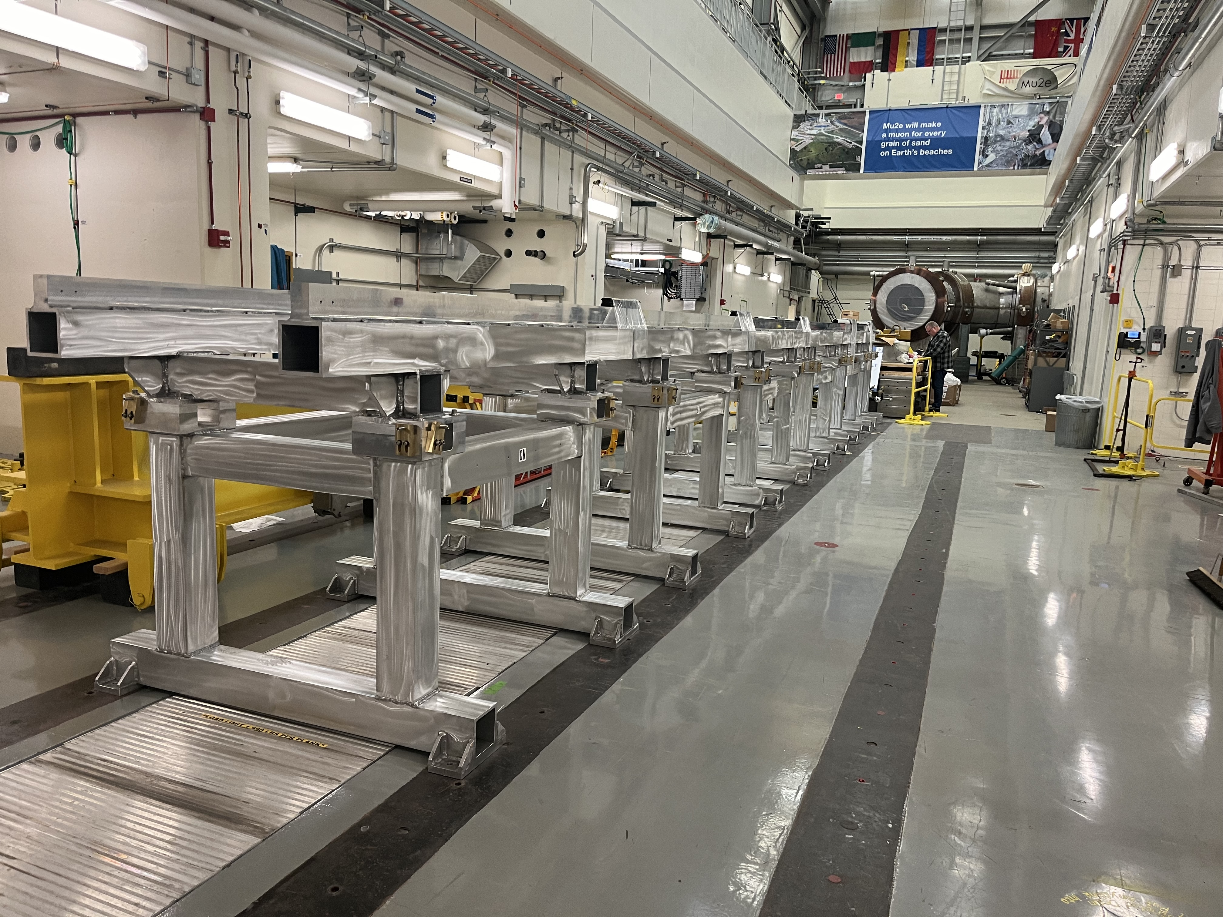
Detector Stands Installation & Plan
External stands are being put into place
Detector Train sits on external stands when it is not in the Detector Solenoid
(Detector Train = Stopping Target + Tracker + Calorimeter + Muon Beam Stop)

Slide 5
Detector Stands Installation & Plan
Install detector stands to roughly the correct position
Final position will be known when Detector Solenoid arrives, since external stands must mate with internal stands
Attach and protect the rails for the linear bearings.
When Instrument Feedthrough Bulkhead arrives, move IFB downstairs and downstream of stands
First object onto the stands will be the muon beam stop.

Slide 6
Other work
Power outages okay on Friday and on Tuesday
Thanks to ISD / JP Pollock for following up at MC1, where there was a smell of burning in the lobby just after the power outage this morning (8:30-8:45).
The suspicion is the heater turned on and was burning off dust. As of 10:00, the smell had dissipated, ISD had checked everywhere and all is okay.
Two more power outage planned that affect MC1 & MC2 (Feeder 46A) – coordinating with Justin Block

