Slide 1


FBK IV analysis* @ Ferrara
*tested by FBK
M. Andreotti, R. Calabrese, D. Casazza, A. Cotta Ramusino, S. Chiozzi, R. D’amico, M. Fiorini, T. Giammaria, M. Guarise, E. Luppi, I. Neri, L. Pierini, L. Tomassetti, in collaboration with the Bologna group
DUNE photo-sensor meeting
22/10/2024

Slide 2

Content
General info
Differences with CACTUS typical data
Results
Changes in the algorithm
Additional results

Slide 3
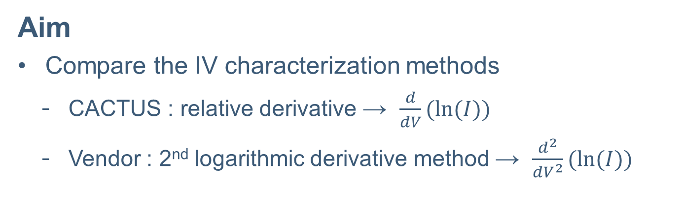
General info
Samples
100 SiPM strips
FBK model (HD pre-production)
Aim
Compare the IV characterization methods
  CACTUS : relative derivative → $\frac{d}{dV}(ln⁡(I))$
  Vendor : 2nd logarithmic derivative method → $\frac{d^{2}}{{dV}^{2}}(ln⁡(I))$

Slide 4
Differences with our typical data
Disclaimer: The CACTUS analysis algorithm is somehow optimized for HPK strips, due to a higher population of measurements
Differences with CACTUS standard measurements
Higher V_{step} : 50 mV vs [10 – 20] mV
Lower noise : probably due to different instrumentation

Slide 5
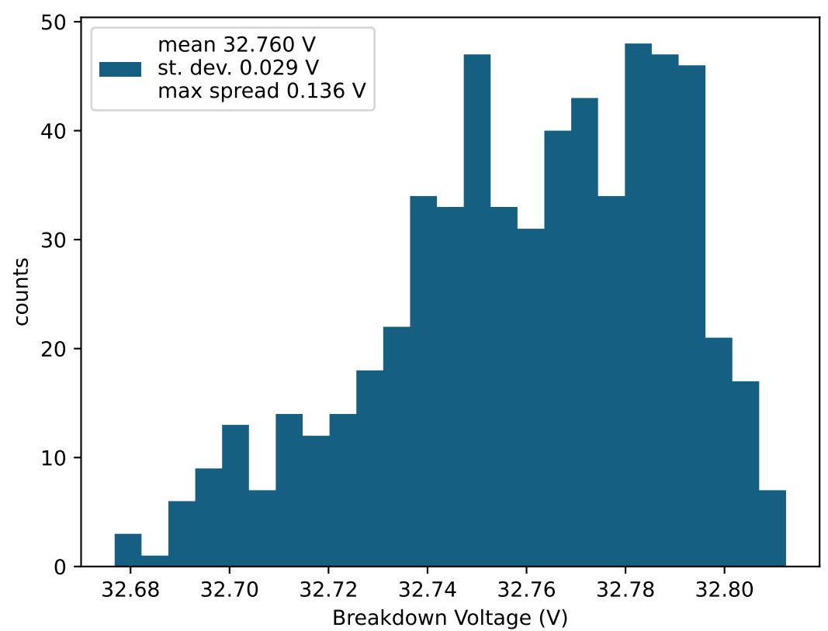
Results – V_{BD} distribution

Slide 6
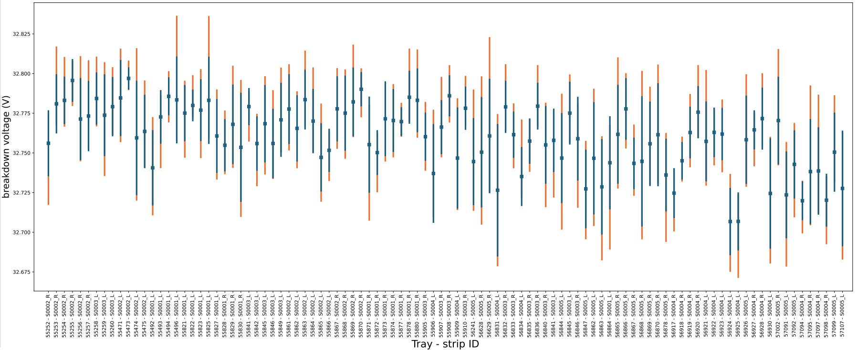
Results – mean V_{BD} per strip

Slide 7
Differences with our typical data
Disclaimer: The CACTUS analysis algorithm is somehow optimized for HPK strips, due to a higher population of measurements
Differences with CACTUS standard measurements
Higher V_{step} : 50 mV vs [10 – 20] mV
Lower noise : probably due to different instrumentation

Slide 8
Differences with our typical data
Disclaimer: The CACTUS analysis algorithm is somehow optimized for HPK strips, due to a higher population of measurements
Differences with CACTUS standard measurements
Higher V_{step} : 50 mV vs [10 – 20] mV
Lower noise : probably due to different instrumentation
The range of the parabolic fit is not optimized

Slide 9
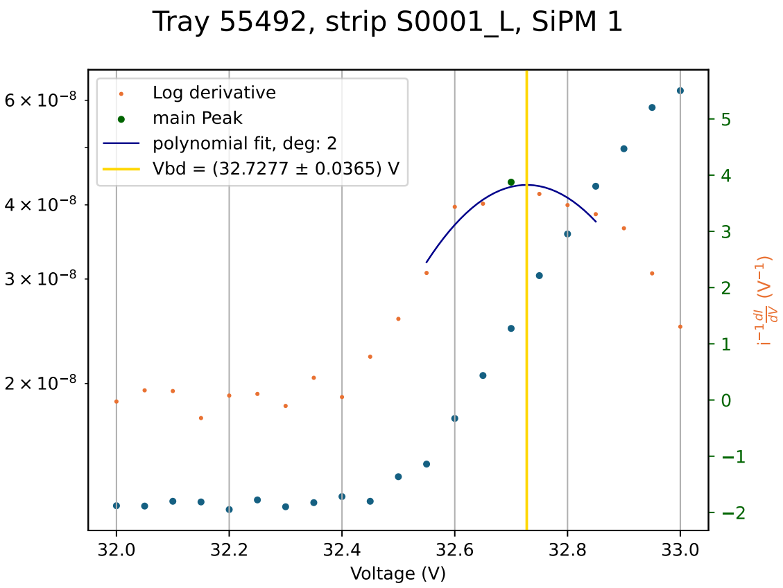
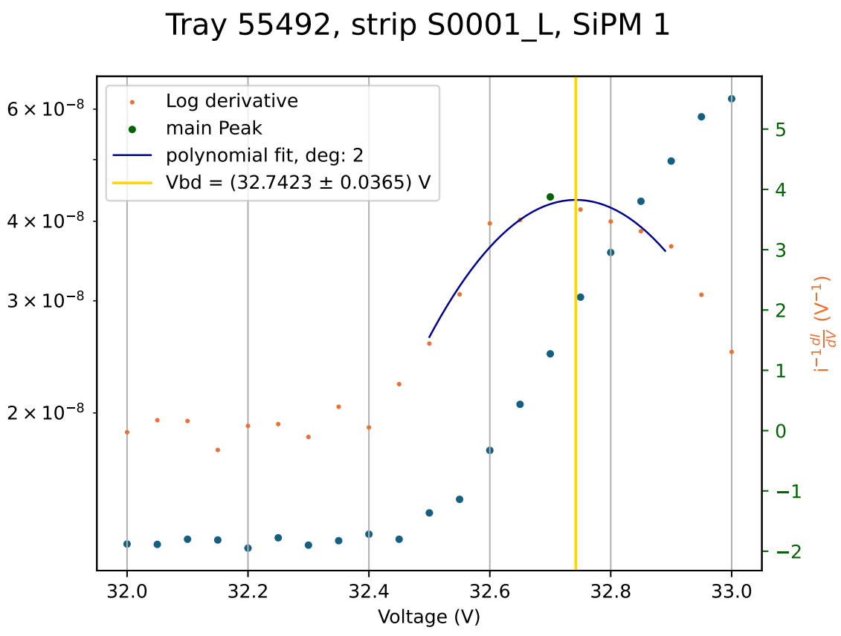
Changes in the algorithm
Raise N_{FIT}* (5 → 8) in favor of V_{BD} spread
N_{FIT} = 5
N_{FIT} = 8
Current (A)
Current (A)
*Minimum number of points for the parabolic fit around the first guess of V_{BD}

Slide 10
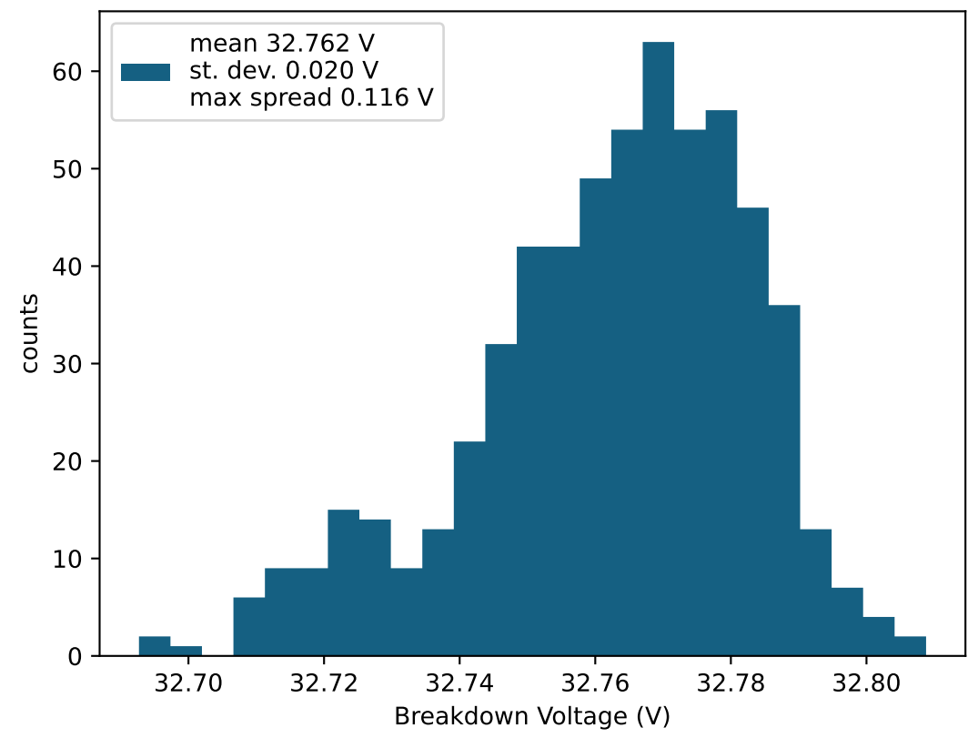
Results - N_{FIT} - V_{BD} distribution
N_{FIT} = 5
N_{FIT} = 8
~ same mean value (Δ = 2 mV)
Smaller spread

Slide 11
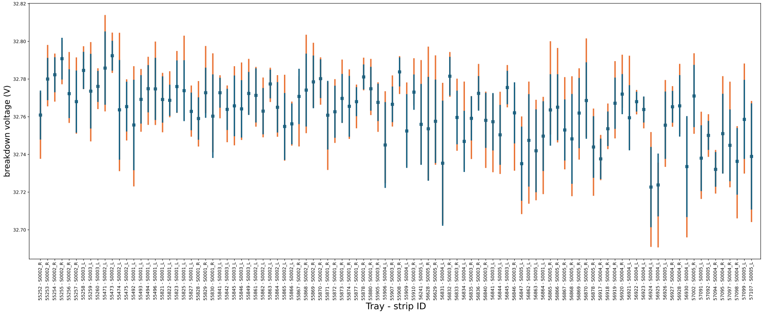
Results - N_{FIT} - V_{BD} distribution
N_{FIT} = 8

Slide 12
Conclusions
Received IV characterizations data from FBK
  100 strips (for HD pre-production)
Analysis with standard CACTUS algorithm
Differences with our data → tune the algorithm
  Optimization of fit range
  Impact on the results

Slide 13
BACKUP

Slide 14
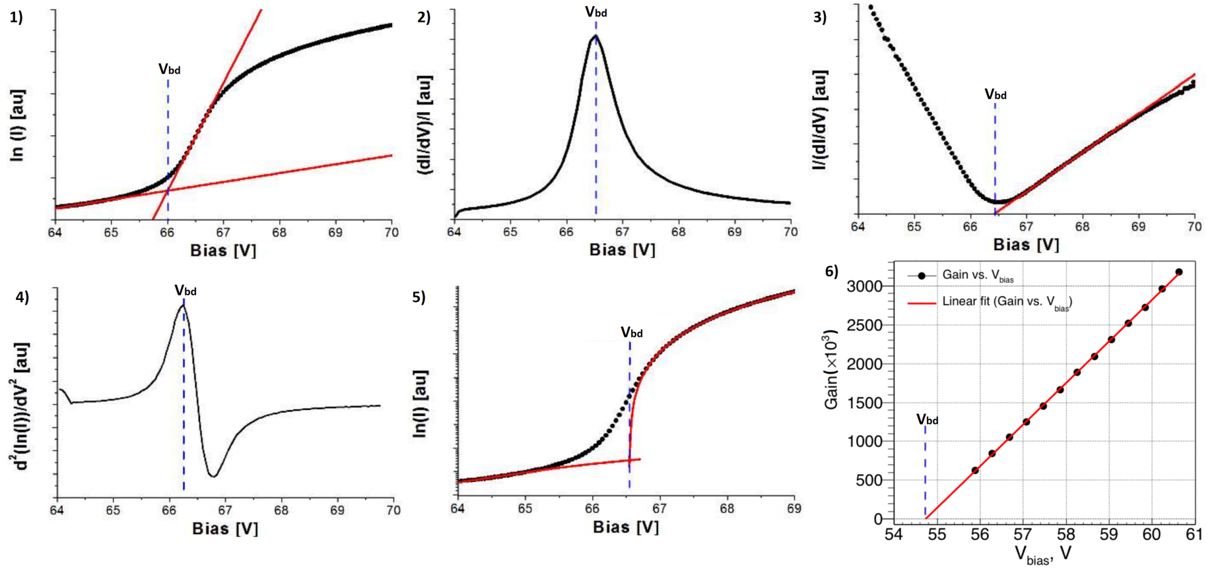
Reverse IV analysis methods
CACTUS
FBK

