Slide 1
Data Management Report
S. Timm / D. Benjamin / W. Yuan
CRAB meeting
25 Oct 2024

Slide 2
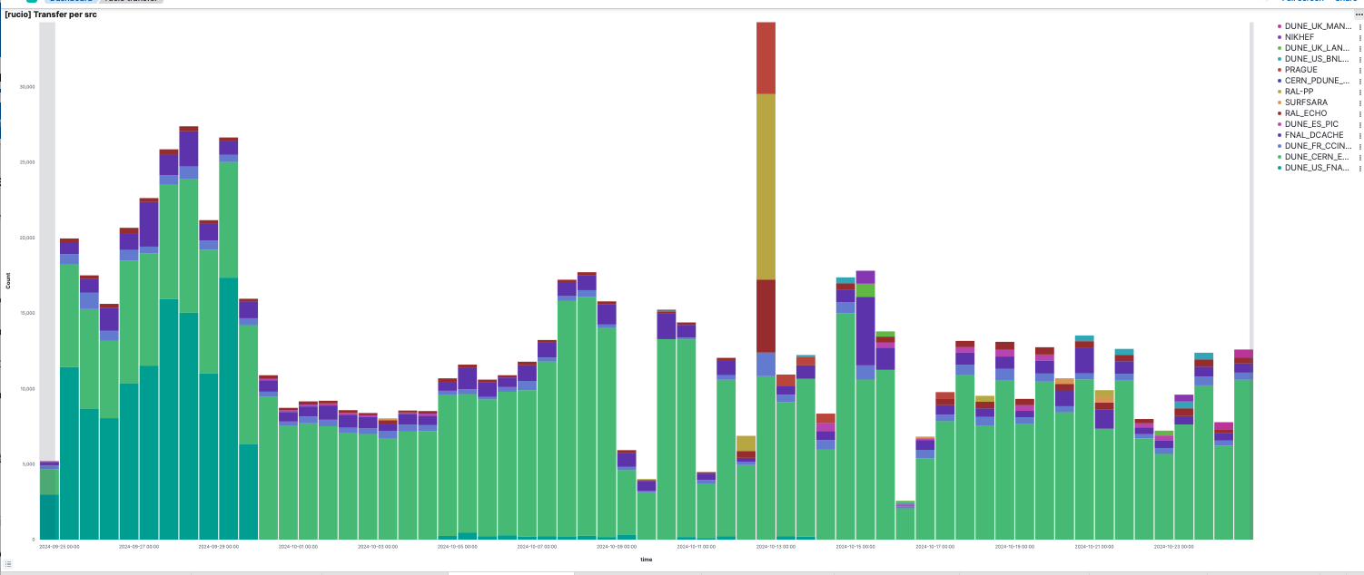
Rucio transfers per day, last month

Slide 3
NP04 2024 Beam Data Summary (TB)
Type of data | Total pre-beam | Total during beam | Total after beam | On disk at CERN
Beam data | 0 | 2938 | 5 | 2042
Cosmics Data | 467 | 717 | 292 | 518
Trig Primitives | 248 | 868 | 397 | 1087
Other |  |  |  | 44
Legacy protodune dp/sp | 150 | 150 | 150 | 150
Free space @ CERN |  |  |  | 710

Slide 4
Known incoming data
Still trickle from NP04 for next few weeks
Fardet-HD Low Energy production
Est. 1.3PB (The 9th different type of MC we have made thus far)
First estimates on NP02 ProtoDUNE-VD beam run:
Event size 120MB (roughly same as ProtoDUNE-HD)
6-8 weeks of beam starting no earlier than April 2025
Cryostat could be full as early as end of January 2025 and thus pure for a couple months before the beam comes
So could again end up with 4-5 PB of data just like ProtoDUNE-HD did
Have to make sure disk and tape pledges for next year allow for this
Have to clear the 3.8PB of ProtoDUNE-HD data off of DUNE_CERN_EOS to make space for ProtoDUNE-VD.

Slide 5
Recent deployed storage
Glasgow. 500TB
CNAF. 500TB
MANCHESTER (back after change to CEPH) 1.07PB total 657TB already full
QMUL comes back at end of October (1 PB)
Clearing ProtoDUNE-HD off of CERN will fill up all of that, or its equivalent.
Coming soon—ComputeCanada
Bumps in quota given between July and now at:
FNAL_DISK(500), LANCASTER(200),RAL-PP (375),IN2P3(100),CERN(650)

Slide 6
Overall RSE usage (TB). July
This is high-water mark thus far
RSE | RuleUsage | RucioUsage | StorageUsage | DuneproLimit | StorageLimit
PRAGUE | 253 | 807 | 821 | 1126 | 1126
NIKHEF | 141 | 791 | 787 | 1143 | 1143
FNAL_DISK* | 657 | 746 | 746 | 1600 | 1973
SURFSARA | 395 | 564 | 563 | 806 | 806
LANCASTER* | 452 | 493 | 492 | 500 | 500
MANCHESTER | 499 | 988 | 983 | 1000 | 1077
QMUL (down) | 178 | 334 | 307 | 1100 | 1100
BNL* | 52 | 371 | 365 | 830 | 830
RAL-PP | 192 | 451 | 469 | 625 | 625
RAL_ECHO | 699 | 987 | 983 | 1050 | 1000
CCIN2P3 | 1000 | 1061 | 918 | 1073 | 1073
PIC | 730 | 760 | 761 | 1439 | 1439
CERN(old) | 747 | 751 | 870 | 945 | 945
CERN(new) | 2726 | 2818 | 2817 | 3100 | 3100

Slide 7
Overall RSE usage (TB) Oct 25
RSE | RuleUsage | RucioUsage | StorageUsage | DuneproLimit | StorageLimit | Change (R.U)
BNL | 597 | 756 | 749 | 830 | 831 | +46%
FNAL_DISK | 1634 | 1670 | 1670 | 2100 | 2674 | +44%
PRAGUE | 776 | 834 | 856 | 1126 | 1161 | +2%
NIKHEF | 1008 | 1102 | 1102 | 1143 | 1143 | +27%
SURFSARA | 456 | 614 | 614 | 781 | 756 | +6%
GLASGOW | 5E-6 | 5E-6 | 0 | 500 | 500 | +1E-6%
LANCASTER | 452 | 462 | 462 | 700 | 700 | -4%
MANCHESTER | 499 | 657 | 657 | 1000 | 1077 | -35%
QMUL (down) | 178 | 334 | 307 | 1100 | 1100 | 0%
RAL-PP | 499 | 637 | 654 | 1000 | 1000 | +18%
RAL_ECHO | 783 | 933 | 929 | 1050 | 1000 | -5%
CNAF | 3 | 11 | 3 | 300 | 550 | +2%
CCIN2P3 | 1000 | 1074 | 1065 | 1100 | 1181 | +1%
PIC | 1200 | 1224 | 1222 | 1300 | 1439 | +35%
CERN(new) | 3826 | 3852 | 3852 | 4500 | 4500 | +23%

