Slide 1
Digital Twin for PIP-II
Abhishek Pathak
Summit on Digital Twins
November 19, 2024

Slide 2
Outline
Introduction to PIP-II
Introduction to Digital Twin
Our efforts and current status
Summary

Slide 3
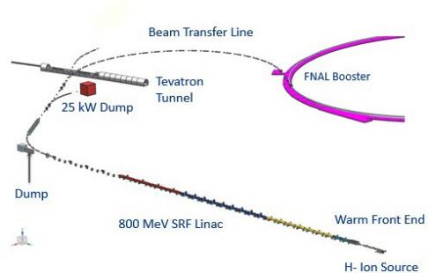
INTRODUCTION TO PIP-II
PIP-II is an essential upgrade to Fermilab accelerator complex to enable the world’s most intense beam of neutrinos to LBNF/DUNE, and a broad physics research program for decades to come.
PIP-II Capabilities
Beam Power
Leading to 1.2 MW from MI
Upgradeable to multi-MW
PIP-II Scope
800 MeV $H^{−}$SRF linac
Linac to Booster Transfer Line
Accelerator Complex Upgrade
Booster
Recycler
Main Injector

Slide 4
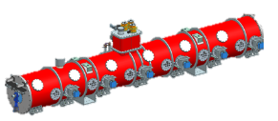
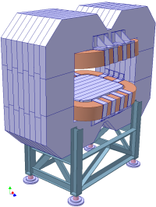
INTRODUCTION TO PIP-II
WARM FRONT END
Ion source->RFQ>MEBT
HWR
$β_{opt}=0.$112
2.1-10 MeV
SSR-1
$$β_{opt}=0.22$$
10-32 MeV
SSR-2
$β_{opt}=0.$475
32-177 MeV
LB-650
$β_{opt}=0.$65
177-516 MeV
HB-650
$β_{opt}=0.$971
516-800 MeV
BEAM
TRANSFER
LINE
BOOSTER
$$CRYOMODULE×1$$
$CRYOMODULE×$2
$$CRYOMODULE×7$$
$CRYOMODULE×$9
$CRYOMODULE×$4
$$×32$$
$$×8$$
$×$16
$×$35
$×$36
$×$24
$$×8$$
$$×8$$
$$×21$$
$$×20$$
$$×21$$
$$×47$$
SUPERCONDUCTING LINAC
BEAM TRANSFER LINE
No. of accelerating cavities | No. of focusing solenoid | No. of focusing & skew quadrupoles
119 | 37 | 41
No. of dipole magnets | No. of quadrupole magnets in BTL
32 | 47

Slide 5
Digital twin initiative

Slide 6
DT INITIATIVE
Initiation of Collaborative Effort: A collaborative effort with ACORN (Tia Miceli, and Pierrick Hanlet) and controls has been initiated to understand the requirements, applications, resources, and implementation strategies for a Virtual Accelerator for PIP-II.
Engagement with Different Laboratories: We have organized several interactions with labs such as Cornell and FRIB, with additional discussions planned to delve into the methodologies used in the implementation of Virtual Accelerators and assess their current status.

Slide 7
Step-1: Interaction With Different Facilities

Slide 8
Facility | Location | Use of Virtual Accelerator | Key Individuals | Codes Used
KEK | Japan | Development of beam control application programs in the KEKB accelerator control system, Testing control algorithms and user interfaces. | Noboru Yamamoto | SAD, EPICS
ORNL | USA | Development of physics applications based on TRACE3D and PARMILA codes. | A. Shishlo, P. Chu, J. Galambos, T. Pelaia | PARMILA, Trace 3D
NSRL | China | Testing the integration of subsystems Testing the integration of high-level application tools before commissioning the Hefei light source. | S.Q. Ma, K. Xuan, W. Xu, C. Li, J.G. Wang, G.F. Liu | EPICS, MAD
Institute of High Energy Physics | China | Modifications to XAL applications for ADS, including database schema adjustments and new device types for online modeling. | Wang Peng-Fei, Cao Jian-She, Ye Qiang | MATLAB’s AT, MML
Taiwan Photon Source (TPS) | Taiwan | Employed for commissioning For developing high-level applications. Debugging using VA tools. | P.C. Chiu, C.H. Kuo, Jenny Chen, Y.S. Cheng | EPICS, Python/Tk
SLAC | USA | Improvement of accelerator optics through determination of quadrupole strengths and sextupole feed-downs, using model-independent analysis to fit orbit measurement data. | Yiton Yan, Yue Cai, Michael K. Sullivan, James Turner | EPICS, MAD
Saint Petersburg State University | Russia | Distributed environment for modeling beam dynamics on computational resources, enabling simulations and control of accelerator complexes through a virtual interface. | Vladimir Korkhov, Nataliia Kulabukhova, Alexander V. Bogdanov, Serge Andrianov | COSY Infinity, Python/Tk
Stanford University (PEP-II Example) | USA | Used MIA to improve PEP-II rings for beta beating fixes, phase and working tune adjustments, and coupling reduction, enhancing luminosity. | Y.T. Yan, Y. Cai, F-J. Decker, S. Ecklund | EPICS, MAD
Facility for Rare Isotope Beams (FRIB) | USA | Online beam commissioning, Cavity tuning Orbit correction Transverse matching Real-time applications. | Tong Zhang Z. He, K. Fukushima, D. Maxwell, M. Davidsaver, Y. Zhang, G. Shen, Q. Zhao | Phantasy, EPICS, Python tools for Archiver Appliance, Impact FLAME, Dakota optimizer, Scipy optimizer
Cornel (CESR . CBETA-V) | USA | Tuning Orbit correction Training | Georg H Hoffstaetter | Tao, Bnad, Bmad Julia
ESS | Europe | online modeling | Mamad Eshraqi | OpenXAL , PyOrbit

Slide 9
INTRODUCTION TO DIGITAL TWIN (DT)
Accelerator components
Beam Optics
Vacuum System
Power Supplies
Control Systems
Diagnostics
Safety Systems
Cooling Systems
Instrumentation
Software Tools
A virtual accelerator is a computer-based representation of a physical accelerator (and its associated environment and processes) that is updated through the exchange of information between the physical and virtual systems
.
It aims to mimic the behavior of the real accelerator.
As it act as an identical twin but is digital in nature it is also known as digital twin.

Slide 10
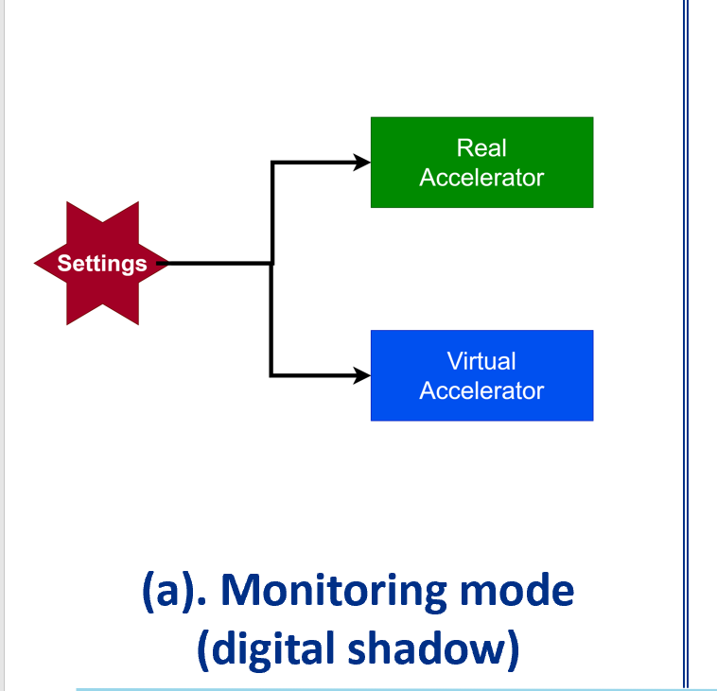
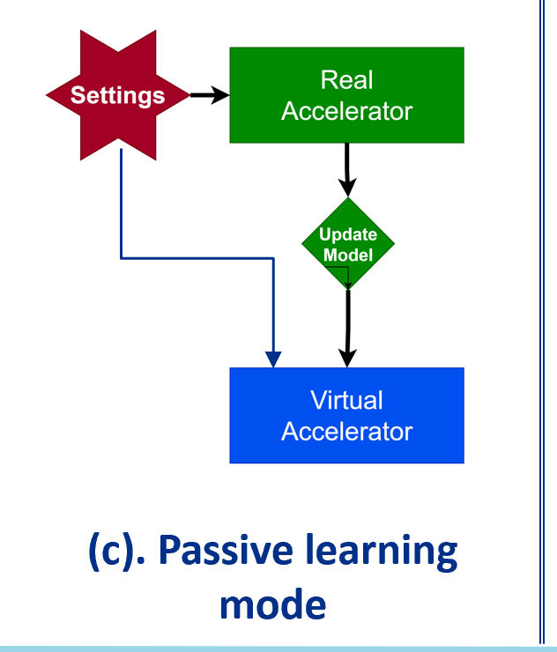
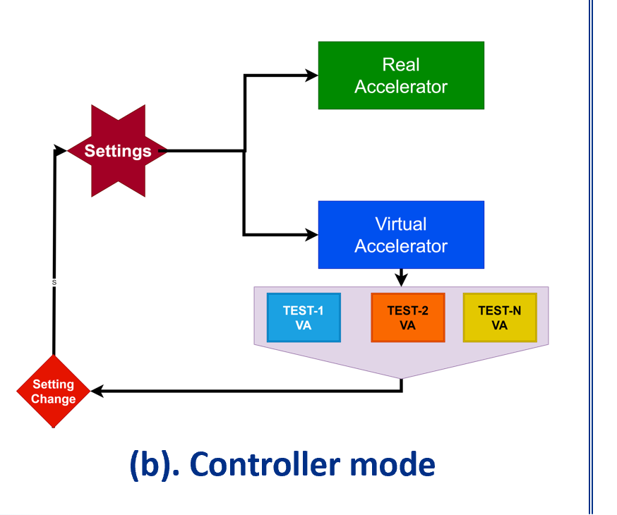
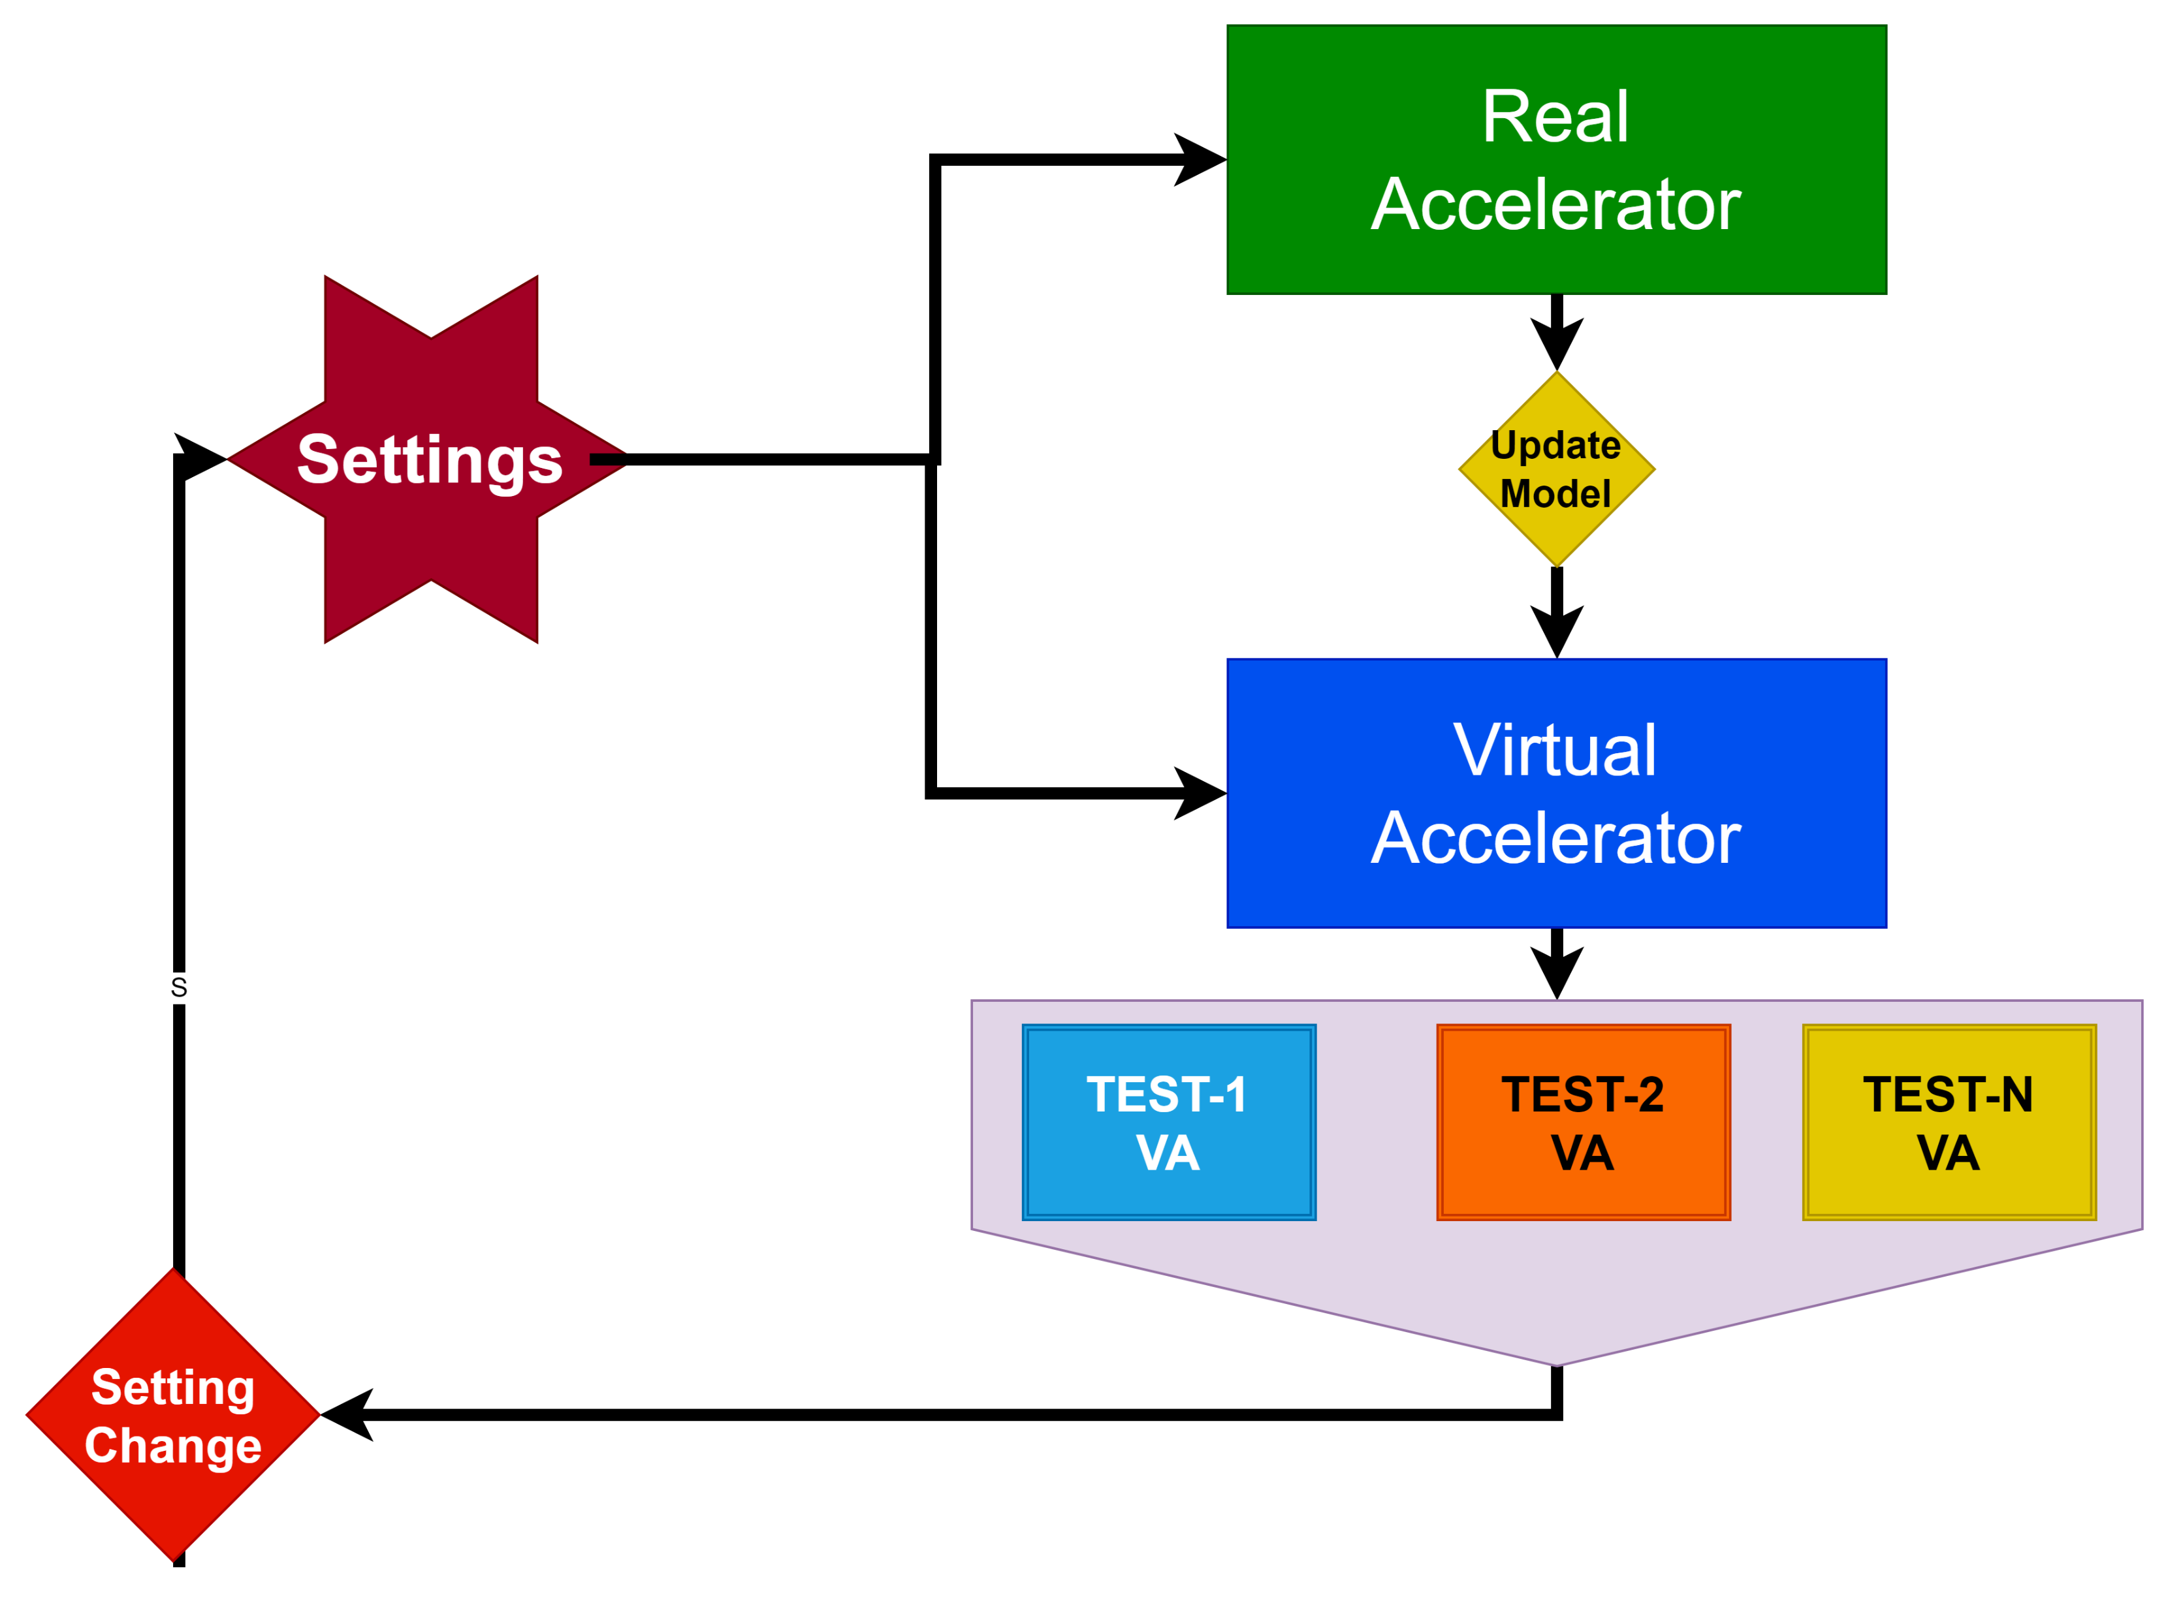
DT: MODES OF OPERATION
(d). Online learning mode

Slide 11
Applications At Multiple Stages: Summary
Dynamic
Stress
Testing
Pre-Commissioning
Stage
Sequence
Testing
HLA
Testing
System
Integration
Interlock
Testing
Fault
Studies
Operator
Training
Lattice
Optimization
(W/WO HLA)
Measurements
& Simulation
Comparison
Integrated
System Simulations:
2
Trajectory
Alignment
Misalignment
Predictions
Trajectory
Back-Tracking
Adjust Settings Iteratively
Commissioning
Stage
Intelligent Maintenance Planning
Real-Time Data Analysis and
Decision Support:
Essential
Scenario-Based Training
Enhanced Visualization
Tools
3
Continuous
Monitoring
Proactive Fault Detection
Operation
New
Technology Design/Testing
Testing of
control
algorithms
Prototyping of
new
algorithms
Testing new elements &
diagnostics
4
Prototype
Testing
5
Fast
Space-charge
Calculations
Real-time
Parameter
optimization
Advanced Data Analysis with Physics models
Continuous
Learning &
evolution
VA With ML
Fast Lattice
optimization
Anomaly
Detection
Dynamics
prediction

Slide 12
Core Components
Accelerator components
Beam Optics
Control Systems`
Diagnost-cs
Instrum-entation
Software Tools
Beam Optics and Lattice Tuning:
Study and optimize beam behavior along the linac in various scenarios.
Diagnostics:
Monitor beam parameters at designated accelerator locations.
Software Tools:
Simulate, analyze, and optimize the system pre- and during operation.
EPICS Integration for PIP-II:
Implement an EPICS-based architecture from the outset for seamless functionality.

Slide 13
CURRENT STATUS

Slide 14
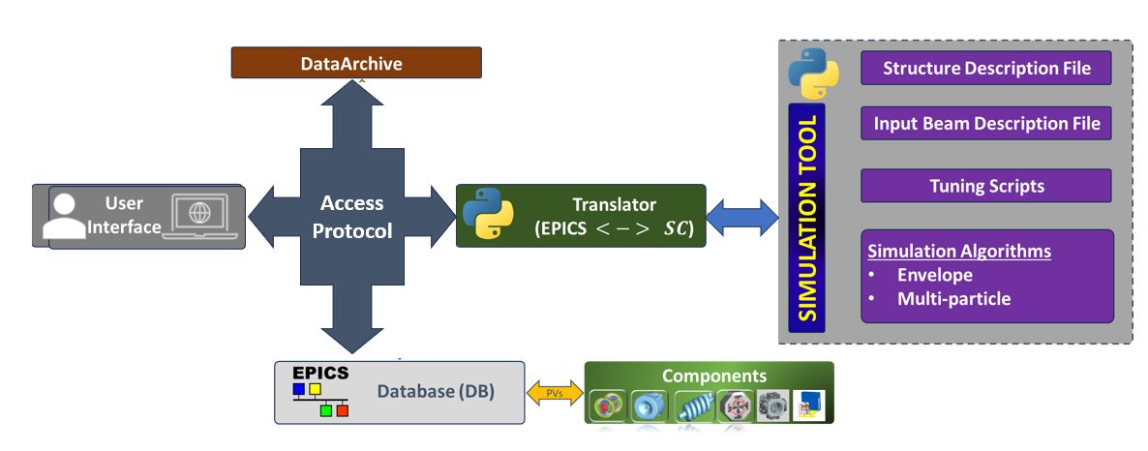
ARCHITECTURE
We have outlined an initial layout for the development of various modules and the data flow between them.
Starting CS-Studio/Phoebus¶

Slide 15
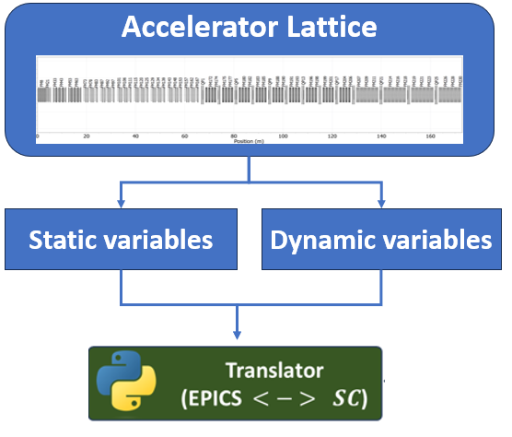
DT TRANSLATOR
By ensuring compatibility across various simulation platforms, the translator safeguards against technological obsolescence and promotes long-term project sustainability.

Slide 16
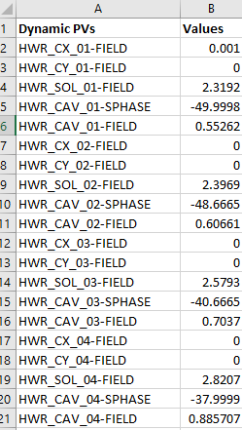
Virtual Accelerator: Functionality and HLA Testing
All dynamic variables in the PIP-II virtual lattice have been assigned process variables. These are accessible through the virtual accelerator’s main interface and can be utilized by other applications for testing with this virtual accelerator
Virtual PIP-II lattice
e
Set of Process Variables (PVs) for dynamics variables
VA Main Controller Interphase
Application Interphase

Slide 17
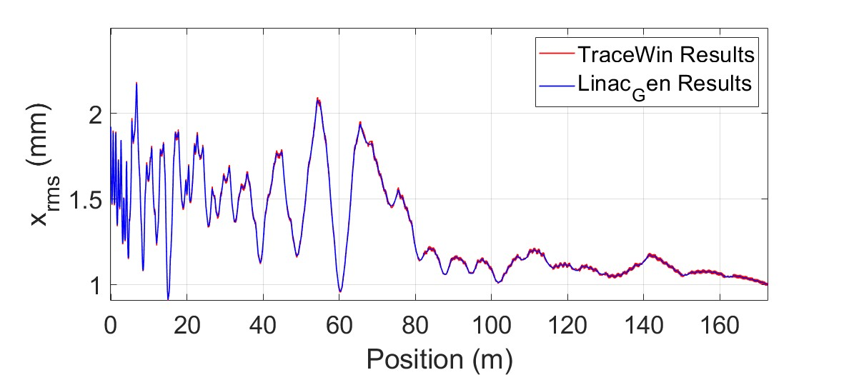
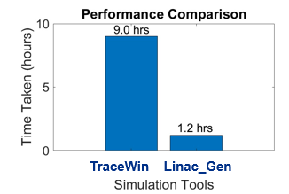
CURRENT STATUS & ONGOING EFFORTS
I have developed a simulation tool named “Linac_Gen” that integrates the particle tracking routines with machine learning algorithms for efficient lattice design and accelerator optimization.
I have implemented and tested several ML algorithms in Linac_Gen to enhance its capabilkities.

Slide 18
DATA for training
Visualizations showcase the predictive model's results, illustrating changes in transverse and longitudinal emittance and beam transmission correlated to adjustments in cavity field strength and phase.
(a)
(a)
$$ε_{4D}$$
$$ε_{4D}$$
$$φ_{s}(deg.)$$
$$Position (m)$$
$$Field factor$$
(b)
$$Position (m)$$
(b)
$$ε_{Longitudinal}$$
$$ε_{Longitudinal}$$
$$φ_{s}(deg.)$$
$$Position (m)$$
(c)
$$Position (m)$$
$$Field factor$$
(c)
$$Transmission$$
$$(\%)$$
$$Transmission$$
$$(\%)$$
$$φ_{s}(deg.)$$
$$Field factor$$
Variation of transverse rms normalized emittance (a), longitudinal normalized rms emittance (b), and transmission with synchronous phase.
Variation of transverse rms normalized emittance (a), longitudinal normalized rms emittance (b), and transmission % with cavity field map factor.
$$Position (m)$$
$$Position (m)$$

Slide 19
SUMMARY
Collaborative Development Initiative:
In response to the broad potential applications, we have initiated the development of a Virtual Accelerator (VA) for PIP-II, in collaboration with ACORN, to enhance research and development capabilities and operational efficiency.
System Architecture:
A foundational architecture has been established within the EPICS environment to support the development and integration of the VA, ensuring compatibility and scalability.
Advancements in Beam Dynamics Simulation:
The newly developed beam dynamics code, Linac_Gen, incorporates machine learning to optimize optimization/simulation processes, achieving a tenfold reduction in computation time compared to traditional commercial codes.
Inter-Laboratory Collaboration:
Ongoing interactions with various laboratories are in place to leverage their experiences with virtual accelerators, aiming to refine our approach and utilize best practices in VA development and deployment.

Slide 20
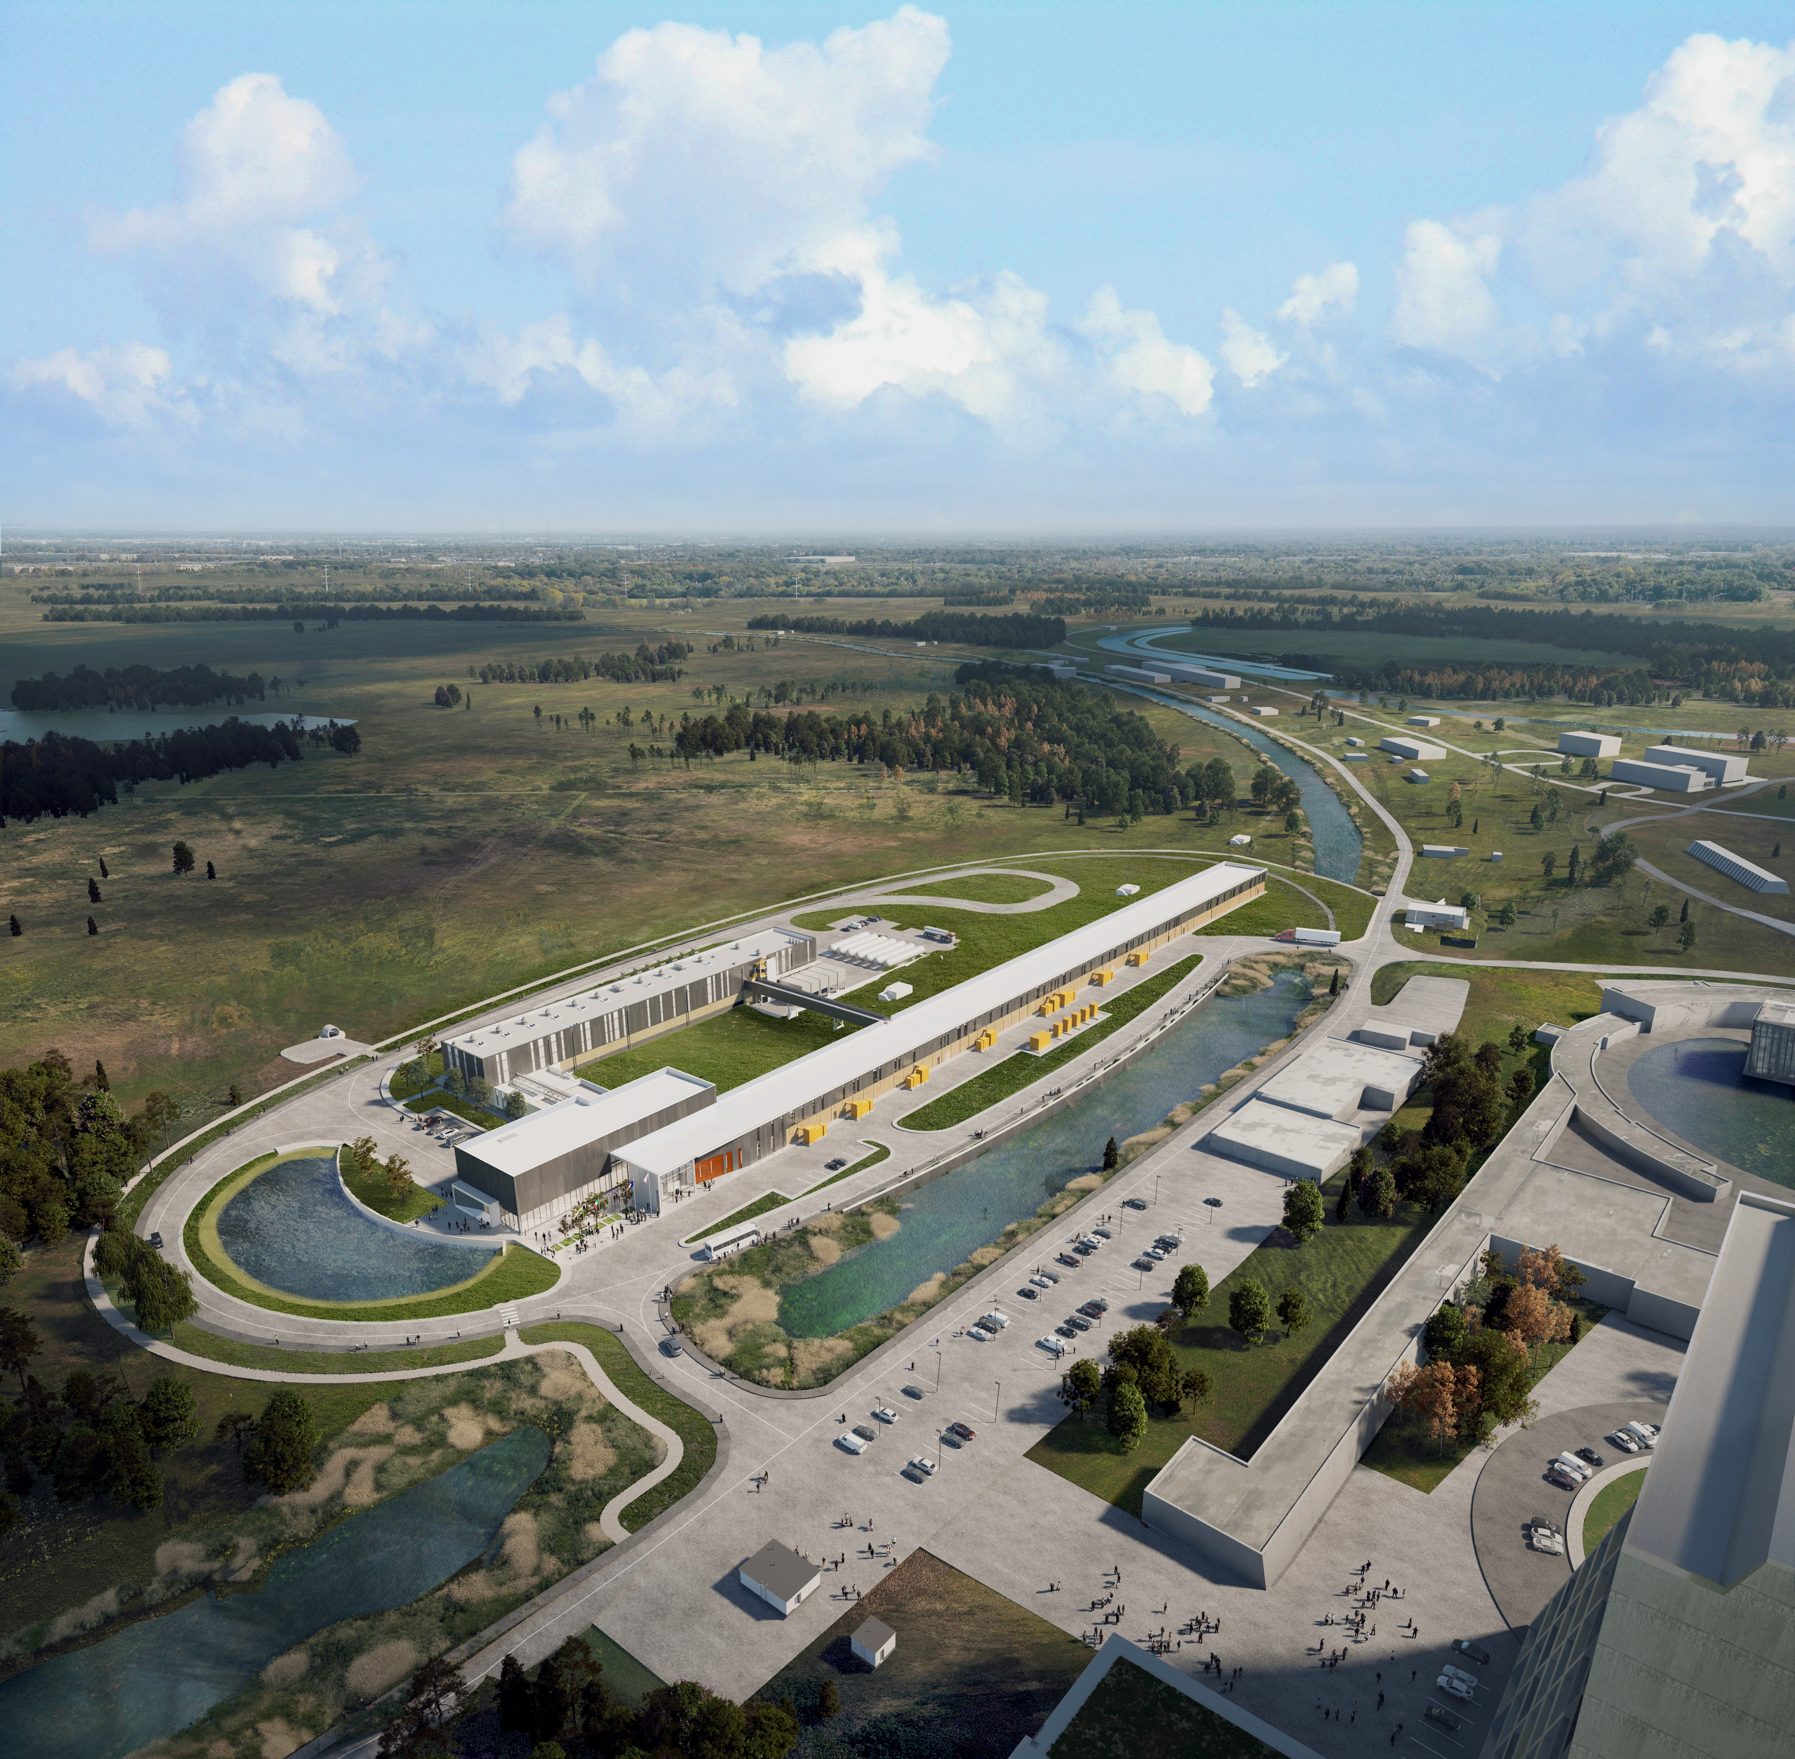
THE FUTURE OF FERMILAB
Follow us:
http://pip2.fnal.gov/
/showcase/pip-ii/
Thank You

