Slide 1
Position Monitoring Interferometry
Dr Thomas Hird, Jesse Schelfhout
(Prof. Chris Foot)

Slide 2
The problem
Motion of imaging cameras gives rise to artificial differential phase
Nefarious systematic
Finite Element Analysis of AION-10 tower design used to model displacements at location of cameras
How well do we trust the models?
How do you verify if vibration isolation is effective?

Slide 3
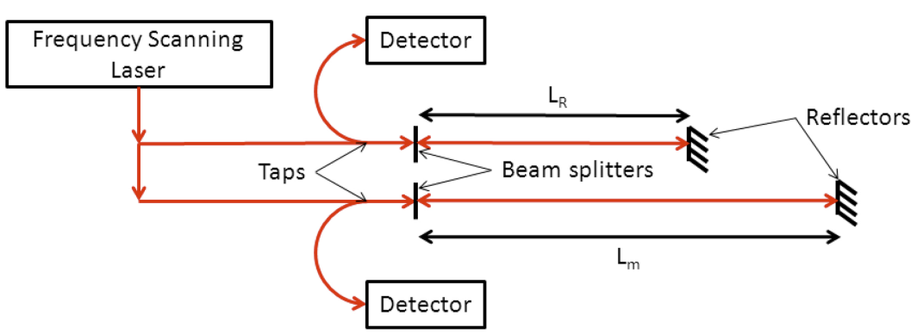
Displacement monitoring
Frequency scanning interferometry (FSI) = absolute distance measurement
Fizeau interferometer (≈ Michelson interferometer with L=0 for one arm)
Reference interferometer (known L, e.g. invar spacer) and measurement interferometer
Ratio of phases = ratio of lengths
J. Dale et al., Opt. Express 22, 24869-24893 (2014)

Slide 4
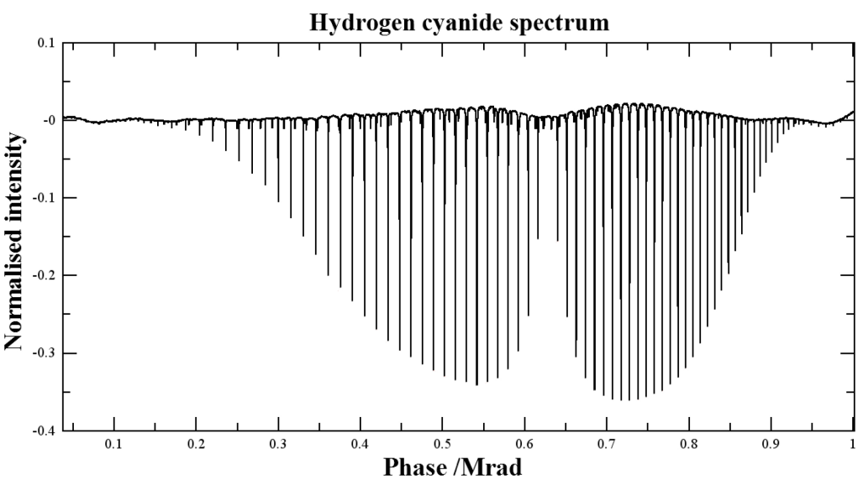
Etalon's improvements
Reference length calibration via frequency differences between features from gas cell
Second laser scanning in opposite direction relaxes requirement than reflected distance is static
Use of telecom technology for simultaneous measurements on multiple channels
J. Dale et al., Opt. Express 22, 24869-24893 (2014)

Slide 5
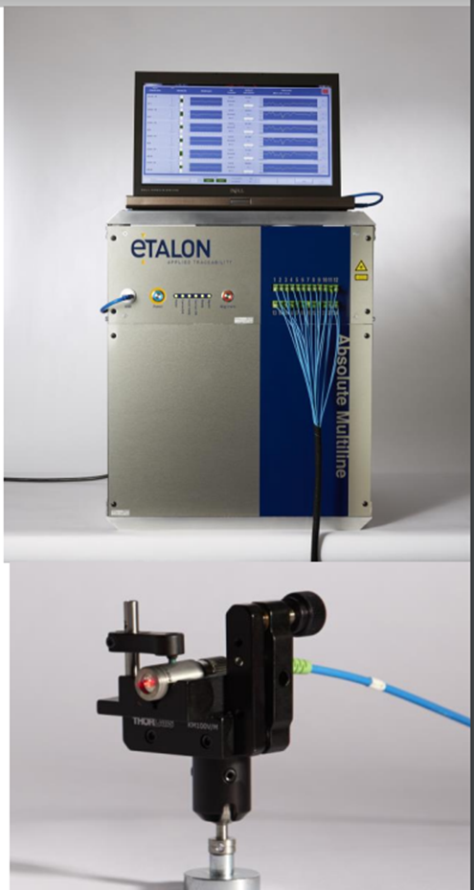
Multiline system
Etalon Multi-line system
Initially 4 channels
Expandable up to 124 channels
300nm / metre uncertainty in measurement (95% CI)
Eyesafe telecoms laser
Measurement length 10cm-30m (each line calibrated for a range)

Slide 6
What is it currently used for?
ETALON ABSOLUTE MULTILINE TECHNOLOGY | Hexagon

Slide 7
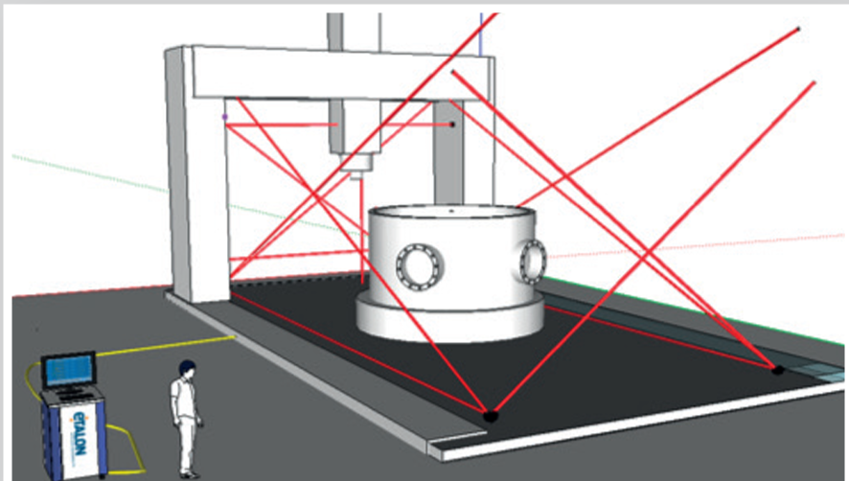
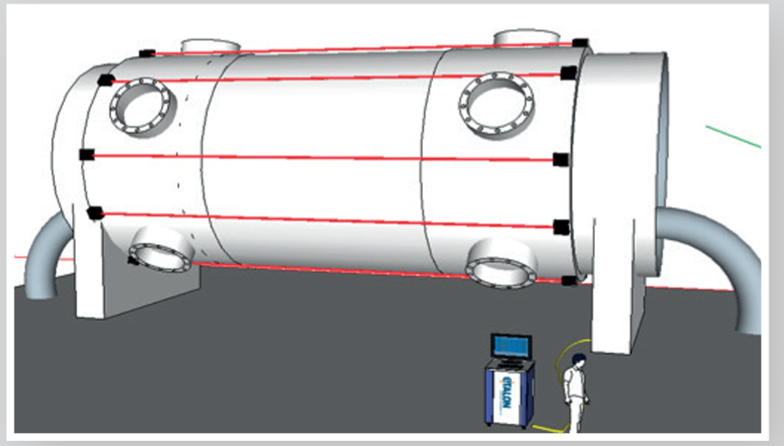
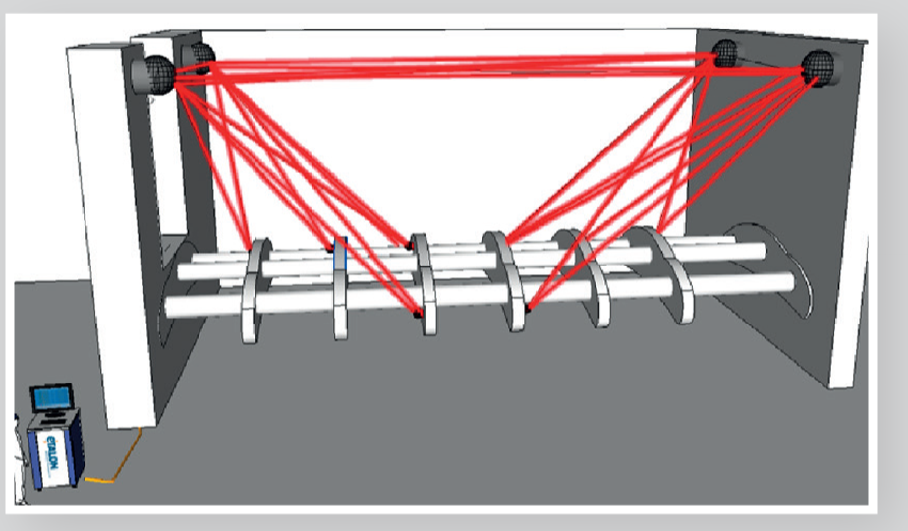
What is it currently used for?
Continuous monitoring
Deformation and vibrations
Geometrical control

Slide 8
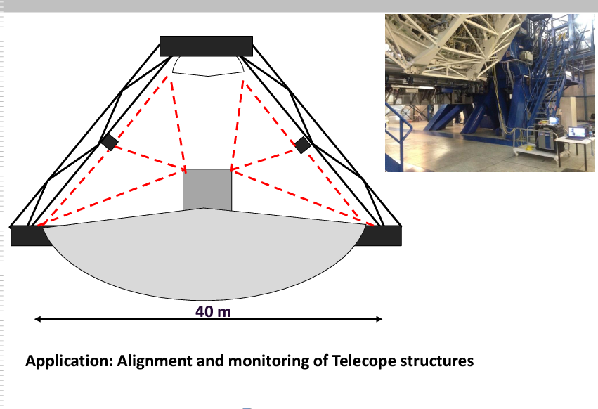
What is it currently used for?

Slide 9
What is it currently used for?
2nd PACMAN workshop (12-15 June 2016): Developments and Applications of the Absolute Multiline Technology · Indico

Slide 10
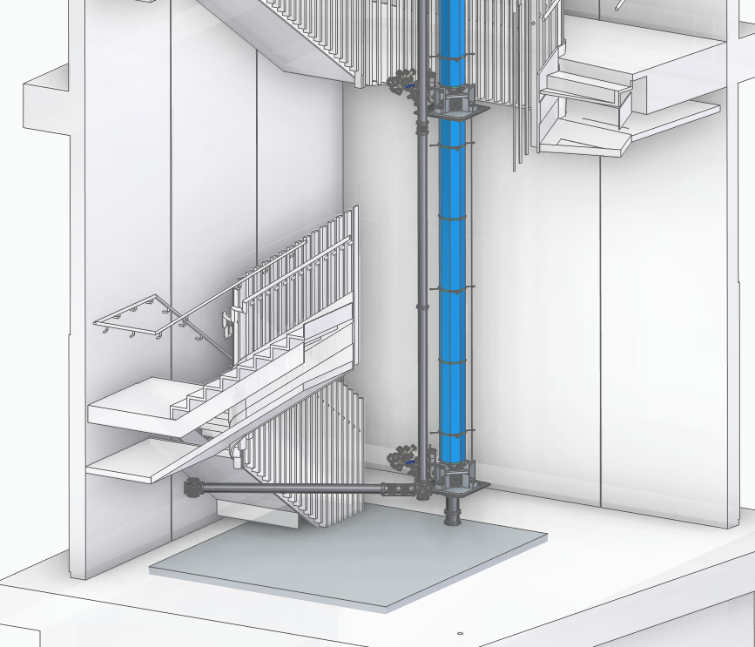
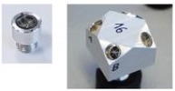
What this might look like?
“Web” or structure of correlated measurements to determine the position of key elements and monitor tower deformation
Calibrated length “rod” that doesn’t change with temperature/pressure
Absolute
Relative

Slide 11
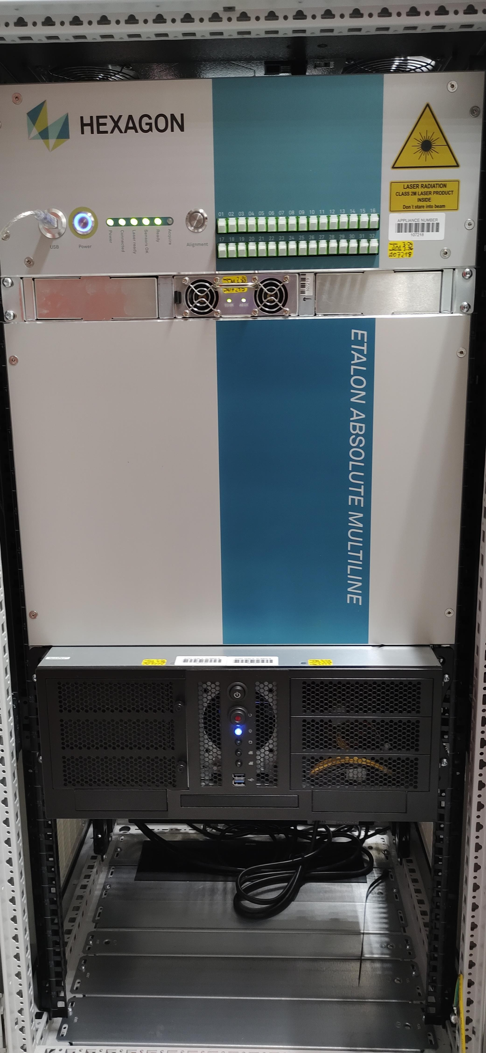
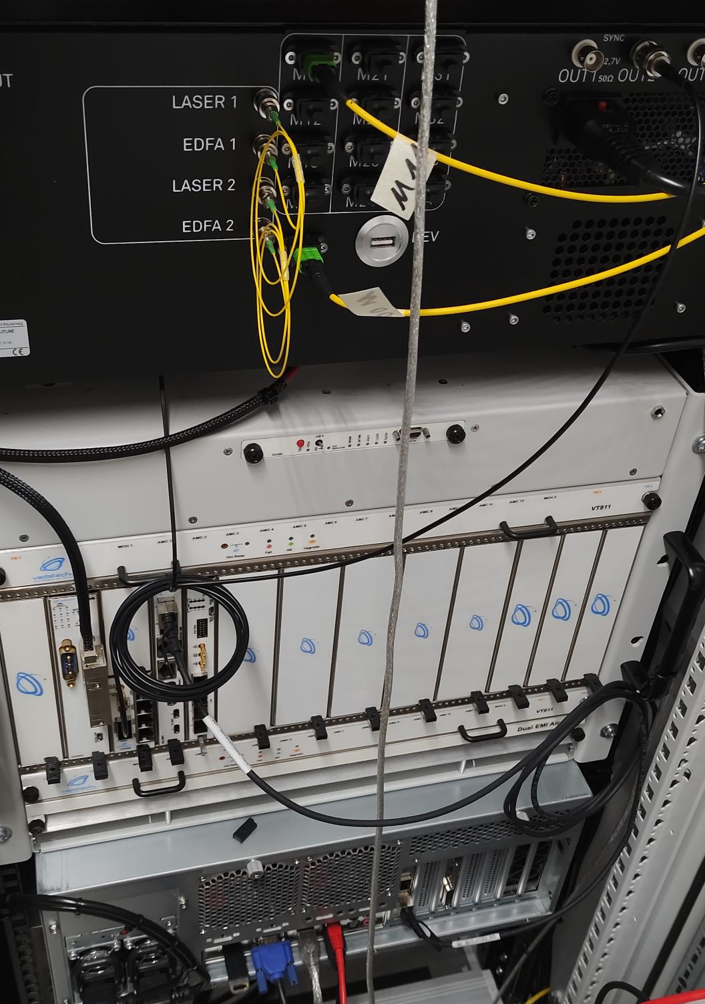
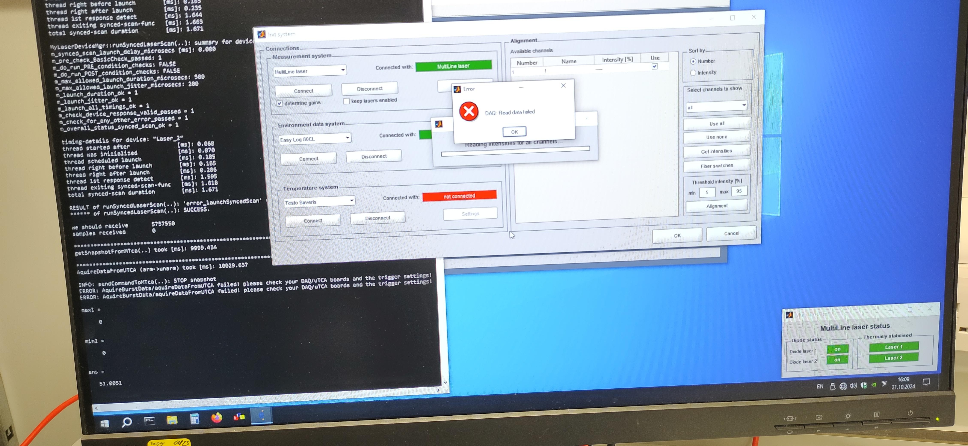
Current status
4 channel device purchased & delivered
Fairly significant hardware issues internal to device
Open ticket with technical support
Monte Carlo simulations being analysed for prospective sensitivity

Slide 12
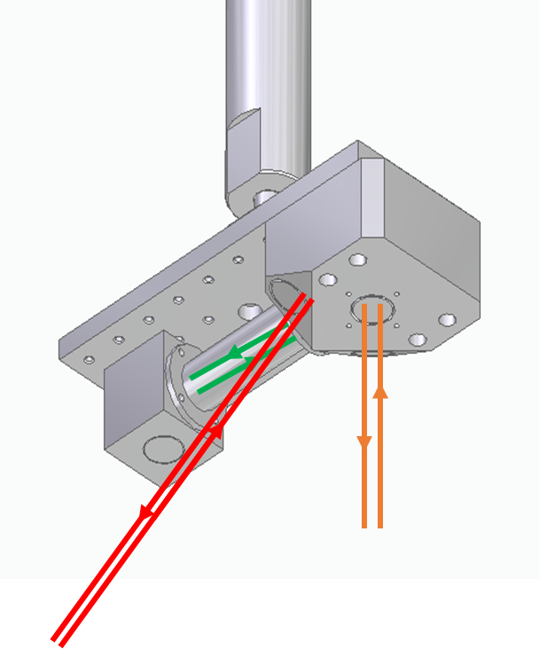
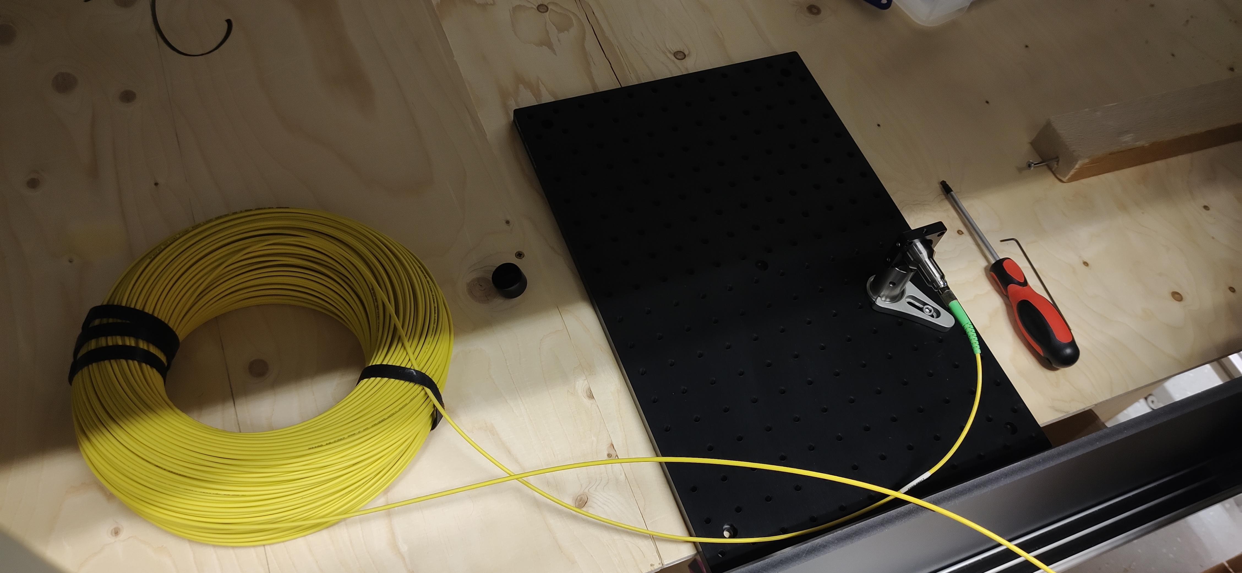
Future plans
Test interferometer on table-top
Mount retro-reflector in/under Beecroft floorplates
Coordinate with ongoing environmental monitoring efforts (Jeremiah)
Simulations to find suitable design for interferometer network

Slide 13
Thank you
Questions?

