Slide 1
Mx2 Data Production Workflow
Tammy Walton for the Mx2 group
Production Meeting
October 31, 2024

Slide 2
Objective
This talk presents the workflow of the Mx2 data production
Preproduction
Calibration
Full Production
We are requesting approval for the following:
The metadata for the offline production
Processing the offline data via production shifter
Archiving the Mx2 offline data to tape
Request data replicas at FNAL and NERSC

Slide 3
Overview of the data production
Minerva-for-2x2 (Mx2) took NuMI data for the following periods
June 2023 (run 0)
https://wiki.dunescience.org/wiki/Production_Run0_data_(June_2023)
March 2024 – July 2024 (run 1)
https://wiki.dunescience.org/wiki/Production_Run1_data
Mx2 data consist of the following data streams:
Pedestal data
PMT light injection data
NuMI data
Mixed mode pedestal and NuMI data
Mixed mode light injection and NuMI data
The data are characterized by MetaCat datasets (see next slide)

Slide 4
Overview of the data production – Mx2 Run1 datasets
“twalton” is the namespace, which can be changed
The name of the dataset is designed to be short and simple
The run periods for each dataset are based on simple Mx2 running conditions

Slide 5
Overview of the data production
Pre-production
Full Calibration
Full Production
Pre-production
Purpose:
Execute the minimal algorithms that are needed to perform the low-level calibrations
Technical details
Performed by the calibration team
Jobs are submitted to the grid via JustIN, where the data are processed using an official release
Output files are transferred to the user scratch area
Calibration team analyzes the output data and uploads the constants to the development database
The analyses are presented at the Mx2 group meeting and then approved
Output data are transferred to the dune persistent area and the validation plots are posted on the wiki
The approved constants are migrated from the development database to the production database

Slide 6
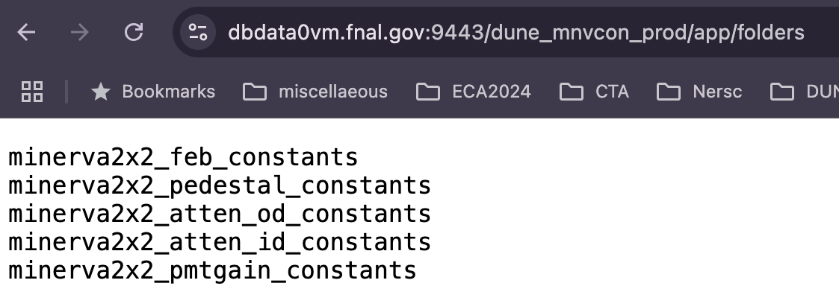
Overview of the data production
Pre-production
Full Calibration
Full Production
Output of the Preproduction Stage
Pedestal and gain data do not have the accompanied metadata
Preproduction constants are in the production database

Slide 7
Overview of the data production
Pre-production
Full Calibration
Full Production
Full Calibration
Purpose:
Using the approved pre-production constants, this stage reconstructs rock muons that are deployed to extract the high-level calibration constants.
Technical details
Performed by the calibration team
Jobs are submitted to the grid via JustIN, where the data are processed using an official release
The full calibration stage involves multiple iterations between different analyses
All output files are transferred to the user scratch area
The final output files are transferred to the dune persistent area and the validation plots are posted on the wiki
The calibration team analyzes the output data and uploads the constants to the development database
The analyses are presented at the Mx2 group meeting and then approved
Constants are migrated from the development database to the production database

Slide 8
Overview of the data production
Pre-production
Full Calibration
Full Production
In Progress
The rock muon files do have the accompanied metadata
The rock muon files are small
Request these data to be catalogued in MetaCat (not archived to tape)

Slide 9
Overview of the data production
Pre-production
Full Calibration
Full Production
Full Production
Purpose:
Using the approved calibrations, this stage reconstructs data into physics objects
Technical details
Need production to be submitted by dunepro
Noe Roy has volunteered to serve as the dune pro shifter on behalf of the 2x2 group
Jobs are submitted to the grid via JustIN, where the data are processed using an official release
Need details on where to transferred the reconstructed data and there are two types of data
Gaudi root files (nested root trees)
Flat root files (input to the 2x2 Common analysis framework)
Request approval for the metadata

Slide 10
Overview of the data production
Pre-production
Full Calibration
Full Production
Full Production
Overview of the submission workflow
CPU node – Execute a sequential three-staged workflow
Raw Data
Build raw digits (data serialization)
Build pedestal suppressed digits
Reconstructed Data
Raw Digits
Sup Digits
Reco Data
twalton:mx2_numib_raw_run1_prod_c
 | Common File Size | Smallest File Size | Largest File Size | Archived to Tape
Raw Digits | ~1.0 GB | 6.9 MB | 1.2 GB | No
Sup Digits | ~800 MB | 6.8 MB | 805 MB | No
Reco Gaudi Data | ~500 MB | 3.1 MB | 545 MB | Yes
Reco DST Data | ~300 MB | 1.8 MB | 325 MB | Yes

Slide 11
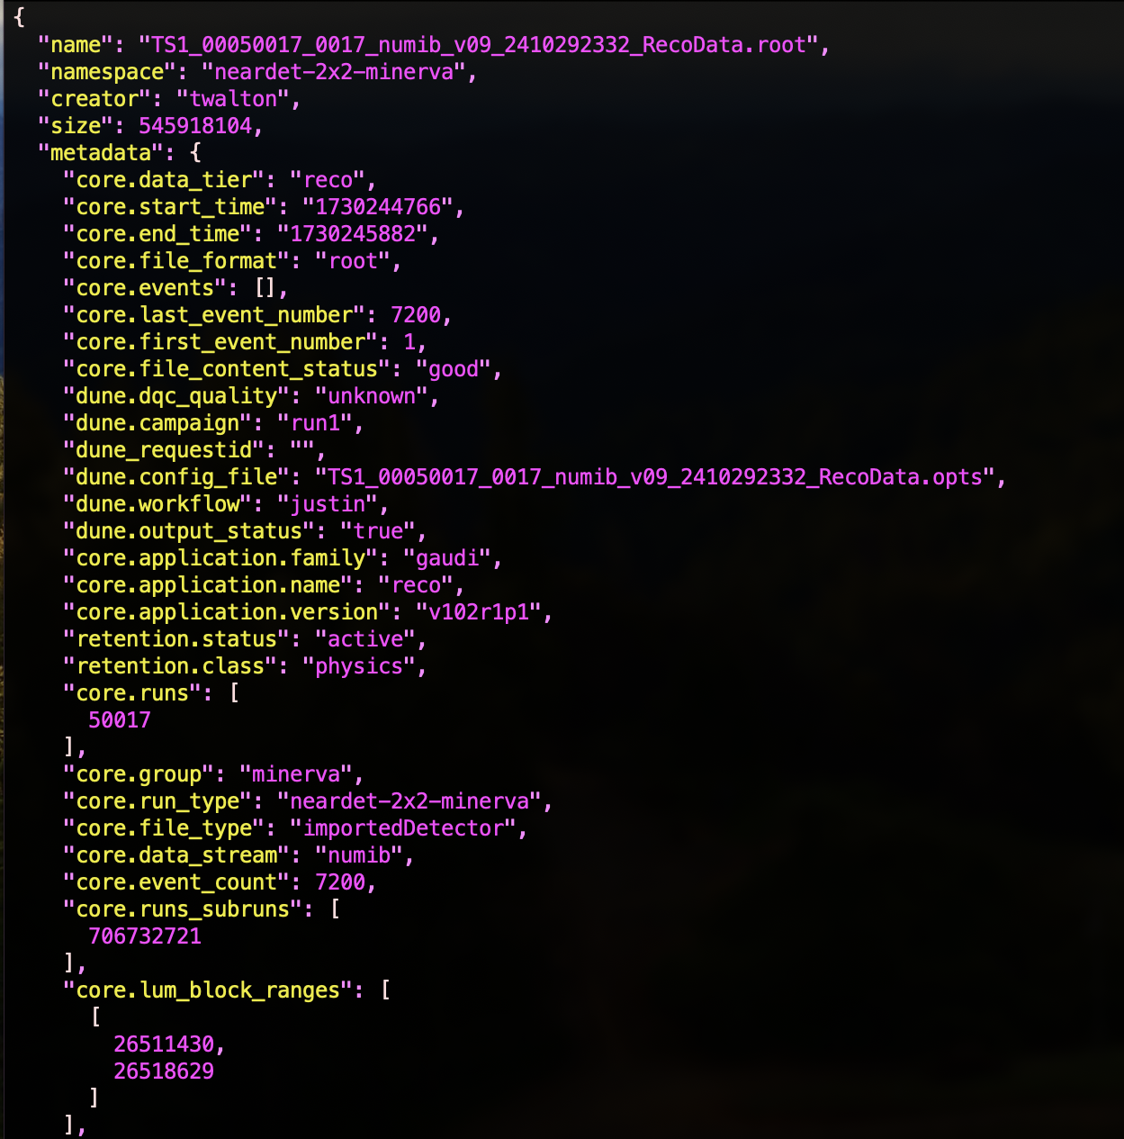
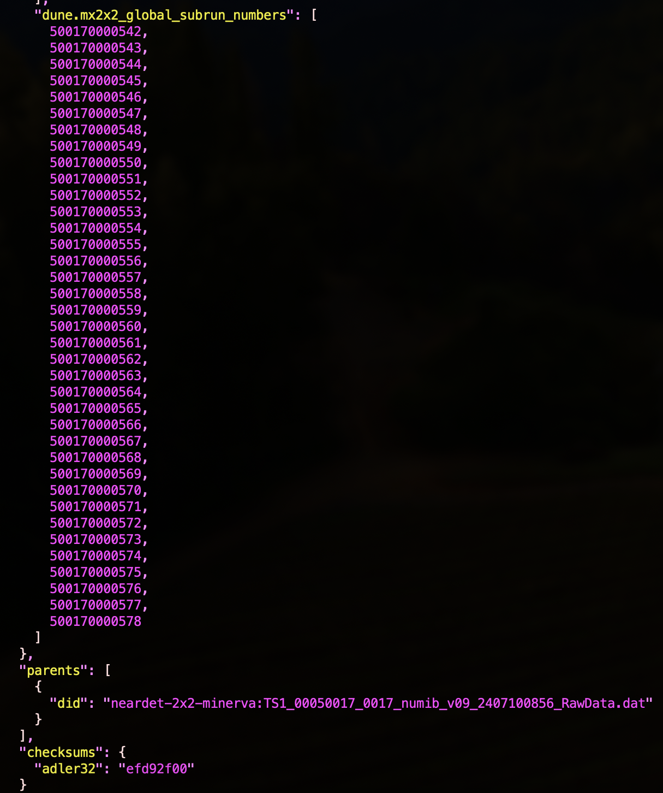
Overview of the data production : Metadata
New Metadata Fields:
dune.dqc_quality – used to create ”good” datasets (may change it to a list)
dune.mx2x2_global_subrun_numbers – used for matching the files from the 2x2 charge and light readout systems
We need to fix the core.runs_subruns

